Slide 1
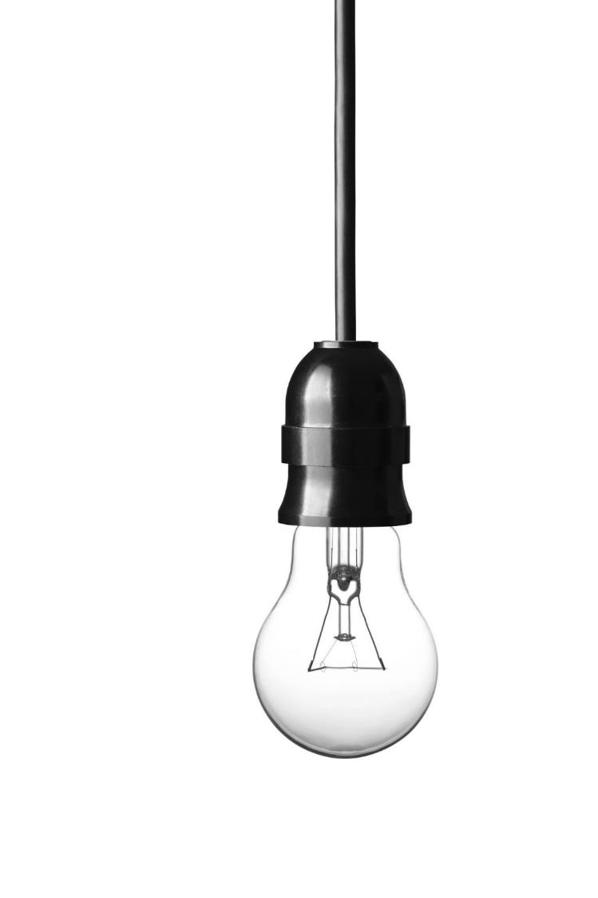

SMART HOME ASSISTANT
ACCENTURE IOT CENTER OF EXCELLENCE
GLORIA:
Would you like to
OPEN
OR
CLOSE
an account?

Slide 2

DISCLAIMER
Restricted Material Non-Public – Not To Be Distributed Further

Slide 3
The best headlines are one line
Level 1 uses bold text in sentence case
Level 2 is regular text in sentence case
Use the “Increase List Level” button in the Paragraph palette of the Home tab to access Level 2 text
You can manually remove the bullet for paragraphs of text.
This is also Level 2 text with the bullet manually removed. Removing the bullet automatically removes the hanging indent.
Level 3 is a smaller size of regular text
This slide is based on the “Title and Content” slide master

Slide 4
FY16 results
Some slides may have very short headlines but need a brief explanation right next to them
Level 1 uses bold text in sentence case
Level 2 is regular text in sentence case
Use the “Increase List Level” button in the Paragraph palette of the Home tab to access Level 2 text
You can manually remove the bullet for paragraphs of text
This is also Level 2 text with the bullet manually removed. Removing the bullet automatically removes the hanging indent.
Level 3 is a smaller size of regular text
This slide is based on the “2 Titles and Content” slide master

Slide 5
divider SLIDE

Slide 6
COLOR PALETTE
R: 0
G: 243
B: 255
R: 161
G: 0
B: 255
R: 126
G: 0
B: 255
R: 117
G: 0
B: 192
R: 95
G: 0
B: 149
R: 56
G: 0
B: 137

Slide 7
Banner title
Chart Title

Slide 8
Banner title
Pie Chart
Stacked Bar Chart
Text here
Text here
Text here
Text here
Text here
Text here

