Slide 1
Project 3: DROP: Reading Comprehension
Group 18: Wai Leuk Lo (wlloaa@connect.ust.hk)

Slide 2
DROP Dataset
Discrete Reasoning Over the content of Paragraphs
Developed in an adversarial way against the BiDAF model
Requires discrete reasoning to solve

Slide 3
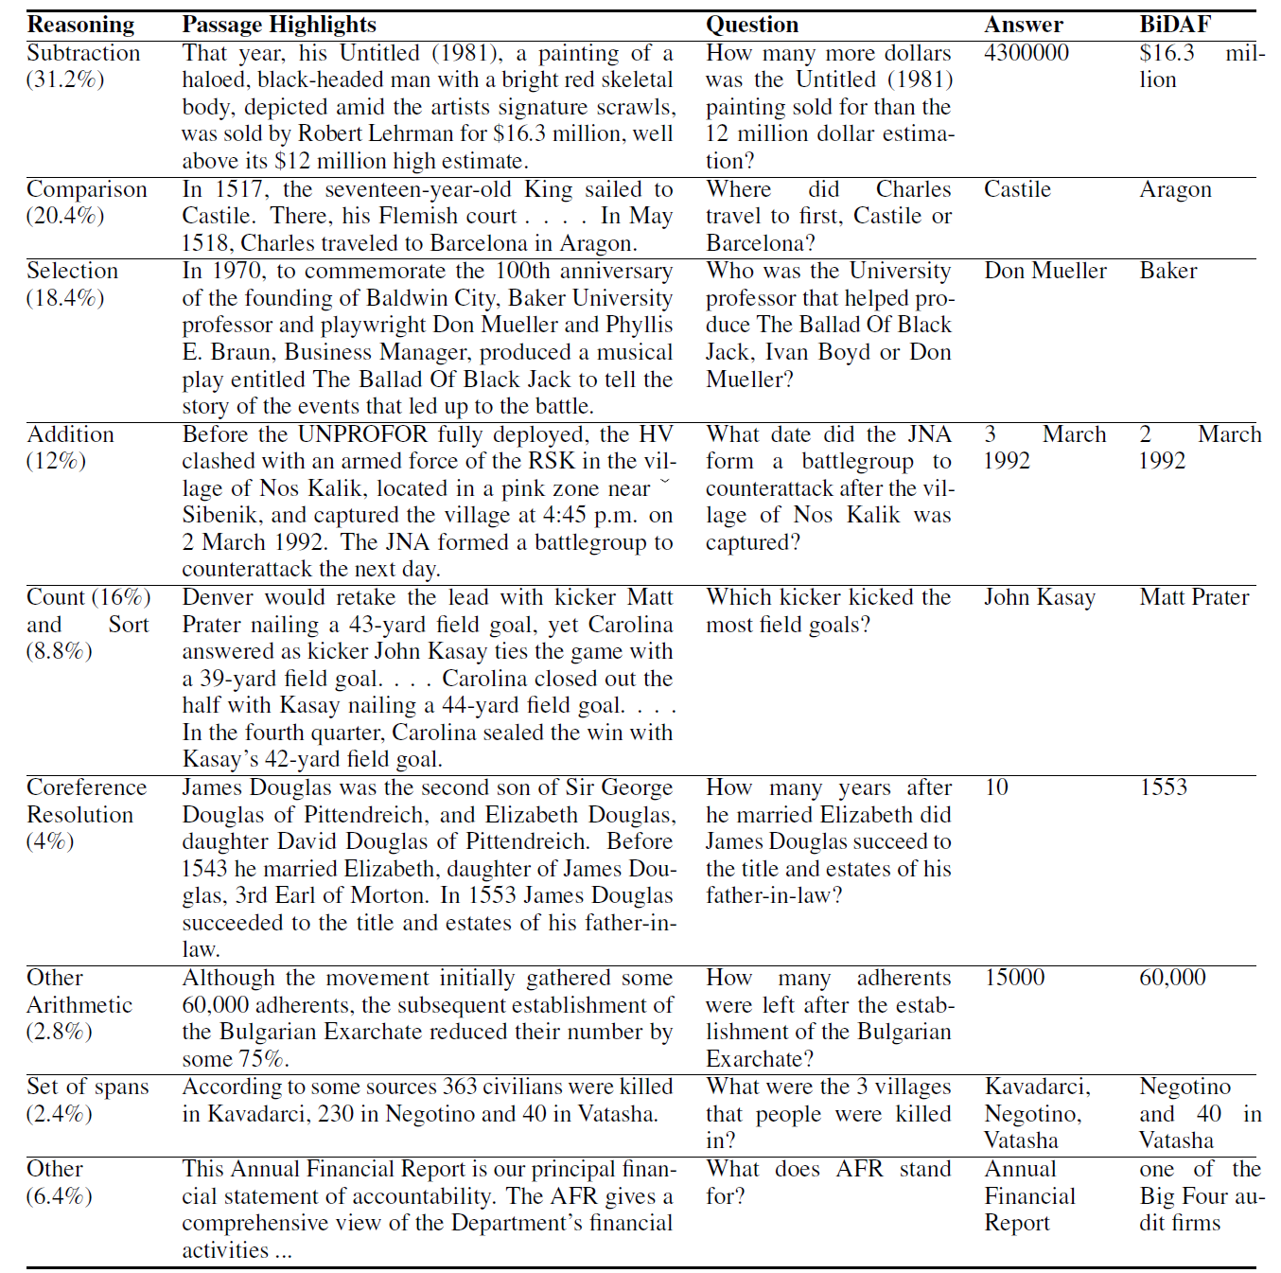

Slide 4
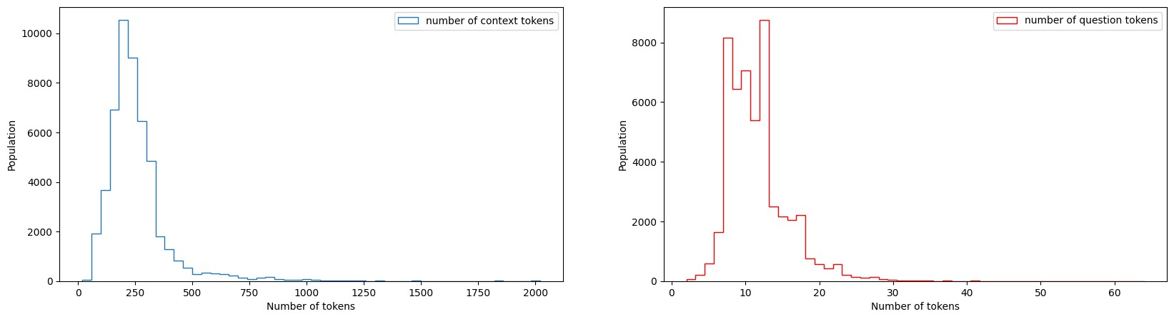
Methodology
Focus on span and number (0-9) answer type
Question-answer pairs shrink from 77k to 50k
Limit context length to 400 tokens, question length to 50 tokens
Question-answer pairs shrink from 50k to 46k
Span answer type: 26,025, Number answer type: 19,854

Slide 5
Methodology
Mainly follow the architecture of QANet and NAQAnet
Add answer type prediction
Add number prediction
Code available at: https://github.com/waileuklo/DROP-Reading-Comprehension

Slide 6
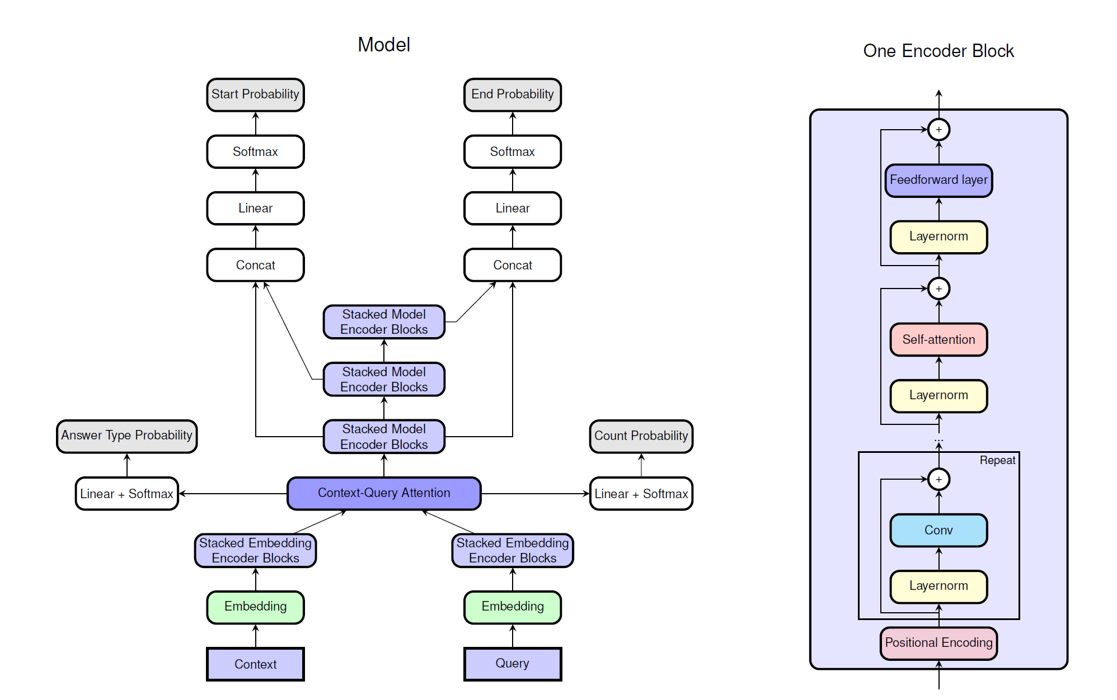
Methodology
Loss function = answer type loss + span answer loss + number answer loss
Span answer loss = sum of losses from different positions

Slide 7
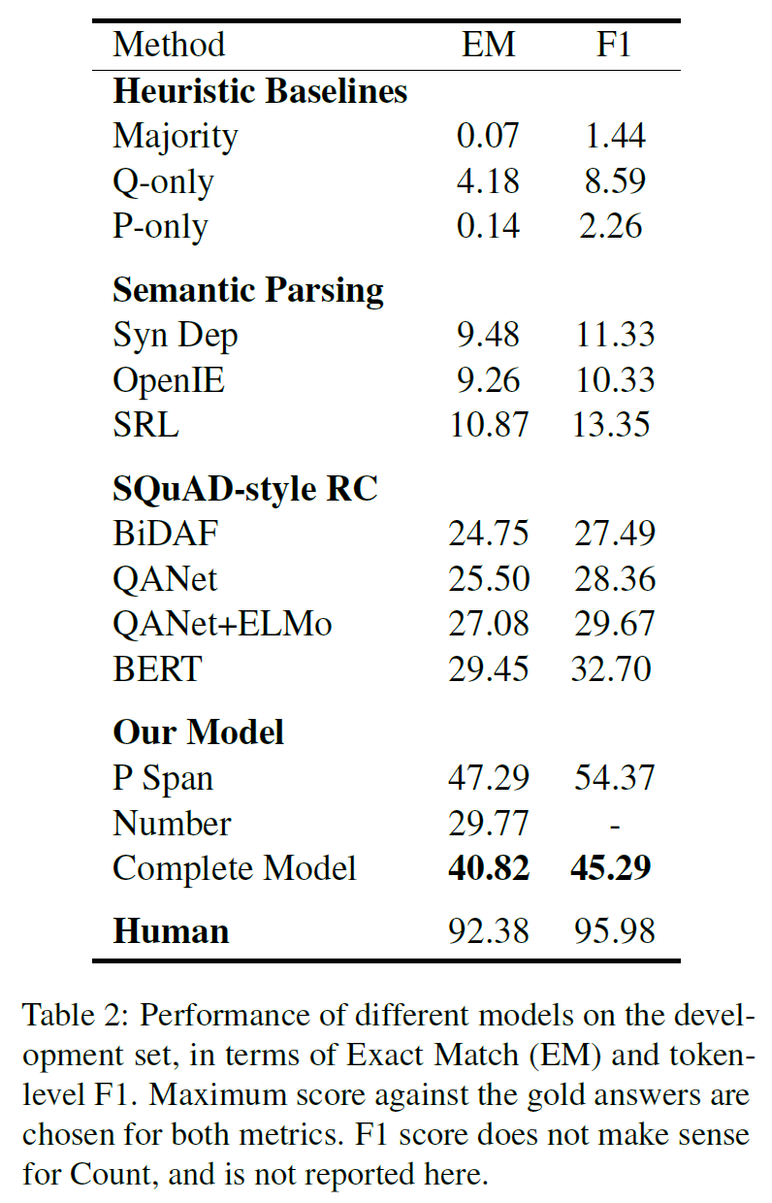
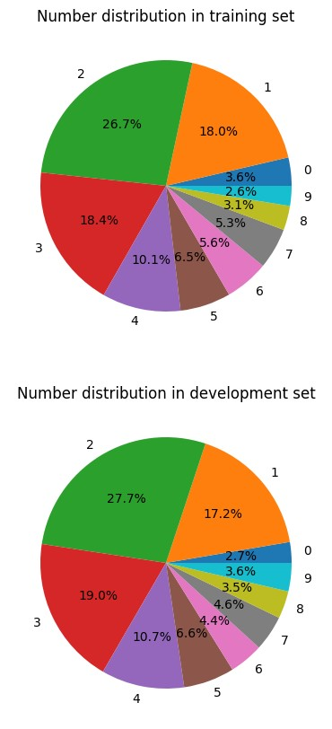
Results
Exact Match
F1
Best score over all ground truths

Slide 8
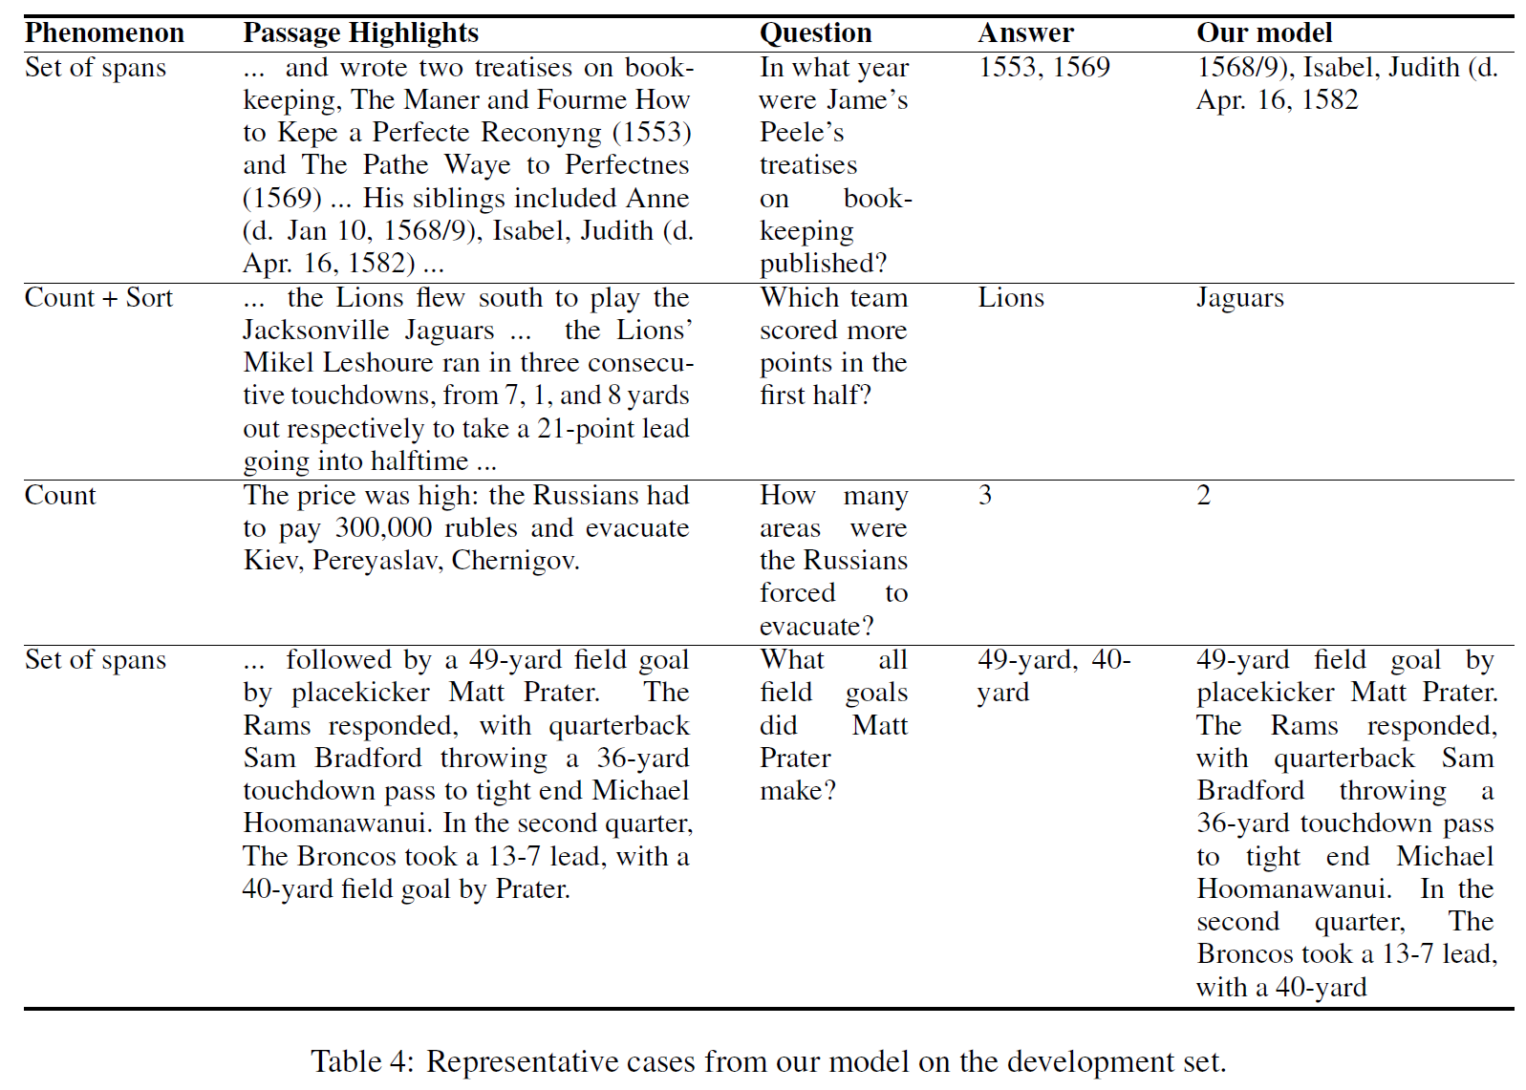
Results

Slide 9
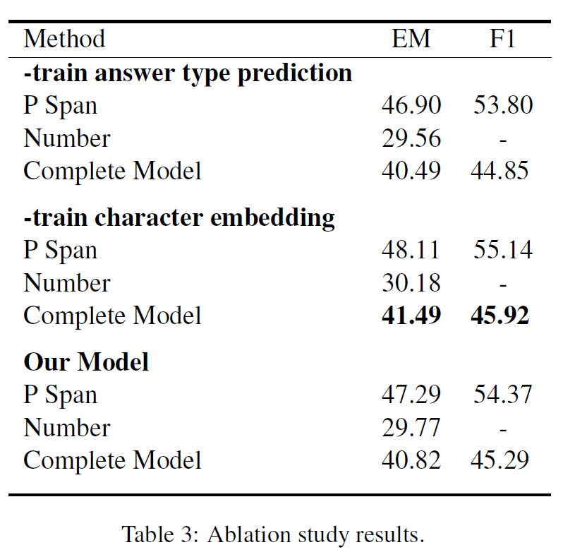
Results

Slide 10
Fun Facts
For an array of shape (batch_size, d, l), which dimension does a torch module act on?
The last dimension.
How to share weights between different layers?
Instantiate it once, use it many times.

Slide 11
Acknowledgement
Our model is built upon the QANet architecture implemented by:
Bang Liu (https://github.com/BangLiu/QANet-PyTorch)
hengruo (https://github.com/hengruo/QANet-pytorch)
andy840314 (https://github.com/andy840314/QANet-pytorch-)
hackiey (https://github.com/hackiey/QAnet-pytorch)

