Slide 1
RAG Chatbot
Wai Leuk Lo (john.lo7242@gmail.com)
Code available at https://github.com/waileuklo/EvaluateAI
Wai Leuk Lo

Slide 2
RAG Chatbot
Model trained on past data
External knowledge base for update
Wai Leuk Lo

Slide 3
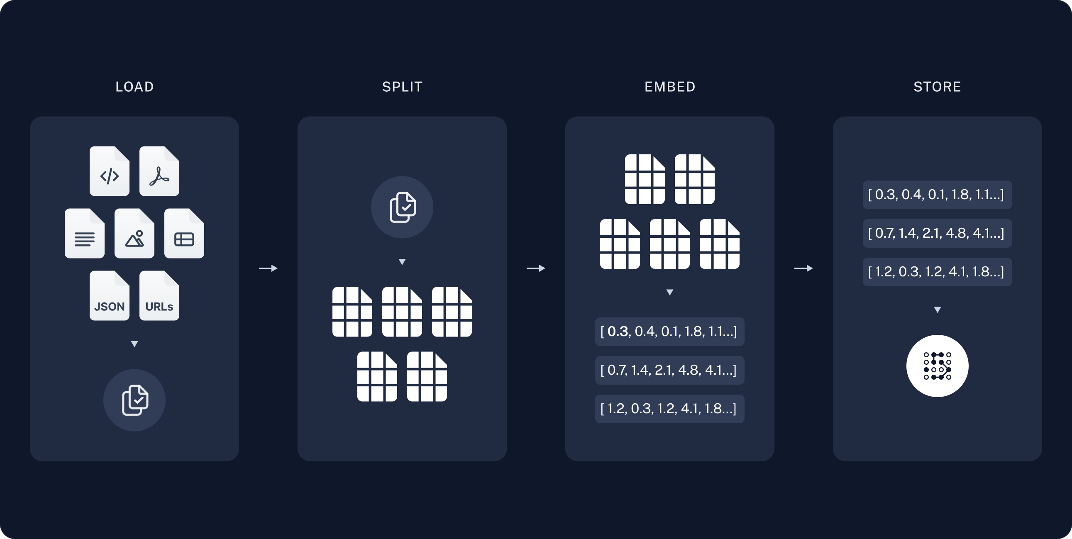
RAG Chatbot
Indexing
Load data / documents
Split documents into small chunks
Store the chunks in a vectorstore
Wai Leuk Lo

Slide 4
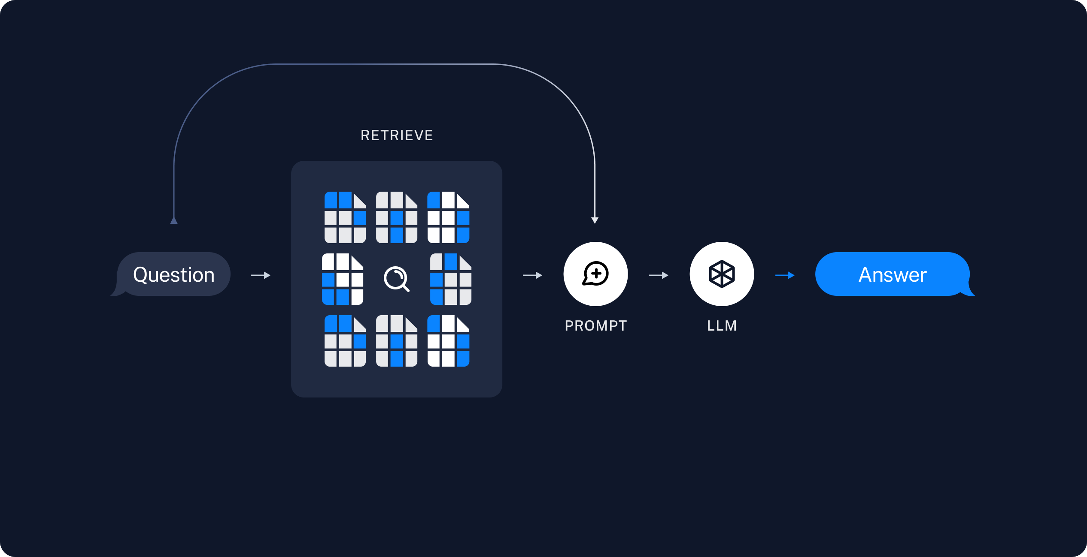
RAG Chatbot
Retrieval and Generation
Retrieve relevant chunks based on input
Generate answer based on input and retrieved chunks
Wai Leuk Lo

Slide 5
Requirements
Guided and interactive AI: User input (Finance, IT, Logistics)
Topic specific: Knowledge base
Evaluation: Need questions & ground truth answers
Usage monitoring: LangSmith (not implemented)
Wai Leuk Lo

Slide 6
Workflow
Knowledge base: documents online
Use LLM to generate questions and ground truth answers
Run RAG on questions to give answers
Evaluate RAG with LLM
Wai Leuk Lo

Slide 7
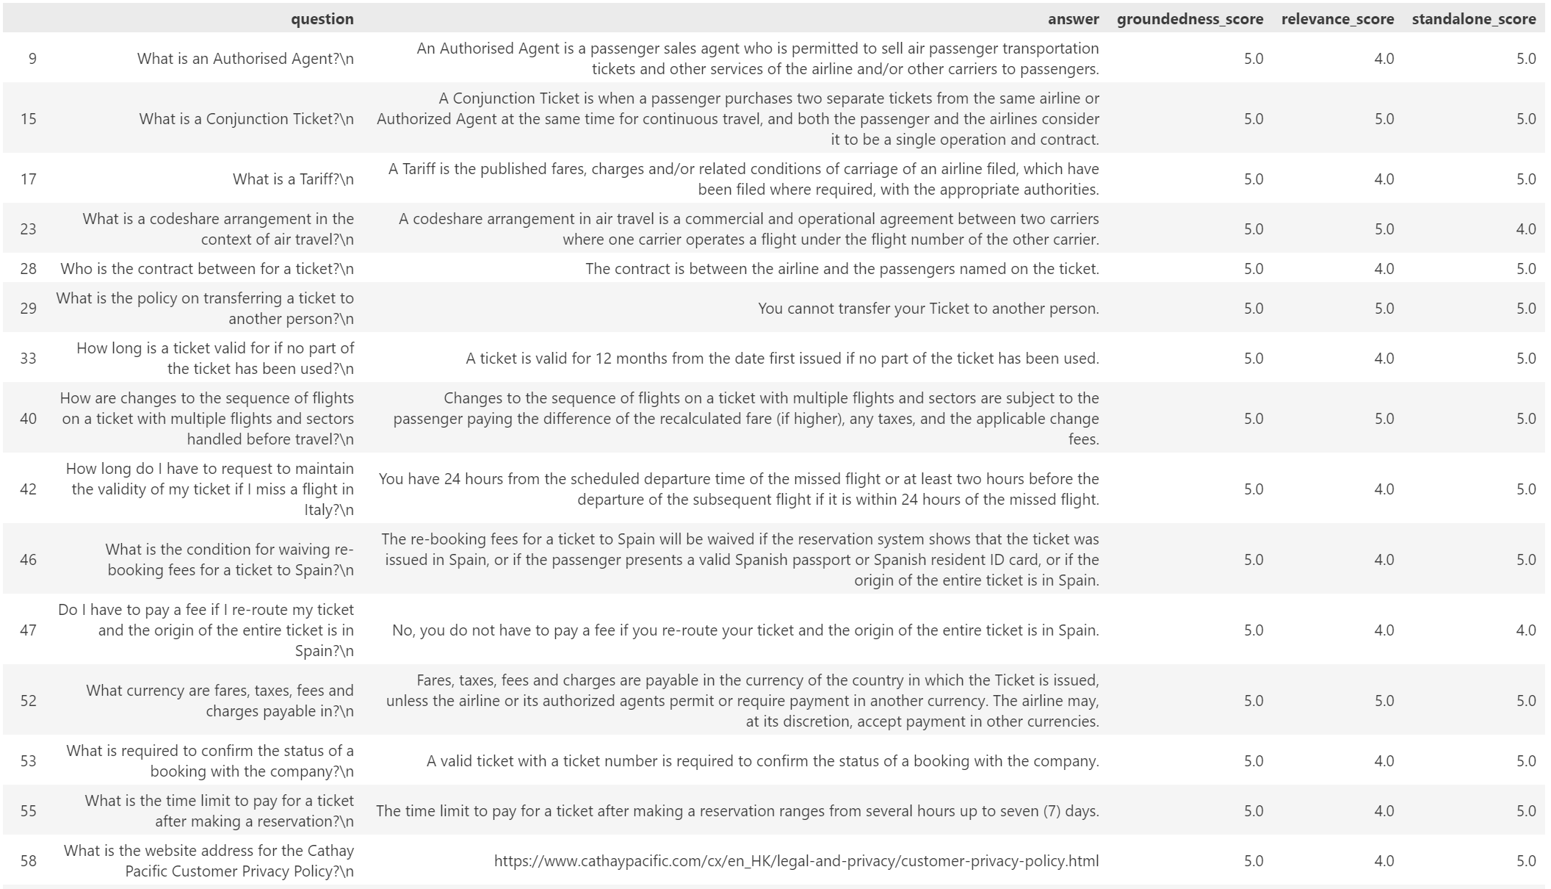
Case Study
Topic: IT
Knowledge base: 2022hkt_security_report
Generate questions & answers based on the pdf: Mistral AI
Select the good ones for RAG evaluation
Build and run RAG: Zephyr
Evaluate RAG: ChatGPT-4
Wai Leuk Lo

Slide 8
Metrics
Faithfulness
Context precision@K
Context recall
Wai Leuk Lo

Slide 9
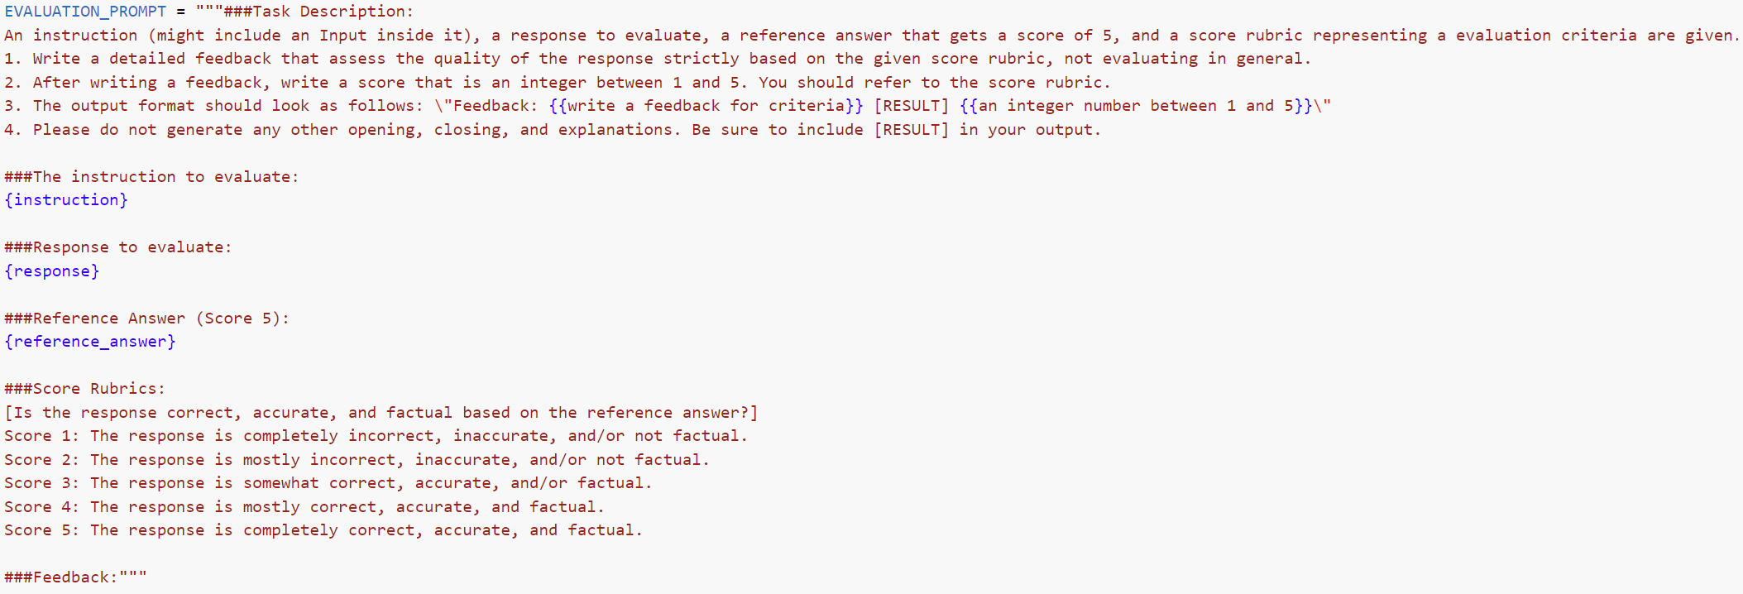
Metrics
Faithfulness
LLM based
Prompt ChatGPT-4 to evaluate the faithfulness
Wai Leuk Lo

Slide 10
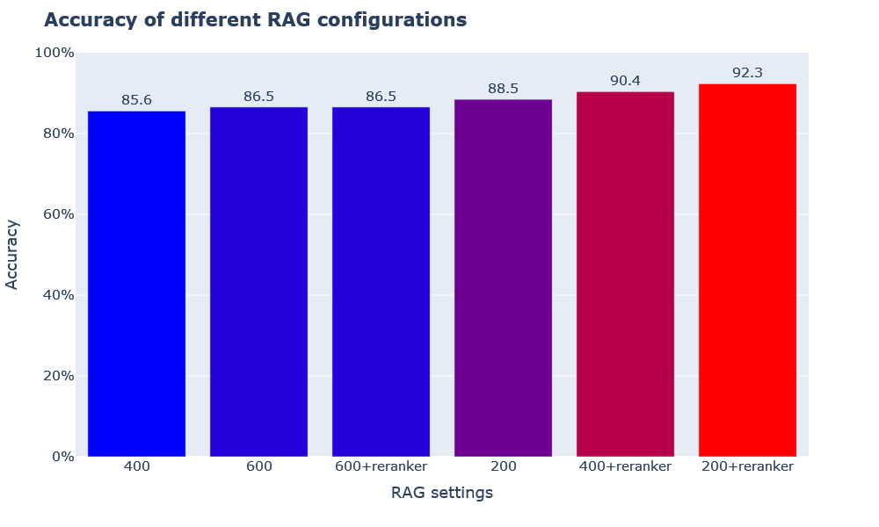
Metrics
Faithfulness
200, 400, 600 represent chunk size
Wai Leuk Lo

Slide 11
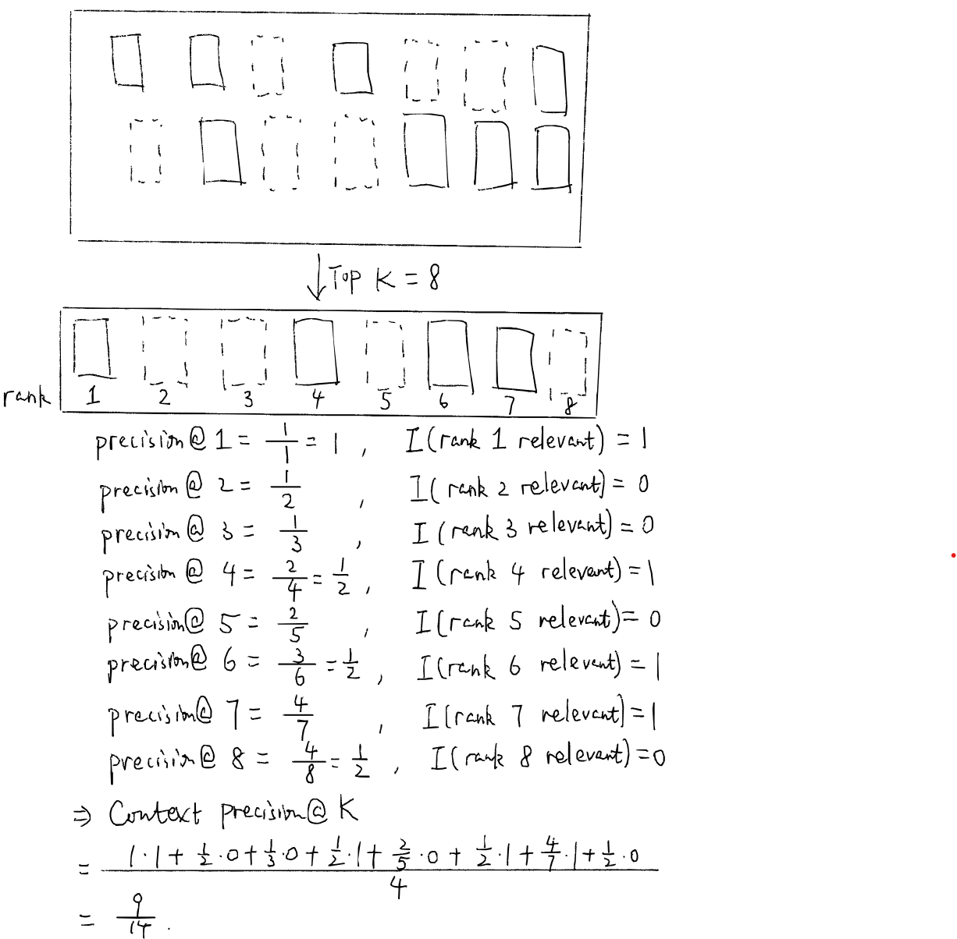
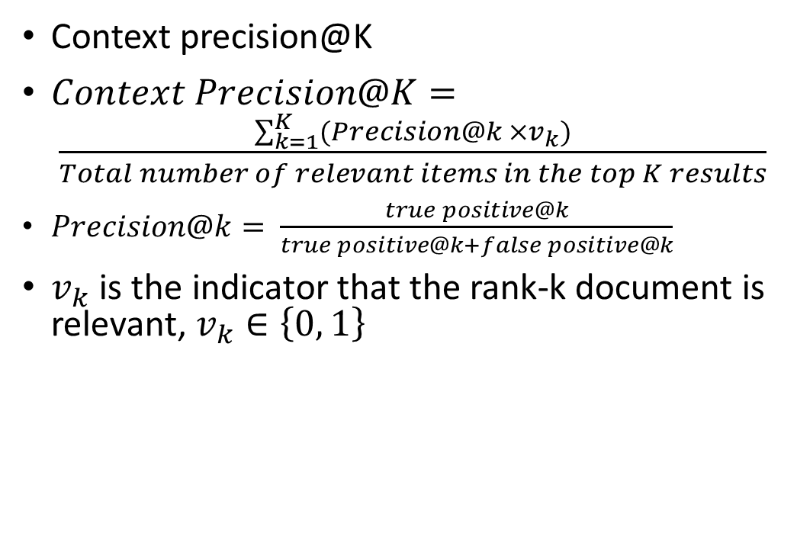
Metrics
Context precision@K
$Context Precision@K= \frac{\sum_{k=1}^{K}{(Precision@k ×v_{k})}}{Total number of relevant items in the top K results}$
$Precision@k= \frac{true positive@k}{true positive@k+false positive@k}$
$v_{k}$ is the indicator that the rank-k document is relevant, $v_{k}∈\left\{0, 1\right\}$
Wai Leuk Lo

Slide 12
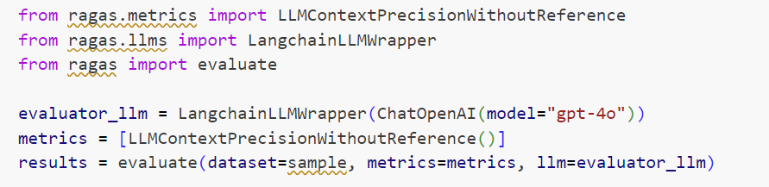
Metrics
Context precision@K
LLM-based and Non-LLM-based
Not yet implemented
Wai Leuk Lo

Slide 13
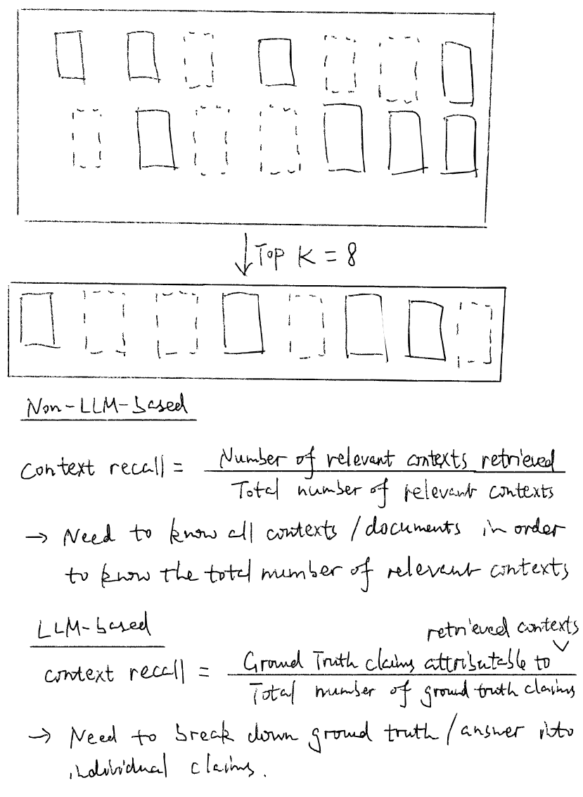
Metrics
Context recall
Not yet implemented
Wai Leuk Lo

Slide 14
Things to do
Deployment: LangServe(https://github.com/langchain-ai/langserve/tree/main?tab=readme-ov-file#deployment)
User feedback: LangSmith (https://docs.smith.langchain.com/evaluation/how_to_guides/attach_user_feedback)
Wai Leuk Lo

Slide 15
Acknowledgements
Most of the codes are from https://huggingface.co/learn/cookbook/rag_evaluation
We referenced the following for metrics https://docs.ragas.io/en/latest/concepts/metrics/available_metrics/
We referenced the following code for pdf loading https://python.langchain.com/docs/tutorials/pdf_qa/
Wai Leuk Lo

