Slide 1
Topic 4: Graph Mining – VQNE: Variational Quantum Network Embedding with Application to Network Alignment - Implementation
Group 3: Wai Leuk Lo (wlloaa@connect.ust.hk)
Code available at https://github.com/waileuklo/VQNE
Wai Leuk Lo

Slide 2
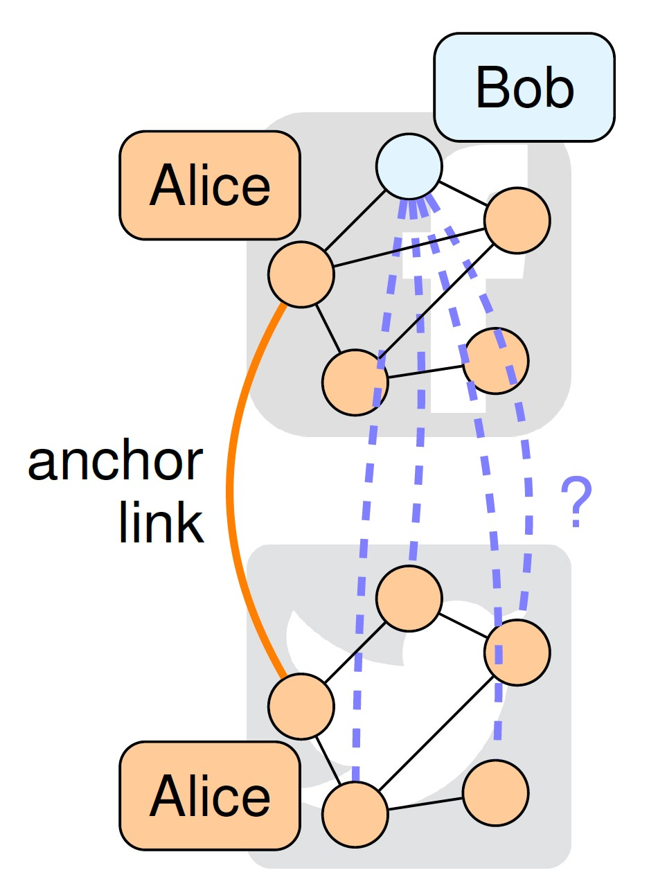
Network Alignment
A (social) network can be modeled as a graph
Node: User
Edge: Relation between two users
Undirected and unweighted graph
Wai Leuk Lo

Slide 3
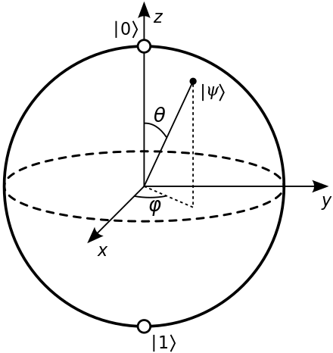
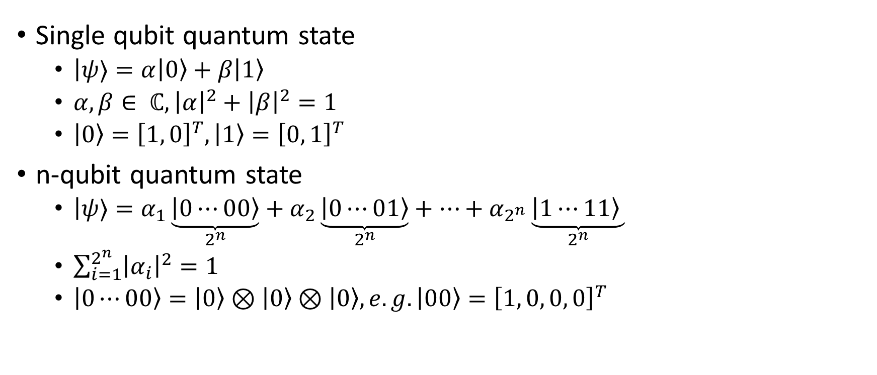
Quantum Computing
Single qubit quantum state
$\left|ψ\right.⟩=α\left|0\right\rangle +β\left|1\right\rangle$
$α, β∈ ℂ, {\left|α\right|}^{2}+{\left|β\right|}^{2}=1$
$\left|0\right\rangle ={\left[1, 0\right]}^{T}, \left|1\right\rangle ={\left[0, 1\right]}^{T}$
n-qubit quantum state
$\left|ψ\right.⟩=α_{1}\underset{2^{n}}{\underbrace{\left|0⋯00\right\rangle }}+α_{2}\underset{2^{n}}{\underbrace{\left|0⋯01\right\rangle }}+⋯+α_{2^{n}}\underset{2^{n}}{\underbrace{\left|1⋯11\right\rangle }}$
$\sum_{i=1}^{2^{n}}{{\left|α_{i}\right|}^{2}}=1$
$\left|0⋯00\right\rangle =\left|0\right\rangle ⊗\left|0\right\rangle ⊗\left|0\right\rangle , e.g. \left|00\right\rangle ={\left[1, 0, 0, 0\right]}^{T}$
Wai Leuk Lo

Slide 4

Quantum Computing
Quantum circuits
Unitary
$R_{x}\left(θ\right)= \left[\begin{matrix}\cos\left(\frac{θ}{2}\right) & −i\sin\left(\frac{θ}{2}\right) \\ −i\sin\left(\frac{θ}{2}\right) & \cos\left(\frac{θ}{2}\right)\end{matrix}\right]$
$R_{y}\left(θ\right)= \left[\begin{matrix}\cos\left(\frac{θ}{2}\right) & −\sin\left(\frac{θ}{2}\right) \\ \sin\left(\frac{θ}{2}\right) & \cos\left(\frac{θ}{2}\right)\end{matrix}\right]$
$R_{z}\left(θ\right)= \left[\begin{matrix}e^{−i \frac{θ}{2}} & 0 \\ 0 & e^{−i \frac{θ}{2}}\end{matrix}\right]$
$CNOT= \left[\begin{matrix}1 & 0 & 0 & 0 \\ 0 & 1 & 0 & 0 \\ 0 & 0 & 0 & 1 \\ 0 & 0 & 1 & 0\end{matrix}\right]$
Wai Leuk Lo

Slide 5
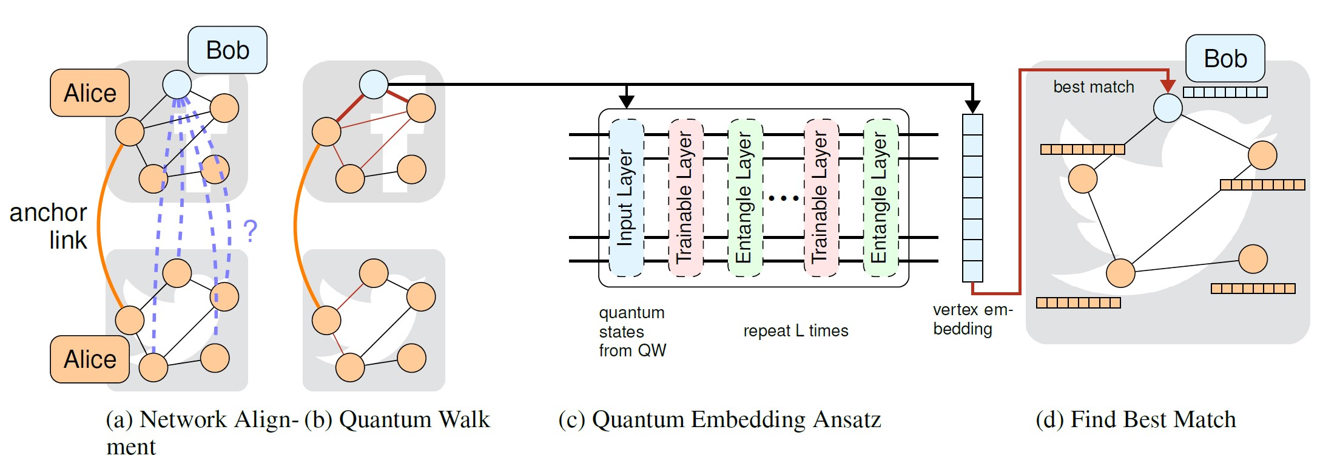
Methodology
Merge source graph and target graph
Discrete-time quantum walk on the graph
Quantum embedding ansatz on the encoded state
Wai Leuk Lo

Slide 6
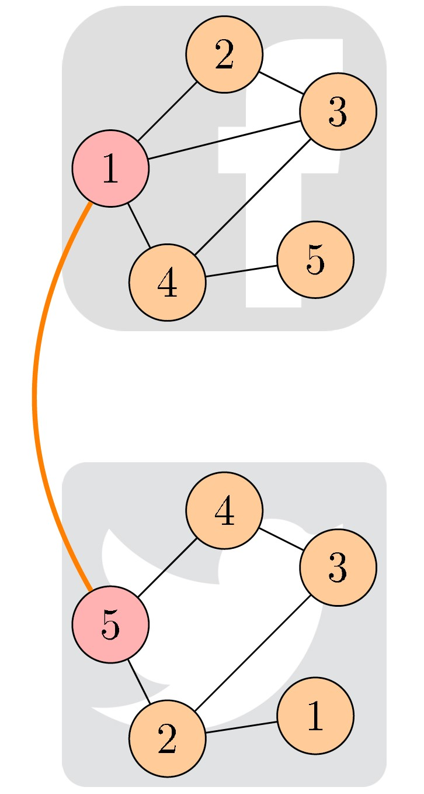
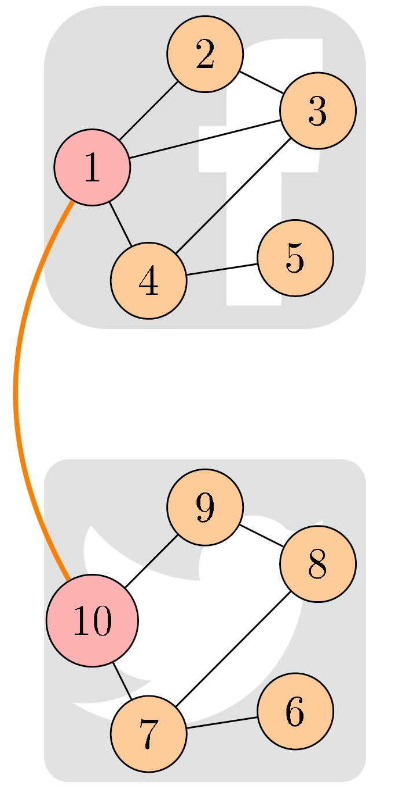
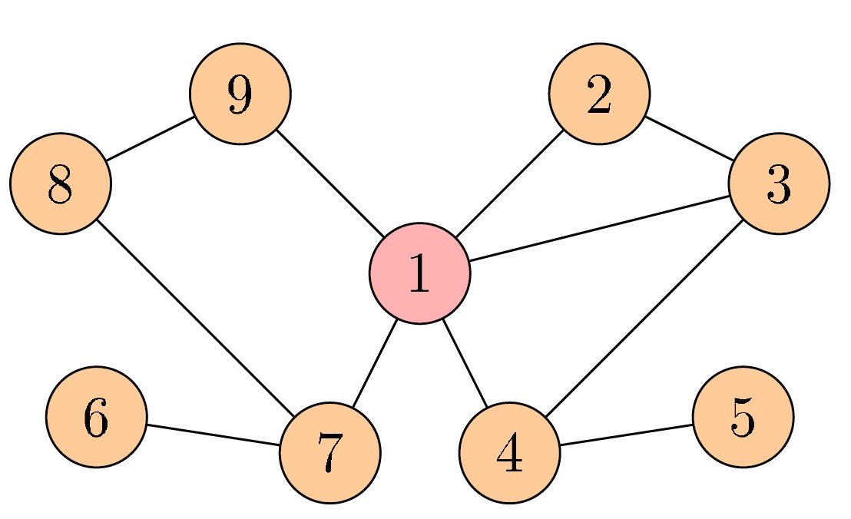
Methodology
Merge source graph and target graph
Start from the source graph G^{s}
Add all edges from the target graph G^{t}
Add only those vertices from G^{t} that are not anchor links
Wai Leuk Lo

Slide 7
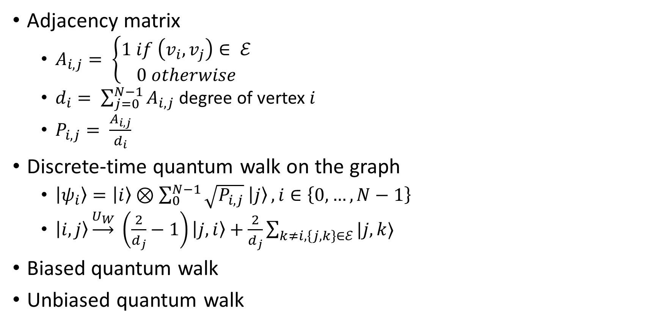
Methodology
Adjacency matrix
$A_{i, j}= \left\{\begin{aligned}1 if \left(v_{i}, v_{j}\right)∈ ℰ \\ 0 otherwise\end{aligned}\right.$
$d_{i}= \sum_{j=0}^{N−1}{A_{i, j}}$ degree of vertex $i$
$P_{i, j}= \frac{A_{i, j}}{d_{i}}$
Discrete-time quantum walk on the graph
$\left|ψ_{i}\right\rangle =\left|i\right\rangle ⊗\sum_{0}^{N−1}{\sqrt{P_{i, j}} \left|j\right\rangle }, i∈\left\{0, …, N−1\right\}$
$\left|i, j\right\rangle \underset{→}{U_{W}} \left(\frac{2}{d_{j}}−1\right)\left|j, i\right\rangle +\frac{2}{d_{j}}\sum_{k≠i, \left\{j, k\right\}∈ℰ}{|j, k⟩}$
Biased quantum walk
Unbiased quantum walk
Wai Leuk Lo

Slide 8
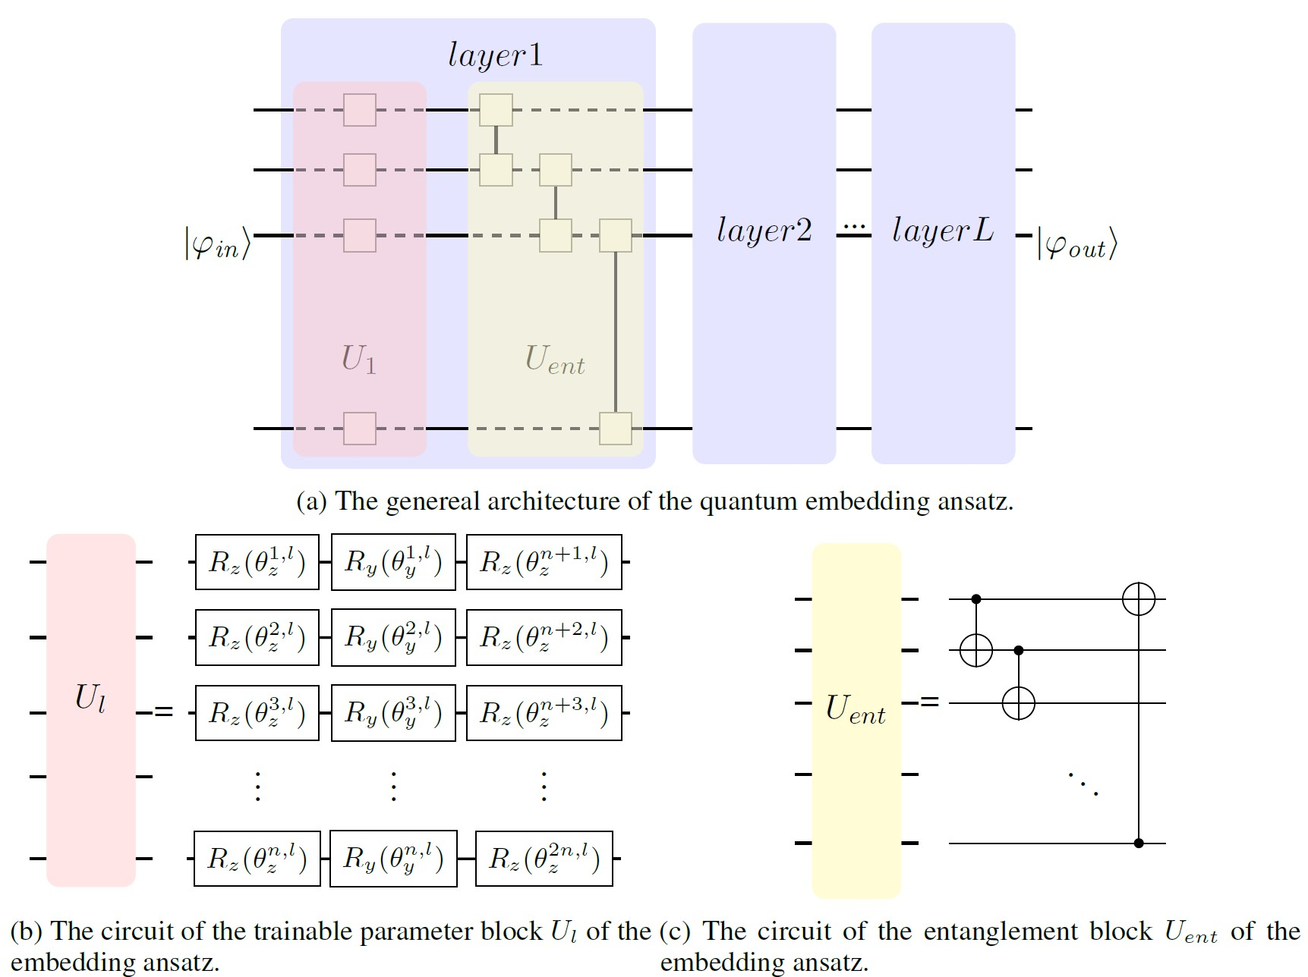
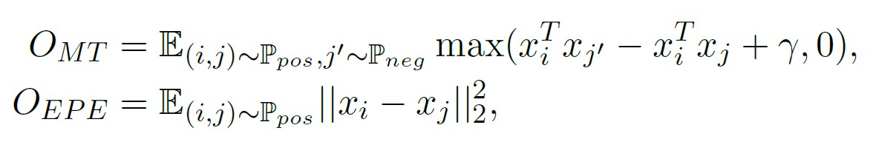
Methodology
Quantum embedding ansatz on the encoded state
Loss function = Triplet loss + Elastic Potential Energy
Wai Leuk Lo

Slide 9
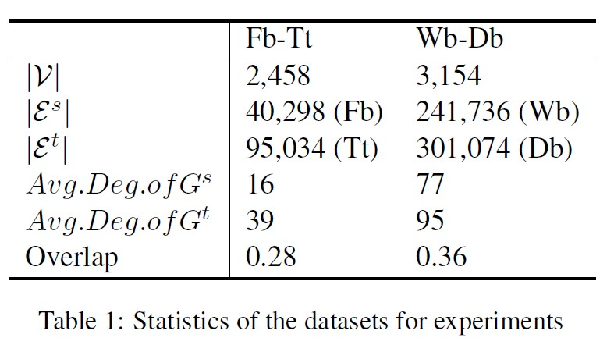
Datasets
Facebook-Twitter
Weibo-Doban
Wai Leuk Lo

Slide 10
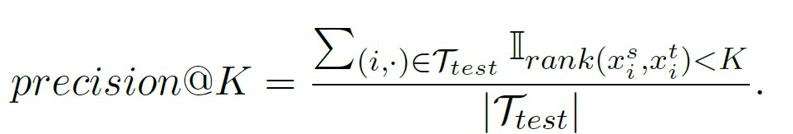
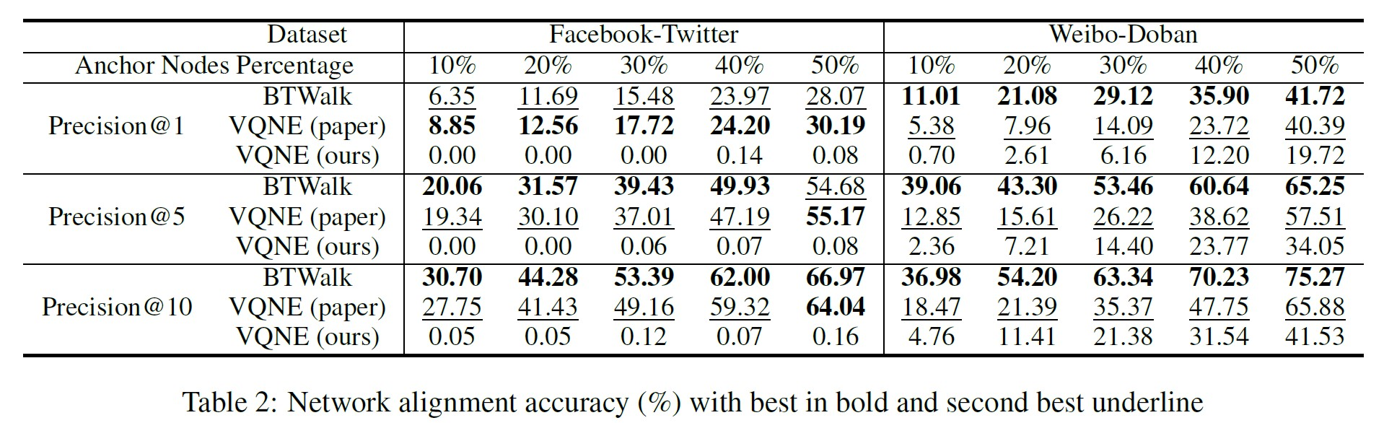
Results
Precision@K
Almost no learning on Fb-Tt dataset
Some learning on Wb-Db dataset
More training ≠ Better performance
Wai Leuk Lo

Slide 11
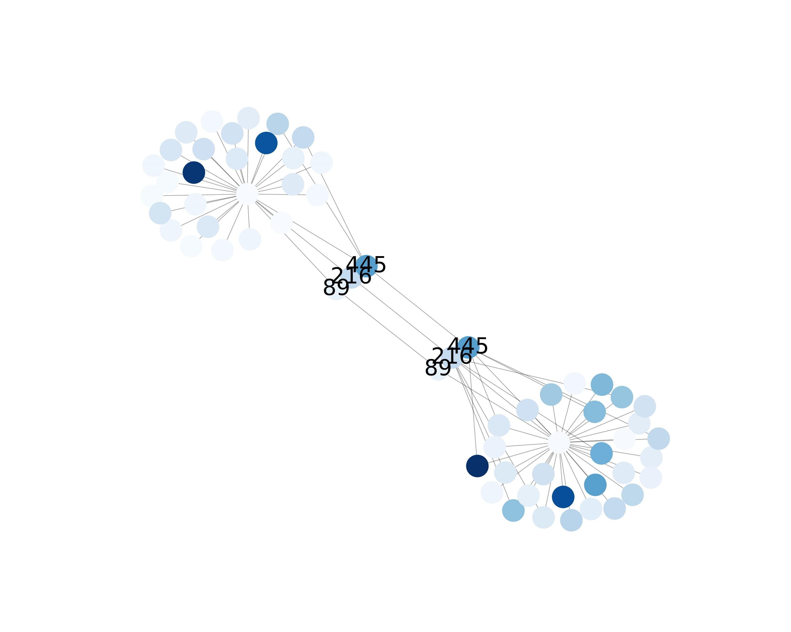
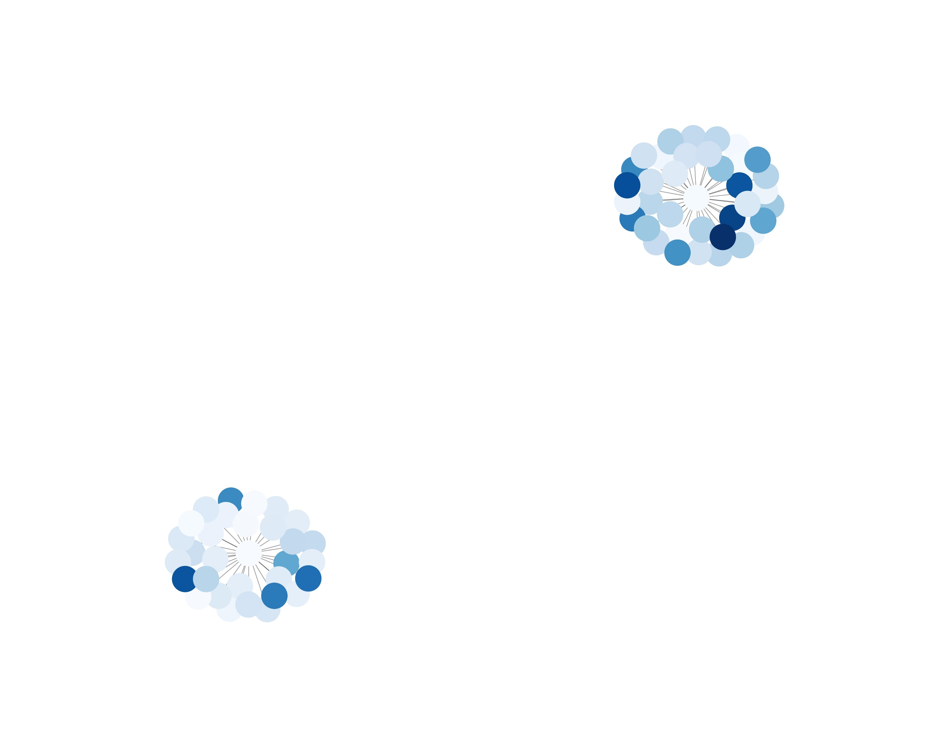
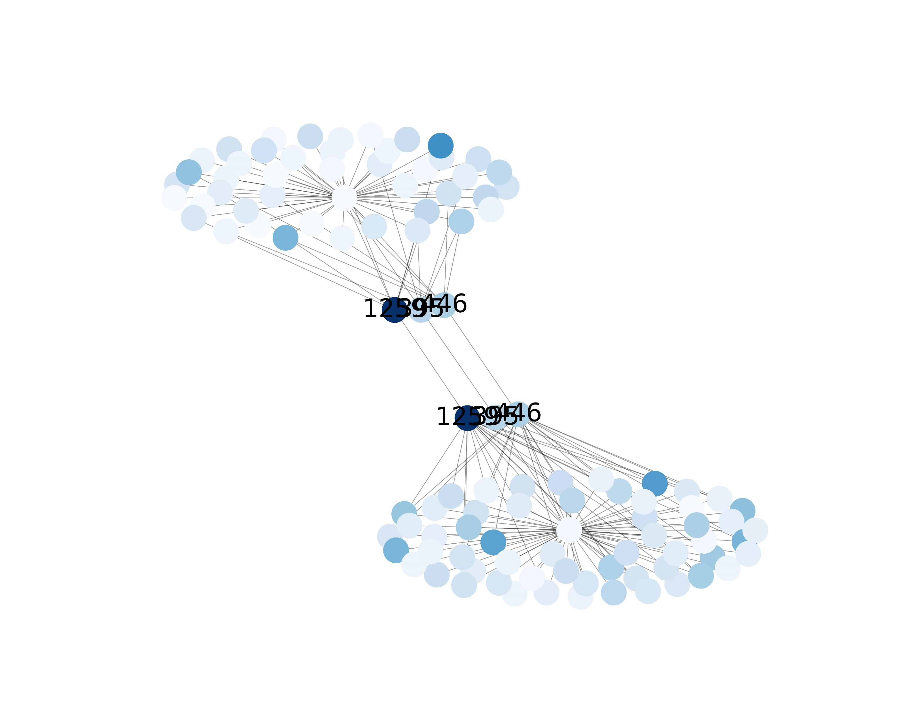
Results
Matched vertices
Un-matched vertices
Un-matched vertices
Wai Leuk Lo

Slide 12
Code Debugging
Parameters have physical meaning (rotation angle)
Print out model parameters
Check inner products between states
Check state vectors after quantum walk
Wai Leuk Lo

Slide 13
Acknowledgements
We referenced the following code for quantum walk (https://github.com/Dywangxin/RED_experiments)
We thank the authors of the original VQNE paper (Ye et al., 2023)for the email correspondence and their input in debugging our model.
Wai Leuk Lo

