Slide 1
RCA approach & architecture
Clean version

Slide 2



Catching Rare Events by Bigram Frequency Counting
Makes up by two main modules: First, the bigram frequency updater
For every single sec (configuarable)
Concat logs
“barcode already existed”
Save for future use
Create bigrams
[barcode already][already existed]
barcode already
Already existed
Update freq

Slide 3

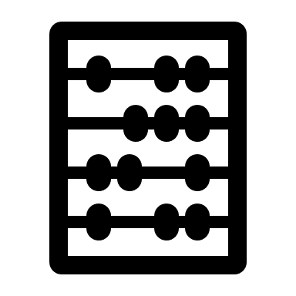
Catching Rare Events by Bigram Frequency Counting
Second, the alert generator
For every single sec (configuarable)
Concat logs
Alert if score < threshold
“Record expired record existed”
Create bigrams
$$\frac{\#record expired+\#record existed+\#expired record}{wordCount −1}$$
[Record expired][expired record][record existed]
Compute (un)rarity scores
record expired
record existed
expired record
Retrieve saved freq of bigrams in incoming logs

Slide 4


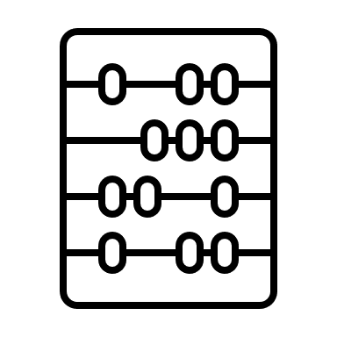




Architecture
Ngram Updaters
(Short-term/
Long-term)
RCA Ngram
Freq Batch Update System
UdpServer
Log
Ngram Freq/
Threshold
Udp Client
RCA Realtime Alert System
Tcp Server
Log
SRE
Payment System
UdpServer
Alert Generators
(Rarity-based/
Gradient-based)
Alert

