Slide 1
The Use of Checking Scientific Research
In a Business Environment (As seen in major System Integrators in Japan)

Slide 2
General uses
Tell you the result (accuracy) you can realistically expect
Show you the best approach
Speed up development time and reduce development cost by using shared source code and trained models in some case
Provide you test data and evaluation technique for converting to kpi
Reveal tricks of vendors claiming unrealistic result in marketing materials (but they can still be cost-effective for what they do)

Slide 3
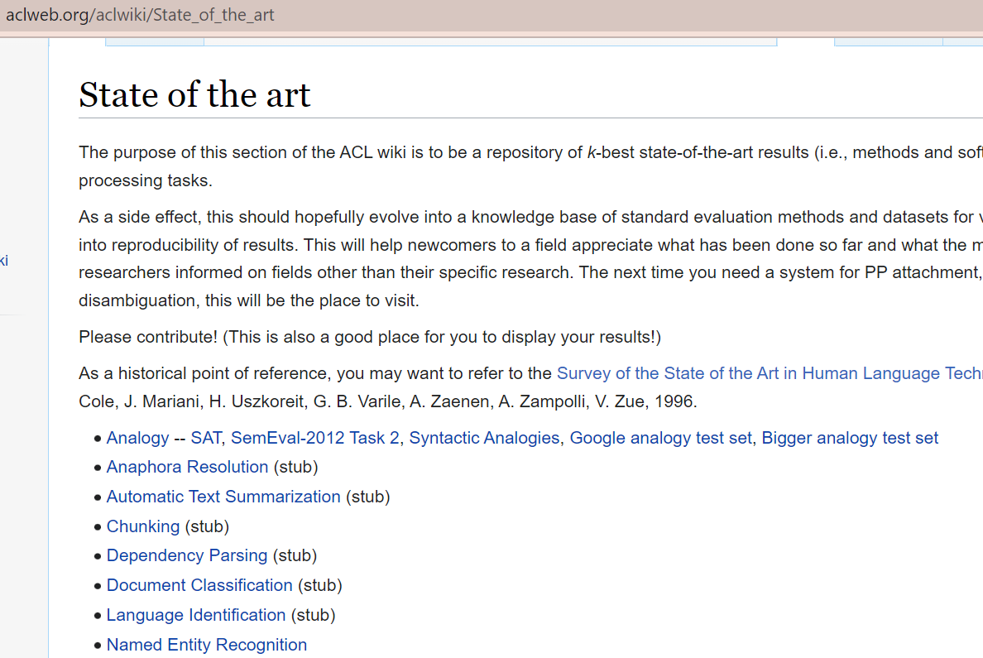
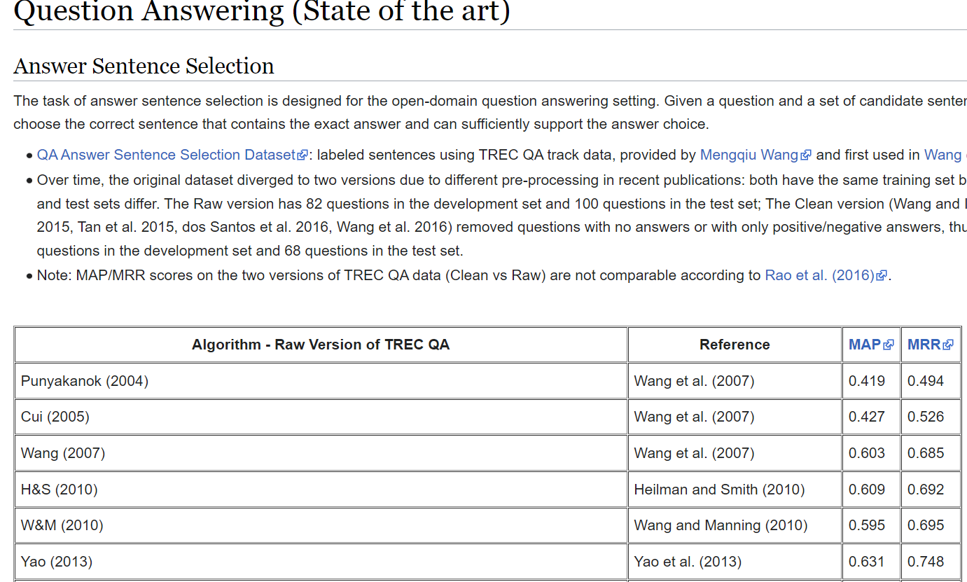
Steps to Check Scientific Research
1 Look for the State of the Art (SOA) list for the general field of your interest
2 Go one level down for the SOA page of the task of your interest
Lets pick QA since you are interested in chatGPT
This one is for NLP

Slide 4
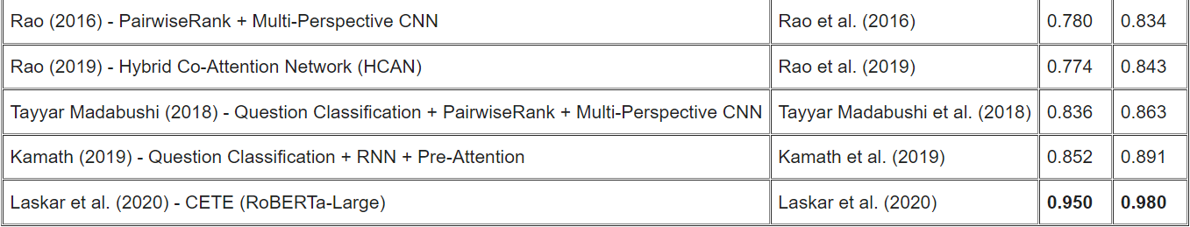
What you can find in a SOA page?
Dataset for evaluation
Evaluation Metrics
Used together for telling:
What we can expect from doing it ourselves
how trustworthy the number claimed by a vendor is
Evaluation Result
The general family (Neural Network) of approaches described in recent papers delivering SOA in are promising.
⇒We should try it ourselves or purchase from vendors doing similar things
Recent Papers
Papers
Recent Papers
Approaches (Rule-based, unsupervised falling out of favor in recent years are unlikely to yield result competitive to the SOA, not to mention beating it
⇒stay away from investing on development following them
⇒doubts on vendors and test their products if not having requirements of approaches yielding SOA
…

Slide 5

3 Read the Best Papers
Papers listed in the SOA page with the best result
Understand their general approaches
You can tell what it can and cannot do
What it can do (in the case of QA)
Selecting the answer most similar to the question as the correct answer
What it cannot do
Avoiding wrong answers designed to be similar to the questions and trick it
Stacks of NN accepting Questions
Stacks of NN accepting Answers
Function comparing similarity

Slide 6
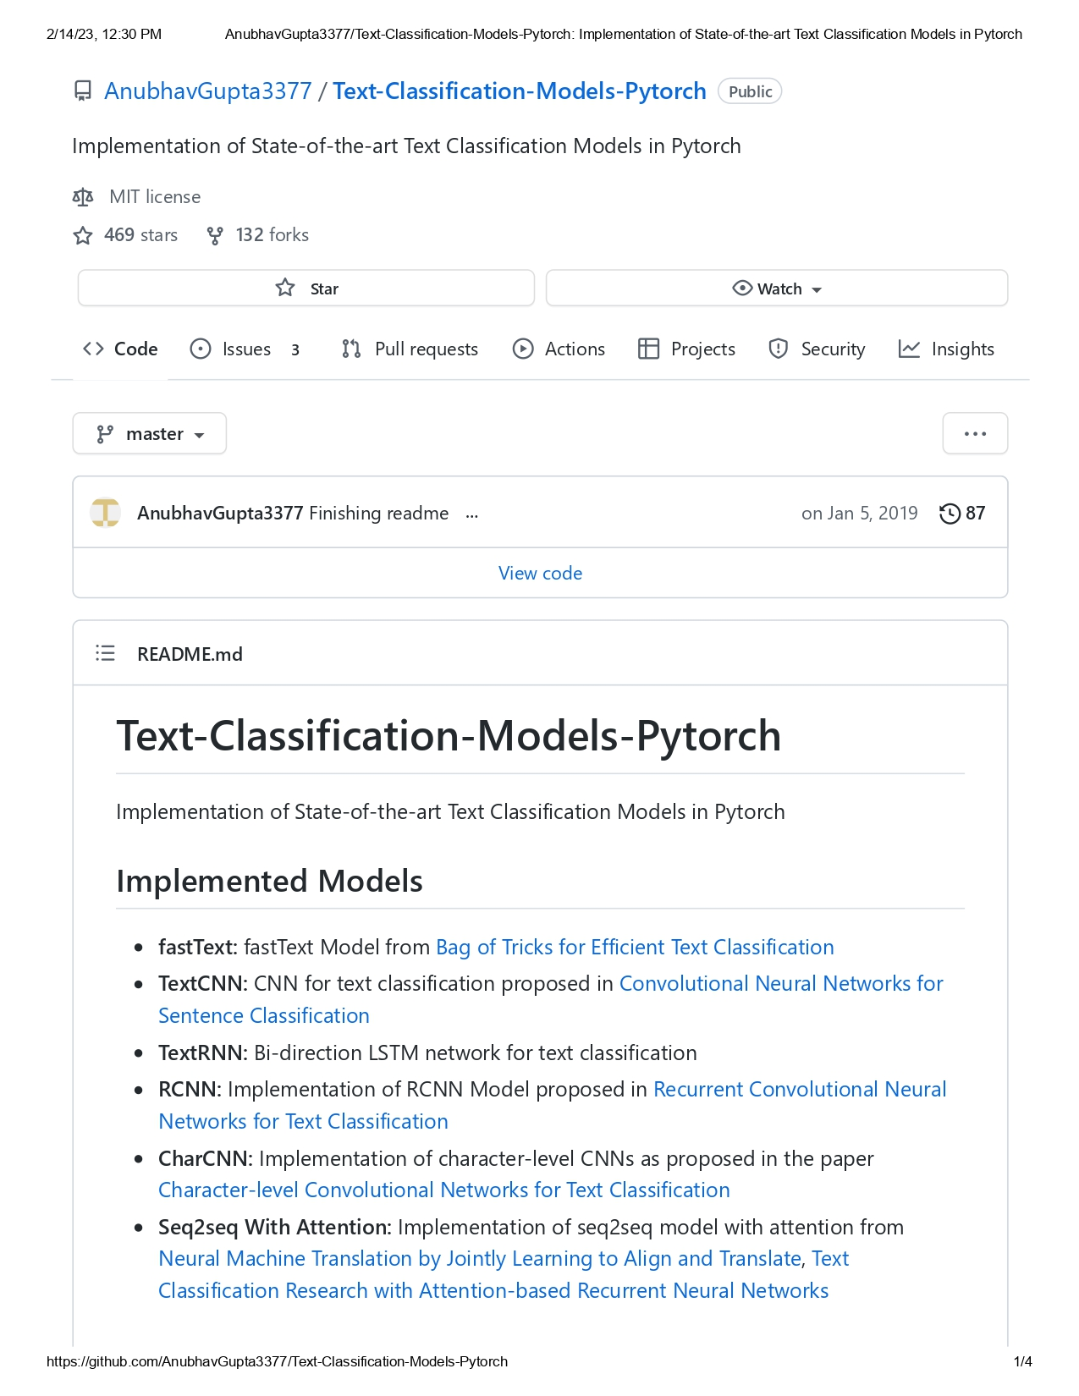
4 Check for Open Source Implementation of the Best Papers (mostly from Github)
If the licence allows commercial use
If source available (for maintenance)
If it can be run following the installation instruction
Go on to customize (for customers or internal use), usually means adapting to Japanese
Check for Licence
Check for Source
Check for Installation Instruction

