Slide 1
FYP Presentation GEO Social Network
Supervised BY Prof. Dimitris Papadias
Members:
Hou Wai Man (20012827)
Lo Wai Tong (20012918)
Tsui Kam Ming (20012724)

Slide 2
Presentation Outline
Background & Objective
Literature Review
Functionalities
System Architecture
System API Design
User Interface Design
Limitations
Further Improvements
Deliverables
Conclusion

Slide 3
Background & Objective
To develop a Scalable Geo-Social Network (GSN) with several functionalities
Find and share your status with your friends
What is a GSN?
Focuses on providing location-based service to users
E.g. Check-in, Find their friends, Personal Status

Slide 4
Literature Review
Foursquare
Allows users to check-in at different places, show friends, comments in venues
RESTful Web Services
Implemented using HTTP and the principles of REST
Unique URL for different Object
Using @Path annotation in java for URL pattern
E.g. @Path("/deleteAnnouncement/{aId}/{annId}")
Emphasis on readability
SOAP V.S. RESTful:
RESTful doesn’t require message header -> small request size, saves bandwidth
RESTful: Lightweight, Human Readable Results and easy to setup

Slide 5

Literature Review (Cont’d)
Haversine Formula
Used for calculating the distance between two points on a sphere(earth).

Slide 6
Functionalities
Welcome Page
Register, Login, Reset Password
Wall Page
Posts, Replies, NewsFeed, View Wall Posts (Personal & Friend’s)
Profile Page
Edit Password, Personal Information
Friend Page
Add Friends, Search, Unfriend
Check-in Page
Check-in at current location, View Check-in History, Find Nearby Friends
Venue Page
Location on Google Map, Check-in Statistics, Friends’ Check-ins
Notification Page
Event Page
Calendar, Creating Event, Event Invitation, Posts, Replies
Administrative Page
Make/Delete Announcement, Lock/Unlock User Accounts, Updating System Parameters

Slide 7
System Architecture
RESTful Web Service
Web Application
(Apache, PHP, HTML, javascript, CSS)
System API Functions
MongoDB
Back-end
Front-end

Slide 8
Database Design
MongoDB
Document-based Database
Data Stored in Binary JSON
No Schema – flexible, easily extensible
No Expensive Joins (compared to RDBMS)
Geographical Data Handling

Slide 9
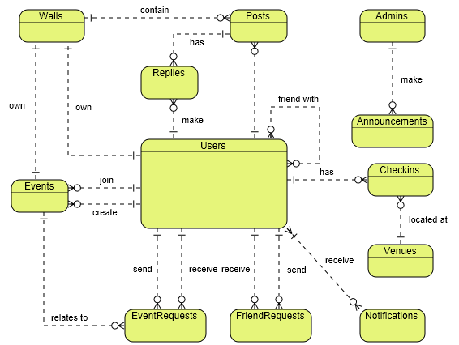
Database Design (Cont’d)

Slide 10
Database Design (Cont’d)
E.g. Checkins Collection
Checkins { checkinId: int, user: { userId: int, name: str, profilePic: str }, venueId: int, venueName: str, location: [longitude, latitude],<--checkin location, NOT Venue location checkinDate: date }

Slide 11
Database Design (Cont’d)
Collections in the database:
Users
Admins
Announcements
Checkins
Venues
Events
EventRequests
FriendRequests
Posts
Notifications
IncrementKey
Parameters

Slide 12
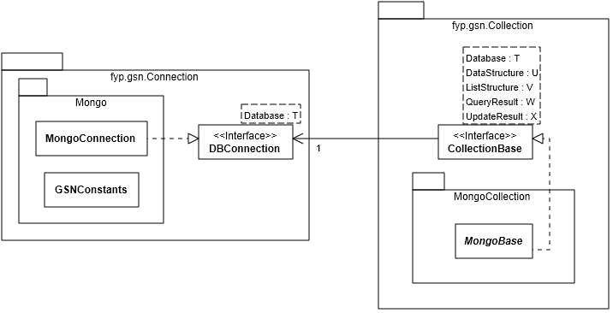
System API Design

Slide 13
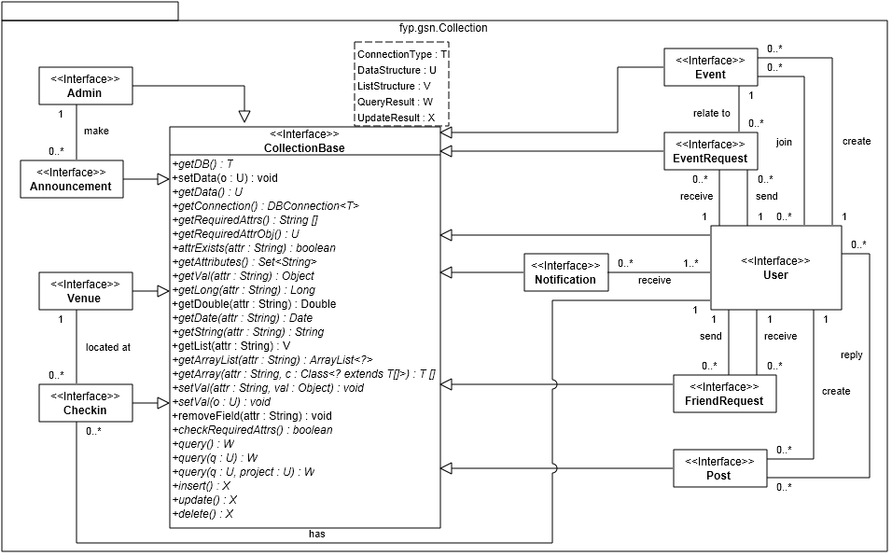
System API Design (Cont’d)

Slide 14
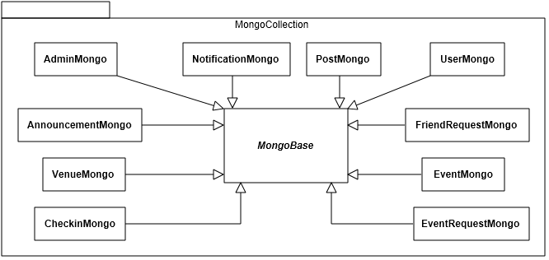
System API Design (Cont’d)
fyp.gsn.Collection.MongoCollection package

Slide 15
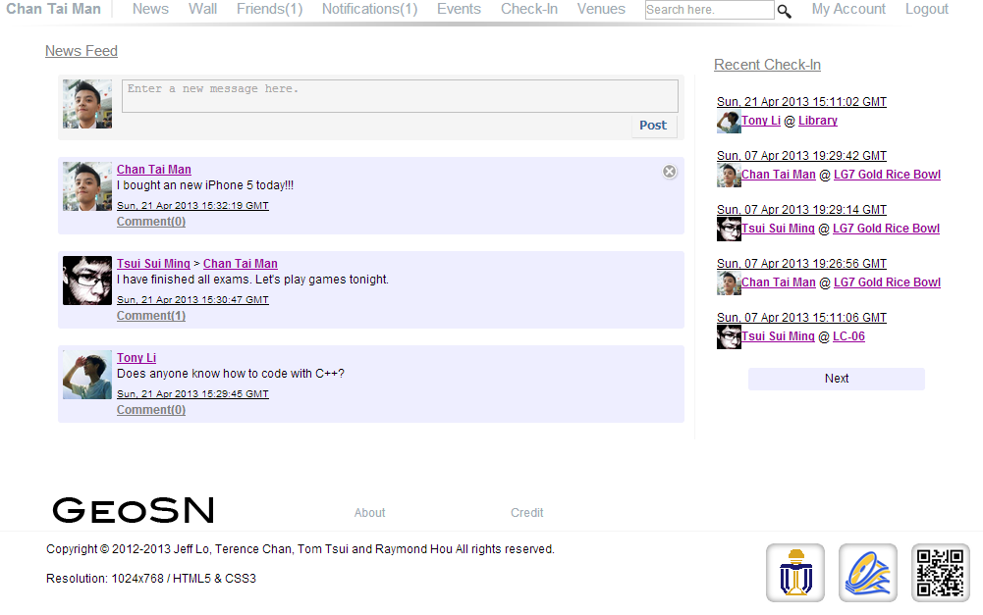
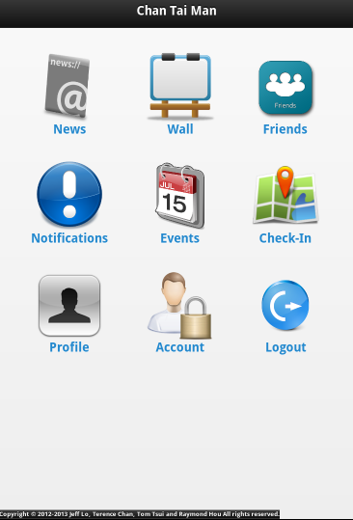
User Interface Design

Slide 16
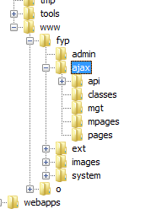
Technologies Applied
MVC
Model: perform web service queries and logic process
View: input and output representation to the user
Controller: handle user requests and changes the view’s presentation of the model

Slide 17

Technologies Applied
jQuery + Ajax
Ajax: send data to, and retrieve data from, a server in the background without refreshing the page.
jQuery: simplifies javascript, easy to use, condensed syntax

Slide 18
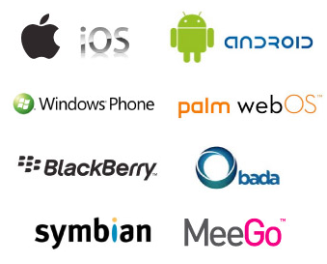
Technologies Applied
jQuery Mobile
Easy to create a consistent layout for mobile devices
Cross platforms - smartphone, tablet

Slide 19
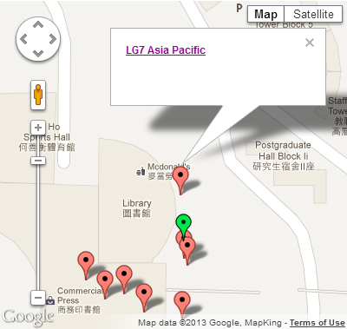
Technologies Applied
Google Maps API
Free
User-friendly
Support markers & labels

Slide 20
Limitations
Wi-Fi Positioning
Inaccurate location – high density of rooms, blind spot
User-Interface Consistency
Browser compatibility
MongoDB: Doesn’t support sorting operation in sub-documents

Slide 21
Further Improvements
Activities at Specific Venue
E.g. games, seasonal activities, discounts
UI on Mobile Devices
Client Side Security
Adding codes in client side to double check data
Post Visibility
Show extra information for specified users

Slide 22
Deliverables
The Geo-Social Network System
Database Design, System API, Web Service, Web Application
Documentations
Reports: Proposal Report, Progress Report, Final Report
JavaDoc for System API
Installation Guide

Slide 23
Conclusion
Scalable, Easily Extensible GSN
Web Application with Convenient User Interface and Cross Platform
Support Mobile Devices

