Slide 1

UNIVERSITY OF COMPUTER STUDIES MEIKTILA
INTERNSHIP PROJECT PRESENTATION
EDUCATIONAL ERP
Submitted by:
5CS-47 Mg Chan Myae Ayung
5CS-?? Mg Phyo Kyaw
10:22:41 PM
8/19/19

Slide 2

INTRODUCTION ABOUT THE COMPANY

Slide 3
VISION OF COMPANY
All across the country by force into the digital society, built by experts to understand
the knowledge of advanced technologies, formed by high-performance organizations,
established by the System Management System, full access to our service people,
while its digital services and information and communications technology ICT industry
to be one of the leading one of the top company.

Slide 4
MISSION OF COMPANY
In accordance with modern and improving your entire Smart Business, Smart Office and
Smart HR business insights needed ,ICT technical ,copyright and legal ,digital All Social
Service and Human Resource Development in digital technology to all service providers.

Slide 5
LEARNING THROUGH THE INTERNSHIP EXPERIENCE
met many experienced people in information technology field
knew the putting of knowledge and skills acquired in the real world
applied code that we developed needs to be flexible
learned time-management skills as well as self-motivation
learned how to communicate with people in the community who are
very different from us

Slide 6
OBJECTIVES OF THE SYSTEM
???

Slide 7
PROJECT PLAN & SCHEDULE
???

Slide 8









TECHNOLOGIES WE APPLIED

Slide 9
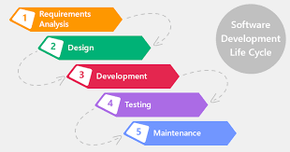
SDLC MODEL

Slide 10
USE CASE DIAGRAM
???

Slide 11



Slide 12
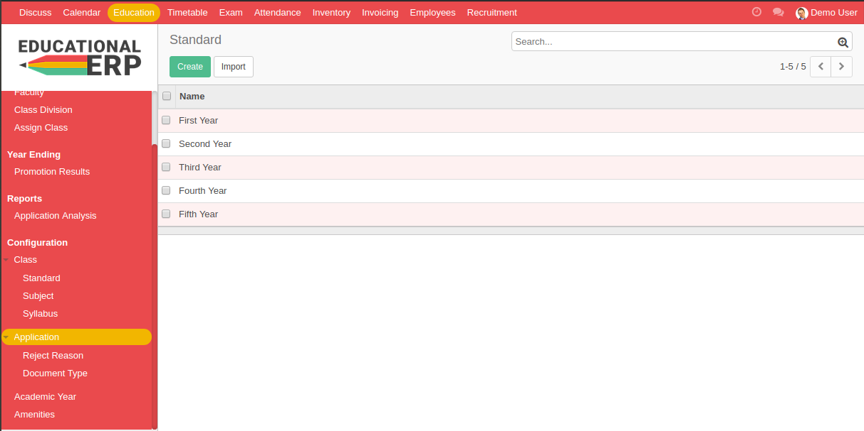
Education ERP is a module in ODOO ERP. First we must install it and then
follow the below picture.

Slide 13
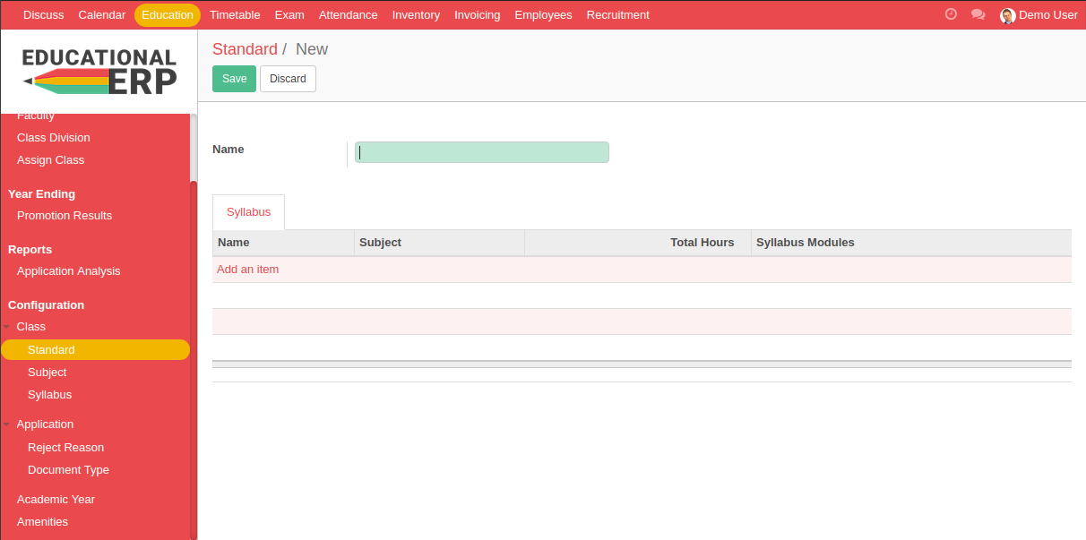
We have to configure the system to use it according to as general system
such as standard, subject, syllabus, reject reason, document tye, academic
year and amenities. The following standard creation form.

Slide 14
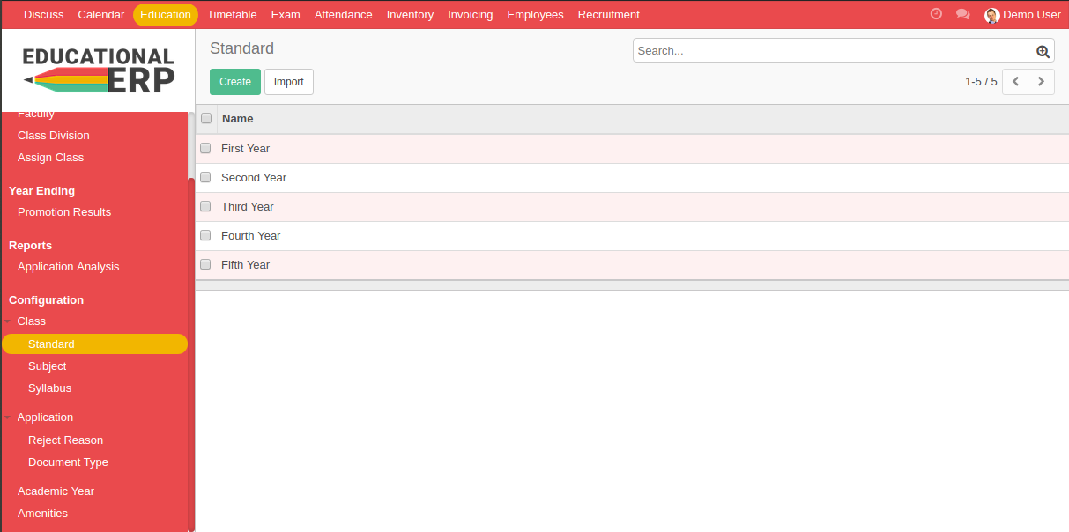
The following is list of configured standards for Educational ERP.

Slide 15
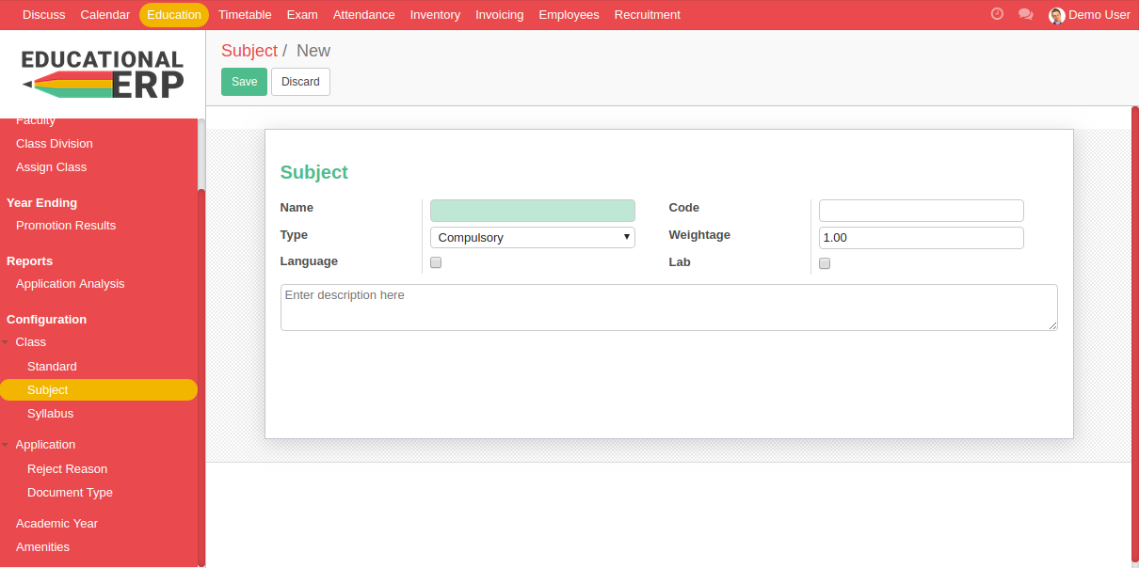
The following is subject creation form.

Slide 16
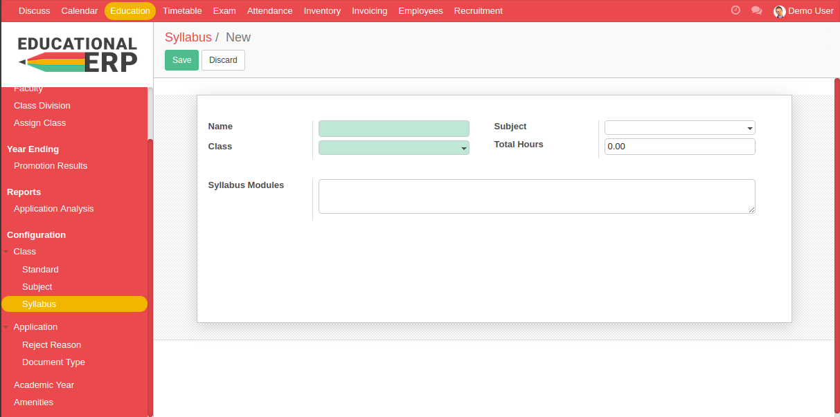
The following is syllabus creation form. This is related with class and subject .

Slide 17
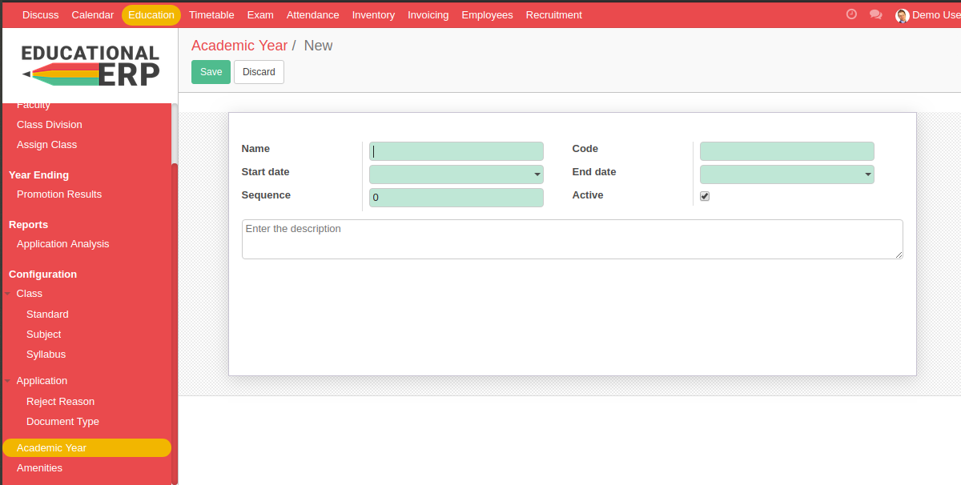
The following is academic year creation form for the period of the system.

Slide 18
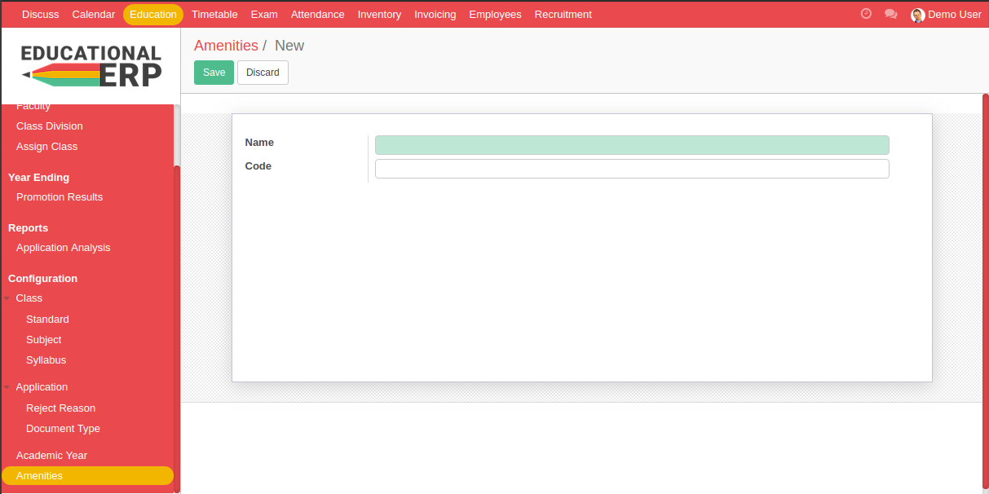
The following is amenities creation form for the happy life of the system.

Slide 19
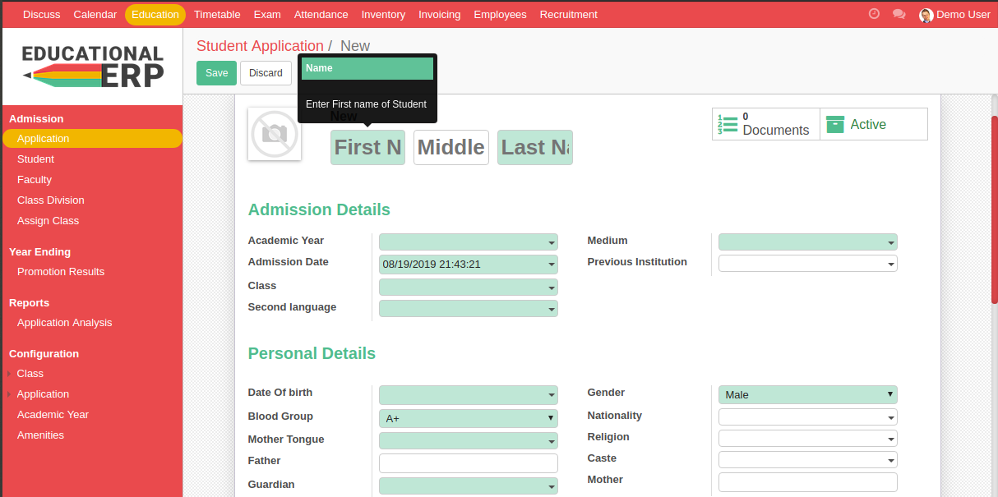
After we configure the system, we can start to use the system. The following is
Application creation form for new student registration.

Slide 20
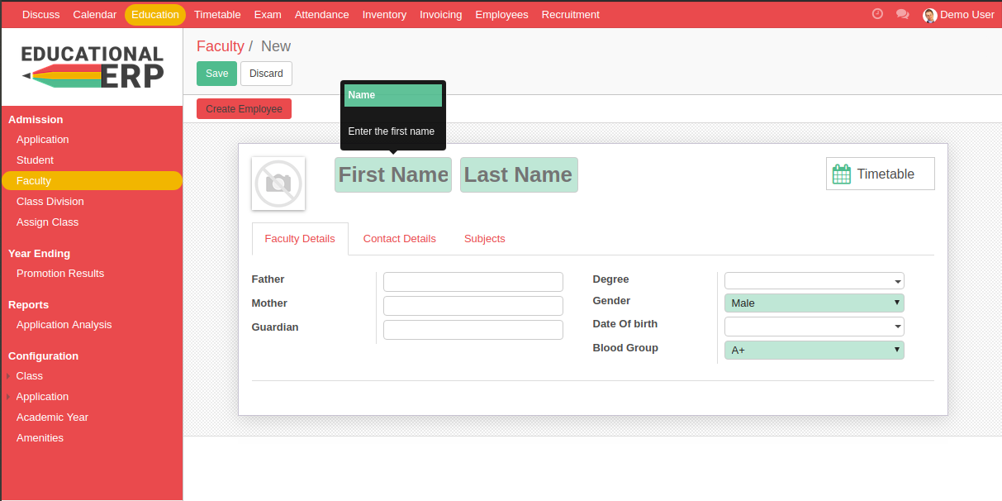
The following is faulty creation form for the system.

Slide 21
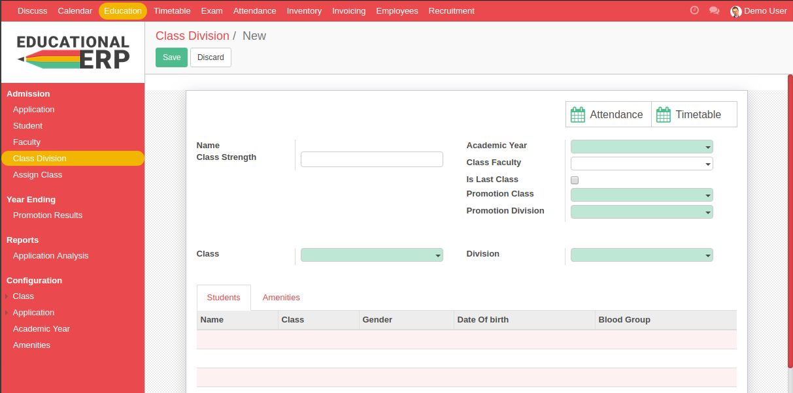
Class division is very important section for our system.

Slide 22
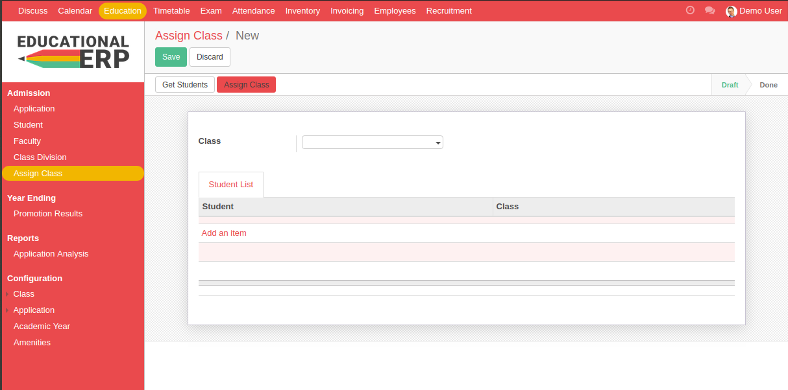
Assign new student to a class is also important of our system.

Slide 23
Promotion results is a showed result section of the ending year.

Slide 24
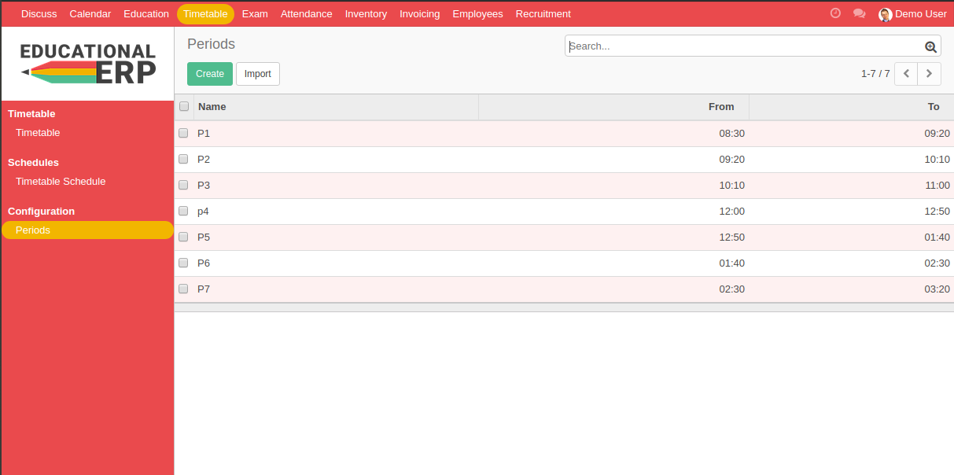
Before create time table, we have to configure period for a class.

Slide 25
Before create time table, we have to configure period for a class.

Slide 26
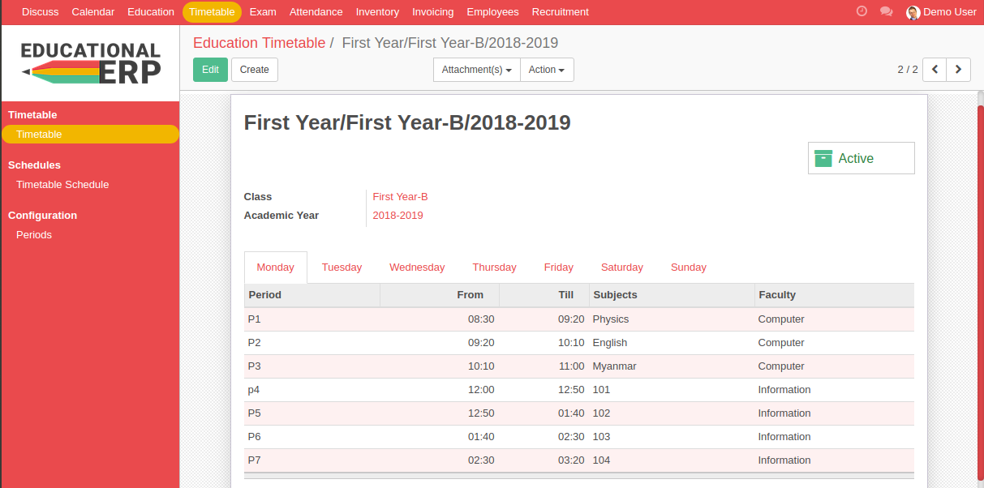
The following is a created time table for the system.

Slide 27
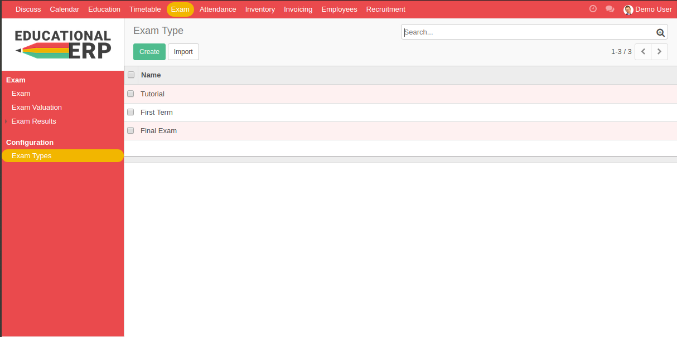
Exam is an essential section for our system. Also we have to configure
the following exam type.

Slide 28
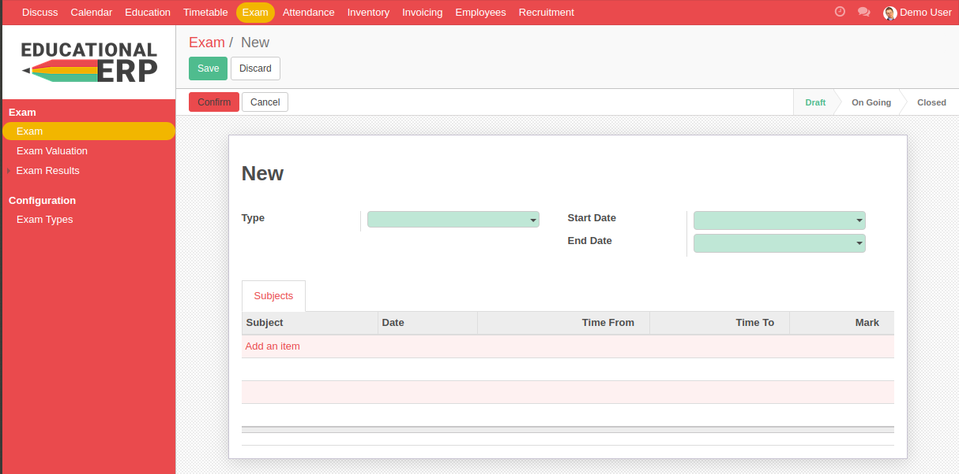
The following exam creation form.

Slide 29
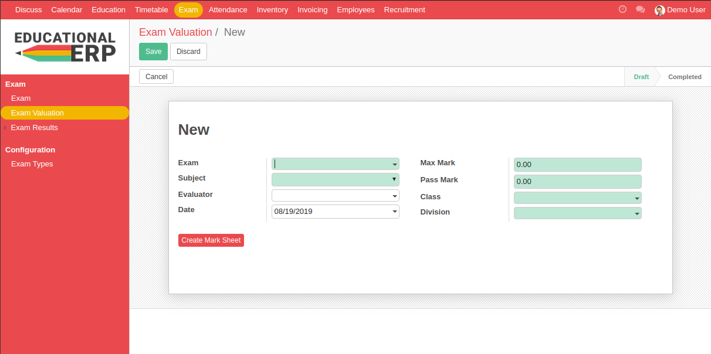
The following exam valuation form to regard standard marks to pass
or fail.

Slide 30
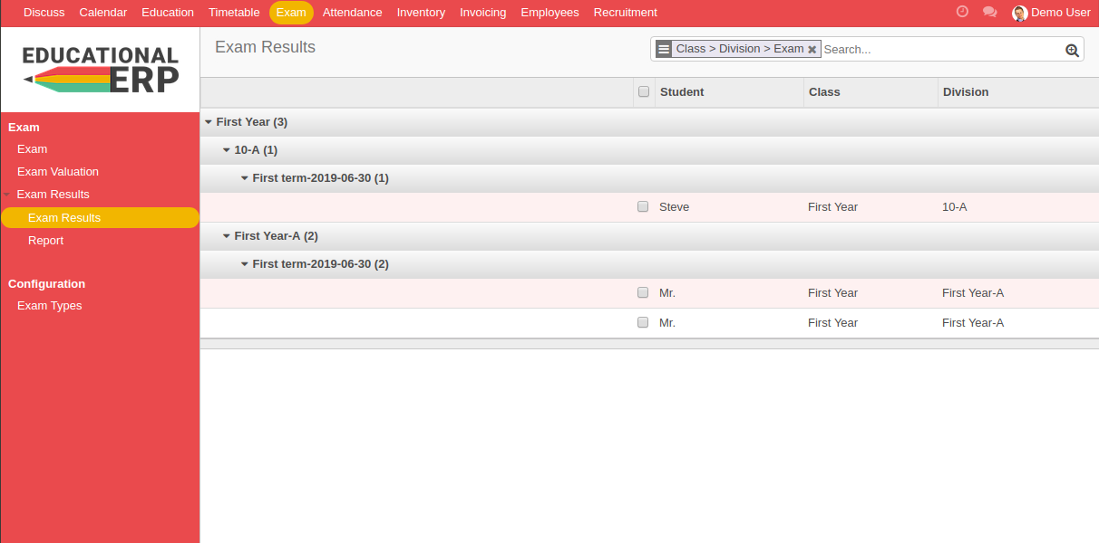
The following exam result for students who is pass or fail.

Slide 31
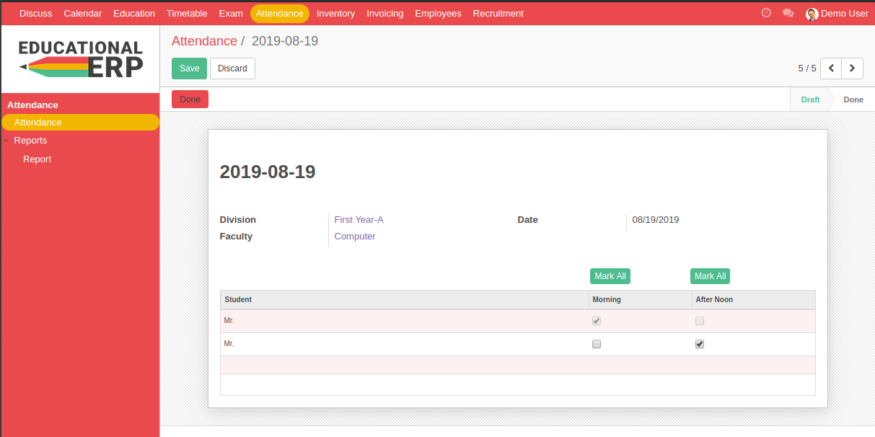
Attendence student creation form is the following.

Slide 32
CONCLUSION
  THE INTERNSHIP PROGRAM -
is very useful for not only students but also organization
helps us with opportunities in the future
gains practical and analytical knowledge and skills
gathers a valuable understanding of their major fields

Slide 33

We would like to answer as much as we can again
when you are more interested at some part of our
presentation.
Thank You for your attention ..

