Slide 1


UNIVERSITY OF COMPUTER STUDIES MEIKTILA
INTERNSHIP PROJECT PRESENTATION
LOGISTICS MANAGEMENT SYSTEM
Submitted by:
5CS-1 Ma Ei Ei Phyu
5CS-30 Mg Wai Phyo Naing
10:29:09 PM
8/19/19

Slide 2


INTRODUCTION ABOUT THE COMPANY

Slide 3
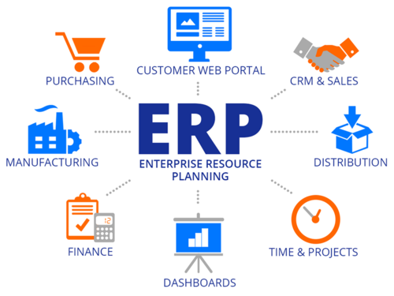





SERVICES & PRODUCTS

Slide 4
LEARNING THROUGH THE INTERNSHIP EXPERIENCE
met many experienced people in information technology field
knew the putting of knowledge and skills acquired in the real world
applied code that we developed needs to be flexible
learned time-management skills as well as self-motivation
learned how to communicate with people in the community who are
very different from us
had assigned to read books such as python, odoo to share knowledge
internally in every Thursday

Slide 5

What is “Logistics” ?
The activity of organizing the movement,
equipment, and accommodation of troops.
The commercial activity of transporting
goods to customers.

Slide 6


OBJECTIVES OF THE SYSTEM
To have trust transfer of products and remittance
To easily manage the order for logistics companies
To calculate invoice, vendor bills for each deliver order
To manage inventory for products
To manage fleets for logistics
To save wasted time for users

Slide 7
PROJECT PLAN & SCHEDULE

Slide 8









TECHNOLOGIES WE APPLIED

Slide 9
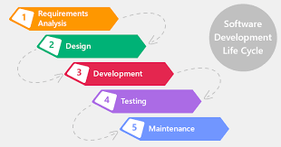
SDLC MODEL

Slide 10







USE CASE DIAGRAM

Slide 11











INTRODUCTION ABOUT THE SYSTEM

Slide 12



Slide 13
CONCLUSION
  THE INTERNSHIP PROGRAM -
is very useful for not only students but also organization
helps us with opportunities in the future
gains practical and analytical knowledge and skills
gathers a valuable understanding of their major fields

Slide 14

We would like to answer as much as we can again
when you are more interested at some part of our
presentation.
Thank You for your attention ..

