Slide 1
Movie Performance Analysis (2010–2019)
Executive Summary:
Analysis of IMDB data to identify drivers of movie success using genre, runtime, and directors.

Slide 2
Defining Movie Success
Success Score = Rating × log(Votes)
Balances quality perception and audience engagement.

Slide 3
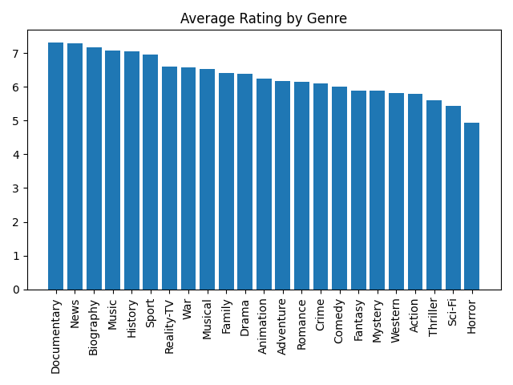
Genre Performance Overview

Slide 4
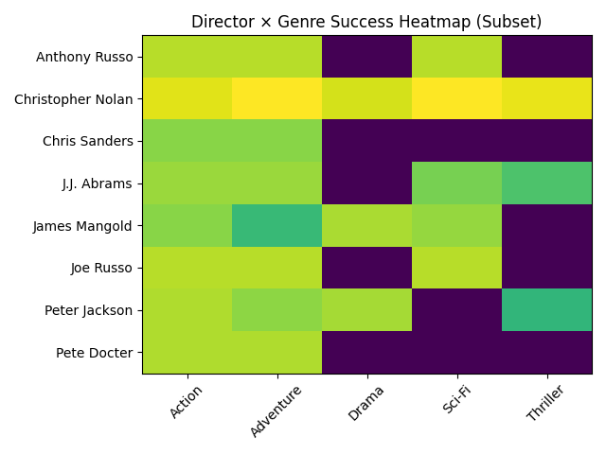
Director × Genre Performance

Slide 5
Strategic Recommendations
Focus on high-rated genres, optimal runtime (90–120 min), and proven director-genre combinations.

