Slide 1

Binary Classification on Taiwan companies’ bankruptcies 2013
By Yang Xiao, WaiShing Wong

Slide 2

Introduction
n = 6819, p = 95
Class Imbalance =
3.23% (bankrupted, or 1)
96.77% (non-bankrupted, or 0)
Features include: 95 normalized financial indicators such as cash flow ratio, book value per share …etc
Motivation on identifying significant predictors:
Consult firms on bankruptcy risks
Utilize this knowledge to short at-risk equities in the market
Link to data source: Kaggle

Slide 3
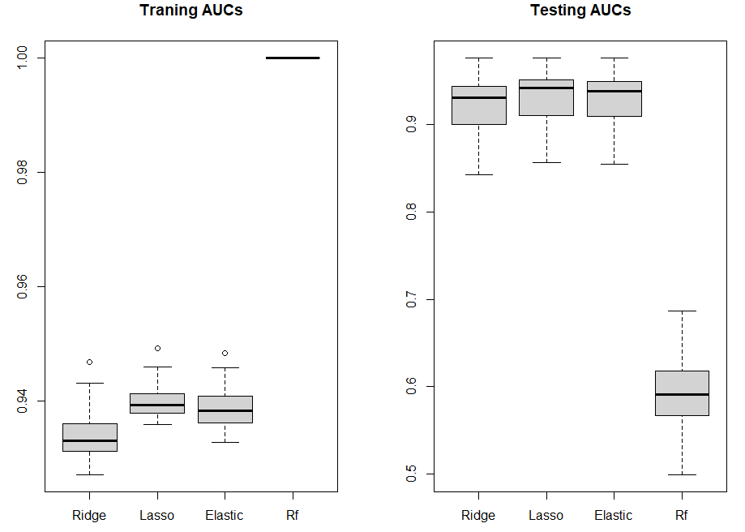
Box Plot of 50 AUCs

Slide 4
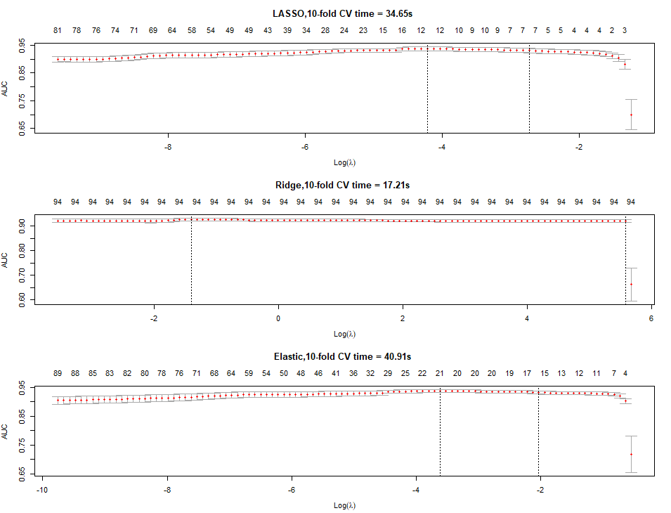
10-Fold CV curve, 50th sample

Slide 5
Training Time vs. Model Performance
 | AUC 90% Interval | Time(seconds)
Ridge | (0.87,0.96) | 21.6
Lasso | (0.87,0.96) | 37.2
Elastic-Net | (0.88,0.96) | 48.1
Rf | (0.52,0.65) | 42.2
In the context of this problem, time to train a model doesn’t positively correlate with model performance.

Slide 6
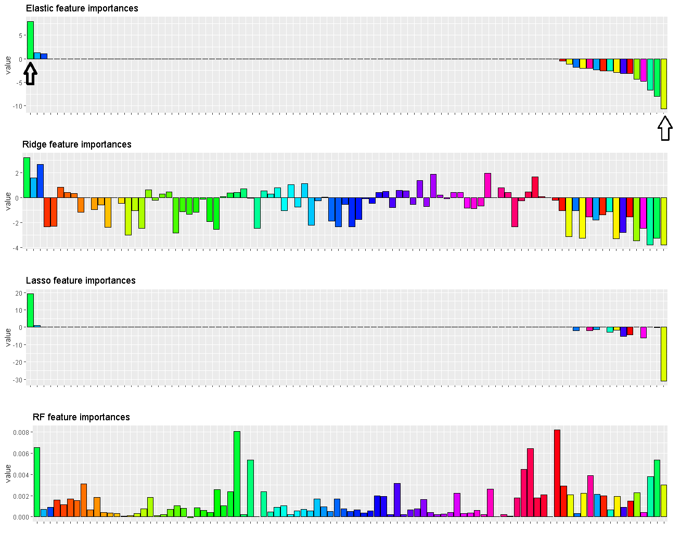
Coefficient Bar Chart

Slide 7
Conclusion
Ridge is preferred
Top two predictors:
a. Liability/Total Asset (+)
b. EPS-Net Income (-)

Slide 8
End

