Slide 1

WaistLess Foods
More time for
WaistLess Foods
Website review and ongoing support
A conversation with Chef Amber
Presented by Zul
Notes:
Open with the purpose: review what Amber can use on the website, understand which recurring tasks take her time, and discuss optional help. Ask what she would most like the website to support this season. Source image: existing WaistLess Foods portrait, public/amber.jpg. No claim of measured time savings or sales growth is being made.

Slide 2
The website tools we can put to work
Customer experience | Amber’s management tools
Consultations and service requests | Booking requests and service invoices
Recipes and cooking-class pages | Paid recipe previews and class registrations
Member newsletter archive | Newsletter Studio and email subscribers
Today’s review: confirm the workflows and agree on the remaining launch checks
WaistLess Foods
02
Notes:
Review the customer and owner sides together. These capabilities are implemented, but this is not launch sign-off. The September 9 website update identified final booking and payment checks, content review, and approval to remove the preview restriction as remaining launch steps. Source: client website update dated September 9, 2026 and https://www.waistlessfoods.com/admin/walkthrough.

Slide 3
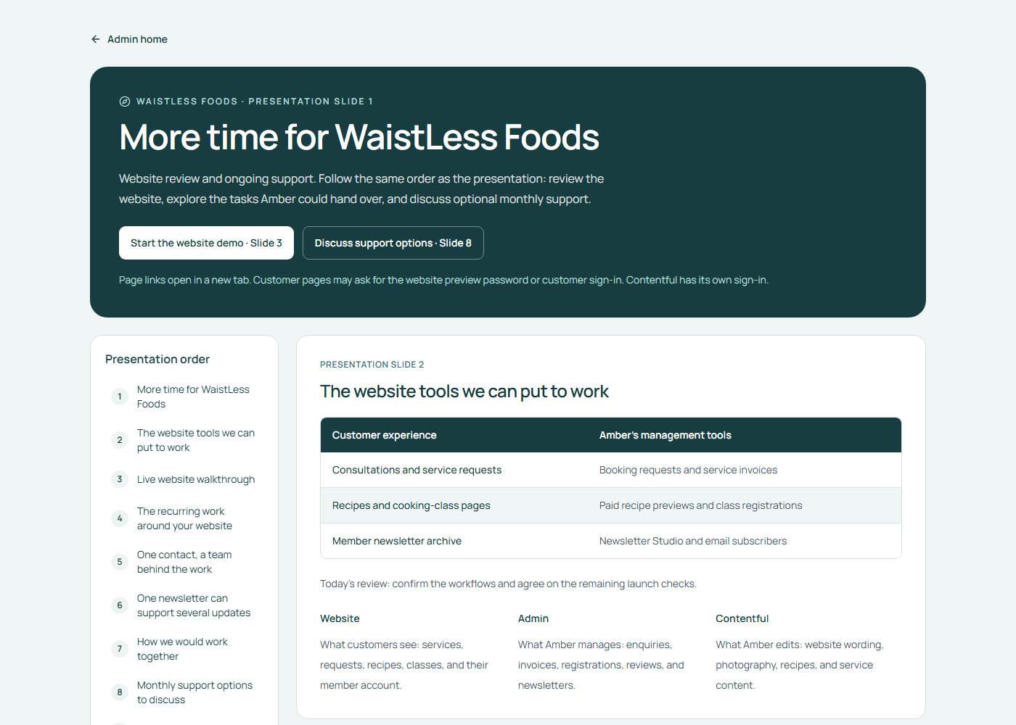
Live website walkthrough
Explore the customer journey
and the tools behind it
The guide keeps each step and its page links together while we review.
Open the live walkthrough
Admin sign-in required
WaistLess Foods
03
Notes:
Open the guide and sign in with the existing admin password. Never display credentials on the slide or share the environment file. Walk through the customer pages, paid recipe preview, newsletter workflow, and the admin tools Amber wants to use. Return to the presentation after the demo. Customer pages may require the separate preview password or customer account sign-in. Screenshot source: live read-only capture of https://www.waistlessfoods.com/admin/walkthrough on October 29, 2026.

Slide 4
The recurring work around your website
Recurring task | What our support would handle
Keep recipes current | Upload approved recipes and check the layout
Promote services or classes | Prepare graphics from approved details
Prepare a newsletter | Format supplied content and organize the archive
Stay on top of inquiries | Maintain a follow-up list and draft replies
You choose what to hand over and keep approval of your brand and customer commitments
WaistLess Foods
04
Notes:
Ask which of these tasks Amber currently does, how often they occur, and what she wants to retain. Treat the benefits as intended outcomes to test during a trial, not established results. Amber previously requested ownership of newsletters, so the team can prepare and format content while she keeps editorial and sending decisions.

Slide 5
One contact, a team behind the work
Zul
Developer
Designer
Assistant
Your point of contact
Website support
Visual content
Content and admin
Priorities, technical decisions,
and final quality checks
Maintenance, troubleshooting,
and small improvements
Class flyers, social graphics,
and newsletter artwork
Recipe uploads, newsletter
formatting, and draft replies
Access to several skills within an agreed monthly allowance
WaistLess Foods
05
Notes:
Zul remains the client contact and is accountable for assigning tasks and reviewing output. Confirm staffing and capacity in the written scope before promising coverage. Designers and assistants work on agreed tasks with appropriate access. Amber supplies or approves content and retains authority over customer prices, booking commitments, and newsletter sends. This is proposed part-time support.

Slide 6
One newsletter can support several updates
Amber provides | The team prepares
A recipe, story, or class announcement | A formatted newsletter draft
Approved photos and event details | Matching promotional graphics
Final edits and approval | The approved website or archive update
A useful starting project for the trial
We estimate the work first and agree what fits the monthly allowance.
WaistLess Foods
06
Notes:
This is an example workflow, not a guaranteed monthly quantity. Amber provides the message and approved content. The team estimates the work against the monthly allowance before starting. Sending a newsletter and publishing it to the archive are separate actions. Do not publish or send without Amber’s approval. Source for existing newsletter functionality: https://www.waistlessfoods.com/admin/walkthrough#newsletters.

Slide 7
How we would work together
01
Choose priorities
Amber shares approved materials and the most important tasks.
02
Confirm the plan
Zul checks the scope, time required, and delivery dates.
03
Prepare and review
The team completes drafts. Amber approves public content.
04
Report and adjust
We share completed work, time used, and the next priorities.
WaistLess Foods
07
Notes:
Explain that Amber has one request list and one point of contact. We estimate and prioritize tasks, then confirm delivery dates. Revisions, meetings, and coordination consume the agreed capacity. Extra work requires approval. Confirm response windows and business days in the final agreement rather than promising same-day availability in this conversation.

Slide 8
Monthly support options to discuss
 | Website support | Website + design + admin
Proposed monthly budget | USD $300 | USD $650–750
Monthly allowance | 5 total hours | 15 total hours
Planned allocation | Technical help and small updates | 5 technical / 8 design or admin / 2 coordination
Best fit | Amber runs routine content work | Amber delegates regular content tasks
Discussion figures. Final scope, staffing, and price confirmed in writing.
Paid monthly in advance. Meetings and revisions count toward the allowance.
Unused hours expire monthly. Extra work needs approval. Provider fees are separate.
WaistLess Foods
08
Notes:
These are proposed discussion figures, not an accepted agreement or confirmed final quotation. Website Support follows the earlier $300 five-hour concept. The combined option is an illustrative $650–750 range from our planning conversation. Confirm delivery costs and staffing before issuing a final written quote. The combined allowance is fifteen total hours: five technical, eight design/admin, and two coordination/review. Do not promise fifteen production hours plus additional management.

Slide 9
A three-month trial
Month 1
Month 2
Month 3
Set up the routine
Use the workflow
Review the value
Choose two recurring tasks.
Agree templates, access, and approvals.
Complete the agreed priorities.
Review time used and revision effort.
Assess the help Amber used.
Agree whether to continue or adjust.
Success means useful work completed and less routine work left with Amber
WaistLess Foods
09
Notes:
The trial begins after the current project closeout is agreed. Record a baseline for recurring tasks in month one. Use completed tasks, time required, revision effort, and Amber’s feedback to judge usefulness. Do not promise sales growth or a fixed number of hours saved. At the end of month three, review whether to continue, resize, or end under the agreed terms.

Slide 10
Launch closeout and ongoing support
Complete the current project
Agree optional support
Final booking and payment checks
Amber’s content review
Approval for public launch
Recurring tasks and monthly capacity
Budget, approvals, and response times
A start date and review at three months
Existing agreed corrections remain part of the current project
WaistLess Foods
10
Notes:
Separate completion of the agreed existing project from optional future service. Remaining original-scope obligations are not charged again through a retainer. Confirm final consultation booking and Meet delivery, payment flow, content review, and preview restriction approval. Larger new features need their own estimate. Sources: client website update dated September 9, 2026 and https://www.waistlessfoods.com/admin/walkthrough#content.

Slide 11

What would you like to hand over?
What would you like
to hand over?
Choose two recurring tasks you would like help with.
We can build the first month around those priorities.
Reopen the website walkthrough
WaistLess Foods
11
Notes:
Ask Amber to identify the two tasks she would most like help with. Ask what monthly level of support would be comfortable. Agree whether she wants a short written scope for website support or the broader team option. Confirm any remaining launch items separately. Do not treat discussion of the options as acceptance. Source background image: existing WaistLess Foods homepage image, public/hero.png.

