Slide 1
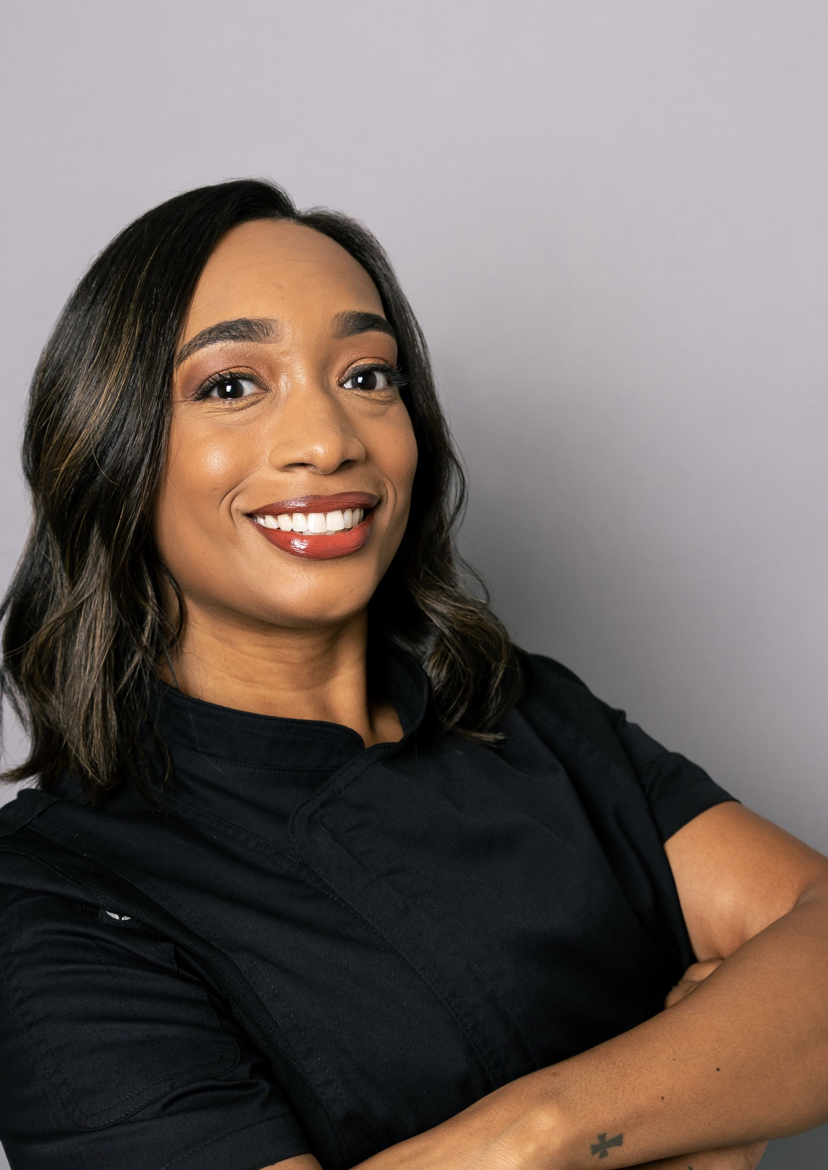
WaistLess Foods
More time for
WaistLess Foods
Website review and ongoing support
A conversation with Chef Amber
Presented by Zul
Notes:
Open with the purpose: review what Amber can use on the website, understand which recurring tasks take her time, and discuss optional help. Ask what she would most like the website to support this season. Source image: existing WaistLess Foods portrait, public/amber.jpg. No claim of measured time savings or sales growth is being made.

Slide 2
The website tools we can put to work
Customer experience | Amber’s management tools
Consultations and service requests | Booking requests and service invoices
Recipes and cooking-class pages | Paid recipe previews and class registrations
Member newsletter archive | Newsletter Studio and email subscribers
Today’s review: confirm the workflows and agree on the remaining launch checks
WaistLess Foods
02
Notes:
Review the customer and owner sides together. These capabilities are implemented, but this is not launch sign-off. The September 9 website update identified final booking and payment checks, content review, and approval to remove the preview restriction as remaining launch steps. Source: client website update dated September 9, 2026 and https://www.waistlessfoods.com/admin/walkthrough.

Slide 3
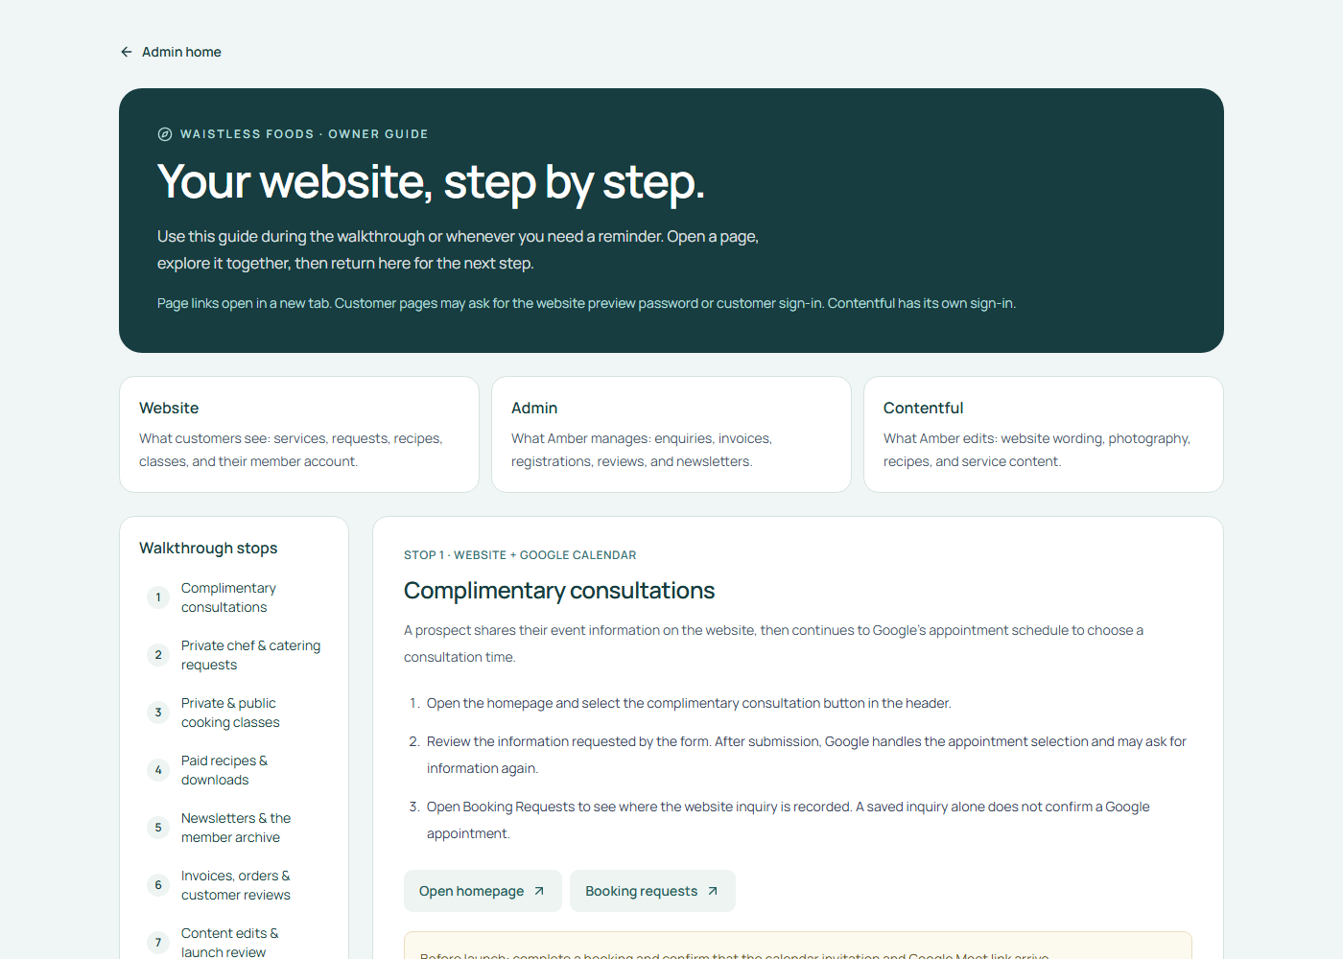
Live website walkthrough
Explore the customer journey
and the tools behind it
The guide includes step screenshots, direct links, and notes on what was tested.
Open the live walkthrough
Admin sign-in required
WaistLess Foods
03
Notes:
Open the guide and sign in with the existing admin password. Never display credentials on the slide or share the environment file. Walk through the customer pages, paid recipe preview, newsletter workflow, and the admin tools Amber wants to use. Return to the presentation after the demo. The guide is a practical training resource and contains no retainer prices or sales sections. Customer pages may require the separate preview password or customer account sign-in. Screenshot source: live read-only capture of https://www.waistlessfoods.com/admin/walkthrough on October 30, 2026. The optional screenshot-reference slides are hidden after the main presentation. Use them from the slide overview when a live demo is inconvenient.

Slide 4
An example month of support
Work we prepare | What it helps you do
1 newsletter draft | Keep subscribers informed without doing the formatting
4 promotional graphics | Share recipes, services, or class announcements
2 website content updates | Keep recipes and existing pages current
1 website check and small fixes | Have someone review the site and follow up on issues
One contact and a monthly review | Delegate without managing several people
You provide the ideas and approve the work. Zul coordinates the team.
Illustrative plan. Confirm team estimates and final scope before committing quantities.
WaistLess Foods
04
Notes:
Source: revised draft support proposal dated October 30, 2026, output/pdf/WaistLess-Foods-Support-Proposal-Draft.pdf. This is an illustrative plan pending a team estimate and final scope, not committed monthly quantities. One newsletter draft uses the existing template, up to 600 words of supplied final copy, one call-to-action link, and one consolidated revision round. Each of four static graphics has one agreed message and size, based on approved templates, with one consolidated revision round. Each of two content updates covers one existing page or recipe entry using final supplied text and one supplied image. Website checks and minor fixes must fit the agreed technical scope. The monthly review is up to 30 minutes. Ask which work Amber actually wants to hand over.

Slide 5
One contact, a team behind the work
Zul
Developer
Designer
Assistant
Your point of contact
Website support
Visual content
Content preparation
Priorities, technical decisions,
and final quality checks
Website checks, minor fixes,
and technical assistance
Promotional graphics
using approved brand templates
Recipe uploads
and newsletter formatting
One person to contact. The team prepares the work for your approval.
WaistLess Foods
05
Notes:
Zul remains the client contact and is accountable for assigning tasks and reviewing output. Confirm staffing and capacity in the written scope before promising coverage. Designers and assistants work on agreed tasks with appropriate access. Amber supplies or approves content and retains authority over customer prices, booking commitments, and newsletter sends. This is proposed part-time support.

Slide 6
One newsletter can support several updates
Amber provides | The team prepares
A recipe, story, or class announcement | A formatted newsletter draft
Approved photos and event details | Matching promotional graphics
Final edits and approval | The approved website or archive update
A useful starting project for the trial
Use the same approved story and photos across the newsletter and graphics.
WaistLess Foods
06
Notes:
This is an example workflow, not a guaranteed monthly quantity. Amber provides the message and approved content. Reusing the same approved theme and assets helps plan the newsletter and promotional graphics together. The team must estimate the effort before committing to the sample quantities shown on slide 4. Sending a newsletter and publishing it to the archive are separate actions. Do not publish or send without Amber’s approval. Source for existing newsletter functionality: https://www.waistlessfoods.com/admin/walkthrough#newsletters.

Slide 7
How we would work together
01
Choose priorities
Amber shares approved materials and the most important tasks.
02
Confirm the plan
Zul agrees the deliverables, revisions, and delivery dates.
03
Prepare and review
The team completes drafts. Amber approves public content.
04
Report and adjust
We share completed work, remaining tasks, and next priorities.
WaistLess Foods
07
Notes:
Explain that Amber has one request list and one point of contact. We estimate and prioritize tasks, then confirm delivery dates. Revisions, meetings, and coordination consume the agreed capacity. Extra work requires approval. Confirm response windows and business days in the final agreement rather than promising same-day availability in this conversation.

Slide 8
A three-month trial
Month 1
Month 2
Month 3
Set up the routine
Use the workflow
Review the value
Choose two recurring tasks.
Agree templates, access, and approvals.
Complete the agreed priorities.
Review time used and revision effort.
Assess the help Amber used.
Agree whether to continue or adjust.
Success means useful work completed and less routine work left with Amber
WaistLess Foods
08
Notes:
This trial is optional and starts only after we agree on the current project closeout, scope, budget, and staffing in writing. Ask what support Amber wants before proposing a package. Record a baseline for recurring tasks in month one. Use completed tasks, time required, revision effort, and Amber’s feedback to judge usefulness. Do not promise sales growth or a fixed number of hours saved. At the end of month three, review whether to continue, resize, or end under the agreed terms.

Slide 9
Launch closeout and ongoing support
Complete the current project
Agree optional support
Final booking and payment checks
Amber’s content review
Approval for public launch
Monthly work and delivery dates
Budget, approvals, and response times
A start date and review at three months
Existing agreed corrections remain part of the current project
WaistLess Foods
09
Notes:
Separate completion of the agreed existing project from optional future service. Remaining original-scope obligations are not charged again through a retainer. Confirm final consultation booking and Meet delivery, payment flow, content review, and preview restriction approval. Larger new features need their own estimate. Sources: client website update dated September 9, 2026 and https://www.waistlessfoods.com/admin/walkthrough#content.

Slide 10

What would you like to hand over?
What would you like
to hand over?
Choose two recurring tasks you would like help with.
We can build the first month around those priorities.
Reopen the website walkthrough
WaistLess Foods
10
Notes:
Ask Amber to identify the two tasks she would most like help with. Close the normal presentation here. Ask permission conversationally to prepare a tailored written proposal after learning her workload and budget. Only show the hidden appendix manually if she asks about pricing. Ask what monthly level of support would be comfortable. Agree whether she wants a short written scope for website support or the broader team option. Confirm any remaining launch items separately. Do not treat discussion of the options as acceptance. Source background image: existing WaistLess Foods homepage image, public/hero.png.

Slide 11
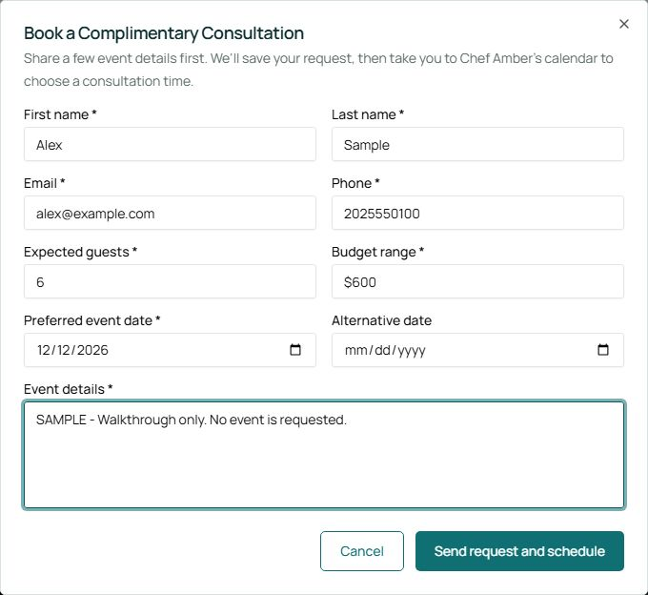
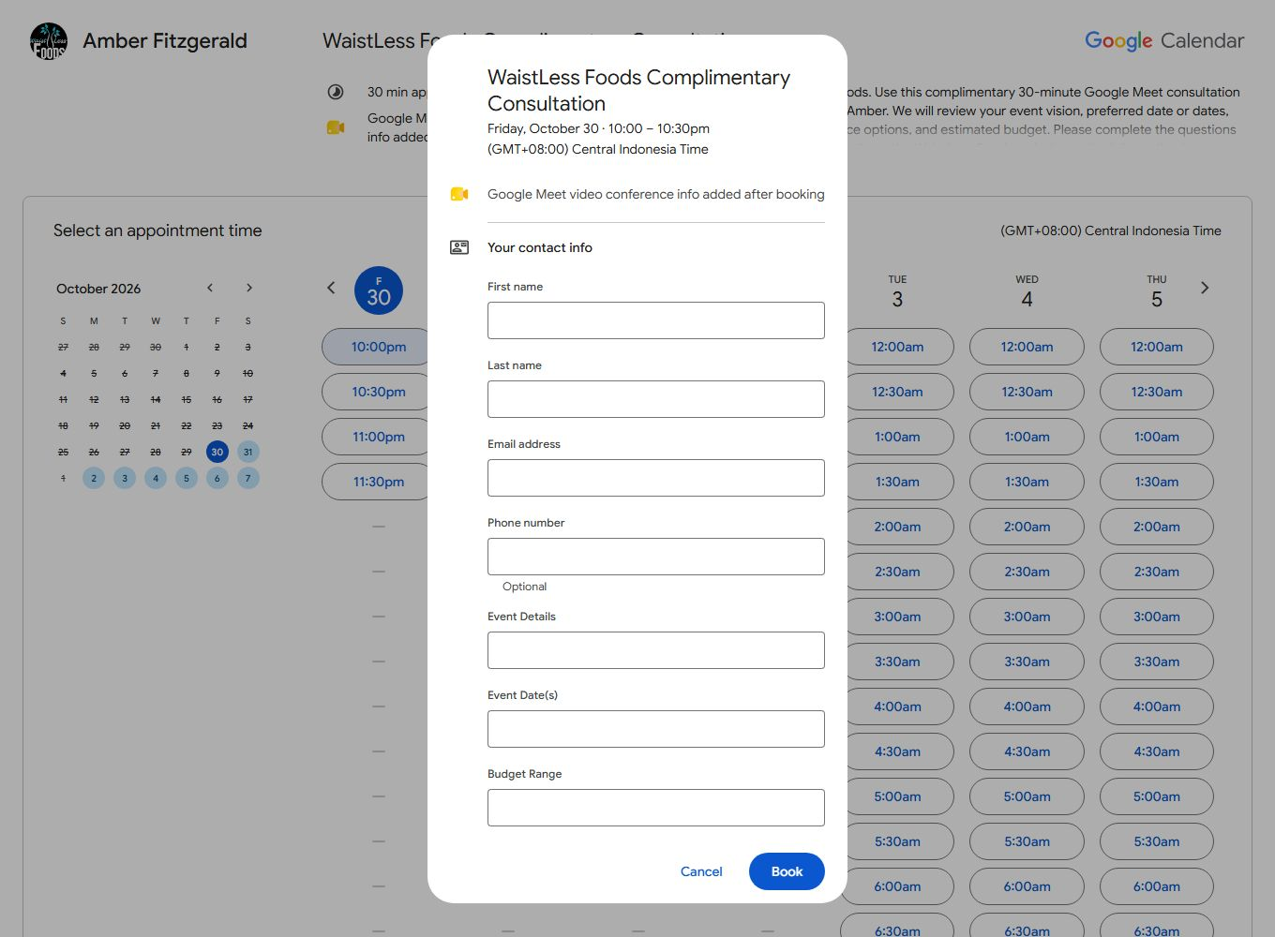
Consultation flow
Open all step images in the guide
Complete the event details
Review Google’s booking questions
Sample data. The form contains browser-only sample information. No inquiry is saved.
Live screen. Required event details, dates, and budget were checked. The Book button was not clicked.
WaistLess Foods
11
Notes:
OPTIONAL SCREENSHOT REFERENCE. Hidden during normal slideshow playback. Open manually from the slide overview when needed.
Complete the event details. Sample data, captured 2026-10-30. The form contains browser-only sample information. No inquiry is saved. Source: docs/walkthrough-evidence/2026-10-30/consultation-complete.jpg
Review Google’s booking questions. Live screen, captured 2026-10-30. Required event details, dates, and budget were checked. The Book button was not clicked. Source: docs/walkthrough-evidence/2026-10-30/google-required-details.jpg
Checked: The live form opens. A browser-only request response reaches the Google schedule. Google event questions are reviewed when available. The admin example uses a synthetic inquiry.
Still to verify: A real saved inquiry, delivered emails, completed Google appointment, calendar invitation, and Google Meet link.

Slide 12
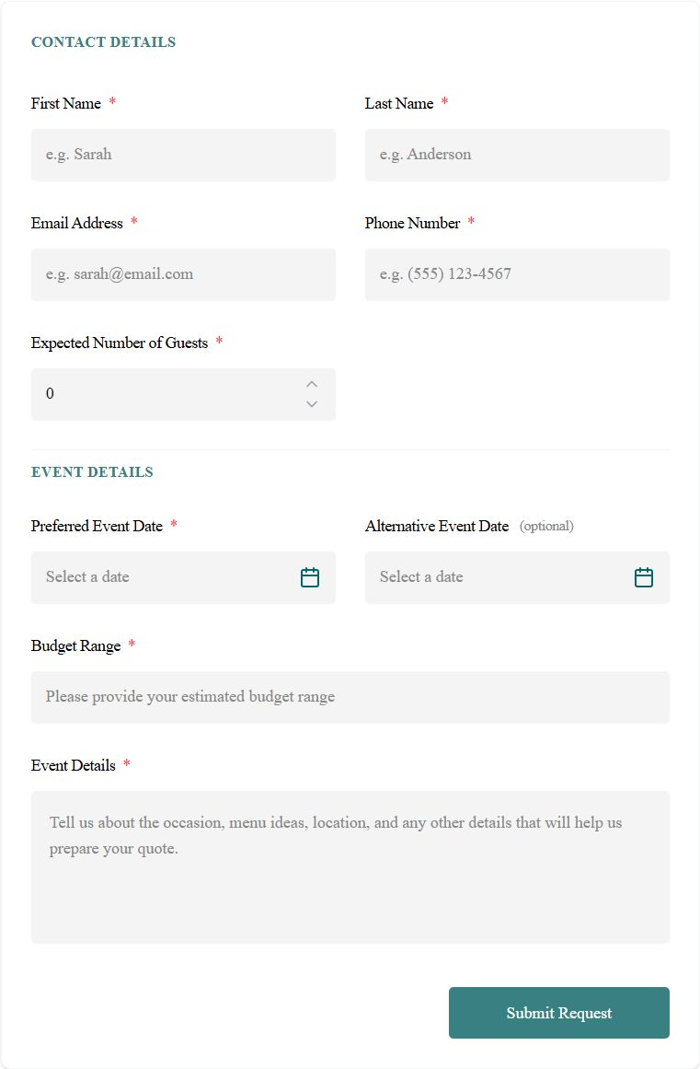
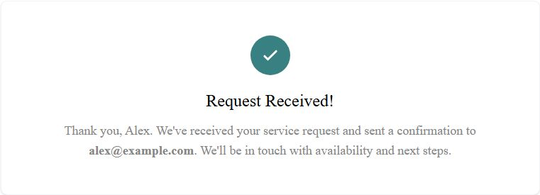
Service request flow
Open all step images in the guide
Review the request form
Review the request result
Live screen. This form requests availability. It does not confirm a booking.
UI test. Simulated successful response. No request record or confirmation email was created.
WaistLess Foods
12
Notes:
OPTIONAL SCREENSHOT REFERENCE. Hidden during normal slideshow playback. Open manually from the slide overview when needed.
Review the request form. Live screen, captured 2026-10-30. This form requests availability. It does not confirm a booking. Source: docs/walkthrough-evidence/2026-10-30/private-inquiry.jpg
Review the request result. UI test, captured 2026-10-30. Simulated successful response. No request record or confirmation email was created. Source: docs/walkthrough-evidence/2026-10-30/private-result.jpg
Checked: Private Chef and Catering request pages, required-field validation, and confirmation states with simulated submission responses.
Still to verify: Persisted service requests and customer/admin confirmation delivery using an agreed test recipient. Replace the Catering starting-price placeholder ($XXX) during content review.

Slide 13
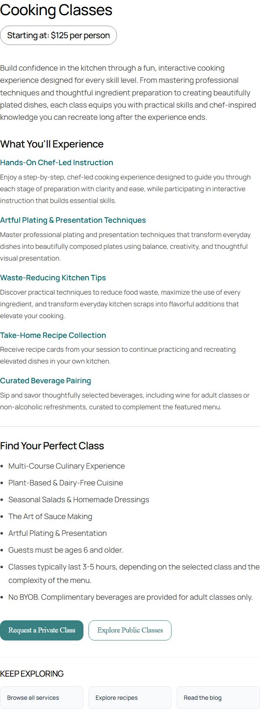
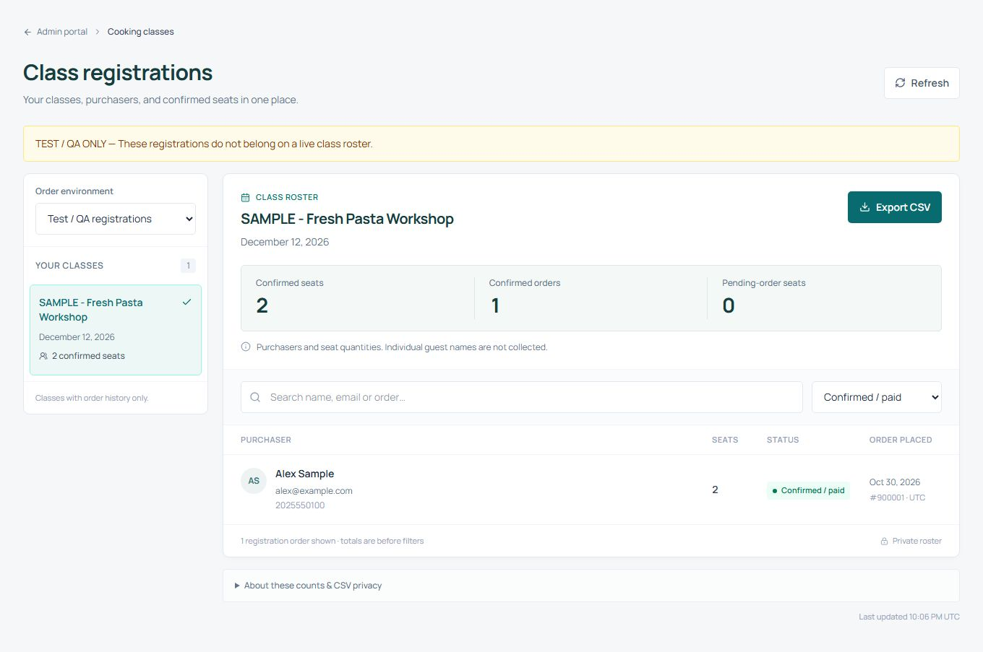
Cooking-class flow
Open all step images in the guide
Choose private or public classes
Review class registrations
Live screen. Current service actions and booking-process information.
Sample data. Synthetic sandbox purchaser and seat counts. No real enrollment is shown.
WaistLess Foods
13
Notes:
OPTIONAL SCREENSHOT REFERENCE. Hidden during normal slideshow playback. Open manually from the slide overview when needed.
Choose private or public classes. Live screen, captured 2026-10-30. Current service actions and booking-process information. Source: docs/walkthrough-evidence/2026-10-30/cooking-classes-actions.jpg
Review class registrations. Sample data, captured 2026-10-30. Synthetic sandbox purchaser and seat counts. No real enrollment is shown. Source: docs/walkthrough-evidence/2026-10-30/class-roster.jpg
Checked: Private-class inquiry validation and simulated confirmation, the live unavailable-class view, and a sample class roster. Database-backed roster access and filtering passed isolated temporary-table tests.
Still to verify: Public-class enrollment, actual payment and seat allocation, and customer notifications before enrollment is enabled.

Slide 14
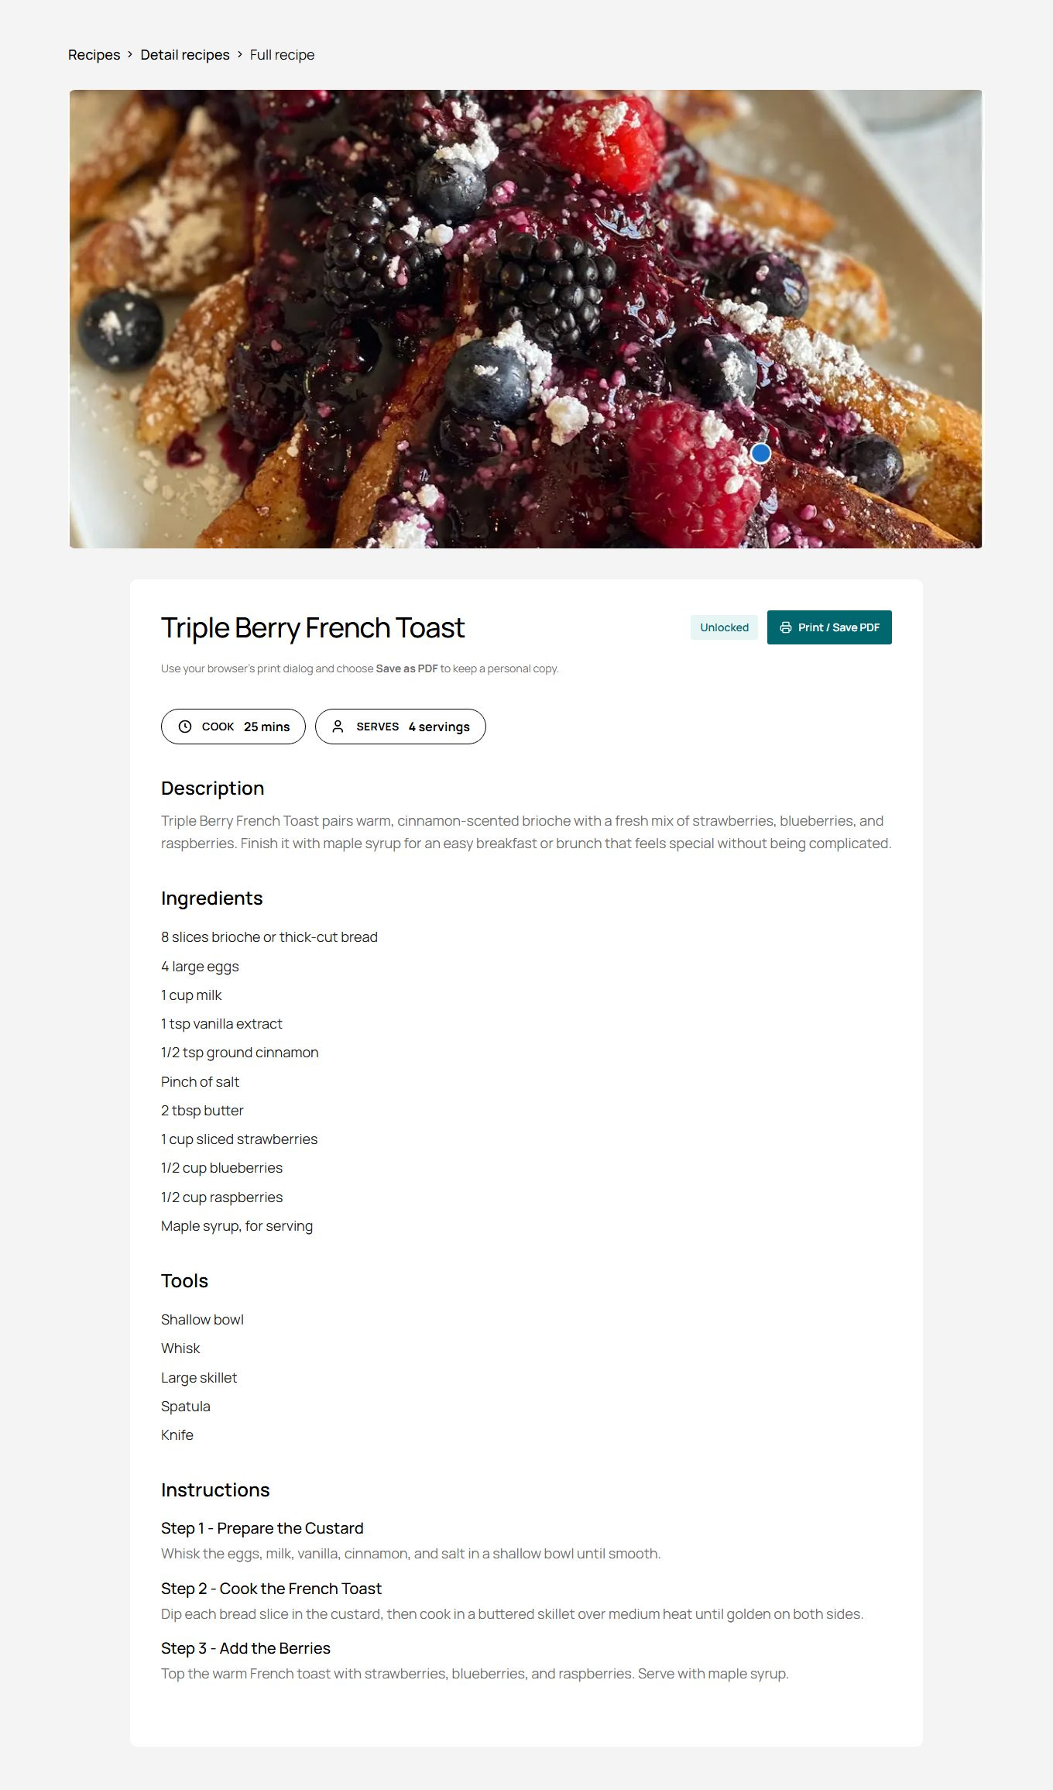
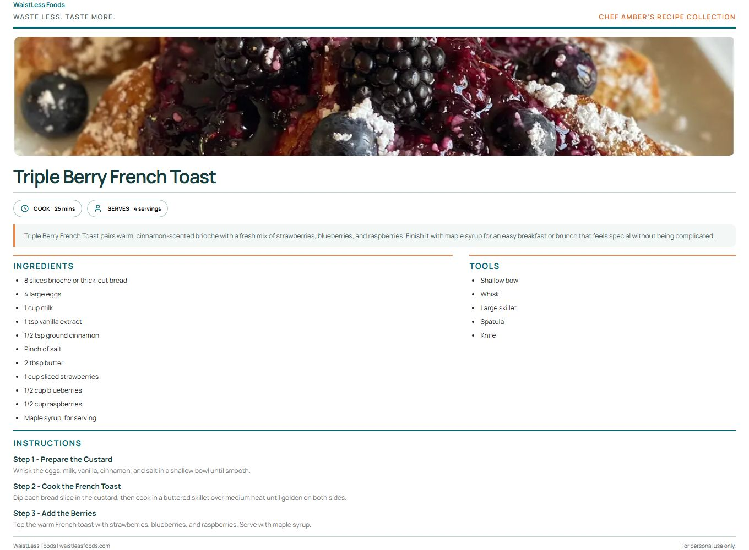
Paid recipes and print layout
Open all step images in the guide
Inspect the full recipe
Preview Print / Save PDF
Live screen. Protected full-recipe owner preview. This is not proof of a completed customer payment.
Live screen. Current print layout from the protected preview. Customer purchase unlocking is tested separately.
WaistLess Foods
14
Notes:
OPTIONAL SCREENSHOT REFERENCE. Hidden during normal slideshow playback. Open manually from the slide overview when needed.
Inspect the full recipe. Live screen, captured 2026-10-30. Protected full-recipe owner preview. This is not proof of a completed customer payment. Source: docs/walkthrough-evidence/2026-10-30/paid-recipe-full.jpg
Preview Print / Save PDF. Live screen, captured 2026-10-30. Current print layout from the protected preview. Customer purchase unlocking is tested separately. Source: docs/walkthrough-evidence/2026-10-30/paid-recipe-print.jpg
Checked: Owner-only paid recipe previews, complete recipe layout, and print styling. No purchase was needed for the admin preview.
Still to verify: A final customer purchase-to-unlock check and the customer’s Print / Save PDF experience after payment.

Slide 15
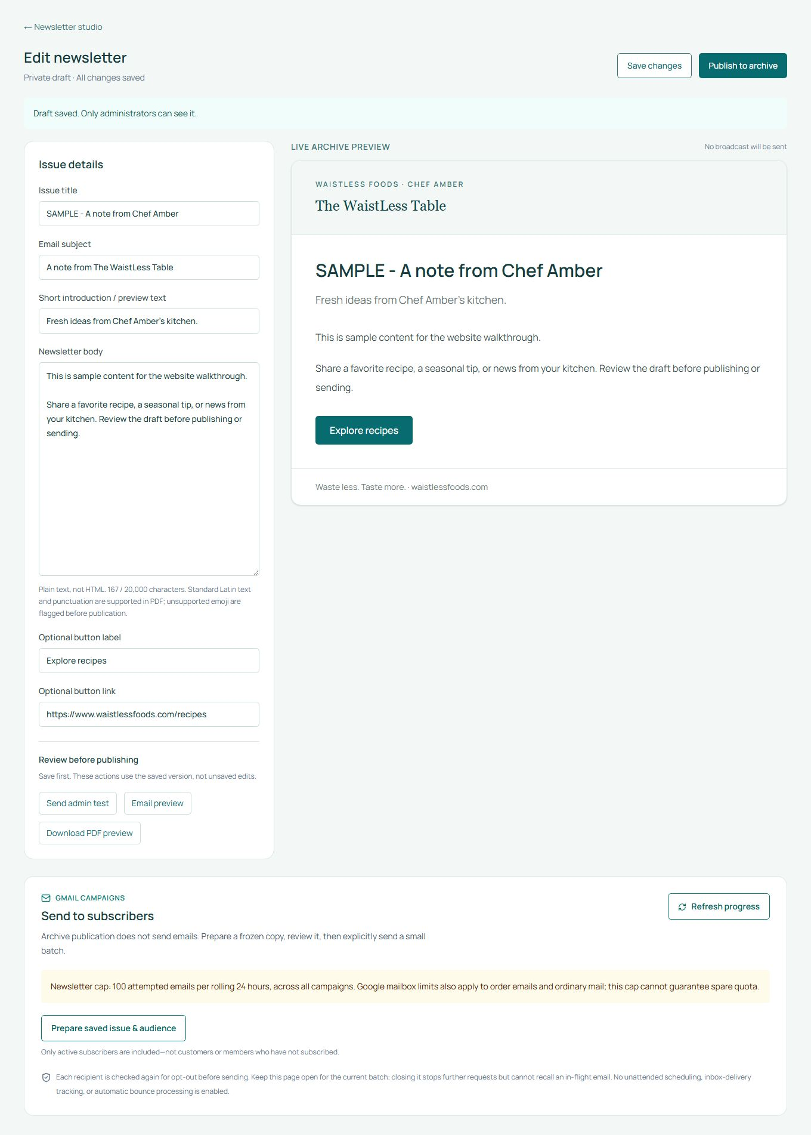
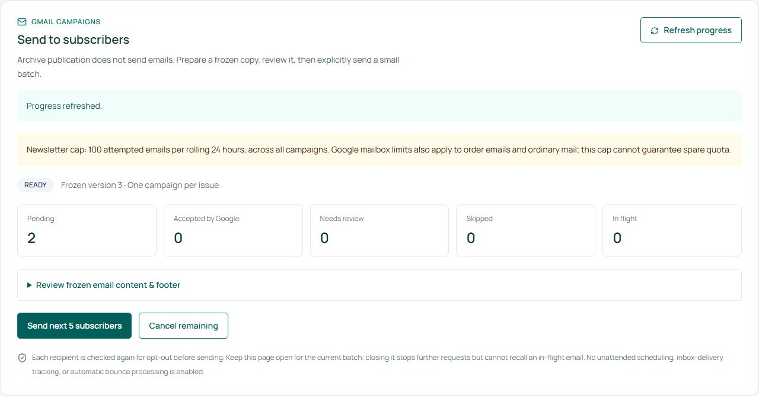
Newsletter workflow
Open all step images in the guide
Write and save an issue
Review before sending
UI test. Save was tested against a browser-only response. No issue was stored or emailed.
UI test. Audience preparation was simulated. No subscriber send button was confirmed.
WaistLess Foods
15
Notes:
OPTIONAL SCREENSHOT REFERENCE. Hidden during normal slideshow playback. Open manually from the slide overview when needed.
Write and save an issue. UI test, captured 2026-10-30. Save was tested against a browser-only response. No issue was stored or emailed. Source: docs/walkthrough-evidence/2026-10-30/newsletter-editor.jpg
Review before sending. UI test, captured 2026-10-30. Audience preparation was simulated. No subscriber send button was confirmed. Source: docs/walkthrough-evidence/2026-10-30/newsletter-campaign.jpg
Checked: Save, preview, publish, and campaign preparation with browser-only sample responses. Publishing did not send an email. Newsletter authorization, publication and PDF-download APIs passed temporary-table tests with a mocked mailer.
Still to verify: Real inbox delivery and a fresh customer sign-in/archive/download check. The member-archive image is explicitly dated September 6.

Slide 16
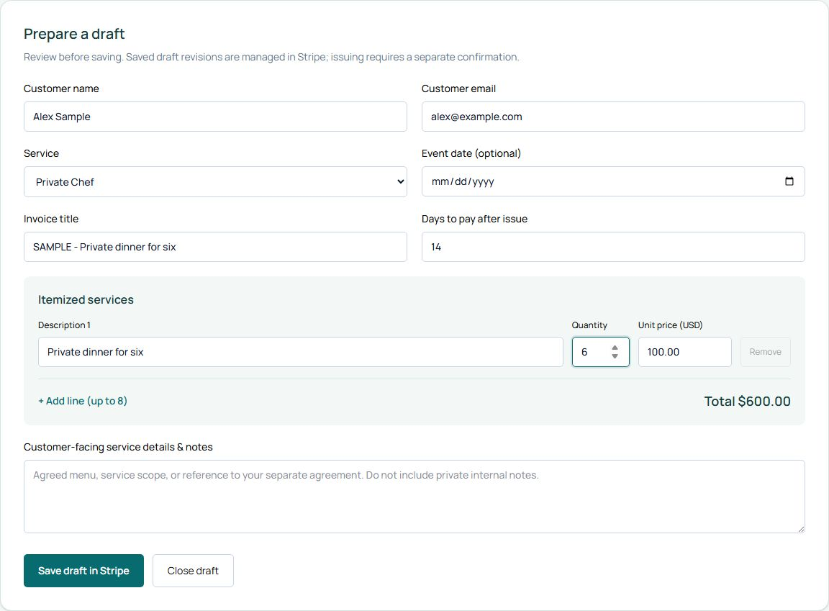
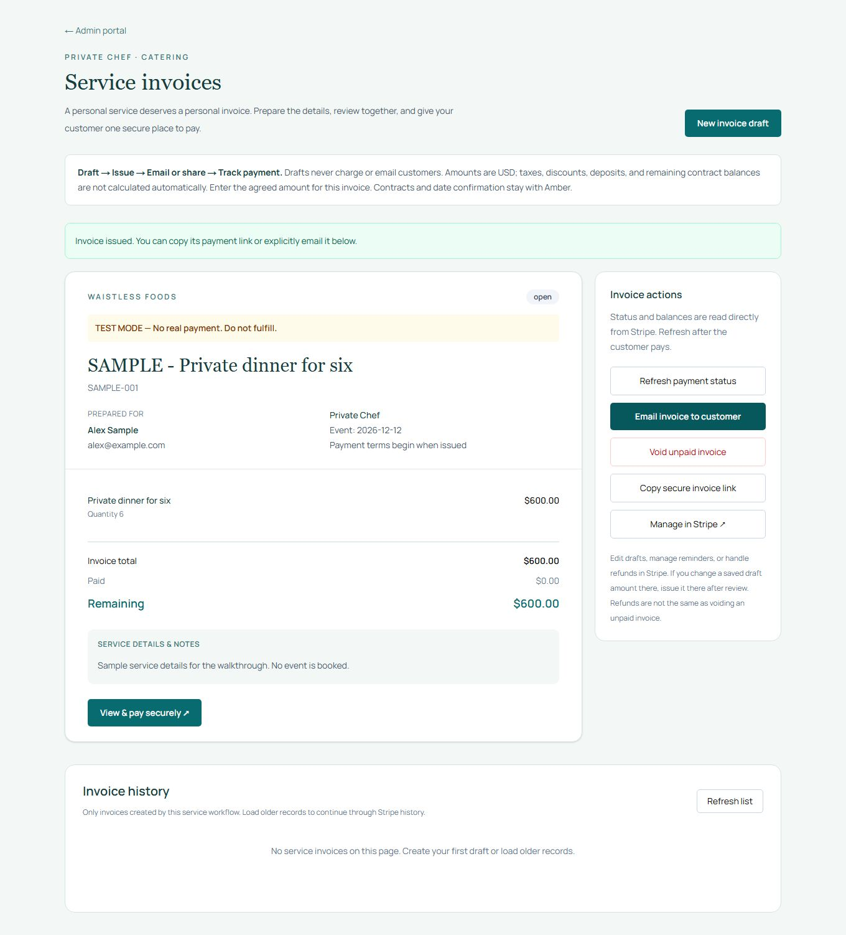
Service invoice workflow
Open all step images in the guide
Prepare a service invoice
Review the invoice and payment controls
Sample data. Current invoice editor with sample details. No Stripe invoice has been created.
UI test. Draft save and issue were simulated. The sample link is not payable. No email or charge occurred.
WaistLess Foods
16
Notes:
OPTIONAL SCREENSHOT REFERENCE. Hidden during normal slideshow playback. Open manually from the slide overview when needed.
Prepare a service invoice. Sample data, captured 2026-10-30. Current invoice editor with sample details. No Stripe invoice has been created. Source: docs/walkthrough-evidence/2026-10-30/invoice-editor.jpg
Review the invoice and payment controls. UI test, captured 2026-10-30. Draft save and issue were simulated. The sample link is not payable. No email or charge occurred. Source: docs/walkthrough-evidence/2026-10-30/invoice-issued.jpg
Checked: Invoice draft and issue controls with simulated Stripe responses. Invoice business rules and HTTP guards passed mocked tests. Review moderation and admin navigation use sample or non-customer views.
Still to verify: Real invoice delivery, live payment reconciliation and a real review publication cycle. No real invoice, charge, email or review change occurred.

Slide 17
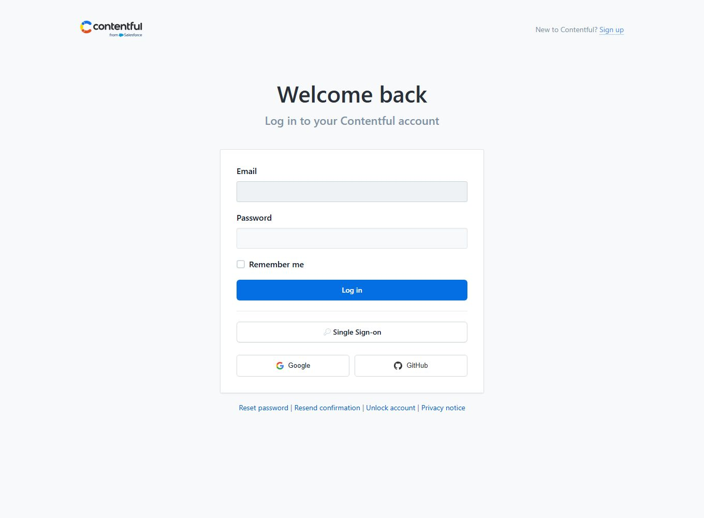
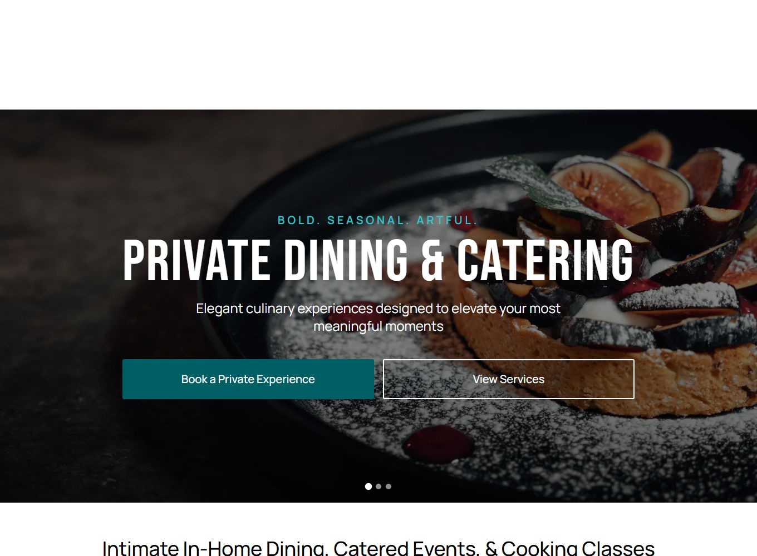
Content and launch review
Open all step images in the guide
Open Contentful
Review the published homepage
Live screen. Contentful requires its own account. Entry editing and publishing were not tested in this session.
Live screen. Current homepage for content review. No Contentful content was changed.
WaistLess Foods
17
Notes:
OPTIONAL SCREENSHOT REFERENCE. Hidden during normal slideshow playback. Open manually from the slide overview when needed.
Open Contentful. Live screen, captured 2026-10-30. Contentful requires its own account. Entry editing and publishing were not tested in this session. Source: docs/walkthrough-evidence/2026-10-30/contentful-access.jpg
Review the published homepage. Live screen, captured 2026-10-30. Current homepage for content review. No Contentful content was changed. Source: docs/walkthrough-evidence/2026-10-30/homepage-review.jpg
Checked: Contentful’s separate sign-in screen, the published homepage, and read-only storefront settings.
Still to verify: Editing and publishing an entry in the owner’s Contentful session, final content approval, and approval to lift the preview restriction.

Slide 18
Optional pricing discussion
 | Website support | Website & content support
Proposed monthly fee | USD $300 | USD $700
Focus | Technical help and small updates | Website care plus regular content preparation
Example work | Agreed checks and minor changes | Newsletter, graphics, and content updates
Best fit | Amber manages routine content | Amber wants help preparing and publishing content
Provisional figures. Confirm team costs and scope before a final quote.
The separate proposal defines scope, revisions, capacity, and trial terms.
Example quantities need a team estimate. Provider fees are separate.
WaistLess Foods
18
Notes:
HIDDEN APPENDIX. Normal slideshow playback skips this slide. Show it manually only if Amber asks about budget after discussing her recurring tasks. Source: revised draft support proposal dated October 30, 2026. Website support is provisionally USD $300 per month with up to five combined service hours for technical work and coordination. Monthly Website & Content Support is provisionally USD $700 per month with fifteen combined staff hours: five technical, eight design/admin, and two coordination/review. These are planning limits in the detailed terms, not extra production time above the sample deliverables. Meetings, revisions, testing, and reporting count. The content plan on slide 4 is illustrative and must be estimated before quantities are promised. Confirm staffing, full delivery cost, and final scope before issuing a quote. One newsletter draft, four graphics, two updates, a website check with small fixes, and a monthly review are the proposed example, not a committed output package.

