Slide 1

WaistLess Foods
More time for
WaistLess Foods
Website review and ongoing support
A conversation with Chef Amber
Presented by Zul
Notes:
Open with the purpose: review what Amber can use on the website, understand which recurring tasks take her time, and discuss optional help. Ask what she would most like the website to support this season. Source image: existing WaistLess Foods portrait, public/amber.jpg. No claim of measured time savings or sales growth is being made.

Slide 2
The website tools we can put to work
Customer experience | Amber’s management tools
Consultations and service requests | Booking requests and service invoices
Recipes and cooking-class pages | Paid recipe previews and class registrations
Member newsletter archive | Newsletter Studio and email subscribers
Today’s review: confirm the workflows and agree on the remaining launch checks
WaistLess Foods
02
Notes:
Review the customer and owner sides together. These capabilities are implemented, but this is not launch sign-off. The September 9 website update identified final booking and payment checks, content review, and approval to remove the preview restriction as remaining launch steps. Source: client website update dated September 9, 2026 and https://www.waistlessfoods.com/admin/walkthrough.

Slide 3
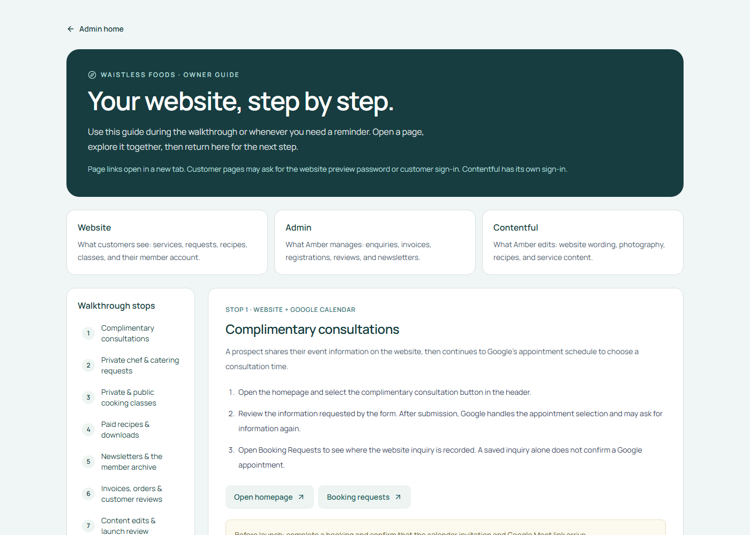
Live website walkthrough
Explore the customer journey
and the tools behind it
The guide keeps each step and its page links together while we review.
Open the live walkthrough
Admin sign-in required
WaistLess Foods
03
Notes:
Open the guide and sign in with the existing admin password. Never display credentials on the slide or share the environment file. Walk through the customer pages, paid recipe preview, newsletter workflow, and the admin tools Amber wants to use. Return to the presentation after the demo. The guide is a practical training resource and contains no retainer prices or sales sections. Customer pages may require the separate preview password or customer account sign-in. Screenshot source: live read-only capture of https://www.waistlessfoods.com/admin/walkthrough on October 30, 2026.

Slide 4
An example month of support
Work we prepare | What it helps you do
1 newsletter draft | Keep subscribers informed without doing the formatting
4 promotional graphics | Share recipes, services, or class announcements
2 website content updates | Keep recipes and existing pages current
1 website check and small fixes | Have someone review the site and follow up on issues
One contact and a monthly review | Delegate without managing several people
You provide the ideas and approve the work. Zul coordinates the team.
Illustrative plan. Confirm team estimates and final scope before committing quantities.
WaistLess Foods
04
Notes:
Source: revised draft support proposal dated October 30, 2026, output/pdf/WaistLess-Foods-Support-Proposal-Draft.pdf. This is an illustrative plan pending a team estimate and final scope, not committed monthly quantities. One newsletter draft uses the existing template, up to 600 words of supplied final copy, one call-to-action link, and one consolidated revision round. Each of four static graphics has one agreed message and size, based on approved templates, with one consolidated revision round. Each of two content updates covers one existing page or recipe entry using final supplied text and one supplied image. Website checks and minor fixes must fit the agreed technical scope. The monthly review is up to 30 minutes. Ask which work Amber actually wants to hand over.

Slide 5
One contact, a team behind the work
Zul
Developer
Designer
Assistant
Your point of contact
Website support
Visual content
Content preparation
Priorities, technical decisions,
and final quality checks
Website checks, minor fixes,
and technical assistance
Promotional graphics
using approved brand templates
Recipe uploads
and newsletter formatting
One person to contact. The team prepares the work for your approval.
WaistLess Foods
05
Notes:
Zul remains the client contact and is accountable for assigning tasks and reviewing output. Confirm staffing and capacity in the written scope before promising coverage. Designers and assistants work on agreed tasks with appropriate access. Amber supplies or approves content and retains authority over customer prices, booking commitments, and newsletter sends. This is proposed part-time support.

Slide 6
One newsletter can support several updates
Amber provides | The team prepares
A recipe, story, or class announcement | A formatted newsletter draft
Approved photos and event details | Matching promotional graphics
Final edits and approval | The approved website or archive update
A useful starting project for the trial
Use the same approved story and photos across the newsletter and graphics.
WaistLess Foods
06
Notes:
This is an example workflow, not a guaranteed monthly quantity. Amber provides the message and approved content. Reusing the same approved theme and assets helps plan the newsletter and promotional graphics together. The team must estimate the effort before committing to the sample quantities shown on slide 4. Sending a newsletter and publishing it to the archive are separate actions. Do not publish or send without Amber’s approval. Source for existing newsletter functionality: https://www.waistlessfoods.com/admin/walkthrough#newsletters.

Slide 7
How we would work together
01
Choose priorities
Amber shares approved materials and the most important tasks.
02
Confirm the plan
Zul agrees the deliverables, revisions, and delivery dates.
03
Prepare and review
The team completes drafts. Amber approves public content.
04
Report and adjust
We share completed work, remaining tasks, and next priorities.
WaistLess Foods
07
Notes:
Explain that Amber has one request list and one point of contact. We estimate and prioritize tasks, then confirm delivery dates. Revisions, meetings, and coordination consume the agreed capacity. Extra work requires approval. Confirm response windows and business days in the final agreement rather than promising same-day availability in this conversation.

Slide 8
A three-month trial
Month 1
Month 2
Month 3
Set up the routine
Use the workflow
Review the value
Choose two recurring tasks.
Agree templates, access, and approvals.
Complete the agreed priorities.
Review time used and revision effort.
Assess the help Amber used.
Agree whether to continue or adjust.
Success means useful work completed and less routine work left with Amber
WaistLess Foods
08
Notes:
This trial is optional and starts only after we agree on the current project closeout, scope, budget, and staffing in writing. Ask what support Amber wants before proposing a package. Record a baseline for recurring tasks in month one. Use completed tasks, time required, revision effort, and Amber’s feedback to judge usefulness. Do not promise sales growth or a fixed number of hours saved. At the end of month three, review whether to continue, resize, or end under the agreed terms.

Slide 9
Launch closeout and ongoing support
Complete the current project
Agree optional support
Final booking and payment checks
Amber’s content review
Approval for public launch
Monthly work and delivery dates
Budget, approvals, and response times
A start date and review at three months
Existing agreed corrections remain part of the current project
WaistLess Foods
09
Notes:
Separate completion of the agreed existing project from optional future service. Remaining original-scope obligations are not charged again through a retainer. Confirm final consultation booking and Meet delivery, payment flow, content review, and preview restriction approval. Larger new features need their own estimate. Sources: client website update dated September 9, 2026 and https://www.waistlessfoods.com/admin/walkthrough#content.

Slide 10

What would you like to hand over?
What would you like
to hand over?
Choose two recurring tasks you would like help with.
We can build the first month around those priorities.
Reopen the website walkthrough
WaistLess Foods
10
Notes:
Ask Amber to identify the two tasks she would most like help with. Close the normal presentation here. Ask permission conversationally to prepare a tailored written proposal after learning her workload and budget. Only show the hidden appendix manually if she asks about pricing. Ask what monthly level of support would be comfortable. Agree whether she wants a short written scope for website support or the broader team option. Confirm any remaining launch items separately. Do not treat discussion of the options as acceptance. Source background image: existing WaistLess Foods homepage image, public/hero.png.

Slide 11
Optional pricing discussion
 | Website support | Website & content support
Proposed monthly fee | USD $300 | USD $700
Focus | Technical help and small updates | Website care plus regular content preparation
Example work | Agreed checks and minor changes | Newsletter, graphics, and content updates
Best fit | Amber manages routine content | Amber wants help preparing and publishing content
Provisional figures. Confirm team costs and scope before a final quote.
The separate proposal defines scope, revisions, capacity, and trial terms.
Example quantities need a team estimate. Provider fees are separate.
WaistLess Foods
11
Notes:
HIDDEN APPENDIX. Normal slideshow playback skips this slide. Show it manually only if Amber asks about budget after discussing her recurring tasks. Source: revised draft support proposal dated October 30, 2026. Website support is provisionally USD $300 per month with up to five combined service hours for technical work and coordination. Monthly Website & Content Support is provisionally USD $700 per month with fifteen combined staff hours: five technical, eight design/admin, and two coordination/review. These are planning limits in the detailed terms, not extra production time above the sample deliverables. Meetings, revisions, testing, and reporting count. The content plan on slide 4 is illustrative and must be estimated before quantities are promised. Confirm staffing, full delivery cost, and final scope before issuing a quote. One newsletter draft, four graphics, two updates, a website check with small fixes, and a monthly review are the proposed example, not a committed output package.

