Slide 1


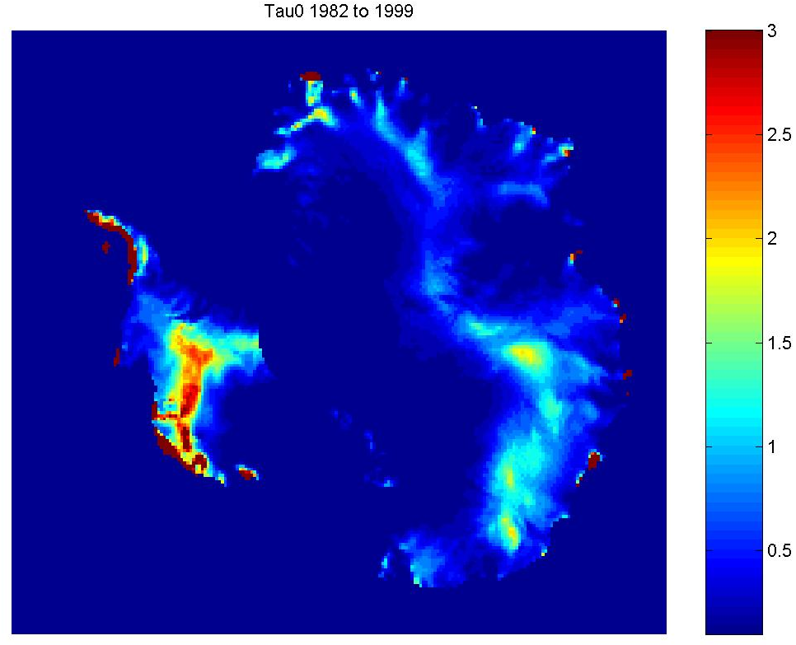
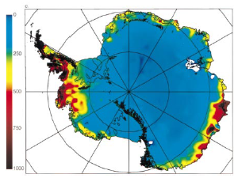
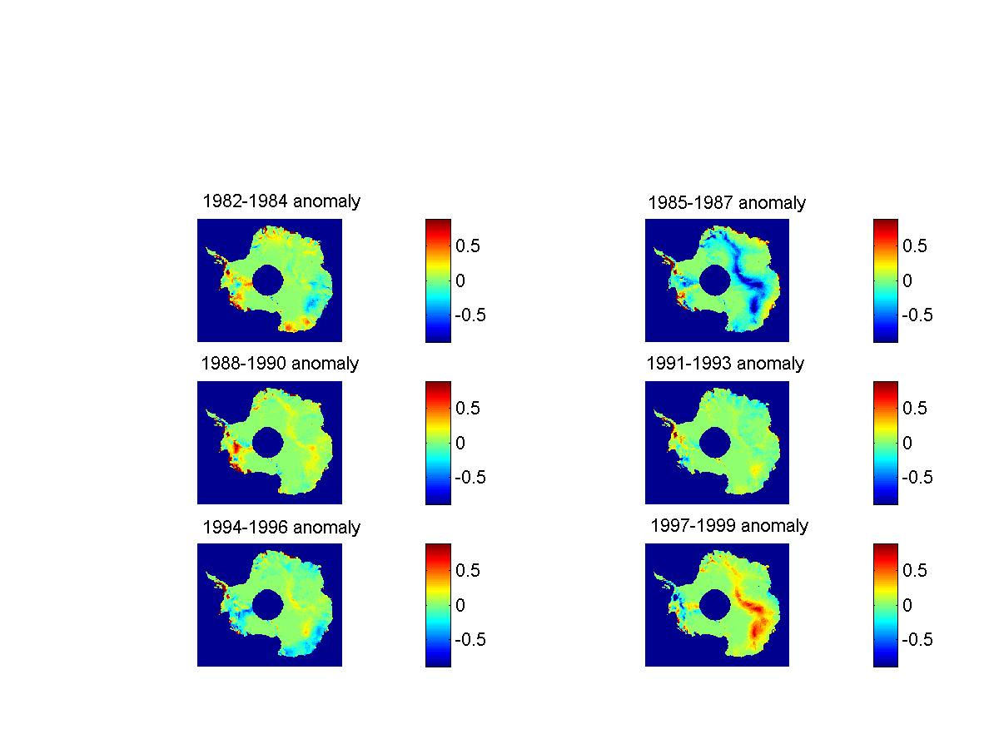
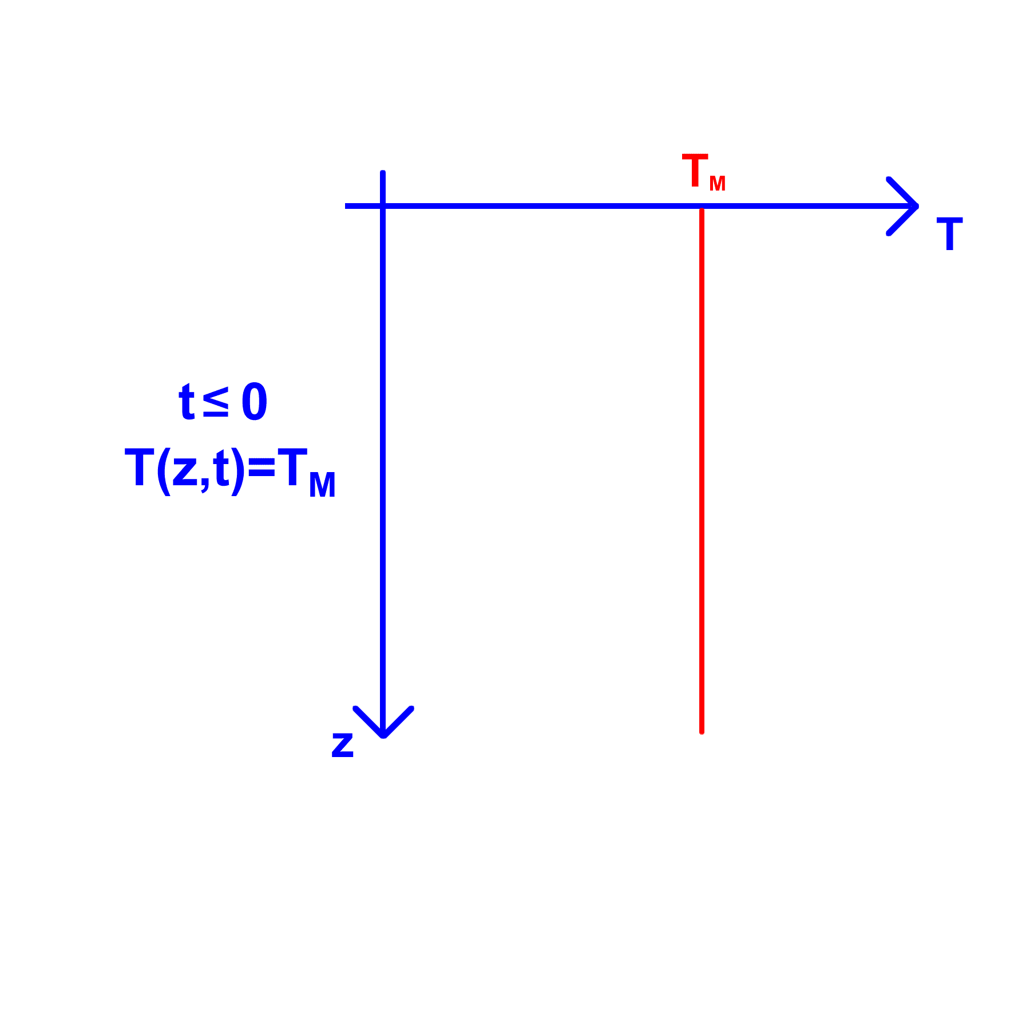
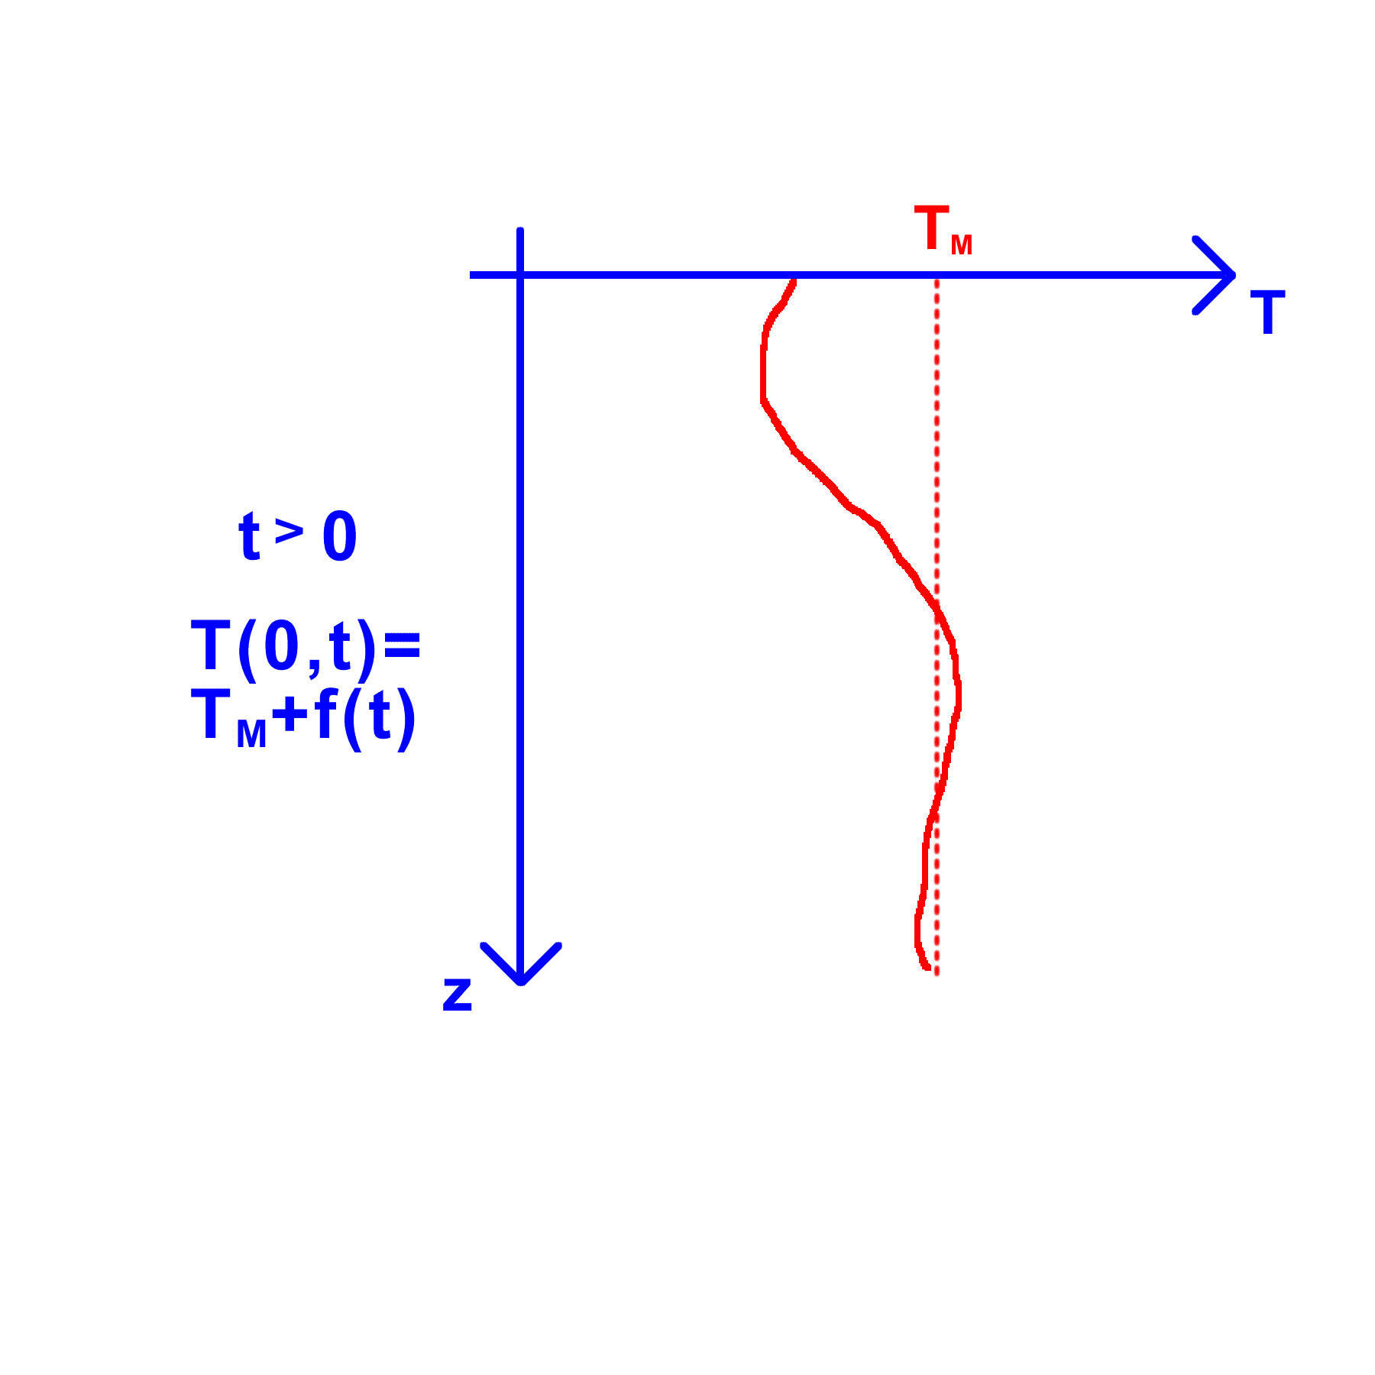
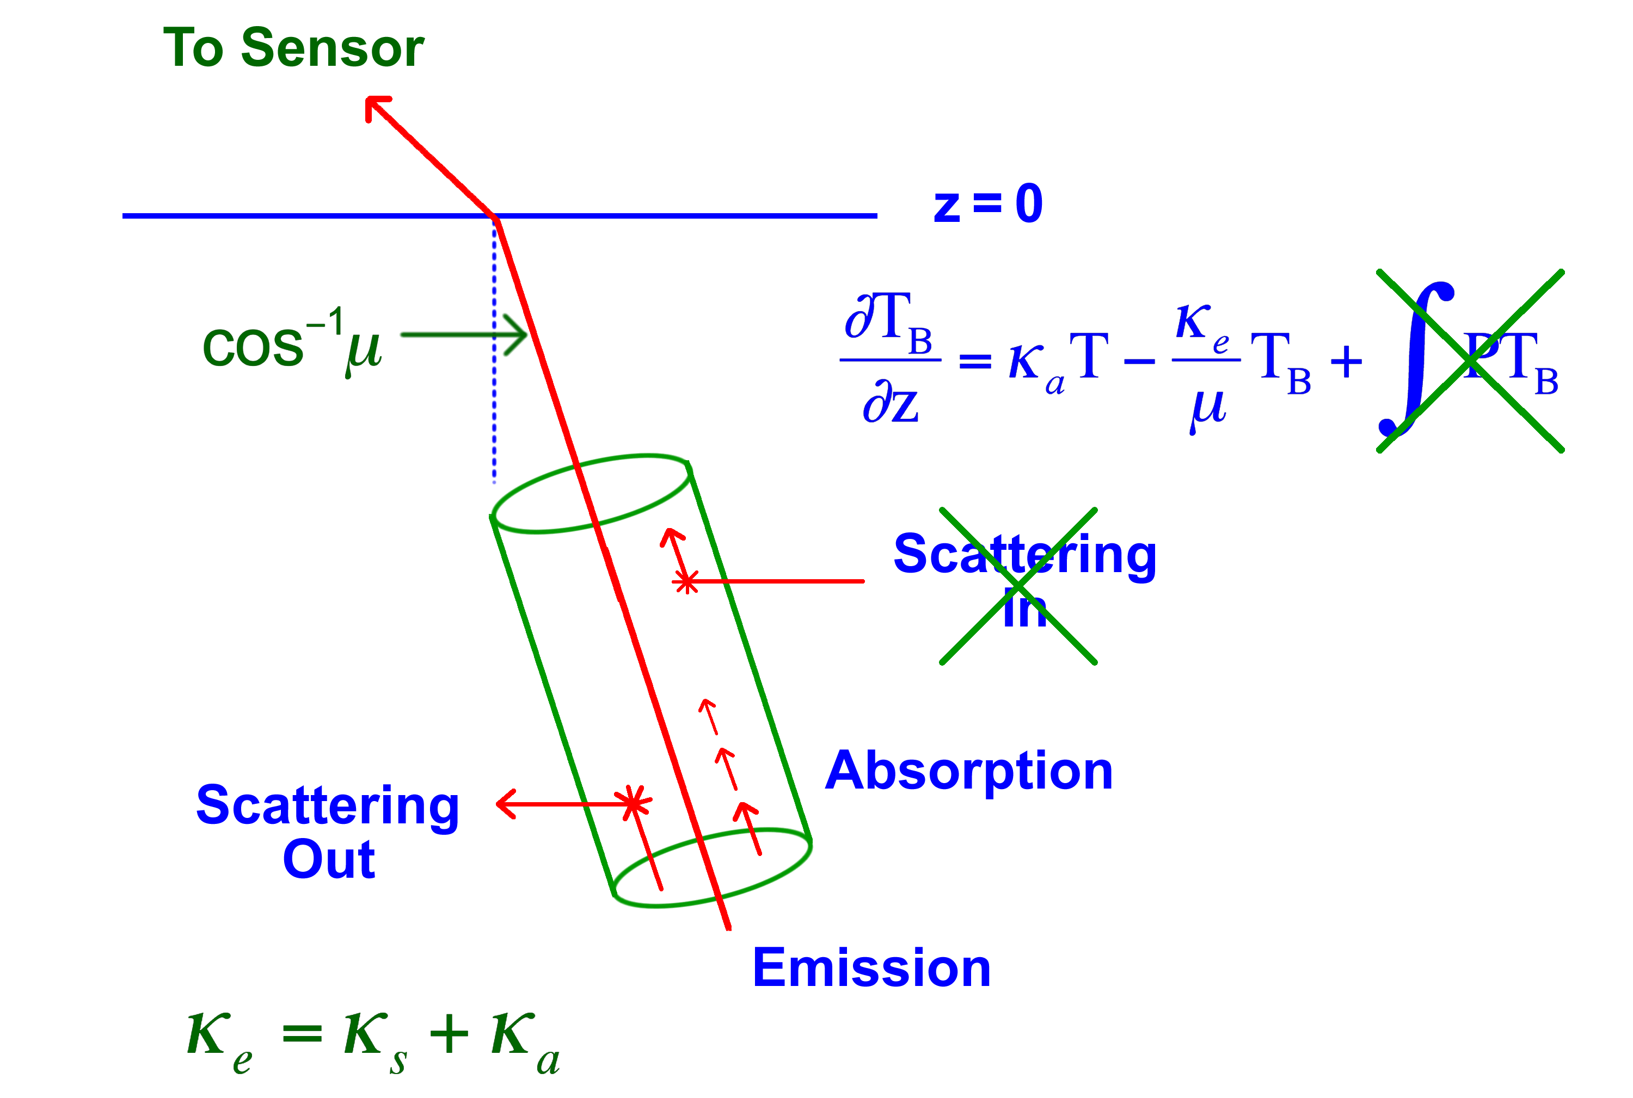
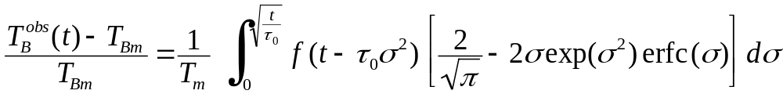
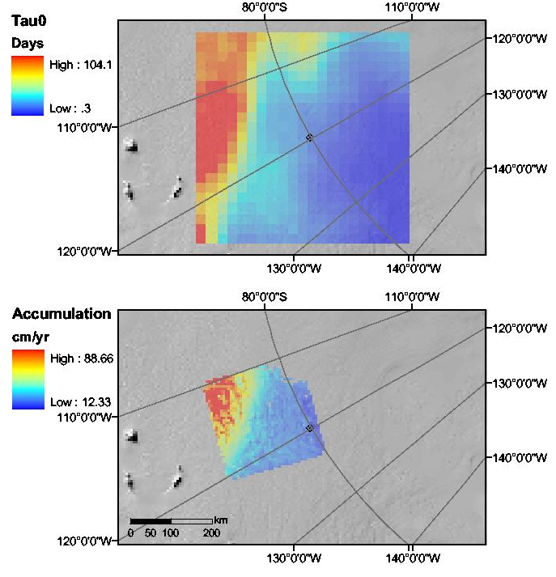
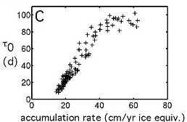
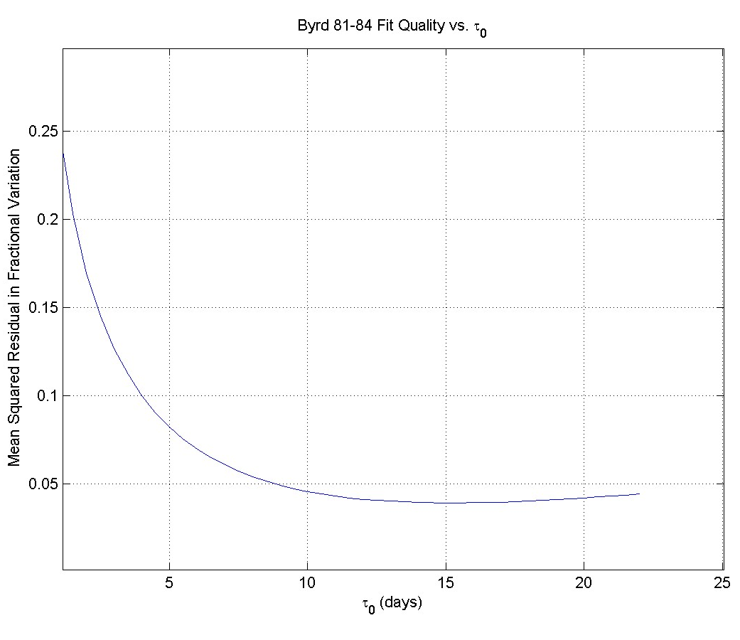
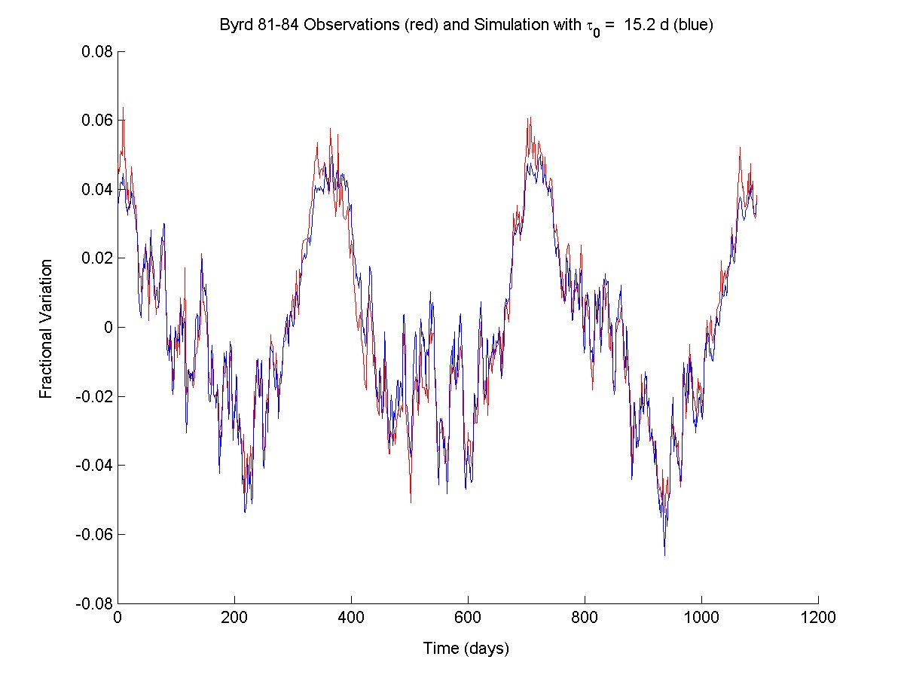
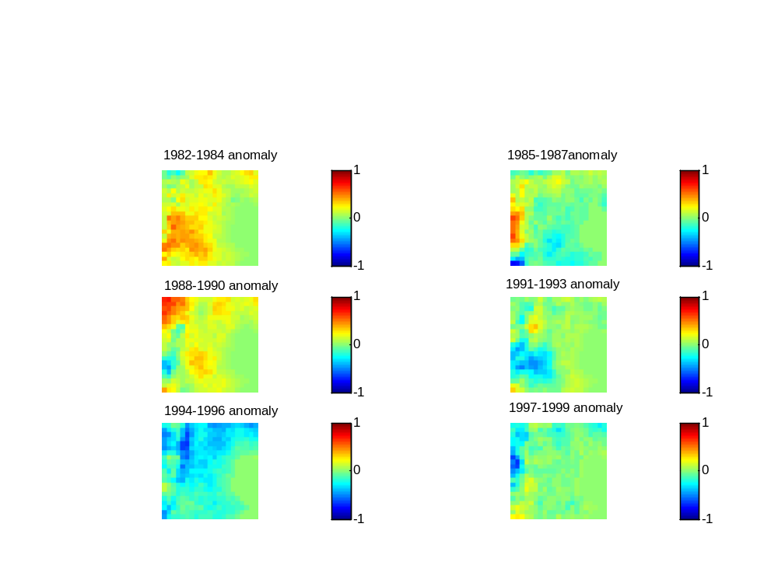
Spatial and Temporal Variation of the Characteristic Time Scale of Microwave Emission with Snow Properties over Antarctica
Authors: Lora S. Koenig, Eric J. Steig and Dale P. Winebrenner*
Department of Earth and Space Sciences, University of Washington, Box 351310, Seattle WA 98195
*Applied Physics Laboratory, University of Washington, Box 355640, Seattle WA, 98195
Introduction:
This research begins an investigation of the capabilities of passive microwave sensors to create surface temperature and accumulation rate datasets on the polar ice sheets. Preliminary results show:
The characteristic time-scale of emission, τ₀, allows for a relationship to be derived between microwave brightness temperature (T_{B}) and previous days and weeks of physical surface temperatures (T_{S}) through a convolution equation.
τ₀ is estimated using known 37 GHz vertically polarized T_{B} and surface temperatures from AWS stations and AVHRR data.
To investigate τ₀’s spatial and temporal variations, monthly averaged space-borne passive microwave T_{B} and AVHRR T_{S} data are used estimate τ₀. Maps show τ₀’s variation in Antarctica from 1982 to 1999. Three year anomaly maps show temporal variability that may track accumulation rate.
Within 250 km of Byrd Station, there is a linear co-variation of τ₀ with radar-generated accumulation rate below 50 cm/year (ice equivalent).
Antarctic mass balance maps generated by Vaughan et al. (1999) do not co-vary with τ₀ over the entire continent. Discrepancies, especially in East Antarctica, suggest that snow properties beyond accumulation rate influence τ₀.
Further research will investigate how the two components of τ₀, the microwave extinction coefficient and the thermal diffusivity relate to accumulation rate.
3. τ_{o} Maps from AVHRR Surface Temperatures
5. Accumulation Rate Over Antarctica
The combination of the space-borne passive microwave brightness temperature dataset and the AVHRR surface temperature dataset allowed for a spatial picture of τ₀ to evolve and be compared to other spatial accumulation maps.
Figure 2: Spatial variability is shown in map of estimated τ_{o} from 1982 to 1999. AVHRR surface temperature data was used in the estimation. τ_{o} given in months.
Figure 6: Comparison of Vaughan et al (1999) derived net surface mass balance to τ_{o} estimations from Figure 2 (directly to the left of this figure). τ_{o} estimations have significantly more structure in East Antarctica signifying that snow properties in addition to accumulation rate are controlling the characteristic time-scale of emission.
1. Characteristic Time-Scale of Emission
The characteristic time-scale of emission comes from a convolution equation relating brightness temperature to physical temperatures. The time-scale, τ₀, depends on the depth-scale of microwave emission (Κ_{e}/μ) and firn thermal diffusivity (α²).
τ₀=μ²Κ_{e}⁻²α⁻²
6. What Next?
The following questions still remain for using the characteristic time-scale of emission, τ_{o,} to derive surface temperature and accumulation rate data from space-borne passive microwave sensors:
To what extent does the empirical relationship between τ_{o} and radar-generated accumulation rate seen near Byrd Station hold? Over how broad and area does it hold, and where does it fail? Can τ_{o} be used to track temporal changes in accumulation rate as determined by dated radar lines?
How do snow properties govern the relationship between accumulation rate and τ_{o}? Where the empirical relationship near Byrd begins to fail, why does it fail there?
How do the sub-pixel distributions of snow properties affect τ_{o}?
What are the limits to inverting brightness temperature time series to yield surface temperature time series? What is the temporal resolution and limit to accuracy?
What changes when considering lower frequencies (19 and 6.7 GHz), and how can observations at those frequencies complement 37 Ghz?
Heat Diffusion
Radiative Transfer
Figure 3: Anomaly maps showing temporal variability in τ_{o}. Large temporal changes in τ_{o} are around .8 of a month. Anomalies are reminiscent of the principal patterns of variability (“modes”) observed in temperature and geopotential height data over Antarctica (Schneider et al., 2004). τ_{o} is given in months.
4. Accumulation Rate Near Byrd Station
(Eq 1)
Figure 4: Comparison of calculations of τ_{o} and accumulation rate for the area of the main West Antarctic ice divide around Byrd Station. A)1982 to 1999 τ_{o} estimations in days. Grid is 525 km on each side, centered on Byrd Station B) 2700-year average radar-generated accumulation rate from Morse et al. (2002)
A
Details given by Winebrenner et al. (2004).
2. Estimating τ_{o} from Observations
Estimation of τ_{o} is accomplished by minimizing the difference between the known T_{B} measured by the SMMR and SSM/I sensors and simulated T_{B}, based on surface temperature measurements.
Averaged daily temperatures from Automatic Weather Stations and monthly averaged clear sky AVHRR infrared measurements from Comiso (2000) are used as physical surface temperature data.
Time scales range from days to tens of days depending on location, with uncertainties of about 10%.
B
Graph 1: Scatter plot showing the linear relationship between accumulation rate and τ_{o} below 50 cm/yr ice equitant.
A
B
References
Comiso, J.C., Variability and trends in Antarctic surface temperatures from in situ and satellite infrared measurements, J. Clim., 13(10), 1674-1696, 2000.
Morse, D.L., D.D. Blankenship, E.D. Waddington, and T.A. Neumann, A site for deep coring in West Antarctica: Results from aerogeophysical surveys and thermo-kinematic modeling, Ann. Glaciol., 35, 36-44, 2002.
Schneider, D.P., E.J. Steig, and J.C. Comiso, 2004. Recent climate variability in Antarctica from satellite-derived temperature data. J. Climate, 17, 1569-1583.
Vaughan, D.G., J.L. Bamber, M. Giovinetto, J. Russell, A.P.R. Cooper, Reassessment of Net Surface mass Balance in Antarctica, J. Clim., 12, 933-946, 1999.
Winebrenner, D.P., E.J. Steig and D.P. Schneider, Temporal co-variation of surface and microwave brightness temperature in Antarctica, with implications for the observation of surface temperature variability using satellite data, Ann. Glaciol., 39, 2004.
Figure 5: Anomaly maps showing the temporal variability within 250 km of Byrd Station. Grids cover the same area shown in Figure 4a with Byrd Station located in the center. The largest temporal changes in τ_{o} are around 1 month. τ_{o} is given in months.
Figure 1 A) τ_{o} estimation fit curve for Byrd Station B) Simulated 37V Brightness Temperatures (blue) compared to actual observed Brightness Temperatures (red) from the SMMR sensor.

