Slide 1
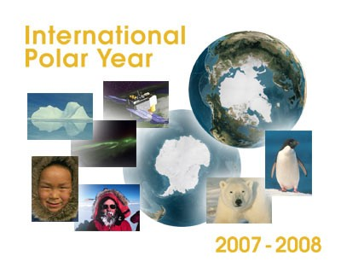
International Planning and Coordination

Slide 2
IPY Vision
An international program of coordinated research to explore the polar regions, deepen understanding of polar interactions including their role in global climate, expand our ability to detect changes, and extend this knowledge to the public and decision makers.

Slide 3
IPY Period
March 2007 to March 2009

Slide 4
ICSU IPY Planning Group
Membership
  Chris Rapley (UK, Chair)
  Robin Bell (USA, Vice-Chair)
  Ian Allison (Australia)
  Robert Bindschadler (USA)
  Steve Chown (South Africa)
  Gerard Duhaime (Canada)
  Vladimir Kotlyakov (Russia)
  Olav Orheim (Norway)
  Zhanhai Zhang (China)
  Eduard Sarukhanian (WMO)
  Michael Kuhn (IUGG)
  Werner Janoschek (IUGS)
  Prem Chand Pandey (India)
  Hanne Petersen (Denmark)
  Gino Casassa (Chile)
Support
  Chris Elfring (US PRB)
  Cynan Ellis-Evans (BAS, UK)
  Tim Moffat (BAS, UK)
  Leah Goldfarb (ICSU)
http://www.ipy.org
ICSU/WMO Joint Committee takes over IPY planning on October 1, 2004

Slide 5
Planning Group Output
Outline Science Plan (drawn from 450+ ideas)
  Science themes (6)
  Observational initiatives (6)
  Data management
  Education, outreach and communication
  Organizational structure
  Implementation process
ICSU/WMO co-sponsorship
IPY network of existing polar organizations and 20⁺ new National Committees
Integrated physical and social sciences

Slide 6
IPY Themes
To determine the present environmental status of the polar regions by quantifying their spatial and temporal variability.
To quantify, and understand, past and present environmental and human change in the polar regions in order to improve predictions
To advance our understanding of polar - global teleconnections on all scales, and of the processes controlling these interactions.
To investigate the unknowns at the frontiers of science in the polar regions.
To use the unique vantage point of the polar regions to develop and enhance observatories studying the Earth's inner core, the Earth's magnetic field, geospace, the Sun and beyond.
To investigate the cultural, historical, and social processes that shape the resilience and sustainability of circumpolar human societies, and to identify their unique contributions to global cultural diversity and citizenship.

Slide 7
Observational Initiatives
A synoptic set of multidisciplinary observations to establish the status of the polar environment in 2007-2008
The acquisition of key data sets necessary to understand factors controlling change in the polar environment
The establishment of a legacy of multidisciplinary observational networks
The launch of internationally coordinated, multidisciplinary expeditions into new scientific frontiers
The implementation of polar observatories to study important facets of Planet Earth and beyond
The creation of datasets on the changing conditions of circumpolar human societies from the First IPY 1882-83 to the present

Slide 8
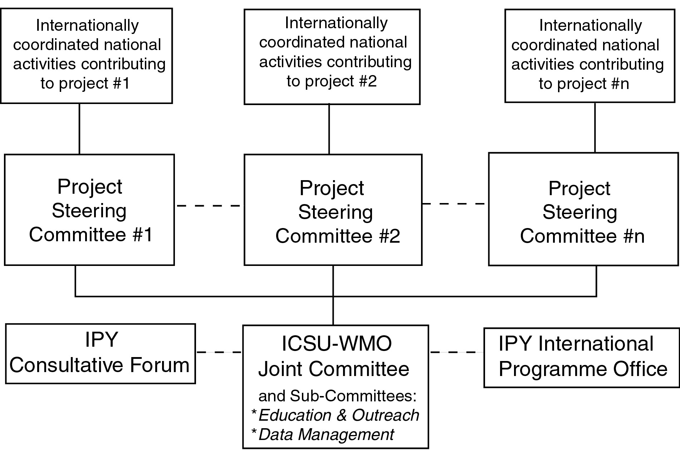
Organizational Structure

Slide 9
Implementation Timeline
Oct. 2004: ICSU/WMO IPY Joint Committee selected
10 Jan. 2005: Pre-proposals due to JC
Feb 2005: JC examines pre-proposals and provides feedback
March 2005: JC reports to Consultative Forum
June 2005: Full proposals due to JC
July 2005: JC announces IPY programme
March 2007: IPY begins
2005
2006

Slide 10
IPY Identification Criteria
Makes significant advances within one or more IPY themes;
Involves at least one polar region and takes place within the IPY timeframe;
Contributes to international collaboration that could include nations not traditionally involved in polar research:
Presents a viable management plan and organisational structure, including a time line when commitments (funding, logistic etc) can be expected;
Presents a viable approach for securing funding;
Proposes a viable plan for securing appropriate logistical support;
Signs up to the principles and aims of IPY data management and proposes a viable data management plan;
Proposes a viable plan or approach for education, outreach and communication activities;
Shows how it will foster the next generation of polar researchers;
Provides the opportunity for a legacy (observation sites, facilities, systems);
Builds on existing plans, programmes or initiatives or, at least, does not conflict with them;
Has interdisciplinary elements (team, project etc.);
Is “endorsed” by one or more National Committees.

Slide 11
Really, really good news for WAIS
NSF/OPP has indicated a high probability that WAIS Inland ice coring will occur during IPY period
  Coring activity will probably be IPY
  Logistic focus affords opportunities for other IPY activities in West Antarctica
  International efforts leveraging off US presence in West Antarctica will be strong IPY candidates

Slide 12
Questions?

Slide 13
Community Response
26 countries responded to ICSU PG letter
Over 20 National Committees formed
450+ research ideas
  Individuals
  National committees
  International organizations
Social Science ←→Physical Science Dialog

