Slide 1

West Antarctic Ice Core Chemistry and Self-Organizing Maps: A First Look
David B. Reusch and Richard B. Alley
Department of Geosciences
and EMS Environment Institute
Penn State University
Paul A. Mayewski
Department of Earth Sciences
and Climate Change Institute
University of Maine
Funded by the Office of Polar Programs
and the Division of Atmospheric Sciences,
National Science Foundation

Slide 2
Preview
Brief intro to self-organizing maps
Results from
  Siple Dome
  Taylor Dome

Slide 3
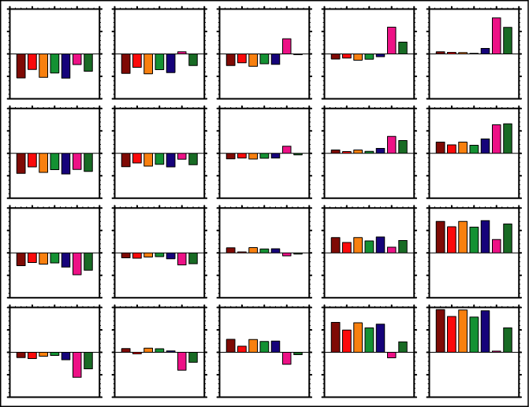
Self-organizing Maps (SOMs)
A tool for extracting generalized patterns of variability from multivariate data
A projection (mapping) from the multidimensional input space to the 2-D pattern space
Patterns arranged in a grid by similarity (closer = more)
Flexible grid size based on problem being studied

Slide 4
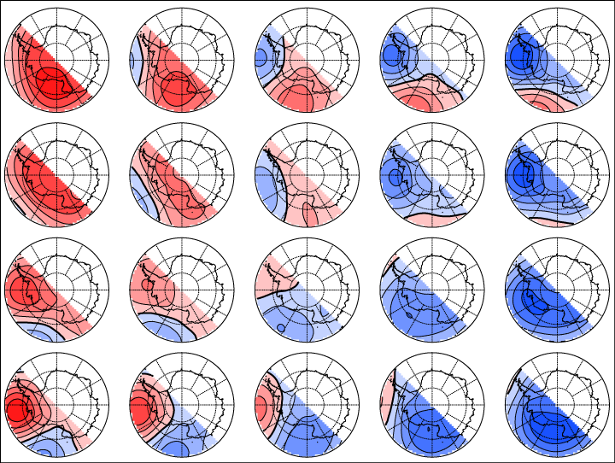
Self-organizing Maps (SOMs)
Also used for classifying multivariate data and studying its temporal behavior
Each input record matches one pattern most closely
Records matching the same pattern have it in common
Basis for frequency, transition and trajectory maps

Slide 5
Holocene West Antarctica
Environmental Context
Retreating ice sheet
Elevation changes at Siple Dome
Changing distance to sea ice/open water
Other circulation changes?

Slide 6
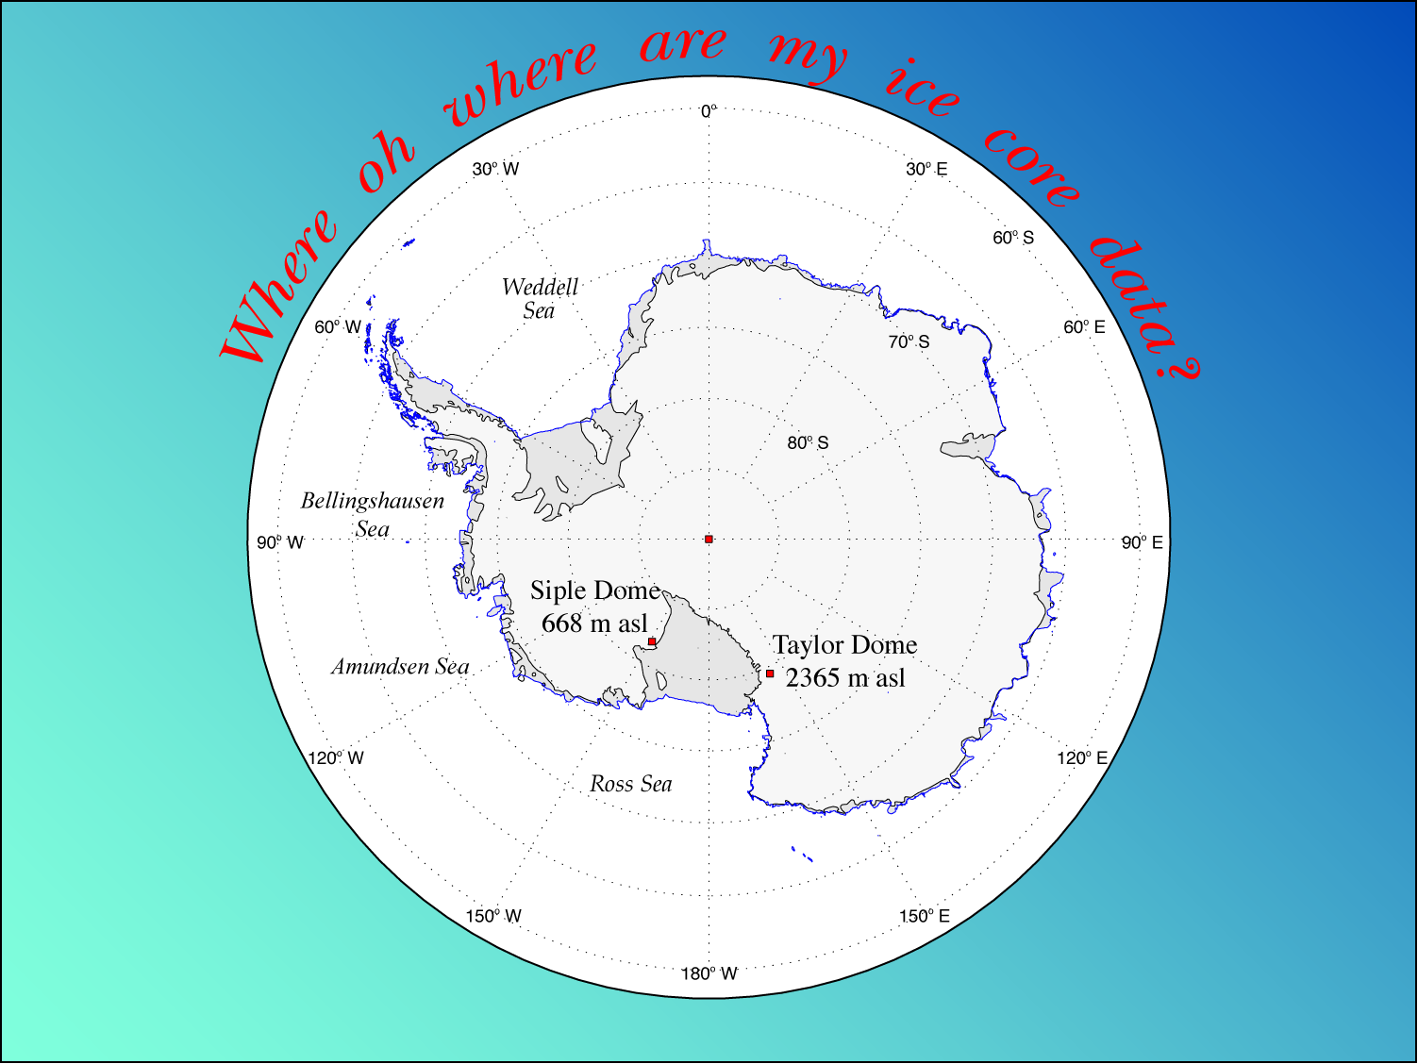

Slide 7
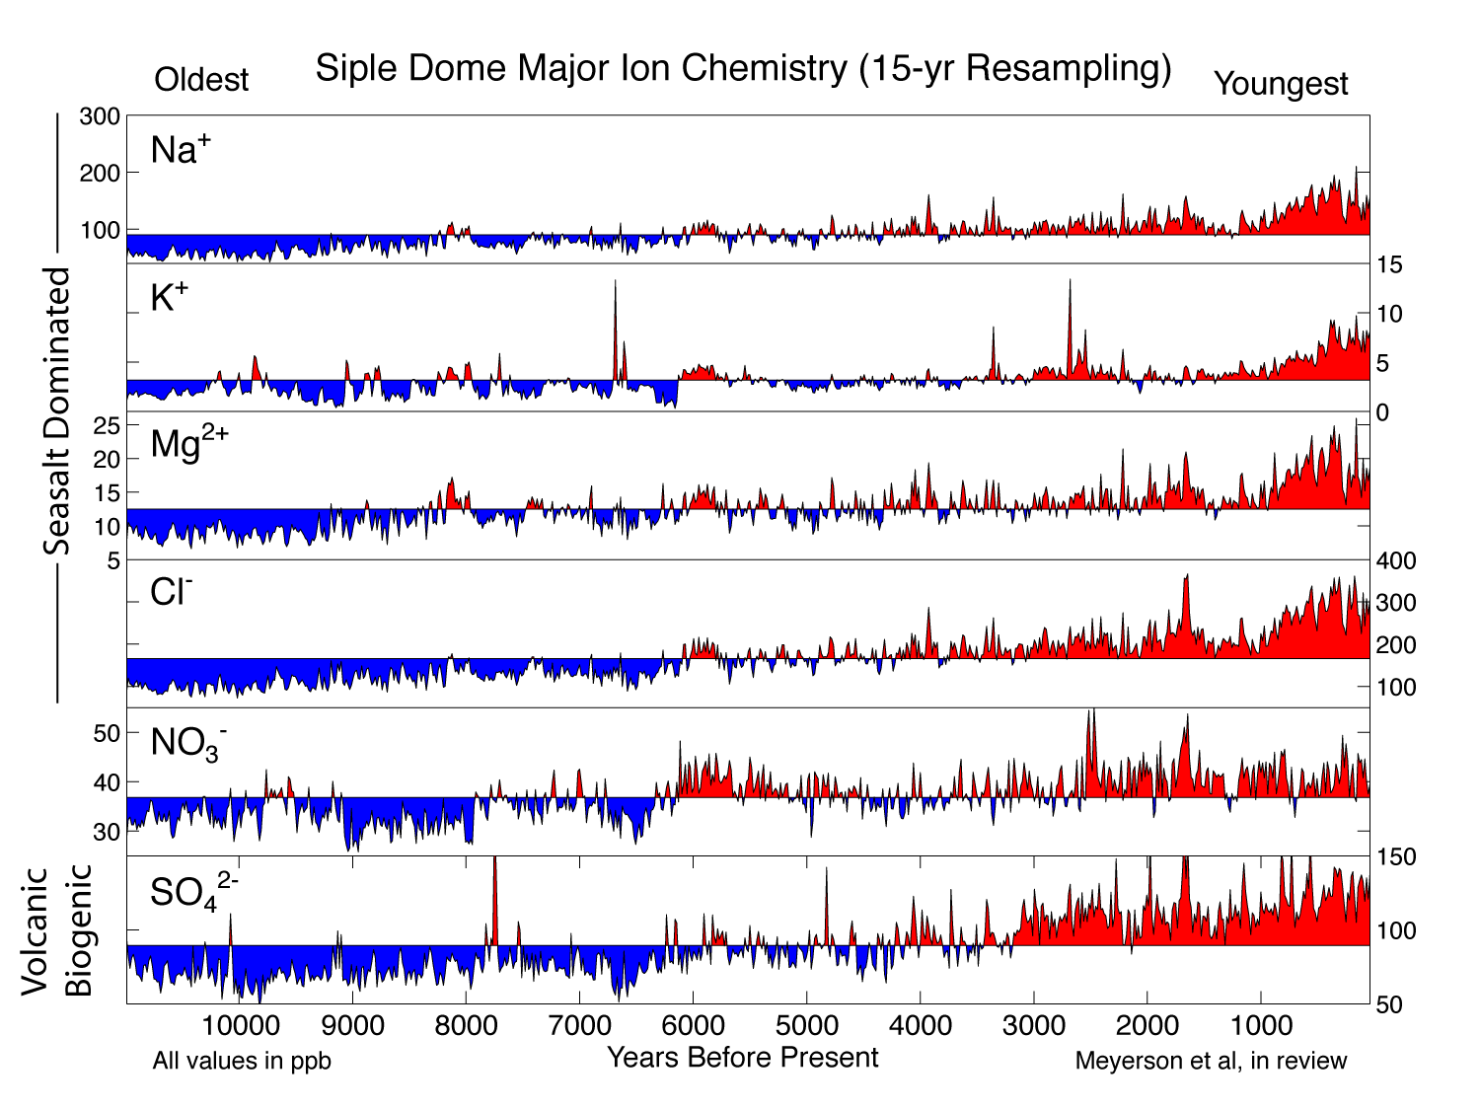

Slide 8
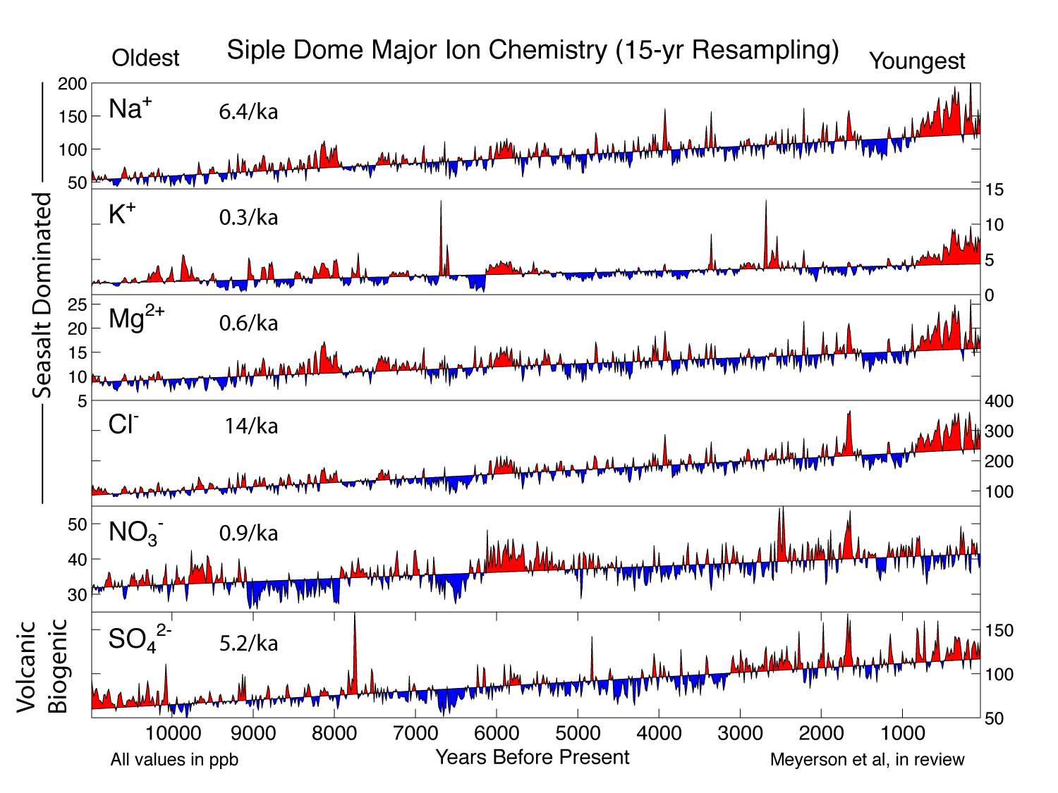

Slide 9
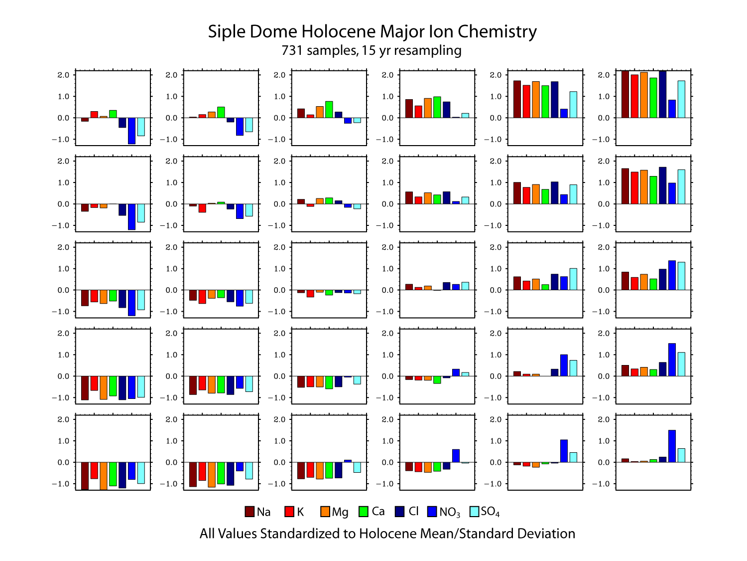

Slide 10
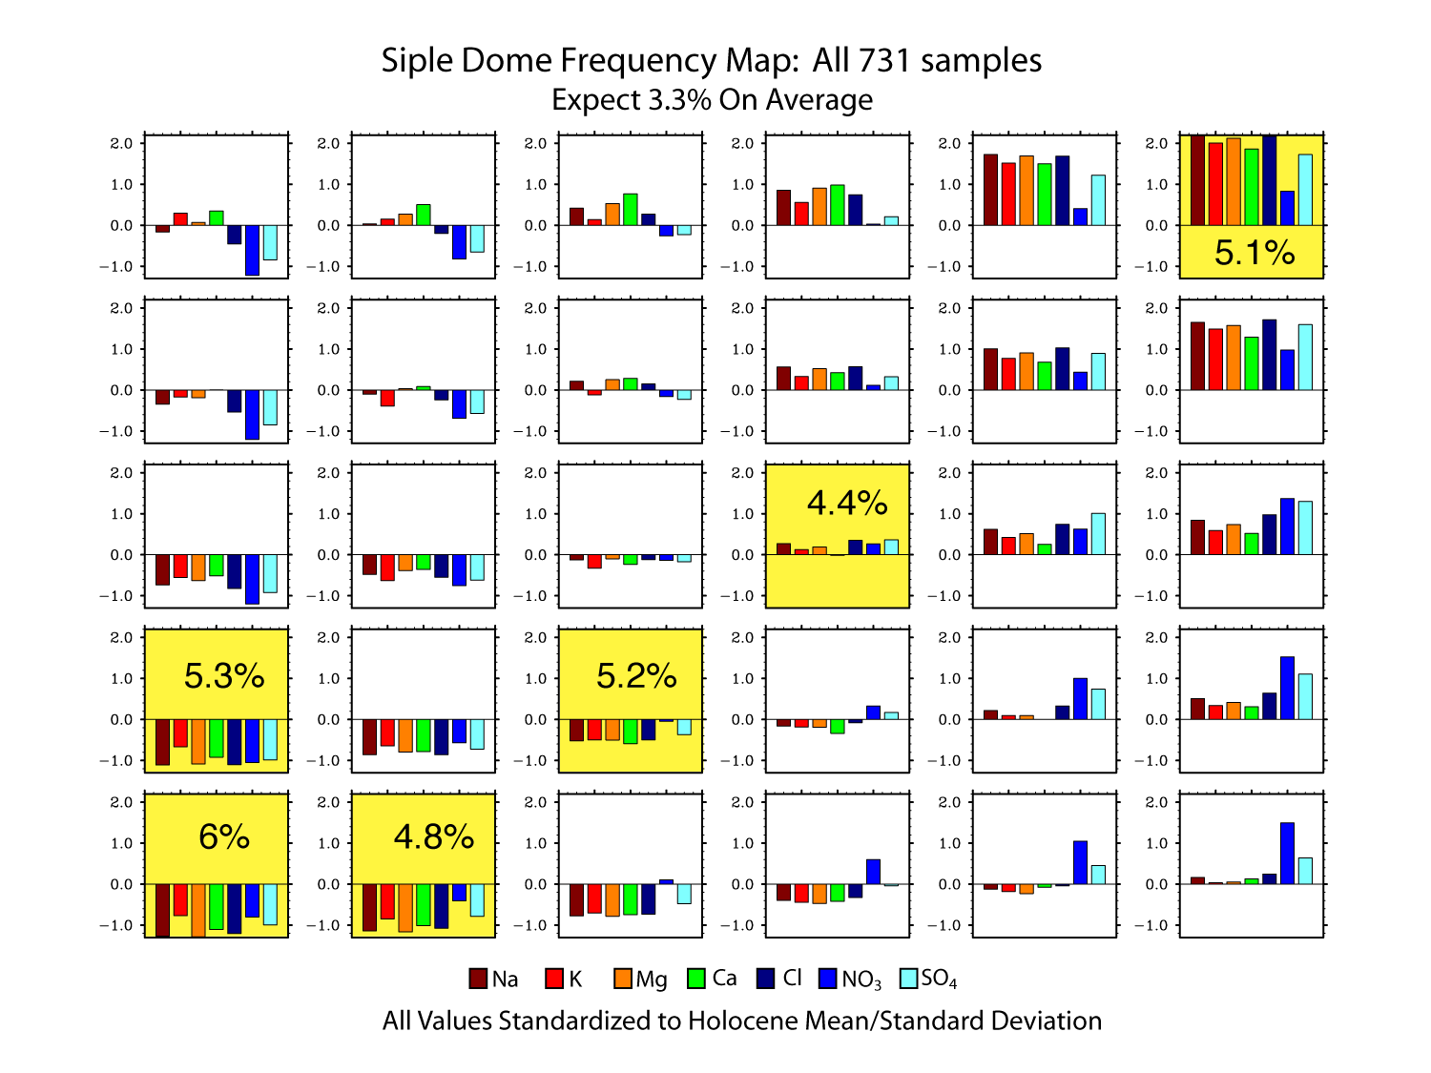

Slide 11
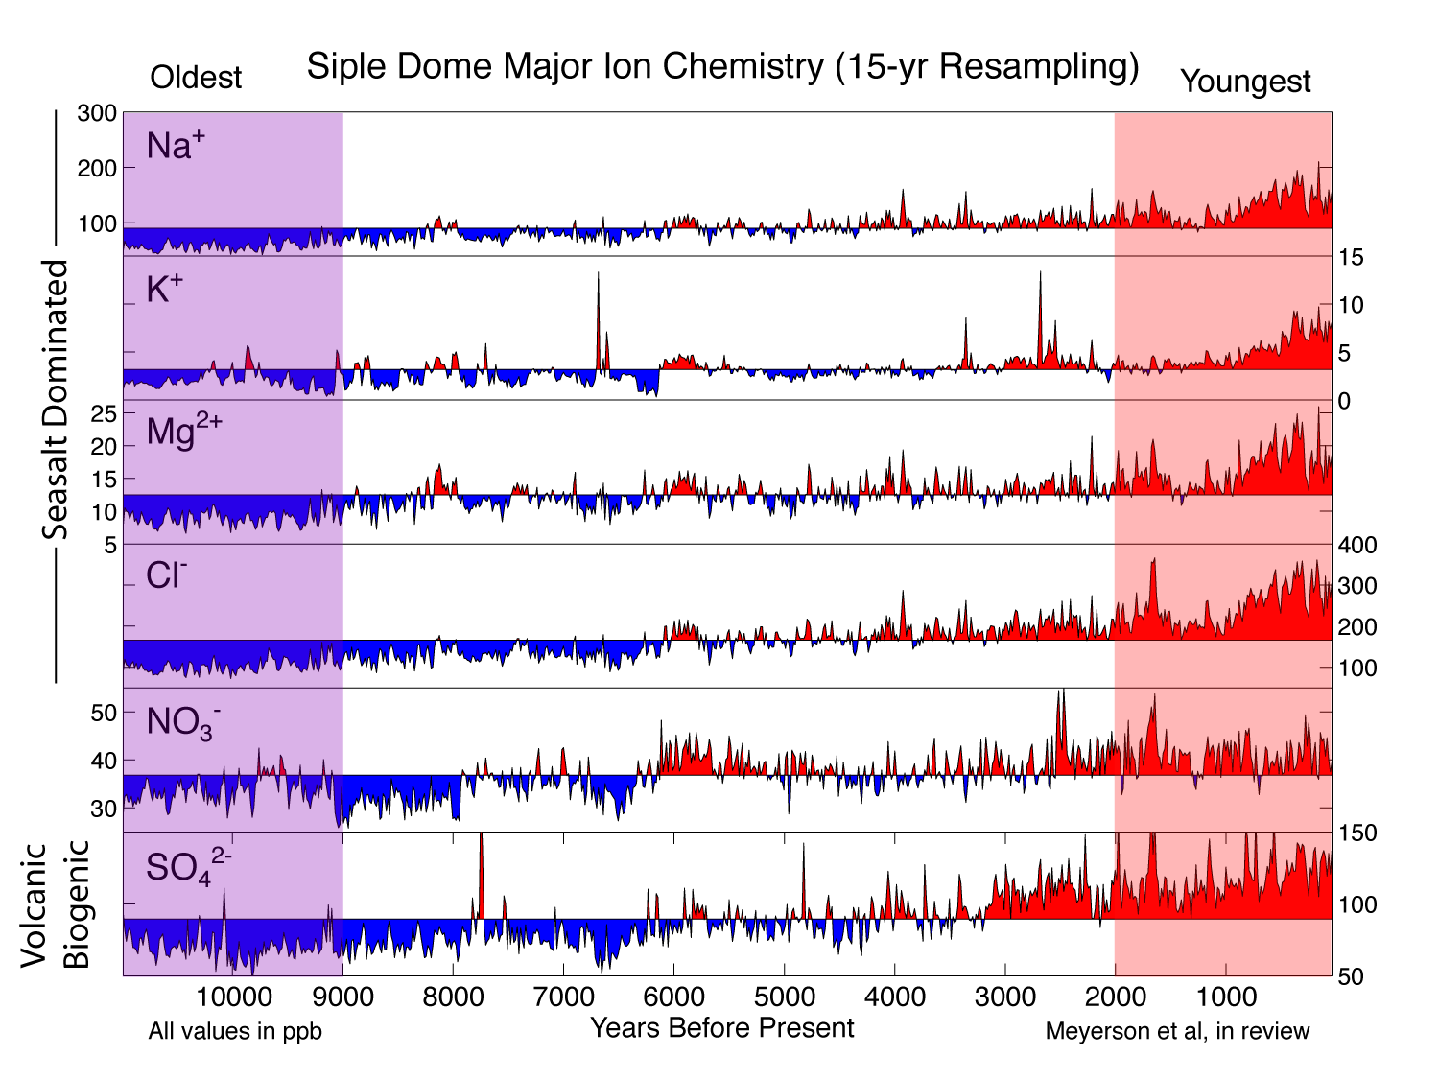

Slide 12
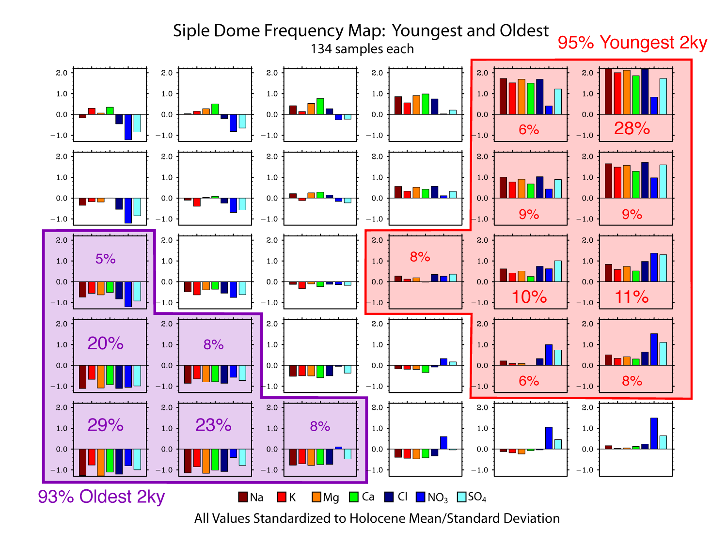

Slide 13
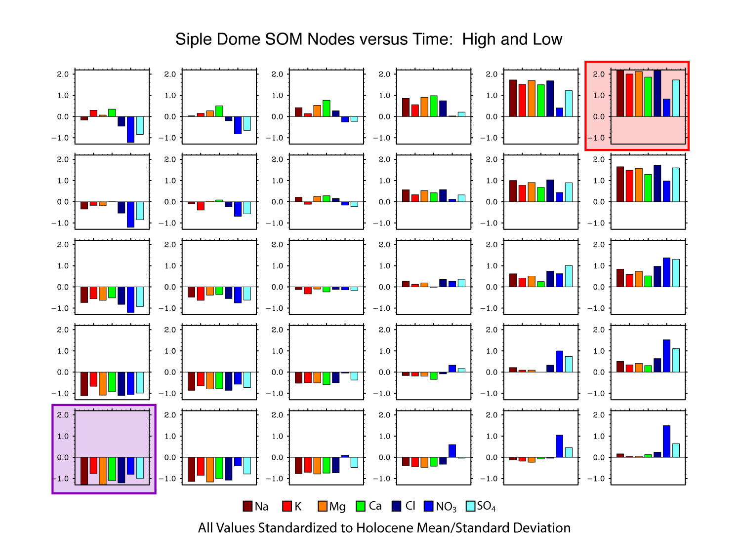

Slide 14
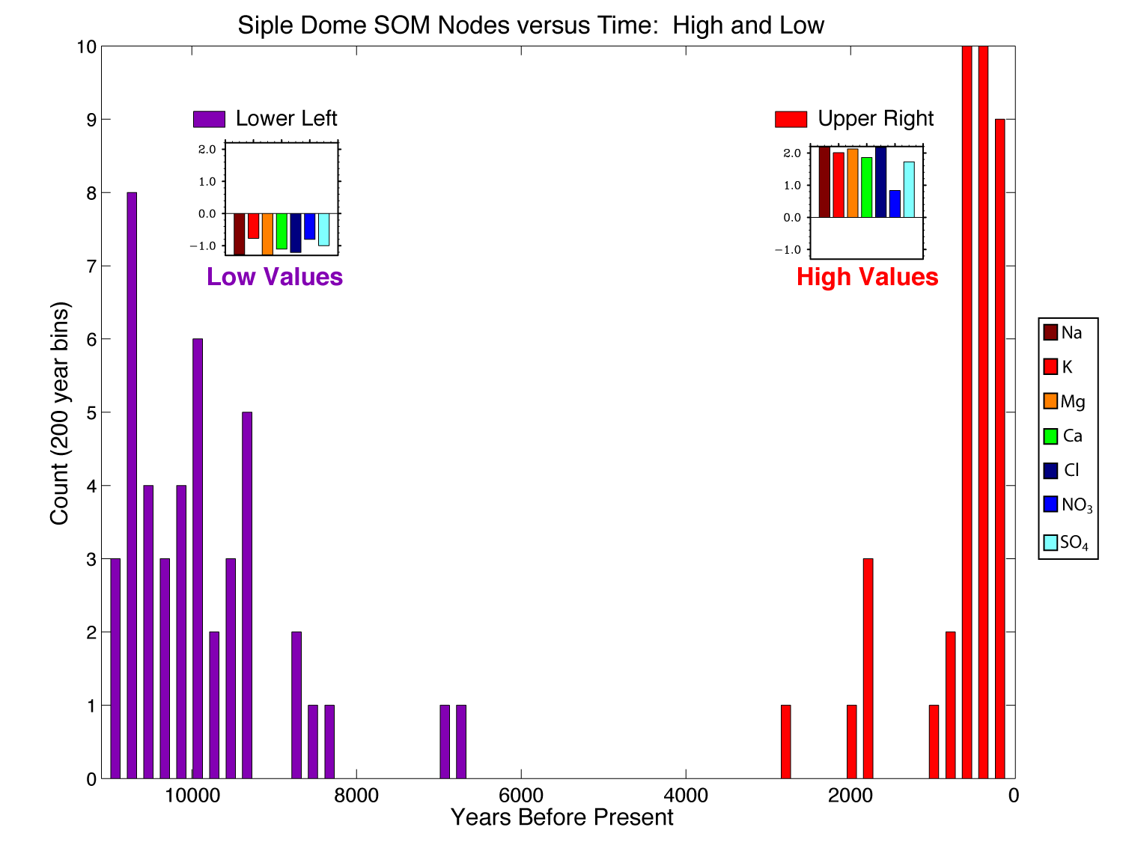

Slide 15
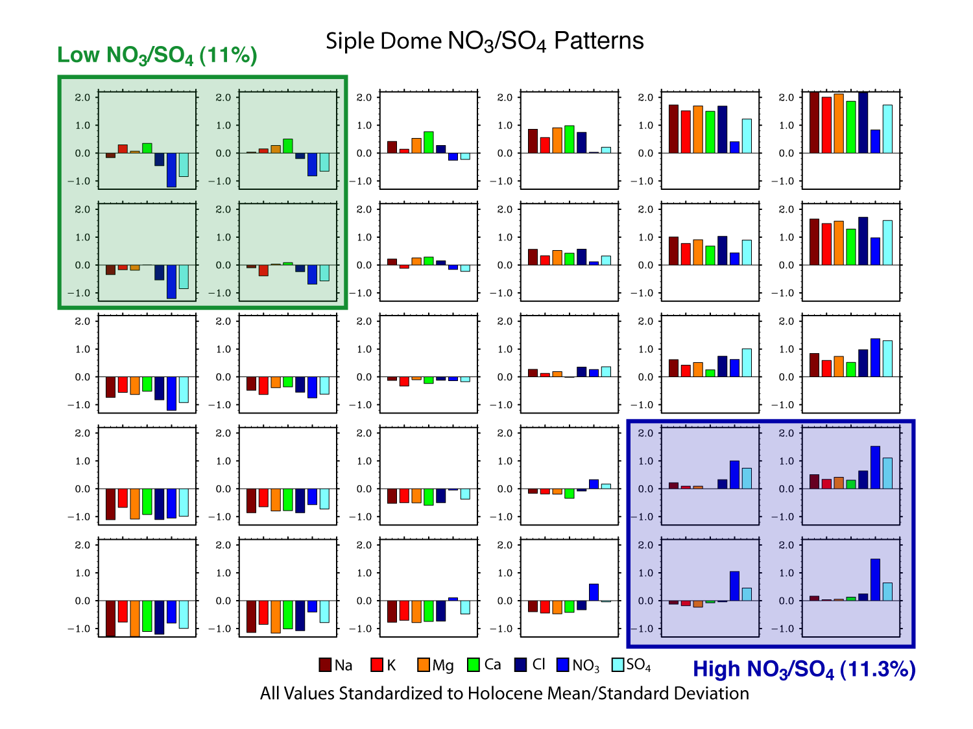

Slide 16
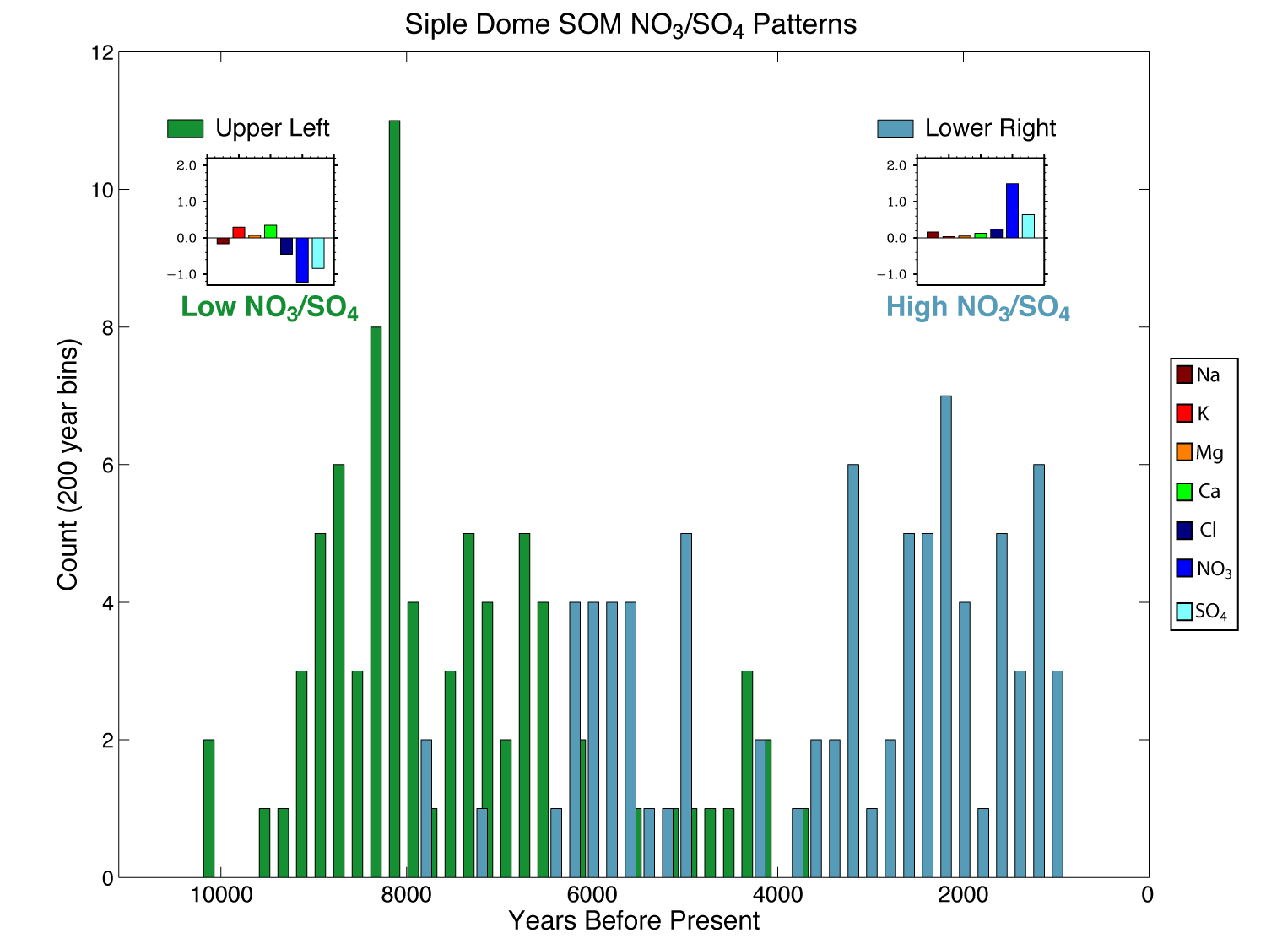

Slide 17
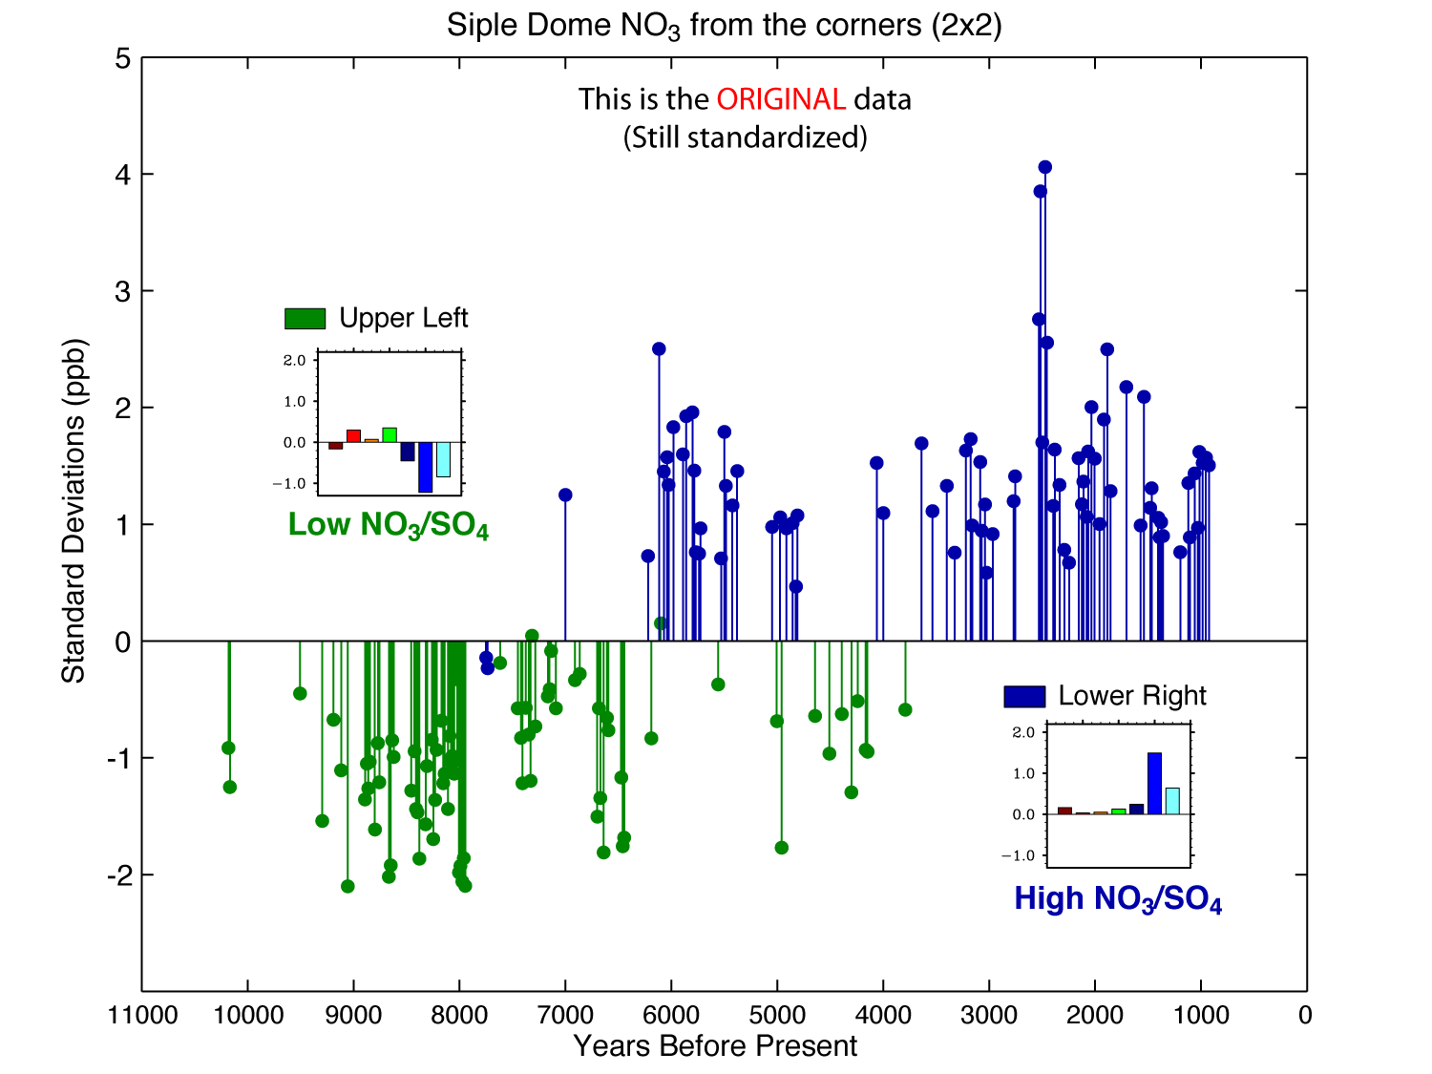

Slide 18
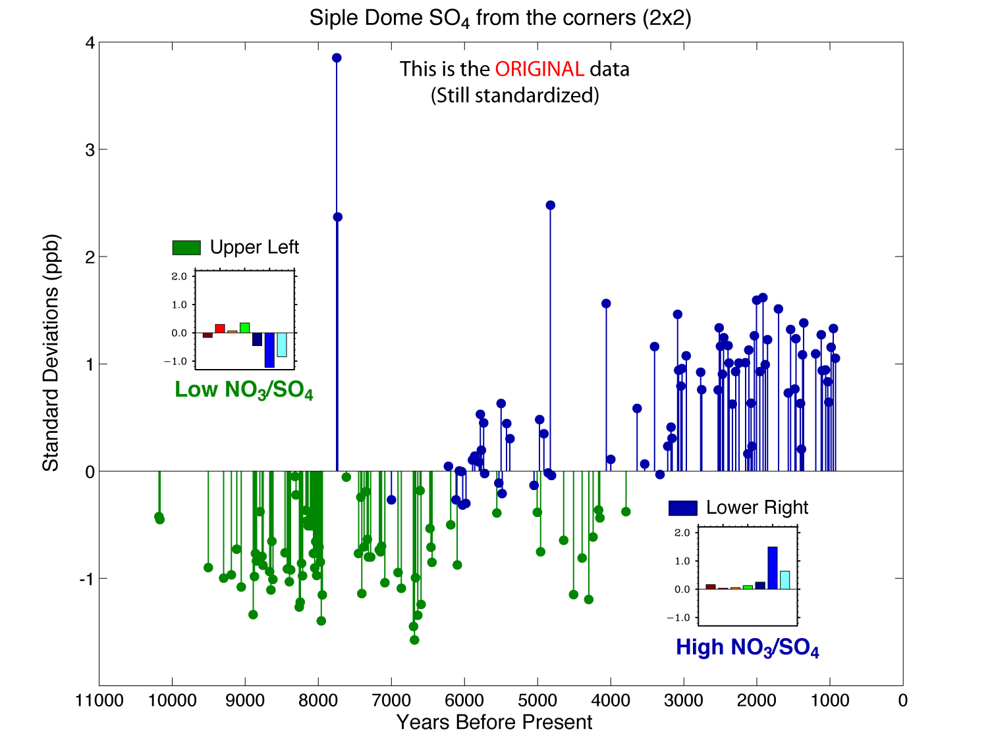

Slide 20
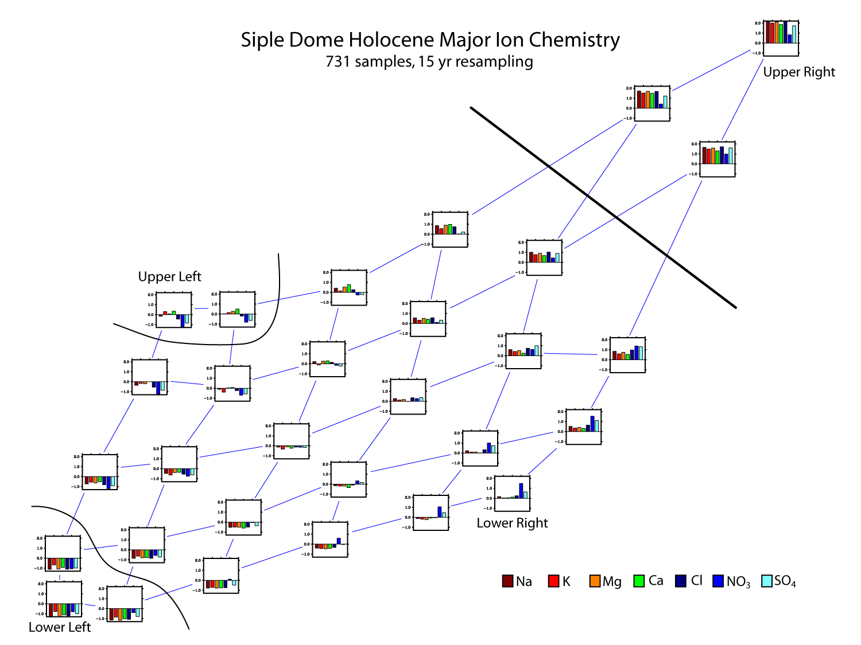

Slide 21
A Brief Look At
Taylor Dome

Slide 22
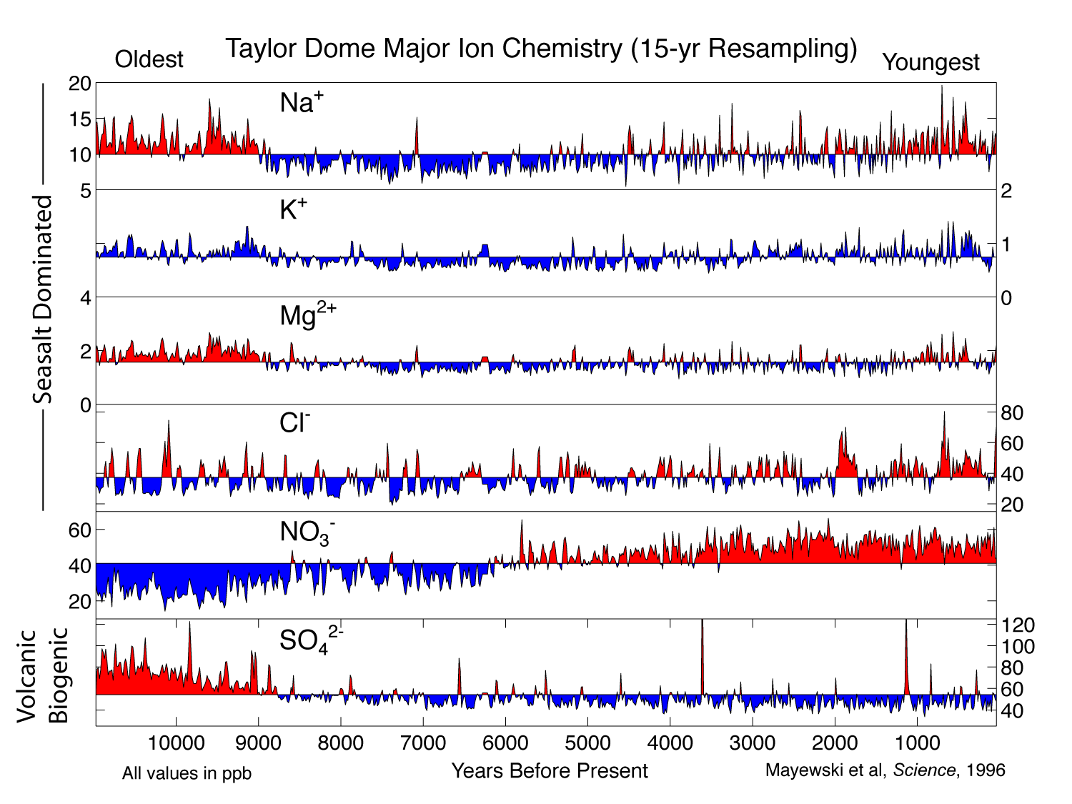

Slide 23
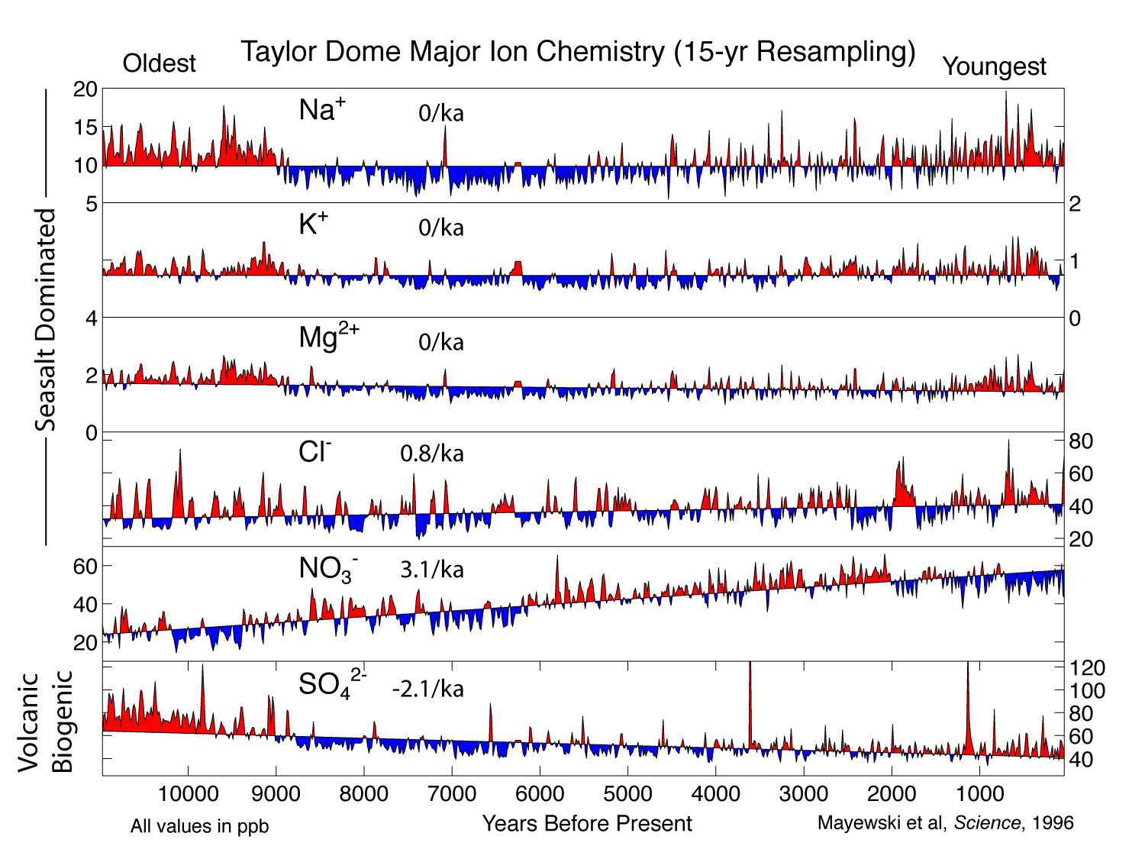

Slide 24
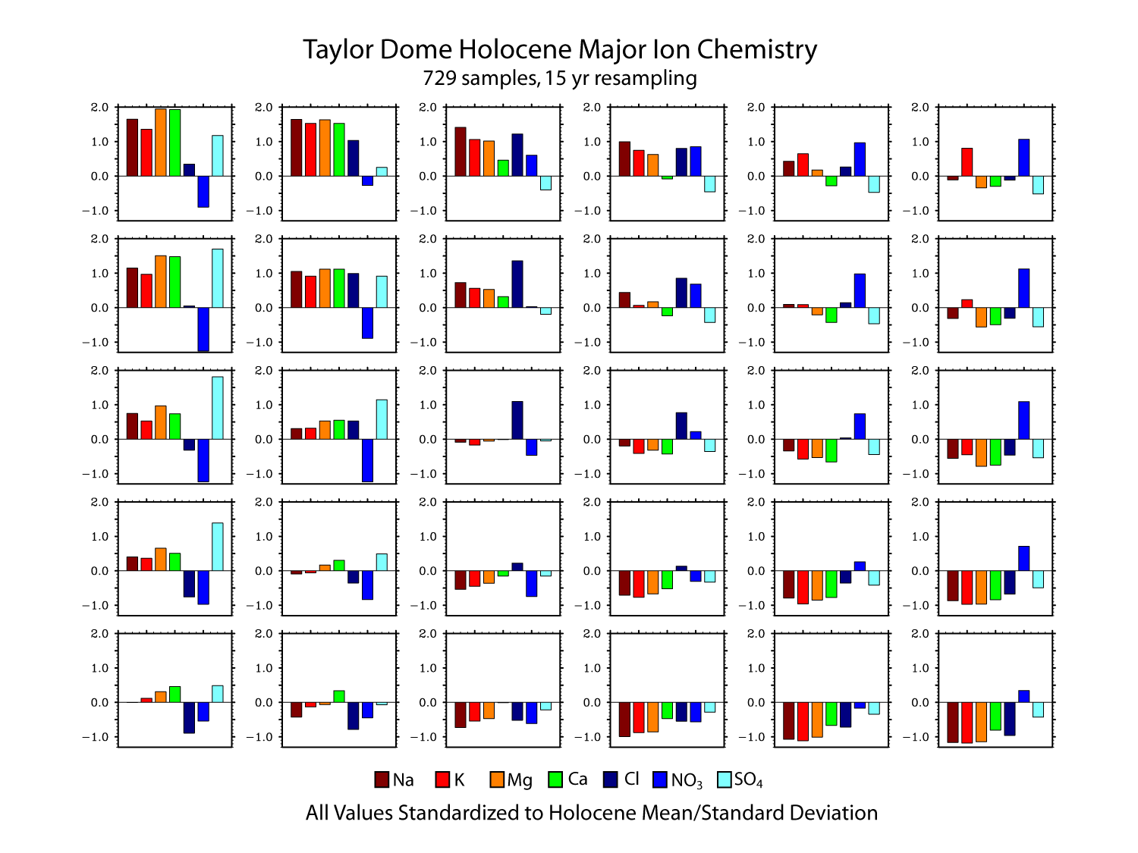

Slide 25
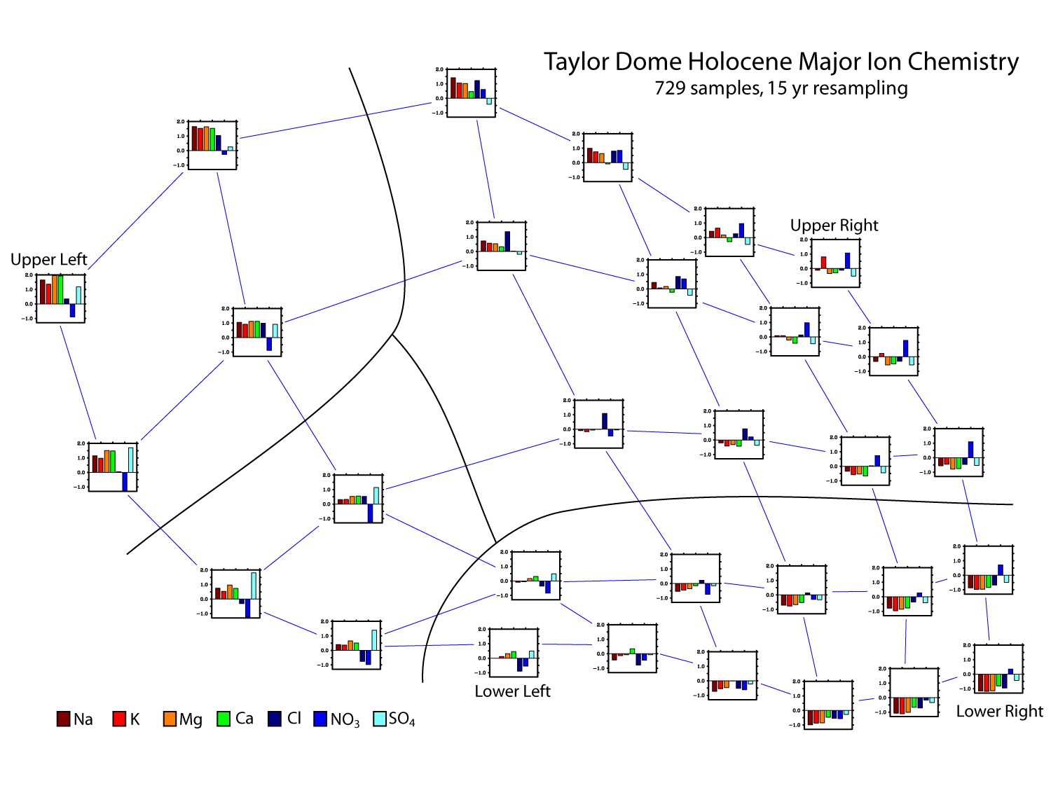

Slide 26
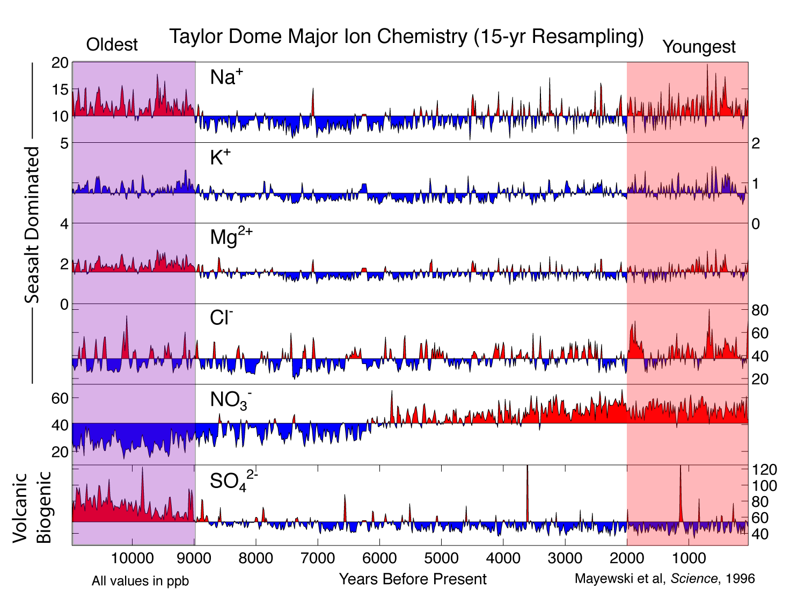

Slide 27
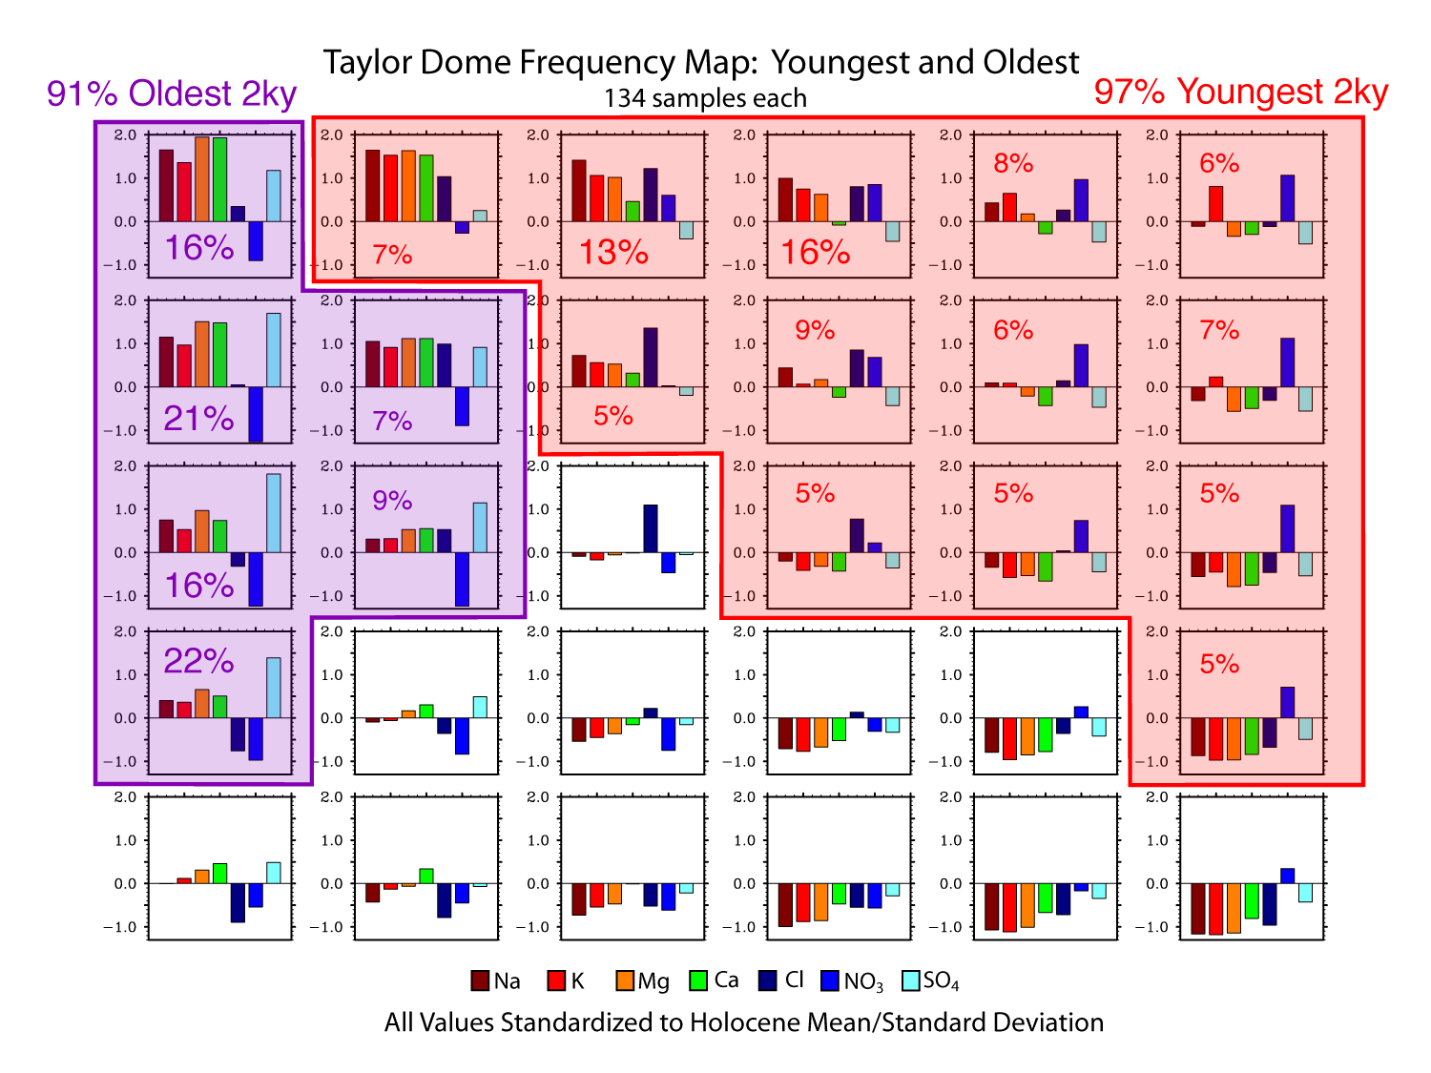

Slide 28
Future Work
Further SOM-based analysis of ice core chemistry data to assess the value of this technique for these data
  Continue with Siple Dome/Taylor Dome
  Add other useful sites/cores
  Add non-seasalt chemistry
Comparisons with other data sources on the climate history of this region

Slide 29
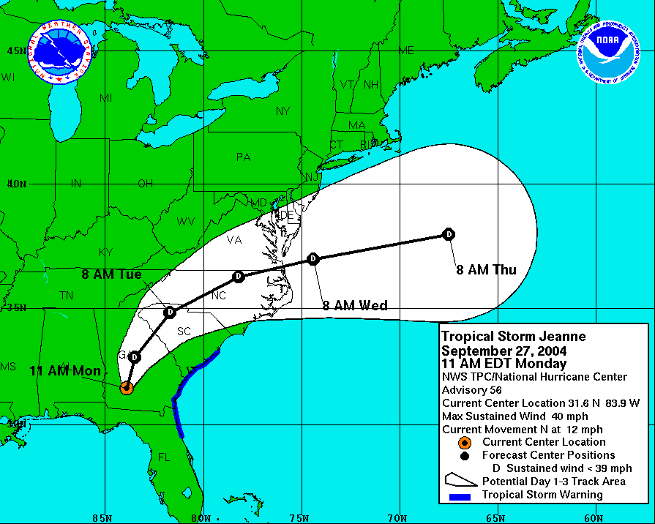

Slide 30
