Slide 1

Estimating surface elevation changes on WAIS from GLAS altimetry
Ben Smith
U of W
9/30/04

Slide 2
Program
Technique
  Cross-overs
  Estimating errors
  Estimating biases
  Estimating elevation change rates
Results
  Elevation change by region
Caveats

Slide 3
Cross-over technique
GLAS measures z(lat, lon) on tracks
The cross-over point is the point whose elevation is measured by both tracks
Elevation found by interpolation at adjacent points for each track
Rate of elevation change estimated by (z_{A}-z_{D})/(t_{A}-t_{D})
Get a better estimate by combining many cross-over measurements
A
D

Slide 4
Estimating errors
Three kinds of errors
  Shot-to-shot errors
    40 Hz
    instrumental noise
    Estimated (2 cm) from apparent surface roughness
  Pass-to-pass errors
    minutes-hours
    orbital/atmospheric error
    Estimated from cross-over residuals and shot-to-shot error
  Instrumental bias
    Weeks-months
    thermal / pointing problems
    Quantified from regression

Slide 5
Masking bad data (temporary fix)
GLAS cloud detection is not necessarily an exact science, but we can filter out the obviously flawed returns.
  Require that return-pulse match a model of a return from a smooth, flat, white surface
  Clouds cause deviations from this model that appear in the GLAS data-parameters
A conservative set of requirements rejects about 80% of all cross-overs (60% of all data)
Help is on the way!
  LIDAR-based cloud-clearing has been implemented, I haven’t used it yet

Slide 6
Elevation change detection
The philosophy:
  If the data speak rot, then let them speak rot!
Look for elevation changes in glaciologically significant regions
  Plot T_{A}-T_{D} vs. Z_{A}-Z_{D}, take the slope to get ∂z/∂t
  Eliminate bad data with filters and a convergent 3 σ edit
  Treat pass/shot errors with a covariance matrix
Z_{A}-Z_{D}
T_{A}-T_{D}

Slide 7
Significance of derived elevation changes
Accumulation variability can mask long-term elevation changes
  Accumulation rates are on the order of 0.1 m/a (§ 20 %) m/a
  Interannual variability is at least 0.34 A
  This translates to an error of 0.9 T^{-1/2} A, or about 0.07 m/a.
We will derive formal errors for rates of elevation change, ignore elevation changes smaller than 2σ or smaller than the accumulation error.

Slide 8
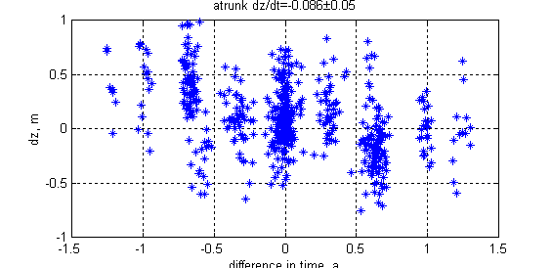
Example: cross-overs on Mercer ice stream

Slide 9
Instrumental bases
GLAS has collected data with two lasers, in a total of 4 different configurations:
  Laser 1 : Feb 20 2003 to Mar 30 2003
  Laser 2a: Sep 8 2003 to Nov 20 2003
  Laser 2b: Feb 16 2004 to May 17 2004
  Laser 2c: May 18 2004 to present
Each period of operation may have a different ranging bias.
One component of bias steady, one reverses sign for ascenting/descending tracks
Can try to solve for ranging biases:
  d_{est}=a(t₂-t₁)+ (b_{L2} – b_{L1}) + (b_{L2A} – b_{L1D} )
∂ z / ∂ t
Difference in laser biases
Difference in laser AD biases

Slide 10
Matrix for bias estimates
Elevation differences
Time difference
0.3
-1
0
1
0
1
0
1
0
Mean dz/dt
Laser difference
Range biases
=
£
Laser A/D difference
A/D biases
LaGrange multiplier
Zero
Constraints
λ £

Slide 11
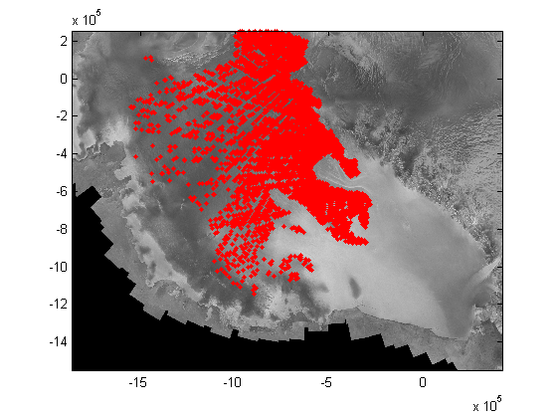
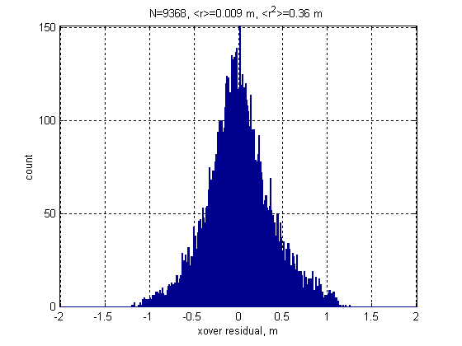
Cross-over locations/residuals

Slide 12
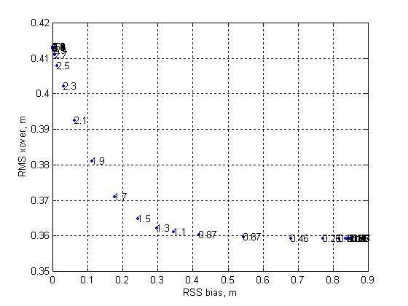
Calculated biases
Increasing λ decreases the calculated biases, increases the residual:
Pick λ by requiring that R<1.01 R_{min}:
  Laser 1 : 0.068 m (constant) 0.004 m (AD bias)
  Laser 2a: -0.151 0.045
  Laser 2b: -0.047 0.098
  Laser 2c: 0.131 0.022
Formal errors are on the order of 0.004 m
λ=10^{1.5}

Slide 13
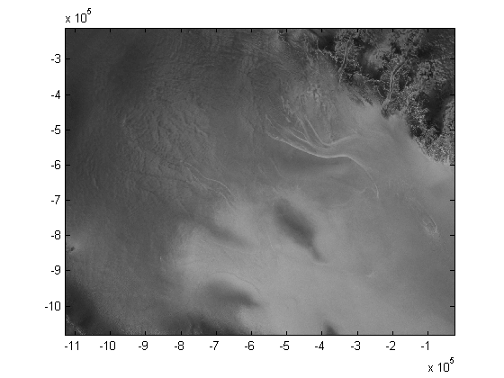
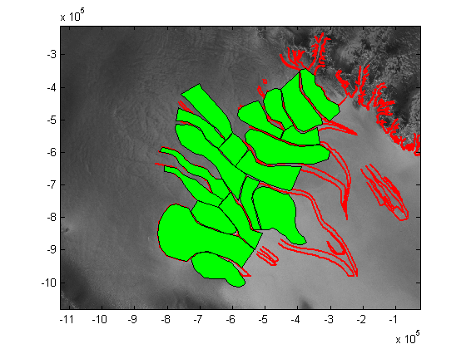
Regions for elevation differences
Elevation changes will be calculated for glaciologically significant regions

Slide 14
Calculating regional elevation differences
For all points within a region of the ice sheet, calculate the rate of elevation change
  Data are estimated:
    z_{est} = T(dz/dt)_{est}
  Inverse:
    (dz/dt)_{est} =(T^{T} C⁻¹ T)⁻¹ T^{T} C⁻¹z
T is a vector of time differences
C is an estimate of the data covariance matrix
  Diagonal elements = RMS residual
  Off-diagonal elements for same pass = [ (RMS residual)² – (shot error)² ]^{1/2}
Z is a vector of elevation differences
  For T^{-g}=(T^{T} C⁻¹ T)⁻¹ T^{T} , the formal error estimate is the square root of the diagonal of T^{-gT}C⁻¹T^{-g}

Slide 15
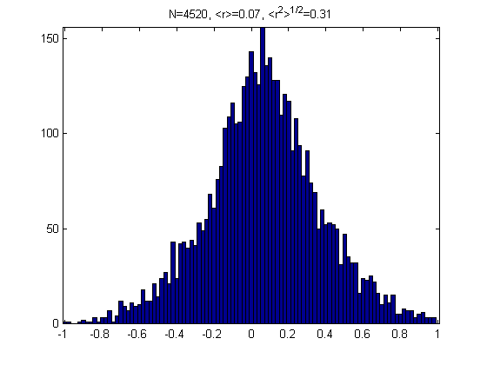
Regions for elevation differences
Elevation changes will be calculated for glaciologically significant regions

Slide 16
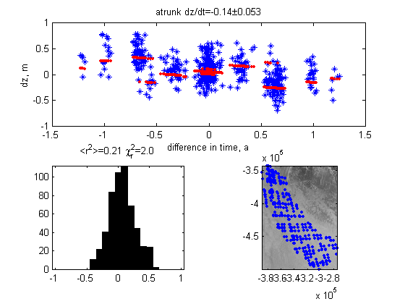
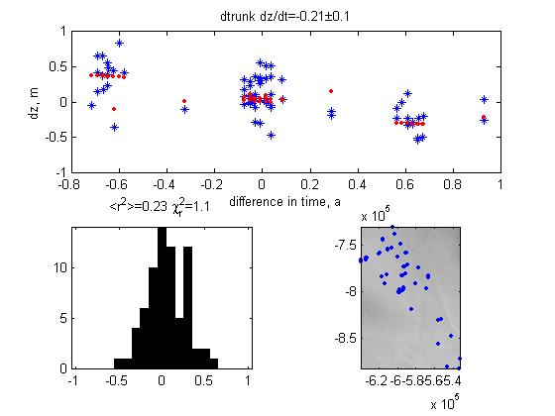
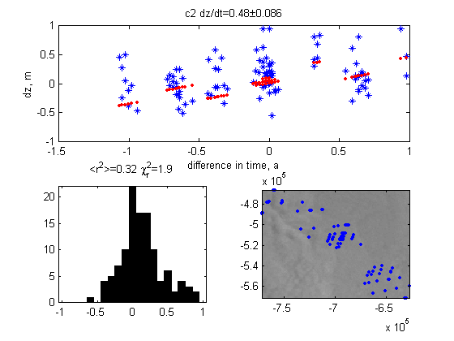
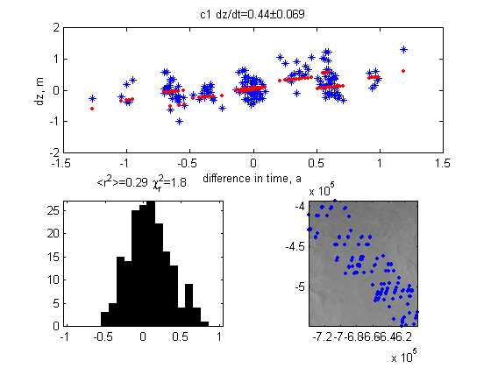
Elevation changes: results

Slide 17
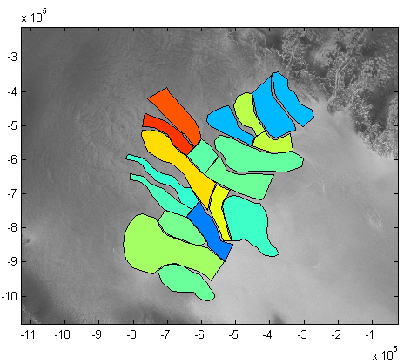
Trunk elevation changes
Location Rate (m/a)
Mercer Trunk -0.11 § 0.05
Whillans Trunk 0.20 § 0.07
Kamb trunk 0.10 § 0.08
Bind. trunk -0.18 § 0.10
Macayeal 0.13 § 0.07

Slide 18
Tributary elevation changes
Location Rate (m/a)
Whillans 1 0.18 § 0.06
Whillans 2 -0.12 § 0.06
Kamb junction 0.08 § 0.12
Kamb 1 0.46 § 0.07
Kamb 2 0.51 § 0.09
Bind. 1 -0.01 § 0.07
Bind. 2 0.05 § 0.08

Slide 19
Interstream ridge elevation changes
Location Rate (m/a)
Conway IR -0.13 § 0.05
Engelhardt IR 0.08 § 0.05
Siple Dome 0.03 § 0.06
Siple IS 0.24 § 0.13
Raymond IR 0.31 § 0.06
Shabtaie IR 0.11 § 0.11
Harrison IR 0.09 § 0.10

Slide 20
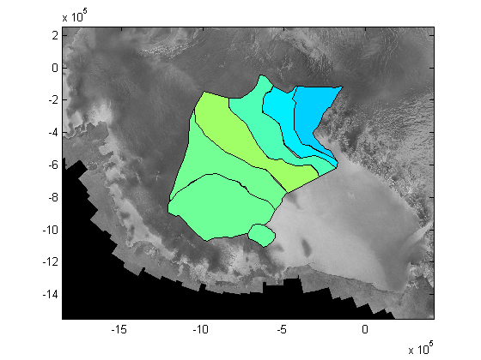
Aggregate elevation changes for catchments
Mercer -0.12 § 0.02
Whillans 1 -0.08 § 0.02
Whillans 2 0.03 § 0.02
Kamb 0.12 § 0.03
Bindschadler 0.07 § 0.04
Macayeal 0.06 § 0.04
Echelmeyer 0.06 § 0.10

Slide 21
Reliability test: Bootstrap tests
To estimate the sampling error on my dz/dt estimates, I
  Generate N synthetic data-sets X_{i} by resampling cross-overs with replacement. Require that we have the right number of cross-overs from each period.
  Recalculate dz/dt(X_{i}) from each re-sampled data-set.
  dz/dt(X_{i}) should have the same distribution as dz/dt would if the experiment were repeated.
Allows assessment of the whole dz/dt process.
May run into problems with covariance matrix estimates.

Slide 22
Bootstrap results
Bootstrap estimates of sampling errors are relatively large. For the significant rates of change:
Region Rate Estimate Bootstrap error
Mercer Trunk -0.11 § 0.05 0.36
Whillans Trunk 0.20 § 0.07 0.61
Whillans 1 0.18 § 0.06 0.54
Whillans 2 -0.12 § 0.06 0.54
Kamb 1 0.46 § 0.07 0.41
Kamb 2 0.51 § 0.09 0.34
Conway IR -0.13 § 0.05 0.34
Raymond IR 0.31 § 0.06 0.52
=> This means that the arbitrary nature of the sampling may have had a strong role in determining the elevation change seen!

Slide 23
Caveats
More data are on the way (New data take in October)
The choice of LaGrange multipliers is somewhat arbitrary- laser bias solution is not unique
Sampling of cross-overs is random- bootstrap shows that different samples would give different results
Some of the ridges appear to be changing at a decimeter/year level- perhaps indicates accumulation anomalies for 2003-04

Slide 24
Conclusions
There are signs of elevation change, particularly thickening in the Kamb tributaries
We can rule out elevation changes larger than 1 m/a (at the 2-σ level) for ice-stream-sized areas.

