Slide 1
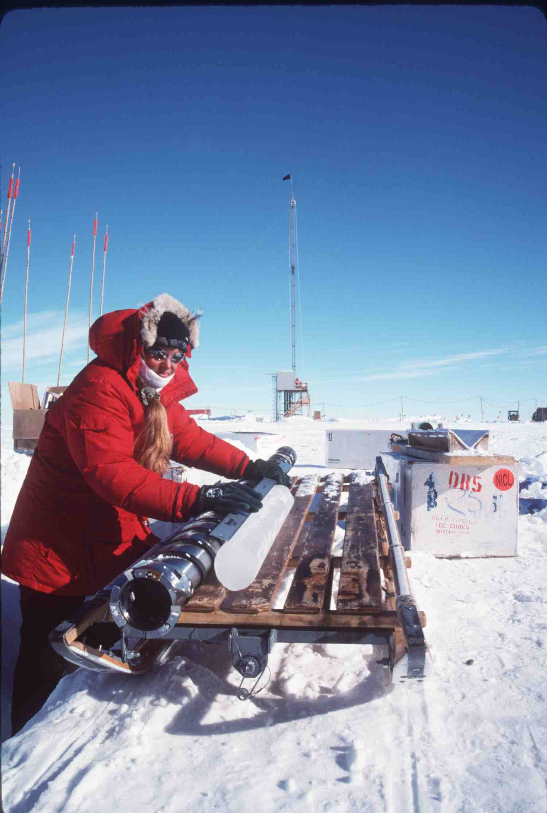
Does the Siple Dome Ice Core Provide Evidence of Abrupt Changes in Siple Coast Ice Dynamics?
Ken Taylor
Jim White
Jeff Severinghaus
Ed Brook
Paul Mayewski
Richard Alley
Eric Steig

Slide 2
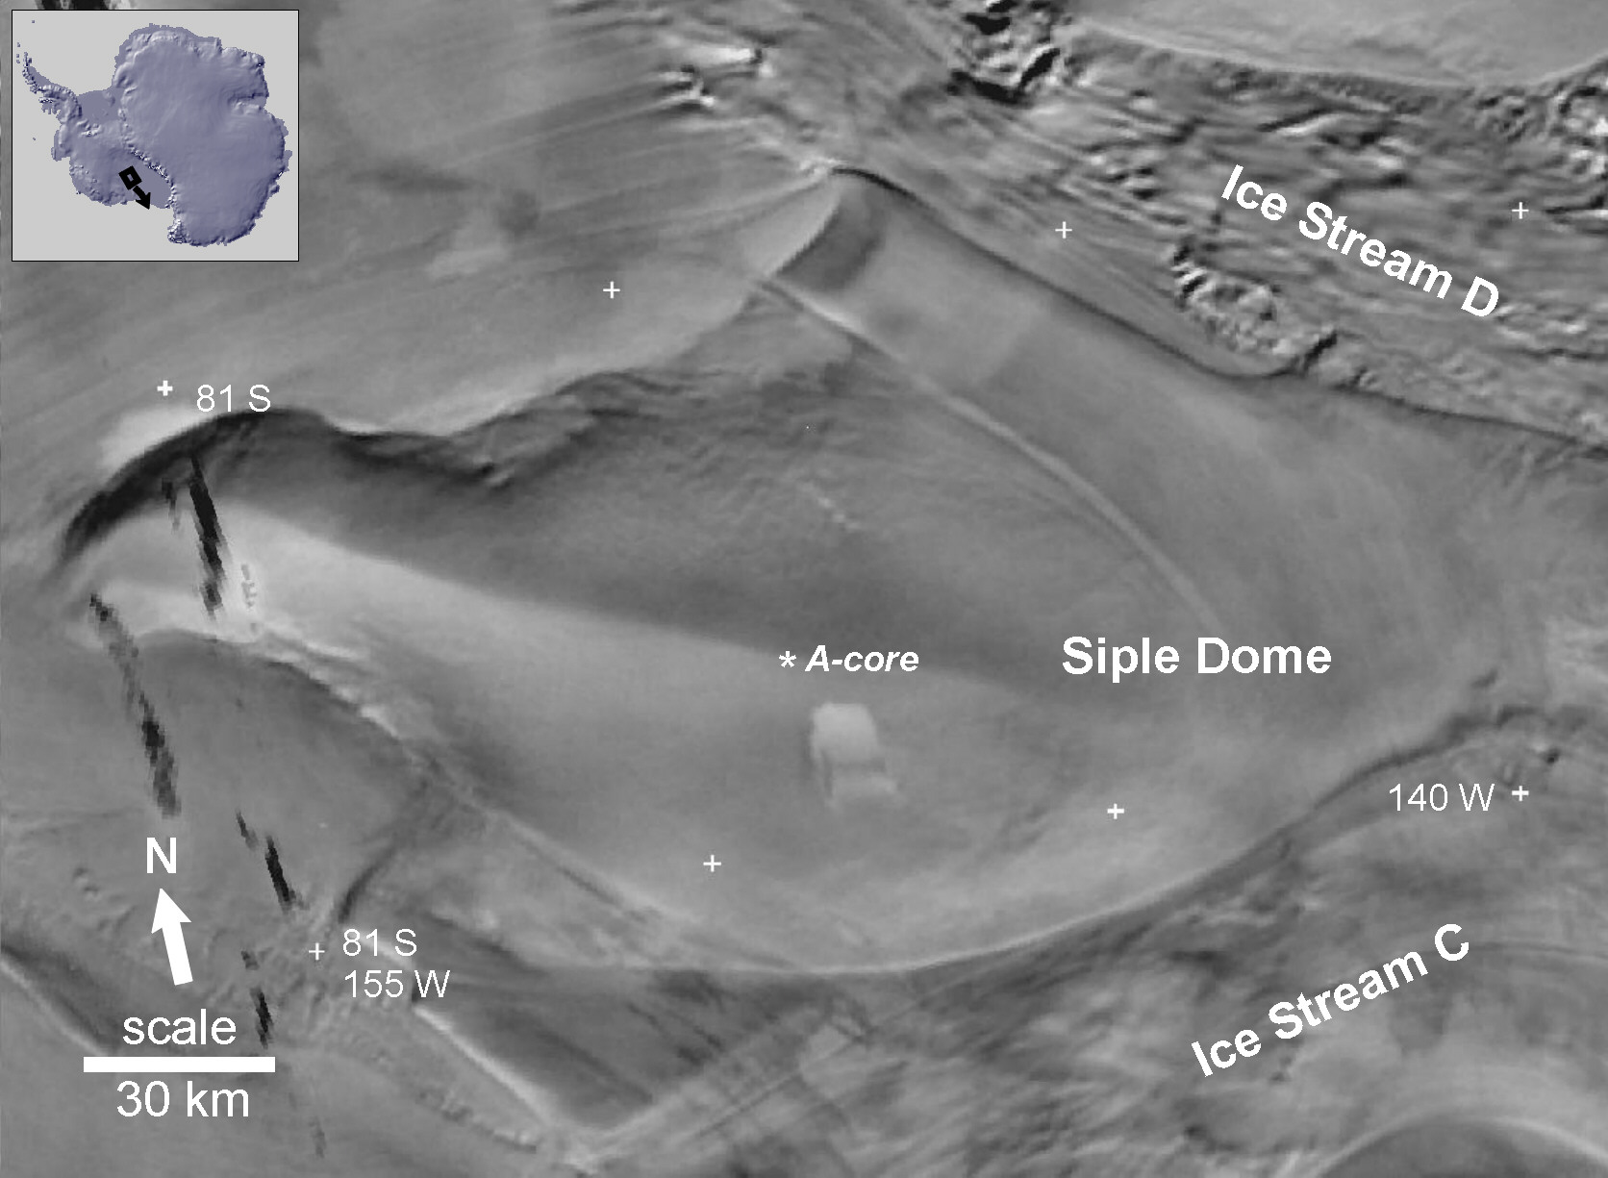
Ross Ice Shelf
Elevation: 621 m a.s.l. 81.654°S, 148.808°W
Hamilton, Annals of Glaciology, 35, 2002
Notes:
SDM is very unusually for a deep core because it is bounded by ice streams. This can affect air flow in ways that cannot occur at other deep core sites.

Slide 3
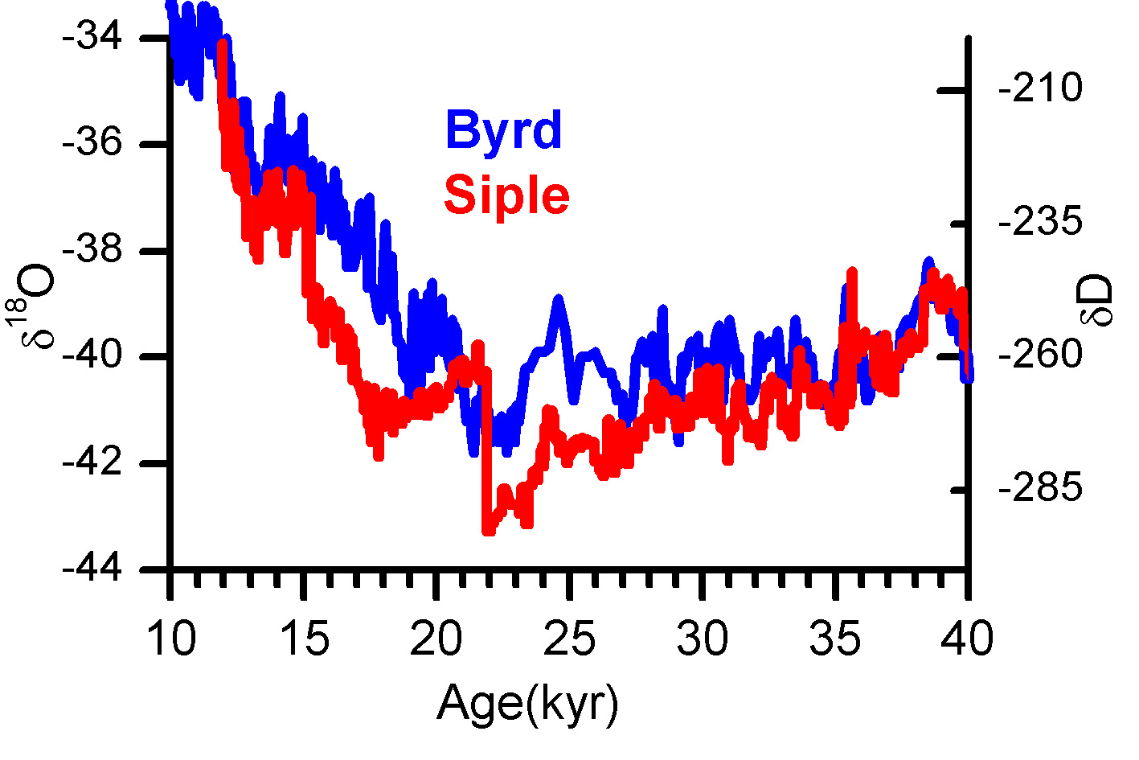
Local temperature
Byrd vs SDM
Warmer
Colder
White & Brook
Notes:
SDM shows abrupt changes that don’t show at Byrd.

Slide 4
Local Surface Temperature
Change of ~6º C in < 50 YR
Byrd vs SDM
Warmer
Colder
White & Brook
Notes:
SDM shows abrupt changes that don’t show at Byrd.

Slide 5
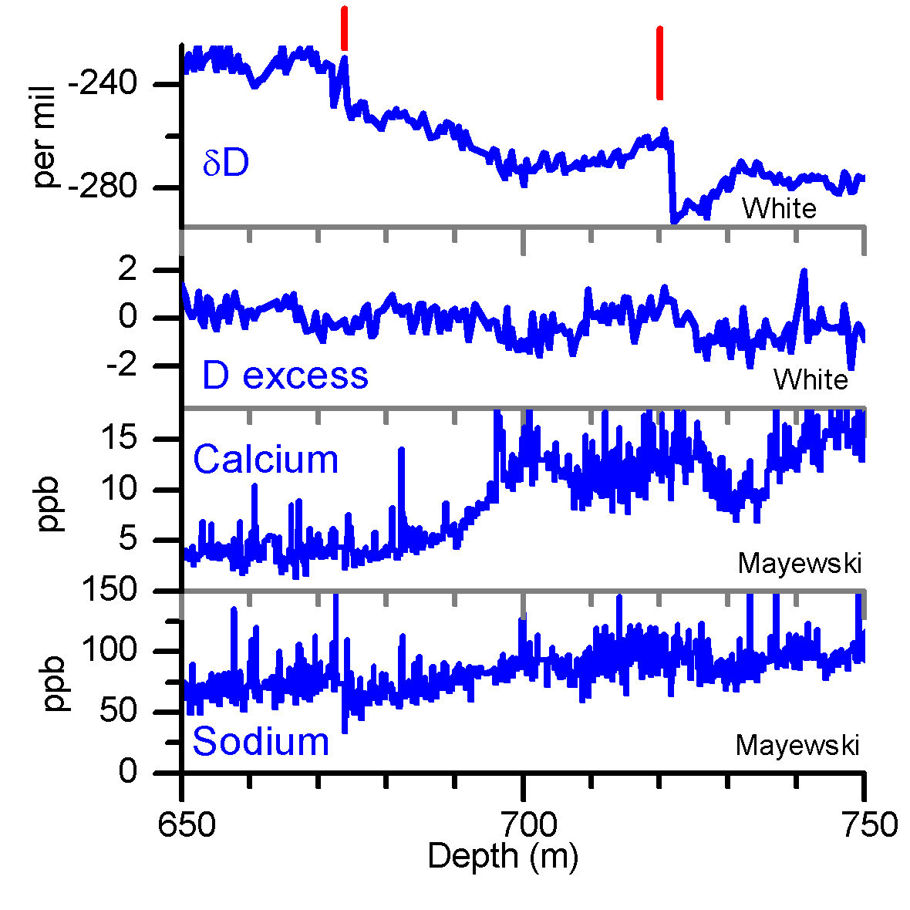
kkks
Local Temperature
Sea Surface Temperature
Dust and Sea Salt
Sea Salt
Gas records
Notes:
The changes in ice isotopes imply a large and abrupt local change, but the change does not show up in records indicative of a regional change.

Slide 6
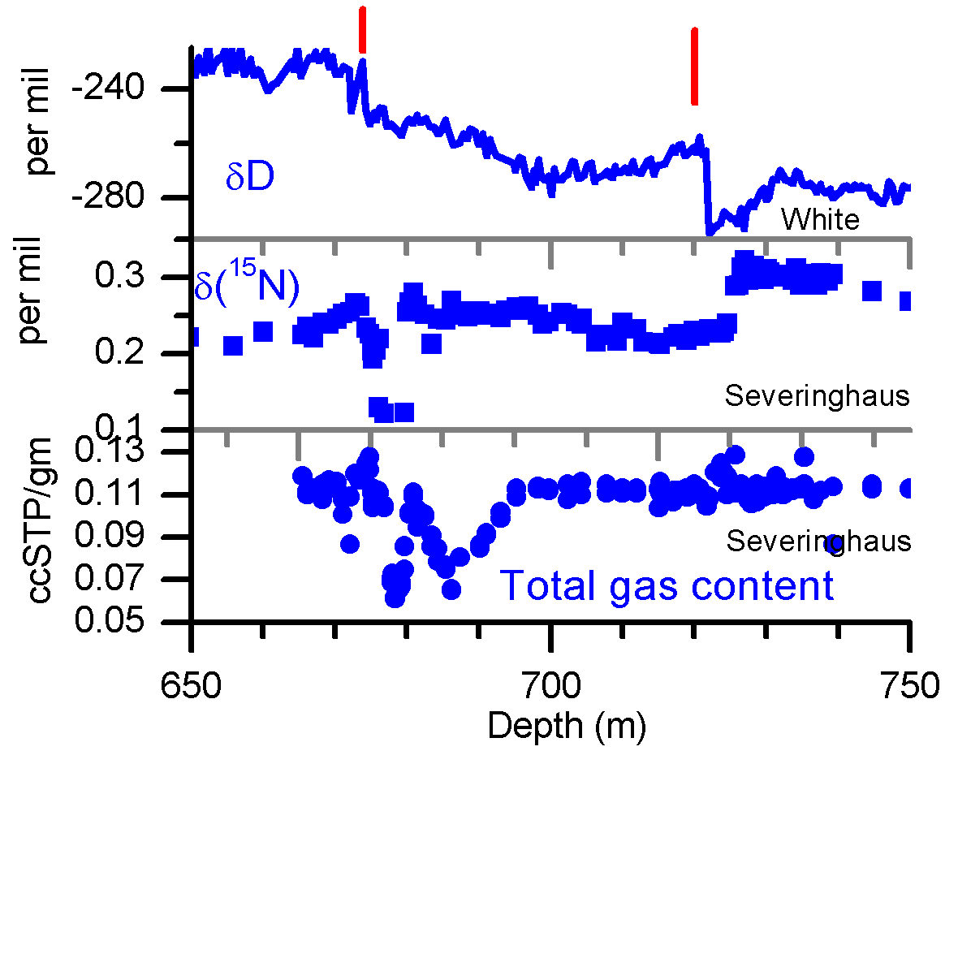
Gas records show:
22 kyr: firn thins from 60 m to 40 m,
surface temperature increase of ~ 6 C
15 kyr: no firn or heavily fractured firn
22 KYR
At 720 m firn thins.
15 KYR
At 675 m there is no fractionation in firn.
The fractionation of δ15N & δ40Ar is controlled by temperature gradient in firn and thickness of the firn.
Notes:
The firn was affected by these changes too, so accumulation rate changed as well as local temperature.

Slide 7
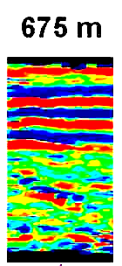
Vertical
Cross Section
15 ka B.P.
Acidity
High
Low
40 cm
Multitrack:
Taylor
Gas data:
Severinghaus
Taylor
Notes:
The multitrack ecm also shows odd stratigraphy at 15 kyr.

Slide 8
Vertical
Cross Section
15 ka B.P.
Acidity
High
Low
40 cm
Multitrack:
Taylor
Gas data:
Severinghaus
Taylor
Notes:
The multitrack ecm also shows odd stratigraphy at 15 kyr.

Slide 9
At 22 ka and 15 ka there are large, local, and abrupt temperature increases (~ 6º C change in < 50 years) and decreases in accumulation.
Warming and lower accumulation?
Big local climate changes that don’t show up in regional records?
The ice core data do not fit well with a conventional interpretation of regional climate change.

Slide 10
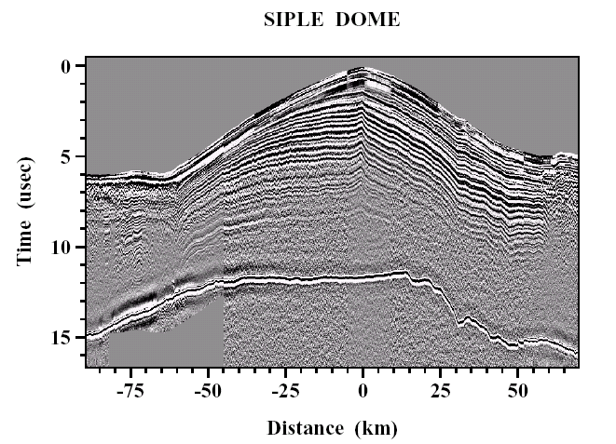
0 kyr
radar
0 -
-75 -50 -25 0 25 5
0
5
10
15
Distance (km)
Time (usec)
SIPLE DOME
250 -
Ice stream
500 -
750 -
1000 -
Bed at 620 m
Nereson et al. (1996)
Notes:
Cross section of SDM, note location of ice streams.

Slide 11
???
22 kyr
radar
0 -
Plateau air flow
Plateau air flow
-75 -50 -25 0 25 5
0
5
10
15
Distance (km)
Time (usec)
SIPLE DOME
250 -
ice stream
ice stream
500 -
750 -
1000 -
How do clouds, temperature, winds, & accumulation change on the top of SDM, when the ice stream elevation slowly increases?
Nereson et al. (1996)
Notes:
It the ice streams are thicker, as they were during cold periods, what does that do to air flow and the inversion layer on the summit of SDM?

Slide 12
???
21 kyr
radar
0 -
-75 -50 -25 0 25 5
0
5
10
15
Distance (km)
Time (usec)
SIPLE DOME
250 -
Plateauair flow
Plateau air flow
500 -
750 -
1000 -
How do clouds, temperature, winds, & accumulation change on the top of SDM, when the ice stream elevation ABRUPTLY DECREASES?
ed at 620
Nereson et al. (1996)
Notes:
Does an abrupt thinning of the ice streams, which is possible, abruptly change the local air flow over SDM, creating local changes that show up in the ice core record.
Such changes would not affect the ice core records that record conditions distant from SDM.

Slide 13
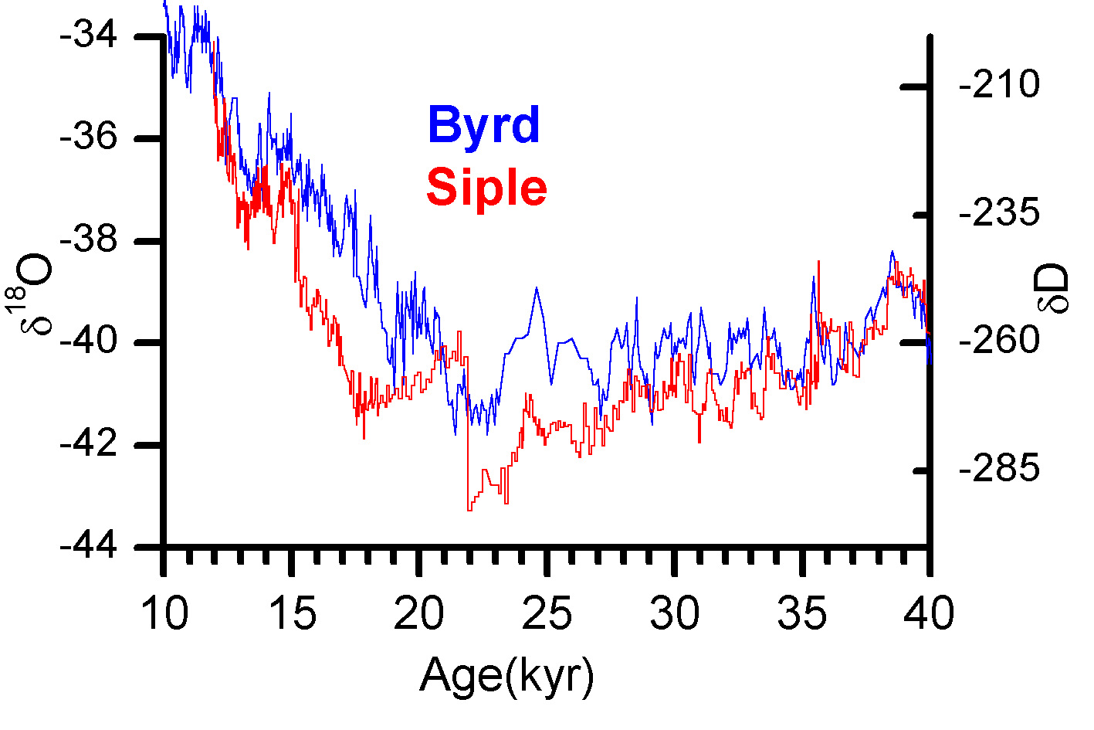
34-40 ka
Byrd vs SDM
Byrd
SDM
White & Brook
Notes:
This interpretation of the ice isotopes is based on the idea that changes in the surface elevation of the ice streams has a strong influence on temperature conditions at the summit of SDM.

Slide 14
22-34 ka
Byrd vs SDM
Ice streams thickening
Byrd
SDM
White & Brook
Notes:
This interpretation of the ice isotopes is based on the idea that changes in the surface elevation of the ice streams has a strong influence on temperature conditions at the summit of SDM.

Slide 15
22 ka
Byrd vs SDM
Ice streams thin abruptly
Ice streams thickening
Byrd
SDM
White & Brook
Notes:
This interpretation of the ice isotopes is based on the idea that changes in the surface elevation of the ice streams has a strong influence on temperature conditions at the summit of SDM.

Slide 16
18-22 ka
Ice streams thickening
Byrd vs SDM
Ice streams thin abruptly
Ice streams thickening
Byrd
SDM
White & Brook
Notes:
This interpretation of the ice isotopes is based on the idea that changes in the surface elevation of the ice streams has a strong influence on temperature conditions at the summit of SDM.

Slide 17
15-18 ka
Ice streams in steady state
Ice streams thickening
Byrd vs SDM
Ice streams thin abruptly
Ice streams thickening
Byrd
SDM
White & Brook
Notes:
This interpretation of the ice isotopes is based on the idea that changes in the surface elevation of the ice streams has a strong influence on temperature conditions at the summit of SDM.

Slide 18
Ice streams thin abruptly
15 ka
Ice streams in steady state
Ice streams thickening
Byrd vs SDM
Ice streams thin abruptly
Ice streams thickening
Byrd
SDM
White & Brook
Notes:
This interpretation of the ice isotopes is based on the idea that changes in the surface elevation of the ice streams has a strong influence on temperature conditions at the summit of SDM.

Slide 19
Ice streams thin abruptly
Byrd vs SDM
Ice streams thin abruptly
Byrd
SDM
White & Brook
Notes:
This interpretation of the ice isotopes is based on the idea that changes in the surface elevation of the ice streams has a strong influence on temperature conditions at the summit of SDM.

Slide 20
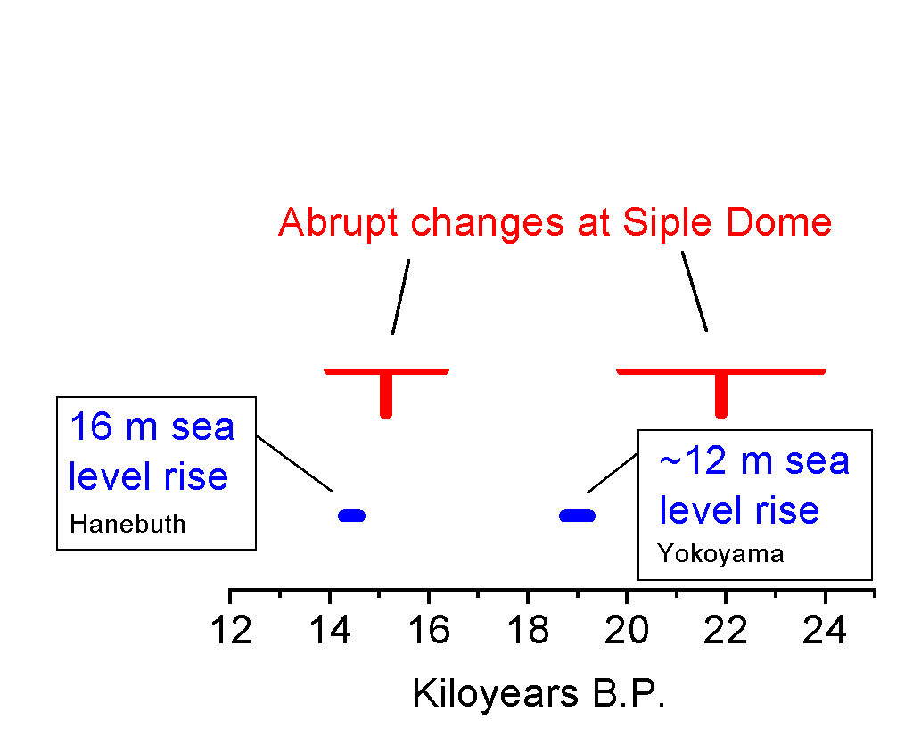
Sea level rise
Are the abrupt changes in the SDM record due to rapid thinning of ice streams that occurred during times of rapid increases in sea level?

Slide 21
If ice stream dynamics, not climate, is the root cause of the abrupt changes at SDM
During the deglacial, ice discharge along the Siple Coast changed abruptly on at least two occasions, the magnitude and abruptness of these changes is much larger than previously considered likely.
2) The increase in ice discharge may be associated with large and abrupt increases in sea level.
Need to test with ice flow and atmospheric models.

Slide 23
radar
0 -
-75 -50 -25 0 25 5
0
5
10
15
Distance (km)
Time (usec)
SIPLE DOME
250 -
500 -
680 m
750 -
15 kyr
1000 -
ed at 620
Nereson et al. (1996)

