Slide 1
Modeling glacial stagnation vs. glacial retreat
WAIS 2004
David Vacco
Richard Alley
David Pollard
Todd Dupont
Byron Parizek
Department of Geosciences
Pennsylvania State University
State College, PA 16802

Slide 2
Goals
Define the problem
Present results to date
Future work

Slide 3
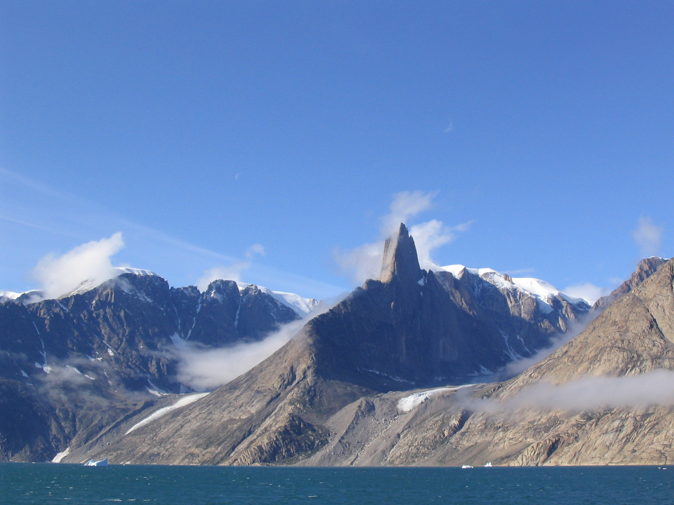

Slide 4
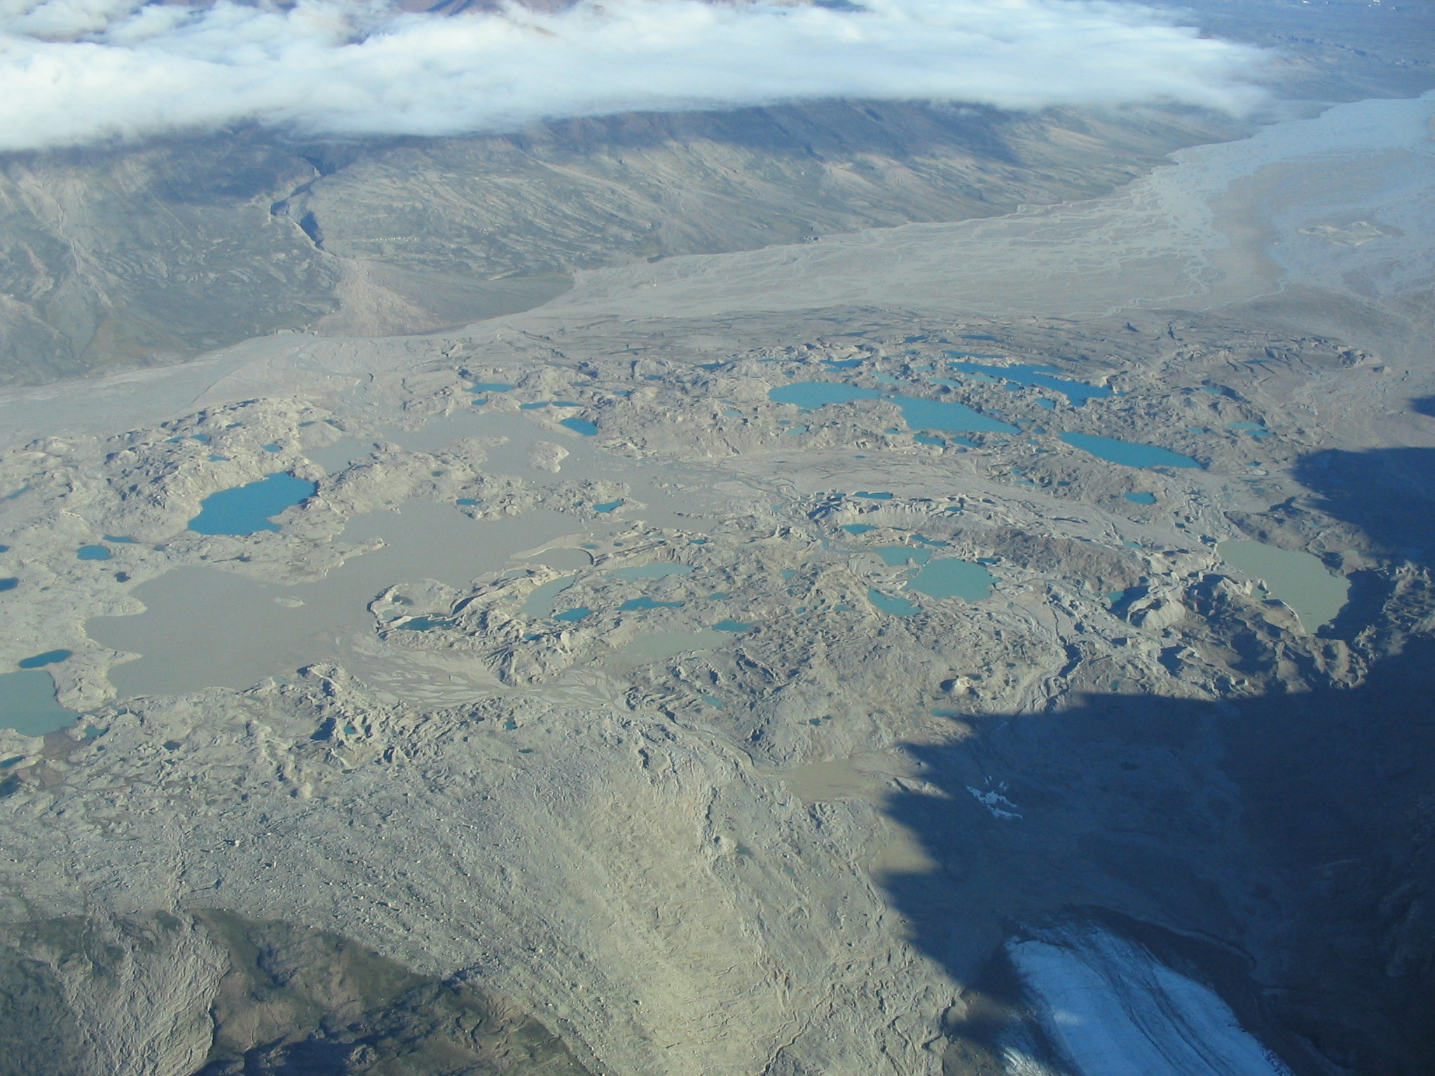

Slide 5
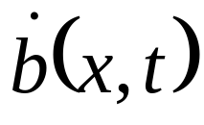
Glaciers typically lose mass by retreating
Ice flow
Rising ELA over time
A(t,x)

Slide 6
Approach: Small hypotheses
Small, Eric E., 1995, Hypsometric forcing
Of stagnant ice margins: Pleistocene valley
Glaciers, San Juan Mountains, Colorado.
Geomorphology 14, p. 109-121.
Stagnation occurs when melt-back does not
Keep up with rapid thinning
Valley hypsometry is the dominant control
on the mass loss mechanism

Slide 7
Stagnation scenario: topographic control (Small, 1995)

Slide 8
Stagnation Scenario: hypsometric control (Small, 1995)
Raise in ELA

Slide 9
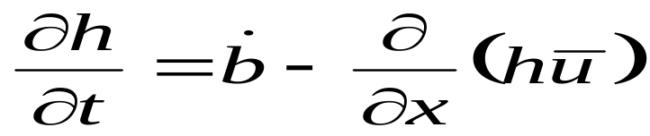
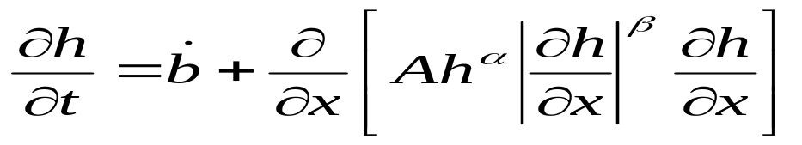
First modeling efforts
Mass conservation
Find steady state profiles for sinusoidal beds
Induce a warming

Slide 10
Example profile
1000
Height, m
Shift the bed
0
0
10
20
Distance, km

Slide 11
Steady state Terminus behavior
The terminus likes
to hang out here
X
X
X
X
X
X
X
X
Mean slope
Doesn’t like to
hang out here

Slide 12
Stagnation vs. retreat
60
50
STAGNATES
40
Bed amplitude, m
30
RETREATS
20
10
2000
3000
4000
5000
6000
Bed wavelength, m

Slide 13
Stagnation vs. retreat
60
STAGNATES
50
40
Bed amplitude, m
30
RETREATS
20
10
2000
3000
4000
5000
6000
Bed wavelength, m

Slide 14
Future work
2-d and 3-d models
Add longitudinal stresses
Subglacial water
Dynamic beds (FEM)
Analytical modeling using perturbation methods, etc…

Slide 15
Questions, comments?

