Slide 1
A WAIS Analog Found on Mars Polar Cap
Weili Wang¹, Jun Li¹ and Jay Zwally²
1. Raytheon ITSS, NASA/GSFC, Code 971, Greenbelt, MD 20771, USA.
2. Ocean and Ice Branch, NASA/GSFC, Code 971, Greenbelt, MD 20771, USA.

Slide 2
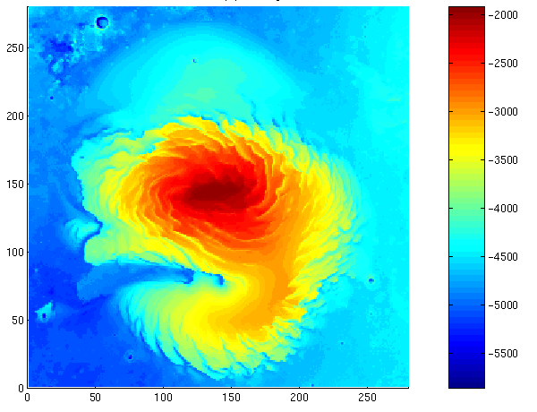
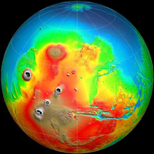
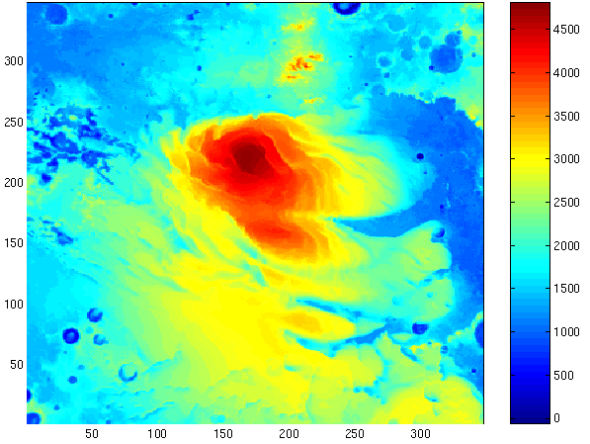
X 5 km
North Polar Cap
(Surface topography)
Mars
Meter
X 5 km
(Maximum thickness: ~ 3000 m at the dome)
X 5 km
South Polar Cap
(Surface topography)
X 5 km
Meter

Slide 3
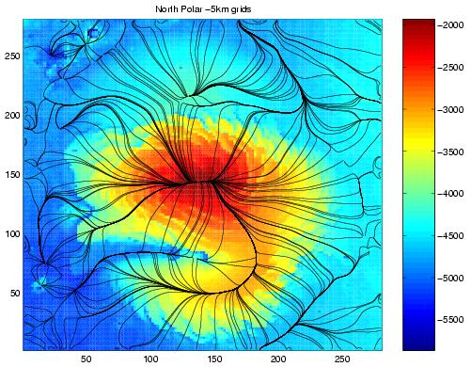
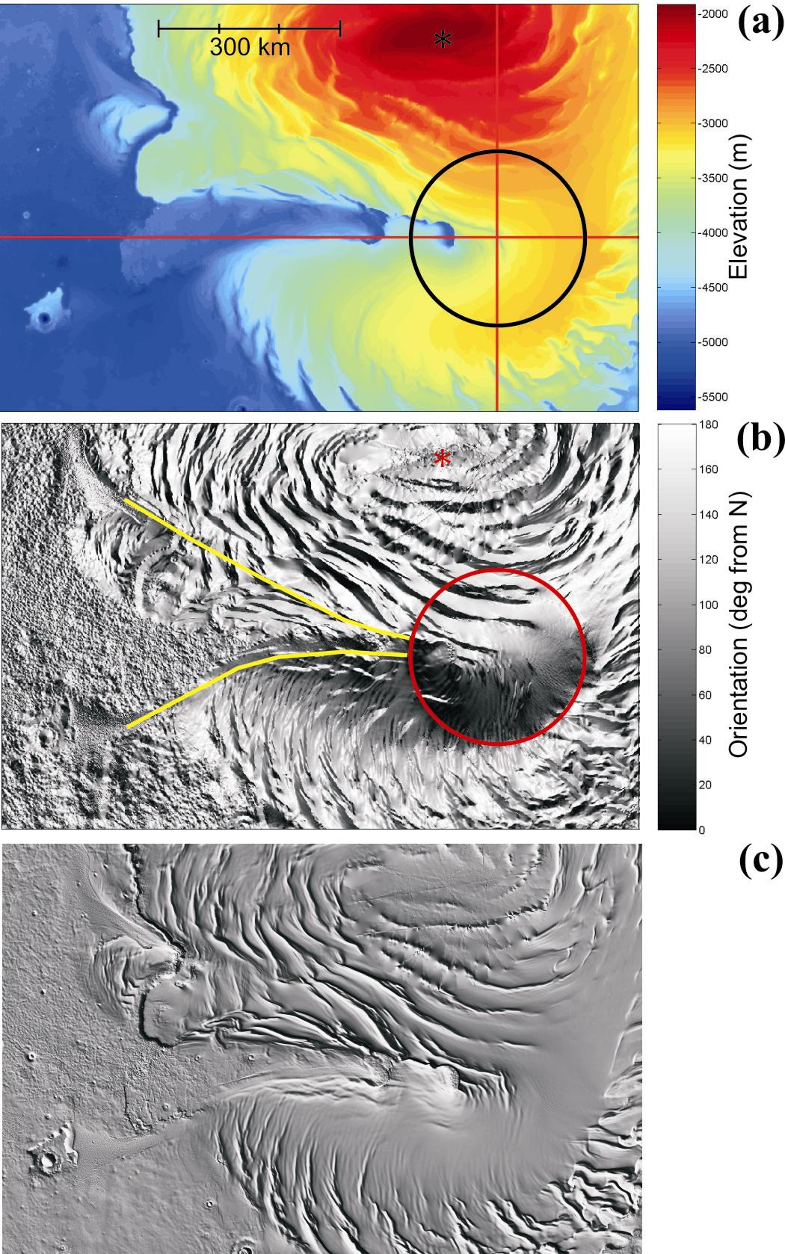
North Polar Cap on Mars
Surface topography and flowlines
Distance ( x5 km)
Chasma Boreale
(meter)
Distance (x5 km)

Slide 4
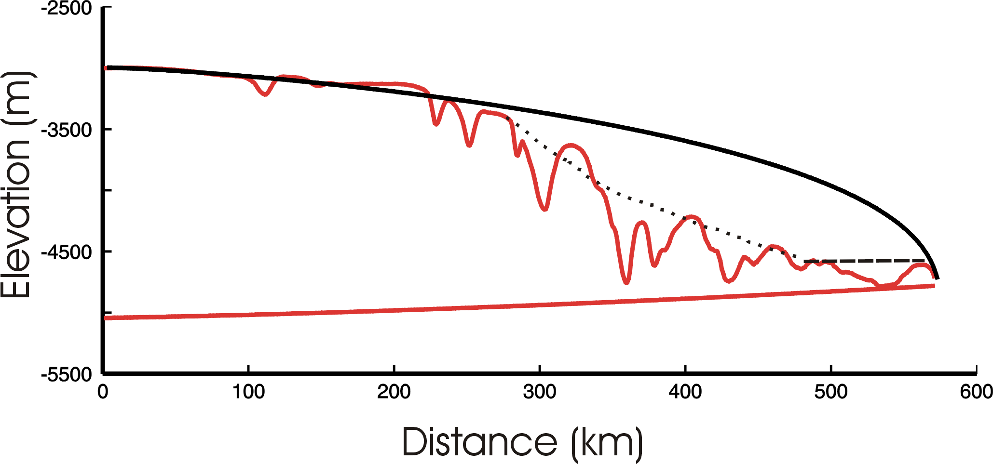
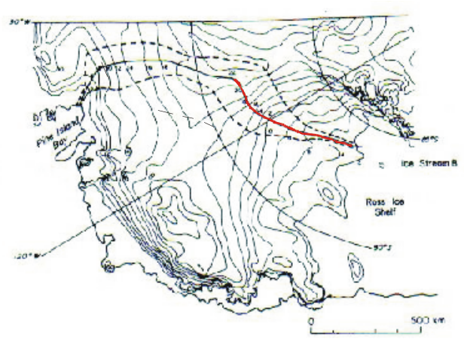
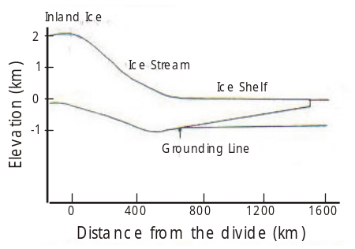
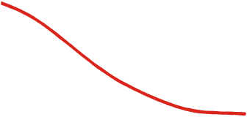
Mars Polar Cap
A
B
Inland Ice
Theoretical (Vialov type)
ice-sheet profile
B
A
Ice Stream
Ice Shelf
Chasma Boreale
Grounding Line
300 km
WAIS

Slide 5
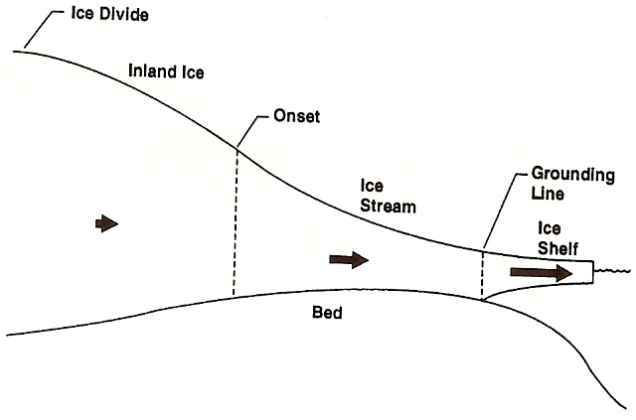
Ice-Stream Onset
(After Bindschadler et al, 2001,
The West Antarctic ice sheet )
The location of the transition between inland ice flow (corresponding to a convex-up shape profile) and ice-streaming flow (corresponding to a concave-up shape profile ).

Slide 6
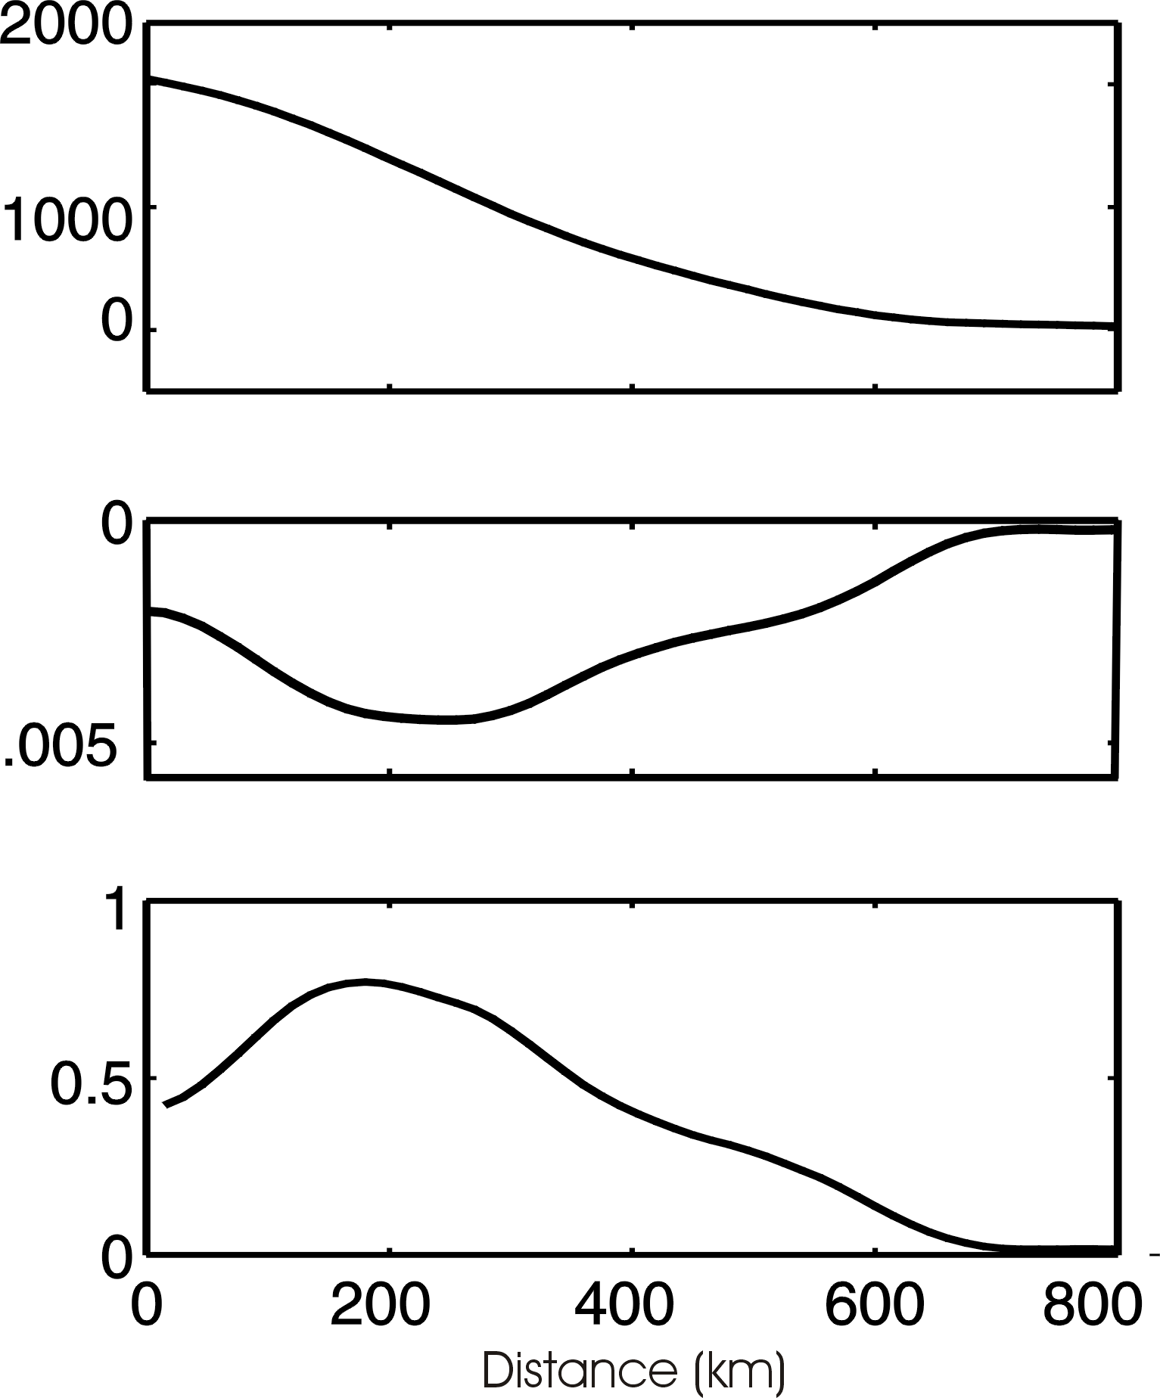
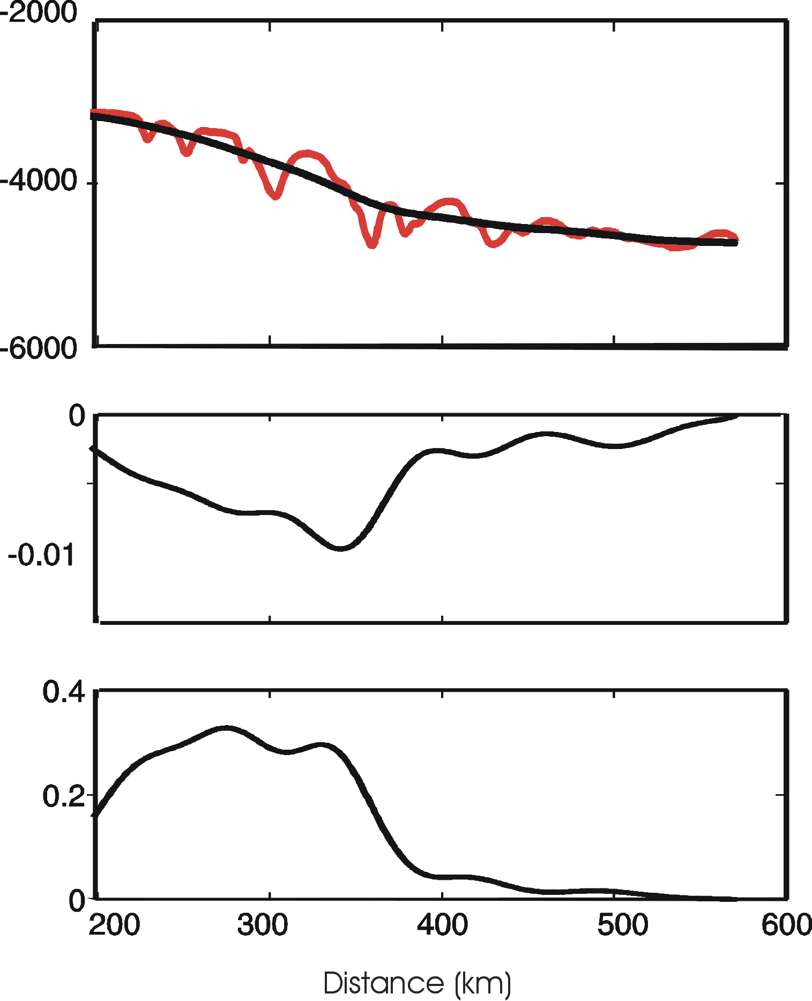
WAIS
Mars Polar Cap
Surface elevation (m)
Surface elevation (m)
Onset
Onset
Surface slope
Surface slope
Driving stress (bar)
Driving stress (bar)

Slide 7
Ice-Sheet Modelling
A flowline model is applied to examine the basal/surface conditions required for maintaining this ice-stream type surface profile.
Model Run I (warm bed)
Model Run II (cold bed)
Inputs:
Inputs:
Flowline geometry
Surface mass balance
Basal temperature
(at pressure melting point)
Basal geothermal heat flux
Flowline geometry
Surface temperature
Basal geothermal heat flux
Outputs:
Outputs:
Distribution of temperature
Distribution of velocity
Distribution of temperature
Distribution of velocity
Surface mass balance

Slide 8

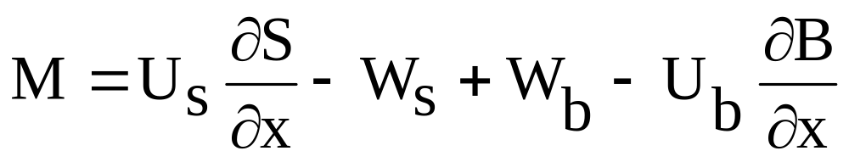
Ice-Sheet Modelling
Continuity Equation
:
{
{
Emergence Velocity
Basal Melting Rate
Surface mass balance (accumulation rate + ablation/sublimation rate)

Slide 9
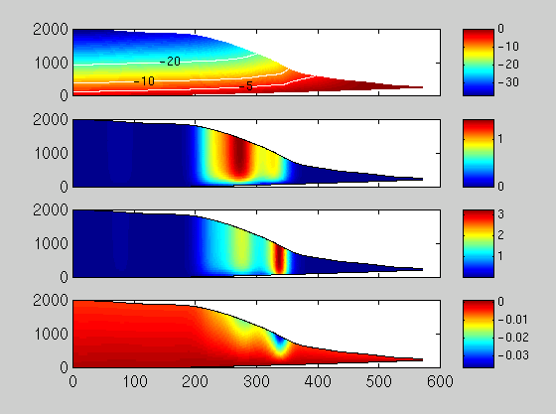
Model Run I (warm bed)
Temperature
(m)
ºc
Dynamic Velocity
(m)
(Glen’s flow law)
m/a
Horizontal Velocity
(m)
m/a
Vertical Velocity
(m)
m/a
Distance (km)

Slide 10
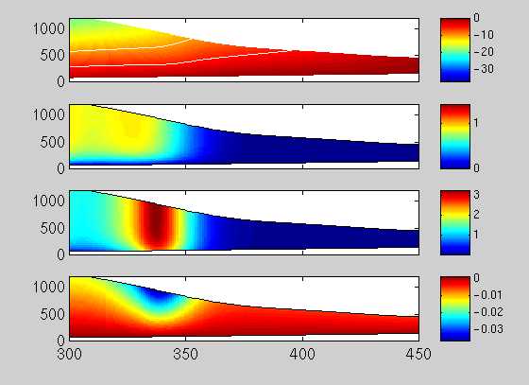
Model Run I (warm bed)
Onset
Temperature
(m)
-10
-5
ºc
Dynamic Velocity
(Glen’s flow law)
(m)
m/a
Horizontal Velocity
(m)
m/a
Vertical Velocity
(m)
m/a
Distance (km)

Slide 11
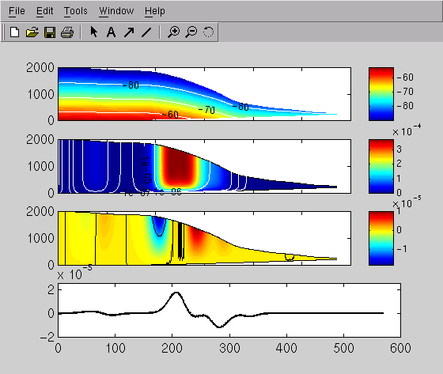
Model Run II (cold bed)
Temperature
(m)
ºc
Horizontal Velocity
(m)
m/a
Vertical Velocity
(m)
m/a
Surface mass balance
(m/a)
Distance (km)

Slide 12
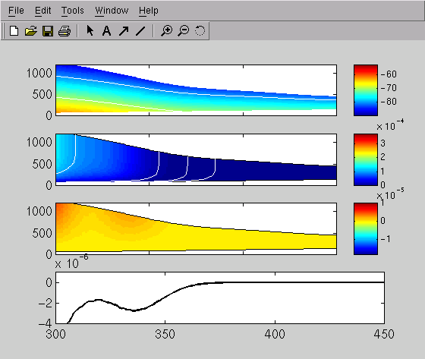
Model Run II (cold bed)
Temperature
-80
(m)
-70
ºc
Horizontal Velocity
(m)
m/a
Vertical Velocity
(m)
m/a
(m/a)
Surface Mass Balance
Distance (km)

Slide 13
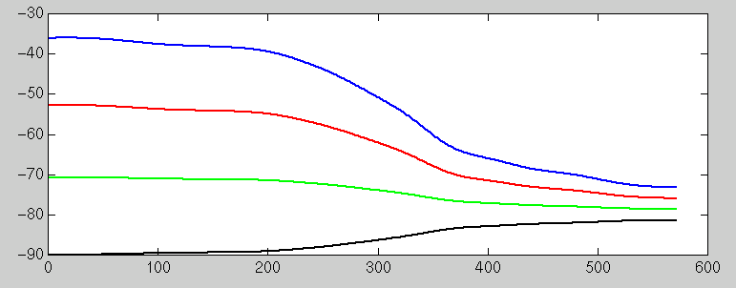
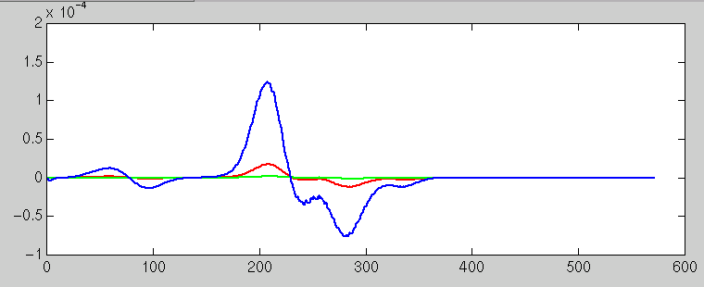
Model Run II (cold bed)
Basal Temperature
Γ= 0.02 ^{ο}C/m
(ºC)
Γ=0.03 ^{ο}C/m
Γ= 0.01 ^{ο}C/m
Surface Temperature
Blue: x 10⁻⁴
Surface Mass Balance
Red: x 10⁻⁵
Green: x 10⁻⁶
(m/a)
Distance (km)

Slide 14
Summary:
  The surface topography determined by MOLA data shows an ice-stream type profile through the head of Chasma Boreale.
  “Onset” (the location of the transition between inland ice flow and ice-stream flow) is clearly detected.
  Modelling study indicates that basal melting may have been experienced over the bed of Chasma Boreale at various times in Mars’ history.

