Slide 1
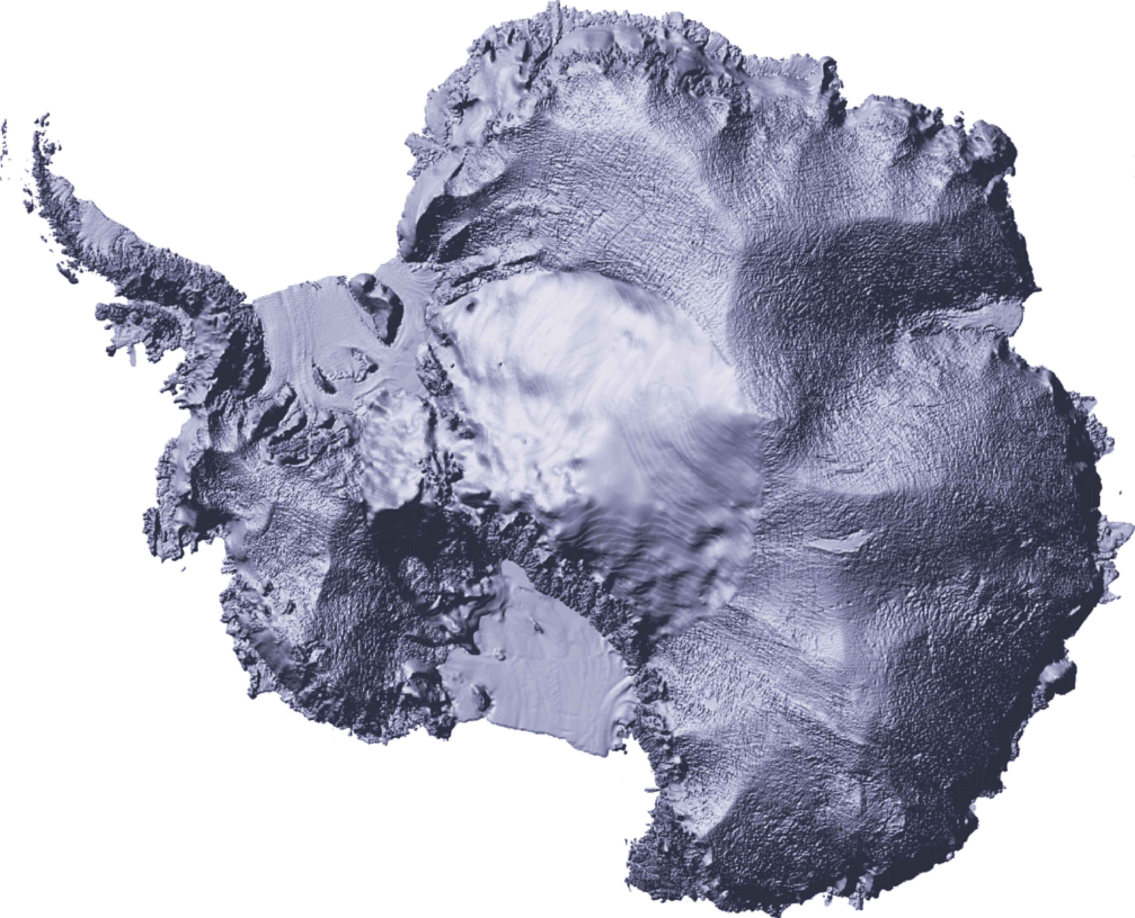
Comparing velocity profiles of Byrd glacier with a simple 2D flow model
Coen.M. Hofstede
Department of Earth Sciences
Climate Change Institute
Fig. 1. Location of Byrd Glacier (red square) at Antarctica. The
enlargement shows the area of interest.
26km
Y1 Y2 Y3 Y4 Y5 Y6 Y7 Y8 Y9 Y10
Abstract
Velocity profiles of Byrd glacier show a transition from a parabolic transverse profile upstream to a plug flow transverse velocity profile. A big change in this velocity profile is observed at the grounding line of Byrd glacier. An explanation for this transition is that the uncoupling of ice from bed and sidewalls is causing the plug flow like behavior. A simple 2D flow model is used to simulate the surface velocity field. The model geometry consists of two parallel plates, representing a simplified top view of Byrd glacier, through which a Non Newtonian fluid flows. The transverse velocity profiles show a similar trend as the field data; a transition from a parabolic transverse profile upstream to a plug flow transverse velocity profile. Interestingly enough the transition is taking place as a result of the parallel plates ending, immediately affecting the transverse velocity profiles between the parallel plates. This provides a new insight in the transverse velocity profiles of Byrd glacier; their plug flow like transition is, at least partly, caused by the ending fjord walls or the entering of the ice stream in the Ross Ice Shelf. The ending fjord walls of Byrd glacier affect the transverse velocity profiles between the walls in the same way as the ending plates in the simple model affect the transverse velocity profiles. Uncoupling of the ice itself may be a result from the ending fjord walls.
no-slip boundary, 70km
Fig. 2. Top view of model showing the locations of the cross sections of the velocity profiles. The most significant profiles are shown in figure 3.
The geometry is a simplified version of the Byrd Glacier.
Introduction
Byrd glacier outlet streams through a trench for the last 70km(fig. 5). In 1979, ice surface velocities were collected in the trench (Brecher 1982). The measured ice velocities show a cross line profile at the entrance of the trench that corresponds to a Non Newtonian flow profile (fig. 4). As the ice flows further downstream, the cross line velocity profile becomes more plug flow like. At the outlet of the trench, the cross line profile is almost rectangular shaped. This changing into plug flow of the velocity profile is thought to be caused by uncoupling of the ice from the bedrock and sidewalls. The uncoupling is probably taking place between cross section W4 to W6 in the trench and indeed that is where the velocity profiles become more ‘plug’ shaped.
A simple 2D finite element model is used to simulate the ice surface velocity profile (fig. 2). The geometry is a simplified situation of Byrd glacier in which the material enters at constant velocity, then streams through two no-slip boundaries representing the fjord walls. As the material moves further downstream, the non-slip boundaries change into two slip boundaries simulating the ice shelf into which Byrd drains. Indeed the modeled cross line profiles show a lot of similarity with the cross line profiles in the field. The model is a steady state 2D situation; it represents the surface velocity of the ice and thus has no depth. The effect of the bedrock friction is ignored. The model can be interpreted as ice uncoupled from the bed or the ice in the trench being deep enough not to be affected by friction on the bed. The last option is unlikely as the friction from the sidewalls affects the ice velocity several kilometers cross line. This is probably also true in the vertical direction so this model represents a frictionless bed.
Fig. 3. Most significant velocity profiles of the 2D model. Cross section Y2 to Y6 have almost the same profile. Y7 and Y8 are caused by transition to
no slip boundary profiles. Compare these profiles with the field data profiles in figure 4.
The model
A simplified geometry for Byrd Glacier was adopted, a rectangular top view with a cross line distance of 26 km. The no slip boundaries on the sides representing the fjord walls have a distance of 70 km. An inflow velocity along the inlet of 800m/yr is defined. The outflow boundary is defined as normal flow or the pressure is 0 Pa. The model was created using FEMLAB 3.1i, a finite element software package. The flow dynamics is described by the Navier Stokes equations:
ρ∂u/∂t - .[η( u+( u)^{T})] + ρ(u . )u +  p = F
. u = 0
in which:
ρ :density of ice
η :dynamic viscosity
u :velocity field
p :pressure
F :volume force field
To simulate non Newtonian flow, a special condition for the dynamic viscosity is used:
η = B/2*(0.5*(ux² + vy²) + (uy²+vx²))^{1/2})^{(1-n)/n}
in which:
B : ice hardness
ux :x derivative of x velocity
vy :y derivative of y velocity
n :power law exponent set to 3
The flow is modeled as steady state and the conditions are isothermal.
Fig. 4. Velocity profiles W1 to W10 from the measured ice surface velocities (Brecher 1982) of Byrd Glacier. The location of the profiles on Byrd Glacier is shown on figure 5 below.
The shape and trend of the profiles matches those of the modeled profiles in figure 3.
Discussion of results
The shape of the modeled graphs shows good resemblance with the field data. In the field data, I chose 10 cross sections at regular intervals, numbered W1 to W10 where I look at the velocity profile. In the model I chose regular 11 km intervals up to y=70km. To focus on the transition to plug flow I than looked at 5km intervals up to y = 100km. The square like profiles could only be obtained by making the flow Non Newtonian or by adding the condition for the viscosity.
W1 to W3
At the entrance, the modeled cross line profile and field data profile are similar in shape. The profiles W2 and W3 are similar except that the velocity increases. The surface velocity profiles are affected by the 3D effect whereas the 2D model does not take this into considerations.
W4 to W6
From W4 to W6 the profiles are becoming squarer, especially at the north side. The south side of W5 flattens out as a result of an inlet glacier. W6 has the best resemblance with the modeled profile at the last part of the no slip boundary. The sidewalls are still coupled here but the effect of uncoupling further downstream is seen by the more square profile.
W7 and W8
At W7 and W8 the profile starts flattening out on the south boundary as a result of the widening of the fjord wall. The model profiles do not show this gradual transition to a no slip condition. The boundaries do not widen and the change from slip to no slip is abrupt.
W9 and W10
The south side of the profiles is now similar to the no slip boundary in the model. The north side still is similar to the no slip boundary of the model. The model does not reproduce the steepness of the north side of profile W10. Only if I let the viscosity decrease along a 1km wide boundary, is the steep gradient reproduced. The steep velocity gradient may be caused by:
    - The viscosity may have changed due to heat produced by shear strain. This seems unlikely as most shearing takes place in the fjord.
    - The north side of the fjord ends abruptly and not gradually as the south side. As a result the fast streaming ice from Byrd is entering slower streaming ice of the shelf on the north side, giving a high velocity gradient over a small distance.
Looking at field velocity profiles of the field data alone does suggest the uncoupling is causing a plug flow. Simulating ice flow of single temperature through two no slip boundaries (fjord walls) shows that the changing boundary from no slip to slip causes a plug flow profile very much like that observed in the field data.
The plug flow profile is only seen if the flow in non Newtonian. Newtonian flow gives parabolic velocity profiles
In the field data, the velocities increase toward the ice shelf, then decrease. The flowing front broadens as well. This would suggest the trench becoming shallower up to the grounding line and therefore the ice thickness more shallow. Another reason could be influx from the sides. There are some smaller inlet glaciers in the fjord that could be causing the increase in velocity but their effect seems negligible
Fig. 5. Surface velocity contours of Byrd Glacier. Contour interval is 20 meters per year. Also shown are the cross sections along which
the velocity profiles, W1 to W10, of figure 4 are taken (Brecher 1982).
Conclusions
The velocity profiles before uncoupling from the sidewalls, change due to the changing boundary conditions, not to the uncoupling.
The square shape of the profiles of the field data shows the flow is Non Newtonian
The 2D approach is close in that is reproduces the trend of the velocity profiles. The model reproduces the transition from the more parabolic to the squarer profiles very well. A limitation is that the model does not reproduce the general increase in velocity as the material flows downstream. That would require a 3D model.
The effect of temperature is ignored in the model. This will affect the ice hardness and thus the viscosity.
The north side of the fjord ends and as a result the fast streaming ice from Byrd is entering slower streaming ice of the shelf on the north side, giving a high velocity gradient over a small distance.
References
Brecher, H.H. 1982. Photographic determination of surface velocities and elevations on Byrd Glacier. Antarctic Journal of the United States, 17(5),79-81

