Slide 1
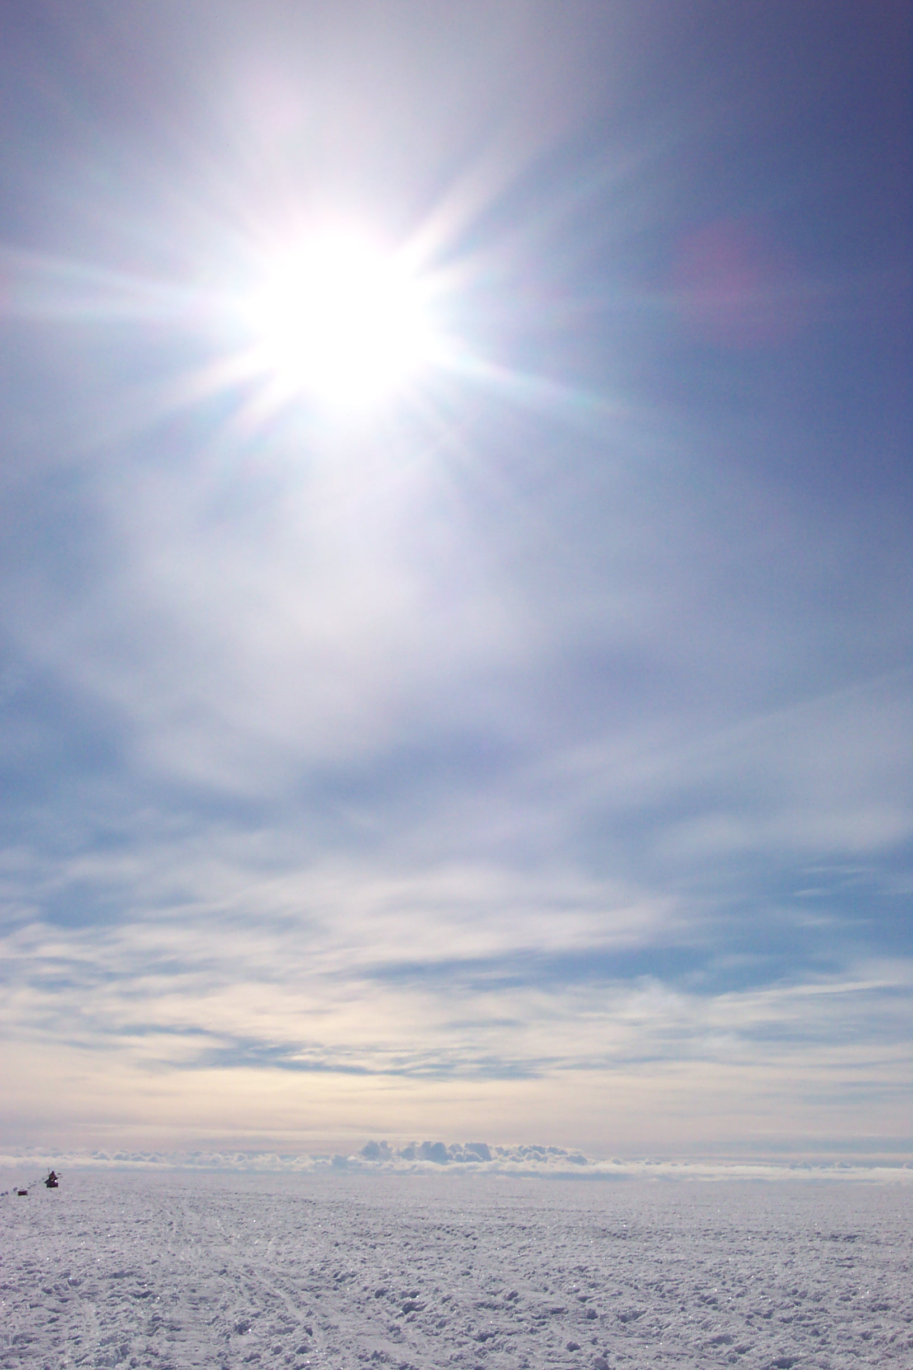

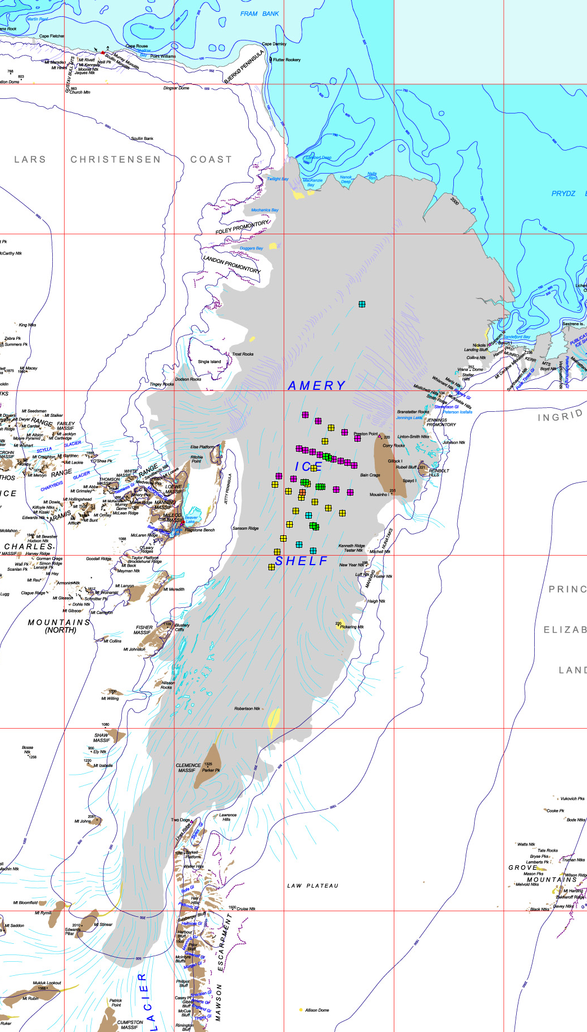
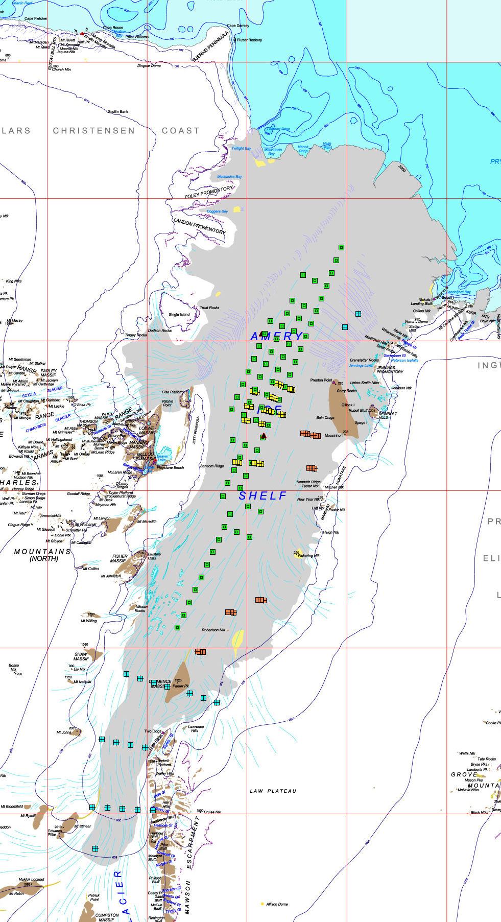
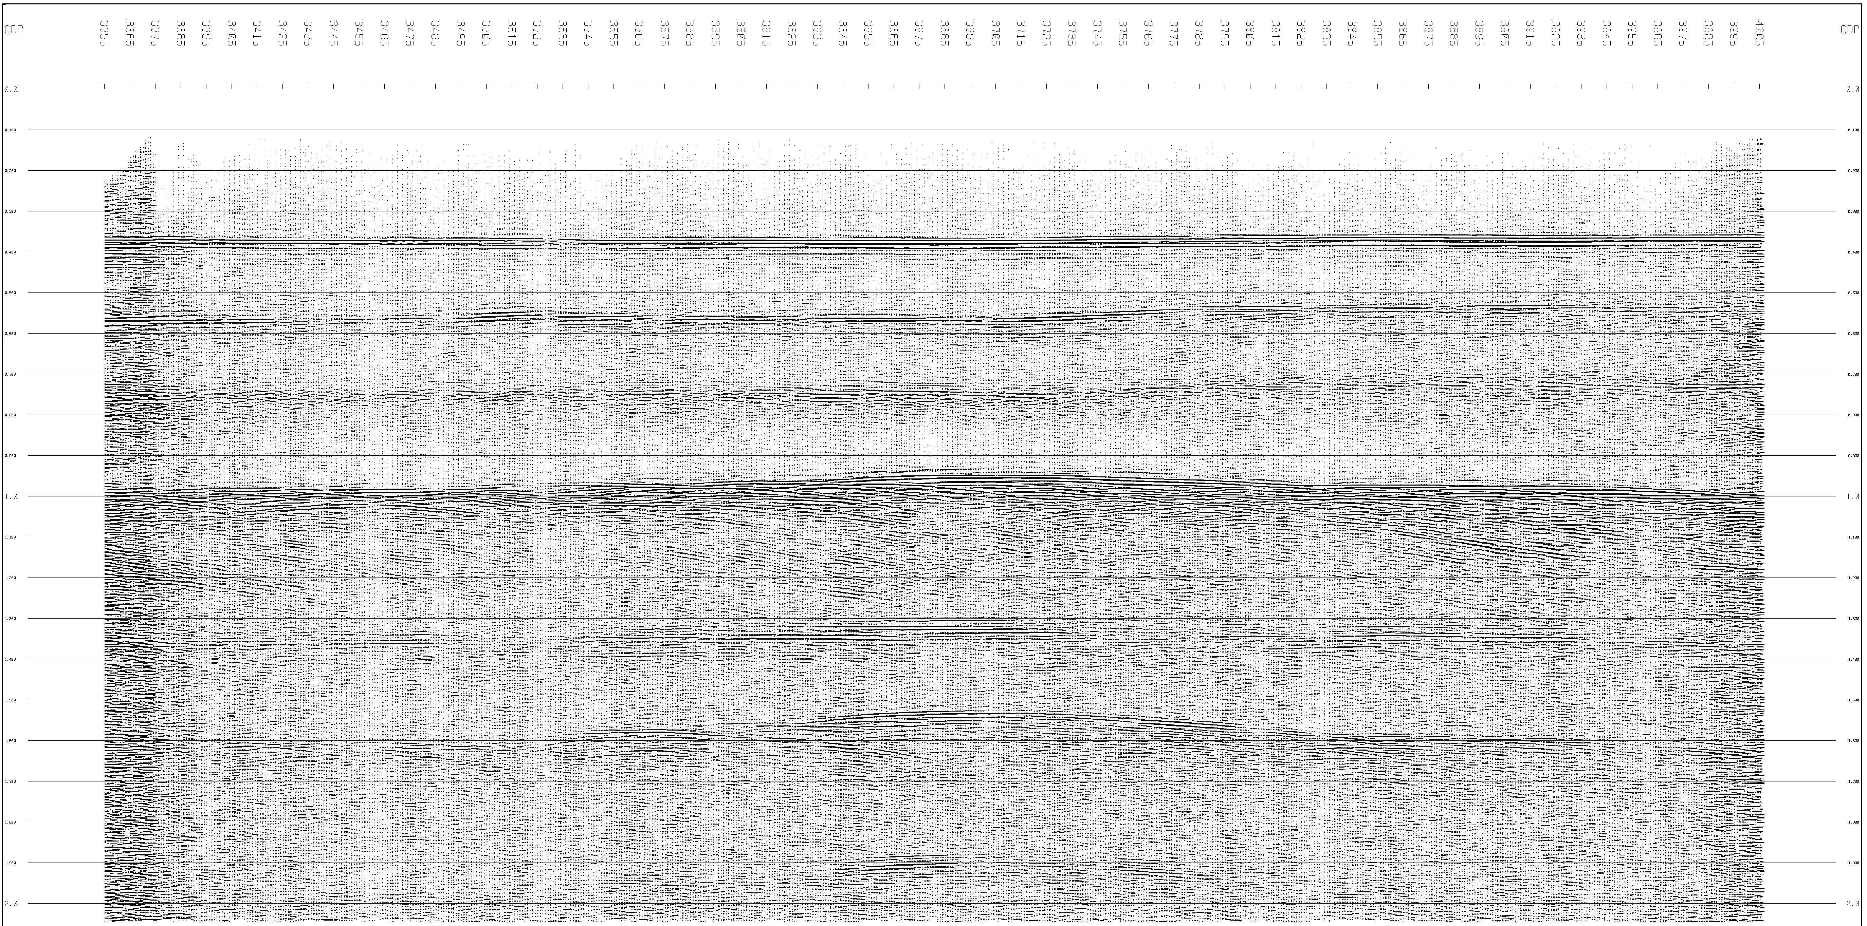
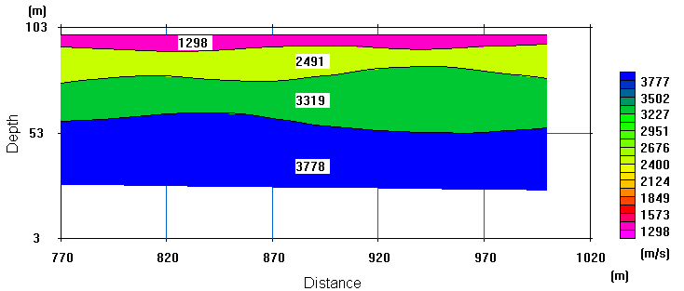
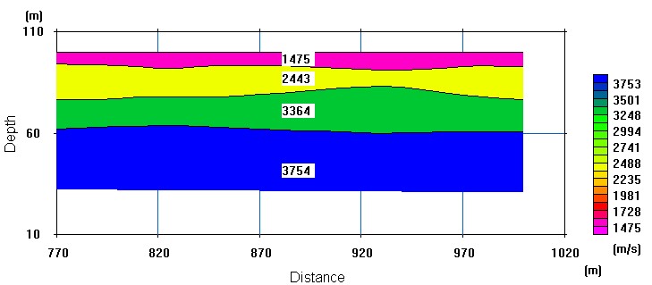
Seismic Studies of the Amery Ice Shelf, East Antarctica: A look at recent work
Kathleen McMahon
PhD Candidate, Macquarie University, NSW, AUSTRALIA, 2109. Email: kmcmahon@els.mq.edu.au
What’s been happening on the Amery Ice Shelf?
The Amery Ice Shelf has been the site of considerable seismic investigation for the past three summer Antarctic seasons.
In the 2002/2003 summer, regional surveys were carried out along a main N-S line running down the centre of the ice shelf, and a perpendicular line across through the centre of this (Fig 1. a). A detailed 1 km survey line was completed to test the feasibility of using the seismic technique to map the thickness of the marine ice layer under the ice shelf. This work was continued and extended in 2003/2004 by Hugh Tassell, formerly of the University of Tasmania.
Last season took a new angle to the seismic exploration of the AIS. The major research undertaken was a study in the anisotropic nature of the near surface ice. Due to heavy crevassing in the desired work area, surveys were carried out along flowlines near the centre of the ice shelf, picked from satellite imagery.
70E
72E
70E
72E
70S
70S
71S
71S
Looking for the marine ice
Before the seismic technique was employed to search for the marine ice layer under the AIS, the thickness of the marine ice layer had been previously calculated from a digital elevation model (DEM) and airborne radio-echo soundings (RES) assuming hydrostatic equilibrium for the shelf (Fricker et al., 2001).
G2A (Fig 1. a) was the first site surveyed, with a marine ice thickness of ~20 m. This matched the thickness produced in Fricker’s model. Last year, AM01, the AMISOR drill site in 2001/2002, was surveyed. AMISOR cored 479 m of ice at AM01, finding the top of the marine ice at 270 m depth (Craven et al., 2003). The two-way travel time for the upper reflections found at AM01 in 2004/2005 are ~170 ms, ~220 ms and faintly at ~250 ms. Applying a seismic velocity of 3700 m/s or 3800 m/s to these times produces depths of 315-323 m for the 170 ms reflection, 405-420 m for the 220 ms reflection, and 460- 475 m for the 250 ms reflection. Early interpretations of this is that the 1st reflection could be the top of the marine ice, the 2nd the beginnings of a porous, brine filled ice, and the 250 ms reflection the base of the ice.
(a)
(b)
Figure 1 (a). Sites for past seismic surveys. Legend: Yellow = 2002/03 regional surveys; Orange = 2002/03 detailed survey (G2A); Purple = 2003/04 regional surveys; Green = 2004/04 anisotropy surveys; Blue = 2004/05 regional surveys (northern point = AM01).
Figure 1 (b). Sites for future seismic surveys. Legend: Orange = Anisotropy surveys within stressed regions; Yellow = Anisotropy surveys over flowlines; Black triangle = Detailed surveys; Green = regional surveys; Blue = Regional surveys in crevassed/remote areas.
Figure 2 (Below). Stack of the detailed CDP line completed in 2004/2005; located at approximately 70.52°S, 70.66°E. (Runmix has been applied)
Detailed surveys: What detail do we see?
Completing detailed CDP surveys gives a much more detailed image of the subsurface of an ice shelf, revealing information such as depths, water properties and seafloor topography.
The figure on the right (Fig 2) displays a stacked section of a 3 km CDP line carried out in the centre of the Amery Ice Shelf in 2004/2005.
A reflection group at the base of the ice can be seen at ~370 ms; with a velocity of 3800 m/s this corresponds to a depth of ~700 m. The seafloor can also be clearly seen at ~1 s. Over this distance a variation in topography can be seen in the form of a hillock around the centre of the spread.
An interesting reflection to note is that at ~550 ms. This is believed to be due to a boundary in the water between fresher, ice-melt water sitting on top of hypersaline sea water. Evidence for this boundary has been found from work carried out by AMISOR elsewhere on the shelf (H. Tassell, pers. Comm., M. Craven, pers. Comm.). Also interesting to note is the possible effect the seafloor topography has on this fresh/saline water boundary.
Isotropic or anisotropic?
The main branch of work for the 2004/2005 season was refraction surveys over flowlines of the AIS, looking for anisotropic properties. It is thought that the merging of glacial streams would lead to a stress on the ice. This stress may lead to a re-alignment of the ice crystals, which in turn would mean that this affected ice would display anisotropy. In a seismic sense, this means the seismic velocity of the ice would be faster in one direction over the other.
Surveys were carried out as two perpendicular lines (one aligned to flow, one normal to it) in sets of three – one over the flowline, and one either side of the flowline, about 1-2 km away. Figure 3 shows the results for one survey on a flowline. This shows a velocity difference of a few percent. The overall results so far are inconclusive whether flowlines display anisotropy.
What’s next?...
This coming season’s work aims to undertake more anisotropy surveys in the regions closer to Gillock Island, and in the south of the ice shelf; these being regions that display high stress, and so more likely to display anisotropy.
The area of regional surveyed sites will be extended in all directions, enabling a better 3D map of the ice shelf to be produced. Detailed CDP surveys will also be used to survey sites of particular interest, including the new AMISOR drill sites.
(a)
(b)
References:
Craven, M., Elcheikh, A., Brand, R., & Allison, I., 2003. Hot water drilling on the Amery Ice Shelf, East Antarctica. Forum for Research into Ice Shelf Processes, Report (14).
Fricker, H.A., Popov, S., Allison, I., & Young, N., 2001. Distribution of marine ice beneath the Amery Ice Shelf. Geophys. Res. Lett., 28(11): 2241-2244.
Figure 3. (a) EW refraction line. (b) NS refraction line. 230 m spread. Layer 1 = snow, layer 2 = firn, layer 3 = representative of upper ice velocity, layer 4 = ice velocity at depth. (all velocities in m/s)

