Slide 1
A new Deep Ice Sheet Coring (DISC) drill for coring to the bed at the WAIS Divide site
C R Bentley, A J Shturmakov,
W P Mason, D A Lebar
Ice Coring and Drilling Services, University of Wisconsin - Madison
WAIS Workshop 2005

Slide 2
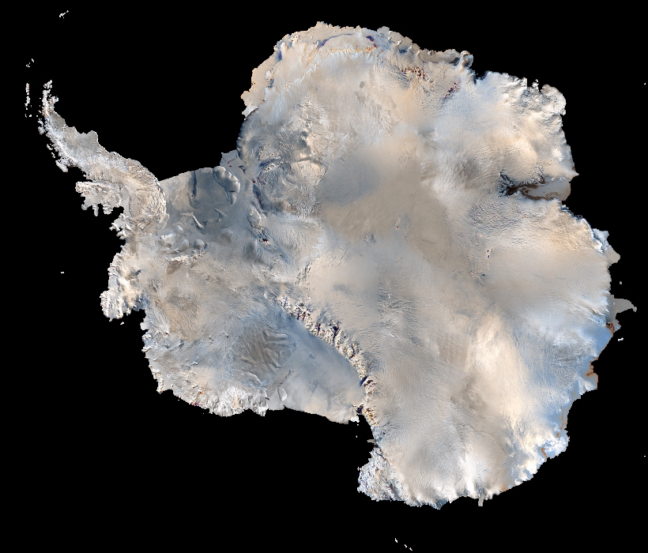
DRILL HERE
Notes:
DRILL HERE (Antarctic satellite
image)

Slide 3
How Will Drilling Be Done?
GISP2 Drill, last used at Siple Dome, in poor condition
Scientists and drillers recommended to NSF/OPP developing new drill, not refurbishing old one
ICDS charged with combining latest technology with best aspects of existing drills.
New “Deep Ice Sheet Coring” (DISC) drill to be fast, user-friendly, flexible, and with maximum feedback of downhole information.

Slide 4
DISC Drill Team Members
Bill Mason – Lead Mechanical Engineer
Don Thielman – Lead Electrical Engineer
Tony Wendricks – Logistics Coordinator
Alex Shturmakov – DISC Project Manager
Don Lebar – ICDS Program Manager
Charlie Bentley – ICDS Principal Investigator

Slide 5
Key DISC Project Milestones
  Completion of system design (Feb 2005)
  Quality & safety plans completion (Dec 2005)
  Completion of fabrication (Jan 2006)
  Completion of pre-field testing (Feb 2006)
  Greenland testing (Summer 2006)
  Repair & modification, as needed (Fall 2006)
  Ship to WAIS Divide site (Fall 2006)

Slide 6
DISC Drill Characteristics
  Ice Core Diameter 122 mm
  Ice Core Length 1-4 m
  Cutter Speed 0-150 rpm
  Fluid Pumping Rate 0-140 gpm.
  Maximum Tripping Speed 3 m/s

Slide 7
DISC Drill Lengths & Weights
  Sonde Length 6.4-14.3 m
  Sonde Weight (max.) 1000 lbs.
  Tower Height (max.) 15.3 m
  Tower Weight 7000 lbs.
  Winch Weight 25,000 lbs.

Slide 8
DISC Drill Special Features 1
Modular design of sonde provides core-length options
Segmented core barrel for easy replacement of bent sections
Rotating outer barrel with or without an inner barrel
Quick connectors allow for fast core removal and sonde servicing

Slide 9
DISC Drill Special Features 2
Drilling fluid: non-toxic, non-aromatic paraffinic hydrocarbon (“Isopar-K”) with densifier (HCFC-141b); (bye-bye butyl!)
Independent motors for drill and pump
High pumping rate should:
  help drilling in warm ice near bed
  increase tripping speeds by pumping fluid through sonde
Notes:
HCFC-141b was used at North GRIP,
Dome C, Kohnen Station, Berkner Island,
& Vostok and is planned for the new
drilling site at Talos Dome (East Ant).
(Italy/France). The Japanese use n-butyl
acetate at Dome Fuji. HCFC-141b is a
Class II ozone-depleting substance. The
current schedule under the Montreal
Protocol is to phase it out completely
by 2015.

Slide 10
DISC Drill Special Features 3
Vibration and acoustic sensors for monitoring the drilling process
High-speed data acquisition system utilizing fiber optics
Tilting tower; modular truss construc- tion for flexibility and portability.

Slide 11
WAIS Divide Schedule 2005-06
Establish camp
Collect 4-inch cores to 30 m & 100+ m
Prepare site for deep drilling; construct housing for drill and core handling

Slide 12
WAIS Divide Schedule 2006-07
Drill & ream pilot hole; install casing
Complete core-handling facilities and drill-support structure
Set up drill
Drill enough to assure drill is functioning properly

Slide 13
WAIS Divide Schedule 2007-10
Core to bed!

Slide 14
Planned Future Developments
    Silty Ice Cutter Head Assembly
    Glacial Bed Cutter Head Assemblies (hard-bed, soft-bed)
    Replicate Coring Drill

Slide 15
Organizations
NSF-Office of Polar Programs (OPP)
Ice Coring and Drilling Services (ICDS)
National Ice Core Lab (NICL)
Raytheon Polar Services Company (RPSC)
VECO Polar Resources (VPR)
Science community

Slide 16
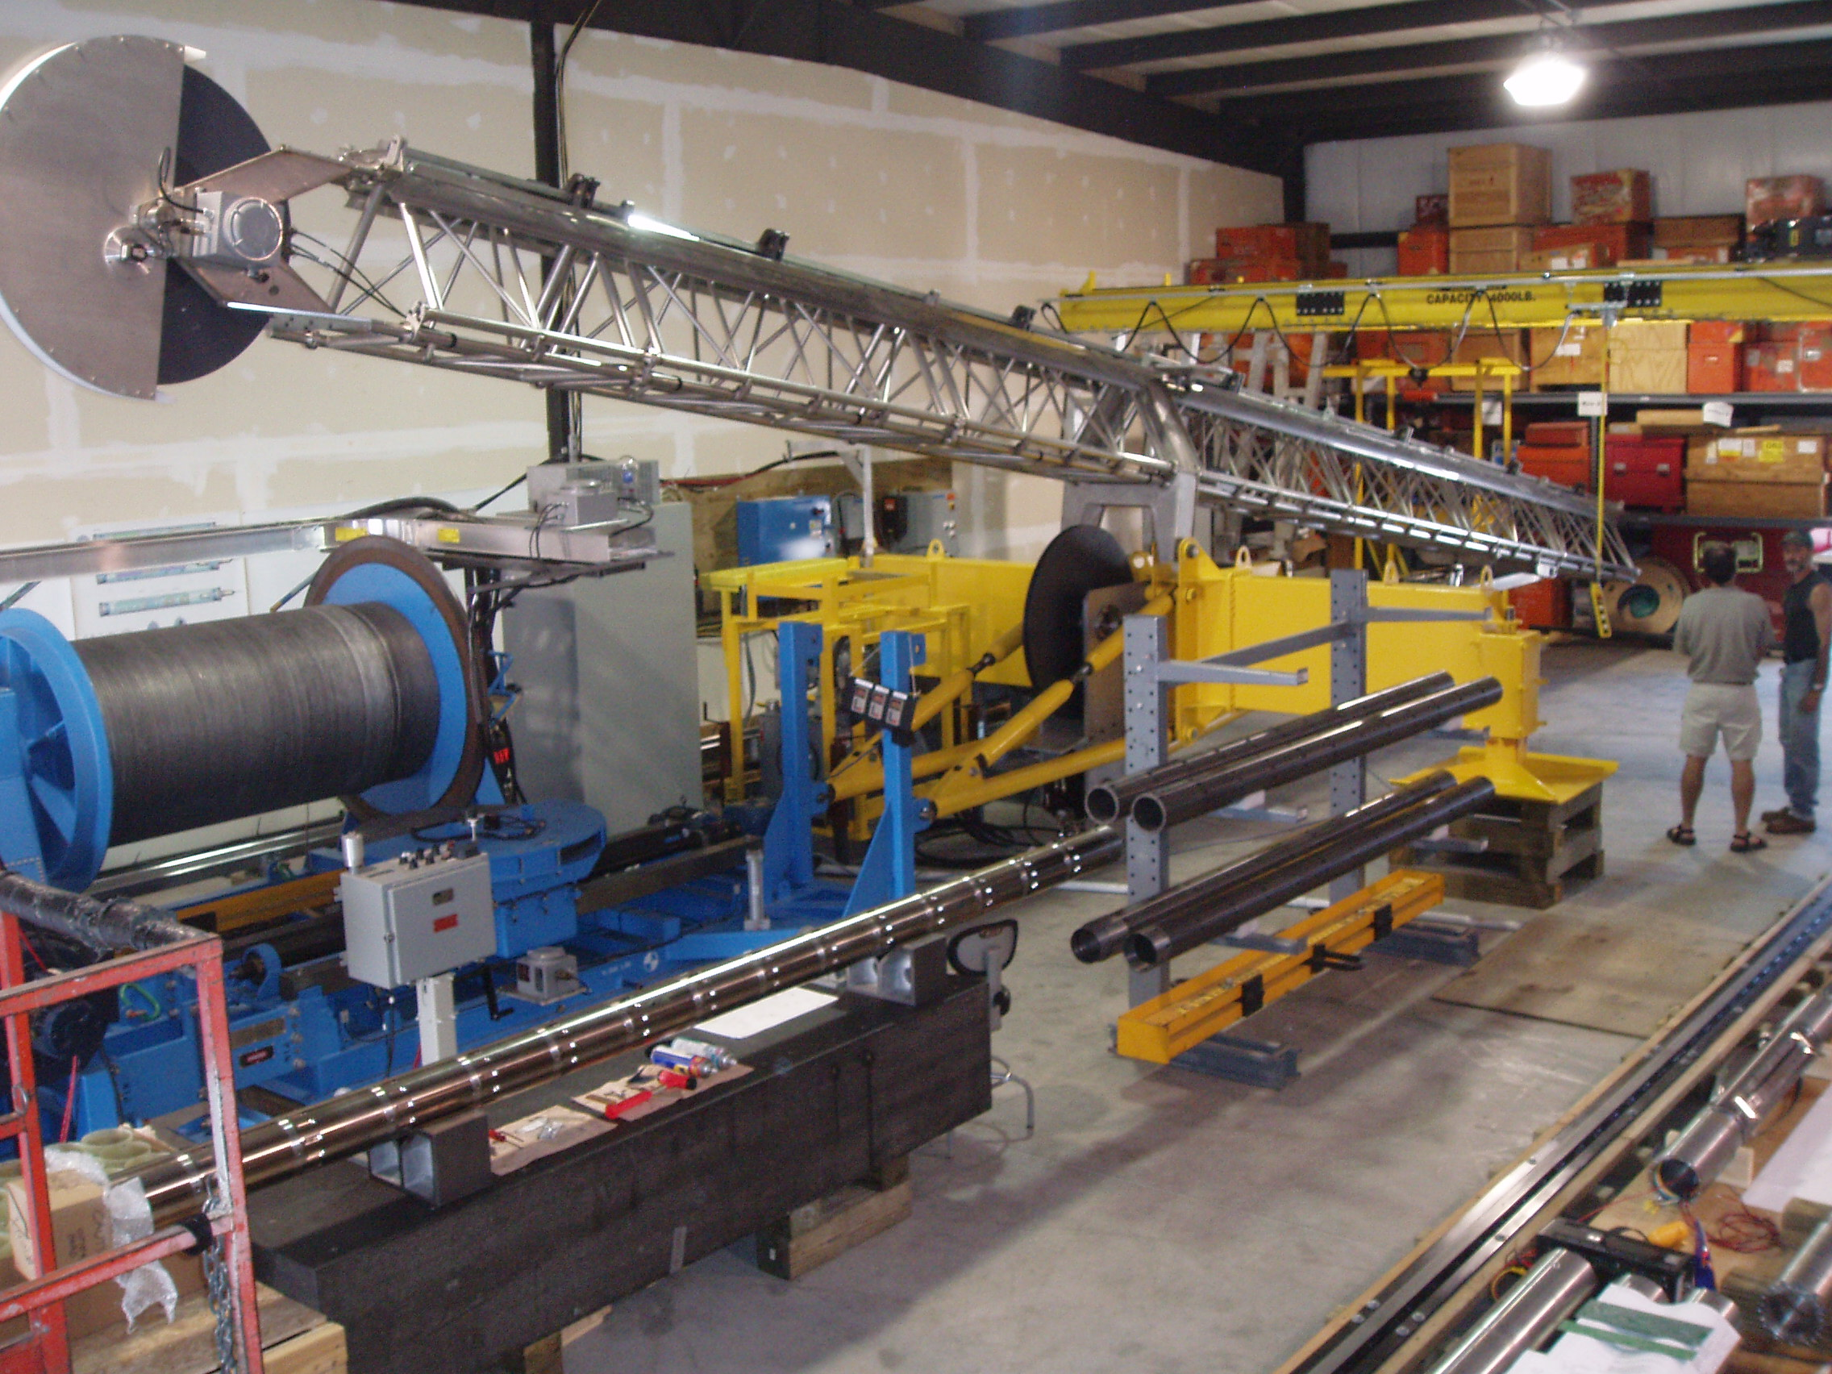

Slide 17
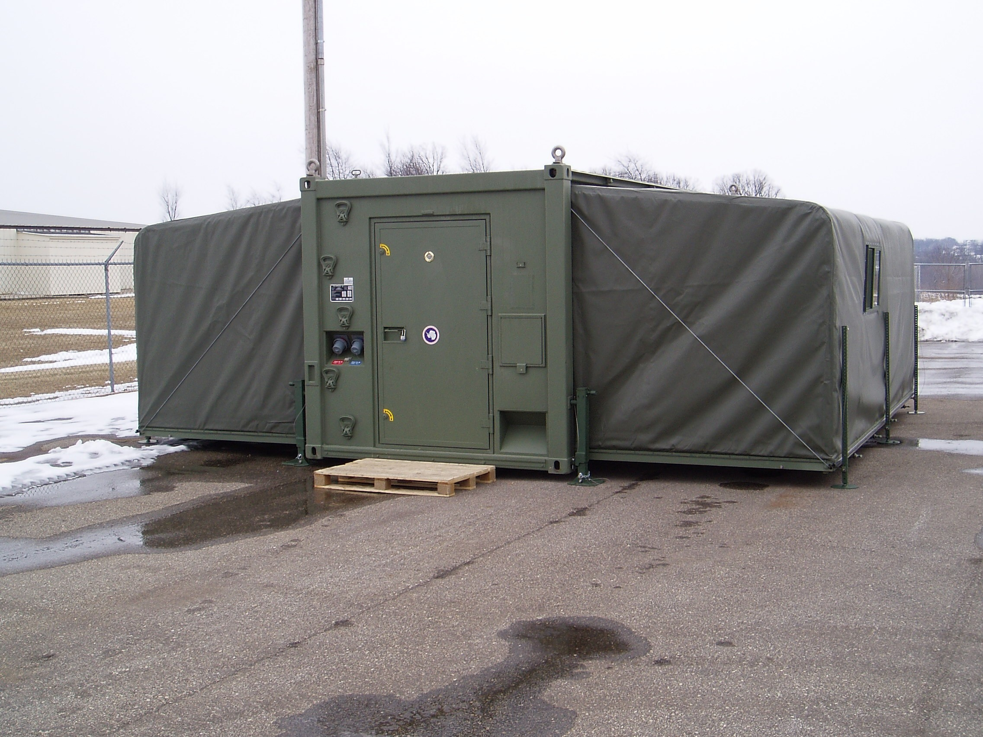

Slide 18
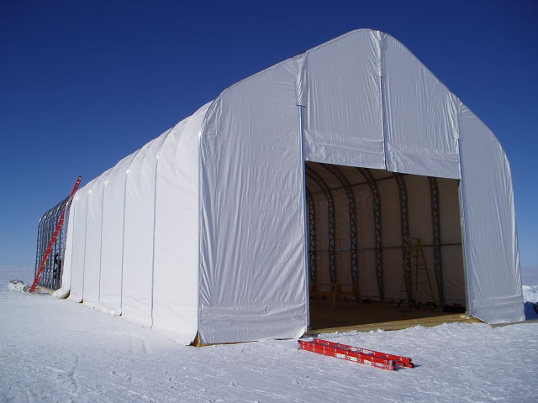

Slide 19
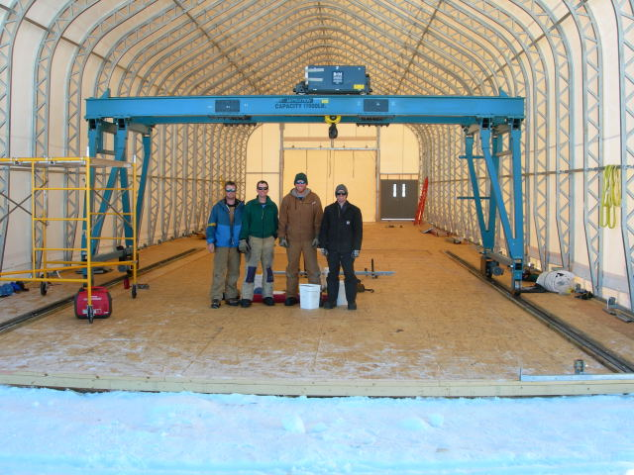

Slide 20
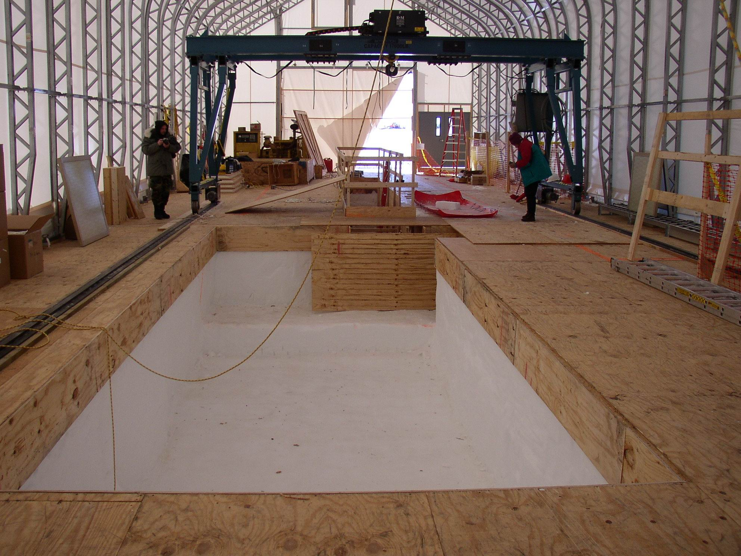

Slide 21
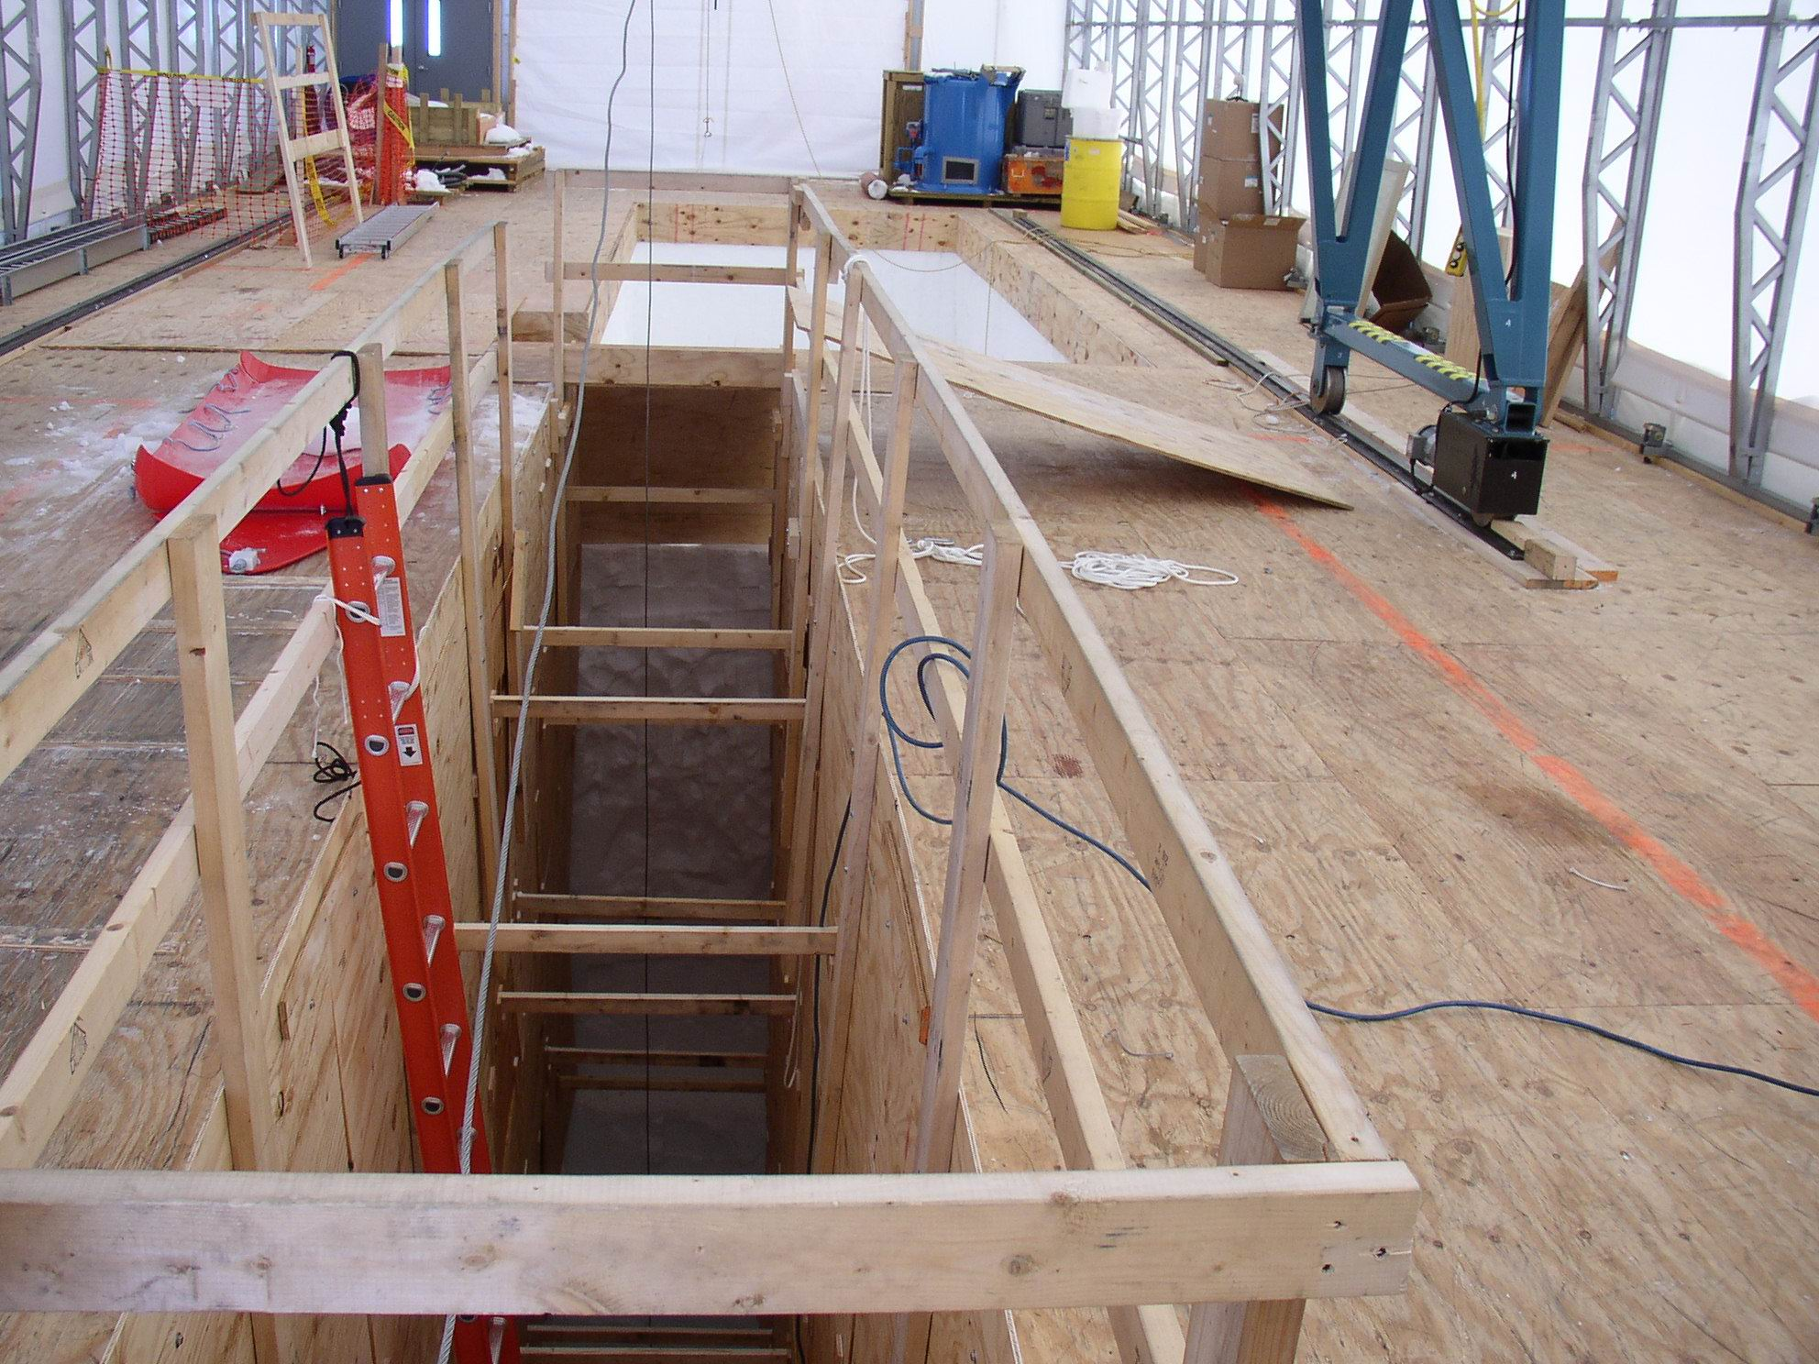

Slide 22
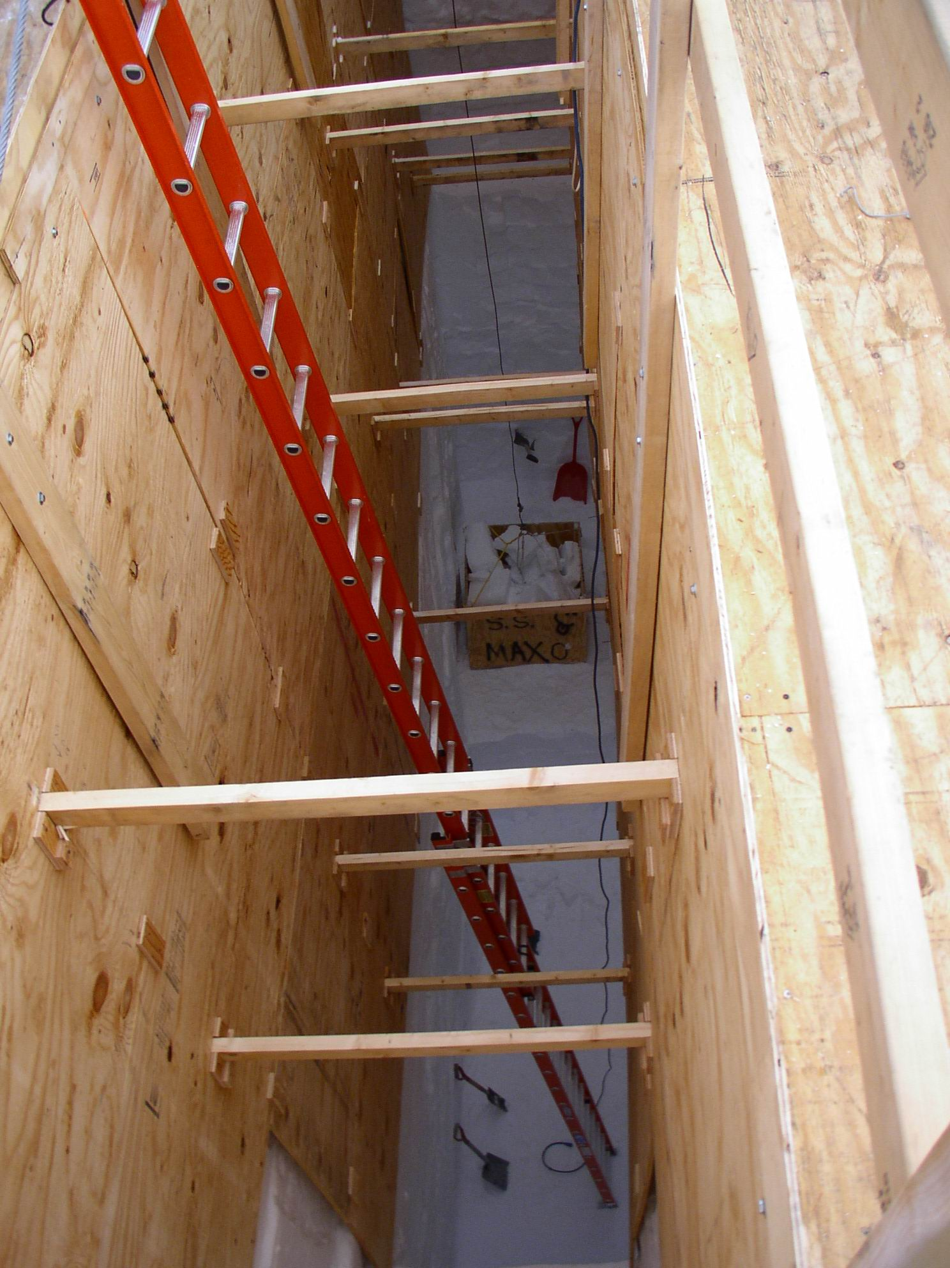

Slide 23
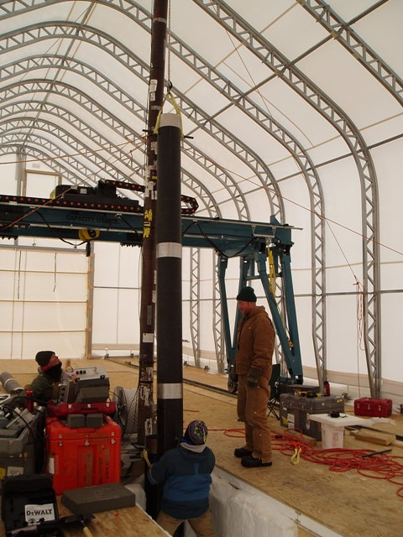

Slide 24
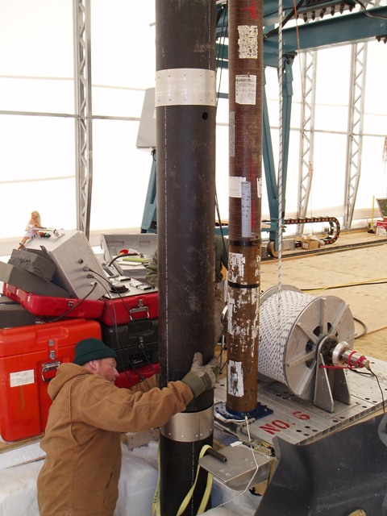

Slide 25
The End
The End

