Slide 1
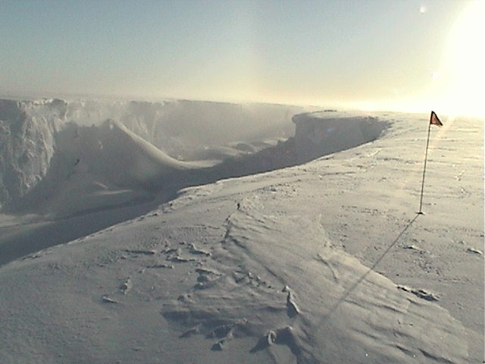
Late breaking news from field studies of the Ross Ice Shelf
Douglas R. MacAyeal , Olga Sergienko, Kelly Brunt , Marianne Okal, Jonathan Tom, Ronald Ross,

Slide 2
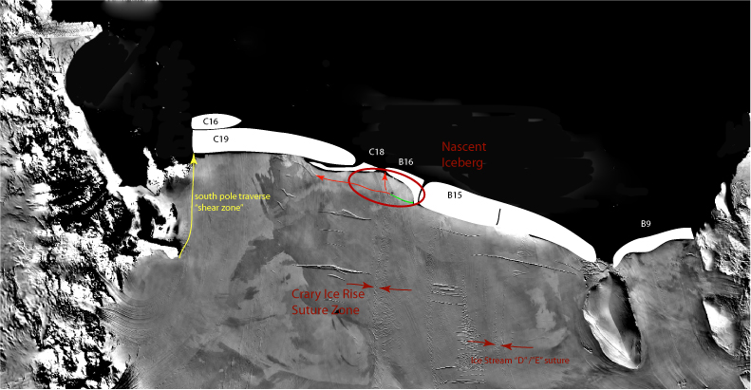

Slide 3
Objective of study
Iceberg calving
Rift propagation
Unplanned opportunities: GPS
12 months of Garmin
3 days of Geodetic

Slide 4
Background
Rift propagation (Joughin and MacAyeal, 2005)
Tidal motion of WAIS Ice Streams (Bindschadler et al, 2003)

Slide 5
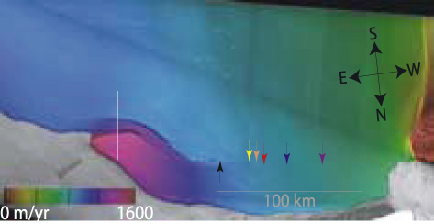
Estimated velocity for C19
Joughin and MacAyeal (2005)

Slide 6
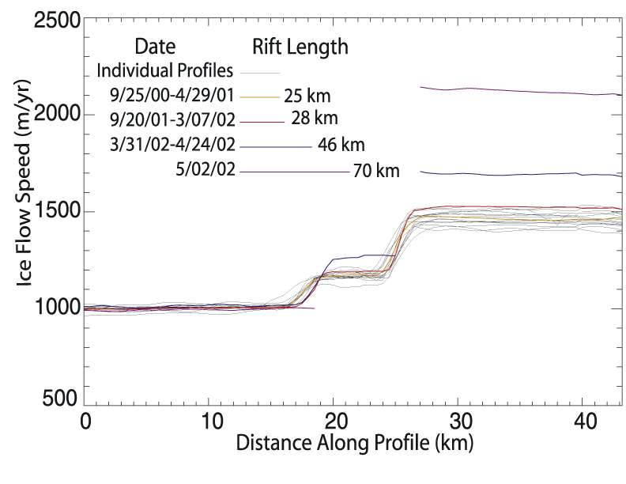
Ice flow speed
Joughin and MacAyeal (2005)

Slide 7
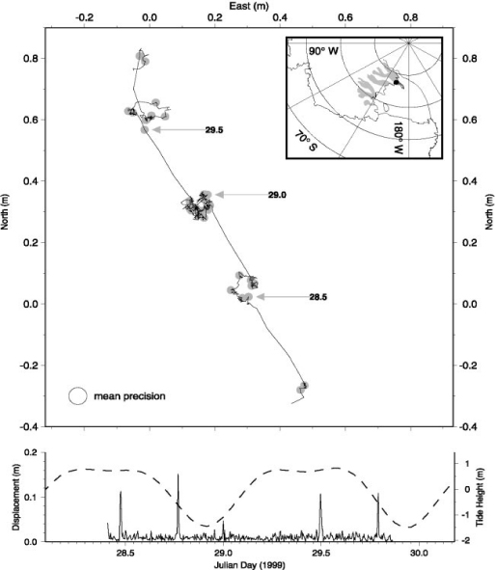
Tidal motion of Whillians Ice Stream
Bindschadler et al (2003)

Slide 8
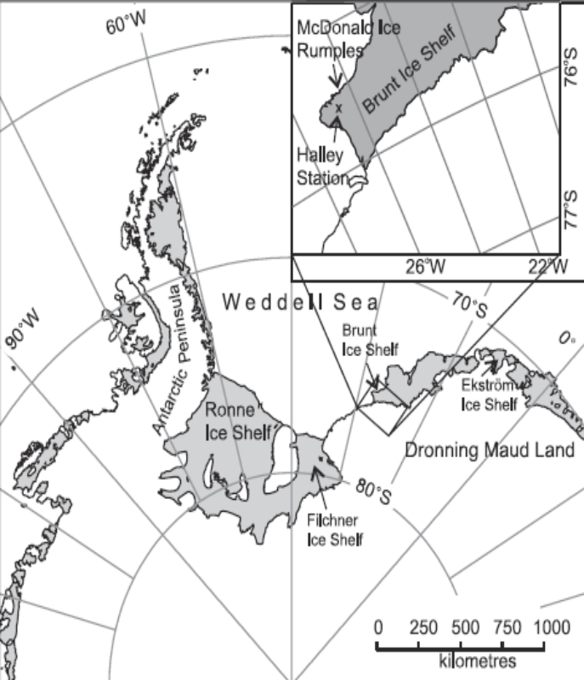
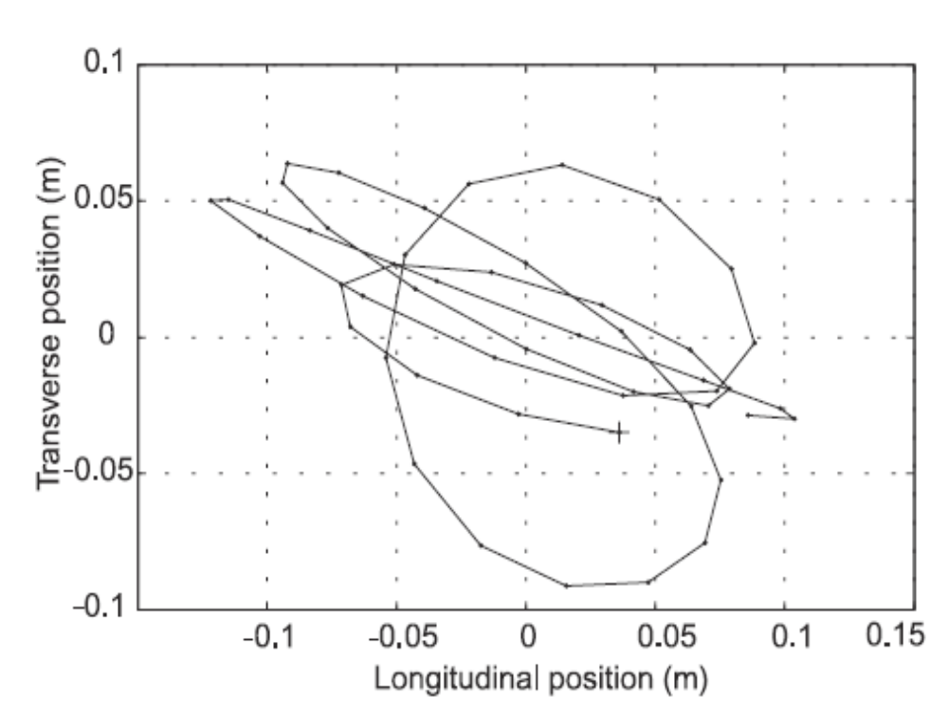
Tidal movement of Brunt Ice Shelf
Doake et al (2002)

Slide 9
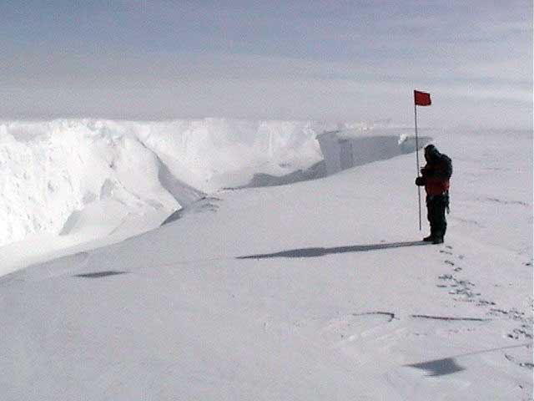
Results from Nascent

Slide 10
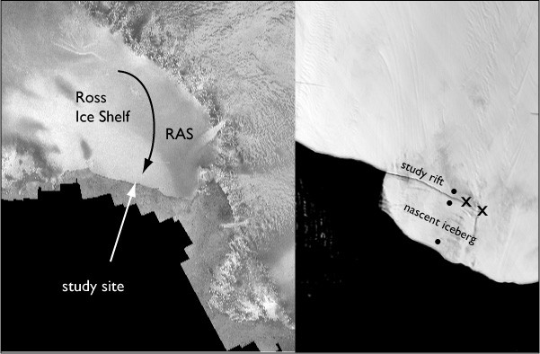
Nascent location

Slide 11
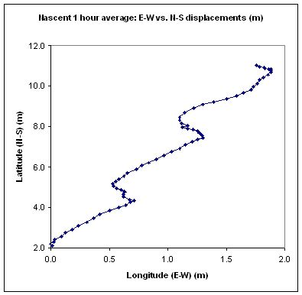
Tidal motion, horizontal displacement
Geodetic GPS

Slide 12
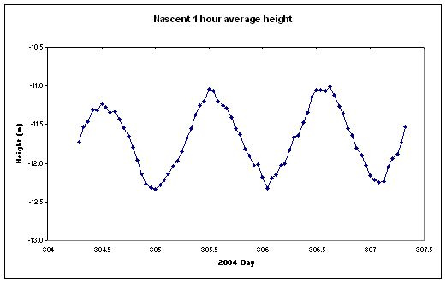
Tidal motion, vertical displacement
Geodetic GPS

Slide 13
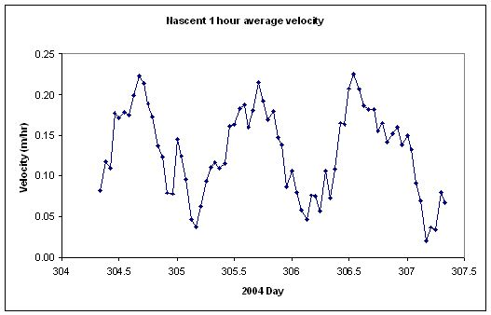
Ice flow speed
Geodetic GPS

Slide 14
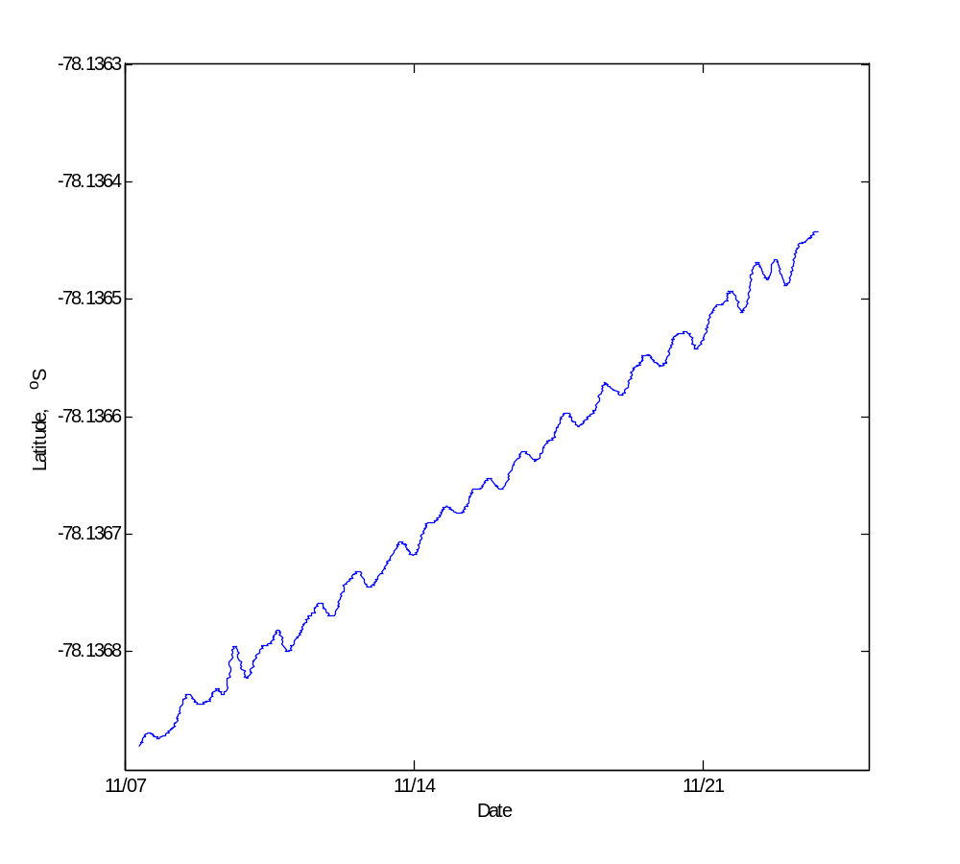
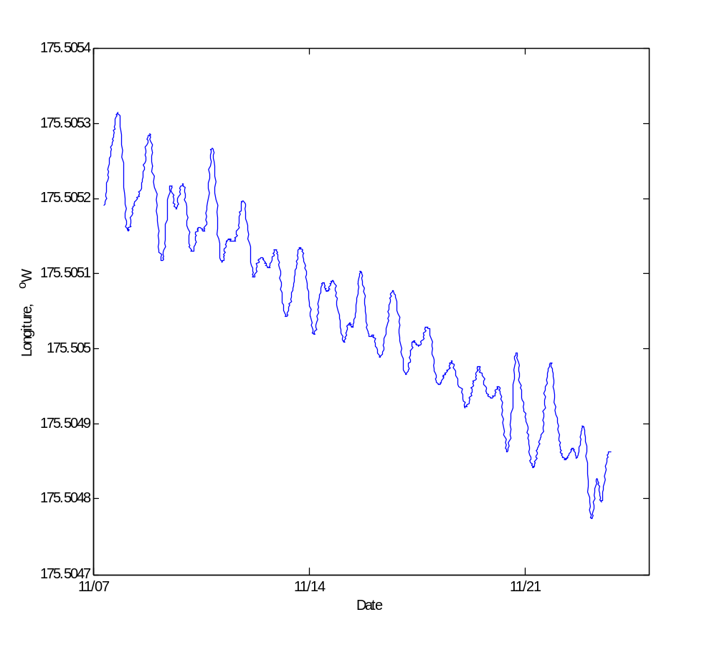
12 hour filtered lat-lon position, Garmin GPS

Slide 15
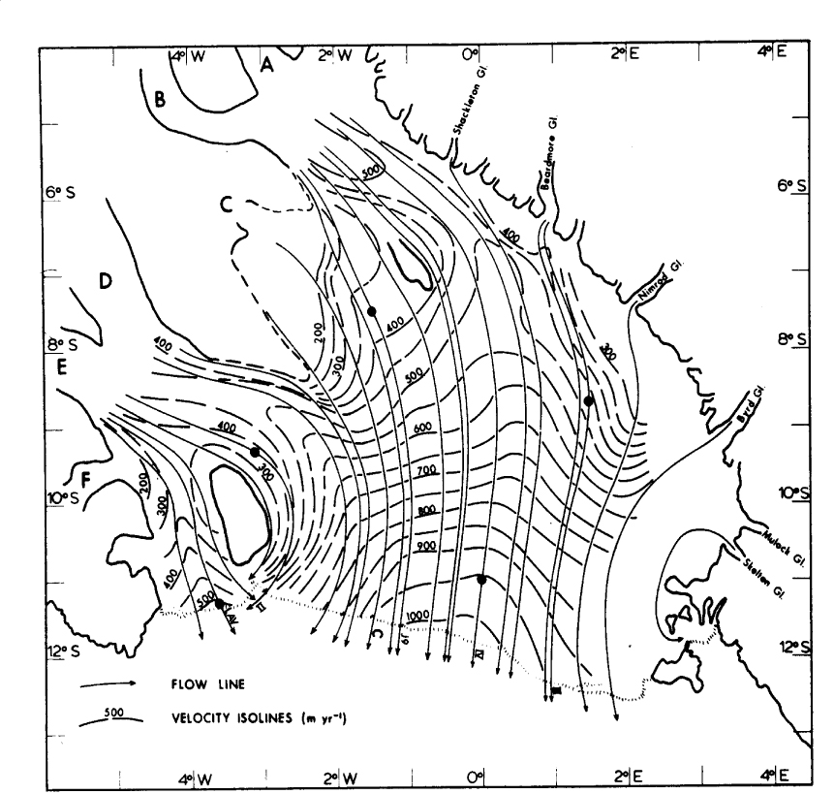
Ross Ice Shelf velocity
Nascent
V ~ 1095 m/yr
10% higher?
Thomas and MacAyeal (1982)

Slide 16
Questions:
Tidal influence on ice shelf velocity
  Origin for ice stream stick/slip behavior?
Speed up relative to 30 years ago (by 10%)?
  Due to Joughin effect?
  Due to acceleration of Ice Shelf?
Driver of rift propagation
  If not background stress, then tide?

Slide 17
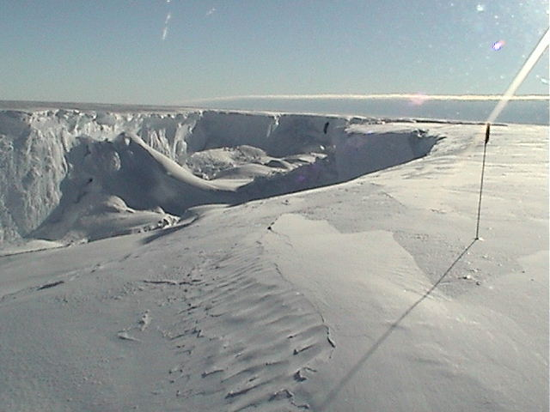
Rift does not open 90m/yr as required by Joughin effect

Slide 18

Tidal rift opening?

