Slide 1
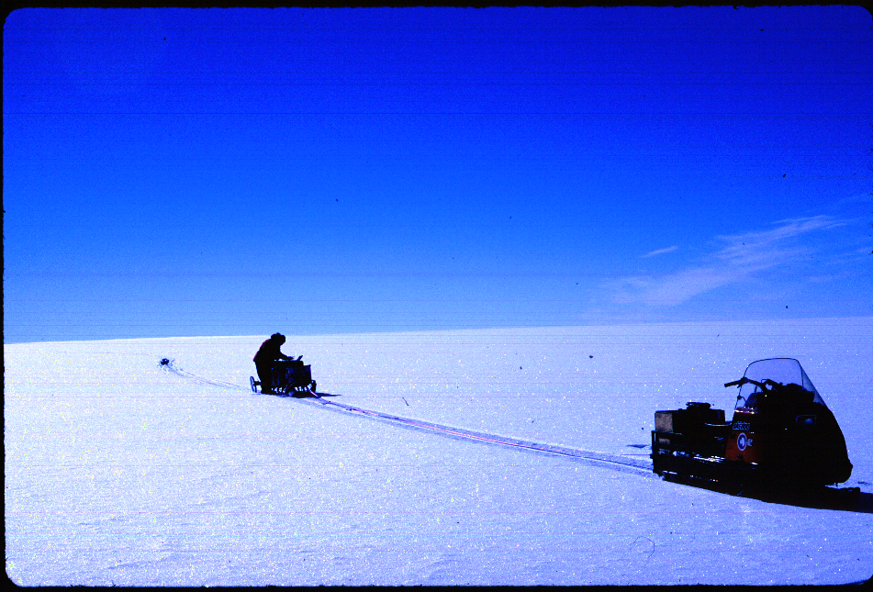
Inferred accumulation and thickness histories near the Ross/Amundsen divide, West Antarctica
T. A. Neumann^{1,2}, H. Conway², S.F. Price², E. D. Waddington², D. L. Morse³
¹Department of Geology, University of Vermont
²Department of Earth and Space Science, University of Washington
³Institute for Geophysics, University of Texas at Austin

Slide 2
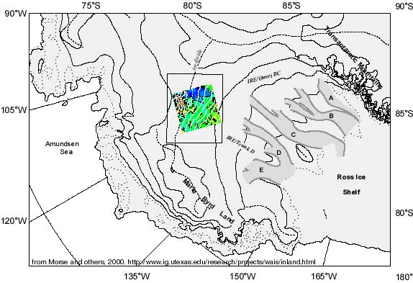
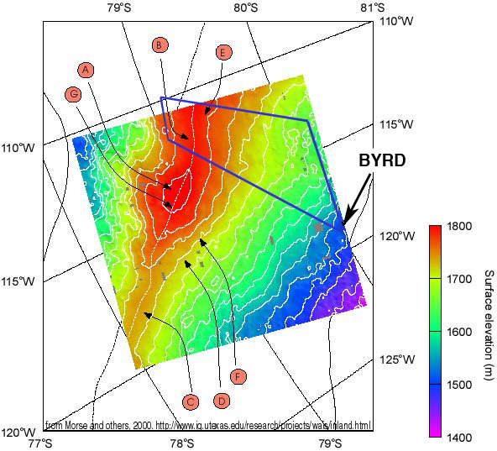
Study Area
from Morse et al. (2002)

Slide 3
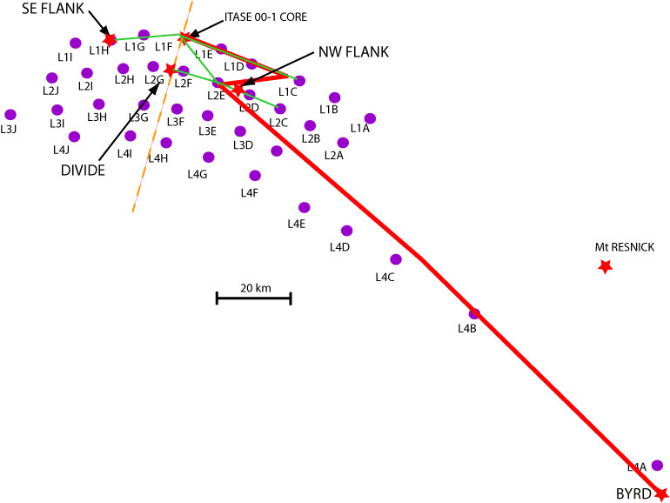
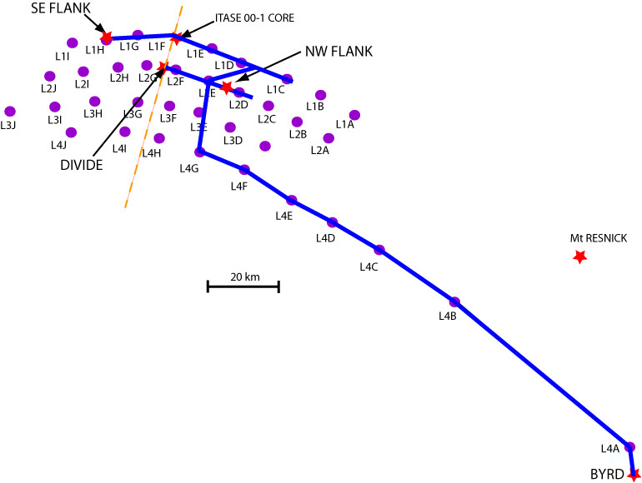
5 MHz data
7 MHz data
flow divide
1.5 / 1.0 MHz data
Profile lengths ~ 200km

Slide 4
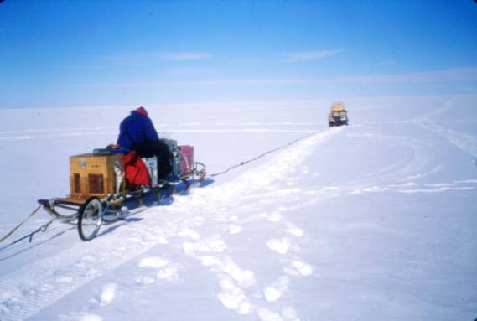
Univ. of WA radar system
ground-based system
mono-pulse transmitter (± 2000 V), 30 Hz
resistively-loaded dipolar antennas
digital oscilloscope records returned amplitude (mV)
returns stacked (~ 1000) to generate single trace
traces co-registered with GPS data.
Can cover (up to) 100 km day

Slide 5
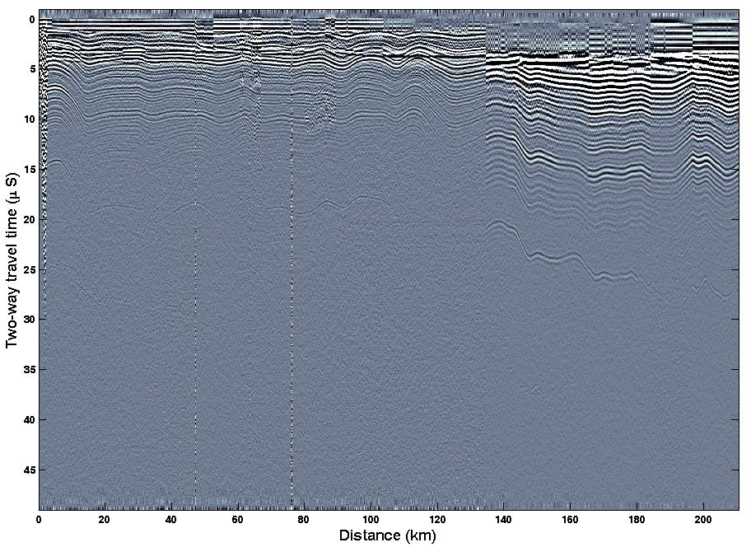
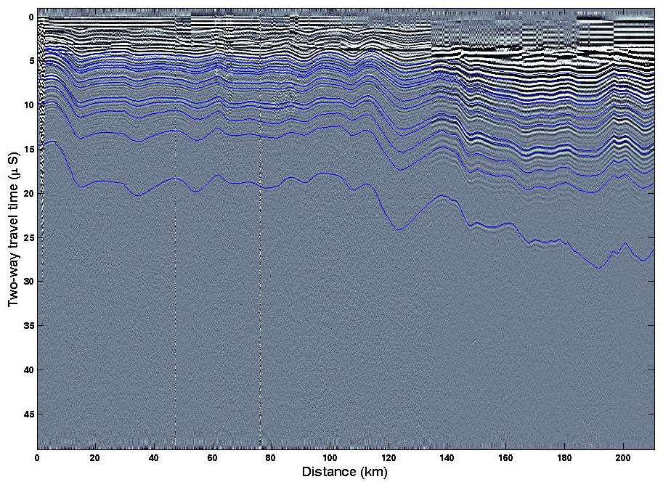
1.5 MHz data
1.0 MHz data
‘Old Faithful’
‘Old Faithful’
Byrd core site
Byrd core site

Slide 6
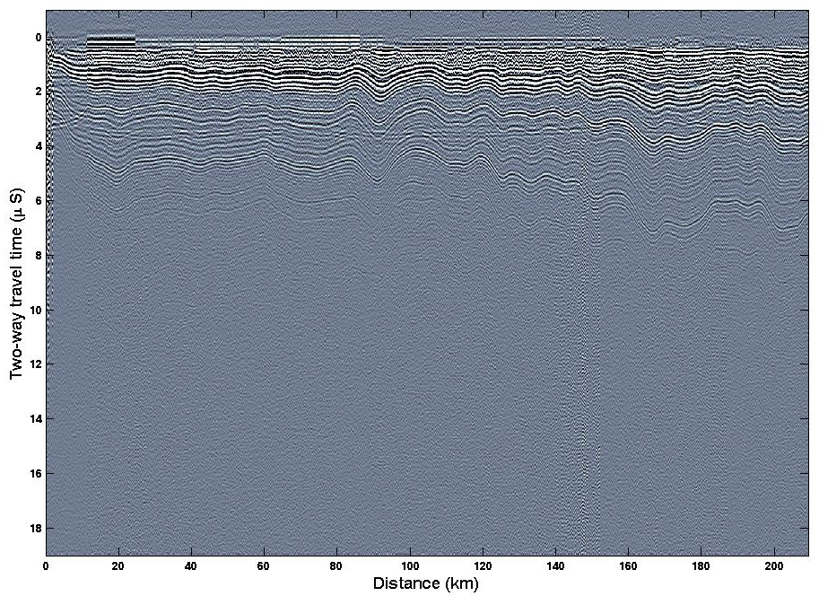
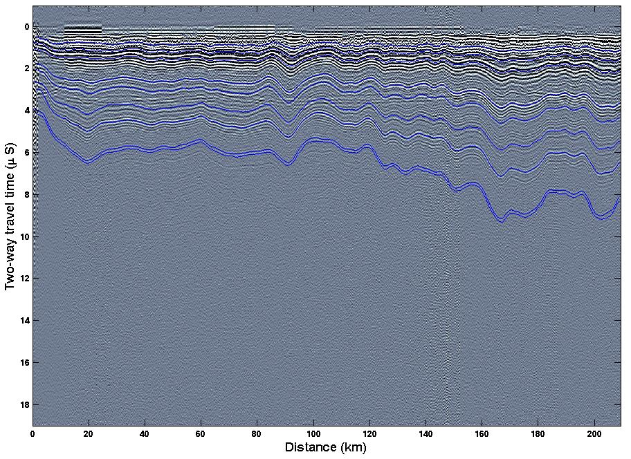
5 MHz data
Byrd core site
Byrd core site
‘Old Faithful?’

Slide 7
Converting picked radar layers to depth-age estimates:
1. Pick radar layers
2. Determine two-way travel time of layer at each site.
3. Convert two-way travel time to depth at sites.
used Herron-Langway (1980) model for ρ(z); Looyenga’s equation.
4. Determine layer age using ice core depth-age data.
used data from Byrd cores [Hammer et al., 1994] and ITASE-00-1 [Dixon et al., 2004].

Slide 8
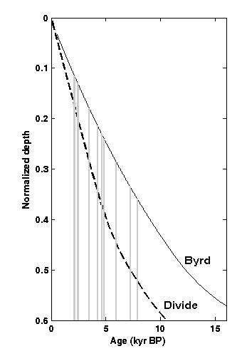
Tracking Layers: extend Byrd time scale
0 to 8.3 ka BP: 14 dated layers
8.3 to 17.5 ka BP: 1 layer
(Old Faithful)
restrict analysis to most recent 8.3 ka
estimate errors as
± 60 years near the surface
± 150 years for deepest point.

Slide 9
Ice flow modeling
1-D transient model (Dansgaard and Johnsen, 1969)
variable acc. rate, ice thickness, vertical velocity (h), and basal melt.
Divide
Accept combinations of:
accumulation rate history
ice dynamics history ( H(t) and h(t) )
to match radar-derived depth-age relationship
Apply method at three sites: Divide, SE and NW flanks

Slide 10
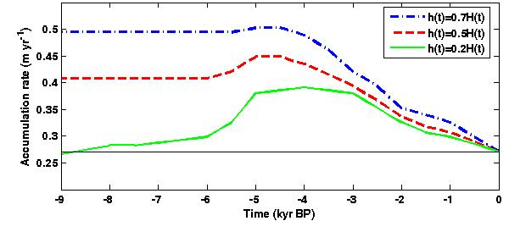
Divide: sensitivity to h
h defines transition from constant to linear strain rate in Dansgaard-Johnsen (1969) model.
h ~ 0.7 H at ice divides
h ~ 0.5 H ‘near’ divides
h ~ 0.2 H flank flow
smaller h requires lower accumulation rate

Slide 11
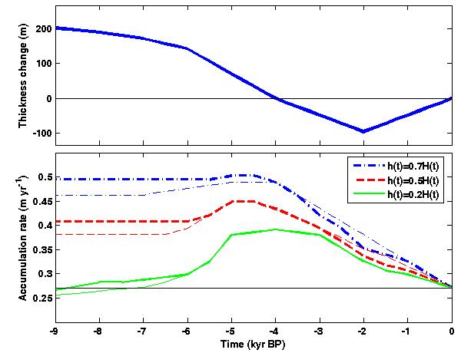
Divide: sensitivity to H
Steig et al. (2001) suggested up to 300m of thinning since LGM at Byrd.
Huybrechts (2002) suggested up to 575m of thinning at Byrd.
Thinning requires higher accumulation to match layer data.

Slide 12
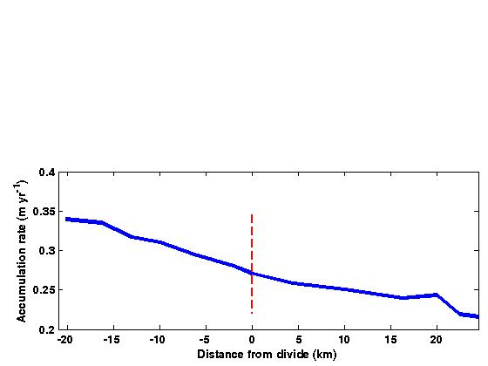
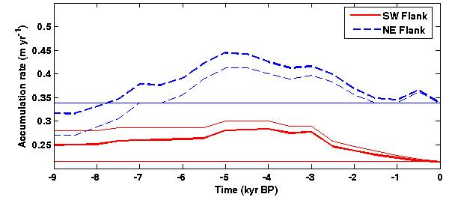
Flanks: correction due to advection
Use 2-D model (Price et al., 2004) to assess importance of acc. rt. gradient
divide
SW Flank
ice flow transports oldest particle (8.3 ka BP) ~13 km to flank sites
NE Flank
Advection correction:
reduces rate at
SW flank
increases rate at
NE flank

Slide 13
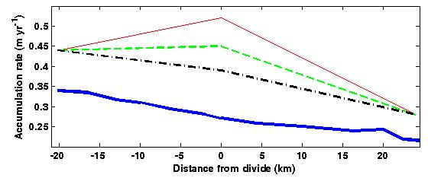
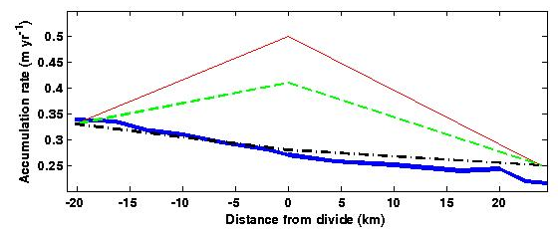
Spatial, temporal pattern
modern spatial pattern
4500 ka BP
h = 0.2, 0.5, 0.7 H(t) at divide
8000 ka BP
Suggests either:
basal ice is sliding, divide has been unstable, or both
NE Flank
SW Flank

Slide 14
Spatial, temporal pattern
melting is likely if Q > 70 mW/m²
Morse et al., 2002
sliding changes vertical velocity profile, reduces h.
Pettit et al., 2003
→ h ~ 0.2 H(t) may be appropriate at divide
accumulation rate was similar to today 8 ka BP,
but 30% higher than present from 5 to 3 ka BP.
consistent with Siegert and Payne (2004) and Goodwin (1998)

Slide 15
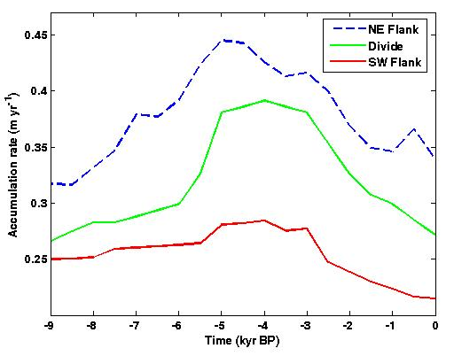

Conclusion:
Accumulation rate 30% higher between 5 and 3 ka BP.
dependent on Byrd time scale; check back in 2008 using new core results
Funding provided by NSF-OPP
Thanks also to Raytheon and 109th ANG for field support.

Slide 16
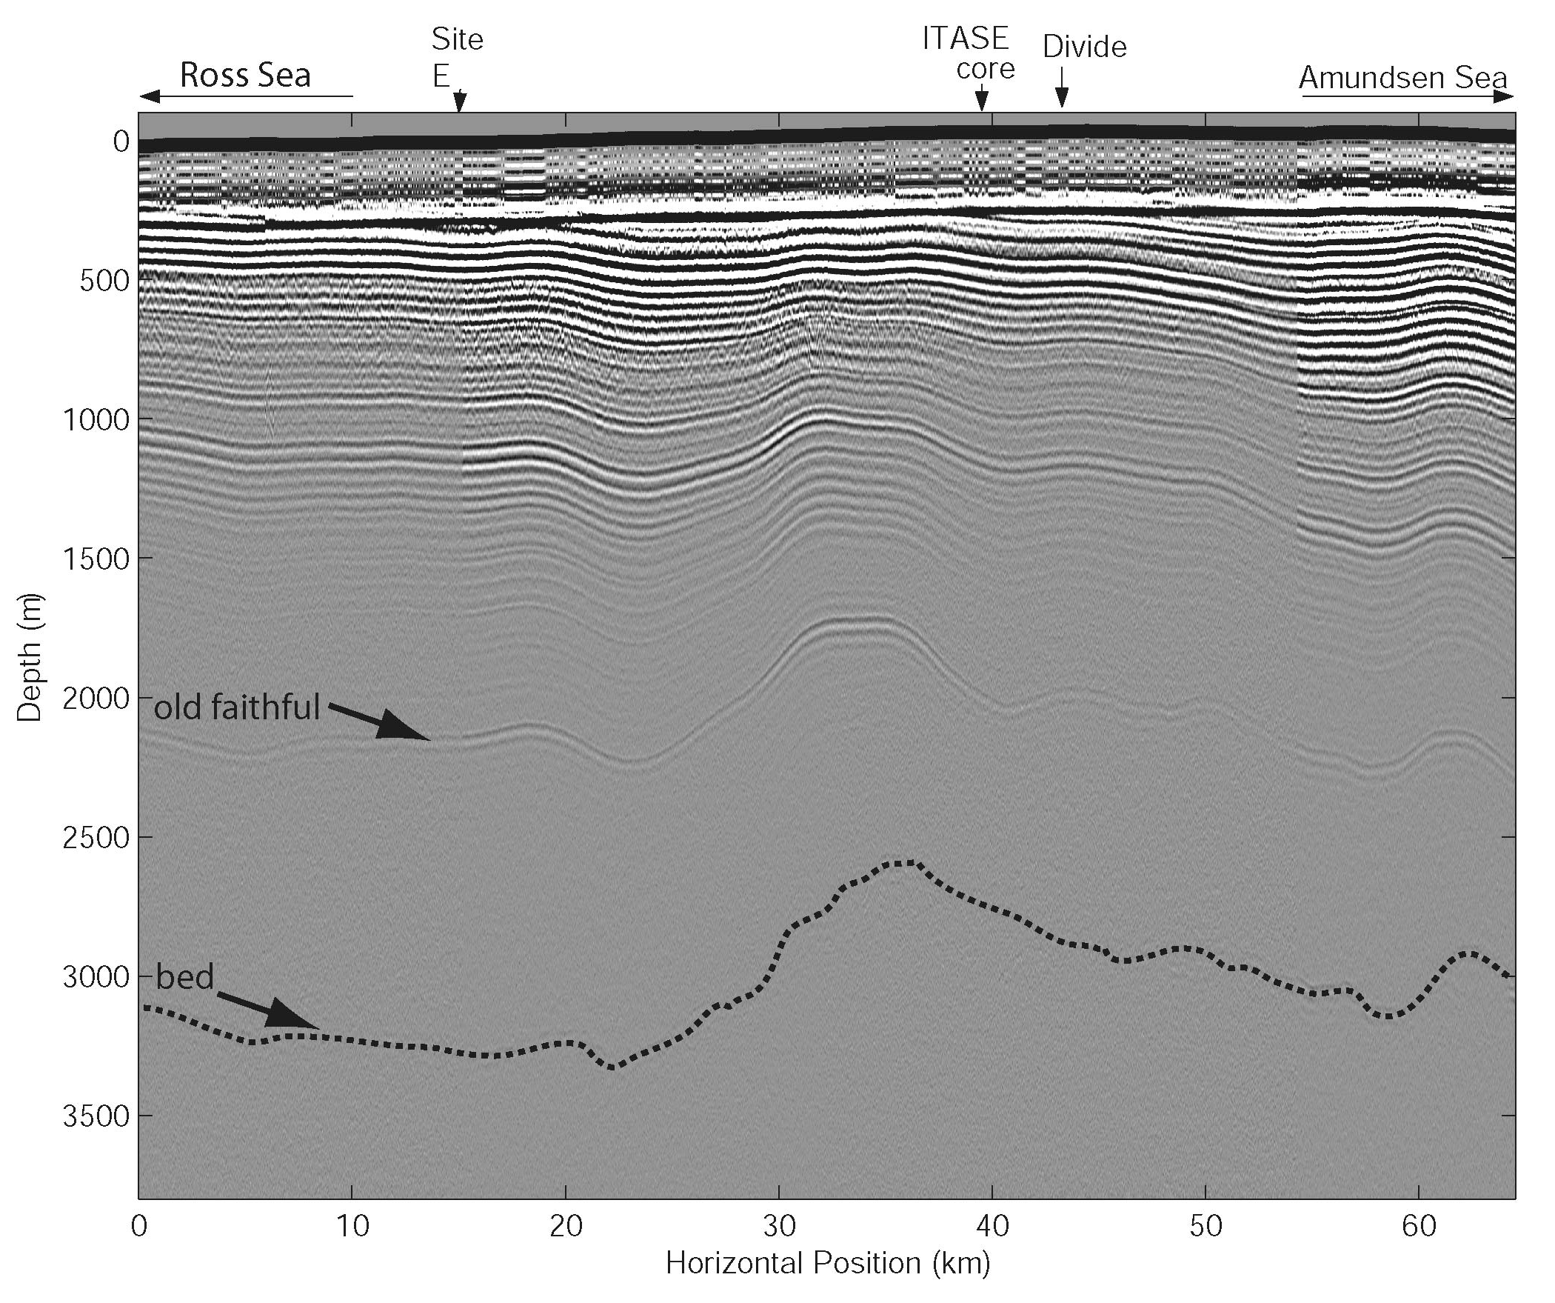
Profile along L1
15:1 aspect ratio

Slide 17
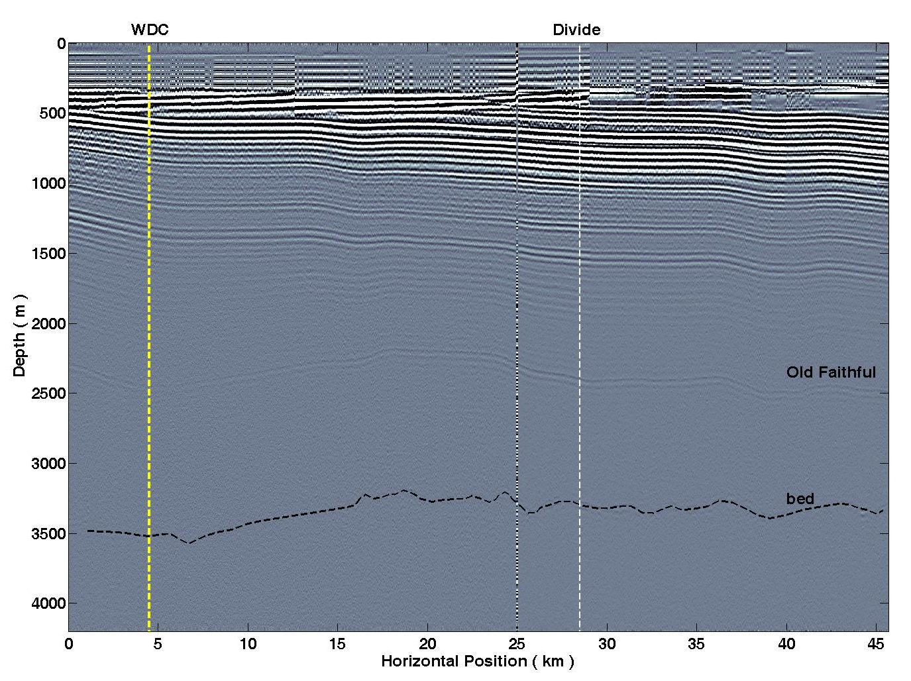
Ross Sea
Amundsen Sea
Profile along L2
10:1 aspect ratio

