Slide 1

Numerical modelling of ocean-ice interactions under Pine Island Bay’s ice shelf
Tony Payne¹
Paul Holland^{2,3} Adrian Jenkins³
Daniel Feltham² Andrew Shepherd⁴
Ian Joughin⁵
¹ Centre for Polar Observation and Modelling, University of Bristol
² CPOM, University College London ³ British Antarctic Survey, Cambridge
⁴ CPOM, University of Cambridge ⁵ University of Washington, USA

Slide 2
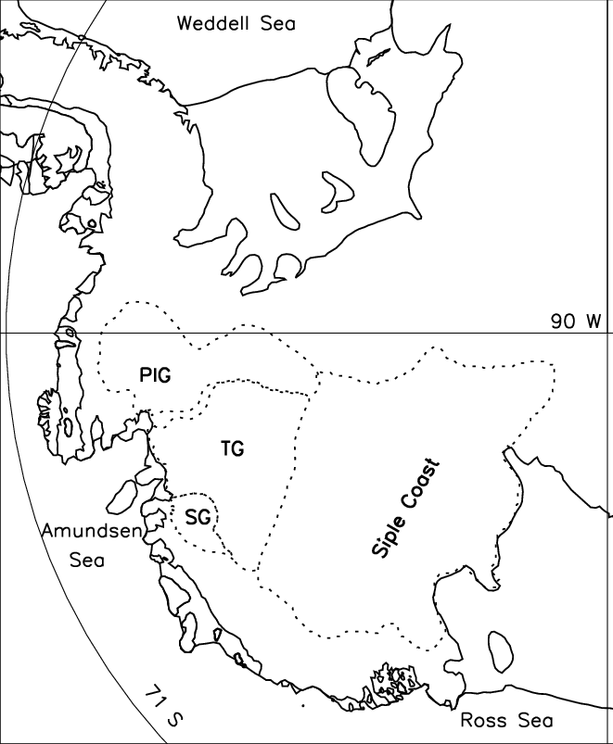
Aim
use two-dimensional model of density currents
derives from work on study Svalbard density currents (Jungclaus and others JGR 1995)
sub-shelf physics of Jenkins (JGR 1991) incorporated
apply to Pine Island using idealised geometry and realistic forcing
conduct perturbation experiments to assess effect of recent oceanographic changes
500 km

Slide 3
Model description
vertically integrated, time dependent
mass balance gives plume depth (D) incorporates
  basal ice melt/freeze (interface heat and salt balances with pressure relationship) and
  entrainment (Pedersen) from ambient ocean
horizontal momentum balances (U and V) (Coriolis, lateral and surface drag, buoyancy etc included)
temperature (T) and salinity (S) transport with lateral mixing
linearized equation of state for density
run to equilibrium in ~ 20 days
ice
melt/freeze
plume
D
T,S,U,V
T,S,U,V
entrainment
ambient

Slide 4
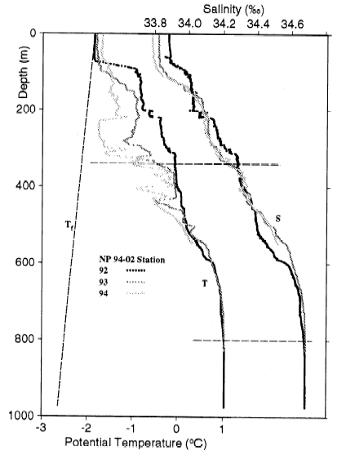
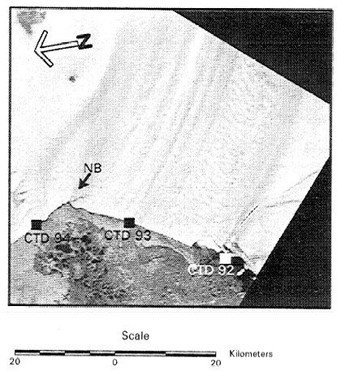
Oceanographic inputs
profiles of ambient temperature and salinity from Jacobs and others (GRL 1996)
33.8
-1.9
34.7
600 m
1.0

Slide 5
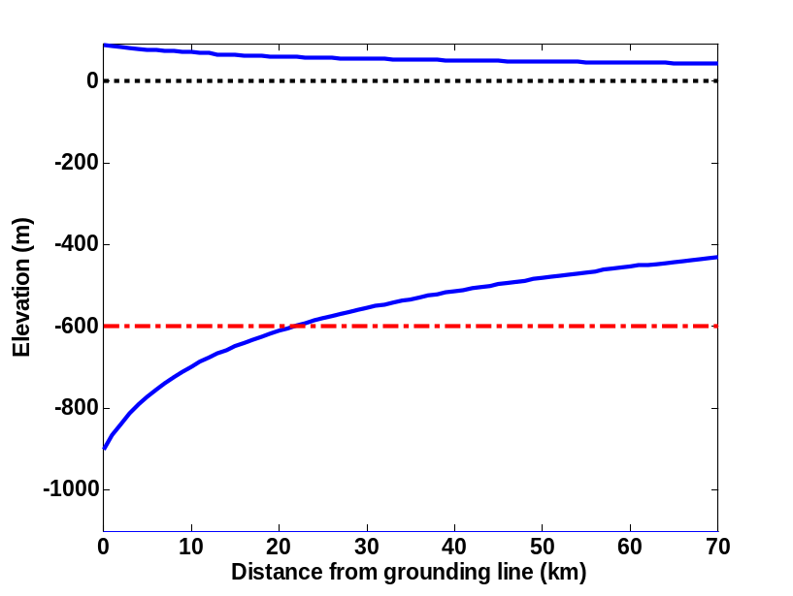
Glaciological inputs
profile of ice-shelf base van der Veen solution tuned to give observed thickness at grounding and shelf front
laterally constant
temperature gradient in basal ice (constant at 0.01 °C m⁻¹)
subglacial meltwater outflow (estimated at 3 km³ yr⁻¹) over ice stream width (~0.1 m)
impermeable lateral boundaries
40 km
70 km
90 km

Slide 6
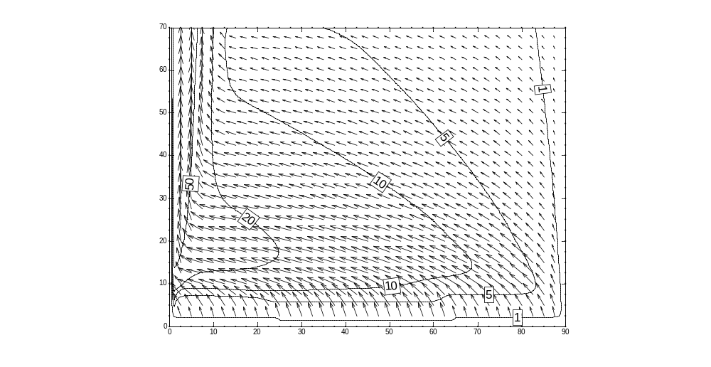
Standard results: evolution after 20 days
Velocity and plume depth (m)
Max. velocity 0.45 m/s.
Grid spacing 500 m (here shown every 2.5 km)

Slide 7
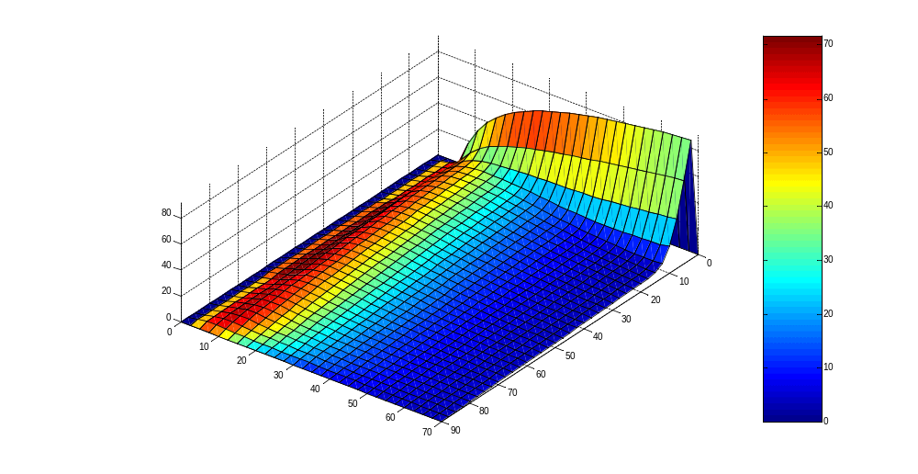
Standard results: evolution after 20 days
Melt rate (m/yr) and plume depth (m)
Grid spacing 500 m (here shown every 2.5 km)

Slide 8
Standard results: summary
Melt rate | m yr⁻¹
Mean model Maximum model | 25 72
Jacobs and others (GRL 1996) Oceanographic data mean | 10-12
Rignot and Jacobs (Science 2002) Ice budget mean maximum | 20-28 40-60

Slide 9
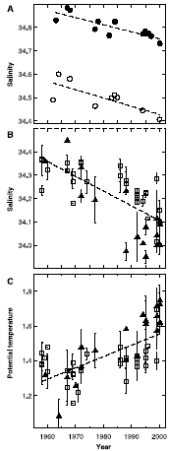
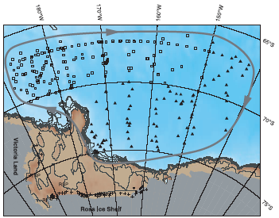
Oceanographic change
Robertson and others (Deep Sea Res. 2002) and Jacobs and others (Science 2002) observations for eastern Ross Sea
suggest warming ~0.3 °C and freshening 0.3 ‰ over last 40 years at 200-400 m
assume true for Amundsen Sea and apply uniformly with depth

Slide 10
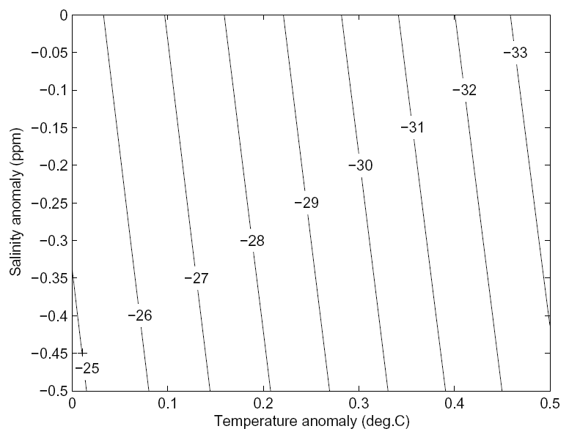
Perturbation experiment – melt rate as a function of temperature and salinity anomalies
Shepherd and others (GRL 2004) estimate thinning rates from ERS altimetry for Pine Island 3.4 to 4.4 m yr⁻¹
this is to the high end of what we estimate here

Slide 11
Effect of sub-shelf roughness
slows flow, reduces Coriolis and weakens boundary current
Type of expt. | Value | Symbol | Mean melt | Melt change
No Coriolis | - | ○ | 53.4 | 13.8
Drag coeff. | 0.0025 | - | 25.5 | 8.2
 | 0.0250 | ◊ | 34.4 | 9.4
Amplitude of corrugation | 0 m | - | 25.5 | 8.2
 | 50 m | * | 33.9 | 10.8
 | 100 m | + | 41.5 | 7.8

Slide 12
Summary
melt rates concentrated at GL (warm water at depth) and in boundary current (high velocity)
perturbation experiments forced using observed changes in oceans reproduce estimated thinning rates
sensitivity estimated as 16-20 m yr⁻¹°C⁻¹ compared to Rignot and Jacobs [Science 2002] sensitivity 10 m yr⁻¹°C⁻¹
results suggest warming of ~0.5 °C would be sufficient to explain thinning

Slide 13
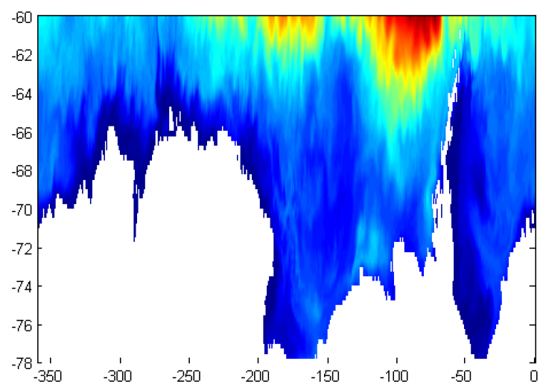
OCCAM global ocean circulation model
0.25° global grid, 66 levels
spun up by restoring to Levitus 1994 data for 4 yrs
forced with NCEP 6-hourly data 1985 to 2003

Slide 14
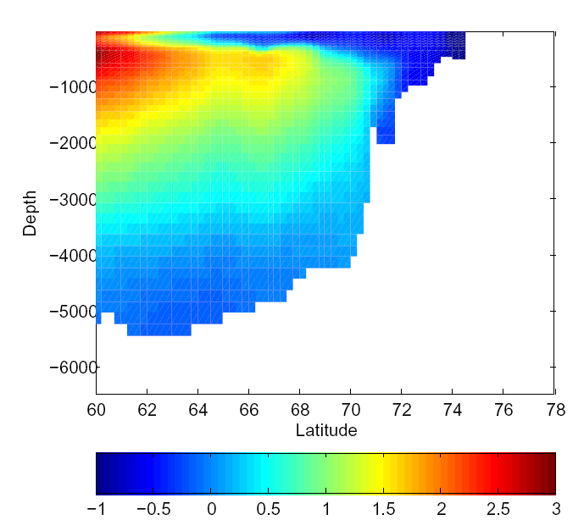
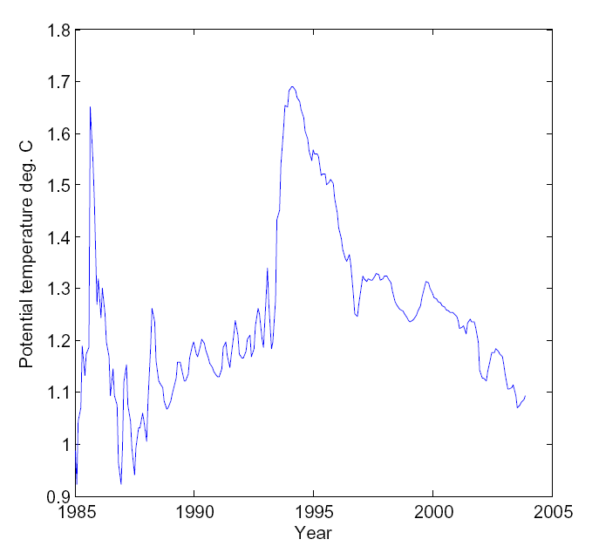
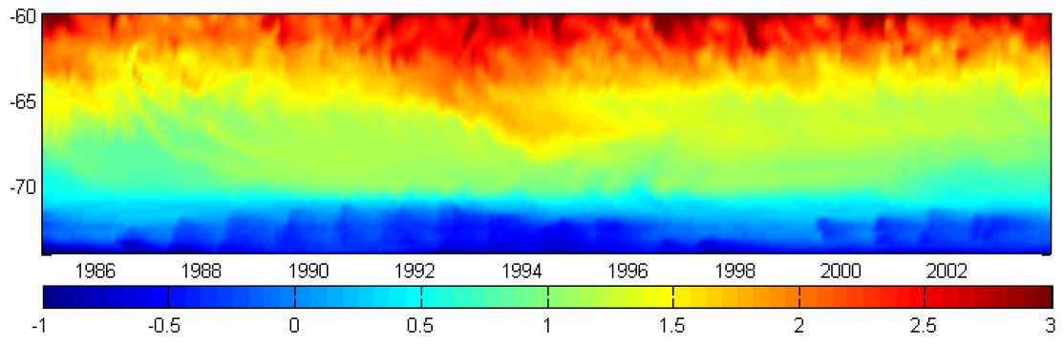
CDW?
Max. water temperature as a function of latitude and date

Slide 15
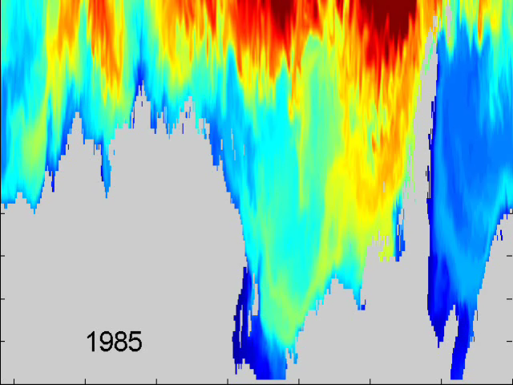
Movie of mean water temperature between 400 and 1000m depth

