Slide 1
Subsurface melting on
Iceberg C16, (Ross Sea)
Olga Sergienko and Douglas R. MacAyeal
The University of Chicago

Slide 2
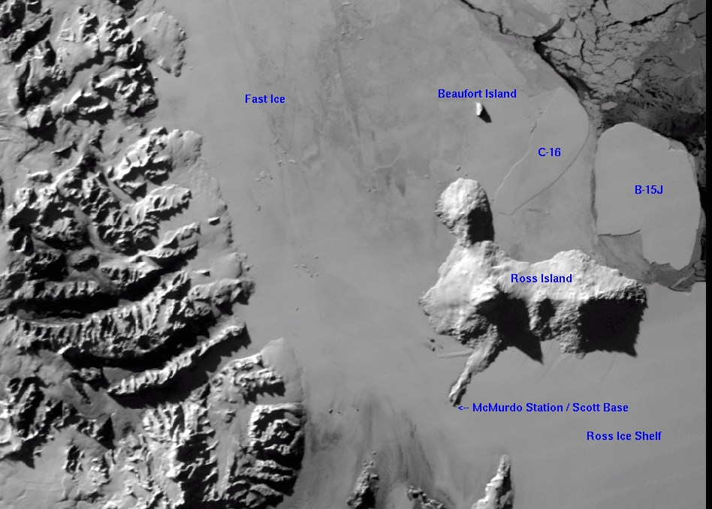
MODIS Image, Sep. 19,2005

Slide 3
In situ density and temperature measurements (Nov 2004)
Long term observations

Slide 4

Ice layer
2 cm

Slide 5
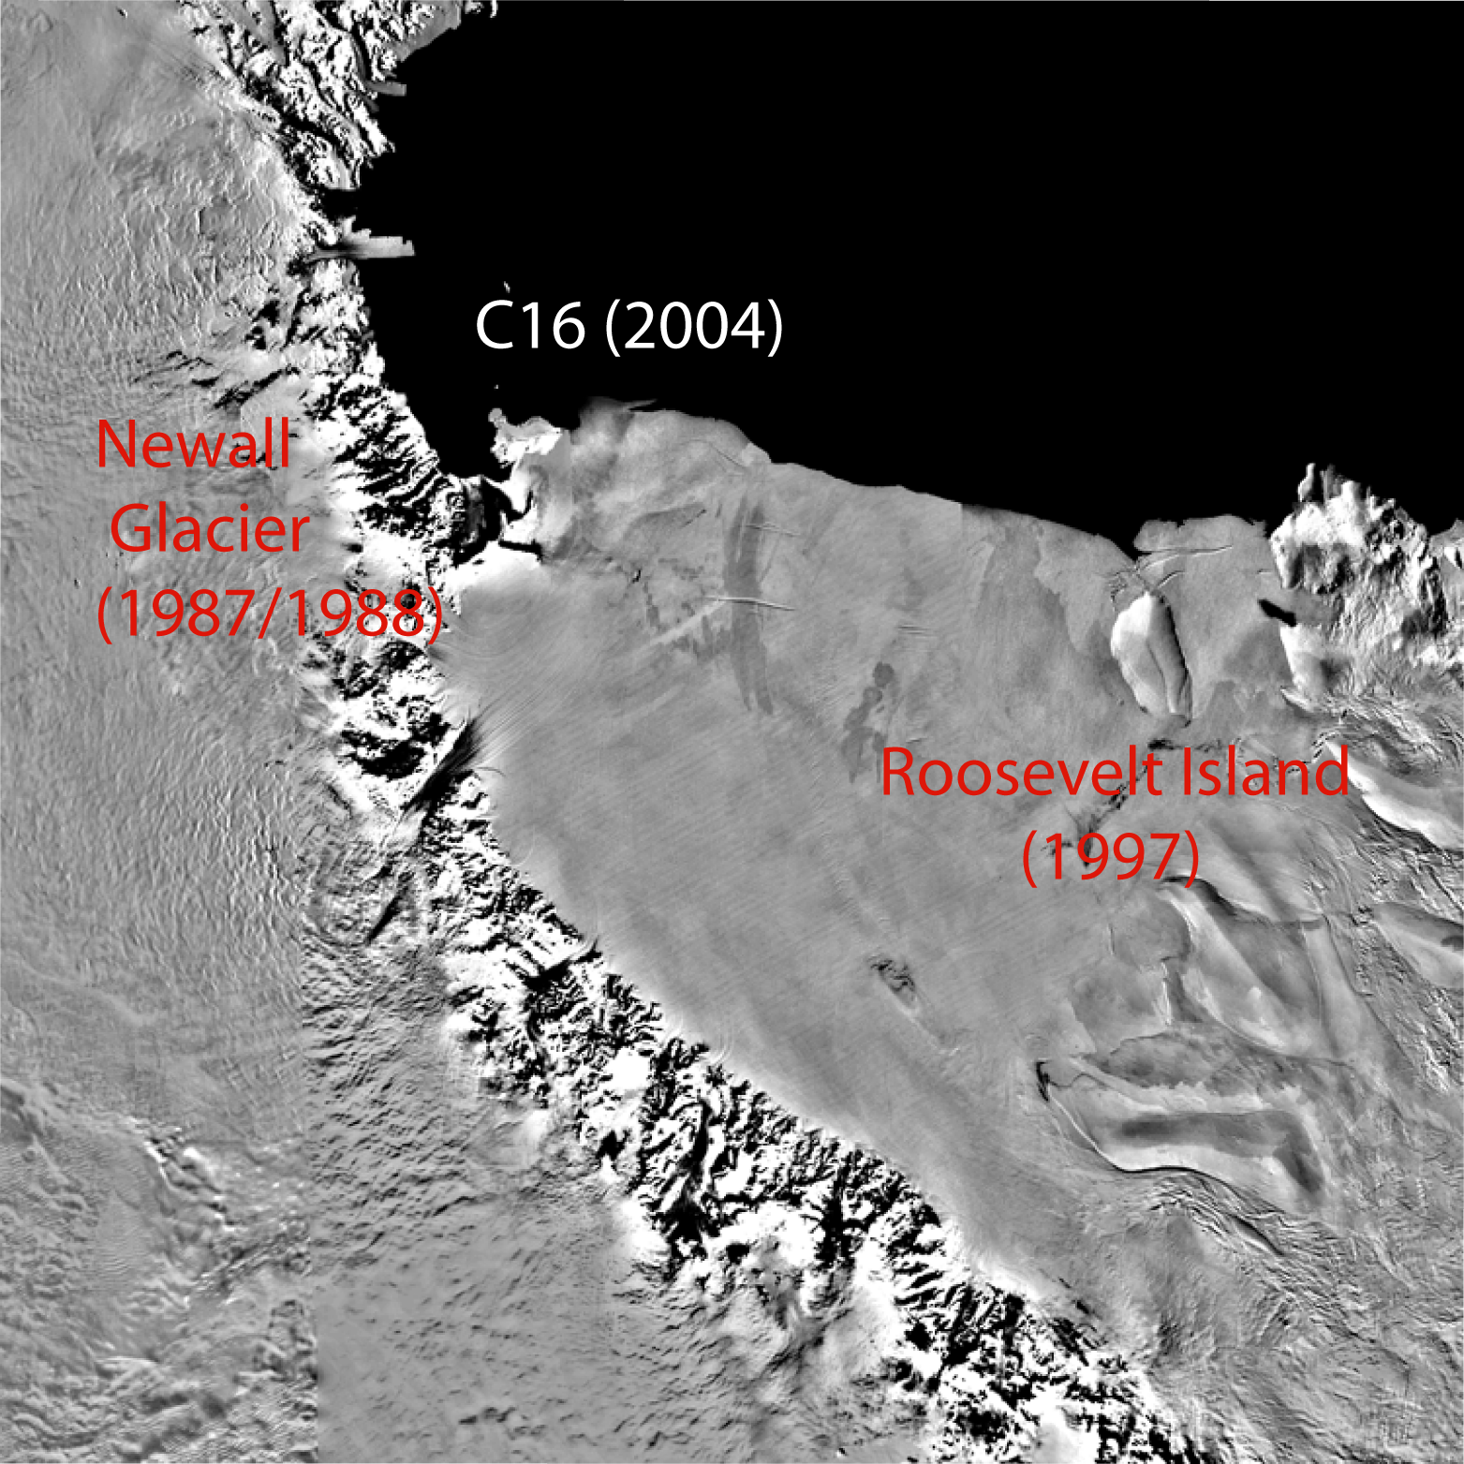
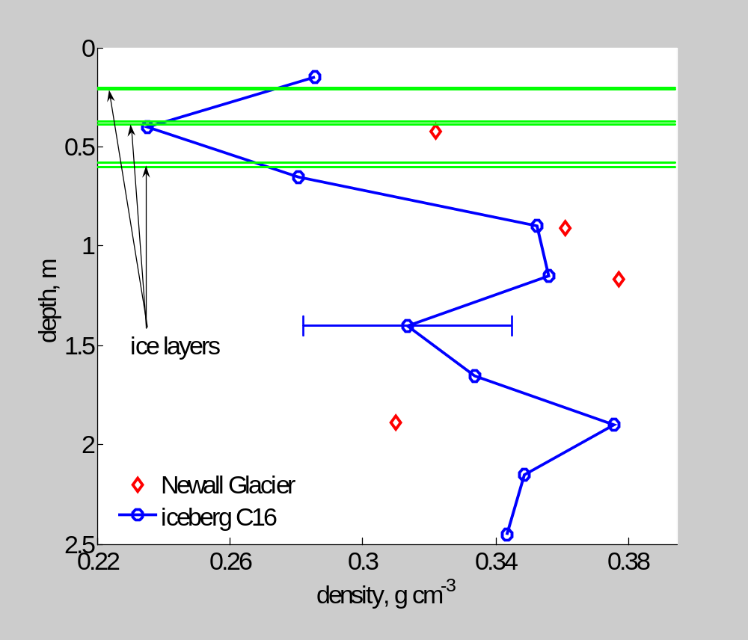
In situ density in the snow pit

Slide 6
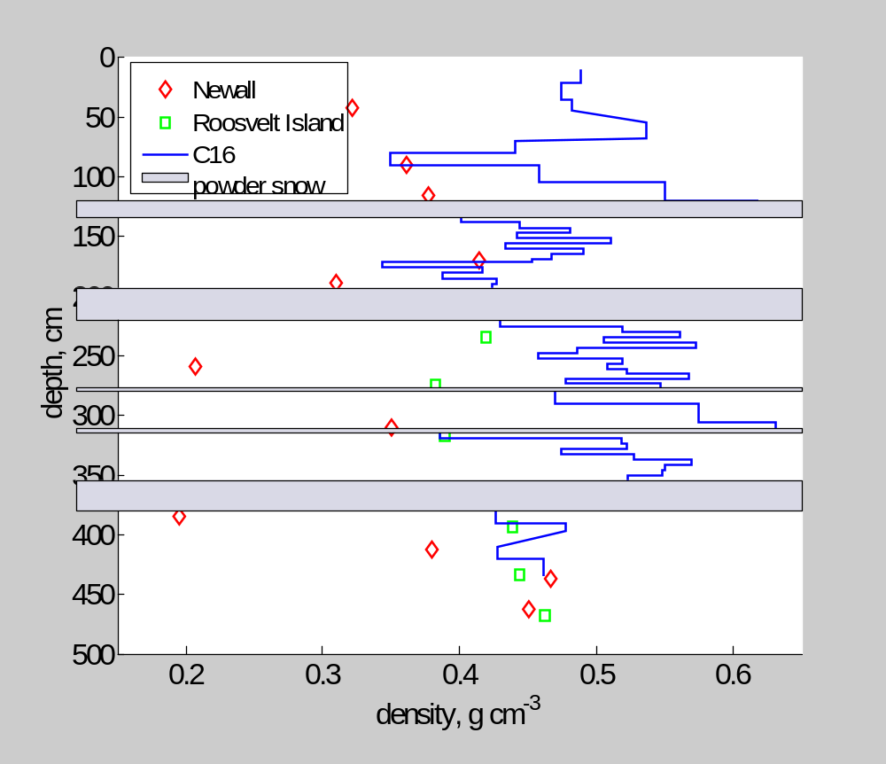
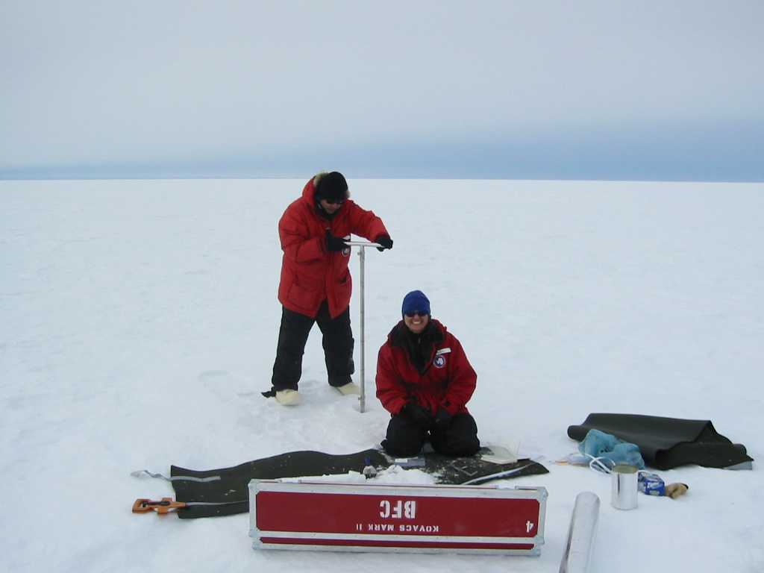
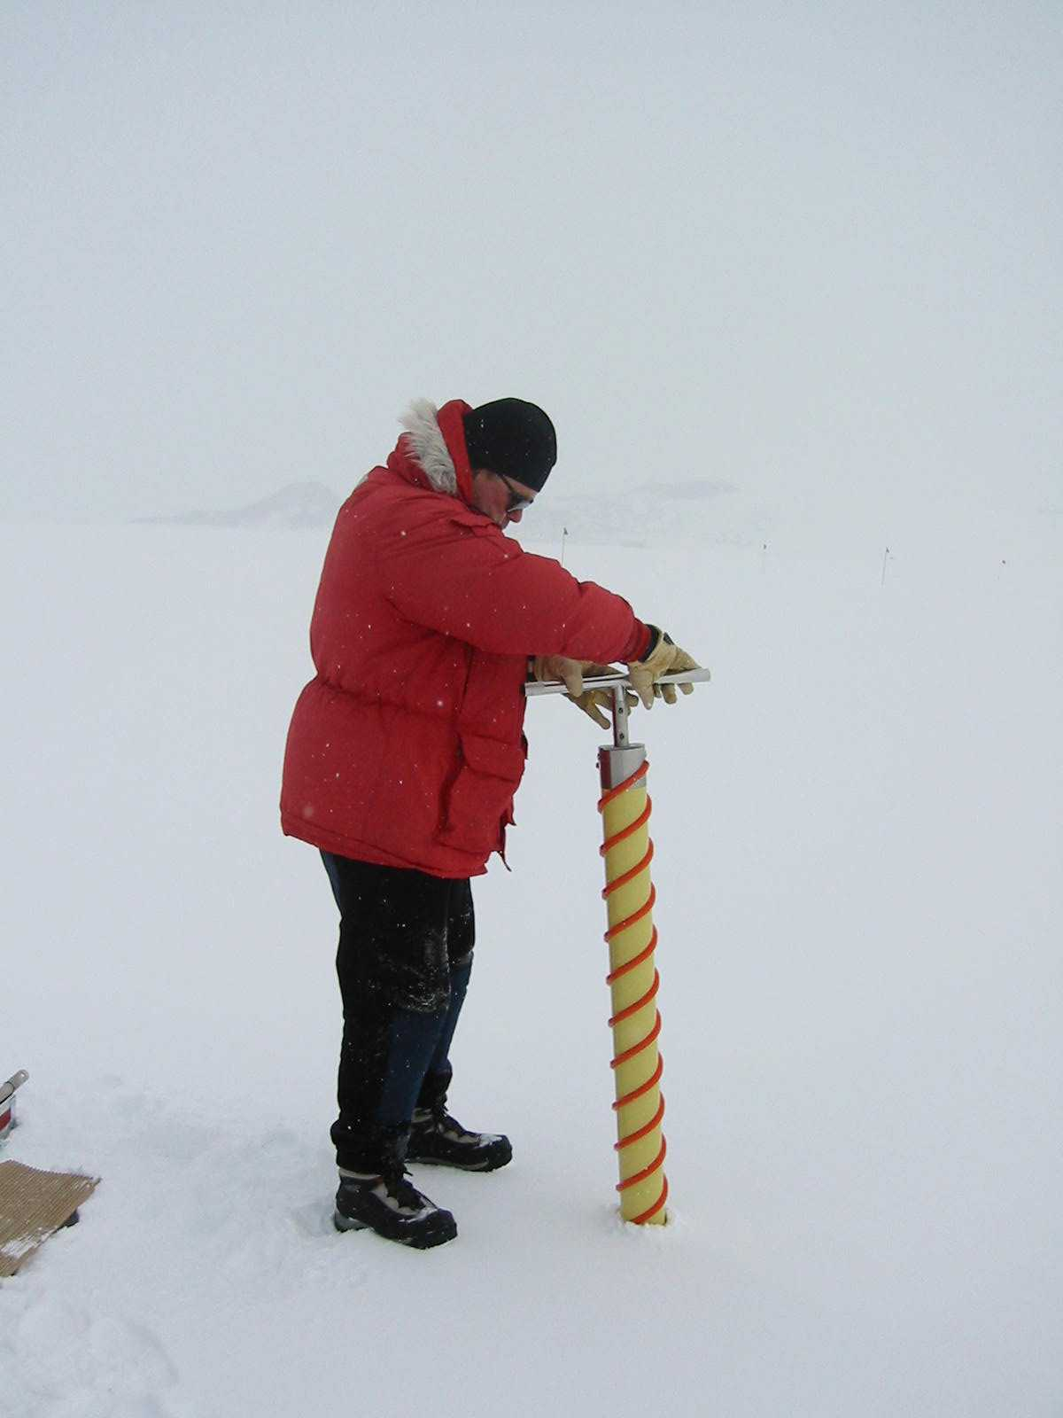
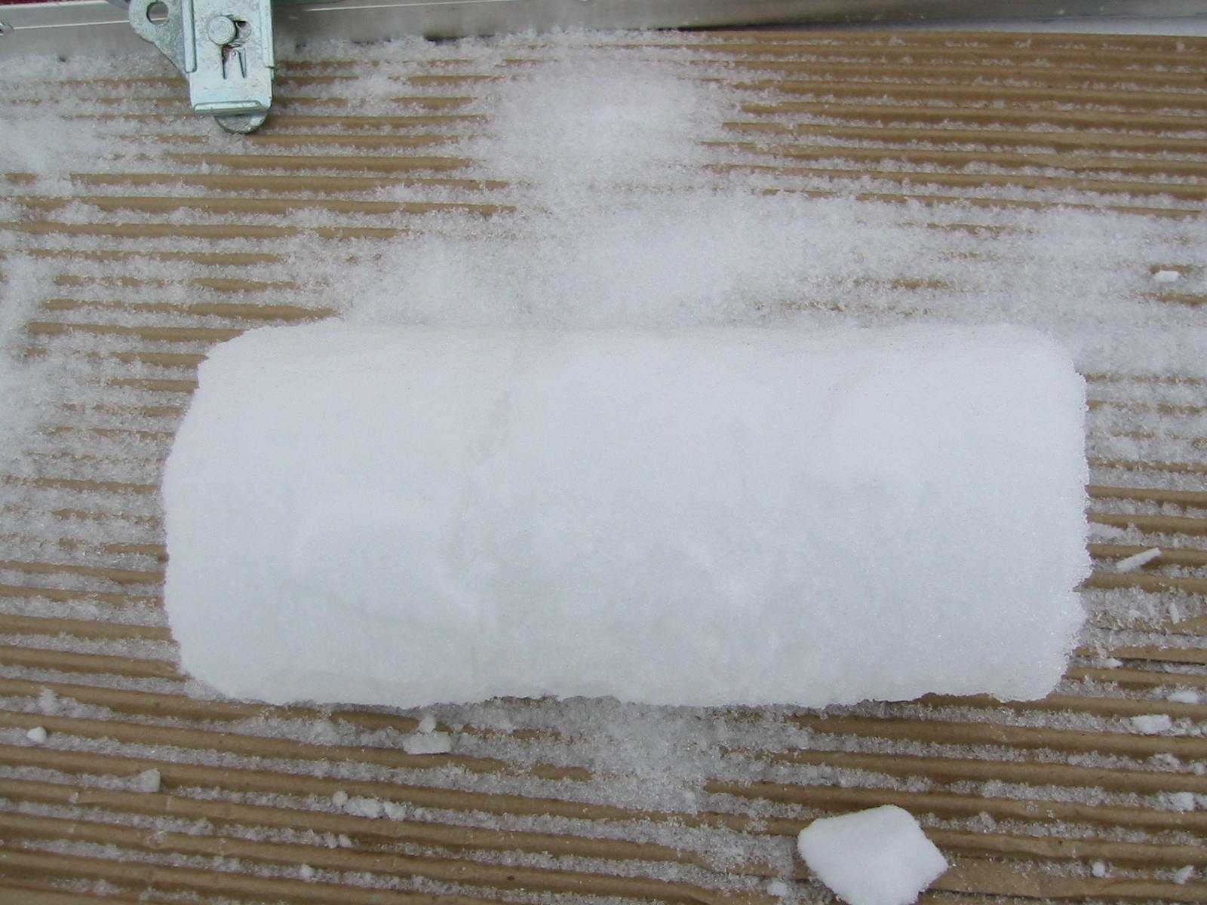
Firn core density

Slide 7
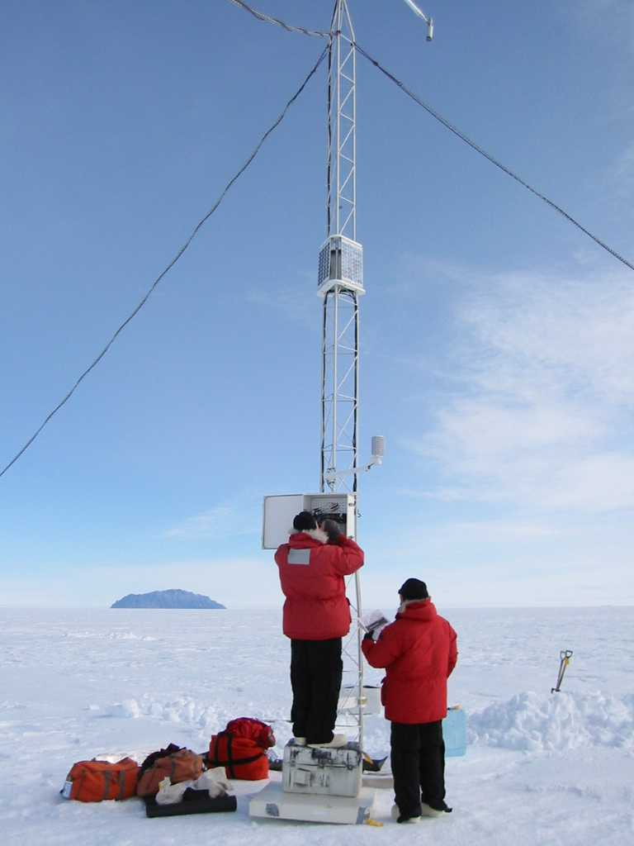
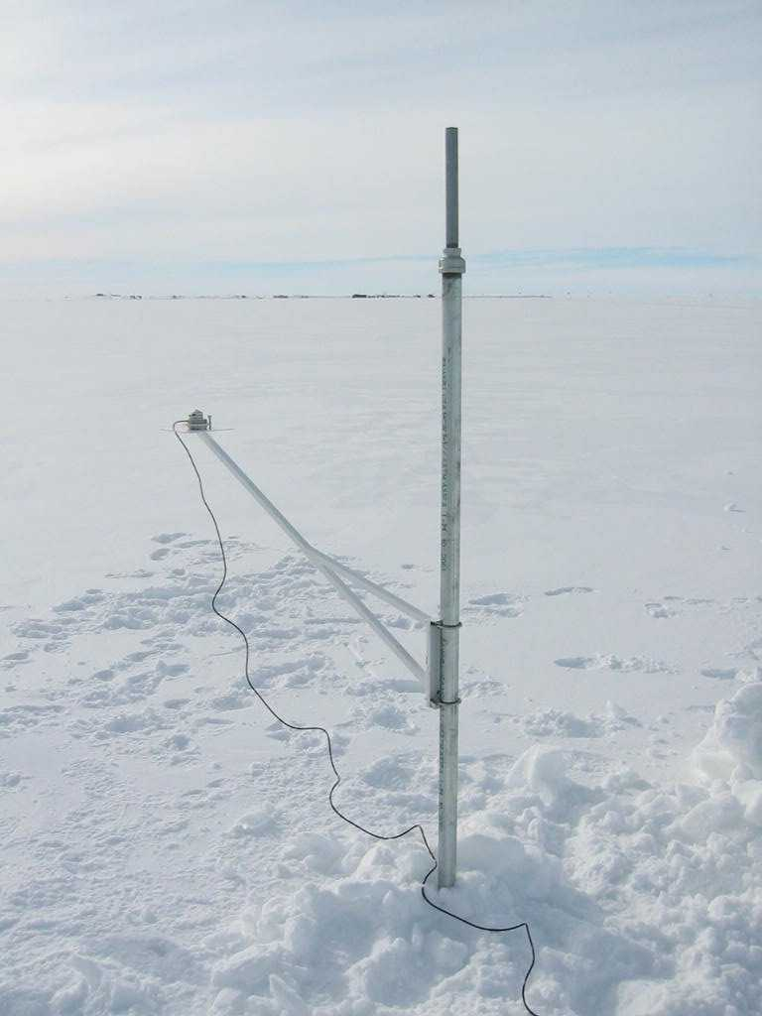
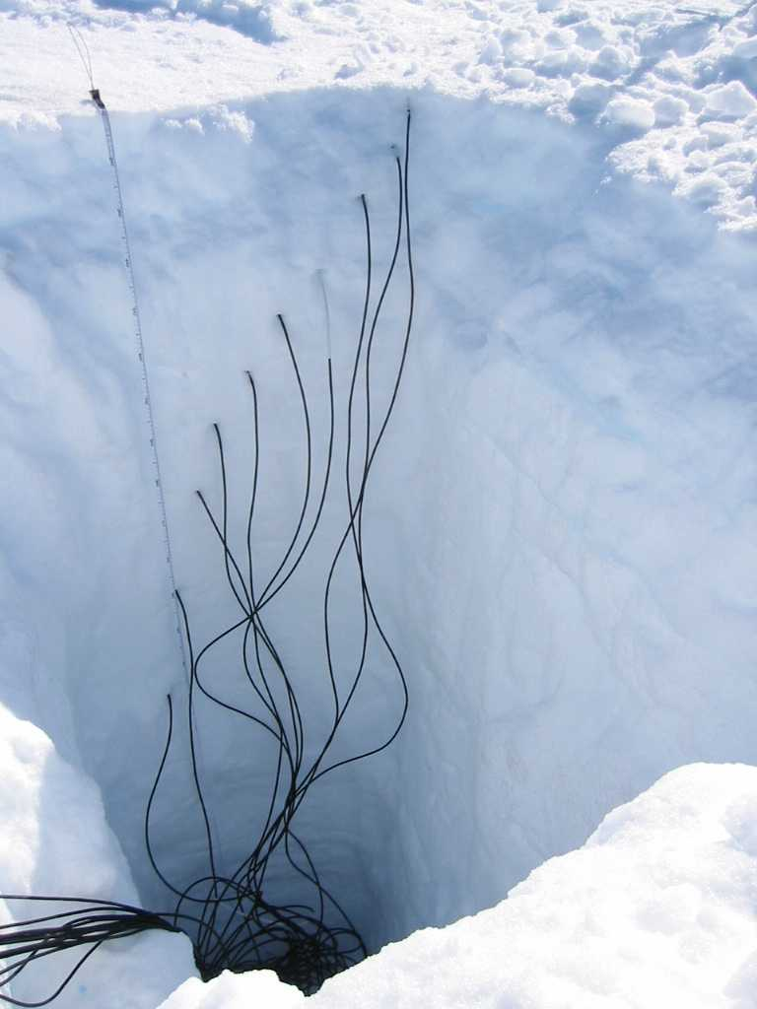
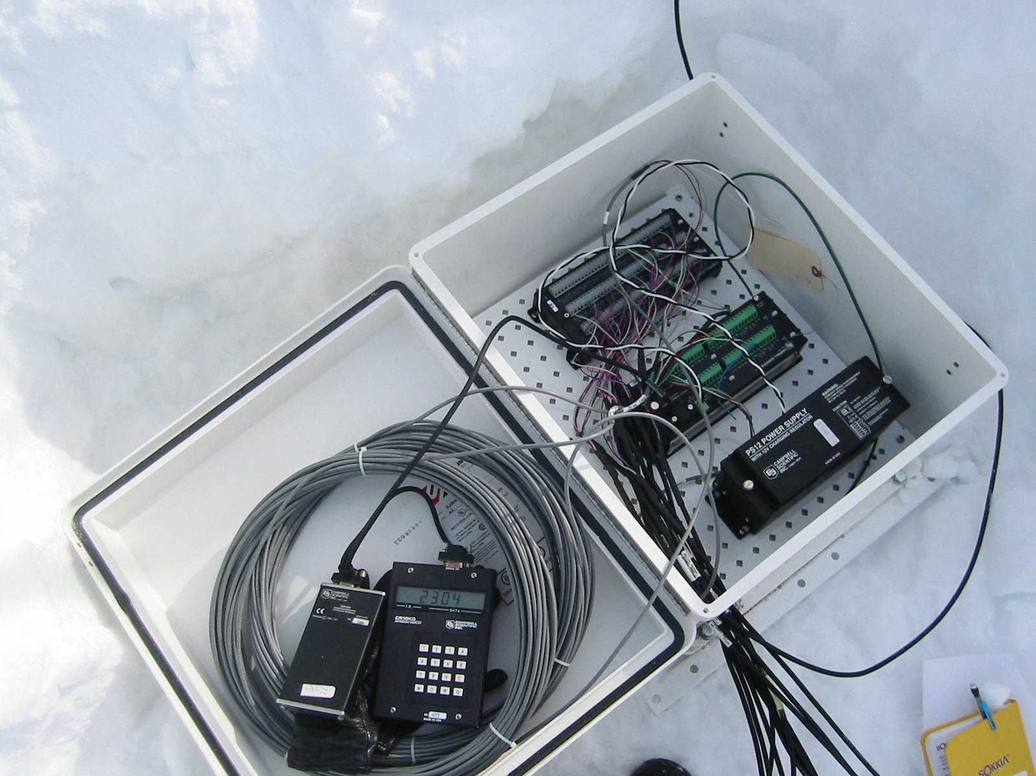
Long-term observation system
AWS
Pyranometer
Thermistors
Data Logger

Slide 8
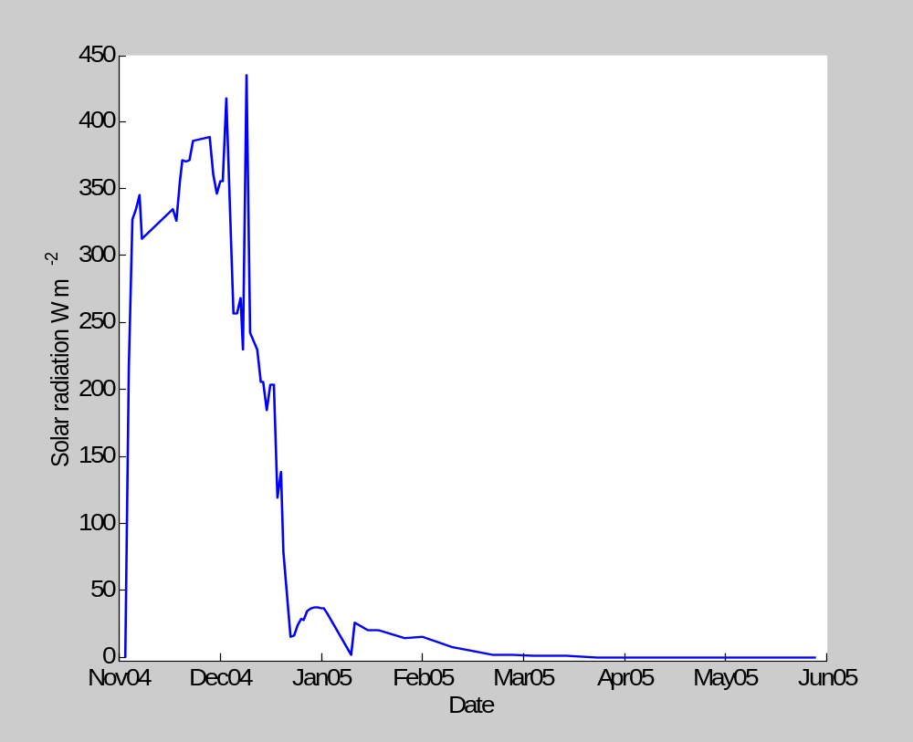
Solar flux, November 2004-Jun 2005

Slide 9
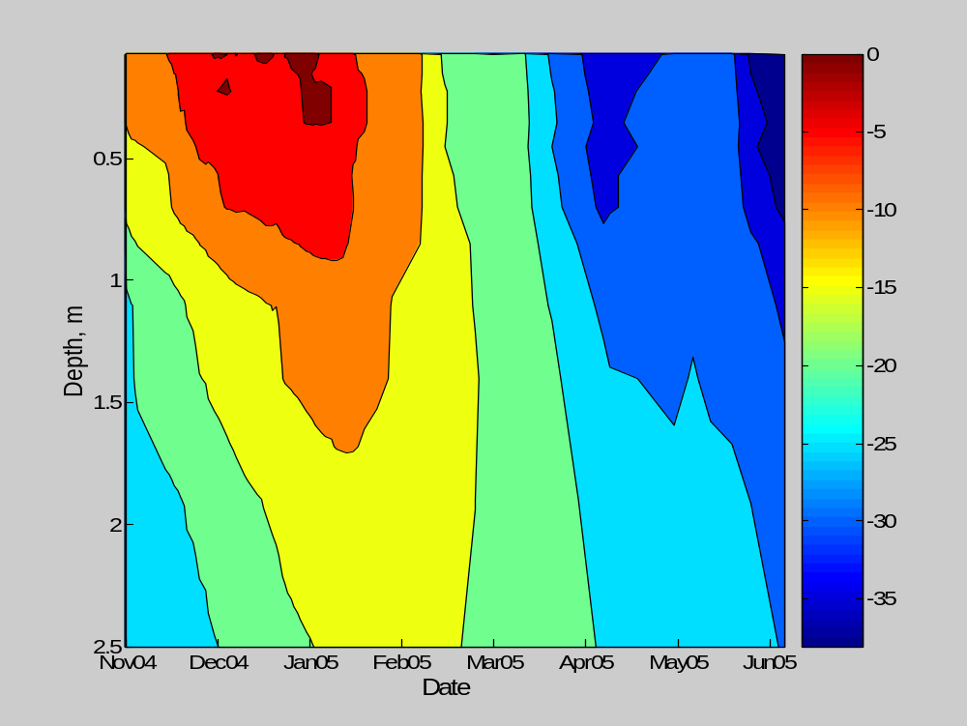
Temperature (ºC) of the 2.5 m subsurface layer, Nov 2004-Jun 2005

Slide 10
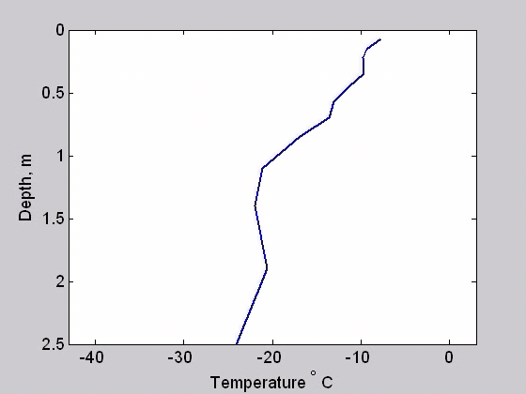
Temperature-depth profile, Nov 2004-Jun 2005

Slide 11
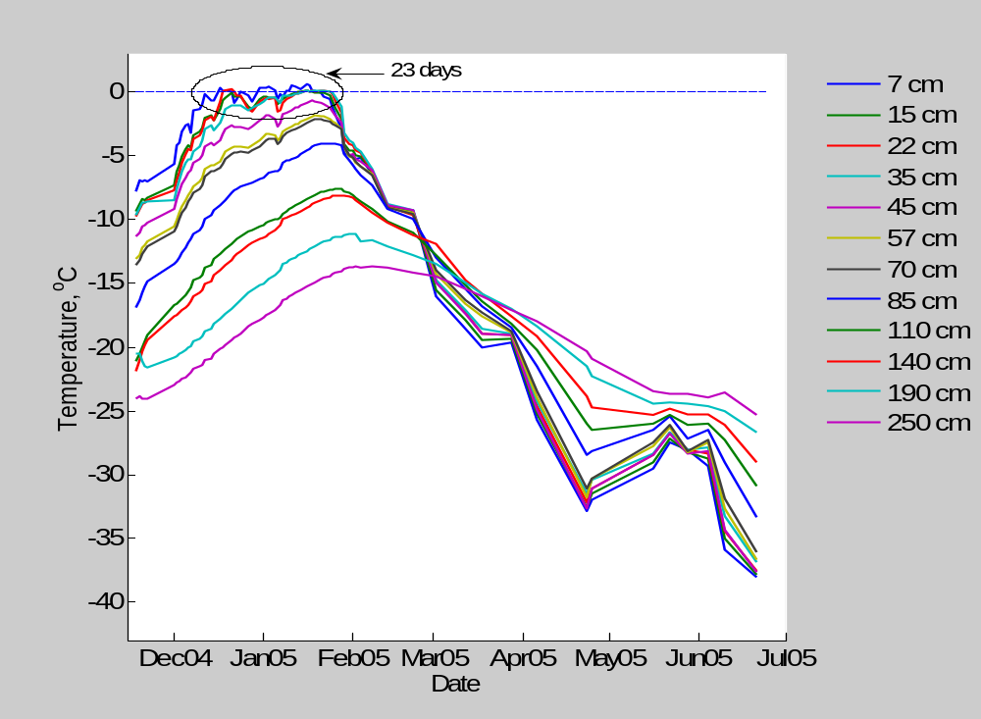
Thermistor temperature measurements, Nov 2004-Jun 2005

Slide 12
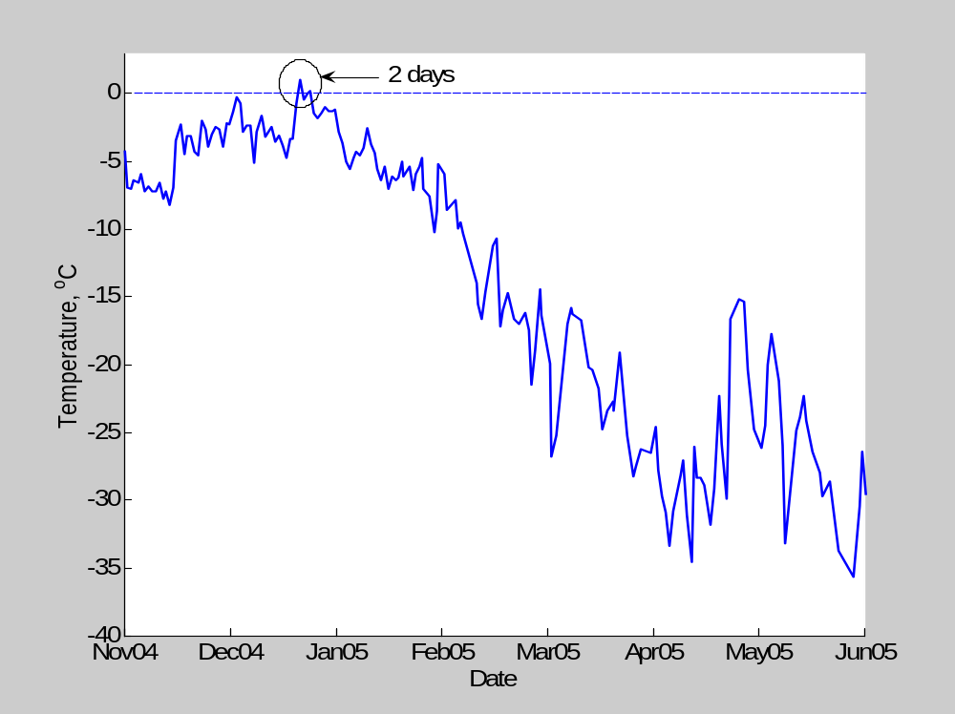
Daily-mean atmospheric temperature, Nov 2004-Jun 2005

Slide 13
Summary
Superimposed ice layers was observed on C16
Higher observed density on C16 suggests increased melting during last decade
Subsurface temperature was positive during 23 days of 2004/2005 austral summer
Improvement of the density measurement technique

