Slide 1
Control of Ice Stream Stick-Slip Mechanics by Frictional Healing
J. Paul Winberry, Sridhar Anandakrishnan, Chris Marone, Richard Alley, and Don Voigt
Penn State University
Robert Bindschadler
NASA
Matt King
University of Newcastle
Ian Joughin
University of Washington

Slide 2
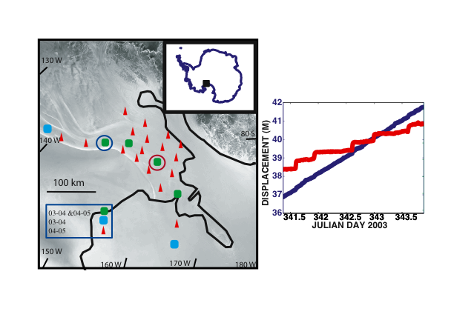
Stick-slip dominates the motion of Whillans Ice Plain (Bindschadler et. al, 2003)
-Two 10-30 minute slip events a day
-Accounts for > 50% of total motion

Slide 3
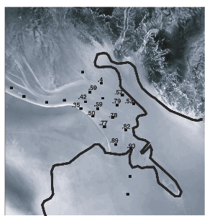
Whillans Stick-Slip
Fraction of Total Motion

Slide 4
Whillans ice plain is wide, > 100 km, limiting the importance of side drag
Simple models of stick-slip may provide insight into basal processes

Slide 5
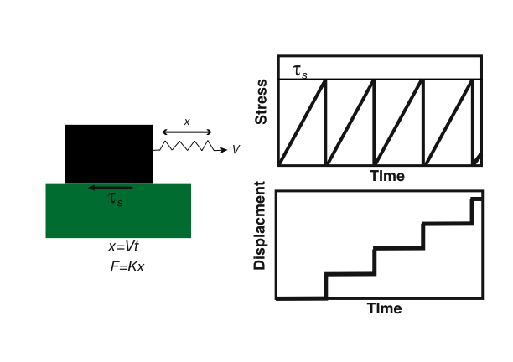
Slider Block Model of Stick-Slip

Slide 6
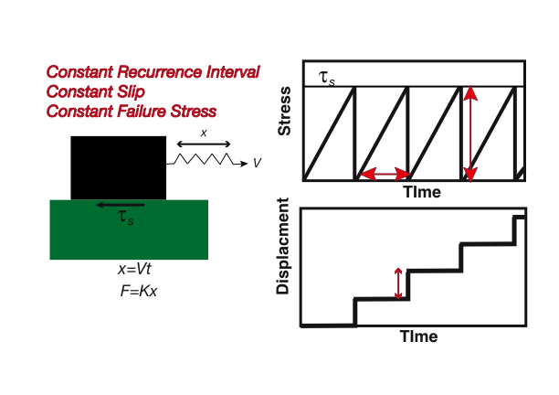
Slider Block Model of Stick-Slip

Slide 7
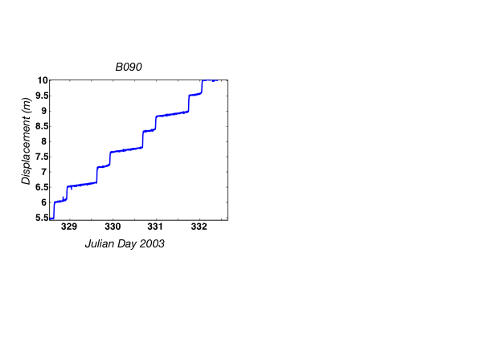
Whillans Ice Stream Stick-Slip

Slide 8
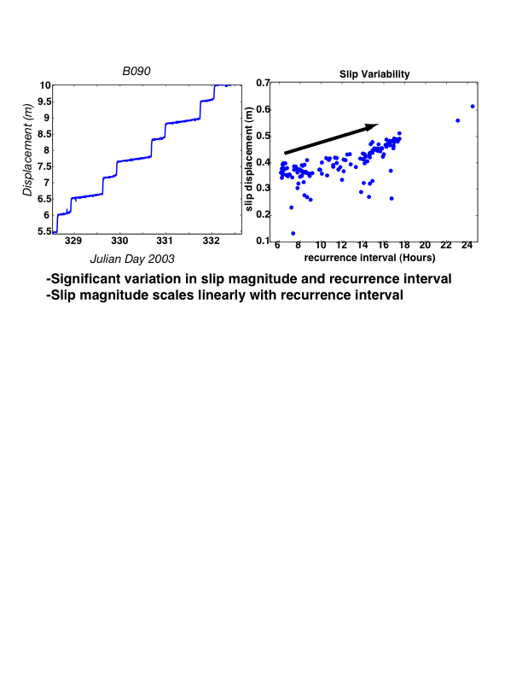
Whillans Ice Stream Stick-Slip

Slide 9
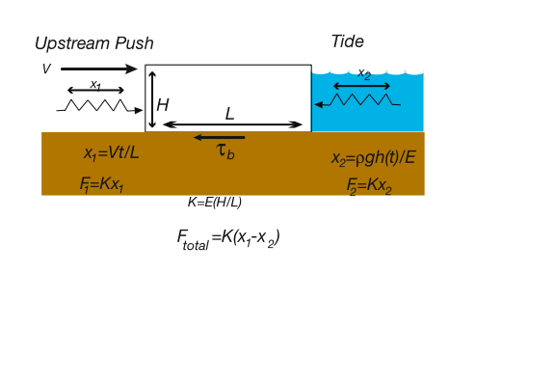
Ice Stream Stick-Slip Model
L=150km, V=700 m/yr, H=800m , E=10^10Pa

Slide 10
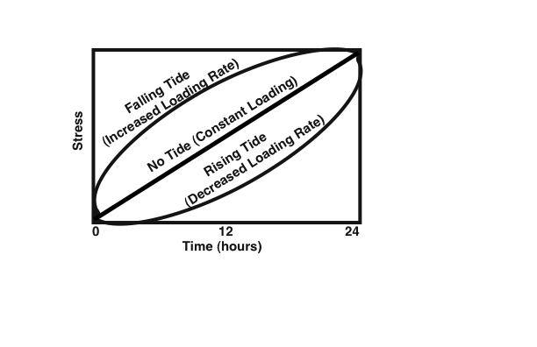
Ice Stream Stick-Slip Model

Slide 11
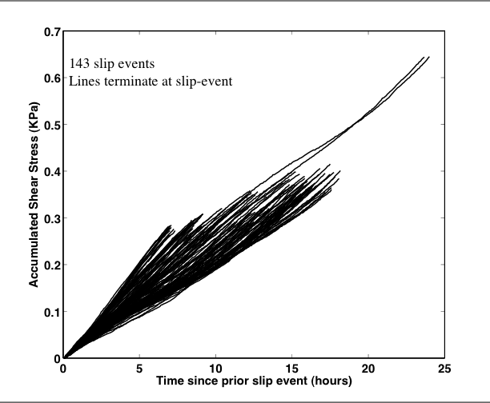
Basal Stress Evolution

Slide 12
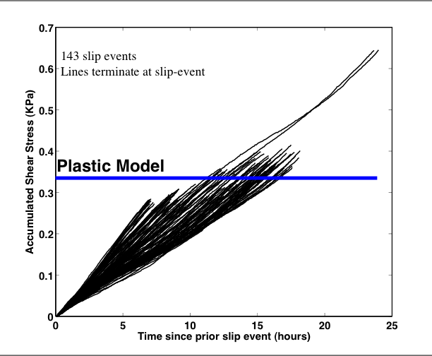
Basal Stress Evolution

Slide 13
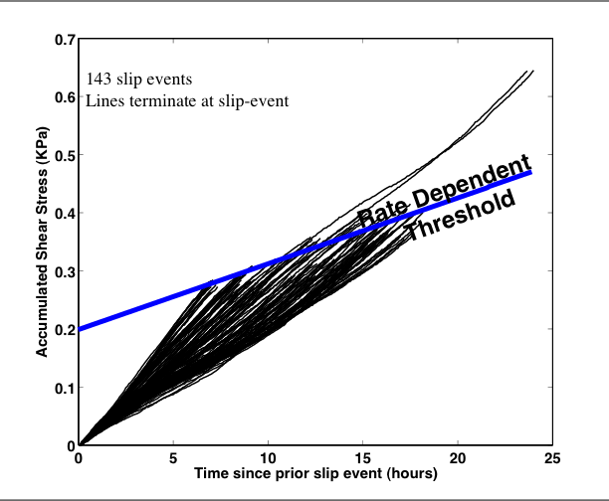
Basal Stress Evolution

Slide 14
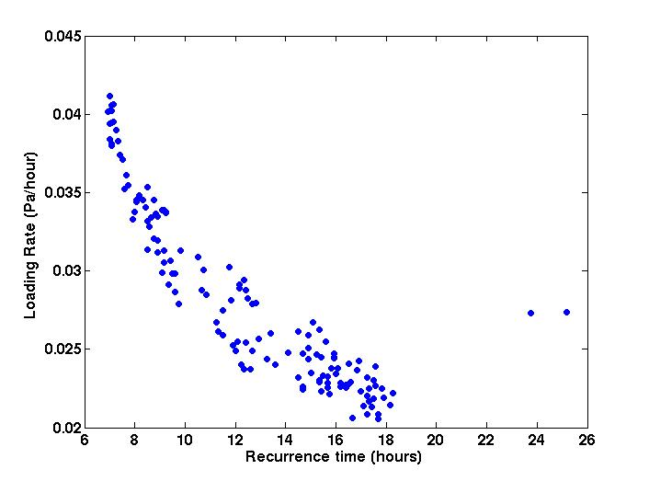
Frictional Healing:
A mechanism for slip variability
-Feature of laboratory studies of
stick-slip
-Healing mechanisms
Subglacial till due to its
rate-dependence
(Iverson, 1998, Tulaczyk,2000)
2) Freezing onto sticky spots
-Time of failure is dependent on
loading rate

Slide 15
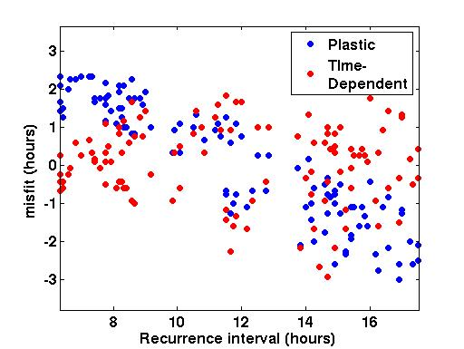
Recurrence Interval Variability

Slide 16
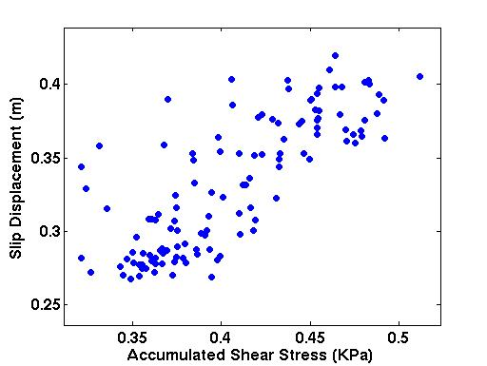
Slip Magnitude Variability

Slide 17
Conclusions
A perfectly plastic bed cannot explain slip variability.
Basal shear strength beneath Whillans exhibits sub-daily variations in strength due to frictional healing.

