Slide 1

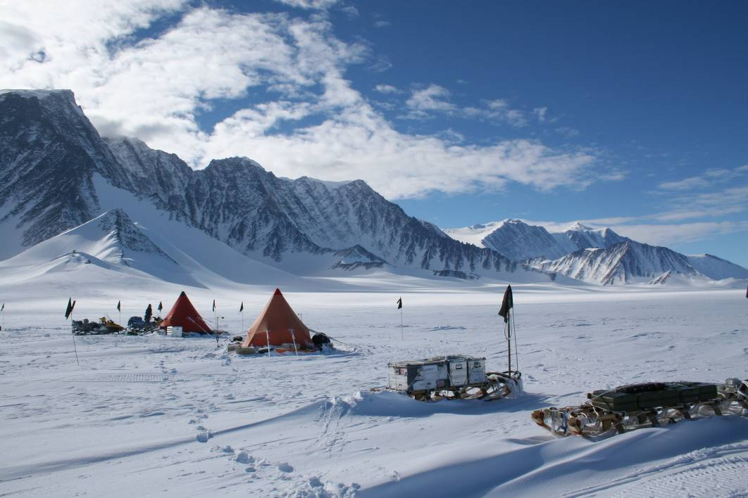
Glacial history and landscape evolution of the Ellsworth Mountains, West Antarctica
Mike Bentley
(Dept of Geography, Durham University)
NERC AFI 5/03
Timing and rates of ice sheet thinning in the Ellsworth Mountains, Weddell Sea embayment: constraints on West Antarctic Ice Sheet dynamics
Co-Is: Chris Fogwill, Alun Hubbard, David Sugden (all Edinburgh); Fin Stuart (SUERC)

Slide 2
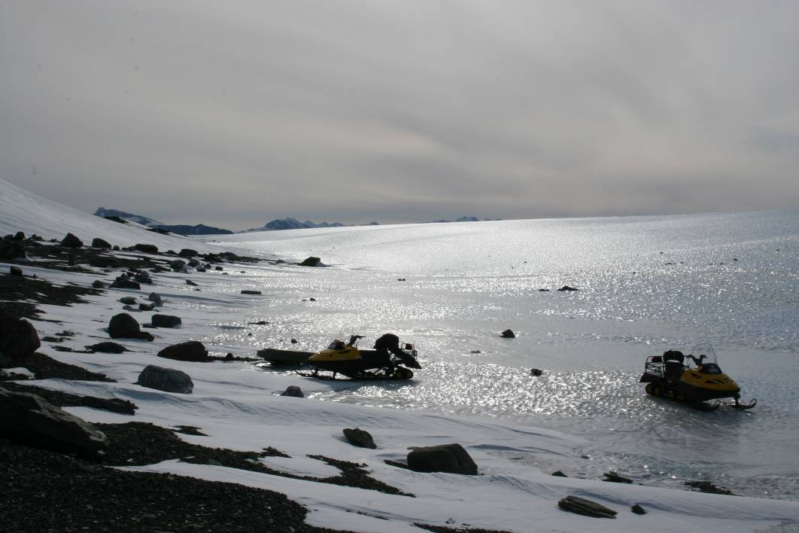
LGM configuration of WAIS
Ice volumes
  can’t yet quantify Antarctic ice volume
  Needed for models
  WSE is biggest unknown
When did ice start thinning and at what rate ?
Meltwater pulse 1A
  ~20m sea level rise in <600 years
  Weddell sea identified as candidate for source of MWP-1A but no geological evidence
Other Qs relating to deglaciation history e.g. influences on Weddell Sea oceanography
Address Qs using: geomorphology, and
cosmogenic surface exposure dating

Slide 3
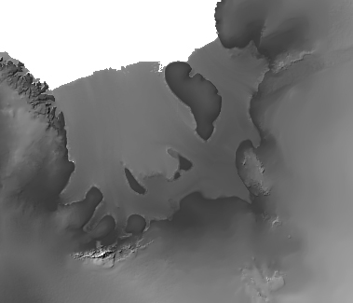
Ellsworth Mountains as a ‘dipstick’ for Weddell Sea ice

Slide 4
Retreat history of Weddell Sea ice
  Did the WAIS thin relatively early to a close-to-present configuration, or has it been thinning progressively from sometime after the LGM until the present day ?
Glacial-interglacial transition
OR
Height
of ice
?
?
Time
Time
now
now

Slide 5
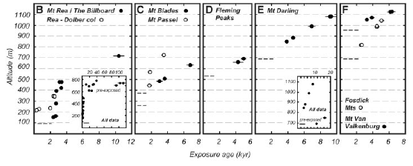
Ross Sea region
Stone et al., 2003. Science

Slide 6
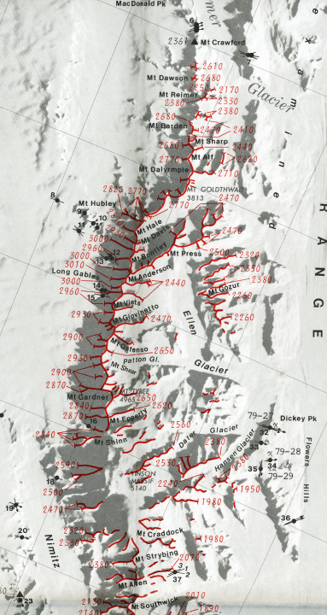
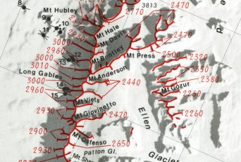
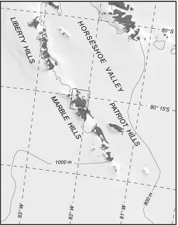
Previous work in Ellsworths
Denton et al., 1992, GSA Memoir
Todd et al., WAIS 2004

Slide 7
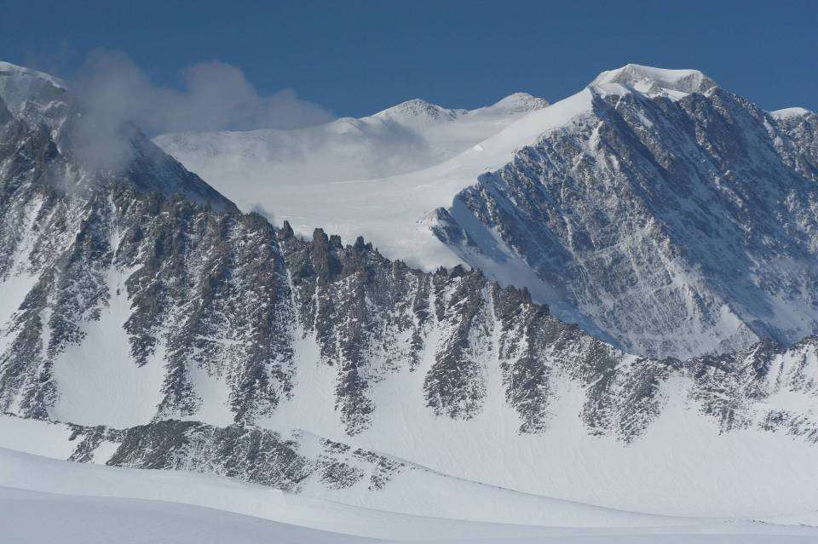
Mt Epperly, Sentinel Range
Denton et al trimline is of unknown age but has been widely assumed
to come from LGM

Slide 8
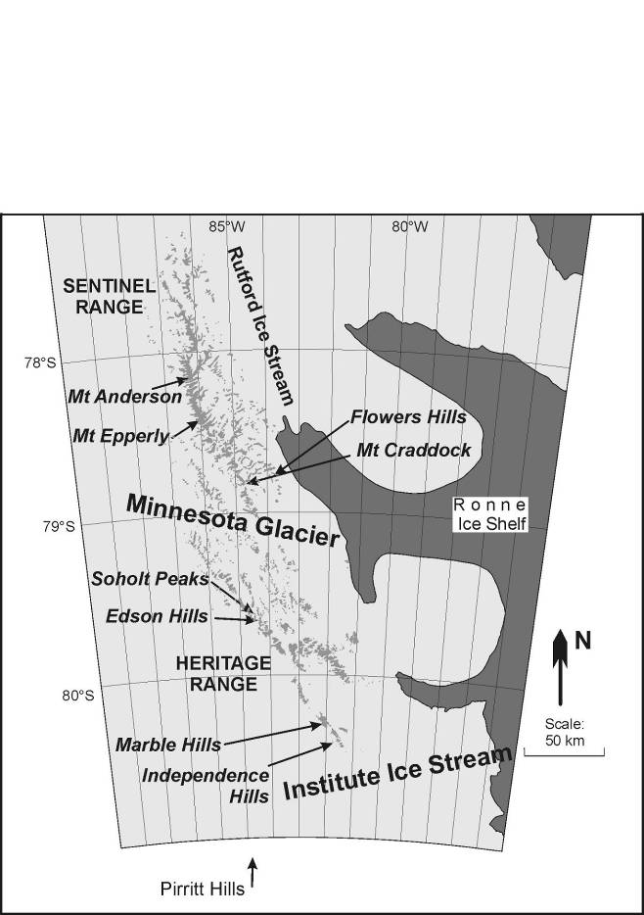
Patriot Hills

Slide 9
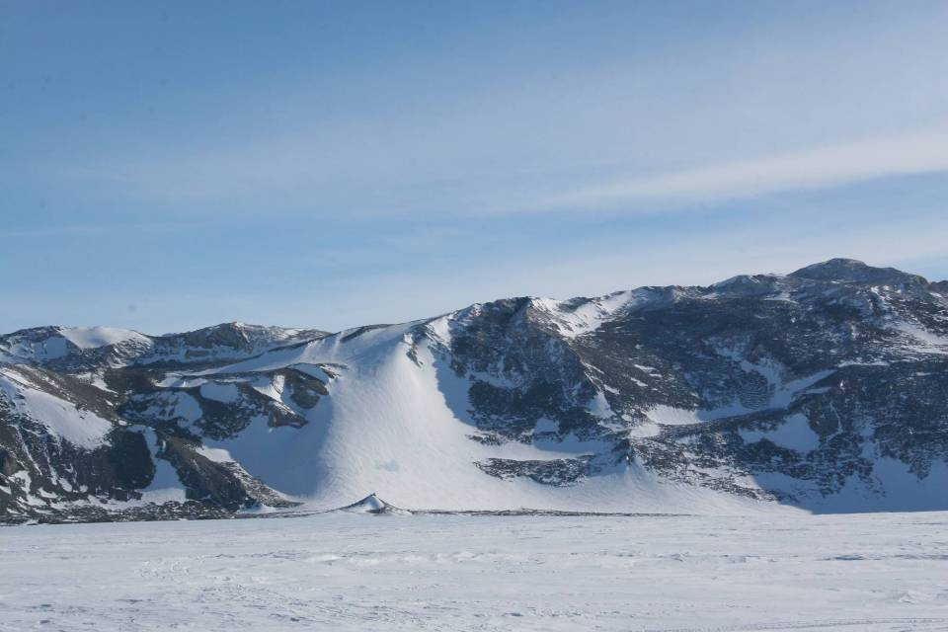
MAR-2-CJF, MAR-3-CJF,
MAR-4-CJF, MAR-5-CJF
MAR-01-MJB,
MAR-02-MJB
MAR-03-MJB
MAR-04-MJB
MAR-06-MJB
MAR-05-MJB
MAR-6-CJF, MAR-7-CJF,
MAR-8-CJF, MAR-9-CJF,
MAR-10-CJF, MAR-11-CJF
MAR-12-CJF, MAR-13-CJF,
MAR-14-CJF, MAR-15-CJF,
MAR-16-CJF, MAR-17-CJF
MAR-22-MJB, MAR-23-MJB,
MAR-24-MJB, MAR-25-MJB
Marble Hills (central)

Slide 10
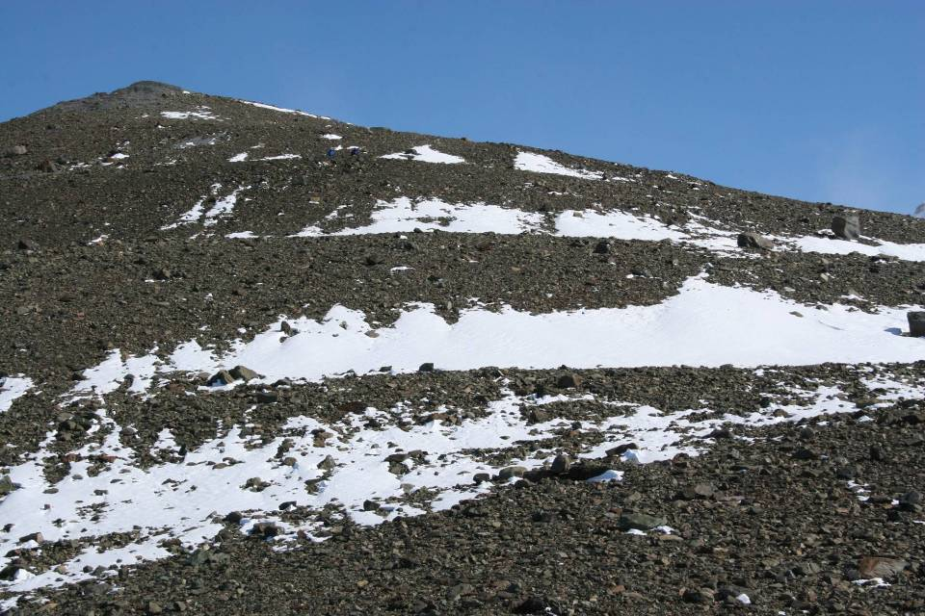
Edson Hills, Heritage Range.

Slide 11
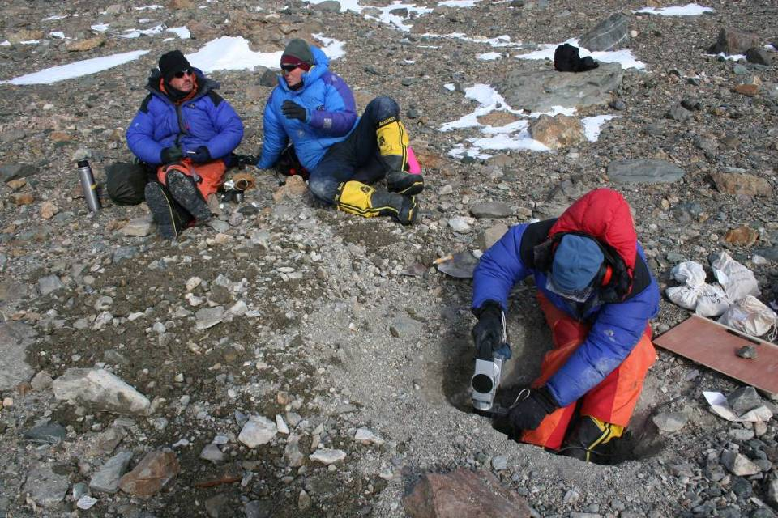
Soholt Peaks, Heritage Range

Slide 12
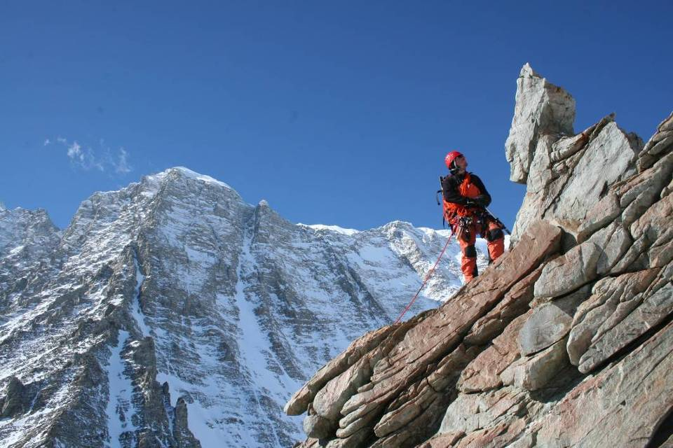
Mt Epperly, Sentinel Range.

Slide 13
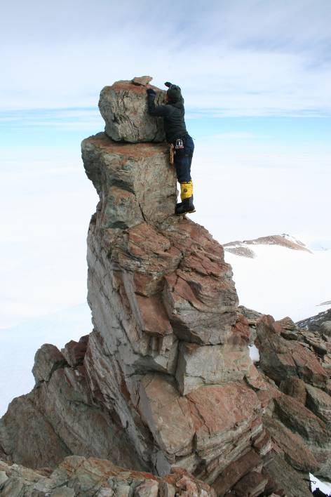
> 2 Ma
Long Gables, Sentinel Range.

Slide 14
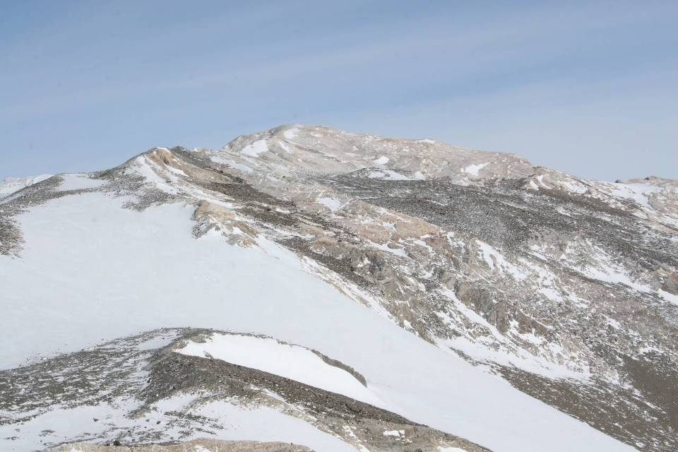
190 ka
~24 ka ?
Marble Hills, Heritage Range

Slide 15
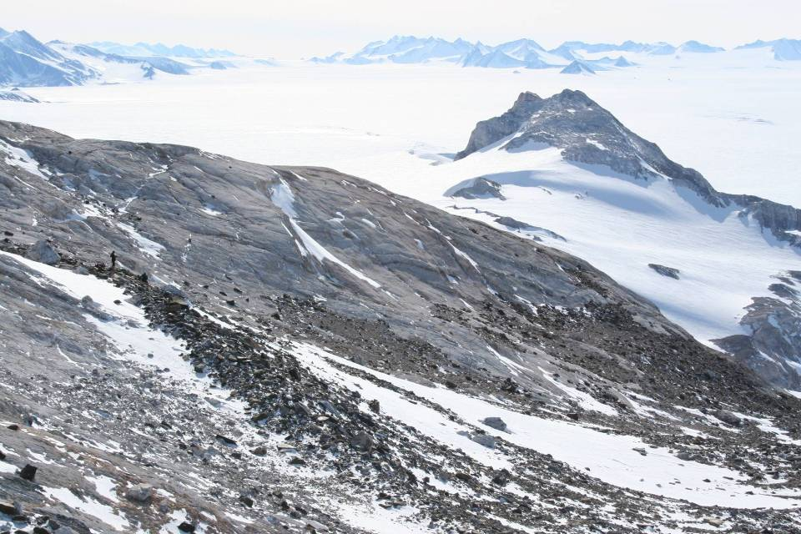
~24 ka ?
Marble Hills, Heritage Range.

Slide 16
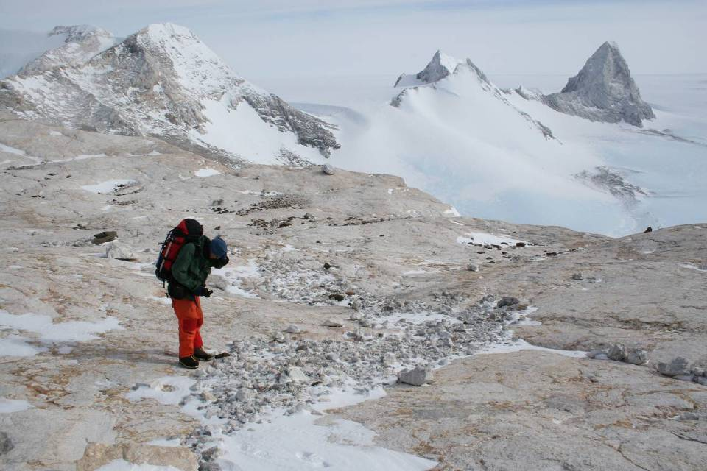
Summit of Marble Hills, and Minaret Peak, Heritage Range

Slide 17
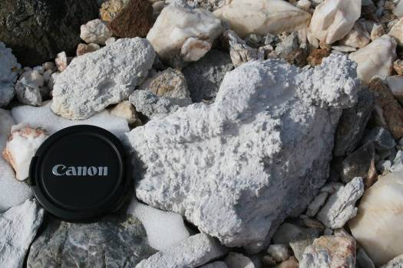
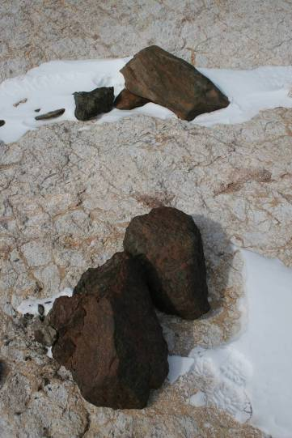
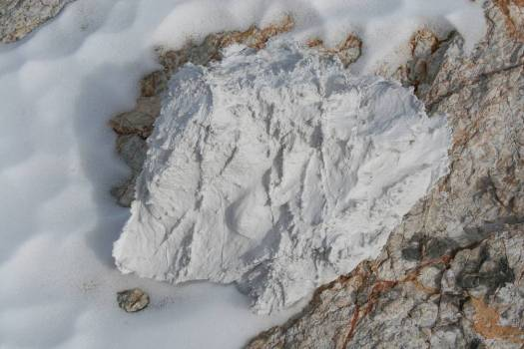
Summit of Marble Hills.

Slide 18
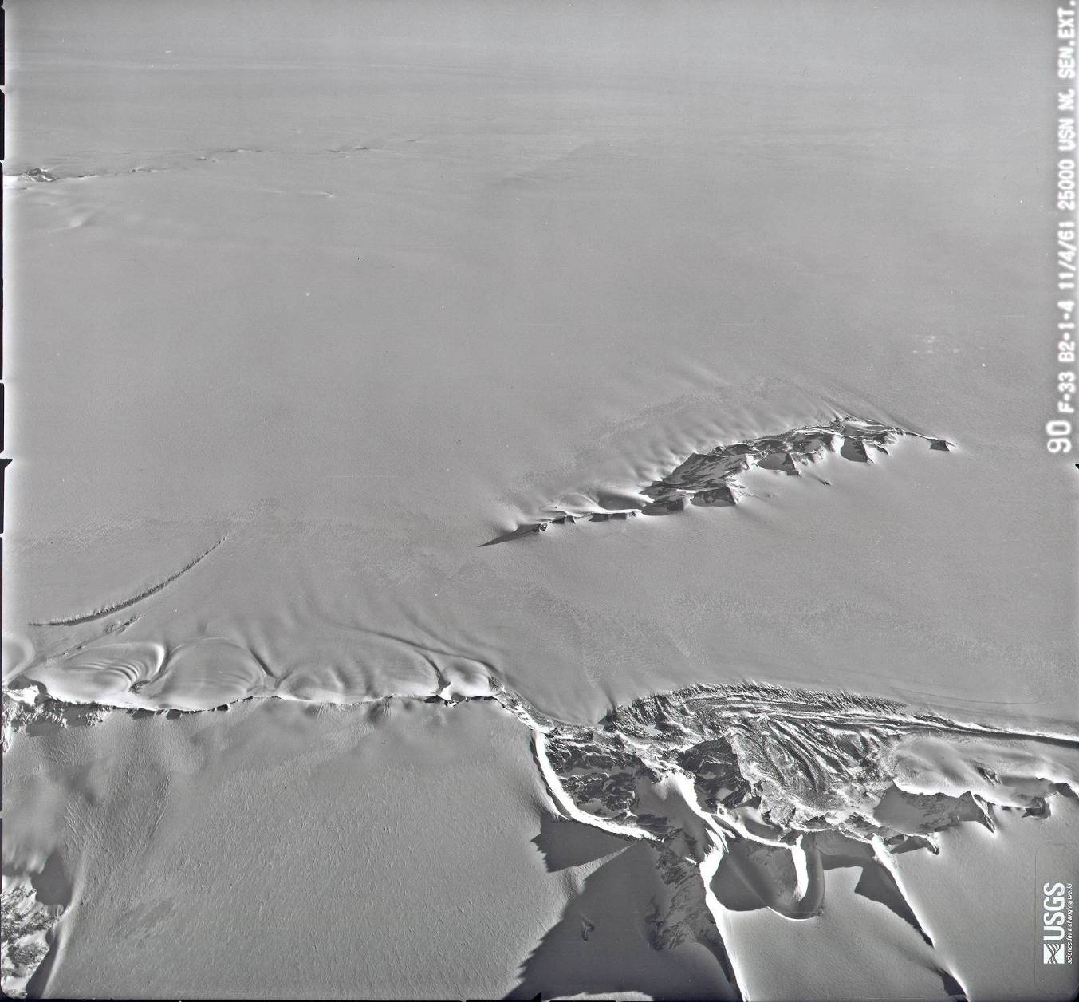
Blue-ice moraines and
ice dynamics
Patriot Hills
Independence Hills

Slide 19
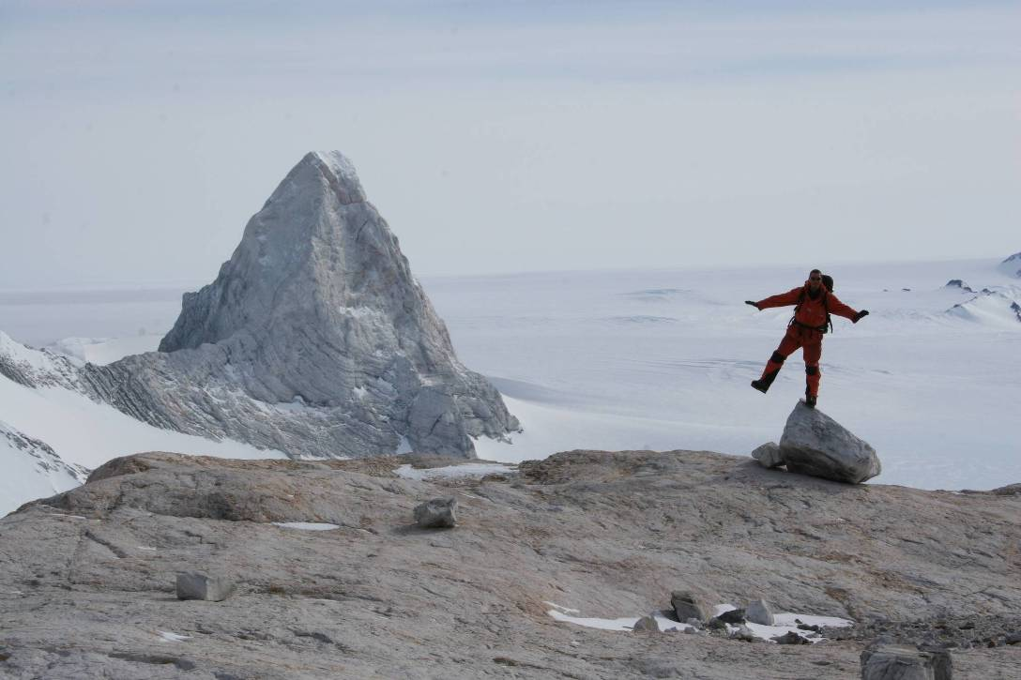
Summary of Glacial History and landscape evolution
Pre-existing fluvial landscape.
Summits, drainage valley pattern
Alpine Glaciation. Formed dominant topography of horns, aretes etc but didn’t completely destroy fluvial. [Very old – likely pre-Quaternary ?] (> 2Ma)
Major WAIS expansion prominent Denton et al (1992) erosional trimline [could be ‘old’ ] (>140-400ka)
Possible cold-based glaciation (?) to a level below (3).
WAIS expansion to intermediate level. [Probably LGM in age] (< 24ka ?)
WAIS thinning. Intermediate moraines
Minor WAIS expansion ? Shown by fluted (overridden) moraines at several sites in Heritage Range. Few tens of metres thickening.
WAIS thinning, possibly ongoing.
Preliminary cosmogenic surface exposure dates in bold

Slide 20
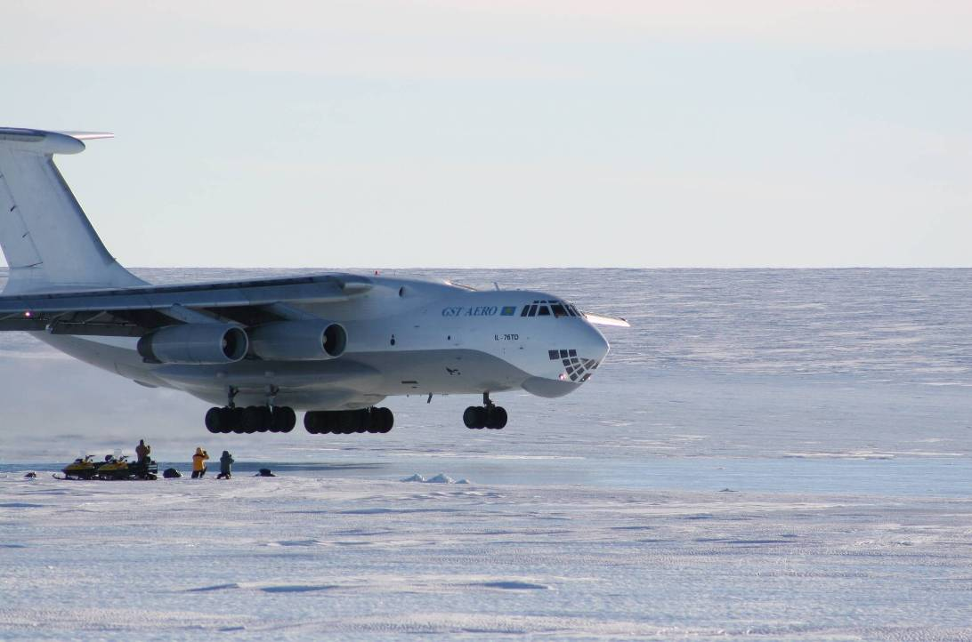
Conclusions
During the LGM the WAIS in the Weddell Sea embayment was much thinner (possibly half as much ice) than previously realised,
  we mapped this lower trimline over a 350 km transect
Main ‘Denton et al’ trimline is much older than thought
  -lots of weathering/geomorphological data
  -preliminary exposure age above trimline > 2 Ma
  -exposure ages below trimline suggest ice expansion > 140 ka
200+ samples from 11 sites (350 km transect) to test thinning hypotheses
  -each site consists of an altitudinal profile of samples
  -awaiting data on lower thinning history but moraine limit may be ~24 ka
Long history of landscape evolution
  -using mapping, image analysis and cosmo analysis

Slide 21
Next steps
Laboratory: cosmogenic 10Be, 26Al, 21Ne analyses – Chris Fogwill
Modelling: linking thinning history to grounding line movements - Alun Hubbard

