Slide 1
Finding subglacial water the "ICESat way" in rough terrain
Robert Bindschadler
Hyeungu Choi
Donghui Yi
Helen Amanda-Fricker

Slide 2
Problem
Repeat tracks are close and parallel, but NOT exact repeats
Cross-track elevation differences can be confused with temporal elevation differences
Correcting for cross-track topography could increase detection sensitivity and improve accuracy of measured changes
Observed Ground Track Footprint Location:
Reference Ground Track:

Slide 3
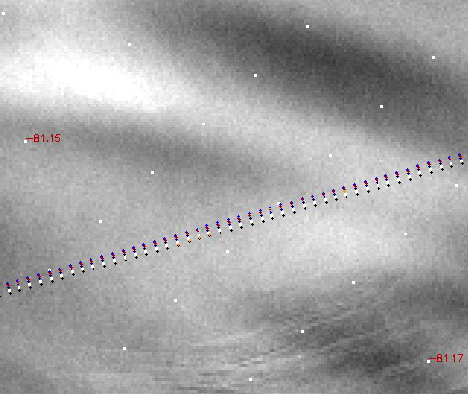
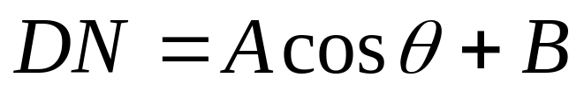
Our Solution
Use optical imagery’s independent measure of surface slope (in sun direction) to adjust profiles to a common track
θ
surface

Slide 4
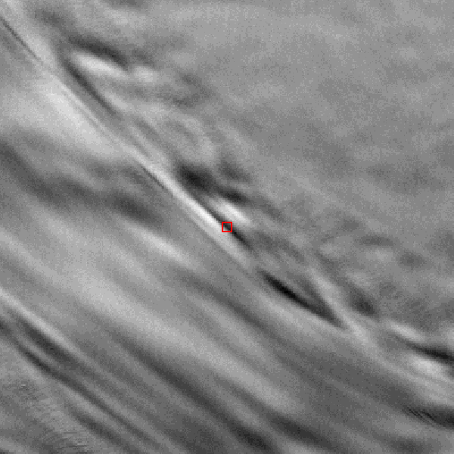
Our Method
For each reference track footprint and each measured profile:
  Determine avgDN and distance from reference track footprint to measured profile
  Convert avgDN to surface slope
  Interpolate measured elevations
  Adjust measured elevations to reference track using slope and distance
Sun
30º
reference profile
measured profile

Slide 5
Considerations
Photoclinometry assumes constant spectral reflectance of surface
Calibration coefficient must be empirically fit
Landsat has +1 DN noise at 15-m pixel level
  Can be averaged to 70-m ICESat footprint
ICESat footprints may not be exactly located

Slide 6
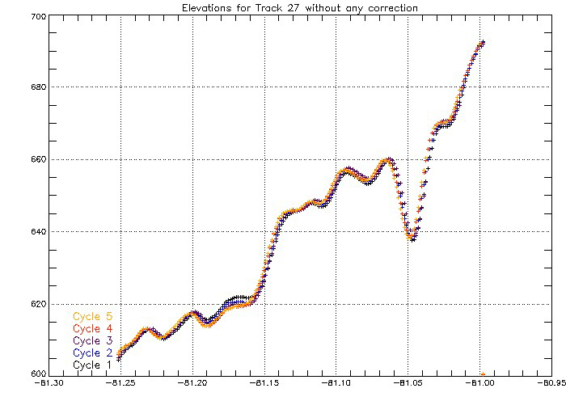
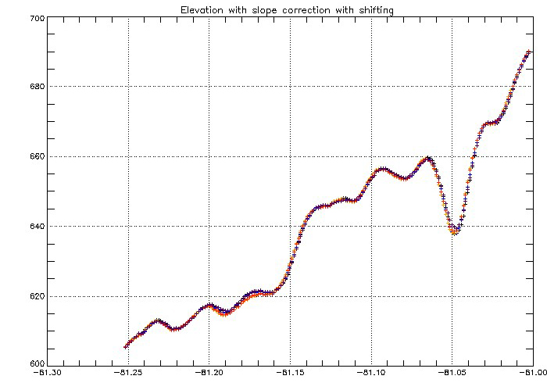
One Example
No adjustment
Adjusted

Slide 7
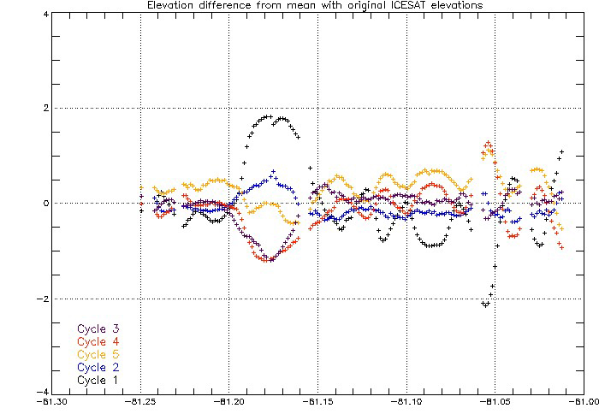
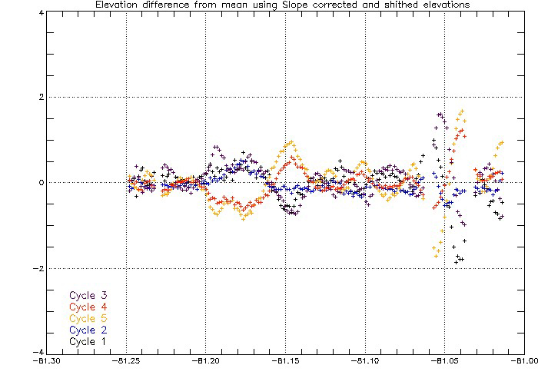
Elevation Differences from Mean
No adjustment
Adjusted
steep slopes
event

Slide 8
Conclusions
Photoclinometry can improve ICESat repeat-track analysis
Cross-slope adjustment is necessary to correctly measure (and identify other?) local inflation/deflation events
More work is needed

Slide 9
Subglacial Water Storage beneath Whillans Ice Stream
Robert Bindschadler
Helen Amanda-Fricker
Ted Scambos
Laurie Padman

Slide 10
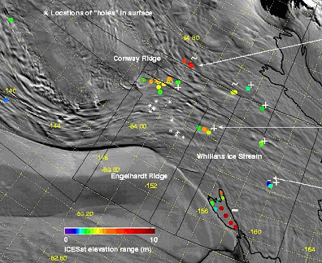
Event Analysis
27 non-lake events

Slide 11
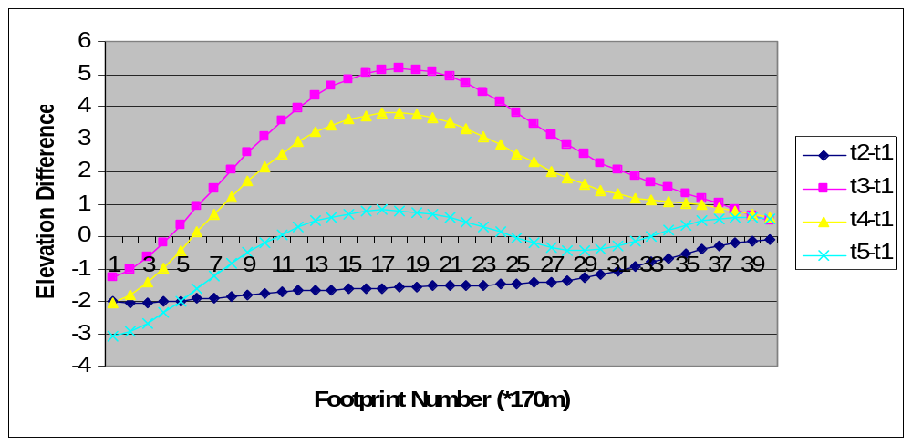
Elevation Differences
length
Determine length and average elevation differences

Slide 12
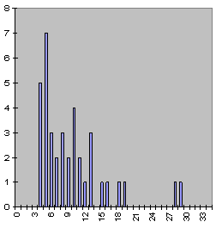
Event Size
Assume circular area and random sampling
ICESat sampling sufficient to identify most events
non-lake events only
Frequency (km)
Event Diameter (km)
Are there smaller events?

Slide 13
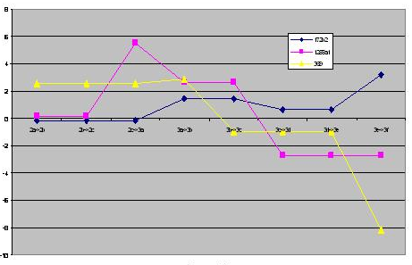
Volume Change
Rate of Elevation Change (m/a)
Observation Interval
Quantifies water storage or drainage

Slide 14
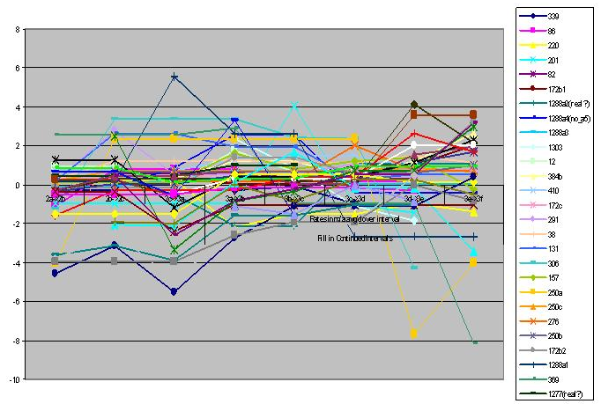
All Non-Lake Events
Rate of Elevation Change (m/a)
Observation Interval

Slide 15
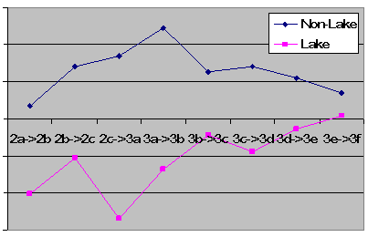
Water Volume Change
1.5
1.0
0.5
Total=5.2 km³
Volume Change (km³)
0
-0.5
Total=4.3 km³
-1.0
-1.5
Observation Interval

Slide 16
Total Water Change
Non-lake: 5.2 km³ gain over 2.7 years
  Lake: 4.3 km³ loss over 2.7 years
Equivalent average layer thickness of non-lake events = 10 cm/yr. (over 100km x 200km area)
A very big number
  Geothermal heat: 1-2 mm/yr.
  Basal sliding: 1-2 cm/yr.
May be an overestimate (x2, but not x10)
  Remember first part of talk and Helen’s talk

Slide 17
My Questions
Where is so much water coming from?
Where does draining water go?
Why isn’t more water draining?
  Is downstream basal freezing preventing water from exiting?
And the ice stream is slowing down?????

Slide 18
Your Questions?

