Slide 1




A Calving Law for Ice Shelves:
Spreading-Rate Control of Calving Rate
R.B. Alley, I. Joughin, H.J. Horgan, T.K. Dupont, B.R. Parizek, S. Anandakrishnan, and K.M. Cuffey
G. Comer Foundation
_x0003_Considering cold, floating termini;
A first estimate, not a final one;
But, this matters;
We suggest the tendency for ice shelves to fall apart (the near-front spreading rate) controls the rate at which they fall apart (the calving rate).

Slide 2
Unbuttressed; friction from local high in bed not stabilizing ice sheet.
ICE
Does it calve here
or there?
Buttressed; friction from local high in bed is stabilizing ice sheet.
ICE
To the best of our knowledge, no ice-sheet model calculates this physically. We should do better.

Slide 3
Very good reason why predicting hard for:
Earthquakes;
New volcanoes;
Whether your ceramic coffee cup will break when you drop it on the floor;
Iceberg calving from ice shelves...

Slide 4
Fracture mechanics is a mess! Depends on:
Forcing (for ice shelves: tides, storms, collisions from passing icebergs, etc.);
Material (temperature, c-axis fabric, impurities, density, etc.);
Geometry (thickness, thickness gradient, transverse character, etc.);
Pre-existing flaws (basal and surface crevasses, etc., hence history, such as tides at grounding line).
Engineers like to calculate everything to several decimal places, then build 3x stronger, just in case…

Slide 5
So, are we screwed? We hope not…
Often, there is a “leading term” across a broad range of situations;
A ceramic coffee cup over a hard floor will almost always survive a one-inch drop and almost always break from a ten-foot drop;
Our hypothesis: tendency of ice shelves to fall apart (longitudinal stretching rate) controls the rate at which they fall apart (calving rate);
Our hypothesis test: see if this explains a lot of the variance across a range of ice shelves.

Slide 6
Procedure:
Measure longitudinal stretching rate about one iceberg-width from the front, especially near center-line of shelf (stress perhaps better, but strain rate more easily measured, and in some formulations strain rate controls);
Measure calving rate (assume steady state--most ice shelves are recognizable across mappings, those that aren’t generate Science and Nature papers, so avoid nonsteady times/places, and near-frontal velocity is calving rate to close approximation);
If hypothesis is correct, calving rate increases with stretching rate, so plot it up and see

Slide 7
There are lots of “issues”
How steady is steady?
Look how far back from the ice front?
Smooth over what length of ice shelf?
Etc.
But, we are cautiously optimistic that these “issues” influence rather than control the outcome (I think that if you did the analysis, you’d get the same trend and similar numbers).

Slide 8
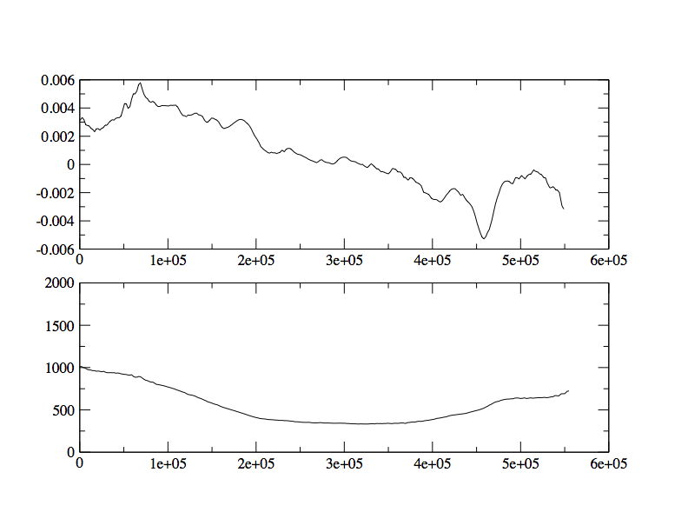
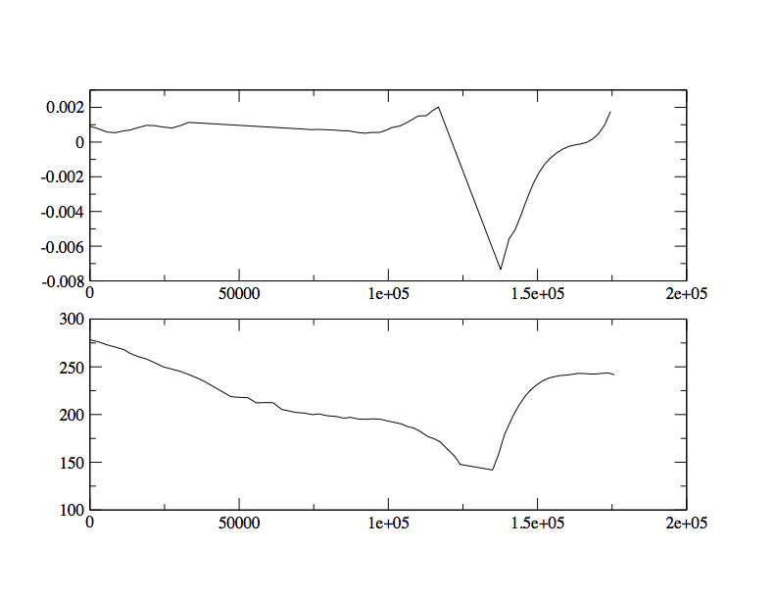
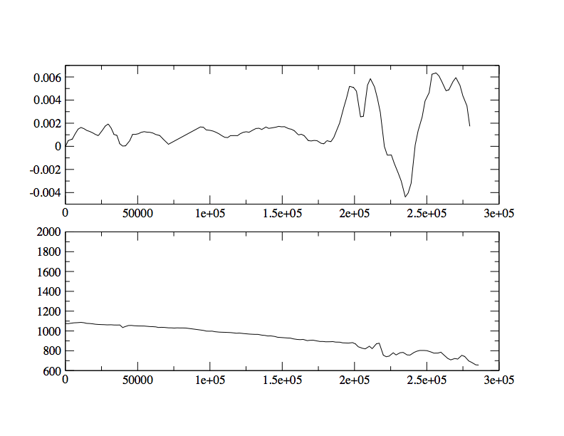
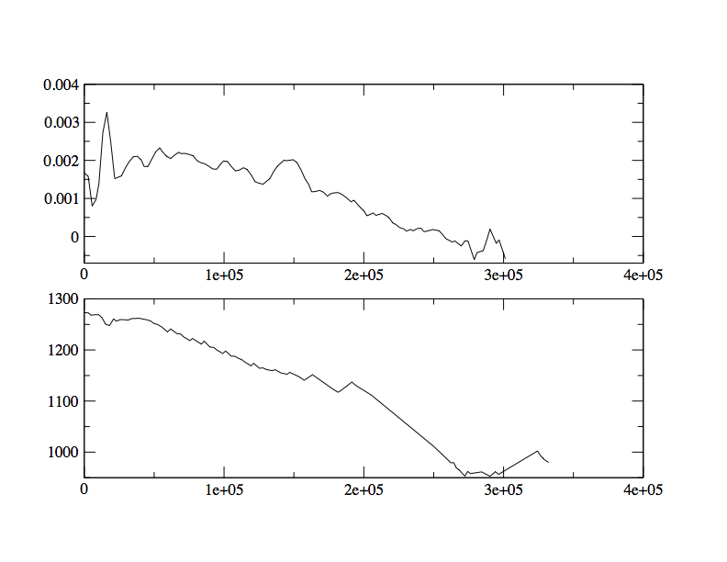
.
ε=0.003/yr
.
ε=0.0008/yr
Amery
Riiser
Data Gap
V=275 m/yr
V=1000 m/yr
600 km
200 km
Calve
Ice flow
.
ε=0.001/yr
.
ε=0.002/yr
Ross
Filchner
V=1275 m/yr
V=1075 m/yr
300 km
400 km

Slide 9
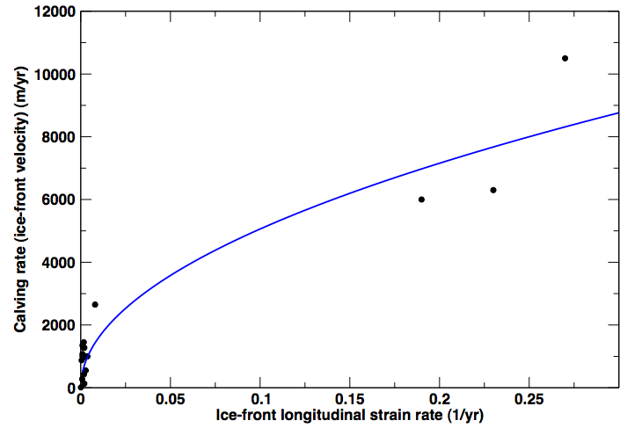
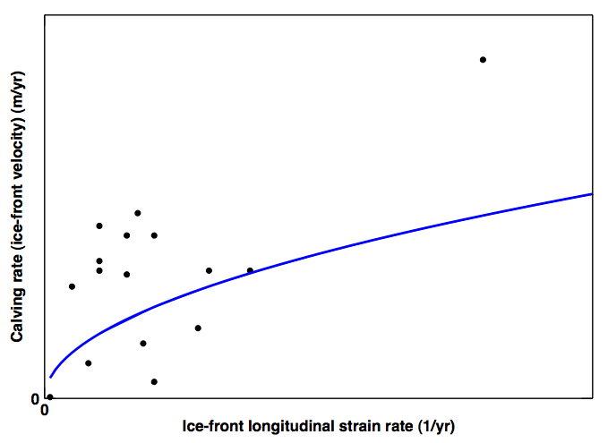
Whole data set. Positive slope is dominated by Jakobshavn (which is shown for three different times; J).
Line is:
Calv=1.6x10⁴*strain_rate^{1/2}
The square-root relation is consistent with fits to various subsets of the data.
J
P
Blow-up of low-strain-rate data. Pine Island (P) and McMurdo (M) dominate, but even omitting them leaves a positive-slope relation (but a noisy one with lowered confidence). The same line is included for reference.
M

Slide 10
Calving rate increases with strain rate
We cannot yet find any obvious way out of this;
This is what we hypothesized from common sense--ice shelves seem to fall apart in response to their tendency to fall apart;
Regression gives calving rate C∼ε^{k}, k~1/2, ε=strain rate
Tendency for basal crevasse of height L to grow under stretching-stress σ is measured by stress-intensity factor K_{Ic}~ L^{1/2}σ. With ε~σ³ and L~σ, K_{Ic}~ ε^{1/2}. Since C~ε^{1/2}, calving rate~ tendency for basal-crevasse growth? (This is probably too simplistic, but interesting…).
.
.
.
.
.

Slide 11
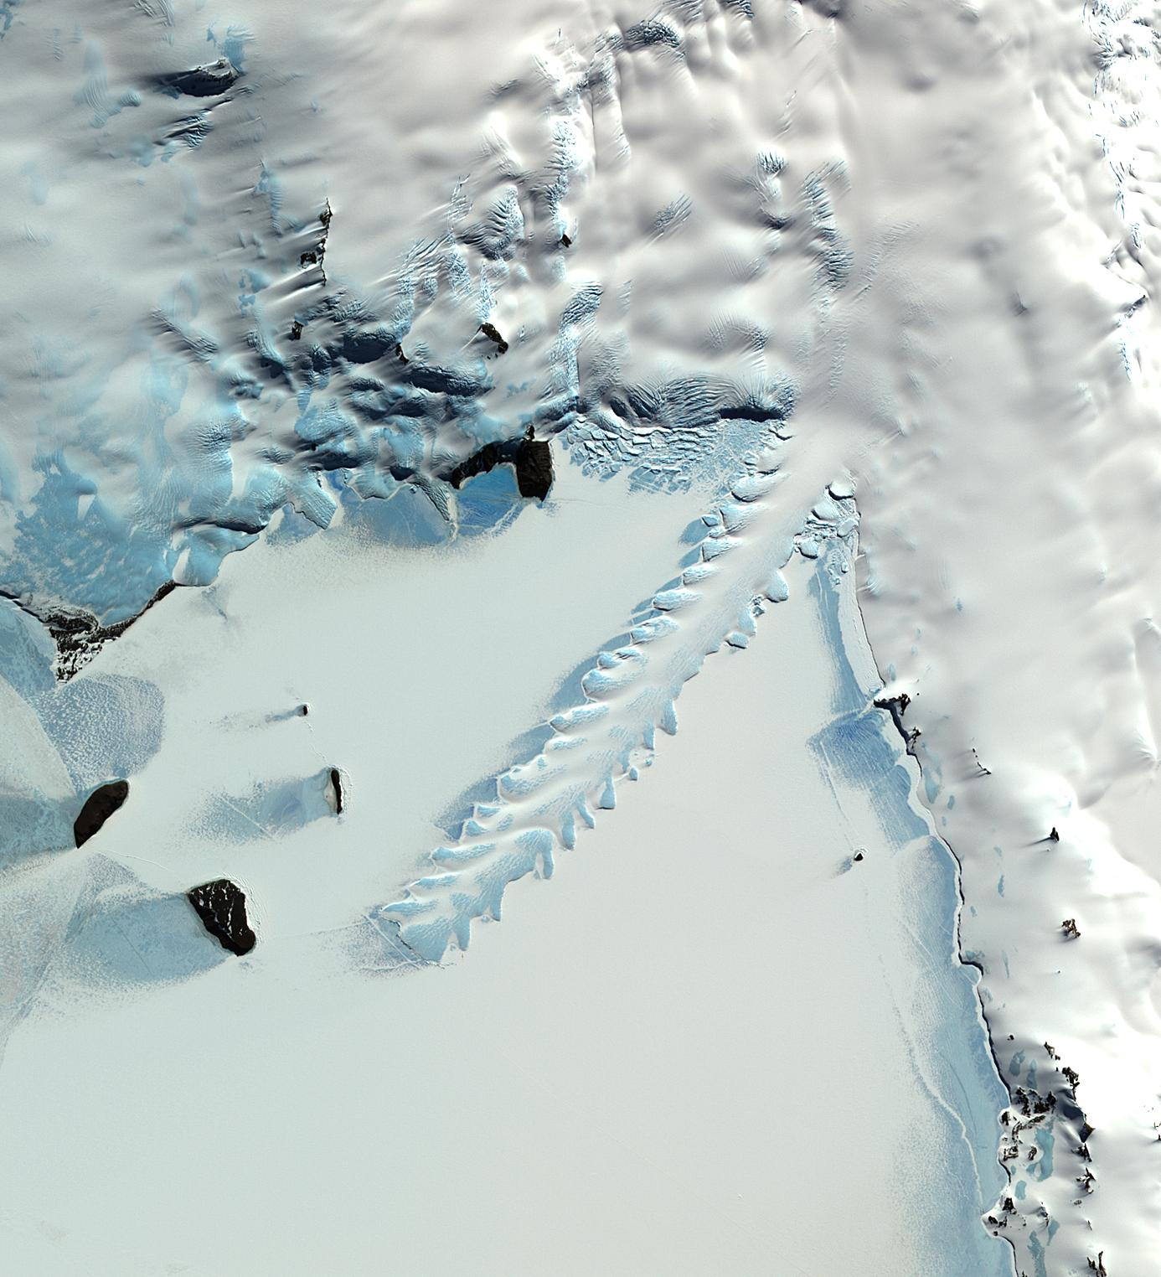
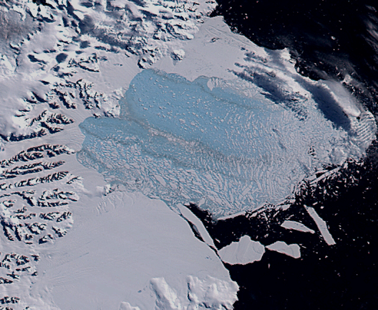
If this is right, some interesting implications-- see Dupont poster!
Fast input, slow spreading, very long shelf (Erebus Glacier Tongue?)
http://svs.gsfc.nasa.gov/vis/a000000/a002400/a002421/index.html
http://asterweb.jpl.nasa.gov/gallery/images/glacier-tongue.jpg
Slow input, fast spreading, unstable without buttressing (high-profile papers and low-profile ice sheets?)

Slide 12
Synopsis
Accurate modeling requires better calving laws, including one for cold ice shelves;
An accurate, all-inclusive law won’t be easy to find;
We have gone looking for a first approximation;
Our initial hypothesis--the calving rate increases with the longitudinal spreading rate (or, the rate at which the ice shelf falls apart increases with its tendency to fall apart) explains a lot of the variance across the ice shelves we have examined, with calving increasing as roughly the square root of spreading;
Such a law may explain some ice-shelf behavior;
We want more data, more-careful consideration of the physics, and more thought whether differences between shelves apply to single shelves;
Pending those, we suggest calving_rate~strain_rate^{1/2}

