Slide 1
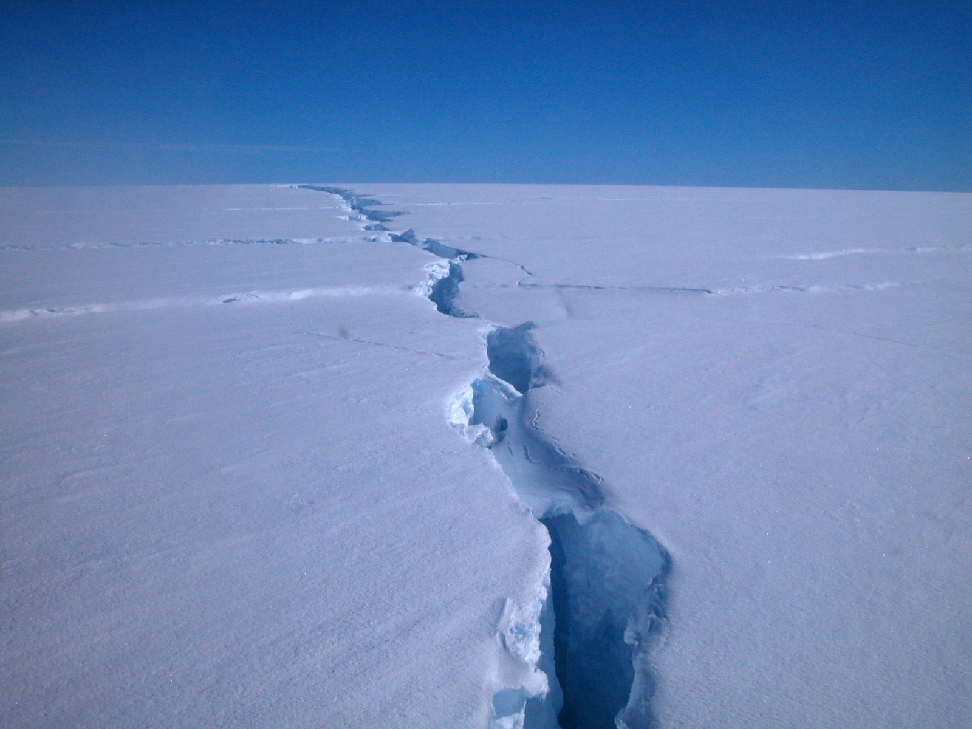


When iceberg calving matters: A cautionary tale
J. N. Bassis
Institute of Geophysics and Planetary Physics, Scripps Institution of Oceanography
Department of the Geosciences, University of Chicago
Project supported by NSF, Thanks to Julie Palais

Slide 2
Overview
What we want: Formulate a calving law that can be implemented into large scale numerical models
Method of approach: Try to implement a calving “law” into an ice sheet/shelf model and see what happens
Key lesson: Most calving laws result in unstable ice shelves
  Original intent was to focus on what happens to grounded ice
  But very concerned that results easily contaminated by “bad” calving law
Working hypothesis: Ice shelves are unstable once they become highly fractured: generalize calving law hypothesis proposed by Benn et al., [2006]
Present preliminary results: Implement calving law into numerical model to study the behavior

Slide 3
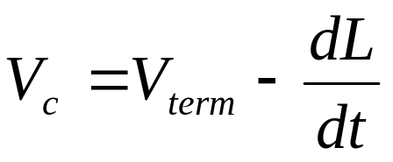
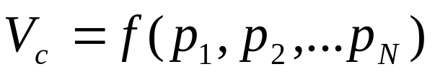
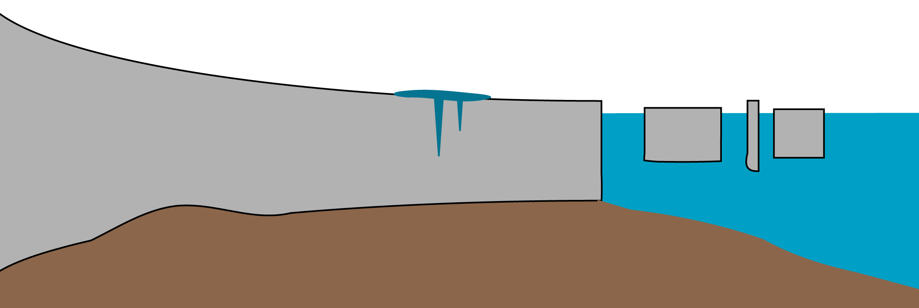
Calving Laws
Traditional approach:
Correlate everything in sight with calving rate:
Calving Rate = Terminus Velocity – Rate of Terminus Advance

Slide 4
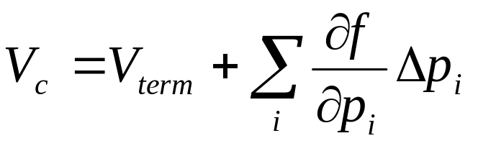
Calving Laws
Traditional approach
Correlate everything in sight with calving rate:
Calving Rate = Terminus Velocity – Rate of Terminus Advance
Taylor Expand

Slide 5
Calving Laws
Traditional approach
Correlate everything in sight with calving rate:
Zeroth order calving law:
V_{c} ≈ V_{term}
Calving Rate = Terminus Velocity – Rate of Terminus Advance
Taylor Expand

Slide 6
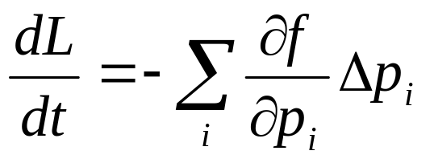
Calving Laws
Traditional approach
Correlate everything in sight with calving rate:
Zeroth order calving law:
V_{c} ≈ V_{term}
Calving Rate = Terminus Velocity – Rate of Terminus Advance
Taylor Expand
Write in terms of rate of terminus advance

Slide 7
Calving Laws
Take home points:
  The rate of terminus advance contains more physics than the calving rate (by itself)
  Need to look at calving glaciers/ice shelves that aren’t in steady-state
  Calving law may be sensitive to many parameters

Slide 8
Calving Laws
Take home points:
  The rate of terminus advance contains more physics than the calving rate (by itself)
  Need to look at calving glaciers/ice shelves that aren’t in steady-state
  Calving law may be sensitive to many parameters
  Need to look for scaling laws – i.e. formulate in terms of non-dimensional criterion

Slide 9
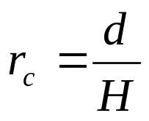
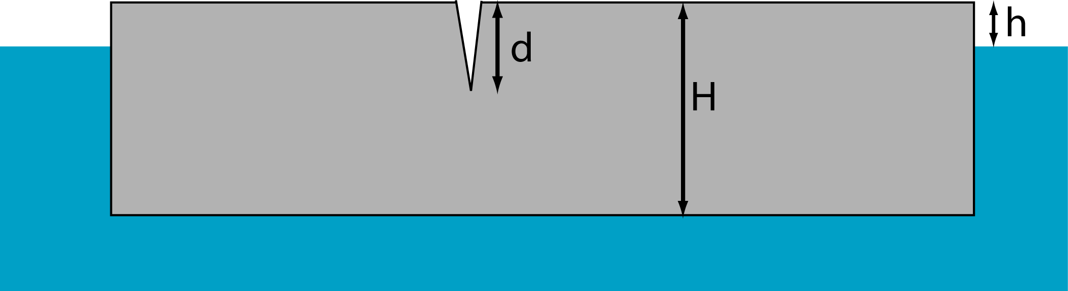
A simple calving rule
Assume ice shelf becomes unstable when ratio of crevasse penetration depth to ice thickness exceeds a critical ratio, r_{c}

Slide 10
A simple calving rule
Assume ice shelf becomes unstable when ratio of crevasse penetration depth to ice thickness exceeds a critical ratio, r_{c}
Calculate crevasse depth assuming viscous flow

Slide 11
A simple calving rule
Assume ice shelf becomes unstable when ratio of crevasse penetration depth to ice thickness exceeds a critical ratio, r_{c}
Calculate crevasse depth assuming viscous flow
L
Generalize slightly: Iceberg of size L detaches when integral of r_{c} from ice front inwards normalized by L exceeds a critical value
Future work: Assume Poisson process with probability determined by the integral

Slide 12
A simple calving rule
Assume ice shelf becomes unstable when ratio of crevasse penetration depth to ice thickness exceeds a critical ratio, r_{c}
Calculate crevasse depth assuming viscous flow
Equivalent to applying a critical strain rate that varies between ice shelves
L
Generalize slightly: Iceberg of size L detaches when integral of r_{c} from ice front inwards normalized by L exceeds a critical value
Future work: Assume Poisson process with probability determined by the integral

Slide 13
A simple calving rule
Assume ice shelf becomes unstable when ratio of crevasse penetration depth to ice thickness exceeds a critical ratio, r_{c}
Calculate crevasse depth assuming viscous flow
Equivalent to applying a critical strain rate that varies between ice shelves
L
Model depends on three parameters:
(i) r_{crit},
(ii) meltwater,
(iii) time between calving events

Slide 14
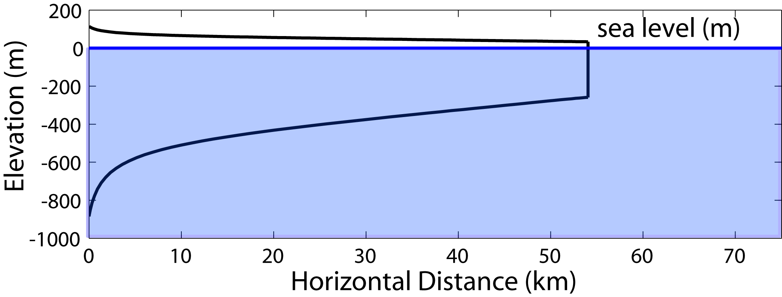
A simple test case
Ice shelf spreading in one direction with no lateral shear:
Two possibilities:
  Grow without limit
  No stable ice shelf possible

Slide 15
A simple test case
Ice shelf spreading in one direction with no lateral shear:
Two possibilities:
  Grow without limit
  No stable ice shelf possible
Not very interesting!

Slide 16
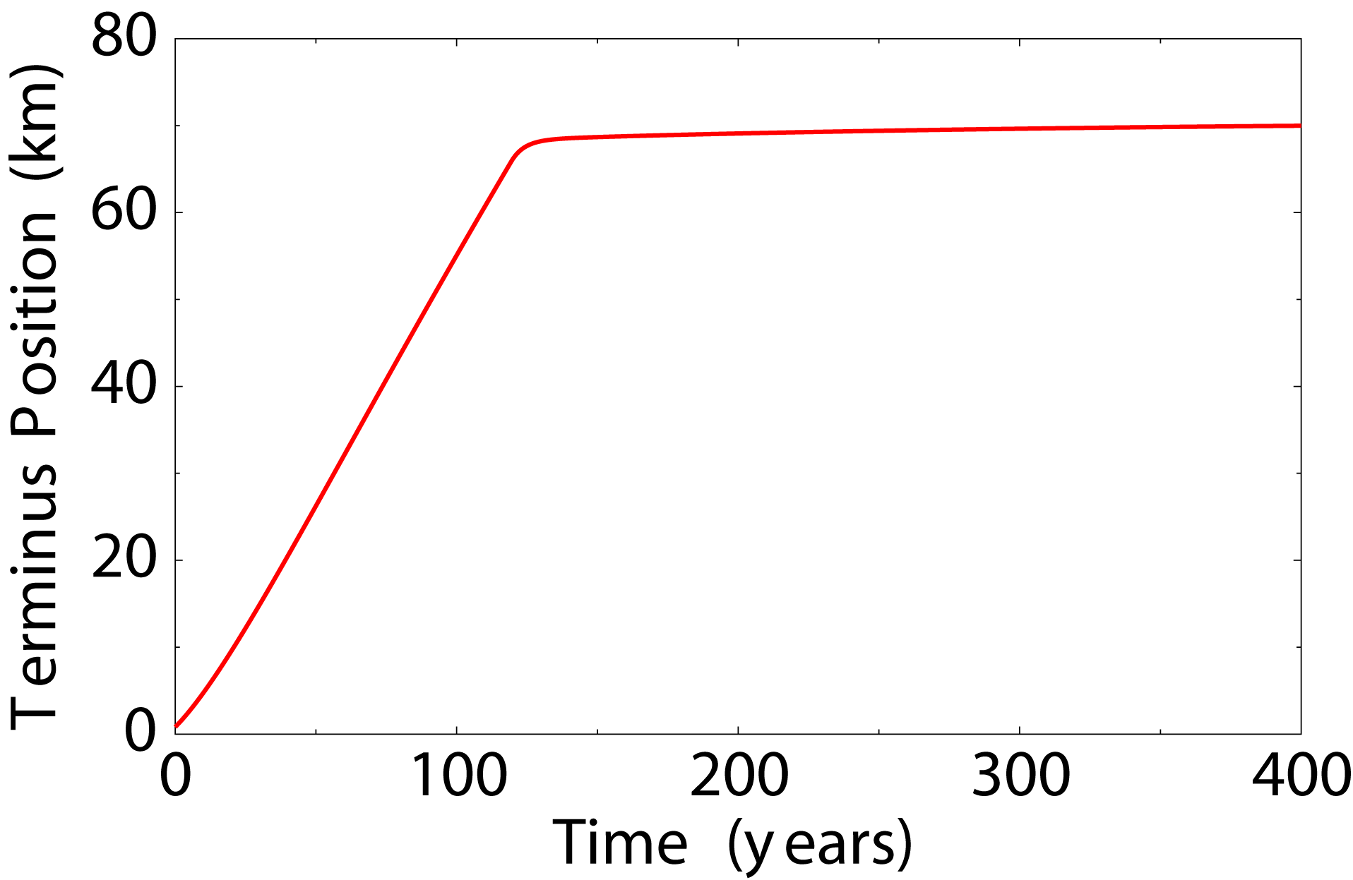
A more complicated test case
Assume ice shelf is in channel with friction along the walls

Slide 17
A more complicated test case
Assume ice shelf is in channel with friction along the walls
Growth phase with no iceberg calving

Slide 18
A more complicated test case
Assume ice shelf is in channel with friction along the walls
Steady calving front with constant calving rate
Growth phase with no iceberg calving

Slide 19
A more complicated test case
Assume ice shelf is in channel with friction along the walls
Position of calving front determined by critical ratio d_{c} and input flux
Steady calving front with constant calving rate
Growth phase with no iceberg calving

Slide 20
A simulated embayment
Combine previous two experiments: assume friction between 0 and 50 km and zero friction beyond 50 km

Slide 21
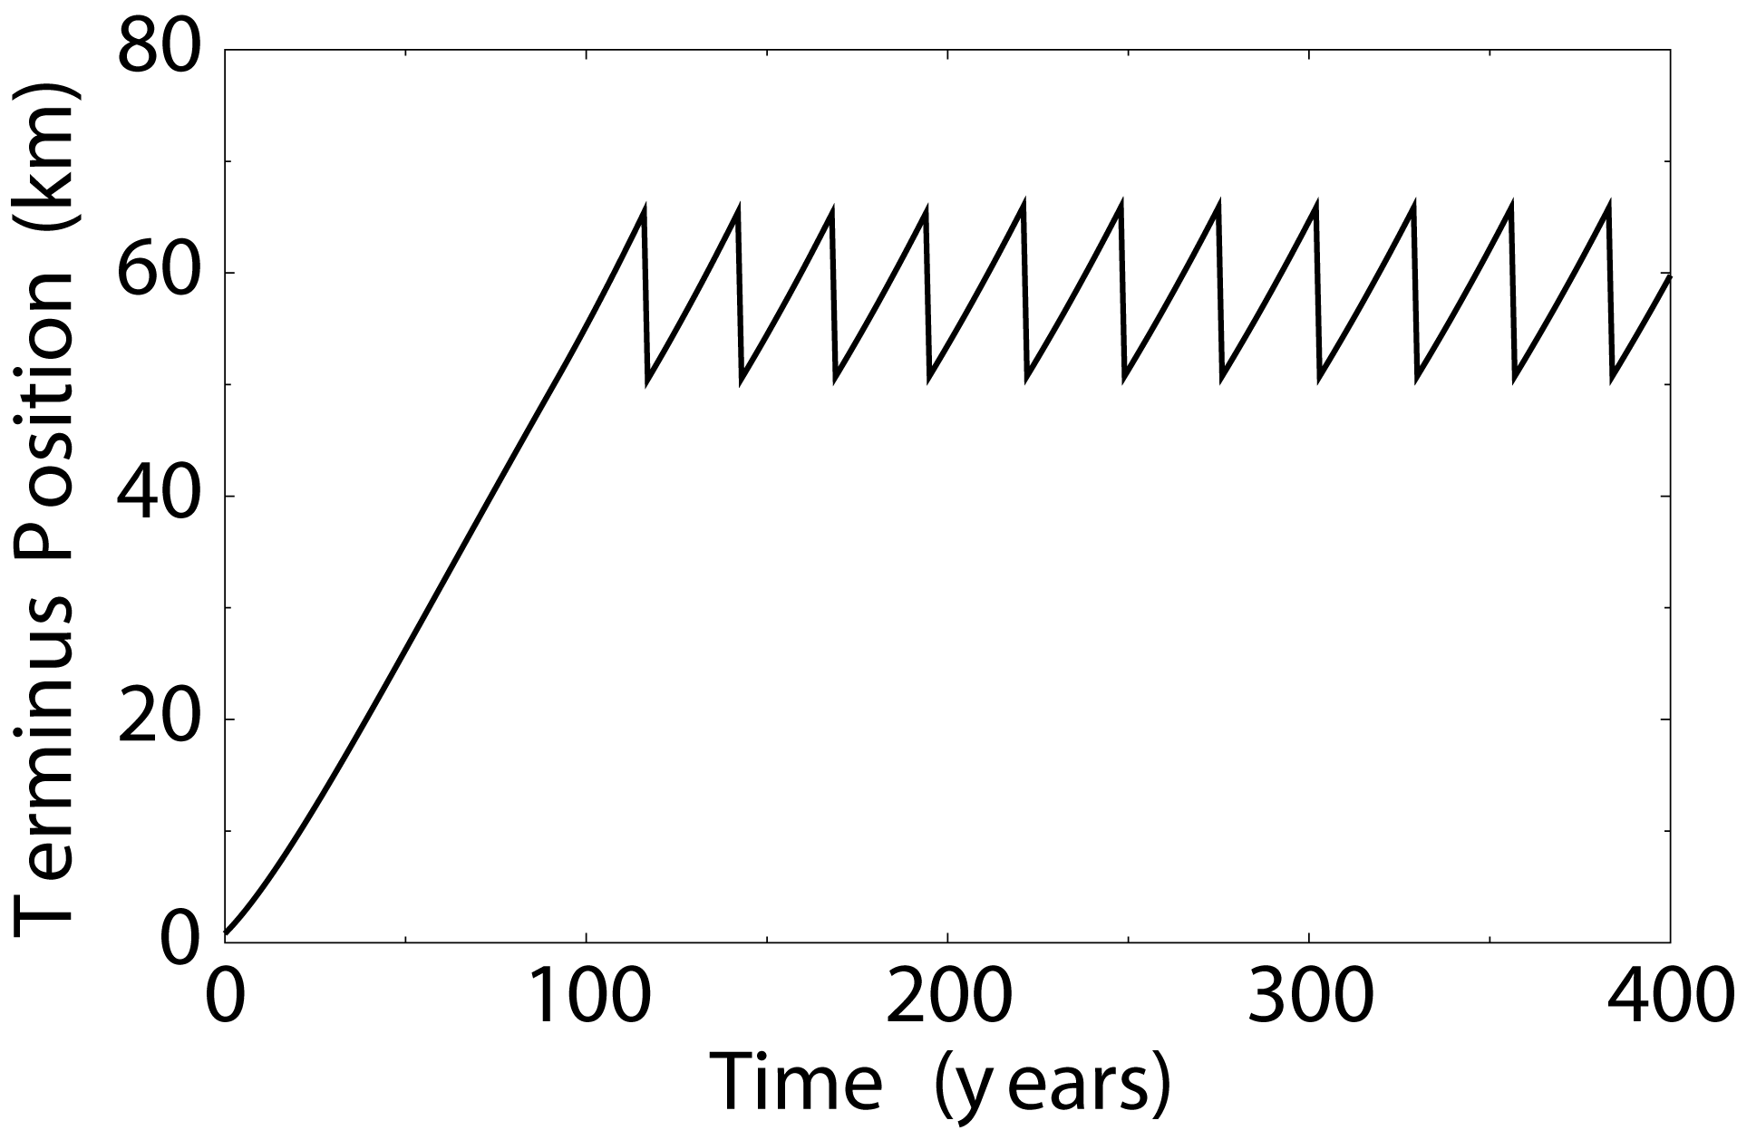
A simulated embayment
Combine previous two experiments: assume friction between 0 and 50 km and zero friction beyond 50 km
Embayment

Slide 22
A simulated embayment
Combine previous two experiments: assume friction between 0 and 50 km and zero friction beyond 50 km
Embayment
Growth phase with no iceberg calving

Slide 23
A simulated embayment
Combine previous two experiments: assume friction between 0 and 50 km and zero friction beyond 50 km
“Sawtooth” oscillations in calving front
Embayment
Growth phase with no iceberg calving

Slide 24
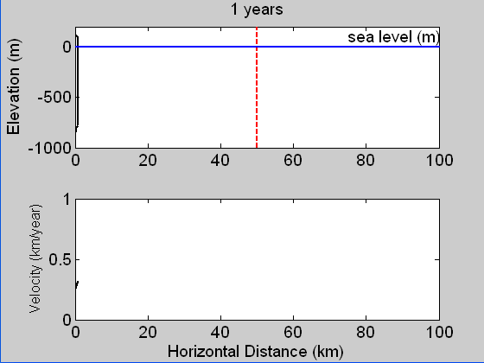
A simulated embayment

Slide 25
A simulated finite embayment
Combine previous two experiments: assume friction between 0 and 50 km and zero friction beyond 50 km
Amplitude and period of oscillations depend on:
1) Critical ratio, r_{c}
2) Time between calving events (i.e. depends on model time step)
3) Flux into the ice shelf

Slide 26
A simulated finite embayment
Combine previous two experiments: assume friction between 0 and 50 km and zero friction beyond 50 km
Amplitude and period of oscillations depend on:
1) Critical ratio, r_{c}
2) Time between calving events (i.e. model time step)
3) Flux into the ice shelf
We are implicitly assuming calving events are time-predictable

Slide 27
A simulated finite embayment
Combine previous two experiments: assume friction between 0 and 50 km and zero friction beyond 50 km
Amplitude and period of oscillations depend on:
1) Critical ratio, r_{c}
2) Time between calving events (i.e. model time step)
3) Flux into the ice shelf
We are implicitly assuming calving events are time-predictable
More trouble: If we truncated the ice shelf at grid points, we would generate irregular oscillations

Slide 28
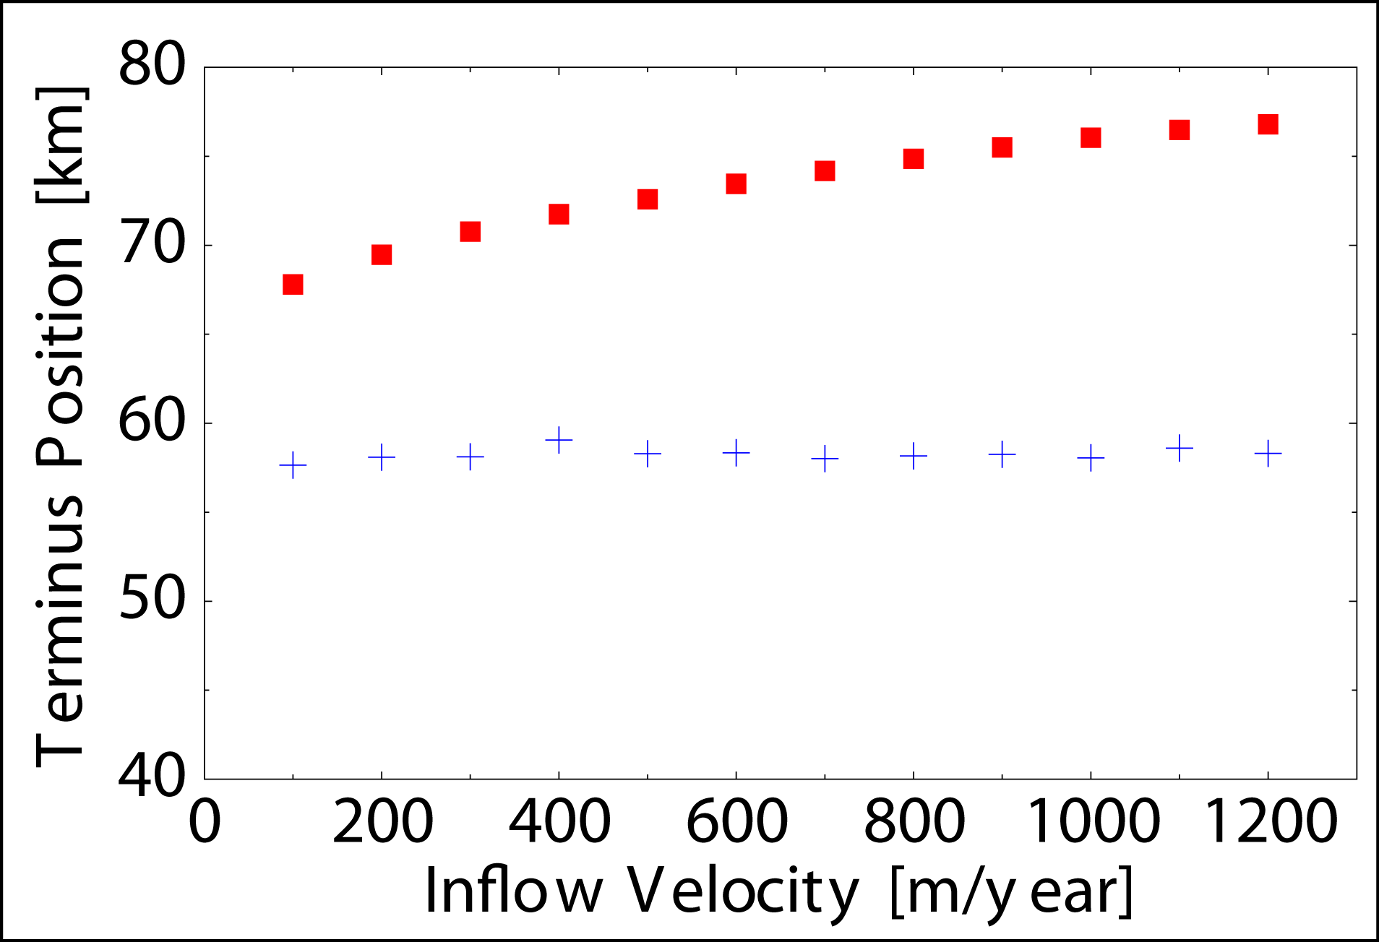
Influence of inflow velocity
Long channel: Ice front position increases with inflow velocity
channel

Slide 29
Influence of inflow velocity
Long channel: Ice front position increases with inflow velocity
channel
With embayment: Terminus position remains constant with increasing inflow velocity
embayment
Length of Embayment

Slide 30
Influence of inflow velocity
Long channel: Ice front position increases with inflow velocity
channel
With embayment: Terminus position remains constant with increasing inflow velocity
embayment
Length of Embayment
Suggests: Embayment geometry has strong control on calving and position of calving front

Slide 31
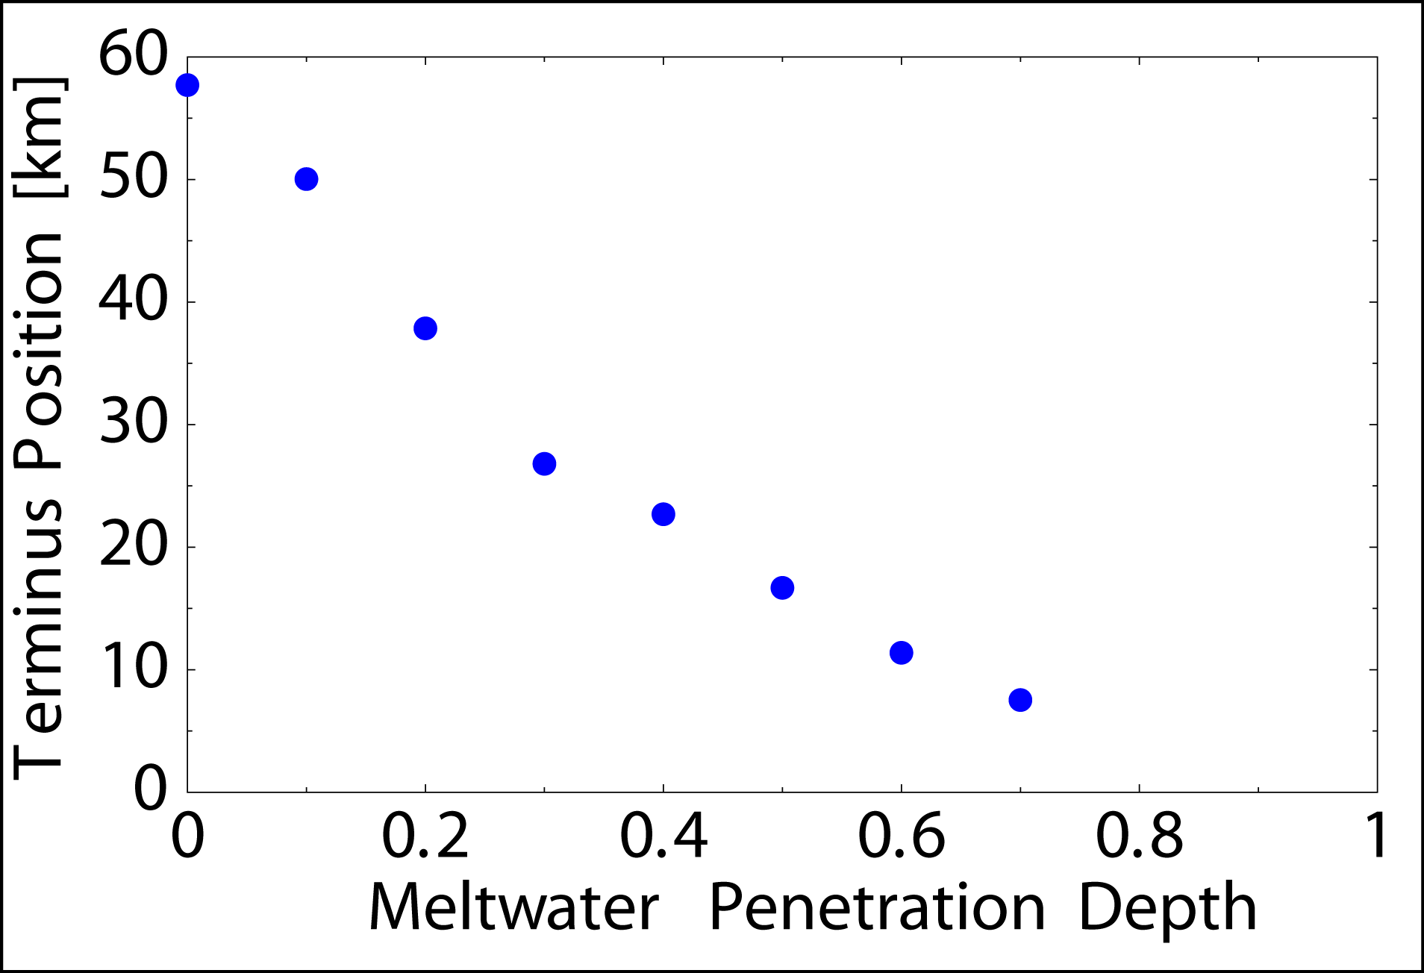
Effect of meltwater on stability
Assume crevasses are partially filled with fresh water

Slide 32
Effect of meltwater on stability
Assume crevasses are partially filled with fresh water
Increasing meltwater results in retreat of ice shelves

Slide 33
Effect of meltwater on stability
Assume crevasses are partially filled with fresh water
Increasing meltwater results in retreat of ice shelves
Beyond a critical amount of meltwater no stable ice shelf configurations
No stable ice shelf possible

Slide 34
Effect of meltwater on stability
Assume crevasses are partially filled with fresh water
Increasing meltwater results in retreat of ice shelves
Beyond a critical amount of meltwater no stable ice shelf configurations
Region of instability grows with basal/surface melting
Ice shelf collapse
Add basal melting of 0-3 m/year

Slide 35
Conclusions
The good: Implementation of a calving law qualitatively predicts stable ice fronts, cyclic calving and ice shelf disintegration
The bad: Law depends on combination of numerical parameters and variables that are not measurable in the lab
The ugly: Fun and games with models isn’t good enough – need to compare with real data
The hopeful: Can be easily generalized to two dimensions (integrate over area) and to include random component
The slightly unrealistic but still possible: Seismicity may provide estimate of crevasse density/critical penetration depth

Slide 36
Why is iceberg calving a hard problem?
Micro-scale
Meso-scale
Macro-scale
Grain size/Laboratory sample
<10 cm
Meso-fracture and rift scale
100 – 1000 m
Ice shelf/Glacier scale
> 10, 000 m
Think: Individual fault strands
Think: Large scale tectonics

Slide 37
Why is iceberg calving a hard problem?
Micro-scale
Meso-scale
Macro-scale
Grain size/Laboratory sample
<10 cm
Meso-fracture and rift scale
100 – 1000 m
Ice shelf/Glacier scale
> 10, 000 m
Think: Individual fault strands
Think: Large scale tectonics

Slide 38
Why is iceberg calving a hard problem?
Micro-scale
Meso-scale
Macro-scale
Grain size/Laboratory sample
<10 cm
Meso-fracture and rift scale
100 – 1000 m
Ice shelf/Glacier scale
> 10, 000 m
Physics of fracture is complicated and poorly understood
Numerically very expensive to compute

Slide 39
Why is iceberg calving a hard problem?
Micro-scale
Meso-scale
Macro-scale
Grain size/Laboratory sample
<10 cm
Meso-fracture and rift scale
100 – 1000 m
Ice shelf/Glacier scale
> 10, 000 m
Physics of fracture is complicated and poorly understood
Numerically very expensive to compute
Large-scale stability of calving glaciers

Slide 40
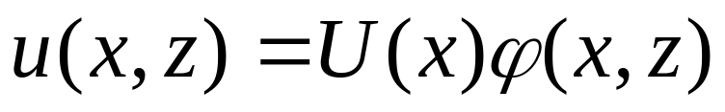
The model: a cheap trick

Slide 41
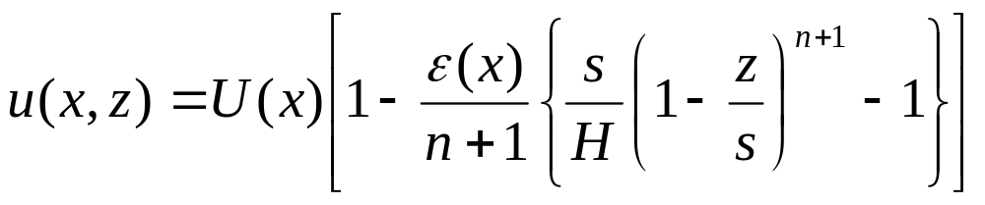
The model: a cheap trick
“kernel” or “shape” function

Slide 42
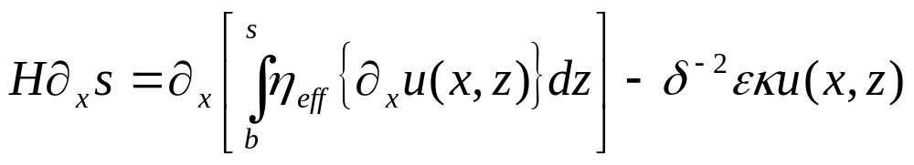
The model: a cheap trick
“kernel” or “shape” function
Depth integrate

Slide 43
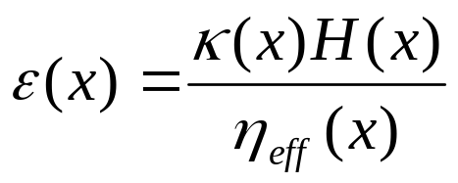
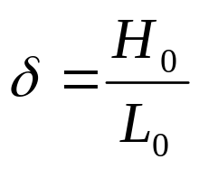

The model: a cheap trick
“kernel” or “shape” function
Depth integrate

Slide 44
The model: a cheap trick
Reproduces asymptotic approximations for ice sheets (SIA), ice streams and ice shelves
Ice sheet, ice stream, ice shelf flow regimes triggered by basal shear stress through ε(x) term
“kernel” or “shape” function
Depth integrate

Slide 45
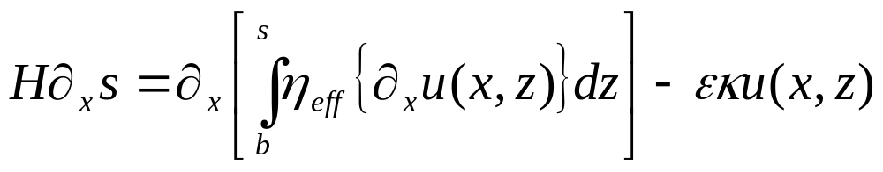
A brief word about the model
The model is more complicated than it needs to be to study ice shelves
  Flowline model
  Includes longitudinal stresses and vertical shear (when basal friction is present)
Use trick to get vertical shear
  Write velocity in terms of shape function
  Choose shape function so that it reduces to ice sheet and ice shelf cases under appropriate basal stress conditions

Slide 46
A brief word about the model
For this study:
Solve pseudo-spectrally (i.e. solution is sum of Chebyshev polynomials)
Use shock following coordinates near the calving front
Allow calving from anywhere in the interior of model (not just grid points)

