Slide 1
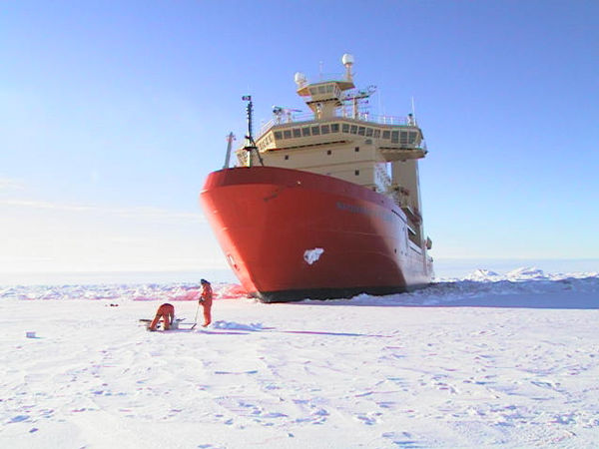
Ocean Temperature Variability in the Amundsen Sea
S Jacobs, B Huber, P Mele, F Nitsche, D Susanto, R Guerrero

Slide 2
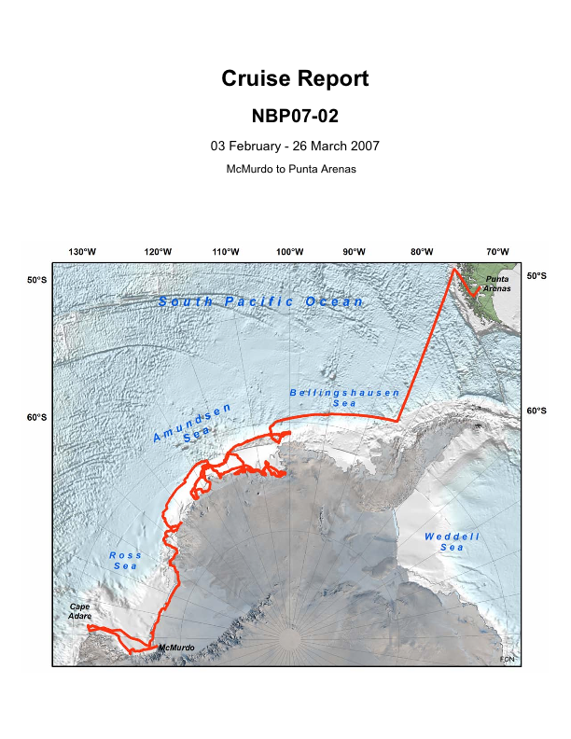
Notes:
Cruise track, NB Palmer cruise 07-02, February-March 2007, McMurdo to Punta Arenas.

Slide 3
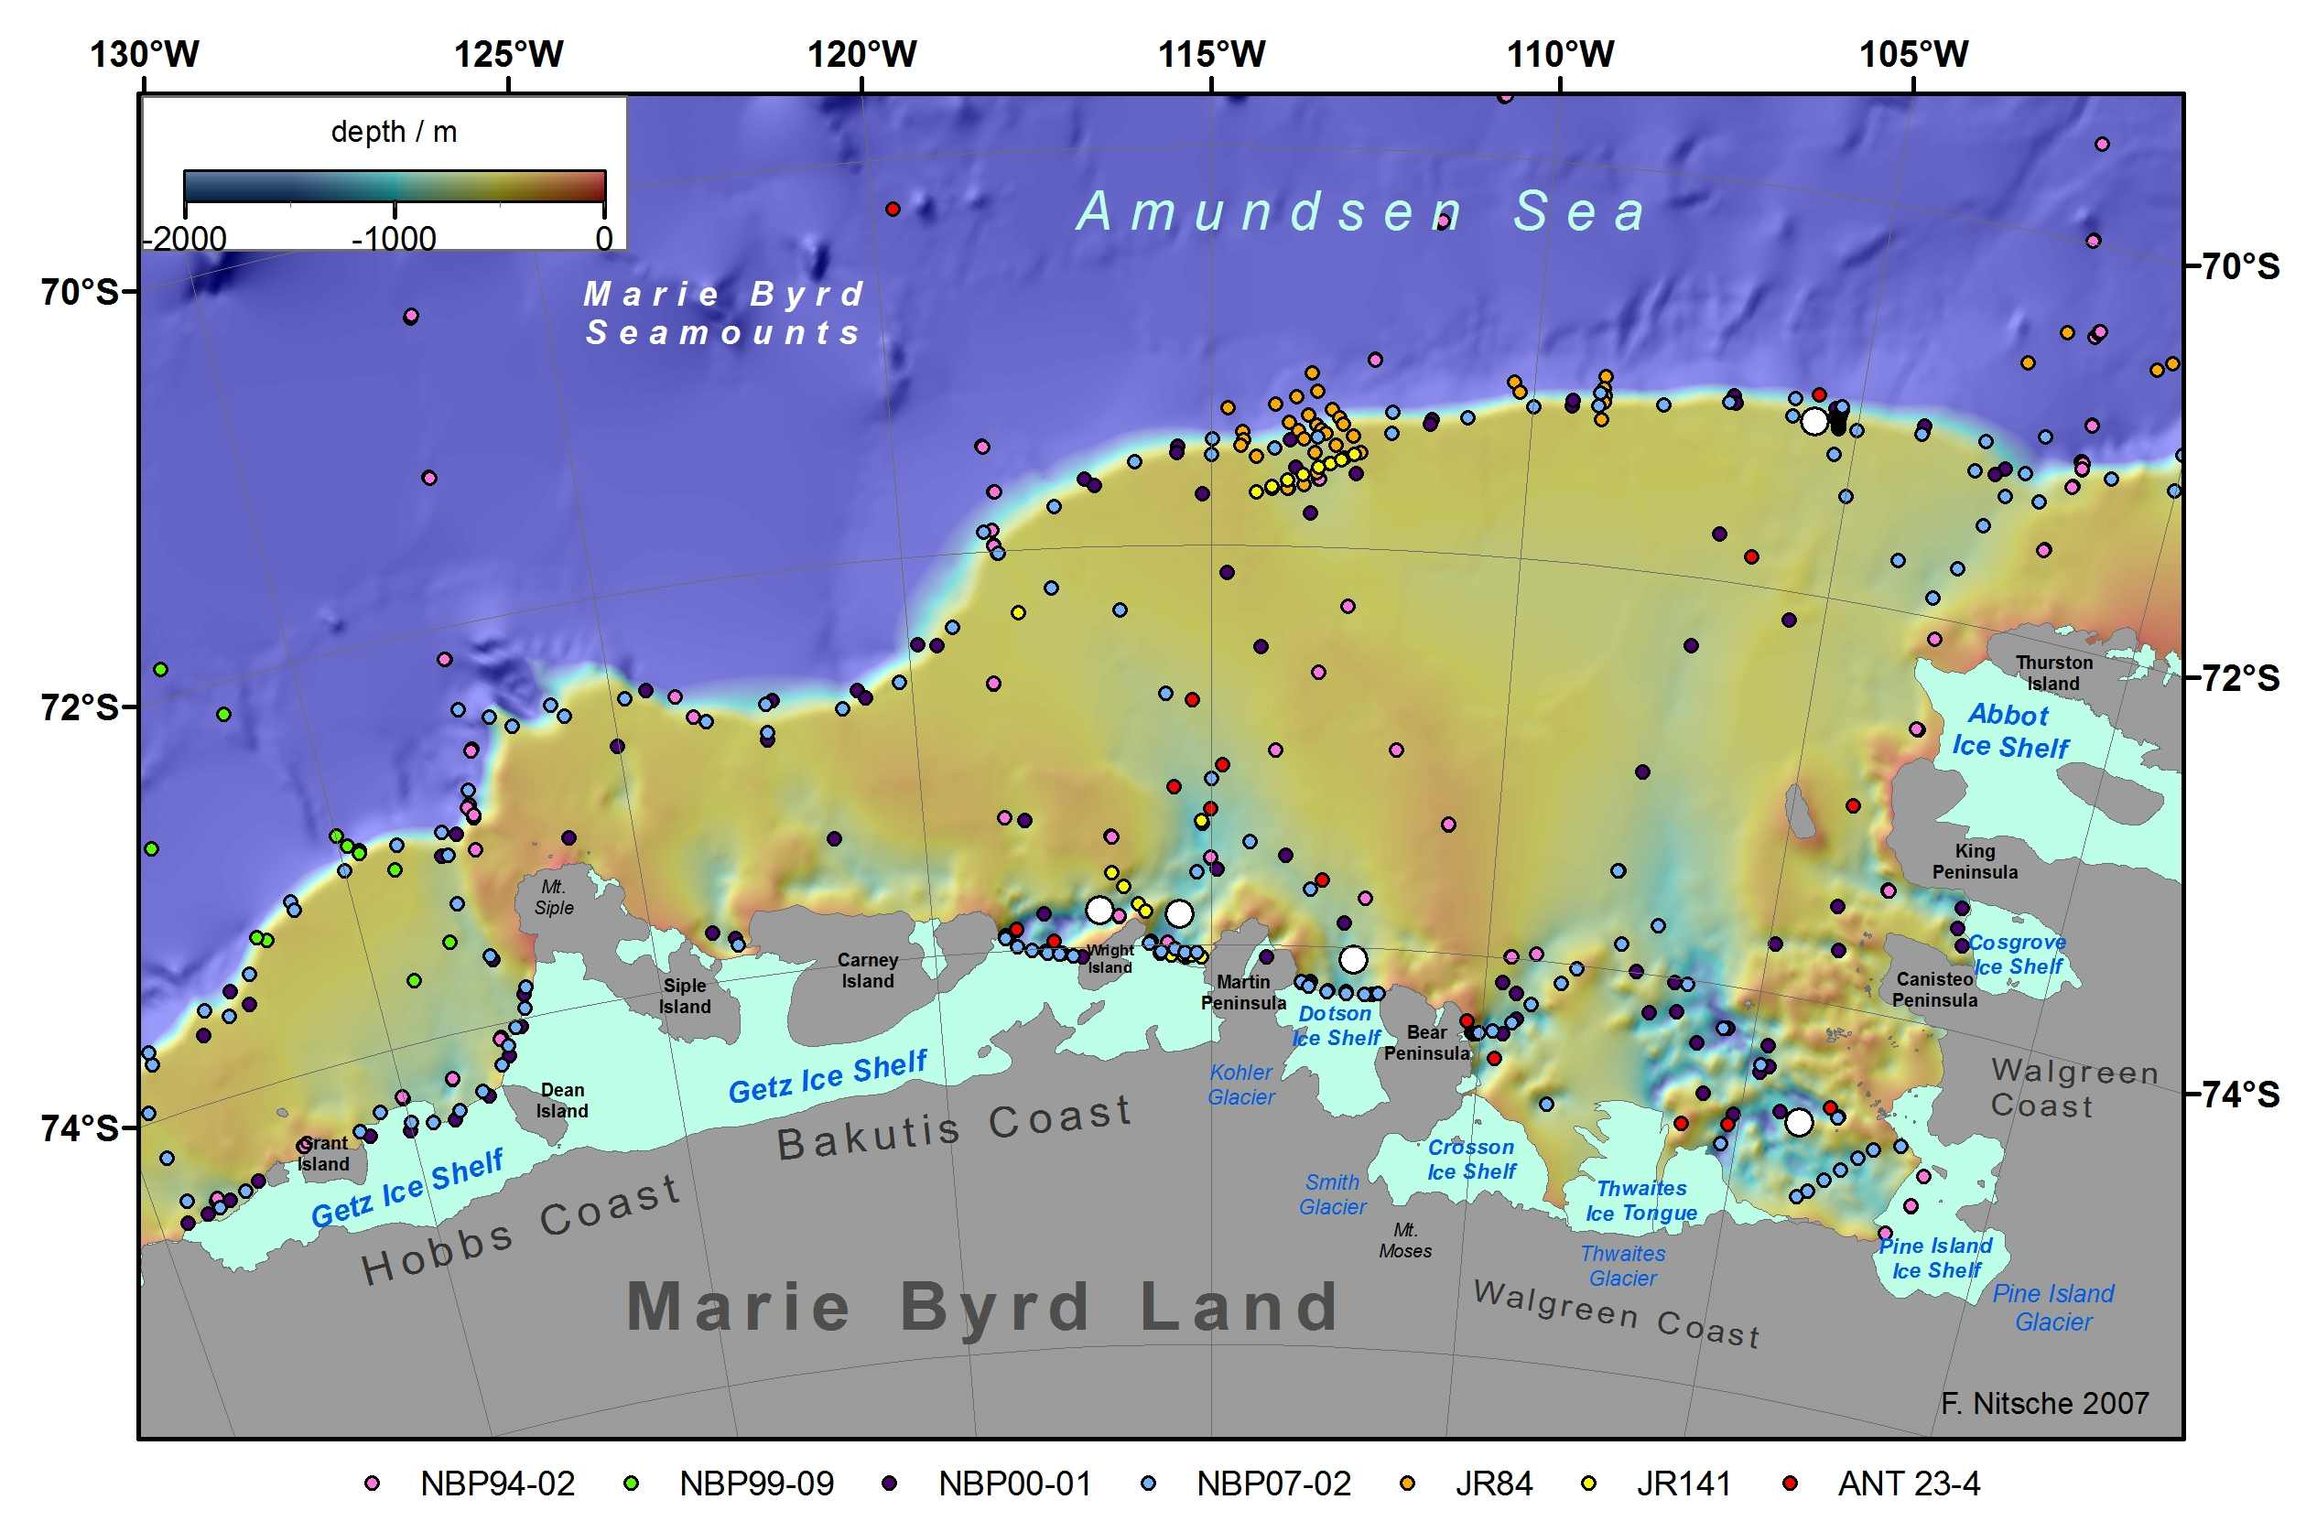
Notes:
Amundsen Sea bathymetry and ice shelves, from Nitsche et al, G3, in press. Colored dots show locations of CTD profiles made from NB Palmer, JC Ross and Polarstern, 1994-2007. White dots show locations of bottom-moored instruments deployed in early 2006. Four were recovered in early 2007.

Slide 4
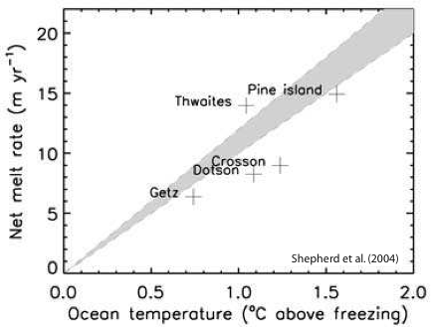
Notes:
Average ice shelf melt rates vs thermal forcing inferred from 1994 ocean stations in the Amundsen Sea by Shepherd et al (GRL). More recent data/analyses indicate higher temperatures apply, along with ocean velocities and cavity shapes.

Slide 5
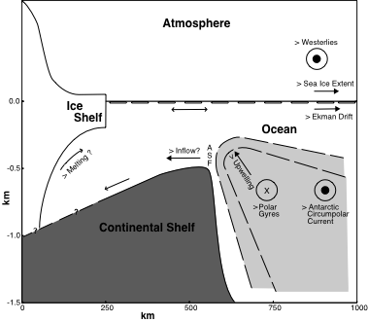
Notes:
Diagram indicating how more positive Southern Annular Mode might increase ice shelf melt rates, from Jacobs (2006). Stronger westerlies move sea ice and surface water northward. Compensating increased upwelling of Circumpolar Deep Water facilitates its flow onto the continental shelf. There CDW fills deep, glacially-scoured troughs that extend under shelf ice, at temperatures 3-4°C above the in situ melting point.

Slide 6
Further work in progress……
For additional information about ocean temperature change in the Amundsen Sea, please write:
sjacobs@ldeo.columbia.edu

