Slide 1
Radar attenuation and temperature near the grounding line of Whillans Ice Stream
Joe MacGregor ¹
Sridhar Anandakrishnan ²
Dale Winebrenner ^{1,3}
2007 WAIS Workshop
09/06/07
¹ Dept. of Earth and Space Sciences, University of Washington
² Dept. of Geosciences, Pennsylvania State University
³ Polar Science Center, Applied Physics Lab, University of Washington

Slide 2
Observation. Ice-sheet radar attenuation is strongly temperature-dependent.
Question: Can attenuation measurements be used to constrain temperature profiles?
Chance! A multiple echo from the ice–ocean interface was detected past the grounding line of Whillans Ice Stream; this echo can be used to estimate attenuation there.
So… Can we estimate the temperature profile there using this measurement and an attenuation model?

Slide 3
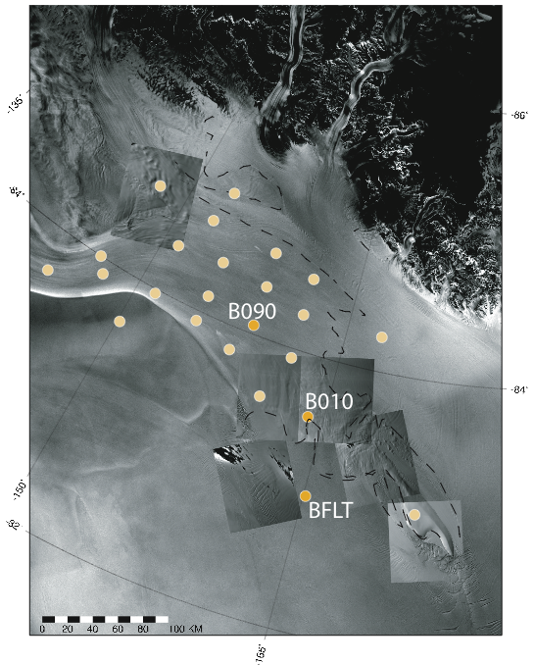
Map showing location of Whillans Ice Stream grounding-line transect
Whillans Ice Stream
Grounding line
Crary Ice Rise

Slide 4
Attenuation from multiple echo (1)
Measurement of attenuation rate from the ratio of the primary to the multiply reflected echo intensities from the bed just past grounding line.
Limited here by a single attenuation measurement to a single reflector (bed), so only one degree of freedom for a modeled temperature profile.
1. Primary
2. Multiple
Seawater
Grounding line
Bed

Slide 5
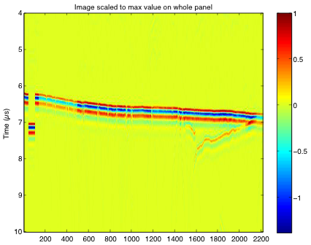
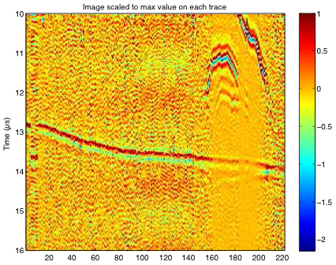
Echograms showing primary and multiple reflections
Primary reflection
Multiple reflection

Slide 6
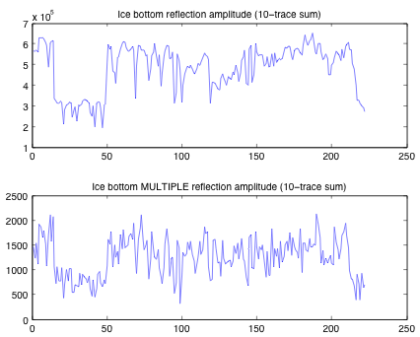
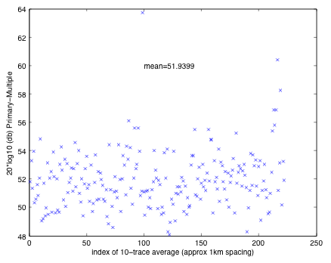
Primary and multiple amplitudes and echo intensity ratios

Slide 7
Attenuation from multiple echo (2)
Ice is ~550-m thick near WIS grounding line.
Attenuation rate calculate requires estimates of ice–ocean and air–firn reflectivities at 2 MHz (–3 dB and –16 dB, respectively).
Air–firn reflectivity calculated using integration of differential equation of the reflectivity as a function of depth-varying permittivity.

Slide 8
High-frequency ice conductivity
1. Linear dependence on concentrations of in-situ acid ([H⁺]) and sea-salt chloride ([ss Cl⁻]).
2. Separate Arrhenius-form temperature dependencies.
3. Density dependence (not shown).

Slide 9
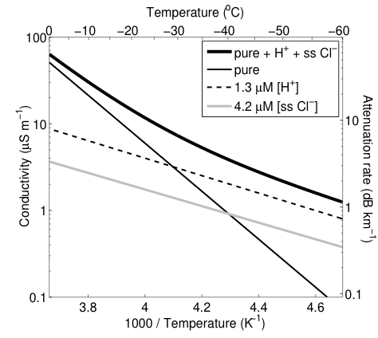
Conductivity as a function of temperature
Impurity concentrations used are mean values from Siple Dome

Slide 10
Modeling attenuation
Conductivity model specified during Siple Dome work, where borehole temperature and ice-core chemistry/density data are available.
Here we use the mean value of [H⁺] from Siple Dome. For [ss Cl–], we use half of the mean value at Siple Dome, based on lower [ss Cl–] concentrations at UpC and CWA-A upstream.
Density and surface-temperature measurements from nearby RIGGS sites (J-9 ice core, G-8, H-8, H-9).

Slide 11
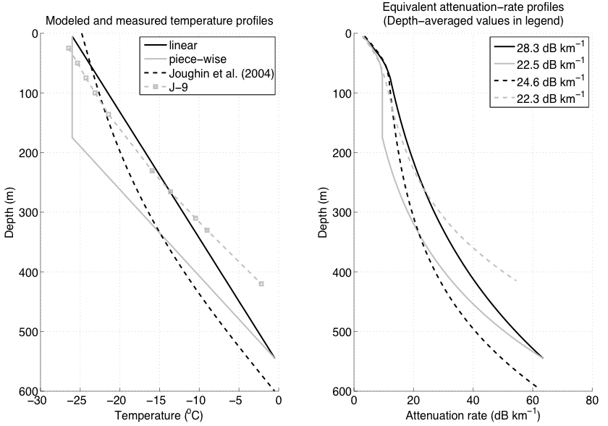
Temperature profiles and modeled attenuation rates

Slide 12
Summary
Model shows that a range of temperature profiles produce a resolvable range of depth-averaged attenuation rates.
We can usefully constrain temperature profile over ice shelves using this method. For grounded sites, we could use a common-midpoint antenna configuration and multiple internal layers.

