Slide 1
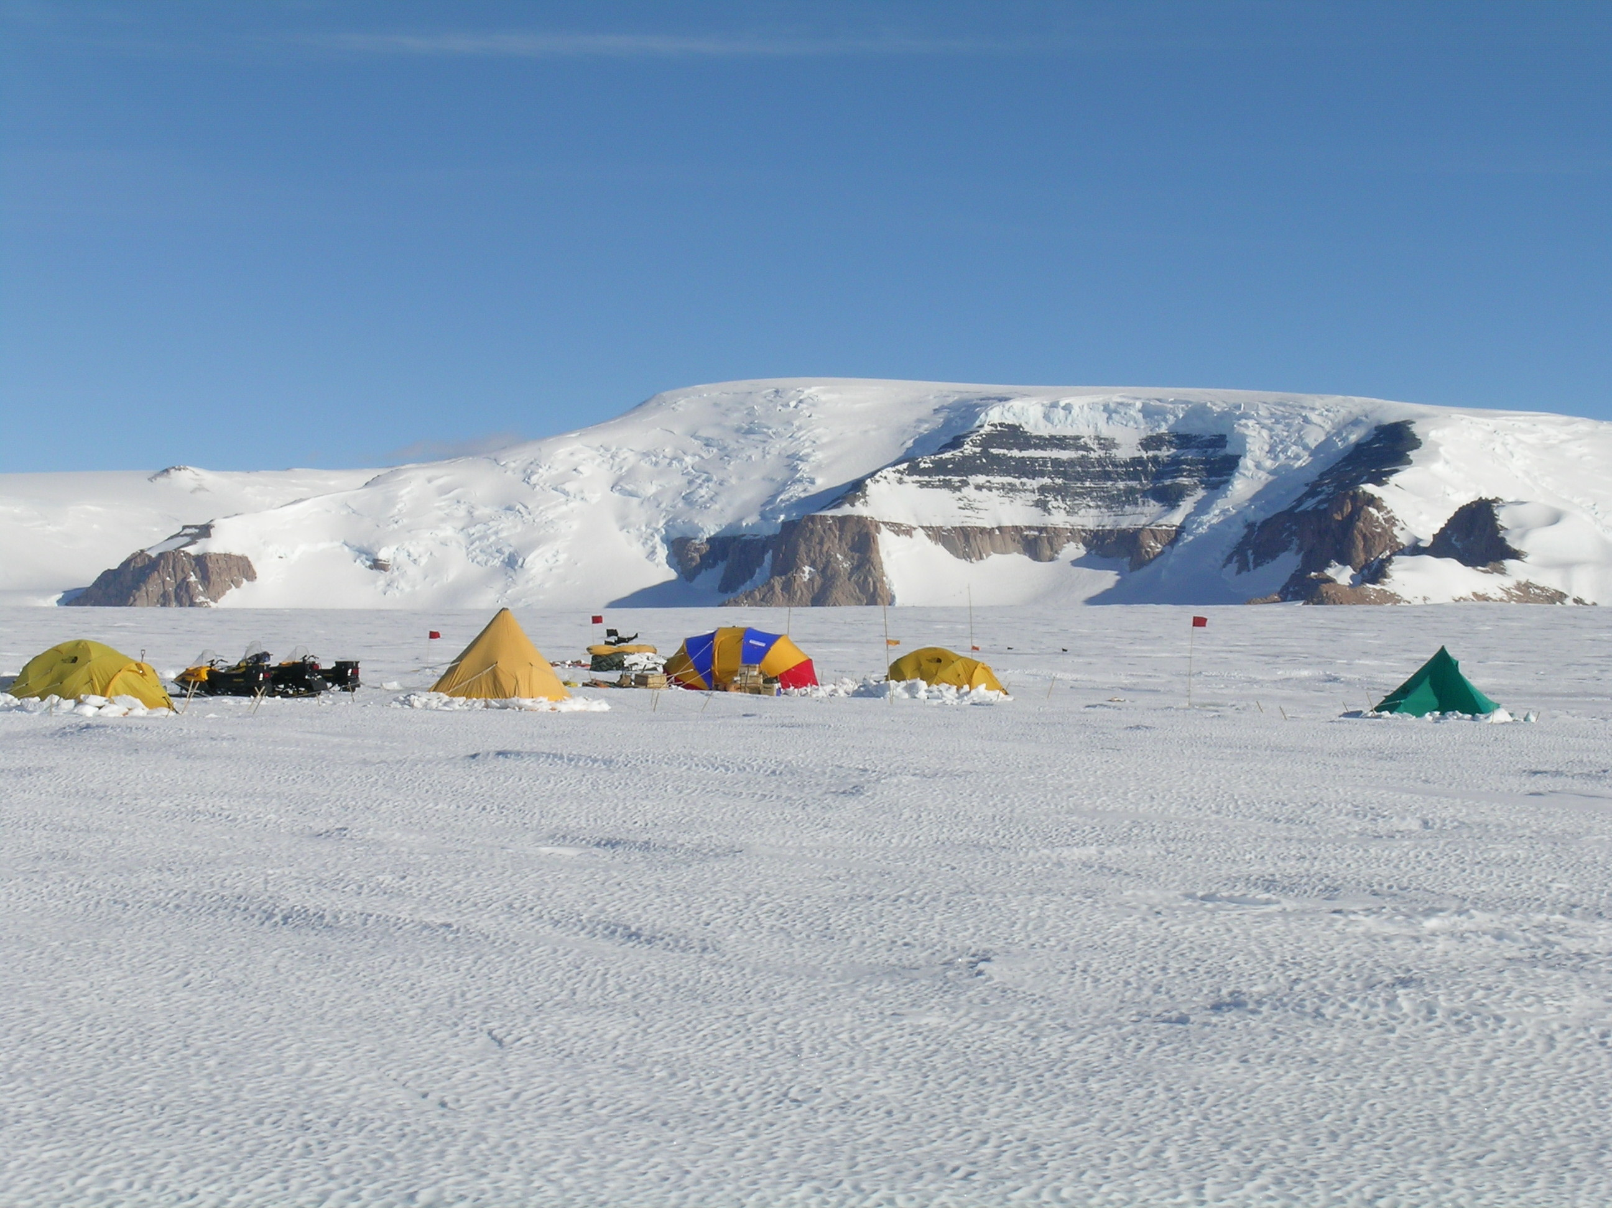
Swinging gate or Saloon Doors?
Do we need a new model of WAIS deglaciation?
Robert P. Ackert Jr.
Harvard University
WAIS 2008

Slide 2
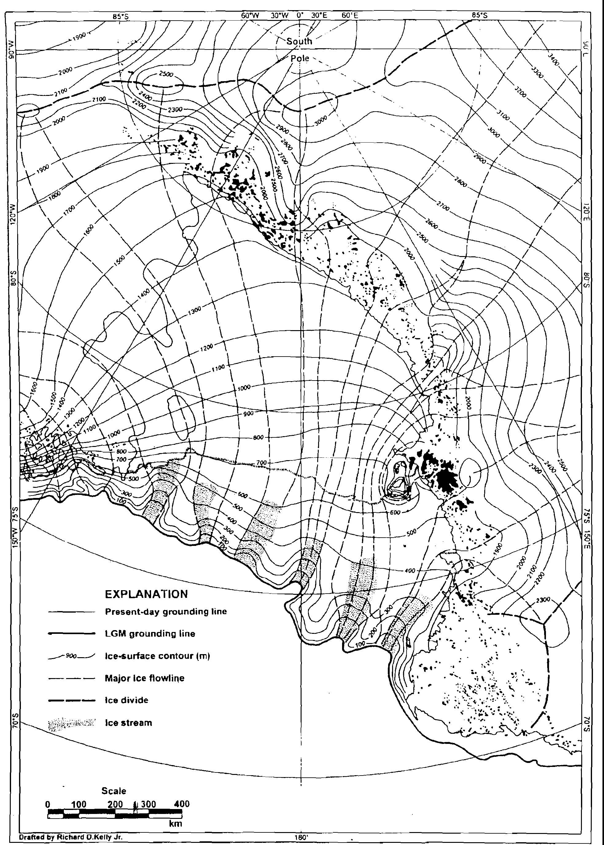
Classic reconstruction of WAIS in the Ross Sea at the last glacial maximum
Denton and Hughes, 2002

Slide 3
Classic reconstruction of WAIS in the Ross Sea at the last glacial maximum
Characterized by ice streams
Similar in length to those of present day.
Grounding line retreat by swinging gate hinged east of Roosevelt island.
Denton and Hughes, 2002

Slide 4
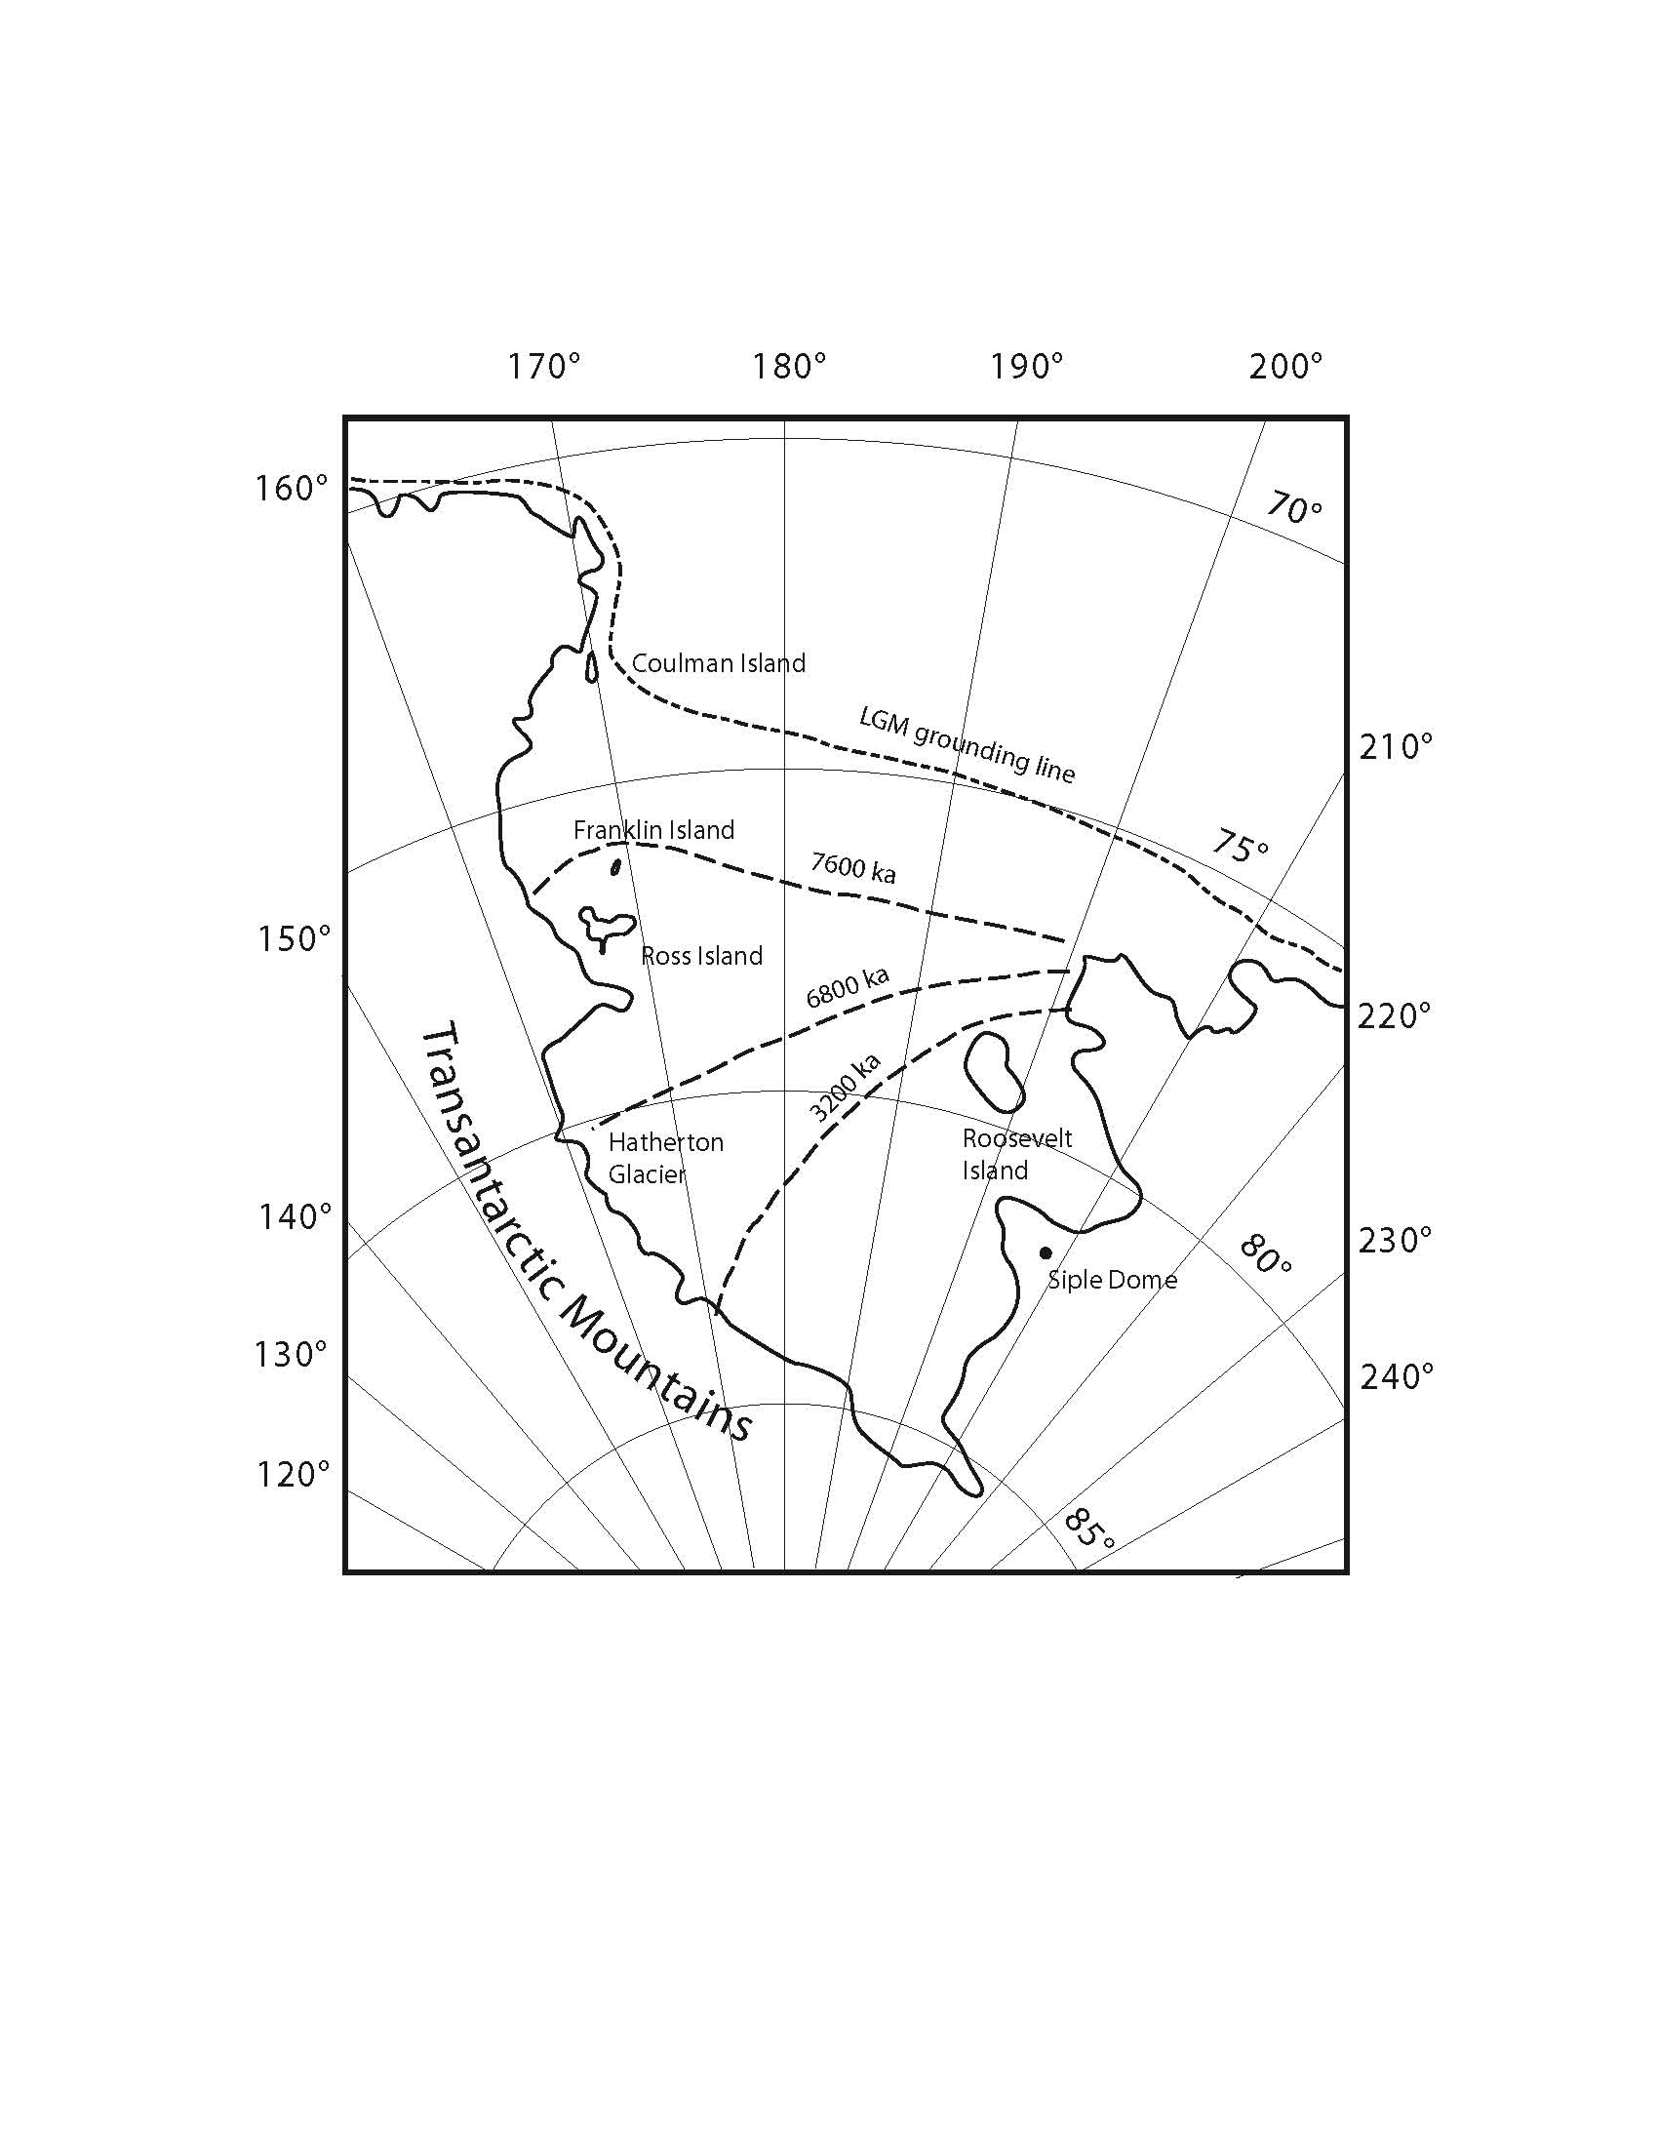
Swinging gate model of deglaciation in the Ross Embayment.
The limited chronologic control from glacial marine sediments, glacial deposits in the Trans-antarctic Mountains and Roosevelt Island.
Conway et al. 1999; Stuiver et al. 1981

Slide 5
Swinging gate model of deglaciation in the Ross Embayment.
The limited chronologic control from glacial marine sediments, glacial deposits in the Trans-antarctic Mountains and Roosevelt Island.
Conway et al. 1999; Stuiver et al. 1981

Slide 6
Classic reconstruction of WAIS in the Ross Sea at the last glacial maximum
Siple Dome
~1000 m
Reconstructed ice elevation over Siple Dome is ~1400 m.
Denton and Hughes, 2002

Slide 7
Classic reconstruction of WAIS in the Ross Sea at the last glacial maximum
Ohio Range
~1680 m
Siple Dome
~1000 m
Reconstructed ice elevation over Siple Dome is ~1400 m.
Reconstructed ice elevation over Ohio Range is ~1900 m.
Denton and Hughes, 2002

Slide 8
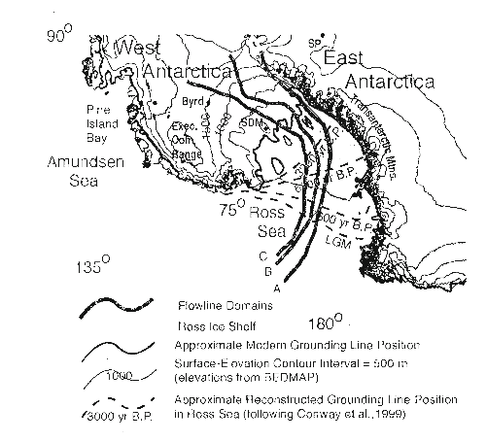
2D Thermomechanical flowline model, with weak linear viscous basal rheology
(slippery bed).
Parziek and Alley, 2004

Slide 9
Ohio Range
2D Thermomechanical flowline model, with weak linear viscous basal rheology
(slippery bed).
Parziek and Alley, 2004

Slide 10
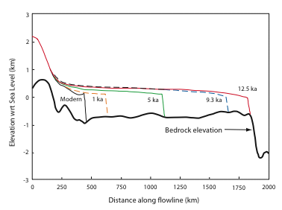
Mercer Ice Stream Profile
Thin, low slope profile with ice stream extending across the Ross Embayment
Ohio Range ~ 75 m above present
Ackert et al. 2007; Parziek and Alley, 2004

Slide 11
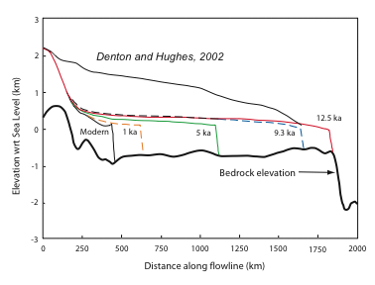
Mercer Ice Stream profile
This is a huge difference!
Parziek and Alley, 2004

Slide 12
Mercer Ice Stream profile
Implications:
1) Much smaller con-tribution to global sea level rise.
2) Much smaller isostatic rebound.
3) Style of deglaciation.
Parziek and Alley, 2004

Slide 13
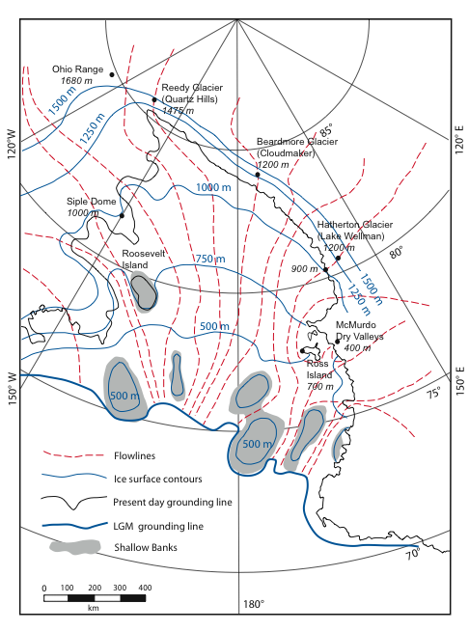
Cartoon Reconstruction of Ross Embayment at LGM consistent with existing glacial and geologic data.

Slide 14
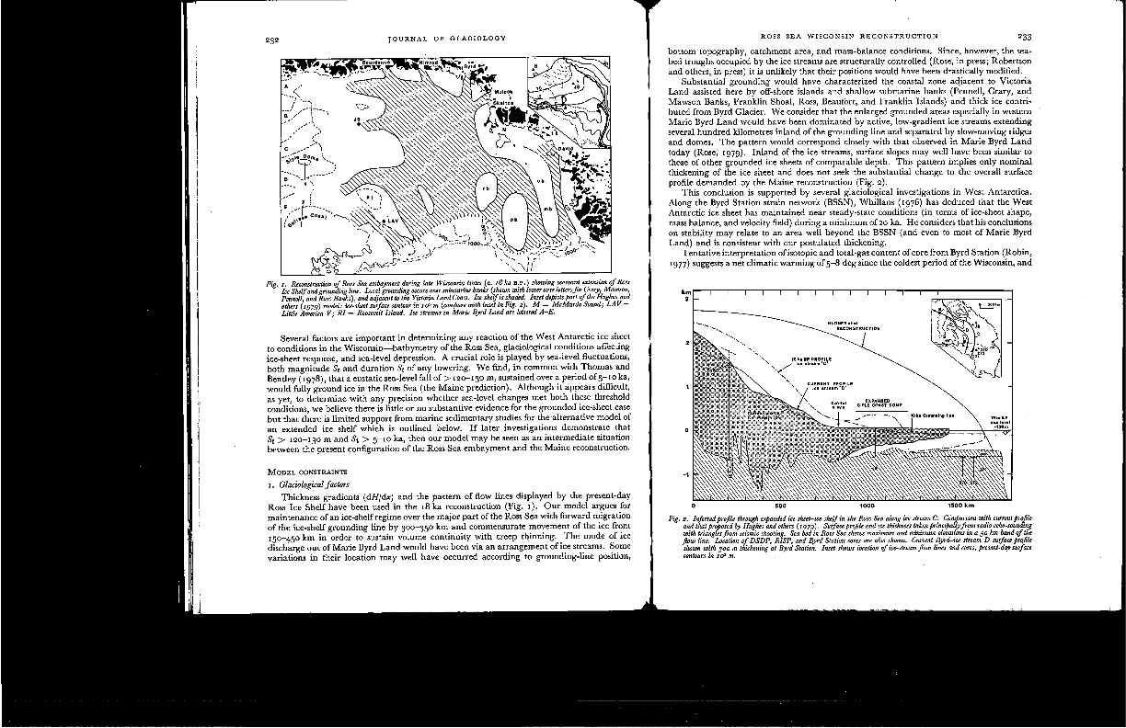
Drewry, 1979

Slide 15
Drewry, 1979
Drewry, 1979

Slide 16
Classic reconstruction of WAIS in the Ross Sea at the last glacial maximum
Denton and Hughes, 2002

Slide 17
Cartoon Reconstruction of Ross Embayment at LGM consistent with existing glacial and geologic data.
Grounding line retreat dominated by calving bay in the Central Ross Sea.

Slide 18
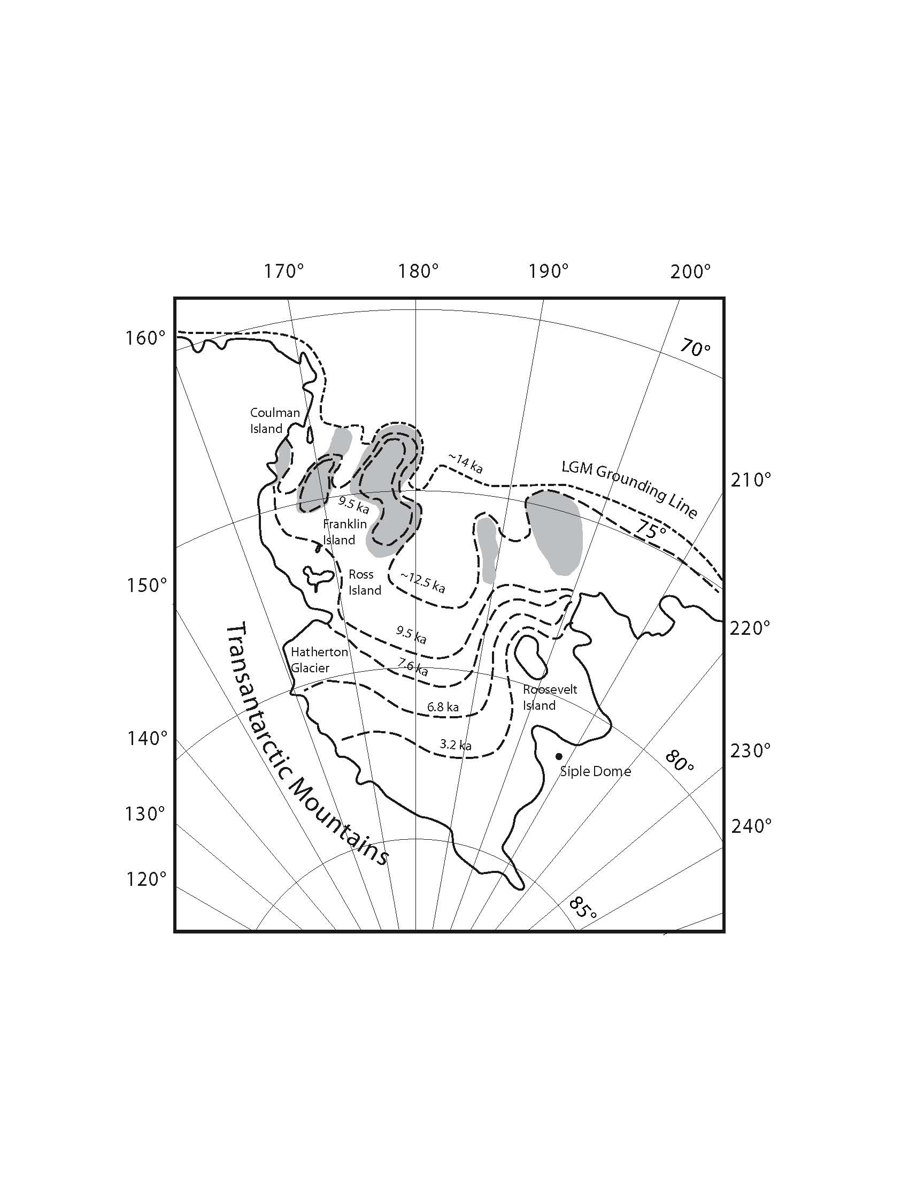
Cartoon of Deglaciation of the Ross Embayment.

Slide 19
Cartoon of Deglaciation of the Ross Embayment.

Slide 20
Cartoon of Deglaciation of the Ross Embayment.
Central Calving Bay propagates past McMurdo Sound.
Rather than a single Swinging Gate, deglaciation may resemble double swinging doors.

Slide 21
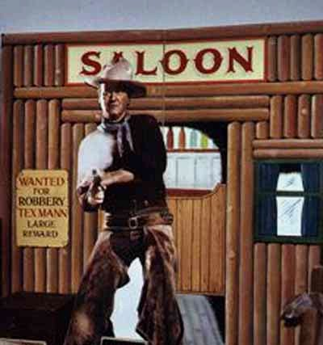
Or more specifically:
Saloon Doors

Slide 22
Implications:
Rates and spacial distribution of glacial rebound.
Sensitivity of WAIS to sea level vs. climate forcing
Has grounding line retreat continued through the Holocene to the present, or is the present configuration stable (to pre-industrial forcing)?

