Slide 1
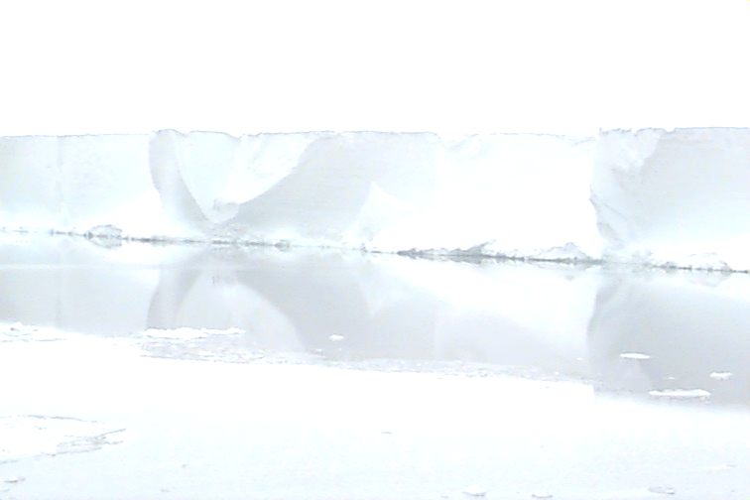



Hydrostatic equilibrium:
a good assumption for the position of grounding lines?
Sophie Nowicki
Duncan Wingham

Slide 2
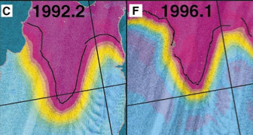
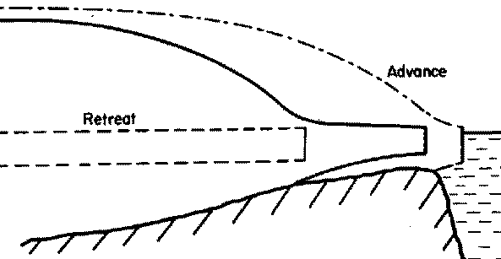
Motivation
Grounding line of Pine Island Glacier retreat ~ 5km
(Rignot, 1998)
Future response: unstable or neutrally stable?
(Weertman, 1974 vs Hindmarsh, 1993)
Sheet
GL
Shelf
How should the position of the grounding line be determined in marine ice sheet models?

Slide 3
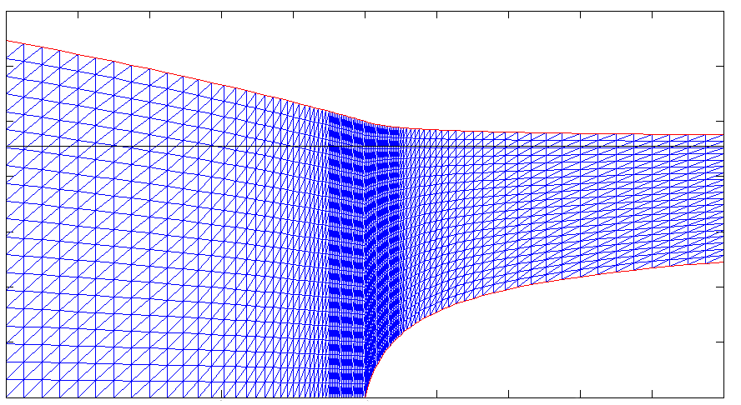
Model set up
Full Stokes finite element model.
Glen’s flow law.
Grounding line is fixed.
Free surfaces to be determined.
No stress
No mass flux
1.2
Sea level
0.8
Shelf stresses
Sheet velocities
0.4
Water pressure
No mass flux
Ice sliding
0
-8
-4
0
4
8

Slide 4
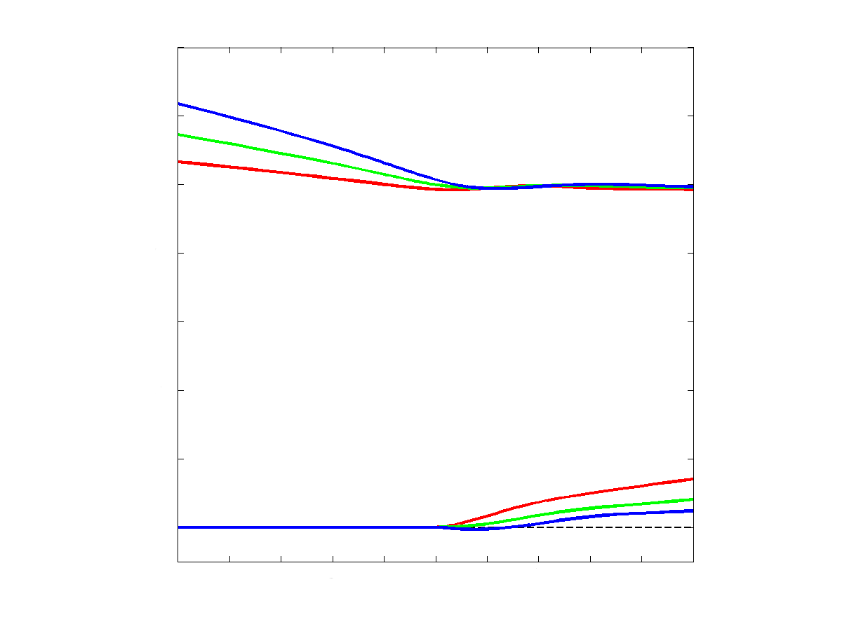
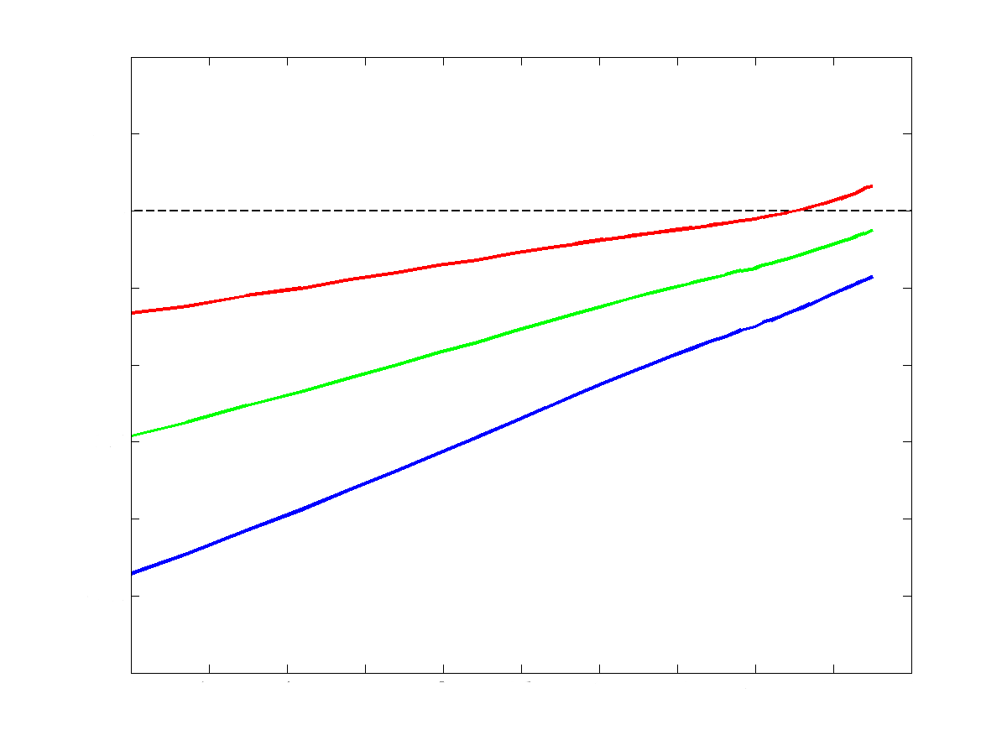
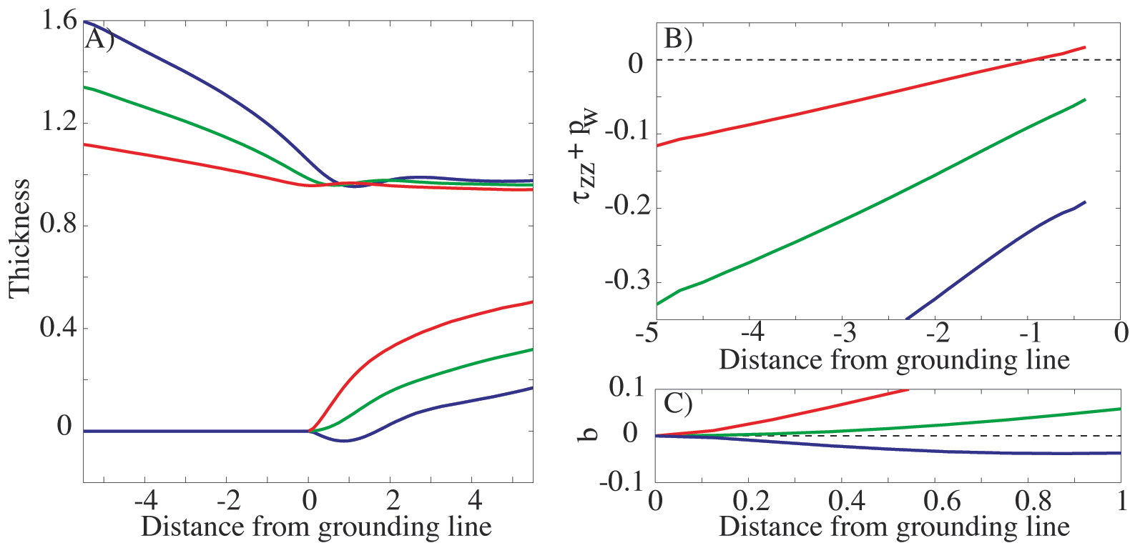
Grounded ice sliding over bedrock
(Fixed sliding coefficient, linear sliding law)
Surface profiles
Upstream stresses
1.2
0
Thickness
-0.1
0.8
-0.2
0.4
-5
-4
-3
-2
-1
0
Distance from grounding line
0
Mass fluxes
-4
-2
0
2
4
Q = 0.45
Q = 0.25
Q = 0.13
Distance from grounding line
Notes:
Fixed sliding coef: b=7, varying mass fluxes q= 0.4453, q=0.2546, q= 0.1264

Slide 5
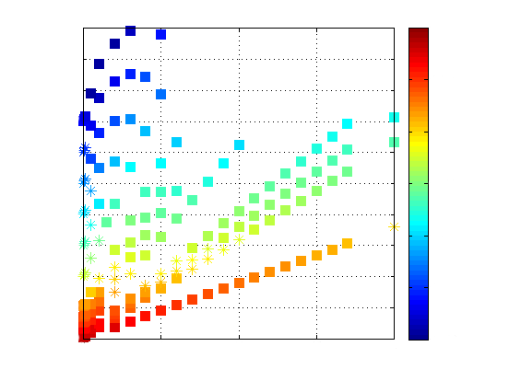
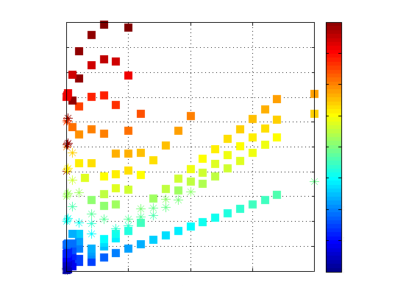
Stress ( ) and thickness ( ) at the grounding line
h_{g}
h_{g}
-1.10
-1.05
-1.00
-0.95
0.96
0.98
1.00
1.02
1.04
1
1
Shelf condition violated
Shelf condition violated
0.8
0.8
Mass flux
Mass flux
0.6
0.6
0.4
0.4
0.2
0.2
Sheet condition violated
Sheet condition violated
0
0
0
5
10
15
20
0
5
10
15
20
Sliding coefficient
Sliding coefficient
Notes:
Point out the spread in the data. In the fast sliding regime would expect only 1 point.

Slide 6
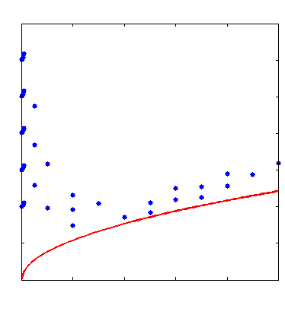
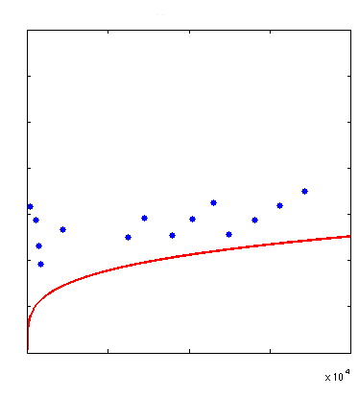
Schoof’s analytical mass flux versus numerical mass flux
Linear sliding law
Non-linear sliding law
0.6
0.6
0.5
0.5
0.4
0.4
Mass flux
Mass flux
0.3
0.3
0.2
0.2
0.1
0.1
0
0
0
5
10
15
20
0
2
4
6
8
10
Sliding coefficient
Sliding coefficient
x10³
Notes:
Point out again that the spread in the data is due to numerical ambiguity (in the fast sliding regime).
More data pts are needed for the non-linear sliding law.

Slide 7
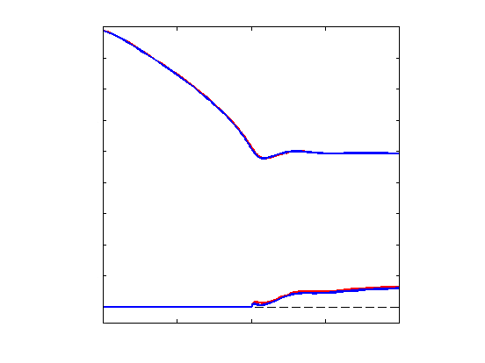
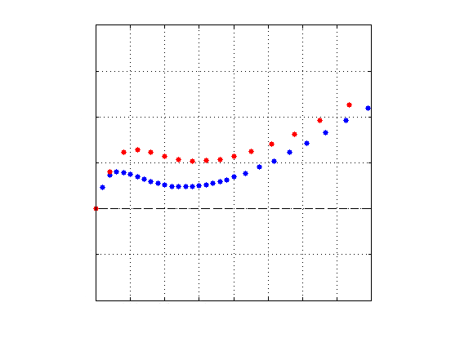
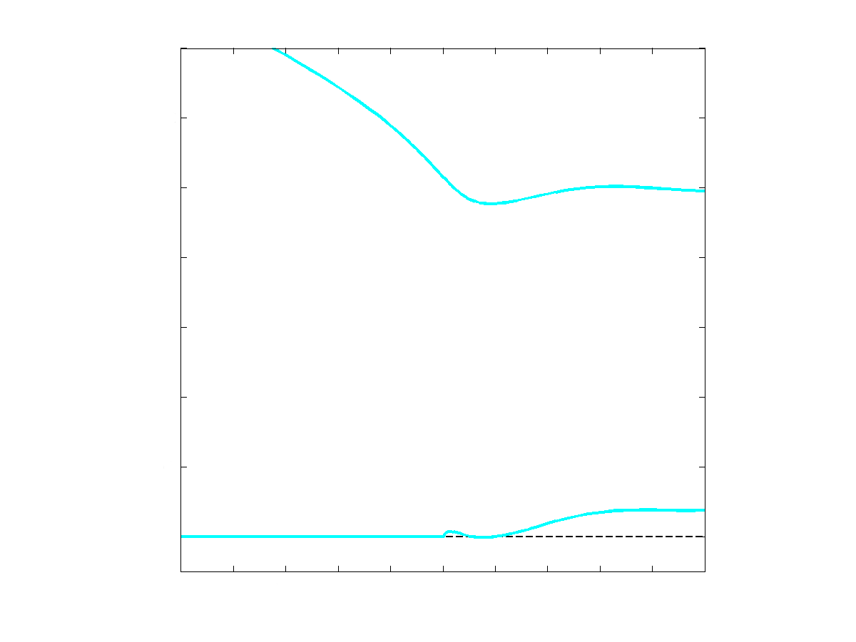
Multiple contacts?
0.1
1.6
Thickness
1.2
1.2
0.05
0.8
Thickness
0.8
0
0.4
0
0.4
-10
-5
0
5
10
0
0.5
1
1.5
2
Distance from grounding line
Distance from grounding line
0
-4
-2
0
2
4
Distance from grounding line
Notes:
Linear sliding law, little sliding
Need for asymptotic (the only thing that I can do is mesh refinement)
Not clear if when include thermodynamics to the pb, that will get same stress behavior at the gl. (Thermodymanics rm sing?)
As deviatoric stresses are infinite at GL, viscosity is very small, would expect melting (heat singularity is integrable, see paper Barcillon & MacAyeal). This underlines the importance of treating the problem with heat.
Point out: property of non linear rheology, (did not have this pb with linear rheology)
Importance of mesh size+ point out scales. Explains why I have a difficulty with my solution/band.
Ie: need to strees that I have been looking at this into a lot of details and limitations of numerical work.
File used: trans_nl_l5b_q07_b005_start_t5b.dat

Slide 8
Conclusion
Accurate determination of the position of the grounding line remains one of the challenges faced by current marine ice sheet models.
We have made progress in understanding that the ‘classical’ hydrostatic hypothesis does not uniquely determine the grounding line position.
At least one other condition is needed, and it appears that Schoof’s contact condition for subglacial cavities is sufficient for ‘slow’ and ‘fast’ junctions.
However, it is remains unclear whether thermodynamics is an essential part of the ‘slow’ junction problem.

Slide 9
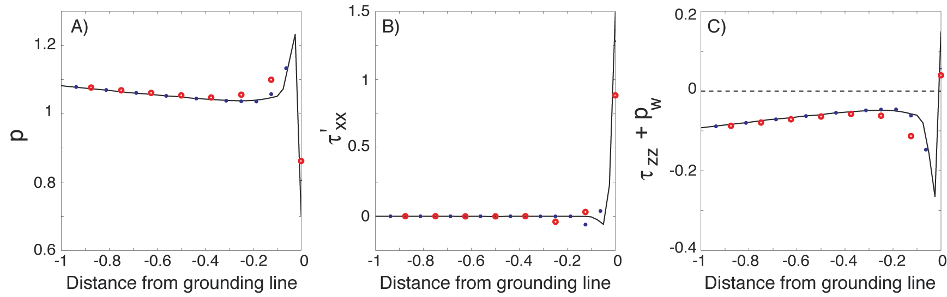
Ice
Contact inequalities
Water
Bedrock
Bedrock
GL
Pressure
Deviatoric stress
Upstream stress
Cf: subglacial cavities (Lliboutry, 1968, Iken, 1981; Schoof, 2005, Gagliardini et al., 2007)

Slide 10
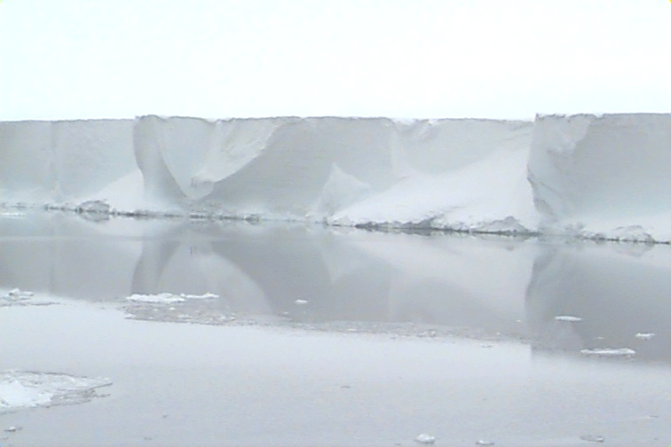
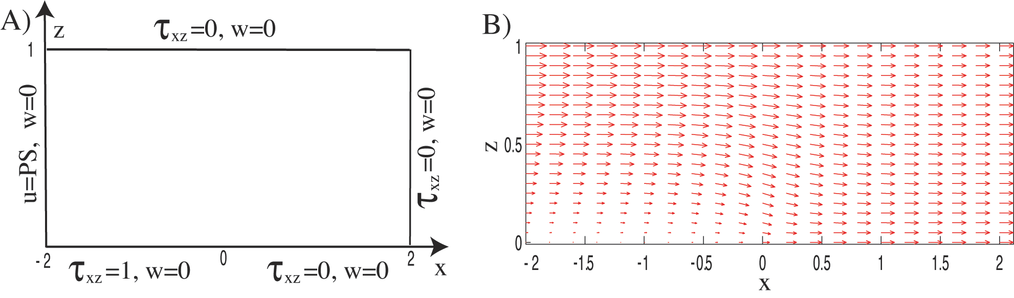
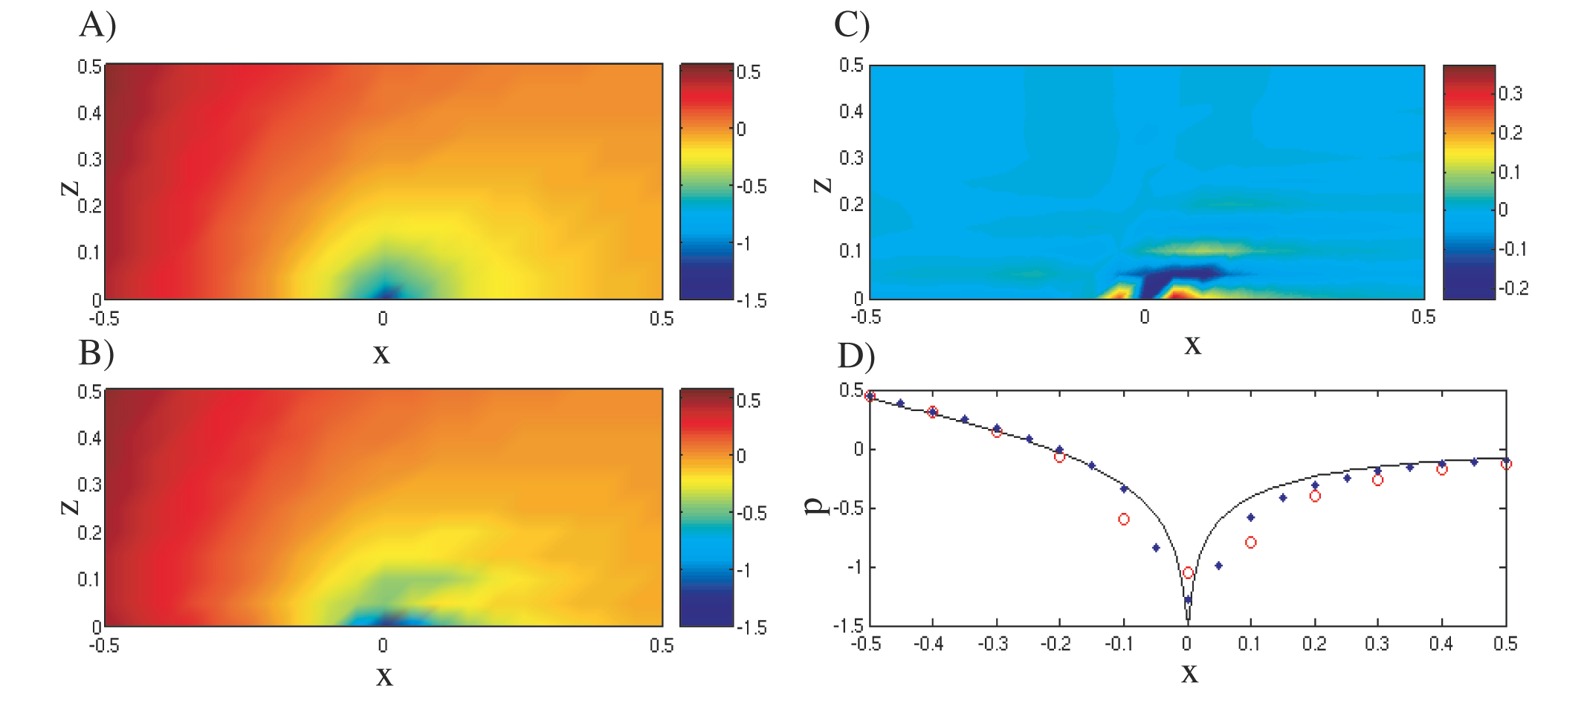
Pressure singularity: Stick-Slip flow
Problem set up
Flow field
Semi-analytical pressure
Semi-analytical - numerical
Numerical pressure
Pressure at lower boundary

Slide 11
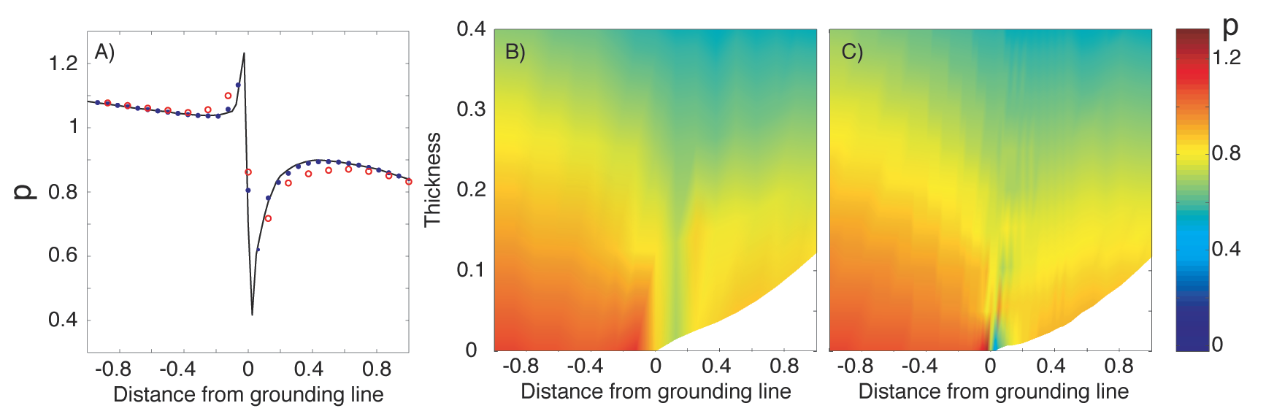
Pressure in the vicinity of the GL

Slide 12
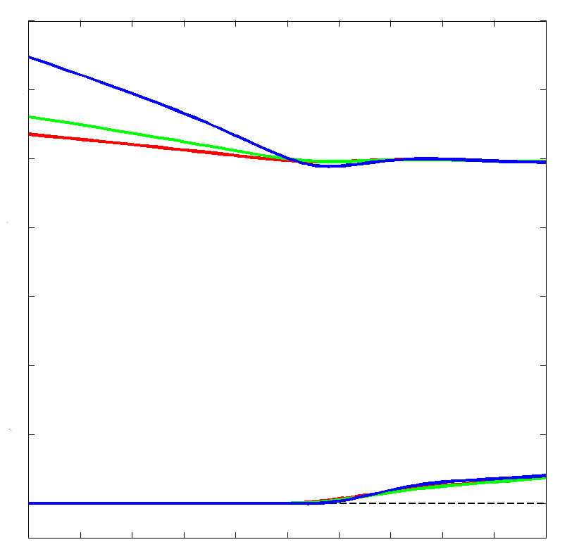
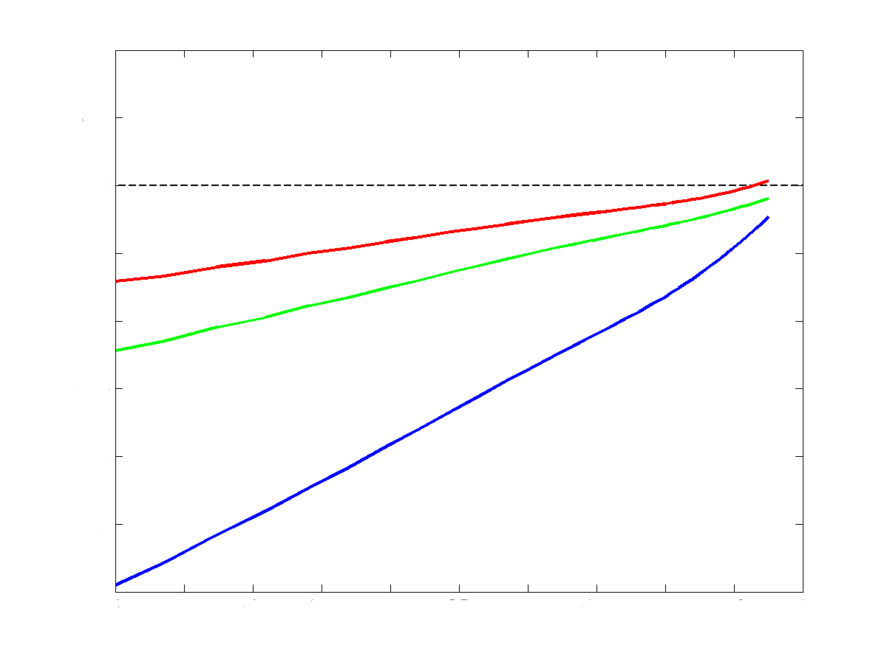
Grounded ice sliding over bedrock
(Fixed mass flux, non-linear sliding law)
Surface profiles
Upstream stresses
1.2
0
Thickness
-0.1
0.8
-0.2
0.4
-5
-4
-3
-2
-1
0
Distance from grounding line
0
Sliding coefficient
-4
-2
0
2
4
= 549
Distance from grounding line
= 14049
= 66037
Notes:
Fixed mass flux q= 0.287

Slide 13
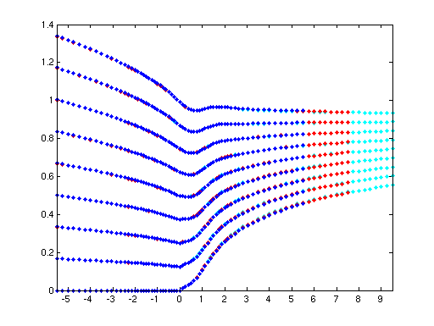
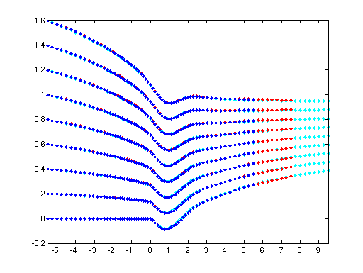
Tests on free surfaces…
Domain length
Q=0.343
Q=0.830
Thickness
Thickness
Distance from grounding line
Distance from grounding line

Slide 14
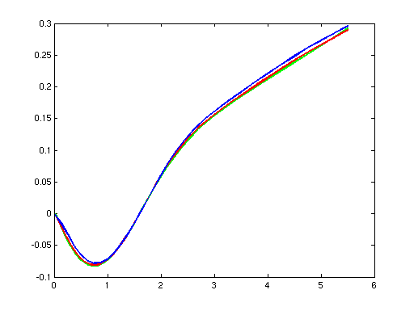
Further tests on free surfaces…
Mesh spacing
Shelf lower surface
X = 0.125
X = 0.0625
X = 0.025
Distance from grounding line

Slide 15
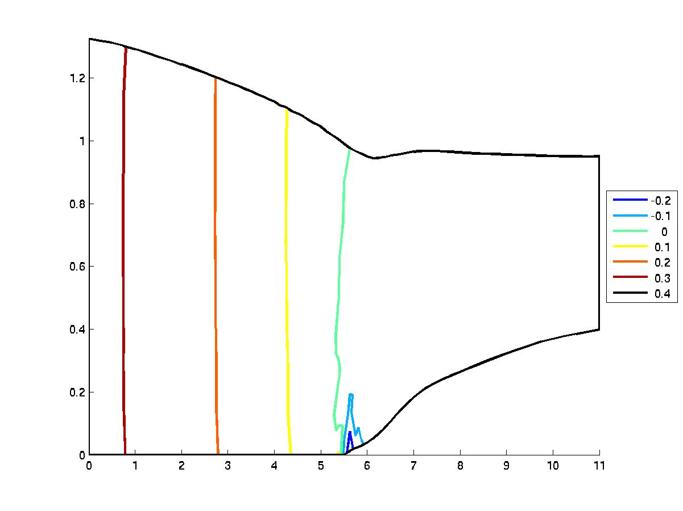
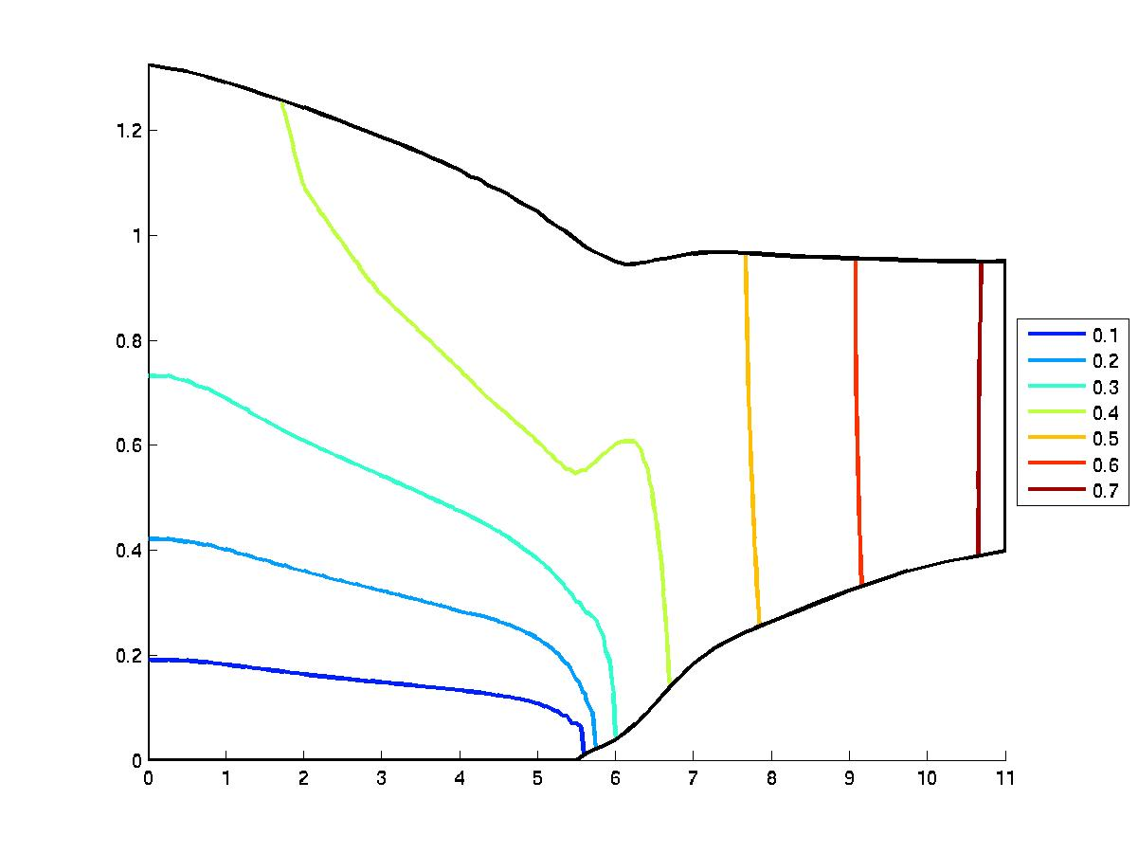
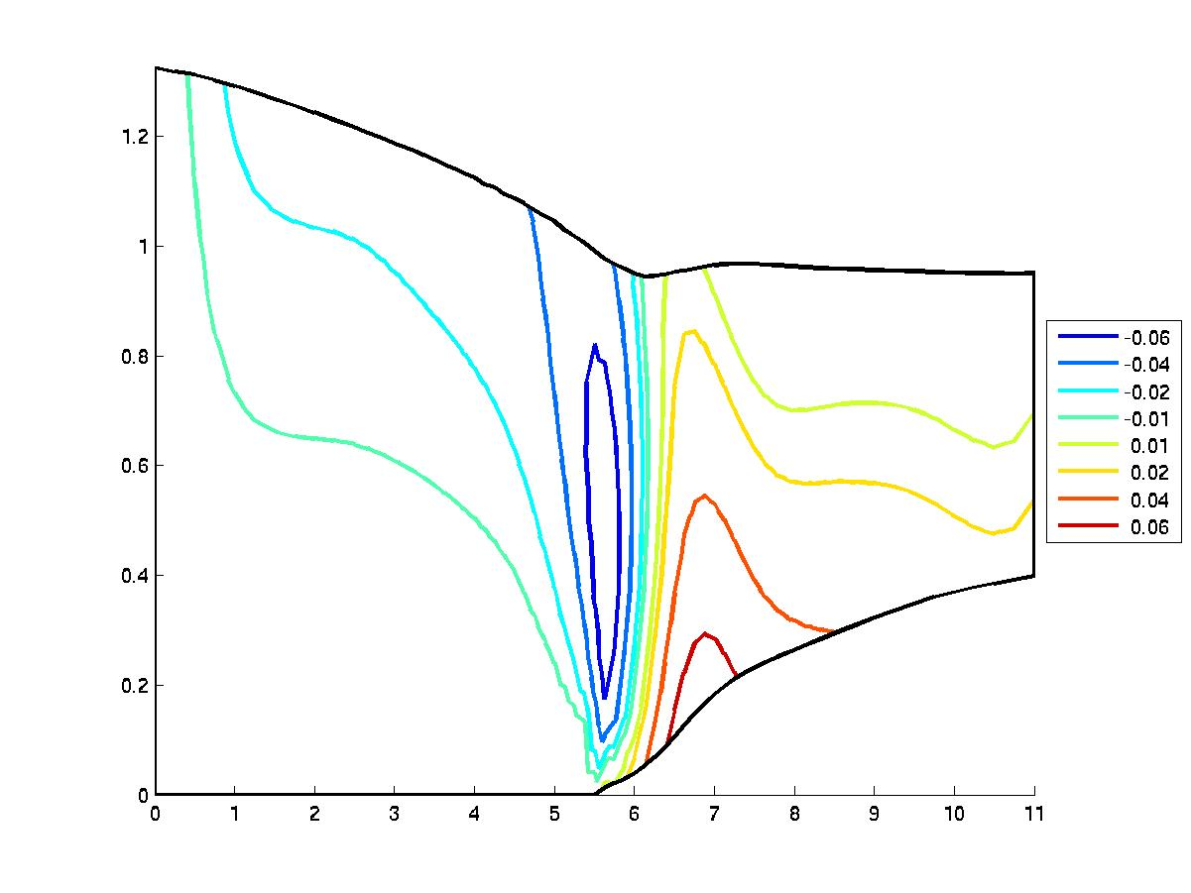
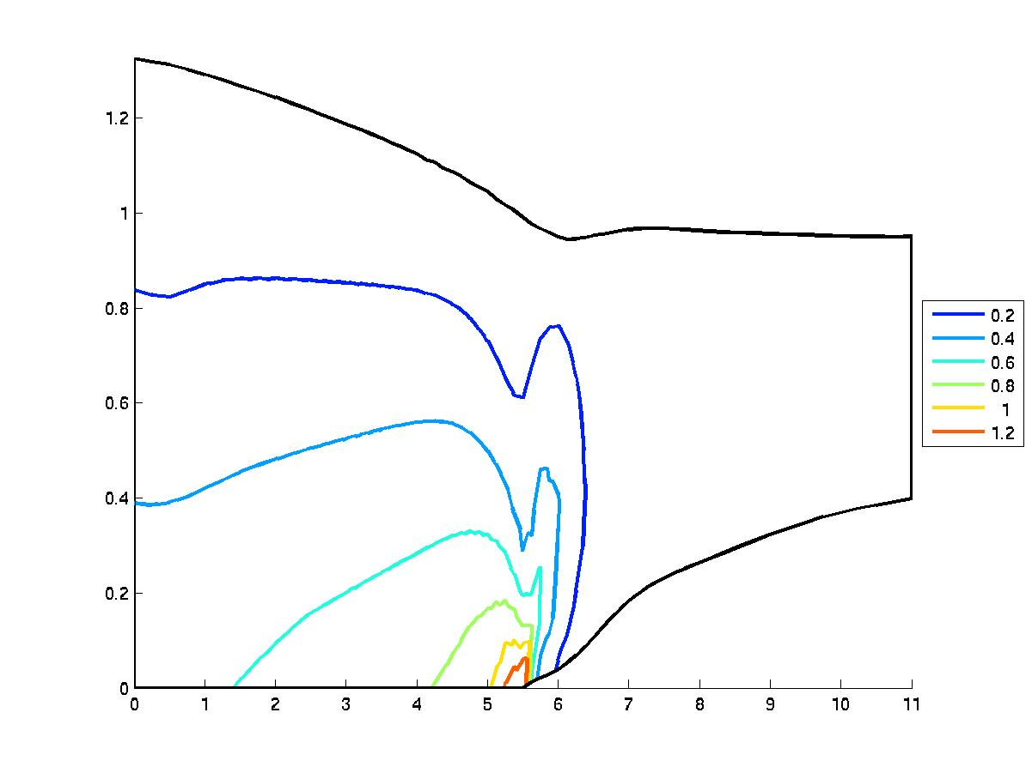
Numerical Results: ice frozen to bedrock
Horizontal Velocity
Pressure
0.4
0.5
0.7
0.3
0.2
0.1
0
0.3
0.6
0.2
-0.1
0.1
0.1
-0.2
Vertical Velocity
Shear Stress
-0.02
-0.04
0.2
-0.01
0.01
0.02
0.4
0.04
-0.06
0.06
1
0.6
0.8
1.2

Slide 16

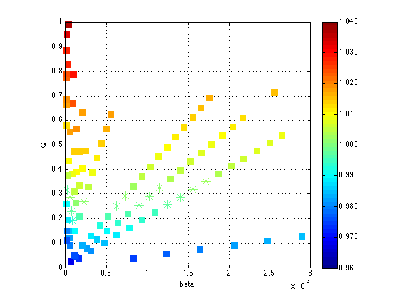
Grounded ice sliding over bedrock
Linear sliding law
Non-linear sliding law
h_{g}
Mass flux
Sliding coefficient
Sliding coefficient
Notes:
Point out the spread in the data. In the fast sliding regime would expect only 1 point.

