Slide 1
SeaRISE (Sea-level Response to Ice Sheet Evolution)
“How bad could sea level rise get?”

Slide 2
Participants
Robert Bindschadler (NASA GSFC)
Ayako Abe-Ouchi (U. Tokyo)
Andy Aschwanden (ETH)
Richard Alley (Penn State)
Jeremy Bassis (U. Chicago)
Ed Bueler (UAF)
Bea Csatho (U Buffalo)
Mike Dinniman (Old Dominion)
Todd Dupont (UC Irvine)
Jim Fastook (U. Maine)
Carl Gladish (NYU/Courant)
Dan Goldberg (NYU/Courant/GFDL)
Ralf Greve (LTI/Hokaido)
David Holland (NYU/Courant)
Paul Holland (BAS)
Saffia Hossainzadeh (UC Santa Cruz)
Christina Hulbe (Portland State)
Charles Jackson (UTIG)
Jesse Johnson (U. Mont.)
John Klinck (Old Dominion)
Constantine Khroulev (UAF)
Anders Levermann (Potsdam)
Bill Lipscomb (LANL)
Doug MacAyeal (U. Chicago)
Maria Martin (Potsdam)
Sophie Nowicki (NASA)
Byron Parizek (Penn State)
David Pollard (Penn State)
Steve Price (LANL)
Catherine Ritz (LGGE)
Fuyuki Saito (Japan)
Olga Sergienko (Portland State)
Miren Vizcaino Trueba (UC Berkeley)
Slawek Tulaczyk (UC Santa Cruz)
Kees van der Veen (KU/CReSIS)
Ryan Walker (Penn State)
Weili Wang (NASA GSFC)

Slide 3
Origins
IPCC AR4 (of course)
“ability to predict dynamic ice sheet response is lacking”
Los Alamos Workshop (August 2008) on Incorporating Dynamic Ice Sheets into Global Climate Models
CCSM is on path to couple advanced-physics ice sheet to NCAR climate model
Not fast enough for IPCC AR5
glaciological community input to 5th IPCC assessment is necessary

Slide 4
Goal
Provide quantitative upper-bound estimates of ice sheet contributions to sea level for the 21st century
complements Ice2Sea
SeaRISE also will:
Strengthen the ice sheet modeling community
Attract new individuals to ice sheet modeling
Facilitate integration of dynamic land ice into global climate models

Slide 5
Strategy
Identify upper bound of future sea-level rise and work toward increasing likelihood scenarios
Experiments replace missing physics by external forcings
e.g., start with removing all Antarctic ice shelves; prescribe subglacial lubrication; require retreat/thinning of selected Greenland outlet glaciers
Multiple models
“Everyone” is more right than any “one”
Ensemble mean interpreted as a rough measure of uncertainty
Use common “best” data sets to remove these as source of model-to-model variations
SeaRISE is NOT a model intercomparison project

Slide 6
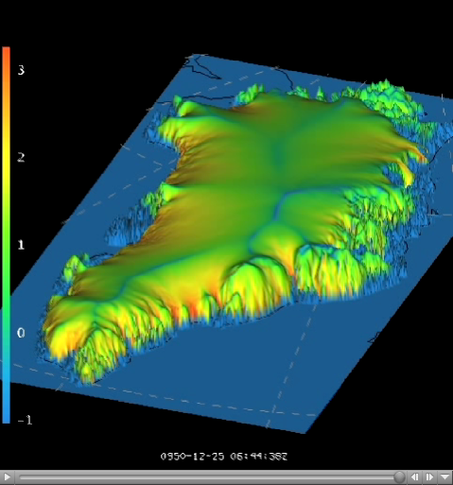
Participating Whole Ice Sheet Models
CISM/CCSM (built on GLIMMER)
PISM
Penn State U
U Maine
SICOPOLIS
GLAM
ICIES
GSFC
LGGE
Each starts from its own control run with varying “spin-up” approaches

Slide 7
Regional models are involved too
2-way interaction
Initialized from control runs of whole ice sheet models to provide spatial detail
Inform the whole ice sheet models through forcing boundary conditions, e.g., prescribe:
rate of grounding line retreat;
changing ice shelf backpressure;
perimeter thinning
basal lubrication from surface meltwater

Slide 8
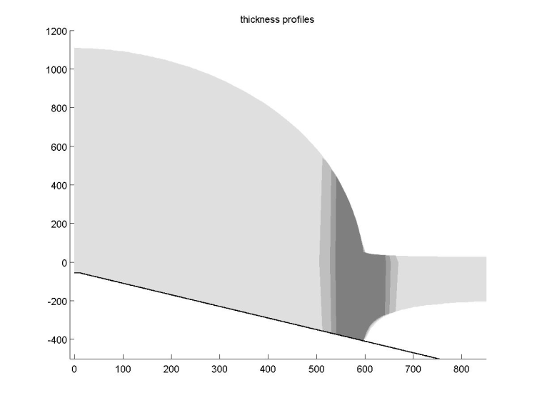
Regional Models Type 1: Ice-Stream/Ice-Shelf
2D or greater
Hulbe
Goldberg
Bassis (2.25-2.5D; an inverse approach)
Price/Payne (GLAM)
1D,2D
Dupont
Parizek (no thermodynamics)
Price/Payne (GLAM run as vertical slice in the x,z plane)

Slide 9
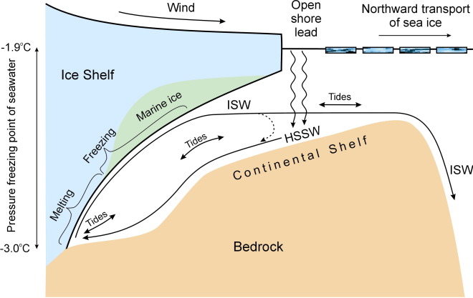
Regional Models Type 2: Ice-Shelf/Ocean
3D
HYPOP and CISM (Los Alamos National Lab; Ringler/Price/Lipscomb
ROMS (Old Dominion University; Klinck/Dinniman; no dynamical ice yet)
HIM (Ocean) (Geophysical Fluids Dynamics Lab; Little; no dynamical ice yet)
MICOM (Ocean) and CISM (University of Bergen ; Drange)
FESOM (Ocean) (Alfred Wegener Institute; Hellmer; and Hadley Center Ice Sheet)
2D-Vertical
HYPOP and CISM (Los Alamos National Lab; Ringler/Price/Lipscomb
Stream Function Ocean Flowline Ice (Penn State University; Walker/Dupont; includes an ice stream)
2D-Horizontal
Plume Ocean, CISM (New York University; Gladish/D.Holland; British Antarctic Survey; P.Holland; and Los Alamos National Lab; Lipscomb)

Slide 10
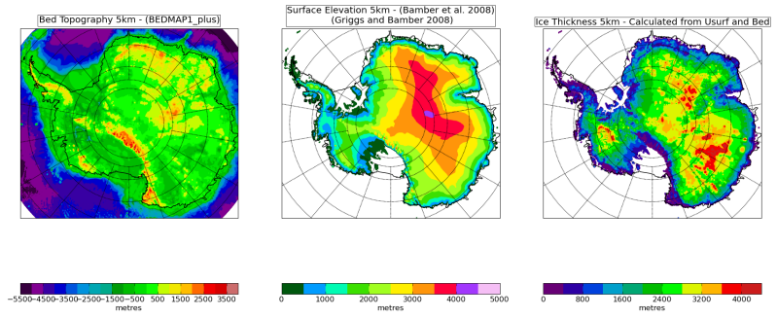
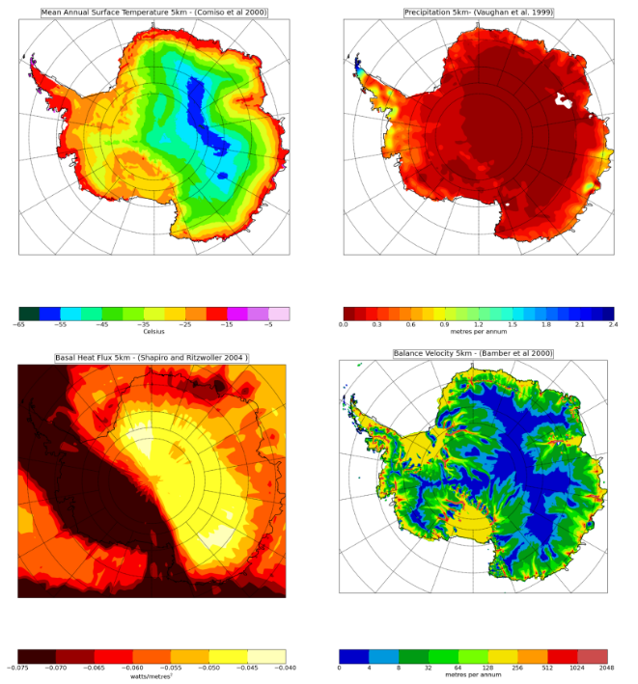
Data Sets Available at U/Montana
Surface Elevation
Bed Elevation
Ice Thickness
Present day Antarctica data sets:
Mean Annual Surface Temperature
Ice Thickness
Accumulation/Ablation Rate
Ice Surface Elevation
Bed Topography
Basal Heat Flux
Thickness Mask
Surface Velocity
Melt(Ross ice streams)
Surface Balance Velocity
Present day Greenland data sets:
Ice Thickness
Bed Topography
Ice Surface Elevation
Precipitation
Basal Heat Flux
Mean Annual Near-surface(2m) Air Temperature
Surface Temperature
Precipitation
Geothermal Heat Flow
Balance Velocity

Slide 11
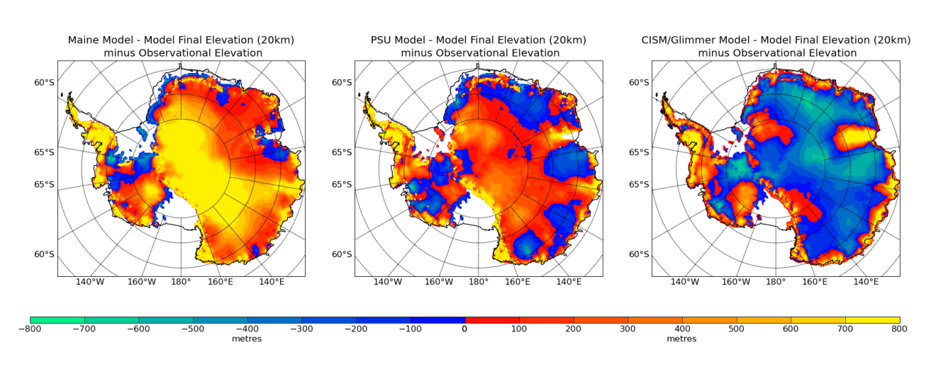
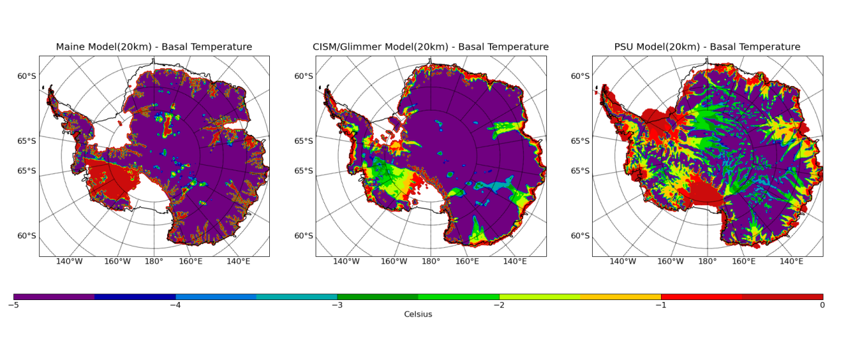
t₀ = January 1, 2004
Surface Elevation
minus Observed
Basal Temperature
Model simulations of present vary
experiment outputs will be compared to control runs of same model

Slide 12
Control Runs
Constant Climate
hold climate constant at present values for 200 years (500 years preferred)
AR4 Climate
Use climate anomalies defined as ensemble mean of IPCC-AR4 models (provided by Tom Bracegirdle/BAS)
Standard output format has been defined to facilitate comparison analysis
Runs to be completed by November 30, 2009

Slide 13
Experiments
Scenario “experiments” are compared to a model’s own control run
Comparison of experiment anomalies minimizes model “peculiarities”
Greenland
Strong basal lubrication (and basal thawing) from surface meltwater
Prescribed glacier retreat/thinning
Antarctica
Ice-shelf removal
Estimate 2 experiments per year per ice sheet (including analysis, workshop and discussion)

Slide 14
Interaction
Bi-monthly telecoms
Bi-annual workshops
CCSM workshop (June)
Land Ice Working Group (February)

Slide 15
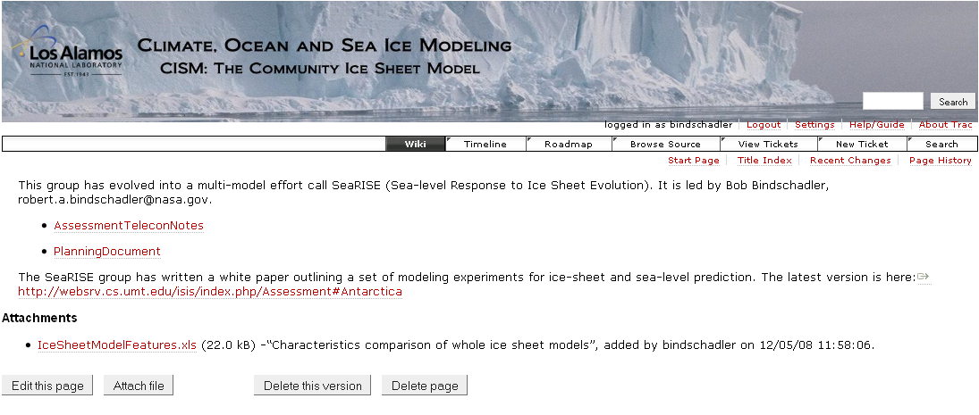
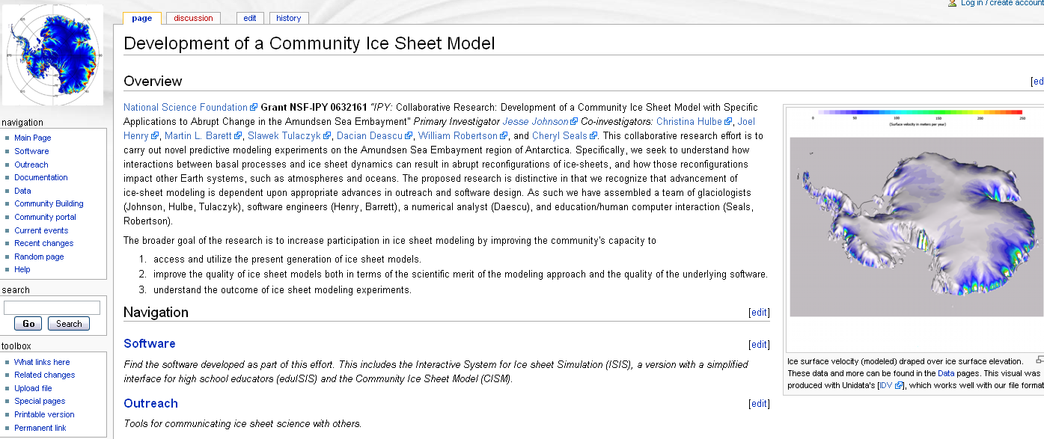
http://oceans11.lanl.gov/trac/CISM/wiki/AssessmentGroup
http://websrv.cs.umt.edu/isis/index.php/Main_Page

Slide 16
Timetable
IPCC-AR5 will be finalized in 2014
Published input likely due by 2Q/2012
Control runs complete 4Q/2009
1st set of experiments complete by 1Q/2010
Review results and define 2nd set of experiments by 2Q/2010
Regional models generate prescribed forcing fields
2nd set of experiments complete by 4Q/2010
Possible 3rd round of experiments in 2011
Review results and write papers by 1Q/2012

Slide 17
Questions?

