Slide 1
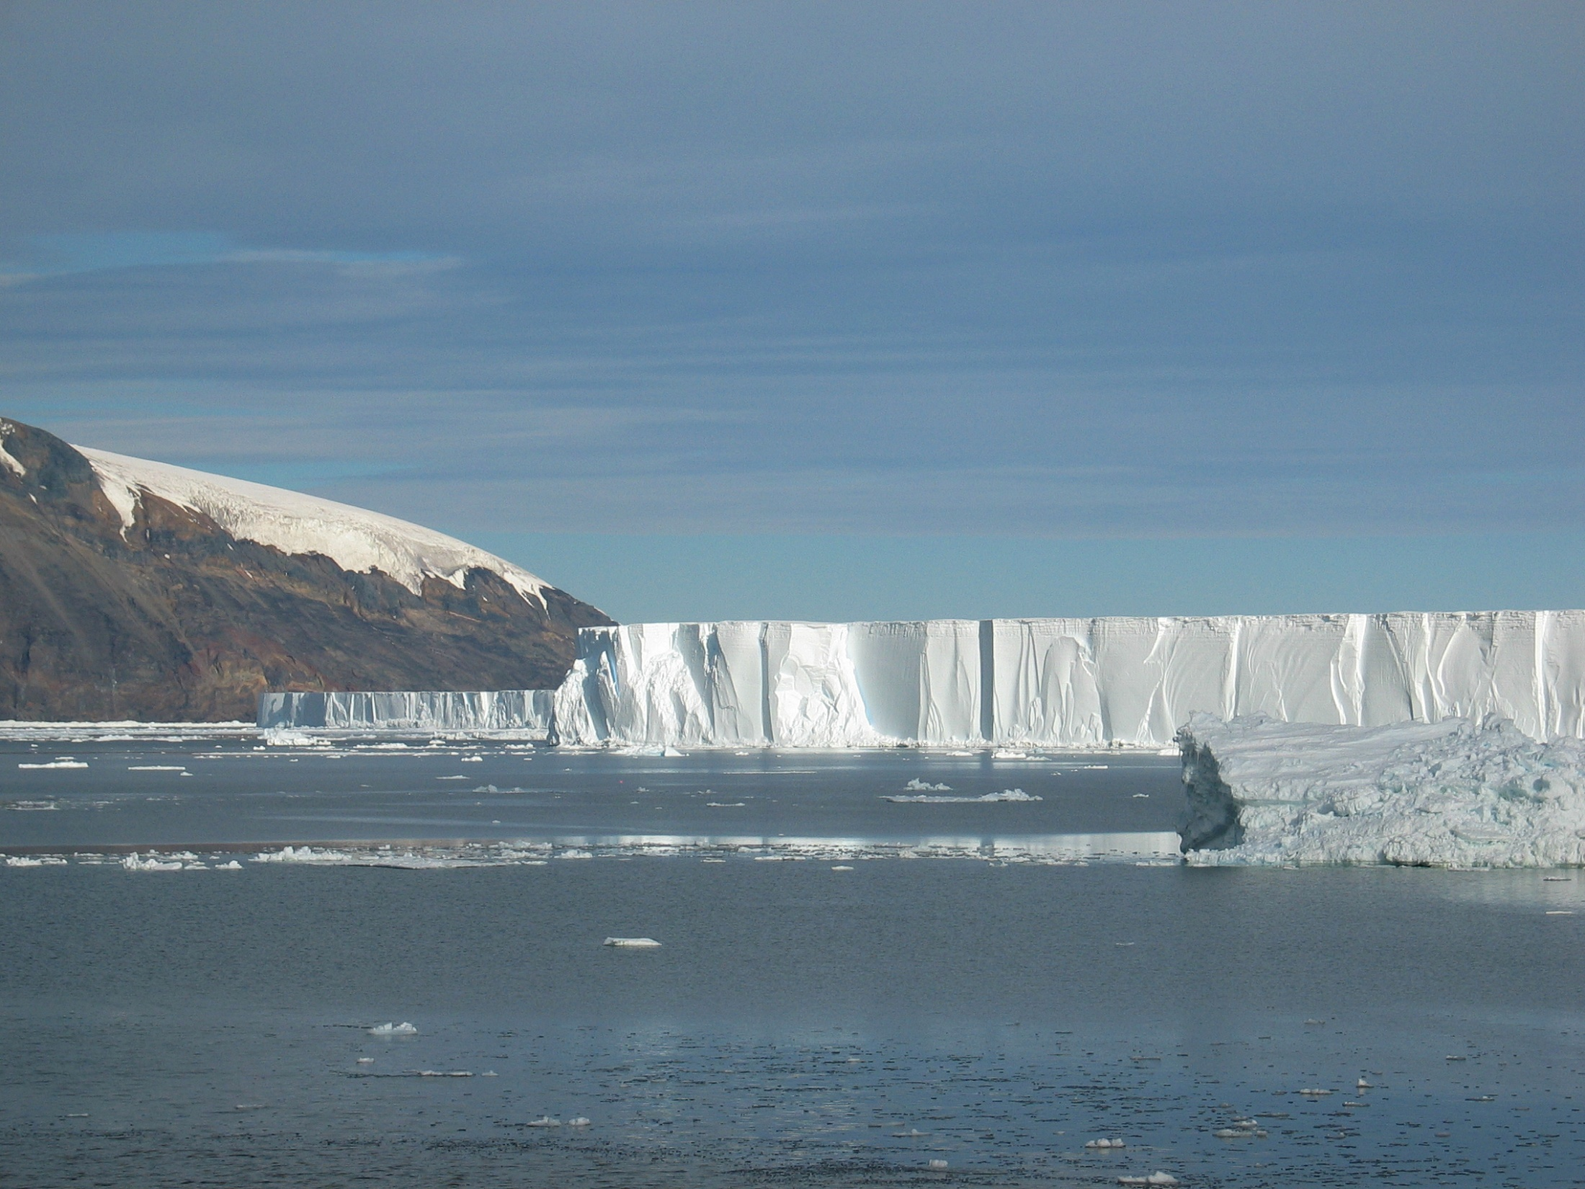


Wind effects on Circumpolar Deep Water intrusions on the West Antarctic Peninsula continental shelf
Mike Dinniman
John Klinck
Center for Coastal Physical Oceanography
Old Dominion University
Norfolk, VA, USA

Slide 2
Outline of Presentation
Introduction
Description of circulation model
Timing of Circumpolar Deep Water (CDW) intrusions on the WAP
“Downscaling” simulations: CDW transport and ice shelf basal melt
Conclusions
Notes:
Not doing real climate downscaling simulations, just doing simple modifications of the winds and ACC xport.

Slide 3
Introduction
Relatively warm CDW found at shelf break around most of Antarctica
Changes in either the temperature or quantity of warm CDW entering the ice shelf cavities have been proposed as a reason for the increased volume loss of the WAIS
Modifications in the wind forcing have been proposed as a mechanism for changes in the flux of CDW onto the continental shelf and to the cavities beneath the ice shelves

Slide 4
Antarctic Peninsula Model
ROMS: 4 km horizontal resolution, 24 levels
Ice shelves (mechanical and thermodynamic)
Dynamic sea ice
Bathymetry: ETOPO2v2 + WHOI SOGLOBEC region + Padman + BEDMAP + Maslanyj
Daily (or better) wind forcing from a blend of QSCAT data and NCEP reanalyses or Antarctic Mesoscale Prediction System (AMPS) winds
Experiments w/ dye representing CDW
Notes:
ROMS: Regional Ocean Modeling System: hydrostatic finite difference OGCM with a terrain following vertical coordinate.

Slide 5
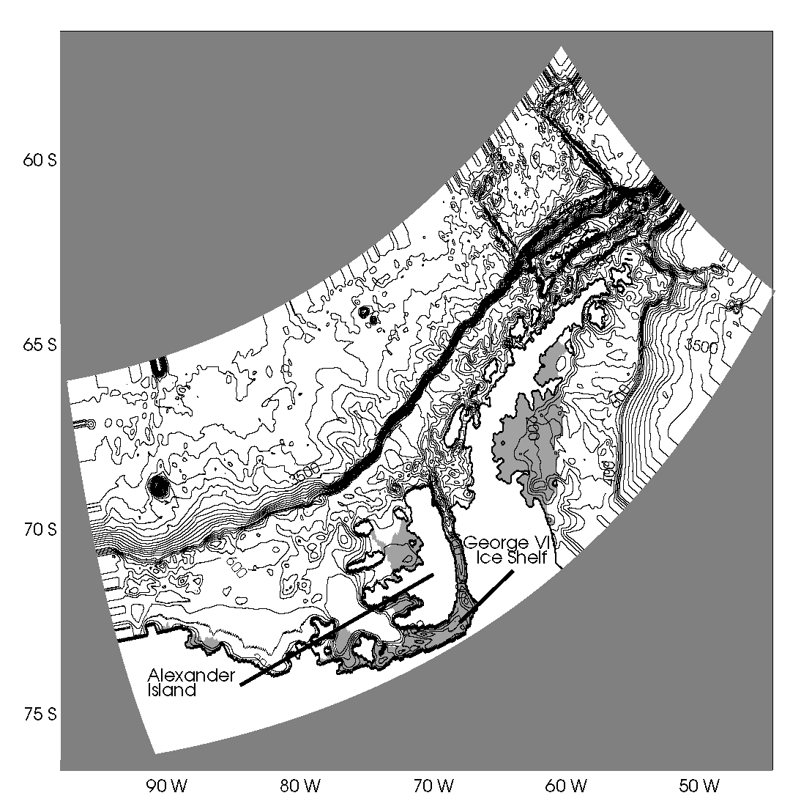
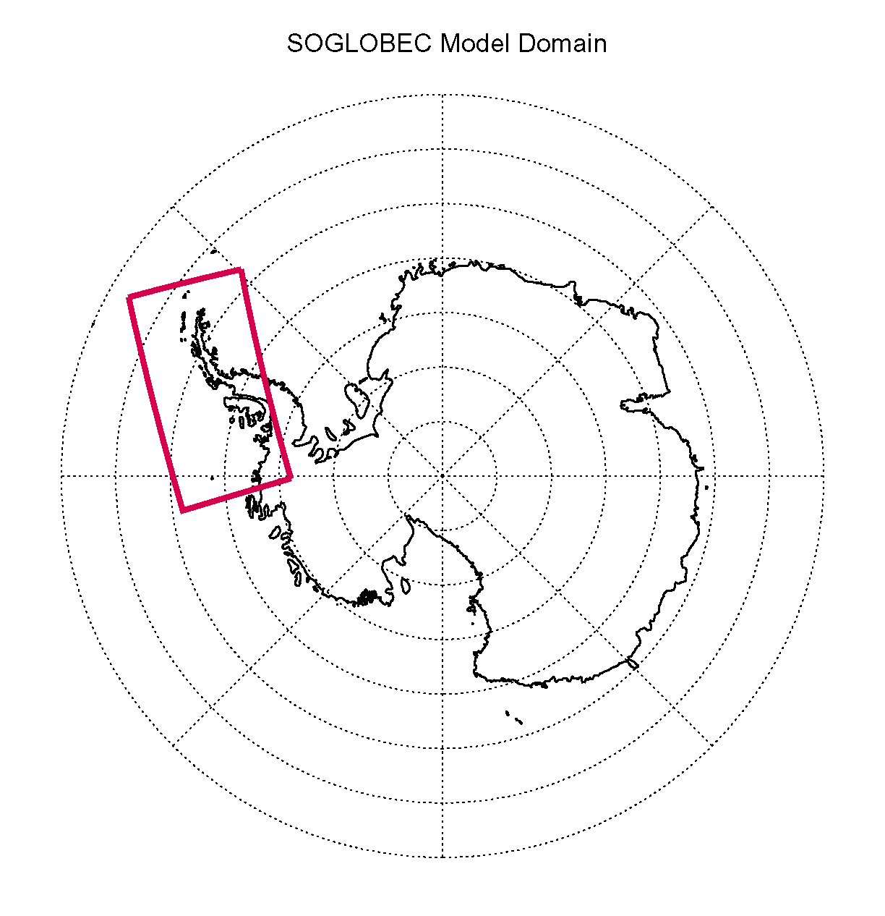
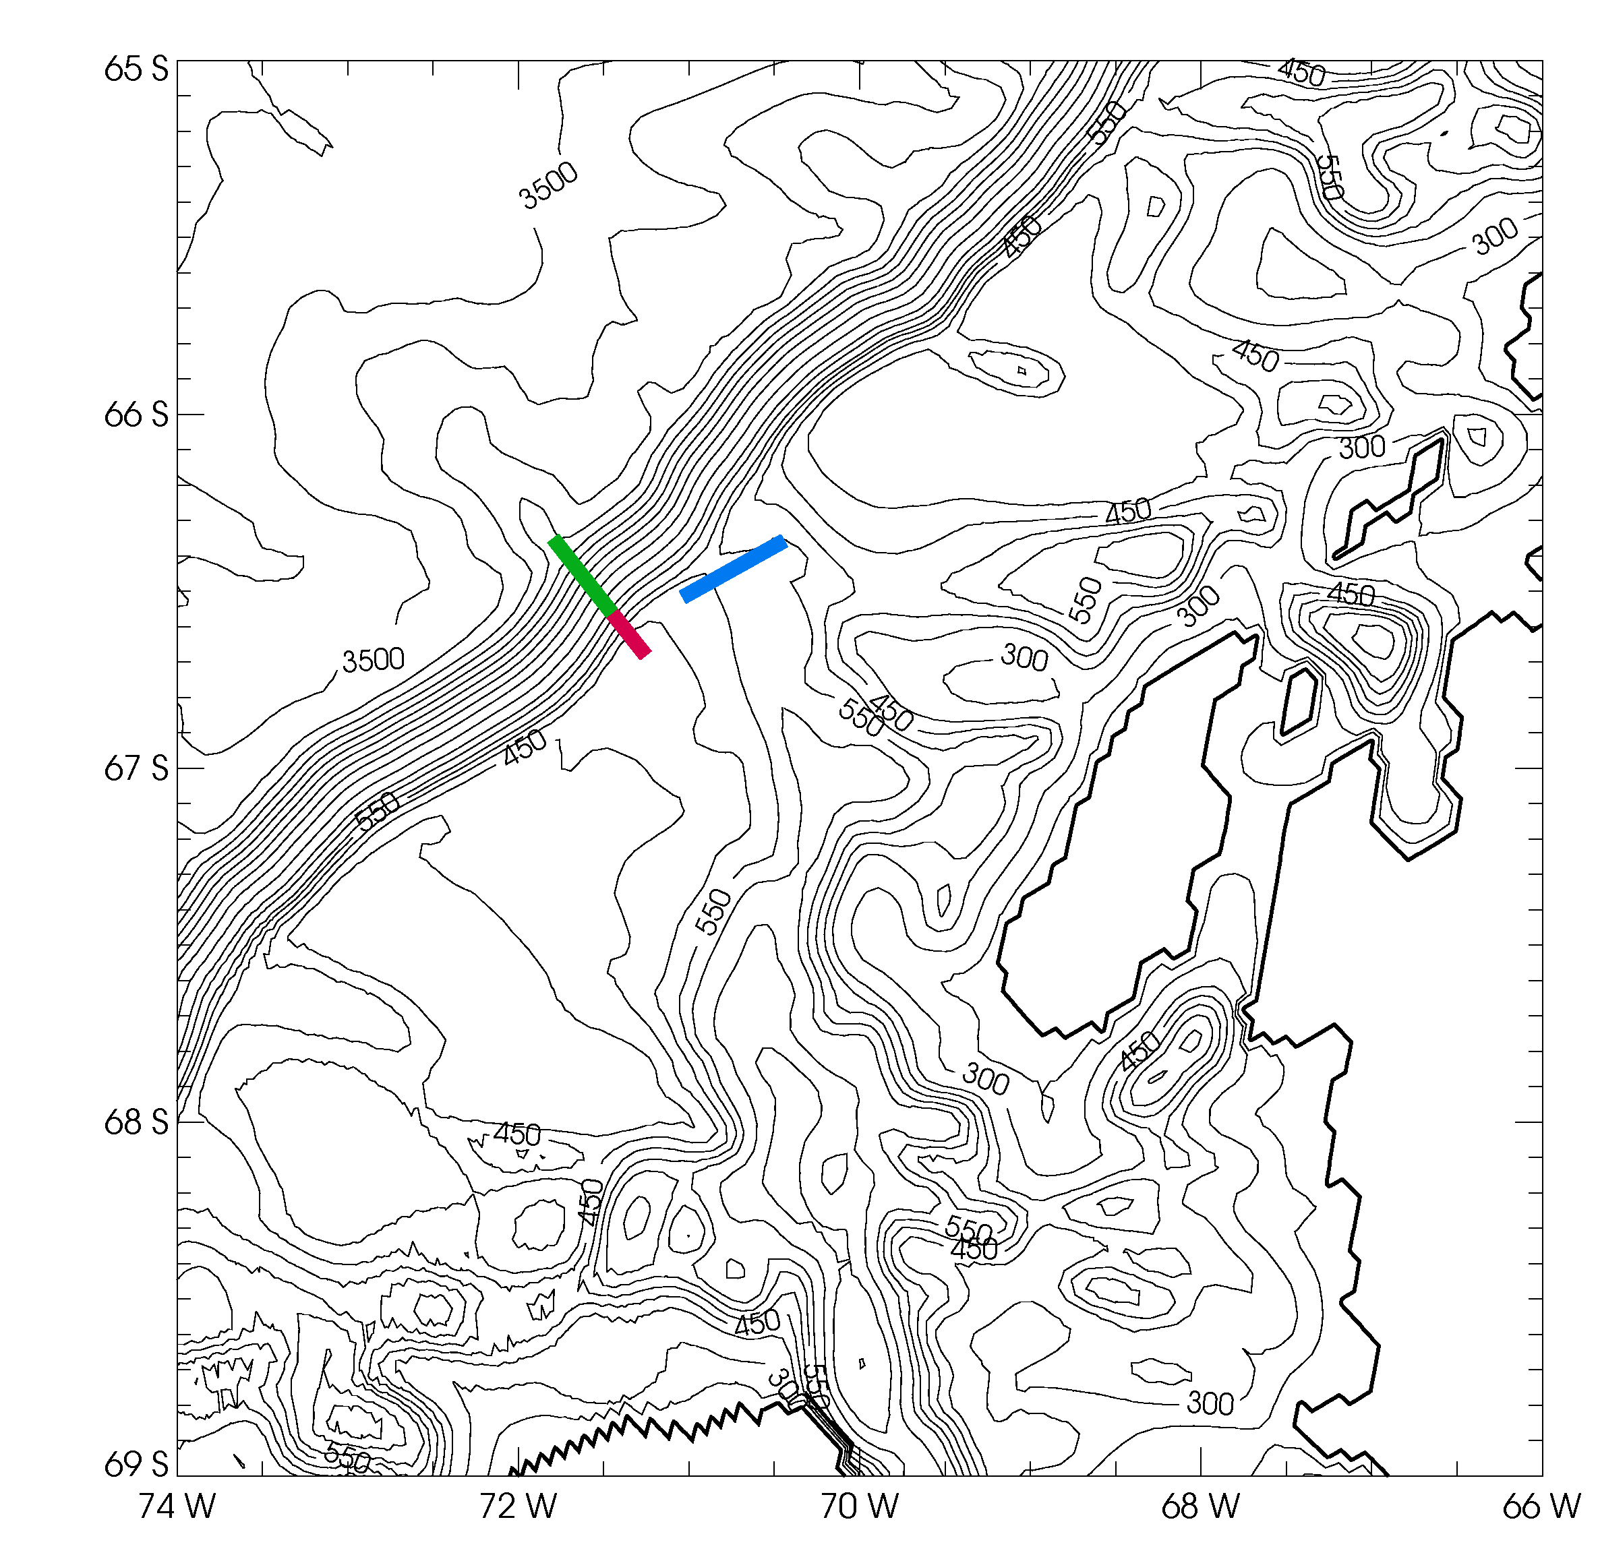

Slide 6
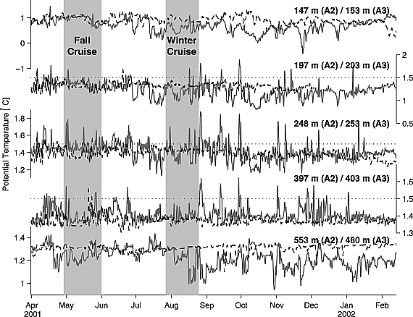
Previous view of WAP intrusion frequency: 4-6 events/year
However, this was based on broad scale hydrographic surveys
Detided, low-pass filtered time series of potential temperature at two moorings within Marguerite Trough => shows much higher intrusion frequency
Moffat et al, 2009
Solid line: A2 – north side of MT
Dashed line: A3 – south side of MT

Slide 7
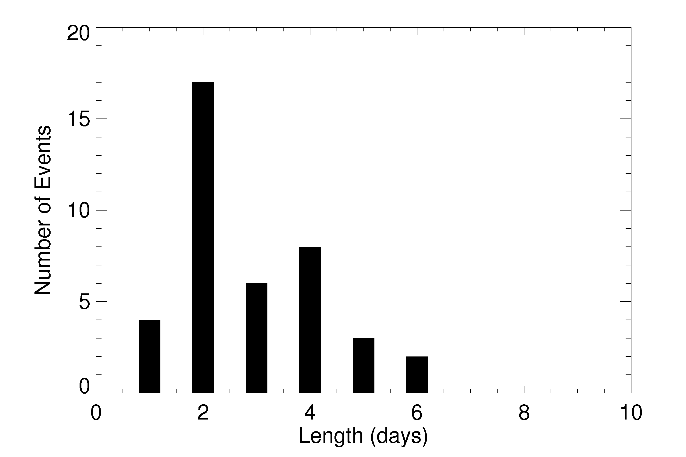
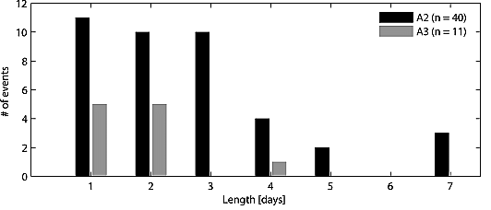
Model histogram of the intrusion duration (50 dye unit-Sv. threshold) for the entire model run
Model: 1.9 events/month
(3.3 events/month w/ 40 dye unit-Sv. threshold)
Typical duration: 1-4 d
Observed histogram of the intrusion duration
A2: 3.8 events/month
Typical duration: 1-3 d
Definition of intrusion is arbitrary, but model is much closer to mooring data than previous survey based picture of 4-6 intrusions per year

Slide 8
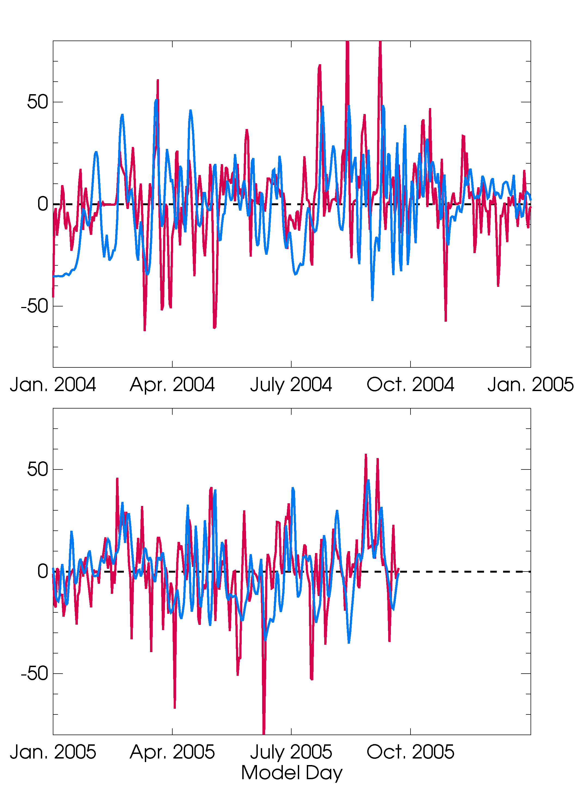
Duration of intrusions suggests wind forcing (weather band frequency: 2-8 days)
No significant correlation between wind perpendicular to flux “gate”, but significant lagged correlation for wind parallel to cross-section:
r = 0.55 (wind leads dye flux by 2-3 days)
Red: Pseudo-stress (x 1/3) parallel to CDW-dye flux cross section
Blue: CDW-dye flux anomaly (reversed sign)

Slide 9
Wind Change Simulations
Positive Southern Annular Mode leads to stronger westerlies in this area
  Simulate regional effects of this with modified winds
  ACC transport in a regional model must be imposed: Simulate global effects by increasing the ACC transport
Simulations run for 3 years that correspond to 2000-2002
Reference case using current conditions (QSCAT/NCEP)
Winds are simply scaled with both components multiplied by a constant factor
ACC transport increased by sharpening the T and S gradients in the ACC fronts on the lateral open boundaries
Notes:
Note that there are some thoughts that increases (and poleward shifts) in the westerlies won’t necessarily result in increased ACC xport (due to eddies).

Slide 10
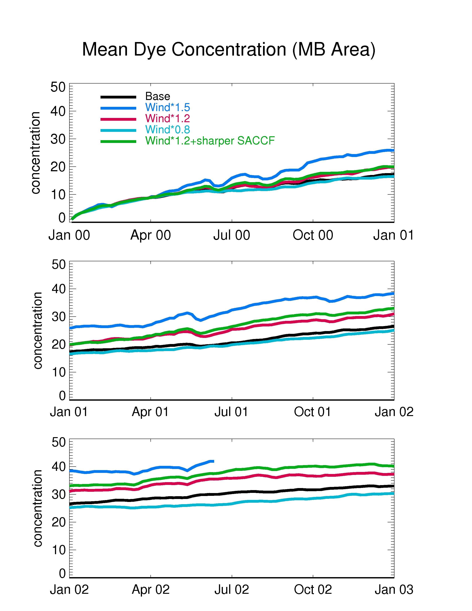
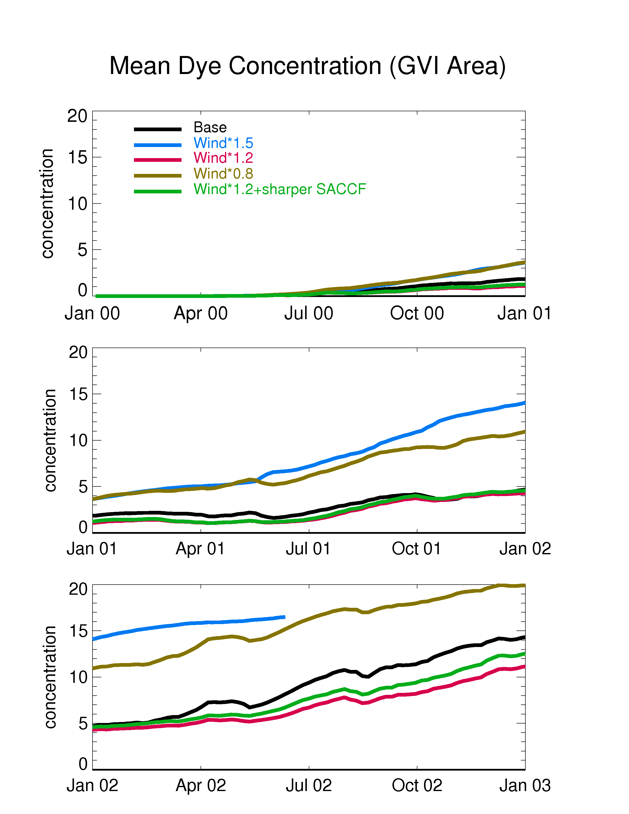
Stronger winds and ACC provide more CDW to open shelf, but not necessarily to the cavity beneath GVI Ice Shelf
Dye concentration
for Margeurite Bay
Dye concentration
beneath GVI Ice Shelf

Slide 11
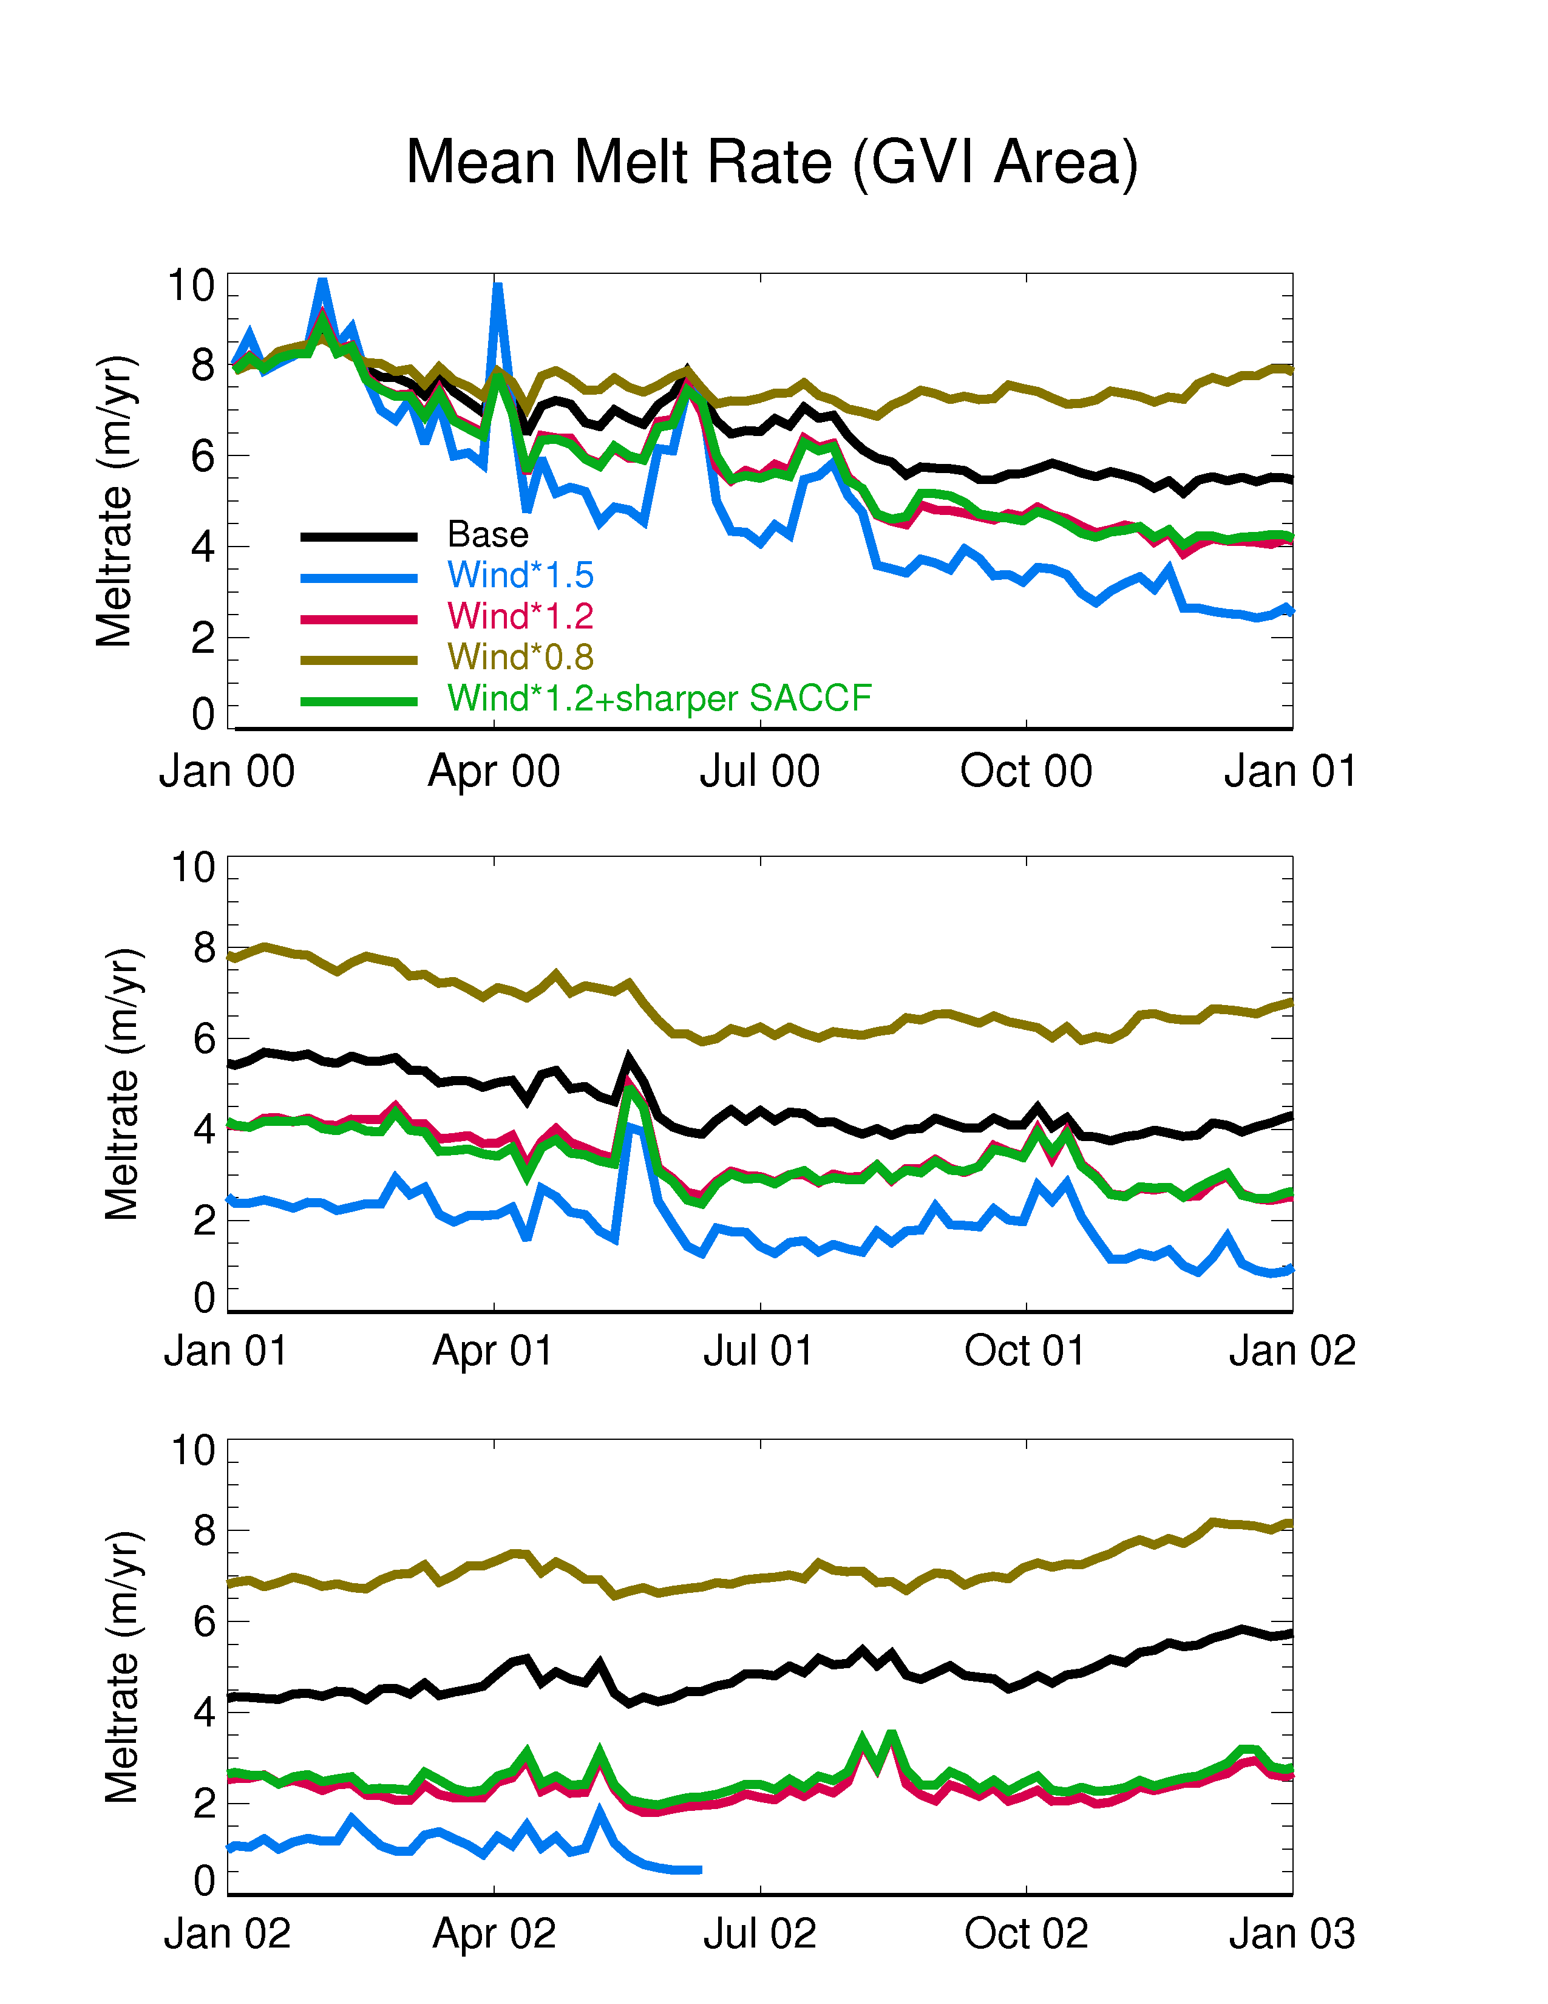
Melt rate beneath
George VI Ice
Shelf
Stronger winds
reduce melt rate
beneath GVI
(stronger ACC makes
little difference)
Why?

Slide 12
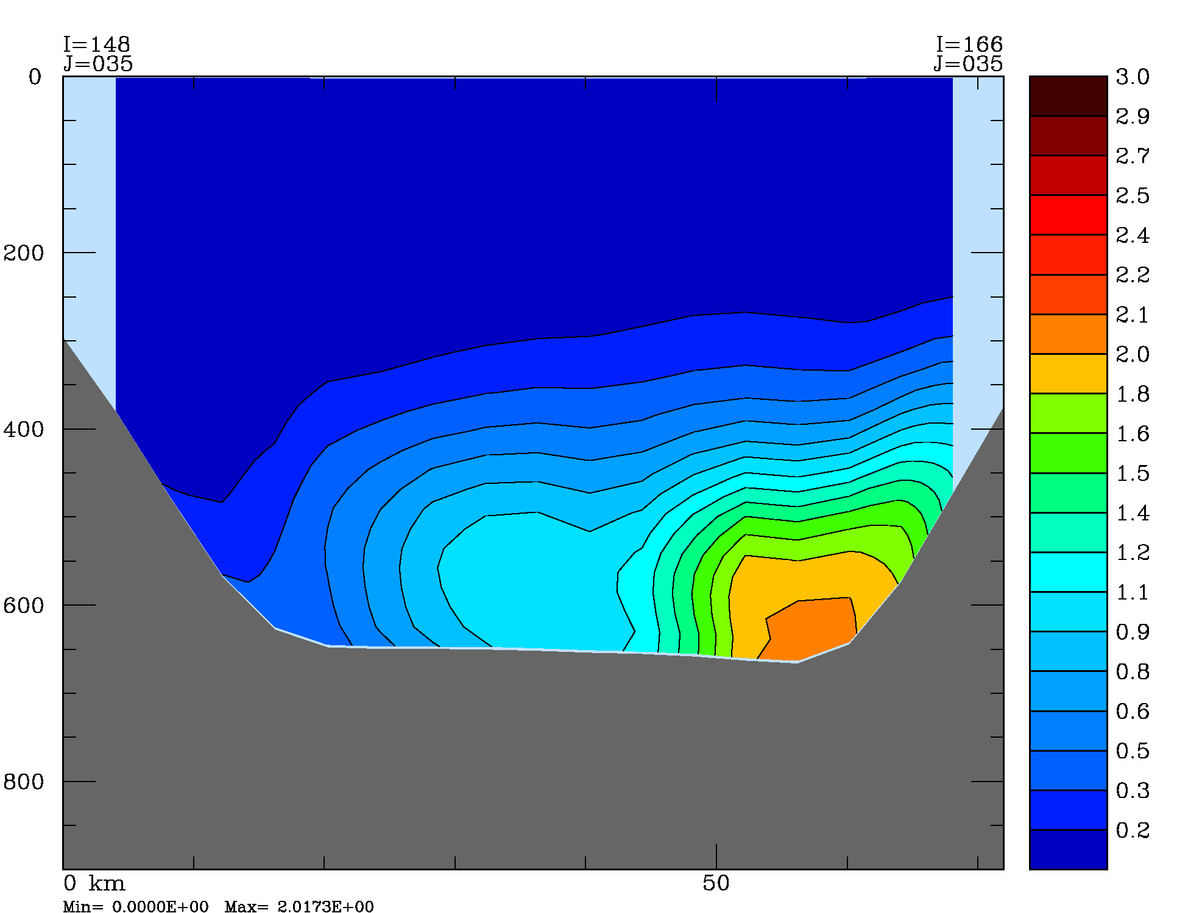
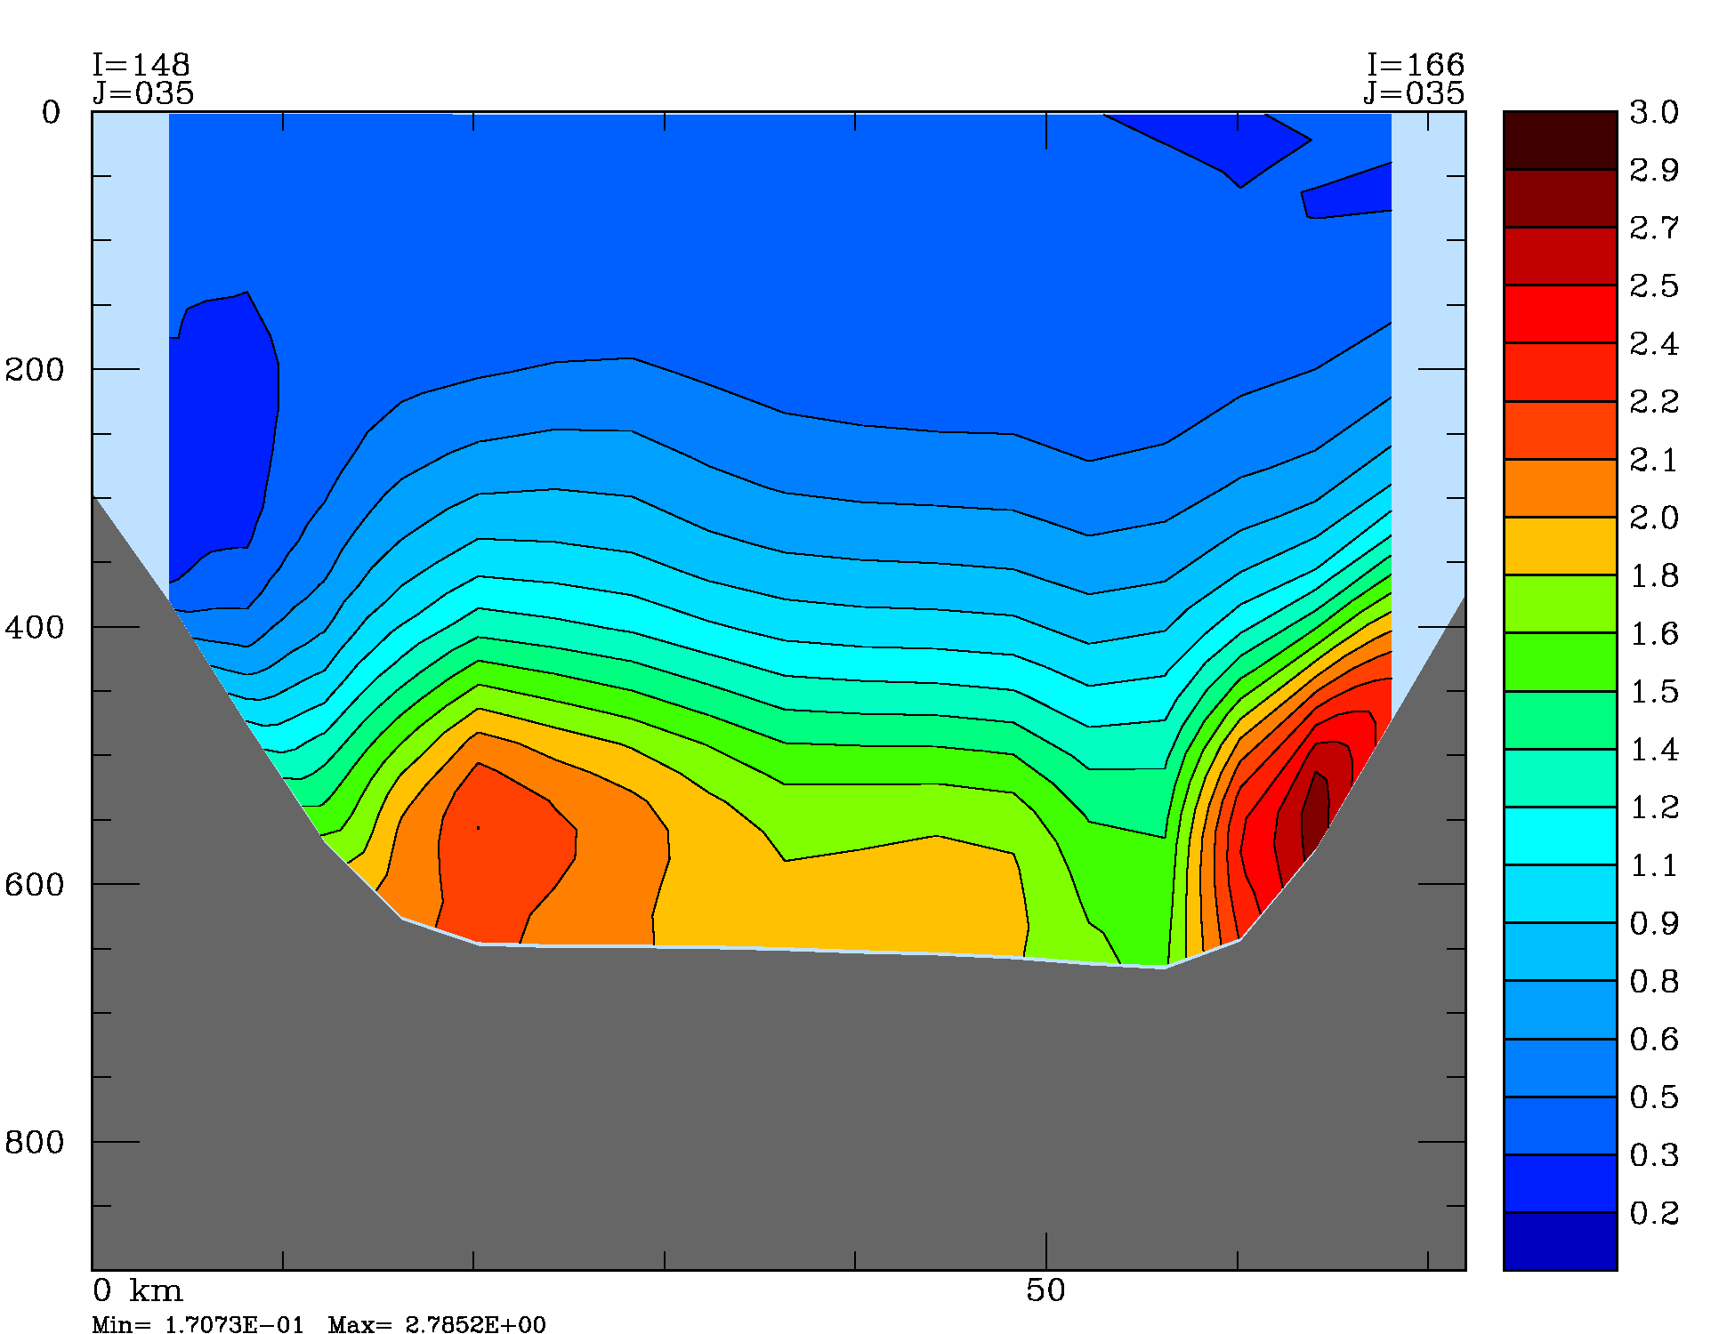
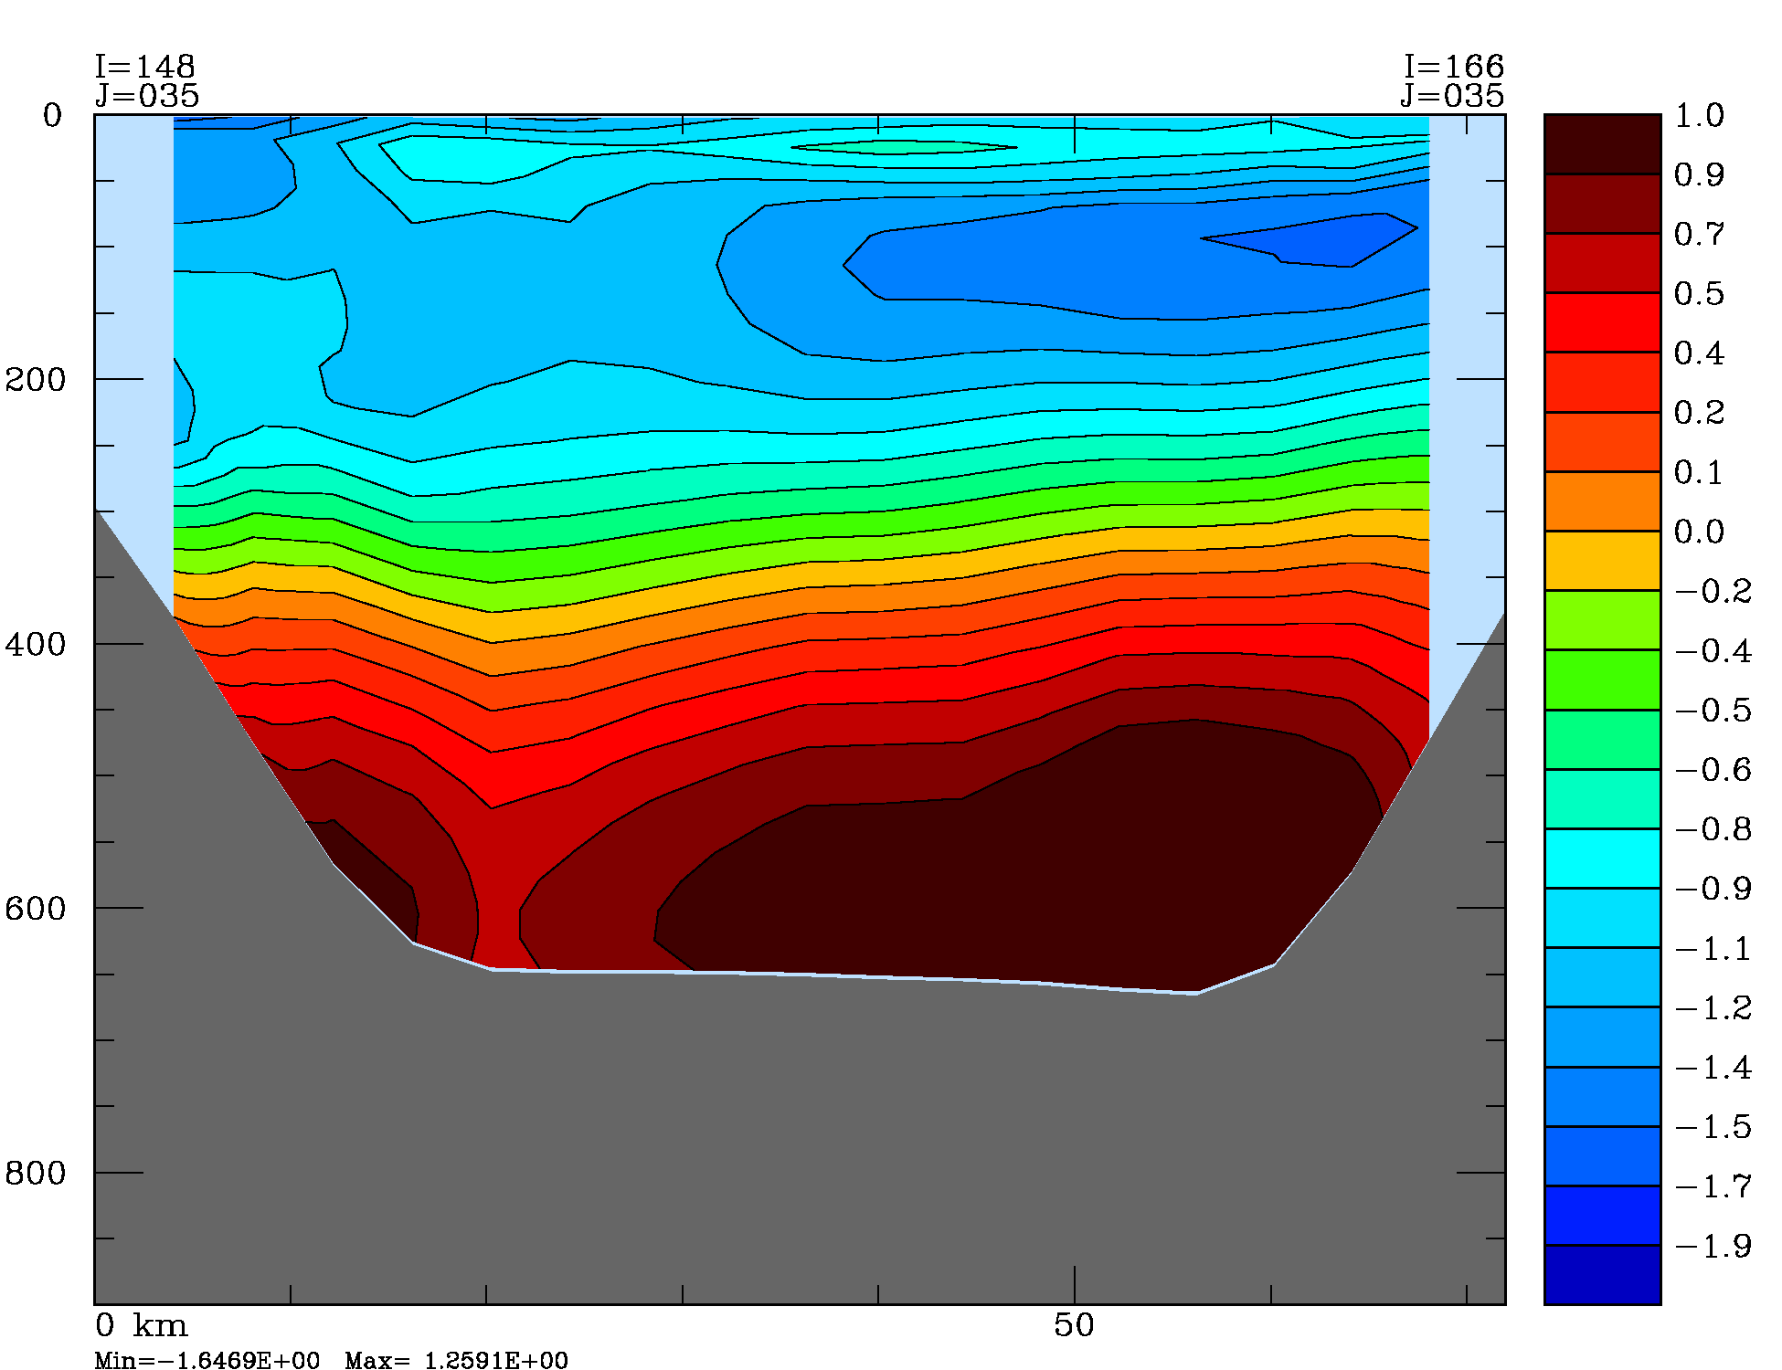
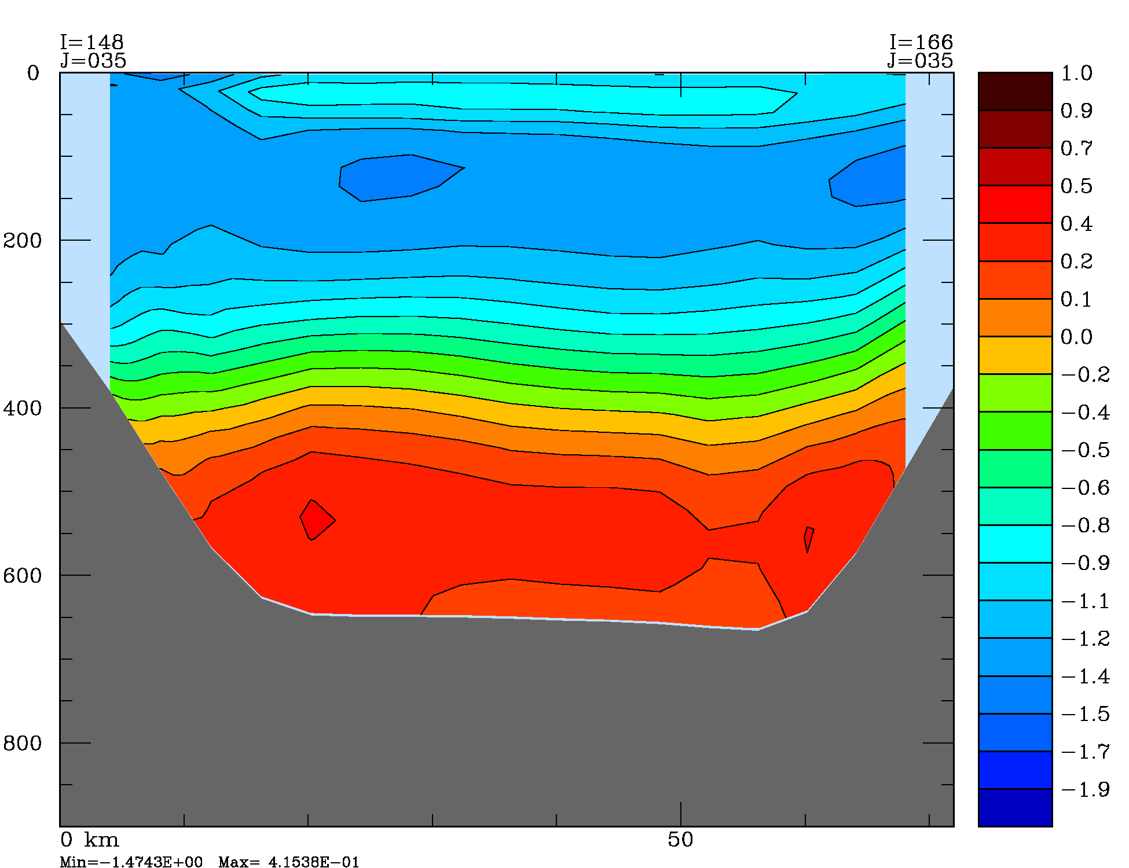
South GVI entrance: Feb. 2001
Dye concentration
Temperature
Base winds
Wind X 1.2

Slide 13
Conclusions
Intrusions of CDW on to the shelf have a much quicker timescale then previously thought and the timescales seem to be related to wind events
Increases in winds and ACC transport lead to increases in the amount of CDW advected onto the continental shelf, but do not necessarily lead to increased CDW flux underneath the ice shelves or increased basal melt

Slide 14
Acknowledgements
BEDMAP data courtesy of the BEDMAP consortium
Other bathymetry courtesy of Laurie Padman and Tom Bolmer
AMPS winds courtesy of John Cassano
Computer facilities and support provided by the Center for Coastal Physical Oceanography
Financial support from the U.S. National Science Foundation (ANT-0523172).

