Slide 1
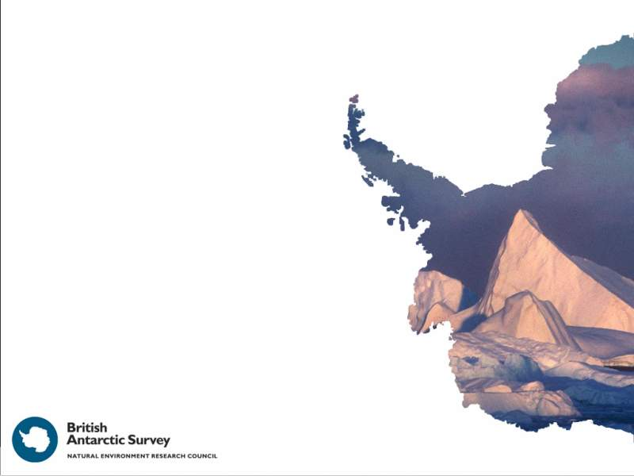
Bathymetry beneath Pine Island Glacier revealed by Autosub3 and
implications for recent
ice stream evolution
Adrian Jenkins¹, Pierre Dutrieux¹, Steve Mcphail², James Perrett², Andy Webb², Dave White², Stan Jacobs³
¹British Antarctic Survey, NERC,Cambridge
²National Oceanography Centre, Southampton
³Lamont-Doherty Earth Observatory, Columbia University, USA

Slide 2
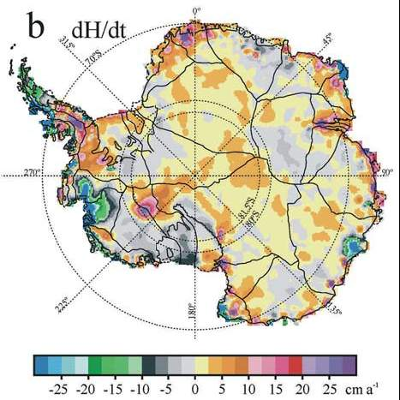
Net mass loss:
1996: −41±27 Gt/yr
2000: −64±27 Gt/yr
2006: −90±27 Gt/yr
[Rignot et al., 2008]
[Zwally et al., 2005]
1992-2002

Slide 3
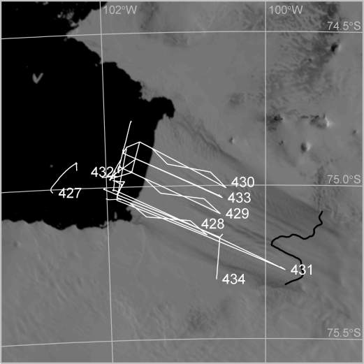

Slide 4
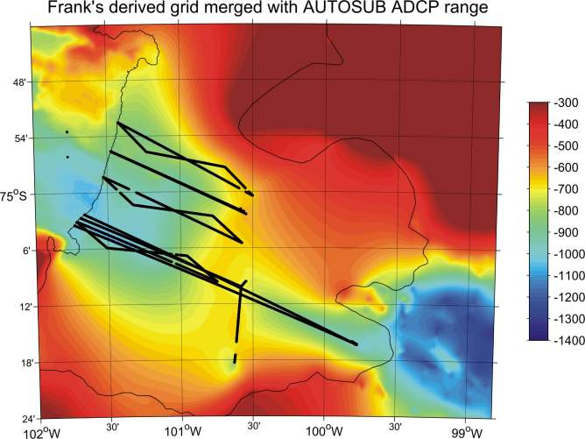

Slide 5
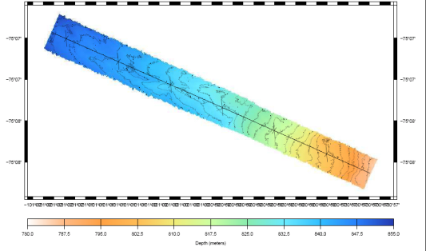
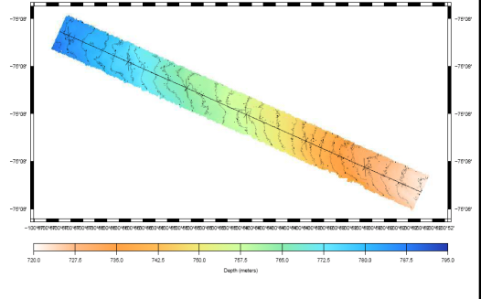

Slide 6
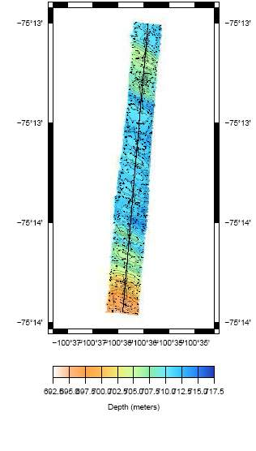
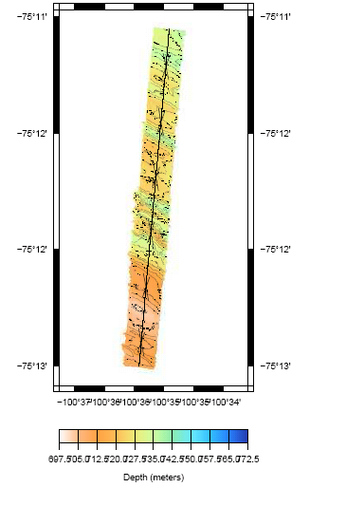
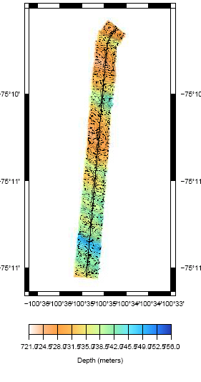

Slide 7
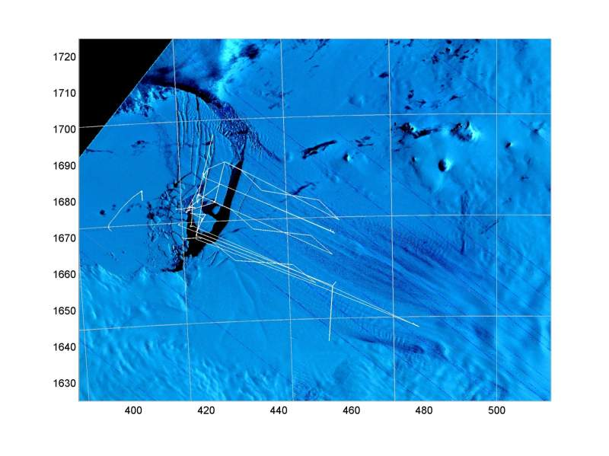
January 24, 1973

Slide 8
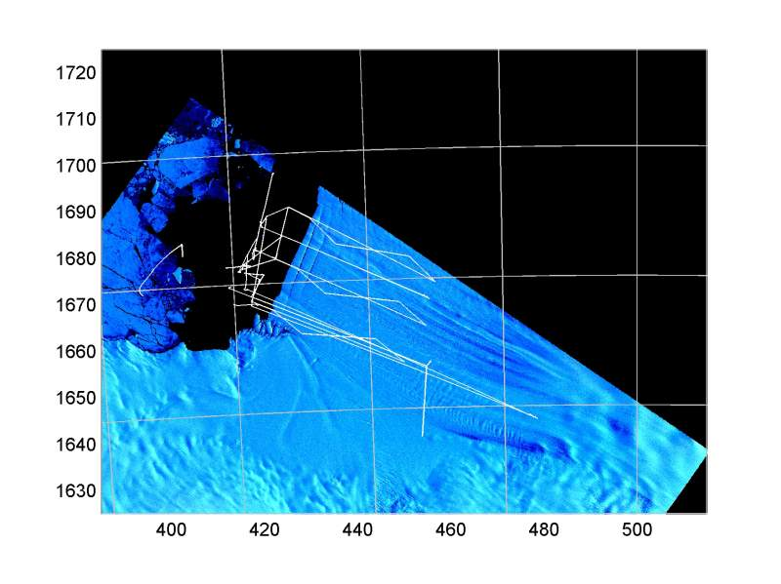
January 15, 1982

Slide 9
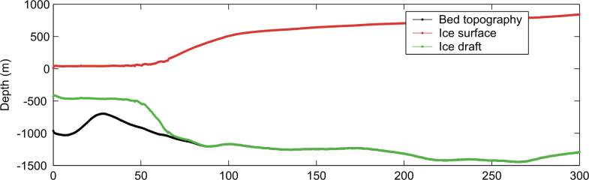
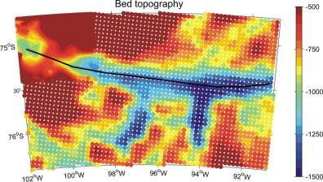

Slide 10
Conclusions:
There is a ridge at around 700 m depth about midway between the front and current grounding line of Pine Island Glacier.
The ridge appears to be a former grounding line.
The glacier may not have completely lost contact with the ridge until a few decades ago.
When and why retreat from the ridge began is unknown.
The ridge was the last significant rise in the bed for around 250 km inland.

