Slide 1
WAIS Ice-Dynamics Progress
R.B. Alley, Penn State
Speaking for Bob et al.;
I’m a cheerleader for real workers.
Special thanks to Sridhar, Don Voight, Byron Parizek, Todd Dupont, Dave Reusch, Dave Vacco, Todd Johnston, Matt Spencer, and the whole PSU crew.

Slide 2
Ice-dynamics progress has been HUGE:
Huge, huge, huge, huge, huge;
From you and a few others;
Raise your arm, crook your elbow, and pat yourself on the back;
Thank Julie, Scott and rest of NSF OPP;
Remember Ian Whillans;
Remember other pioneers who couldn’t come today.

Slide 3
Ice shelves really do restrain flow of inland ice:
Pine Island Bay changes look to result from ice-shelf loss (Joughin, Rignot, etc.);
Inland ice-flow speed-up after Larsen B breakup (Scambos, etc.);
Jakobshavn speed-up with ice-shelf retreat (Thomas, etc.);
Tides (Anandakrishnan, Bindschadler, etc.)
MacAyeal, Thomas, Weertman, Mercer, etc. right!

Slide 4
Ice shelves vulnerable:
Warming sub-ice-shelf ocean water a little can melt a lot of ice;
Warming summer air a little can fill cracks with meltwater and detonate a shelf;
So ice shelves vulnerable from above and below;
Remember:

Slide 5
“Then new troubles came, from above and below,
A skritz at my neck and a skrink at my toe,
And now I was really in trouble, you know.”

Slide 6
Trouble does follow ice streams:
Fast changes have gone up Pine Island Bay ice streams;
And Jakobshavn;
And the fast changes on the Siple Coast are in the ice streams, not the central regions of ridges, domes or catchments.

Slide 7
We know ice streams much better:
Fast flow and low driving stress mean a thawed, soft till bed from sediments;
Sides and sticky spots matter;
Really slippery beds favor freeze-on, which is opposed by latent-heat transport in water from inland;
Numerous mechanisms for rapid and surprising changes.

Slide 8
We know ice streams much better:
Large and rapid changes have occurred repeatedly in at least some ice streams;
Elongated ice streams persisted at glacial maximum at least near Siple Dome, so changes in ice-sheet area more spectacular than in volume.

Slide 9
We don’t know ice streams well enough yet:
Poorly known but critical aspects include:
    Geothermal fluxes;
    Bed roughnesses;
    Controls on ice-stream-margin positions;
    Till rheology (nonsteady as well as steady);
    Better histories;
    Are there sediment-hosted, nearly-thawed potential ice streams hiding out there somewhere?

Slide 10
We don’t know ice shelves well enough yet:
Poorly known but critical aspects include:
    What is the balance of side versus island drags?
    Nonsteady behavior; will a retreating grounding line triggered by ice-shelf loss form a new stabilizing ice shelf or run away?
    How well can the oceans pump heat under the ice shelves?

Slide 11
We don’t know the system well enough yet:
What does the future hold?
What warming threshold/rate would dump the ice sheet?
What warming threshold/rate is “safe”?
How do we get all the stresses into an ice-flow model, and all the mechanisms we now know and the data we now have to make predictions?

Slide 12
We don’t know the system well enough yet:
Humans are pushing CO₂ toward levels that last existed on an Earth with NO permanent land ice;
Recent work (DeConto and Pollard) suggests that CO₂ is more important than continental positions in controlling this, and that the hysteresis loop is not as broad as we might like (is easier to keep ice than to grow it, but maybe not as much as we’d like).

Slide 13
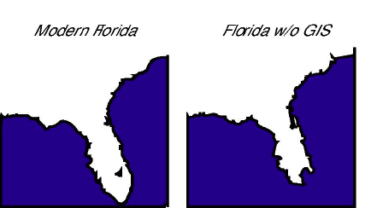
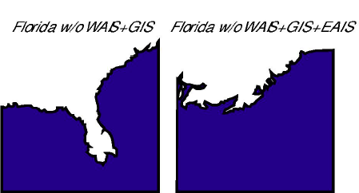

Slide 14
So, a call to action:
Honor our pioneers, for we stand on their shoulders;
Thank our funders, drillers, flyers, sailors, for they get us where we’re going and back out again;
Rededicate ourselves to solving the problems…

Slide 15
“I’d have no more troubles, that’s what the man said,
So I started to go, but I didn’t, instead,
I did some quick thinking inside of my head,
Then I started back home to the Valley of Vung
I know I’ll have troubles, I’ll, maybe, get stung,
I’ll always have troubles, I’ll, maybe, get bit,
By that green-headed quail, on the place where I sit,
But I’ve bought a big bat, I’m all ready, you see
Now my troubles are going to have troubles with me.”
--Dr. Suess, I Had Trouble in Getting to Solla Sollew

