Slide 1
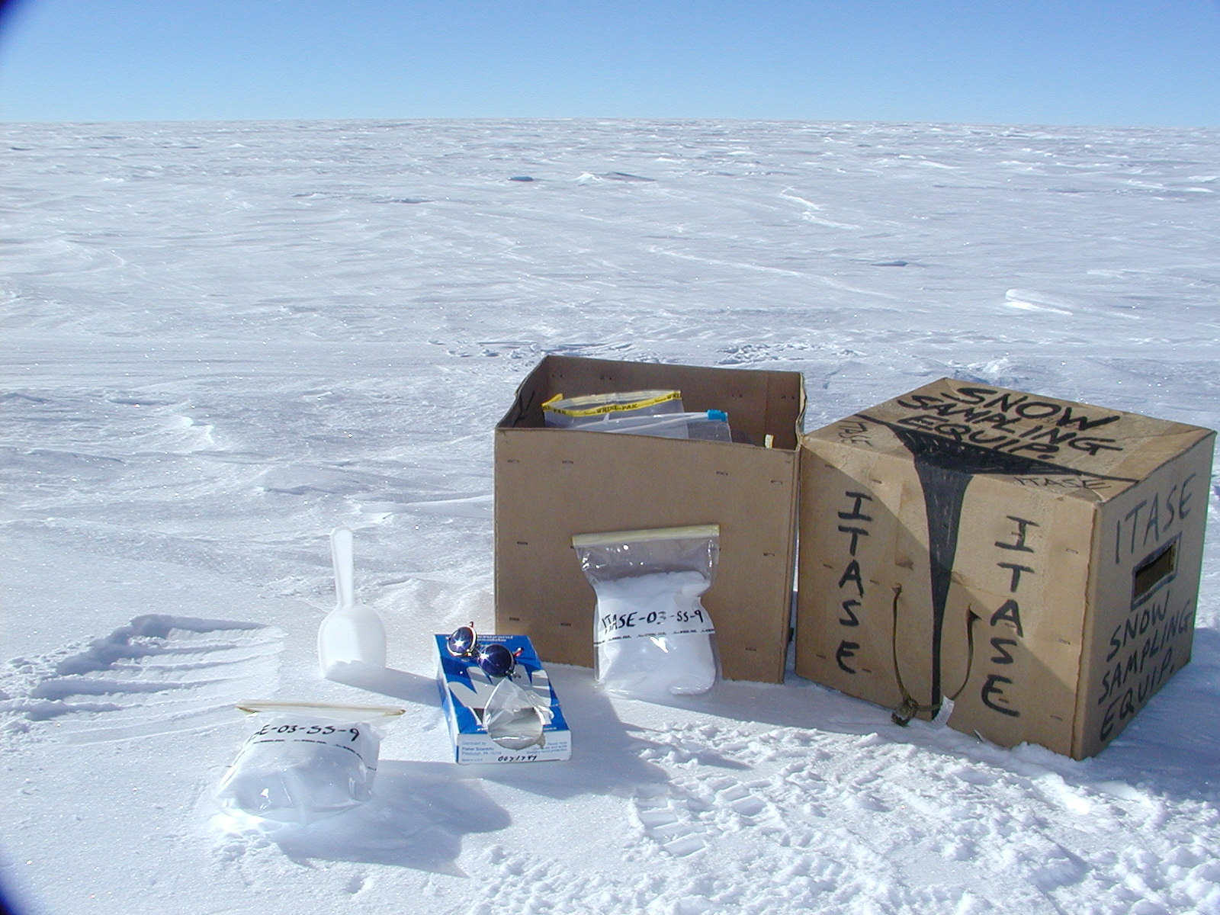




IC, ICPMS AND OXYGEN ISOTOPE
MEASUREMENTS FROM THE 2002
AND 2003 ITASE TRAVERSES
Daniel A. Dixon,
P. A. Mayewski, S. Kaspari, S. Sneed,
M. Handley, D. Introne, K. Kreutz,
K. Maasch, G. Hamilton
ACKNOWLEDGEMENTS: Office of Polar Programs, National Science Foundation, 109th Air National Guard,
Ice Core Drilling Services, Raytheon Polar Services.

Slide 2
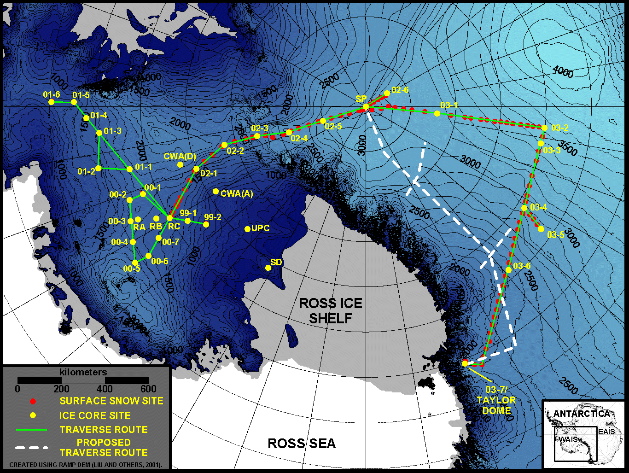
U.S. ITASE TRAVERSES

Slide 3
MEASURING:
ISOTOPES:
Delta O-18
H/D
DISSOLVED MAJOR IONS:
Na, K, Mg, Ca, Cl, NO3, SO4, MS
ICPMS ELEMENTS (35!):
Sr, Cd, Sb, Cs, Ba, La, Ce, Pr, Nd,
Sm, Eu, Gd, Tb, Dy, Ho, Er, Tm, Yb,
Lu, Pb, Bi, U, As, Tl, Al, S, Ca, Ti, V,
Cr, Mn, Fe, Co, Cu, and Zn

