Slide 1

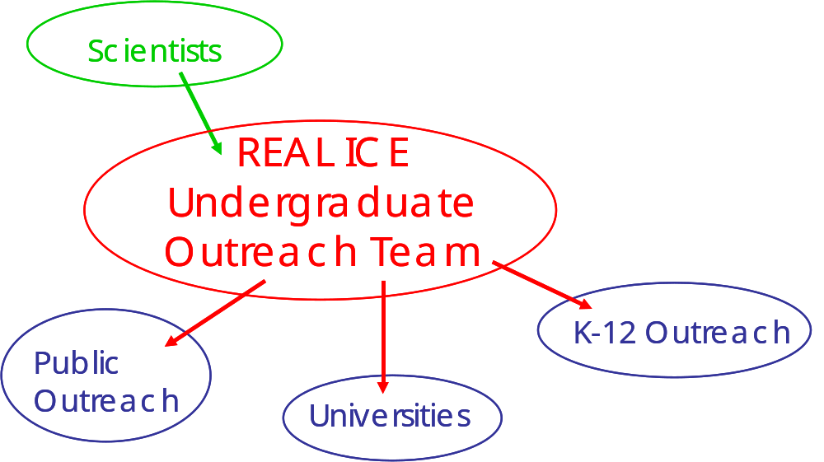
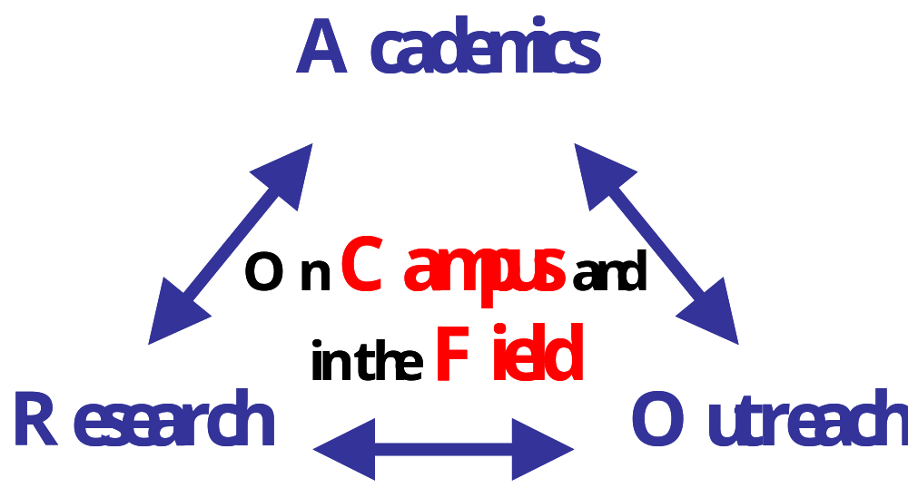
REAL ICE – a proposal
Research Experience in Antarctica Linking Ice and Climate Education
Erin Pettit (UW and PSU)
Ed Waddington (UW)

