Slide 1


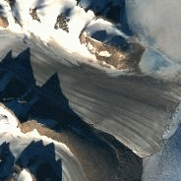
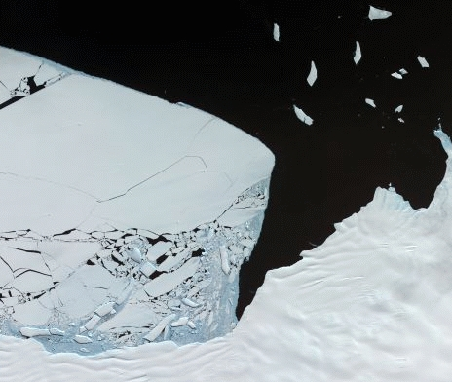
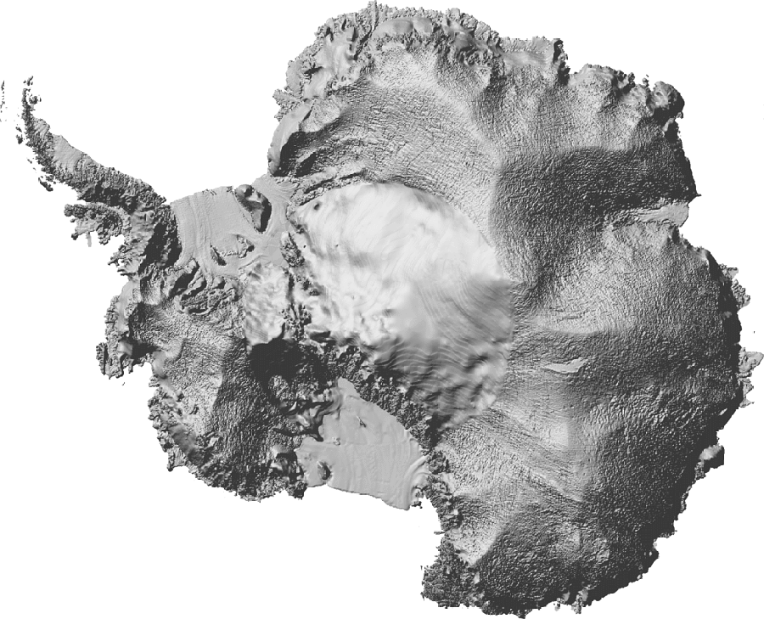
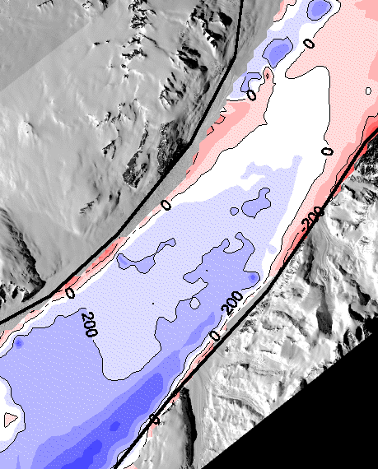
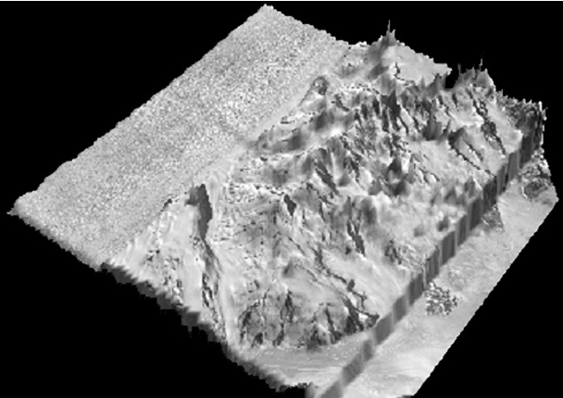


ASTER Imagery of Antarctica:
geographic coverage, data availability
and glaciological applications
Glacier mapping
Ice shelf mapping
DEM generation
Ice velocities
Leigh Stearns
Gordon Hamilton
Climate Change Institute, University of Maine

