Slide 1
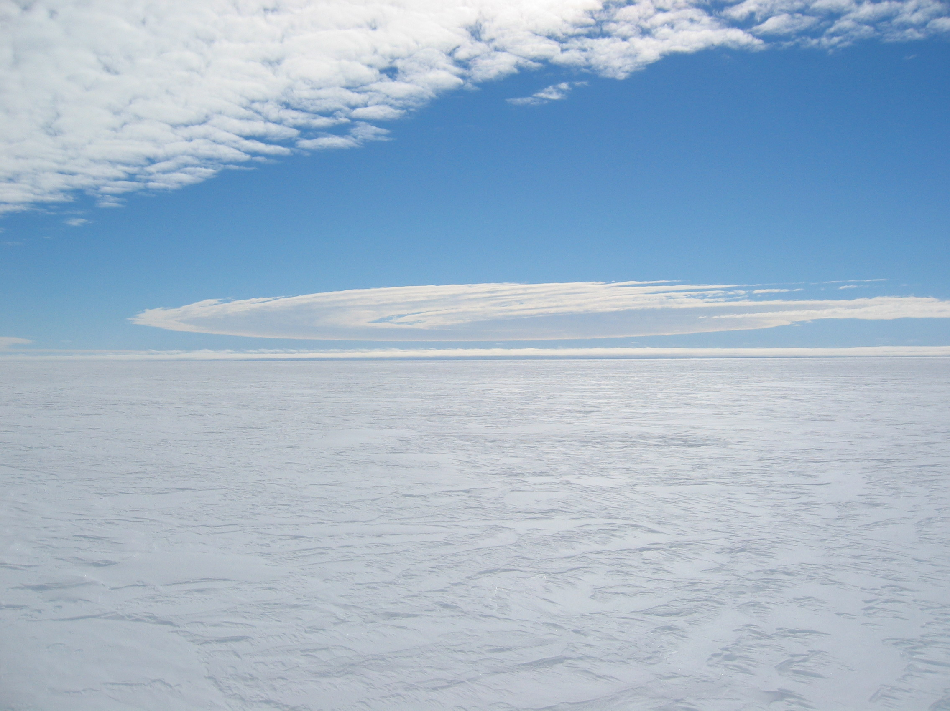
ASEP-Ice Dynamics
WAIS 2005

Slide 2
What We Know
Pine Island Glacier (PIG), Thwaites, and other Amundsen Sea Glaciers thinning rapidly.
PIG has accelerated by ~25% since 1974.
Thinning appears related to high basal melt rates on floating sections.

Slide 3
What We Don’t Know?
Firm understanding of the processes driving thinning.
Controls on fast flow (e.g., bed, margins, shelf).
How the system will evolve (most models assume fixed perturbations).
Other sources of thinning (e.g., accumulation variability).
Mass balance (with good error bars).

Slide 4
What Data We Have in Hand?
Velocity over most of basin (ERS tandem 1996).
Velocity near grounding line at several other times (SAR, Optical).
Surface topography at 5-15 km resolution (GLAS, ERS).
Elevation change from 1992 onwards.
Bed elevation at ~15-km spacing.
Archive of SAR and Optical imagery extending back to the mid 1970’s.

Slide 5
What Data We Don’t Have
Data to determine bed conditions (e.g., seismic).
Fine temporal resolution velocity data (tidal effects).
Accurate accumulation rate/mass flux data.
Improved RES coverage (hole filling, increased density).

Slide 6
Potential Measurements
Seismic probing for basal conditions/ice shelf cavity geometry.
GPS measurements “Tides” and strain grids.
Airborne shallow radar and shallow coring for accumulation.
Ground/Airborne RES for ice/bed properties.
Boreholes for ice temperature.

Slide 7
Challenges
Distance from McMurdo/existing camps.
Weather
Surface conditions (e.g., heavy crevassing).
Coordination of multiple groups.
Limited logistics.

Slide 8
Issues to Resolve
Science to be done?
Where to go (e.g., PIG or Thwaites)?
What kind of camp and where to put it?
Whether to submit single or multiple proposals?
How to coordinate activities for most efficient use of logistics?
…?

Slide 9
