Slide 1
Five Years to History
An update on the WAIS Divide Core
Richard B. Alley
Penn State
I shouldn’t be doing this; Kendrick should…
Apologies if I don’t know the answers.

Slide 2
WAIS Divide Core:
Long-anticipated (Ice Core Working Group agreed in 1987 that a high-resolution southern core to match GISP2 should be the highest priority);
First science plan when I was chair of ICWG (1992), revised and updated by ICWG/Kendrick Taylor;

Slide 3
WAIS Divide Core:
Now really happening!
NSF heavily committed,making very difficult things happen very quickly across the board, esp.:
--> Julie Palais, money, planning, coordinating;
--> Brian Stone, Antarctic Logistics, cutting Gordian knots, getting resources that lots of people want;
ICDS well-advanced in building drill (beautiful drill from Bill Mason et al.; focus now on control systems; Charlie Bentley will discuss);
NICL getting ready to help collect, archive (Todd Hinkley, Geoff Hargreaves, and co.).

Slide 4
WAIS Divide Core:
Science Coordination Office funded; Mark Twickler manager, doing his usual first-rate job of hard work and nitty-gritty details;
Site selection clearly completed, site selected (great work by the site-selection team, many papers, key insights);
SCO funded, and two science projects so far (electrical and borehole); plus
Multi-investigator firn-gas project (Sowers, etc.);
Many proposals submitted this past June 1; room for plenty more (hint, hint).

Slide 5
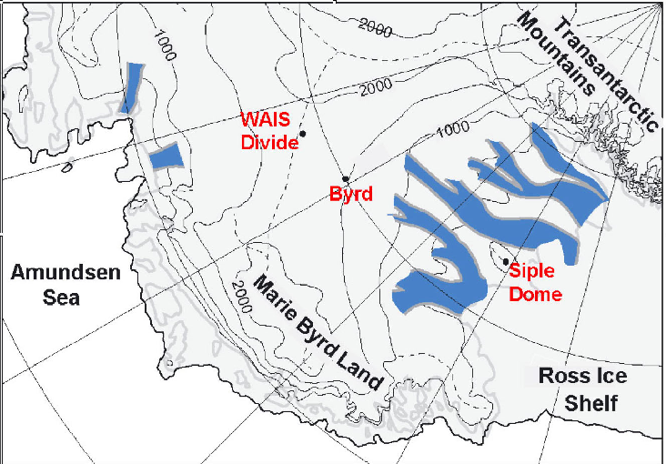

Slide 6
Schedule:
Drill ready by January 15;
Camp construction 2005-06 season;
Drill test summer 2006 at Summit, Greenland, to 600 m (into brittle ice);
Then drill to Antarctica for 2006/07--install drill, handling equipment, start coring (at least 10 m), maximize efficiency for serious drilling seasons;
2007-08, 08-09, 09-10, drill two miles of ice. Lots of options for student field experience as assistant drillers and core handlers--don’t have to be ice-core people, just interested.

Slide 7
Management:
Steering Committee in place;
Chair Kendrick Taylor, DRI;
Loyal followers Ed Brook (Oregon State), Jeff Severinghaus (Scripps), Jim White (Colorado), me (Penn State).
To be recast when PIs for projects funded.

Slide 8
Payoff:
High accumulation rate, small gas-age/ice-age difference, accurate correlation dating to north;
Annual layers possible to 40,000 years or so;
Highest-resolution CO₂ record ever is possible;
Finally may learn leads and lags in climate system;
Fame, fortune, truth, beauty, justice (but no Porsches, sorry).

