Slide 1
Wind-Blown Snow Infilling of a Rift in the Ross Ice Shelf
Katherine Leonard,
Bruno Tremblay, Doug MacAyeal

Slide 2
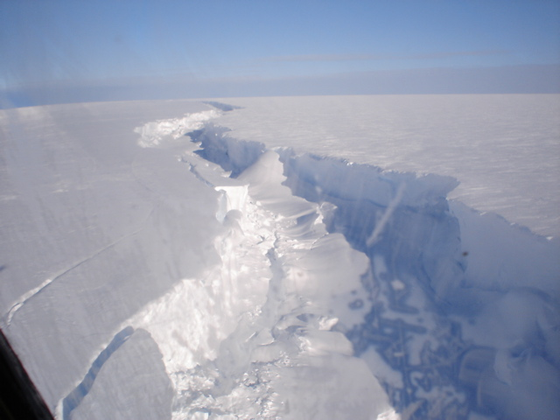
Nascent Rift, Ross Ice Shelf

Slide 3
Ice Melange
Mixture of marine ice, windblown snow, and blocks of broken ice shelf (talus)
Forms within iceberg calving rifts
Typically fills rifts, bridging gap between incipient berg and ice shelf
May ‘glue’ shelf together, wedge rift open, or serve no active role

Slide 4
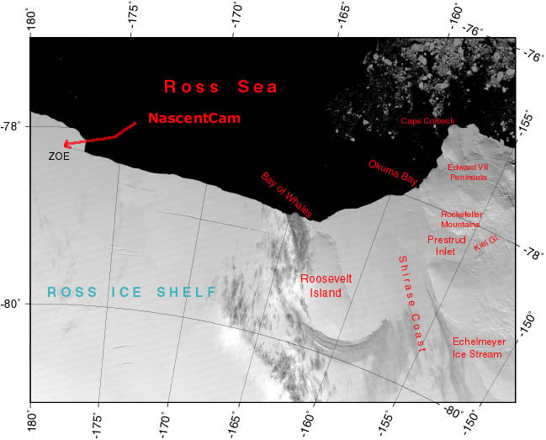

Slide 5
Nascent Rift Site
Melange-filled rift near the edge of the Ross Ice Shelf
Sustained high windspeeds capable of transporting snow (near Ross Air Stream)
Webcam observations of blowing snow
Principal wind direction is perpendicular to the rift axis (blowing towards the sea)
Adequate snowcover to use a northern-hemisphere blowing snow model

Slide 6
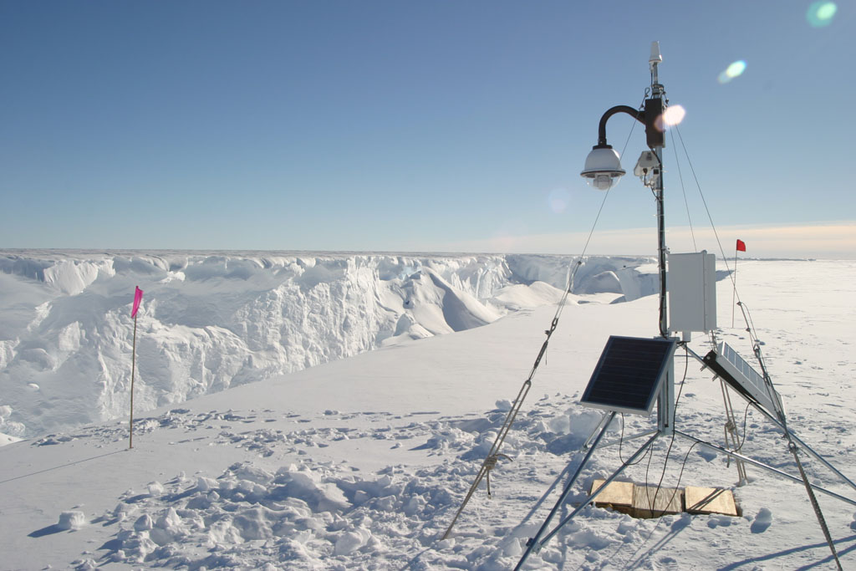

Slide 7
Nascent Rift 2005 Webcam Animation (D. MacAyeal)

Slide 8
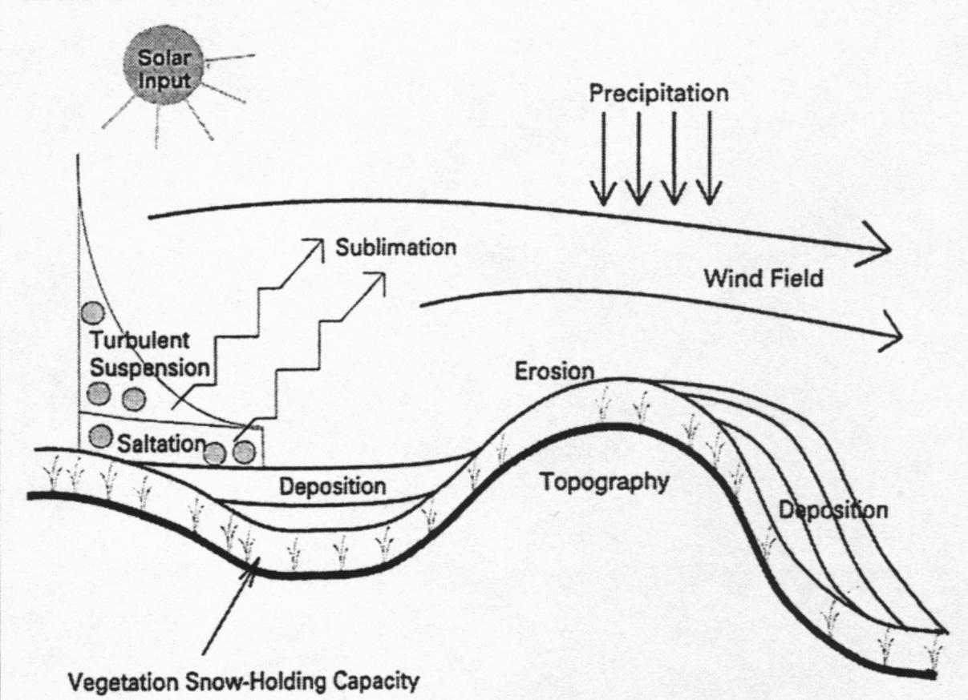
Brief Intro to Blowing Snow
Liston & Sturm, 1998

Slide 9
Piektuk-Tuvaq Model
Models temporal evolution of a column of sublimating blowing snow in an atmospheric boundary layer
Basal Boundary Condition is ~1cm above ground, top of laminar flow horizon / saltation layer
1m horizontal resolution, vertical resolution is 0.055m at base, 326m at 1km height (top)
(name means blowing snow and sea ice in Inuit)

Slide 10
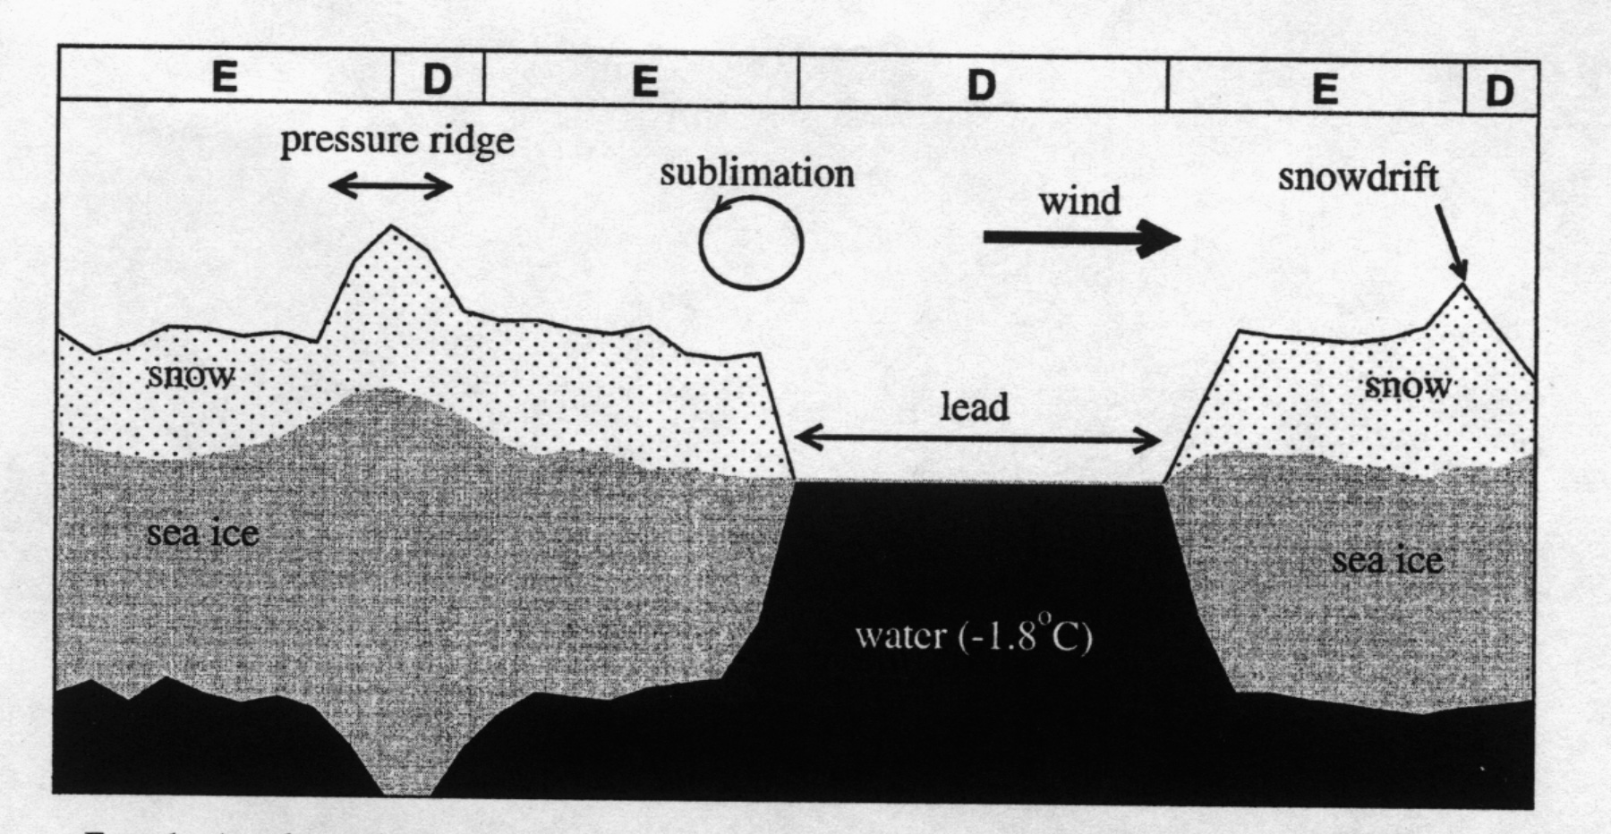
Piektuk-Tuvaq Model Concept
Dery & Tremblay, 2004

Slide 11
Model Input & Output
Snow cover thickness
Precipitation
Vertical humidity
Vertical air temp
Wind speed
Surface geometry
Blowing Snow Mixing Ratio
Particle # concentration
Air Temperature
Water Vapor Mixing Ratio

Slide 12
P-T Model Products
Vertically integrated blowing snow sublimation
Transport rate of blowing snow (product of mixing ratio & wind velocity)
Amount of snow eroded off of ice and into leads (or rifts…)

Slide 13
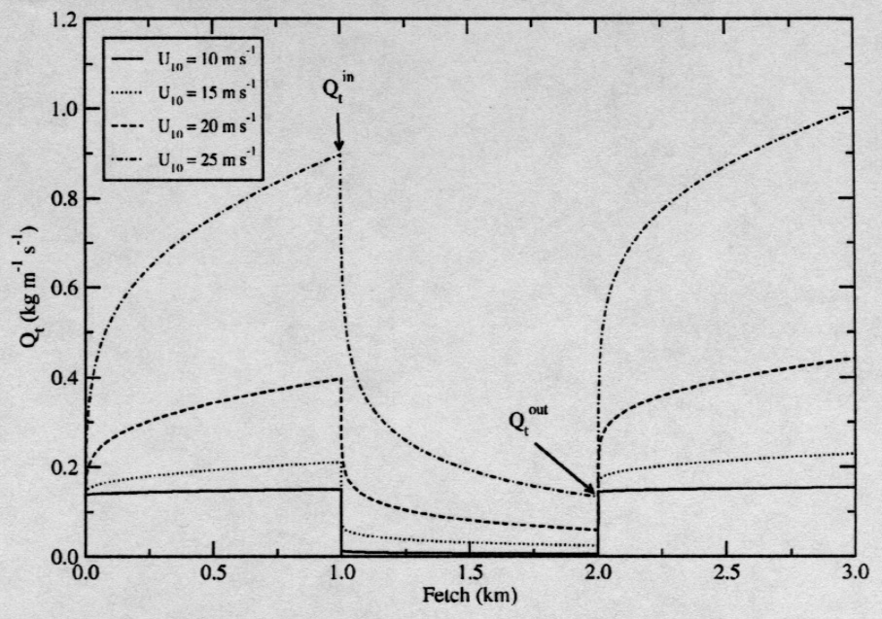
Blowing snow transport rate at various windspeeds
Dery & Tremblay, 2004

Slide 14
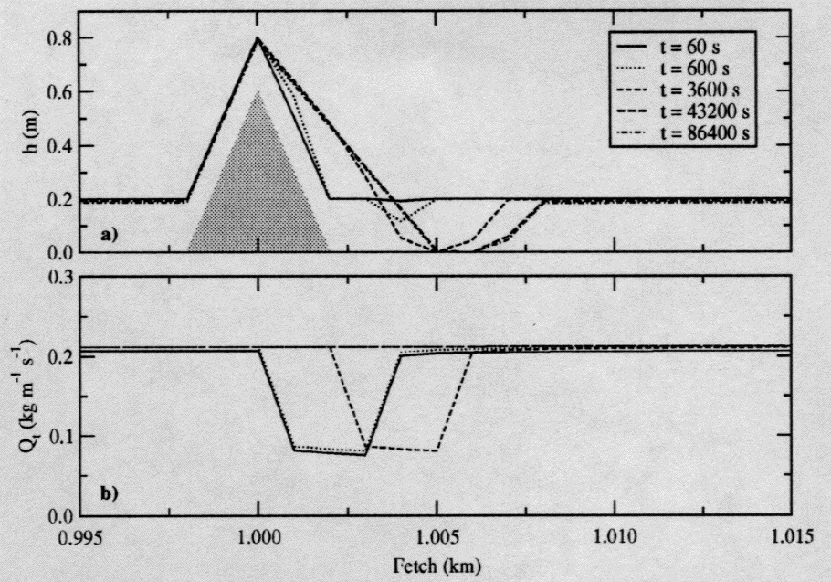
Topographic evolution over time
Dery & Tremblay, 2004

Slide 15
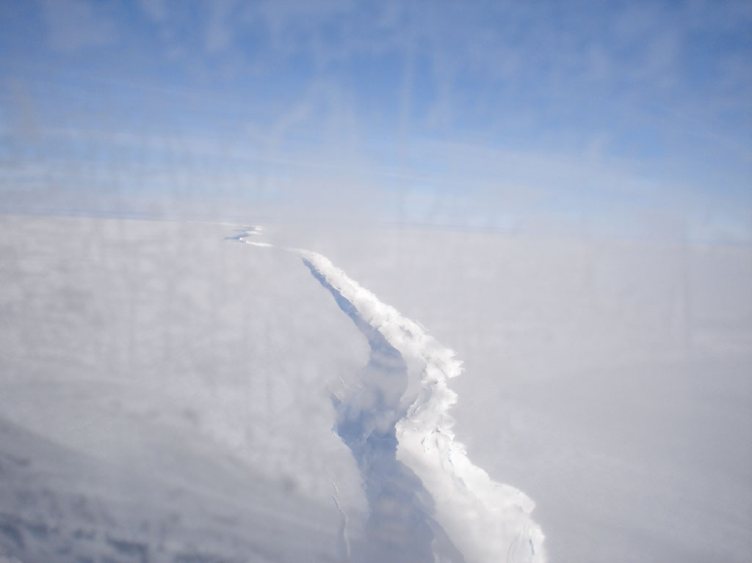
Adapting a blowing snow model for sea ice
(Piektuk-Tuvaq) to the nascent rift
Separate ice surface from snow surface
(avoid eroding ice at low windspeeds)
Specify topography (eventually use ICESat data?)
Remove leads (no open water in rift to increase humidity)
* Adapt topographic description to allow large slopes
* Incorporate variable windspeeds

Slide 16
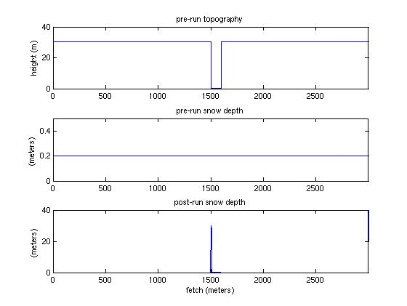
Model Configuration for the Nascent Rift Site
30m deep rift
100m wide
Add 2cm
of snow
Pile of snow
lands in rift

Slide 17
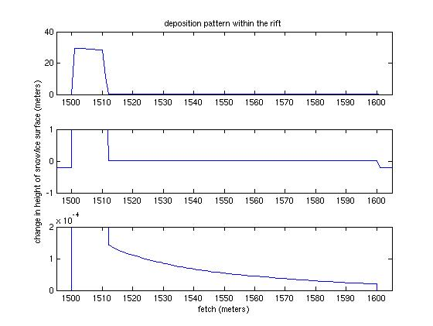
Deposition in the rift, erosion elsewhere

Slide 18
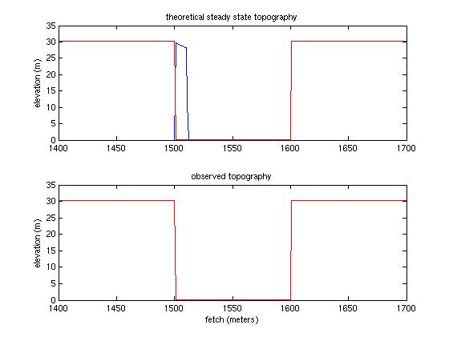

Slide 19
View Across Rift, over ice melange

Slide 20
Why isn’t model predicting observed topography of ice melange?
• Snow supply issue?
Timescale of rift widening?
Subsidence of ice melange beneath weight of new snow?
Loss of snow into the water?
Other suggestions?

Slide 21
Conclusions
Moderate wind and a light upflow snow cover can fill a rift in less than 1 year
Saltating snow is more important to rift-filling process than suspended snow is
Nascent Rift does not exhibit steady-state snow-filled topographic profile

