Slide 1
IPY: Collaborative Research: Ocean-Ice Sheet Interaction in the Amundsen Sea: The Keystone of West Antarctic Stability
A joint proposal to NSF and NASA for the International Polar Year

Slide 2
by
US Investigators
UK Collaborators
Robert Bindschadler/NASA Goddard Space Flight Center
Sridhar Anandakrishnan/Penn State University
Alberto Behar/NASA Jet Propulsion Laboratory
David Holland/New York University
Miles McPhee/McPhee Research Company
Timothy Stanton/Naval Postgraduate School
Martin Truffer/University of Alaska, Fairbanks
David Vaughan/British Antarctic Survey
Hugh Corr/ British Antarctic Survey
Adrian Jenkins/ British Antarctic Survey
Andy Smith/ British Antarctic Survey
Tony Payne/University of Bristol

Slide 3
Why Keystone?
The WAIS goal of predicting the future sea-level contribution of the West Antarctic CAN’T BE MET without understanding the interaction of ocean on ice shelves and of ice shelves on ice streams and outlet glaciers

Slide 4
Goal
To understand the interaction of the ocean and ice (heat, mass and salt fluxes) at the sub-ice-shelf interface and to incorporate this knowledge into a coupled model that includes dynamics of the ocean and of the ice along with their interaction.

Slide 5
Objectives
Define the shape (surface elevation and thickness) of the ice shelf (Bindschadler)
Define the shape of the ocean cavity beneath the ice shelf (Anandakrishnan)
Access the cavity by drilling through the ice shelf (Truffer)
Develop and deploy remotely controlled instrumentation to measure the temporal and spatial variations of water properties and of the mass exchange with the ice shelf (Stanton)
Interpret these measurements to define the nature of heat, mass and salt exchange between the ocean and the ice (McPhee)
Visually explore the ocean cavity, sea floor and ice-shelf underside (Behar)
Incorporate the interactive processes into a coupled ocean-ice dynamics model (Holland)

Slide 6
Strategy
PIG is relatively well-studied, is known to be changing and contributes significantly to sea level
Grounding line area is accessible
  Imagery shows smooth area as possible landing site
  Ice thickness (~580 m) is within range of hot-water drill
Commandable ocean profilers
  Follows sub-shelf water masses
  Tracks thinning ice shelf
Survey of cavity shape and profiling of model grid cell enable improved modeling

Slide 7
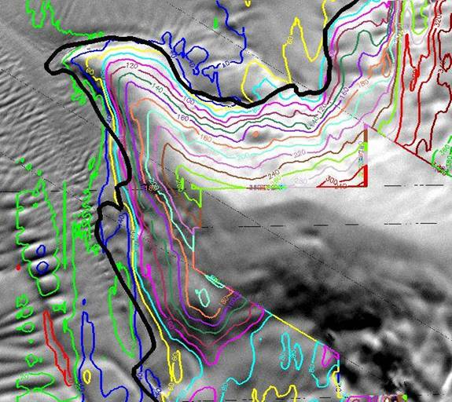
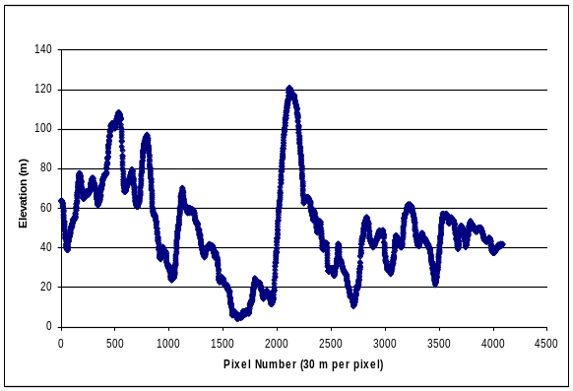
1. Define the shape (surface elevation and thickness) of the ice shelf
Elevation ground control from ICESat altimetry
  Spacing ~10 km
Complete elevation field with photoclinometry
Convert elevation to thickness
  Average column density from field holes

Slide 8
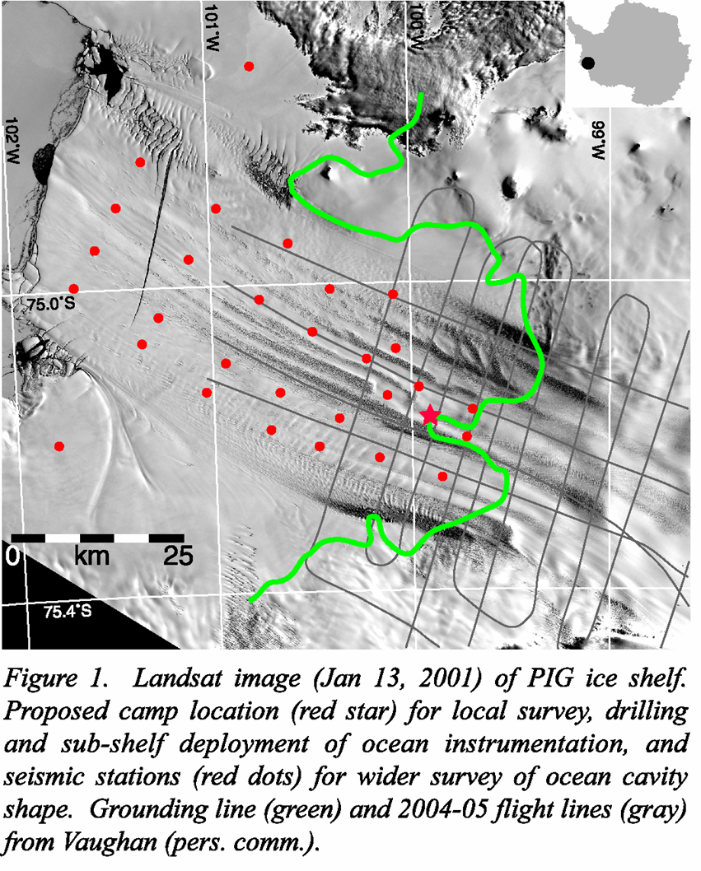
2. Define the shape of the ocean cavity beneath the ice shelf
Seismic shots at 28 sites
  Ice and water thicknesses
  Maybe bed slope
Gravity to assist in interpretation of BAS aerogravity survey in 2004-05

Slide 9
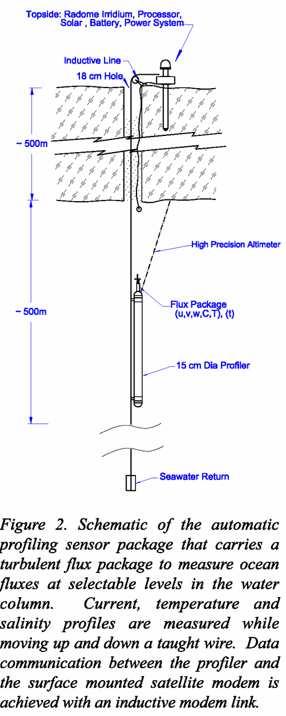
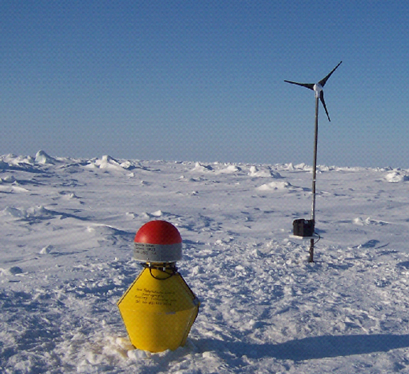
4. Develop and deploy remotely controlled instrumentation to measure the temporal and spatial variations of water properties and of the mass exchange with the ice shelf
Deployed through hot-water holes
CTD profiler
Data linked to surface
Inmarsat to USA
Controlled from USA

Slide 10
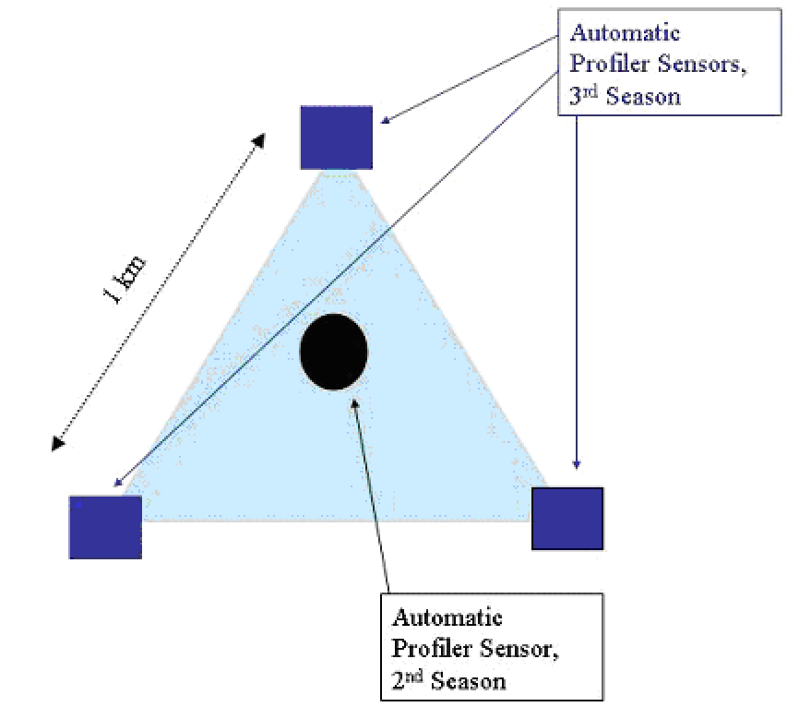
7. Incorporate the interactive processes into a coupled ocean-ice dynamics model
Seismic measurements define the sub-shelf cavity
Ocean profiler measurements quantify fluxes along a model “grid cell”
  Holland’s “PIG pen”

Slide 11
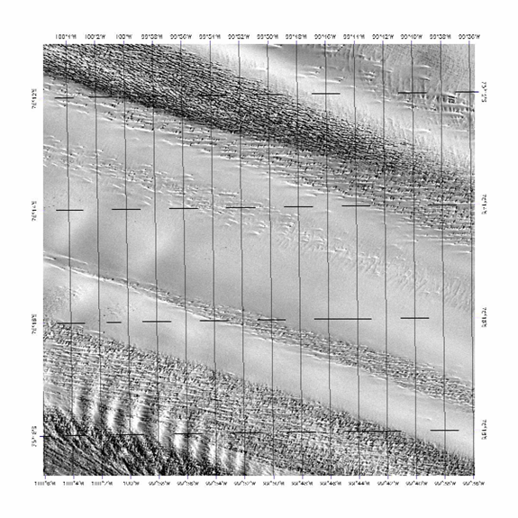
Field Work
2007-08
  Recon landing site
  Local radar and seismic surveys
    measure ice thickness
    Measure water thickness and cavity shape
  Conduct phase-sensitive radar survey for melting rate
  Establish GPS and AWS
  Hand auger for firn profiles of density and temperature
  Media?

Slide 12
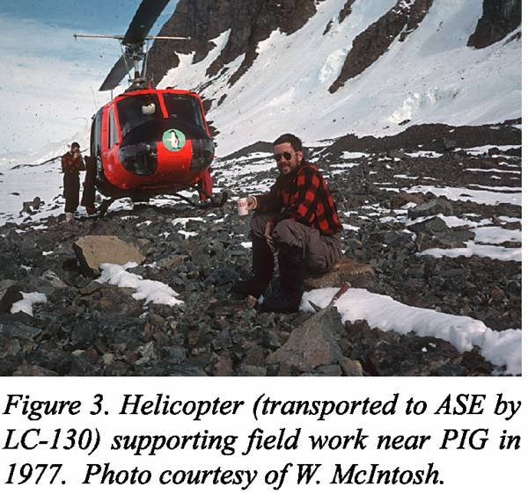
Field Work
2008-09
  Drill one hole
    Explore with optical probe
    Leave vertical strain gauge
    Deploy ocean instrument package
  Large-scale seismic/gravity survey
    Helicopters required
    2 other proposals have requested helos
  Maintain/repair AWS/GPS
  Deploy 3 additional GPS
  More phase-sensitive measurements?
  Media?

Slide 13
Field Work
2009-10
  Drill three holes
    Deploy ocean instrument package
  Maintain/repair AWS/GPS
  Collect data not telemetered back
2010-11
  Recover surface instrumentation and data

Slide 14
Fingers are crossed
Proposal submitted for joint funding from NSF and NASA
Likely success ratio at each is < 10%

