Slide 1
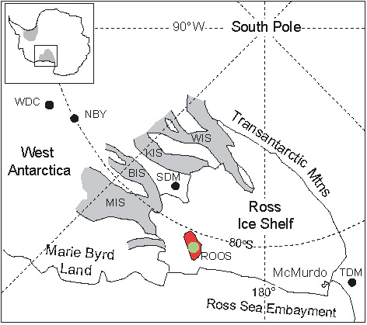
Roosevelt Island: a good place for an ice core
H. Conway, Nancy Bertler, David Bromwich, Ed Brook, Dorthe Dahl-Jensen, Karl Kreutz, Andrei Kurbatov, Paul Mayewski, Eric Steig, Ed Waddington, and Jim White
Motivation
understand recent climate variability; help reduce famines in SE Asia
understanding past deglaciation; help reduce hazards in coastal regions
Notes:
cross-section of a radar traverse across Roosevelt Island.
Vertical scale is in meters above sea level; horizontal scale is in kilometers from the divide. Vertical exaggeration is more than 50x.
The deepest bright reflector is the bed. Beneath the divide the bed is 200m below sea level and the ice is about 720m thick.
Of special interest is the pattern of up-warping of layers is a result of flow dynamics.

Slide 2
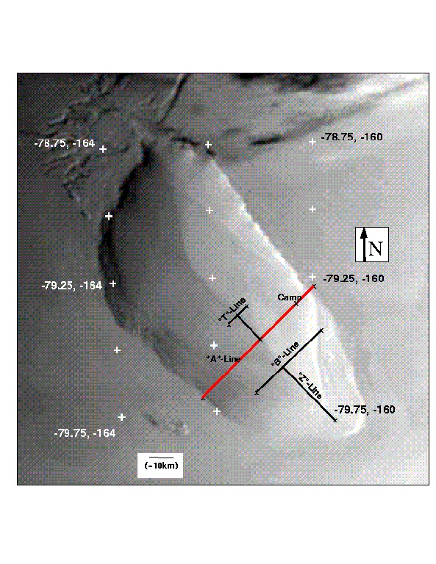
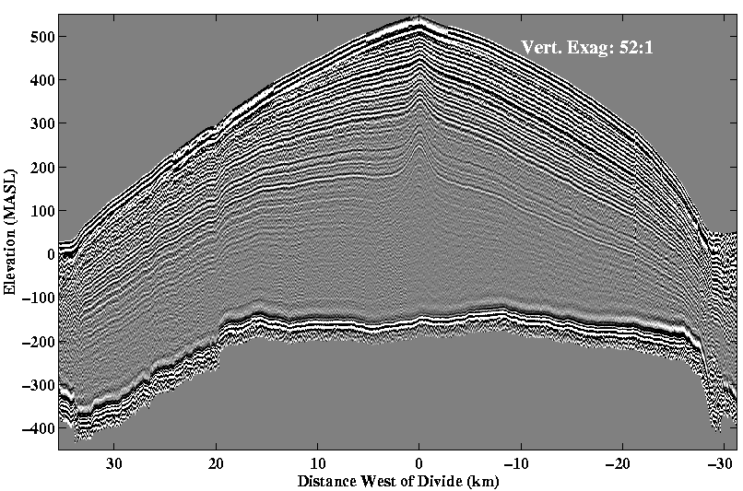
Roosevelt Island: selected previous work
1961 to 1972: geophysical field work by Univ. Wisconsin (Bentley, Boman, Clapp, Clark, Doss, Giovinetto, Heidemann, Heilman, Hochstein, Kieffer, Kreiling, Logie, Tranter, Unger)
1974 to 1977: short (up to 50m) ice cores (Chiang, Clausen, Herron, Langway)
1997 to 1998: geophysical field work by UW&UW (Wisconsin & Washington) (Bentley, Conway, Conway, Gades, Lord, Smith)
About 100 km by 60 km. Rises ~500m above the surrounding ice shelf.
Submarine bedrock rise topped by an ice cap.
Divide ice thickness ~745m.
4. Divide accumulation ~0.21m/yr
7MHz radar profile
Notes:
cross-section of a radar traverse across Roosevelt Island.
Vertical scale is in meters above sea level; horizontal scale is in kilometers from the divide. Vertical exaggeration is more than 50x.
The deepest bright reflector is the bed. Beneath the divide the bed is 200m below sea level and the ice is about 720m thick.
Of special interest is the pattern of up-warping of layers is a result of flow dynamics.

Slide 3
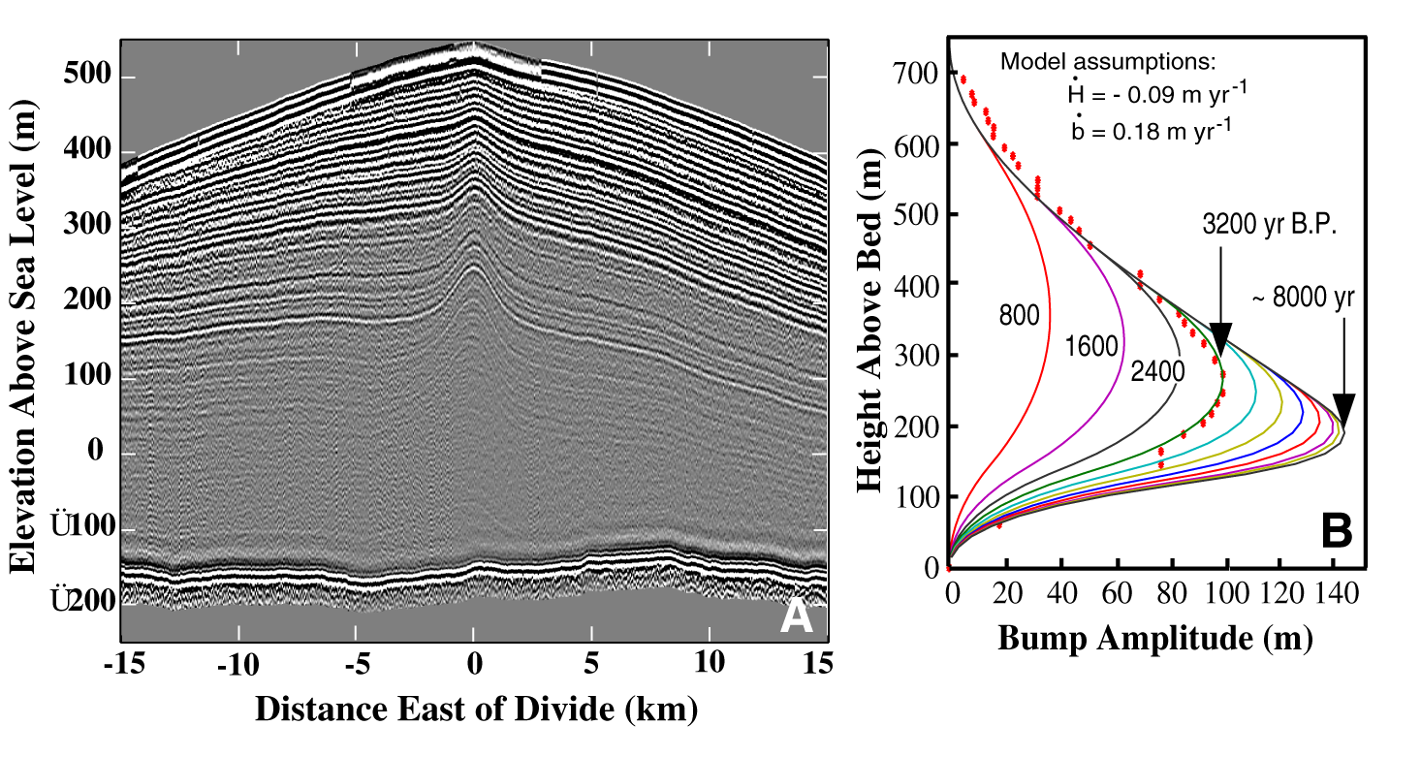
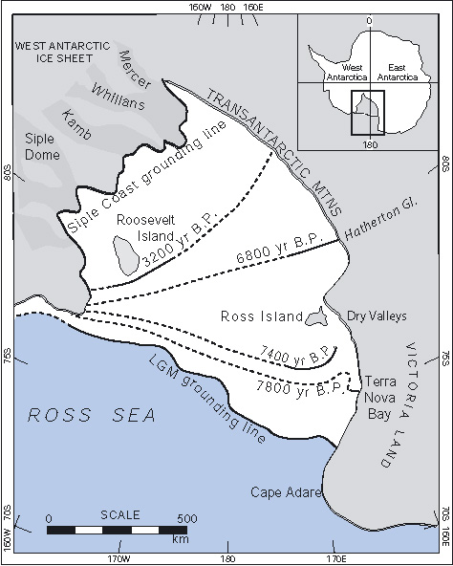
Roosevelt Island: interpretation of radar layers
interpretation of bump-amplitude profile (Waddington, Martin et al., 2005); onset of divide flow ~3ka BP; thinning ~9cm/yr
used to help constrain grounding-line retreat in Ross Sea Embayment (Conway et al., 1999)

Slide 4
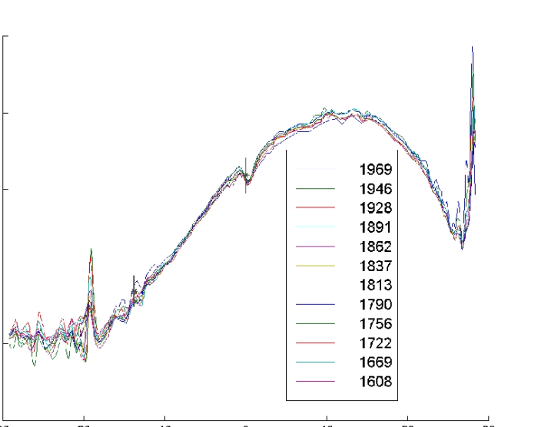
Roosevelt Island: accumulation-rate profile
0.25
0.20
0.15
0.10
Accumulation rate (m/yr)
Accumulation data
from beta cores and high-frequency radar by Ben Smith

Slide 5
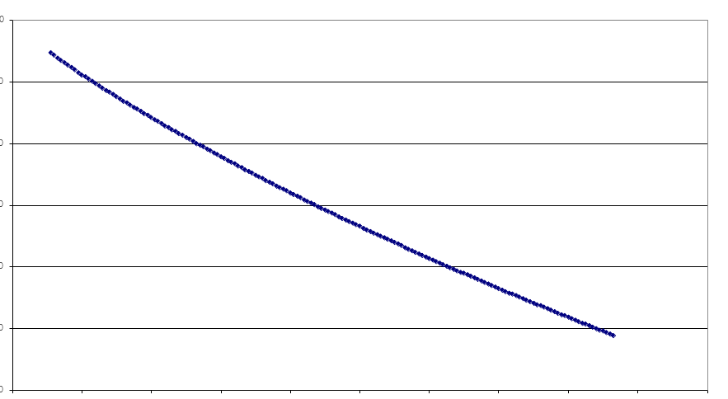
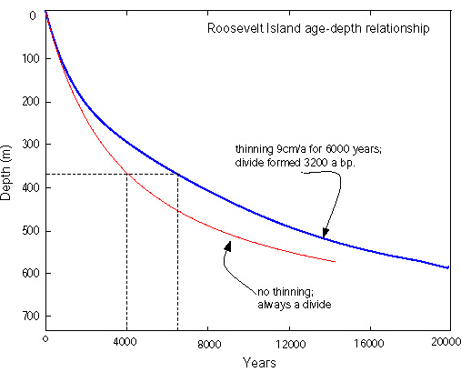
Roosevelt Island: age-depth relationship
0
20
40
60
Measurements from
Clausen, 1975
Model from Waddington in Conway et al., 1999
Depth (m)
0 50 100 150 200
Years before 1975
Age-depth relationship depends on histories of ice thickness and accumulation
likely good resolution extending back >40ka BP

Slide 6
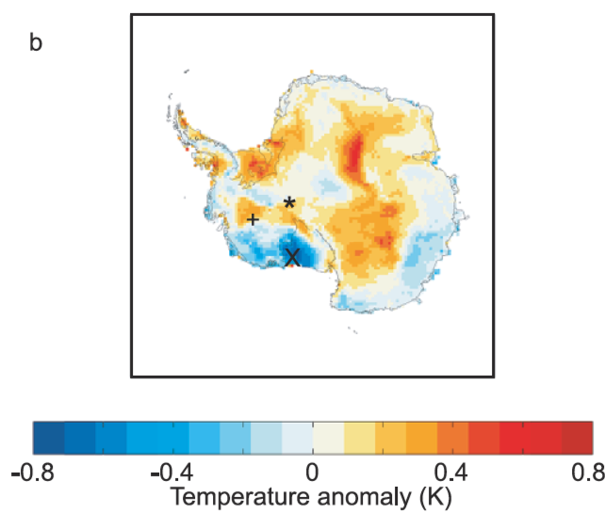
Improve understanding of recent climate variability
Correlation-map of surface temperature with the Southern Oscillation Index
(1982-1999 monthly averages)
- except for central East Antarctica
(where data are sparse), the highest
correlation occurs at ROOS
(Jacobel, Welch, Steig, Schneider, 2005)
Hercules Dome
1. temperature history from the ice core will extend the ENSO record back in time
Wais Divide
Roosevelt Island

Slide 7
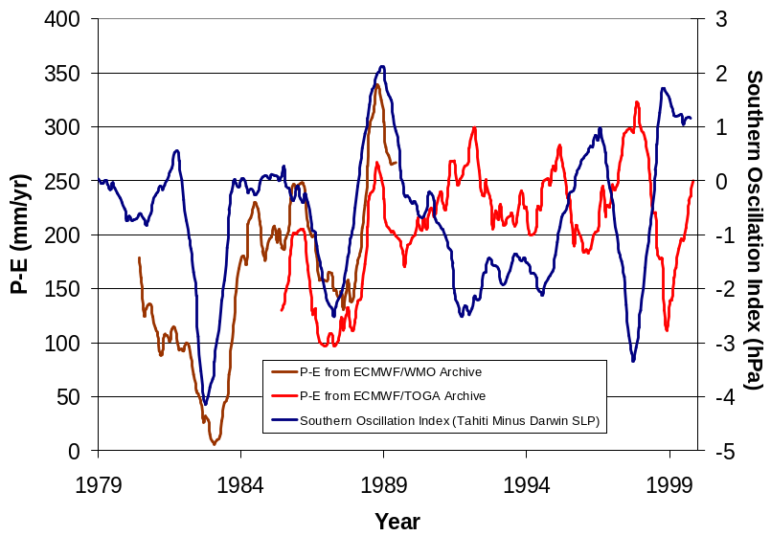
Improve understanding of recent climate variability
Accumulation for S. Pacific sector is correlated with Southern Oscillation Index from 1982-1990, but then switches and appears to be anticorrelated at least through 2001
2. accumulation history from the ice core will help understand switches in climate mode

Slide 8
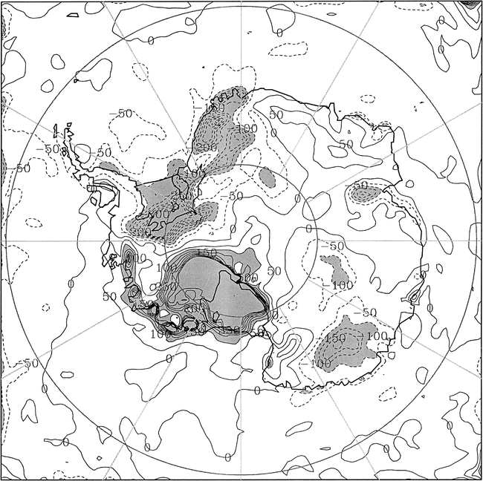
Improve understanding of recent climate variability
Results from Polar MM5: % change in precipitation between La Niña (DJF 1998/99)
and El Niño (DJF 1997/98).
Positive (negative) changes indicate greater (less) precipitation for the El Niño summer.
Areas with change > |100%| are shaded; negative contours are dashed
(Bromwich, Monaghan and Guo, 2004)
3. accumulation history from the ice core will help understand ENSO and SOI variability
Roosevelt Island

Slide 9
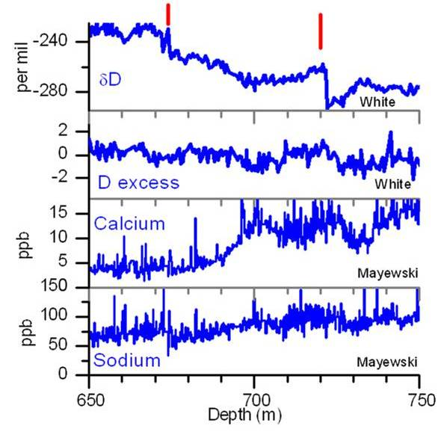
Improve understanding of climate variability
15kaBP
22kaBP
4. Profiles of stable isotopes and ionic chemistry will help understand apparent rapid transitions in surface temperature that have been observed at Siple Dome (but not at Byrd).

Slide 10
Improve understanding of Holocene deglaciation of Ross Sea Embayment
Holocene grounding-line retreat in the Ross Sea Embayment
(Conway and others, 1999)
BUT

Slide 11
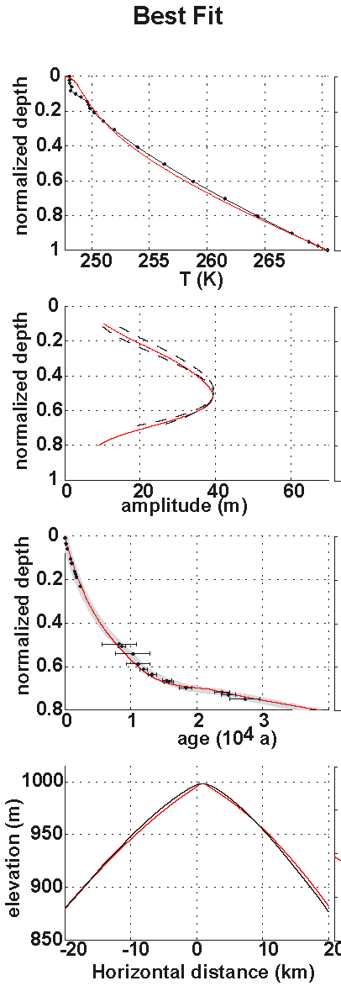
Emerging results using Siple Dome as a “dipstick”
(Waddington et al, 2005; Price and others 2006)
an ice-flow model constrained by measurements:
- Temperature profile
- Raymond bump amplitude profile
- Age-depth relationship
- Surface elevation

Slide 12
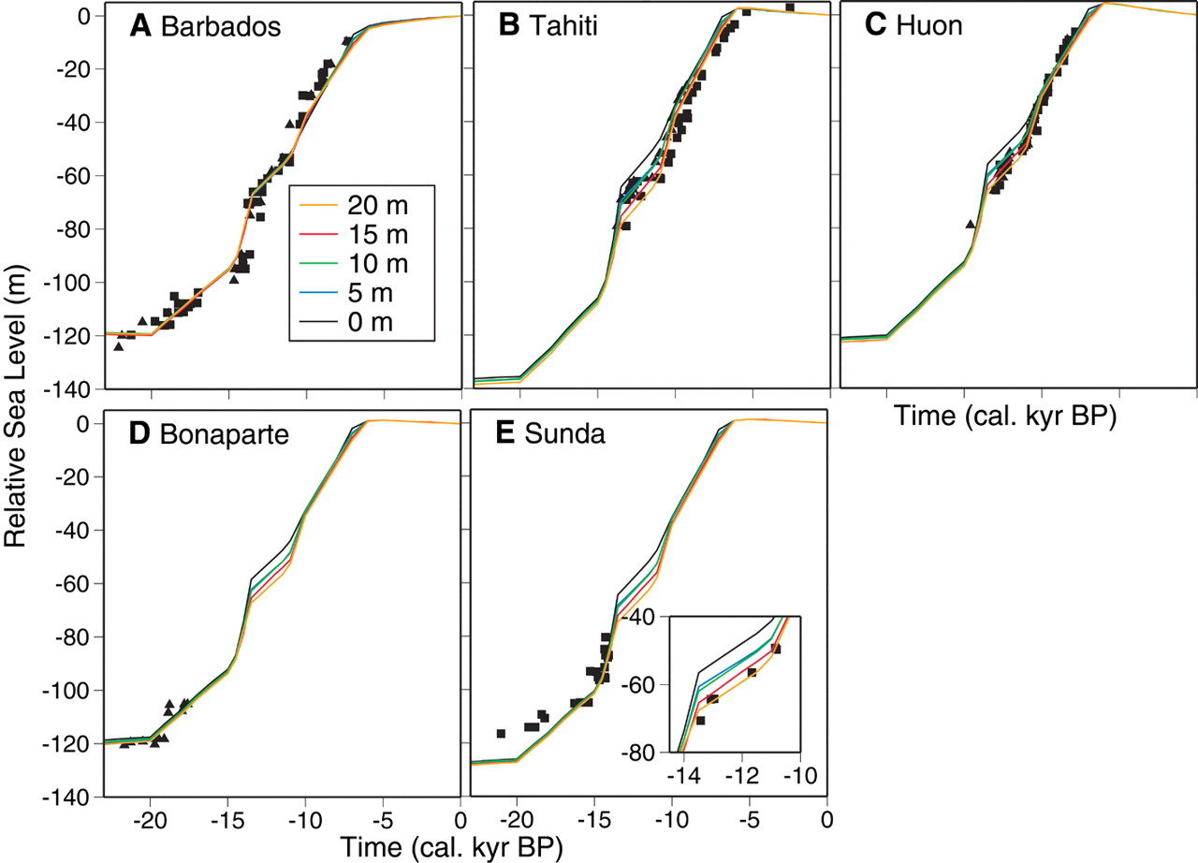
Results point to:
- SDM thinning of only ~350m
- likely between ~15ka and 14ka BP
1350
1000
ice thickness (m)
15 10 5 0 ka BP
Coincident with MWP1A.
Raises the possibility of rapid transfer of perturbations at grounding line up ice streams. Modern analog:
observations at Thwaites and PIG (Joughin+2003; Rignot, 2002, Shepherd+ 2002).
models (Payne+2004)

Slide 13
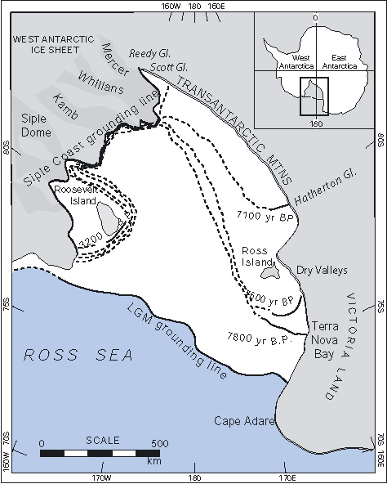
Improve understanding of Holocene deglaciation of Ross Sea Embayment
Results suggest a low-profile ice sheet during the LGM and rapid deglaciation of Central Ross Sea
5. Measurements of:
- age-depth relationship
- temperature profile
- stable isotope profile
- accumulation rate history
at Roosevelt Island will constrain models of past ice dynamics, necessary to understand deglaciation.

Slide 14
Logistical issues
Only ~650 km from McMurdo
Possible drills:
Danish Hans Tausen drill (Dorthe D.
Jensen). Shallow drill set up (drill
equipment 500kg). Twin Otter operation.
New Zealand drill (Nancy Bertler). Specifications still not clear (drill still to be built).

Slide 15
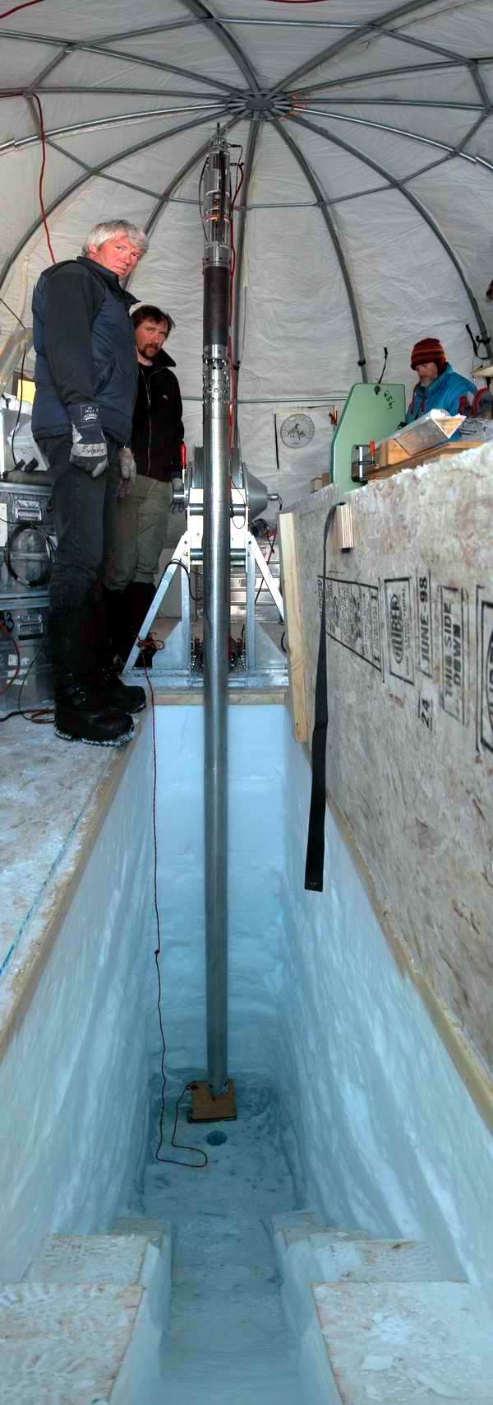
Conclusion: Roosevelt Island - an excellent place for an ice core
Accumulation
an ENSO climate record through the Holocene
contribute to the IPICS 40-ka array
a “dipstick” that will help constrain models of deglaciation
Notes:
cross-section of a radar traverse across Roosevelt Island.
Vertical scale is in meters above sea level; horizontal scale is in kilometers from the divide. Vertical exaggeration is more than 50x.
The deepest bright reflector is the bed. Beneath the divide the bed is 200m below sea level and the ice is about 720m thick.
Of special interest is the pattern of up-warping of layers is a result of flow dynamics.

