Slide 1
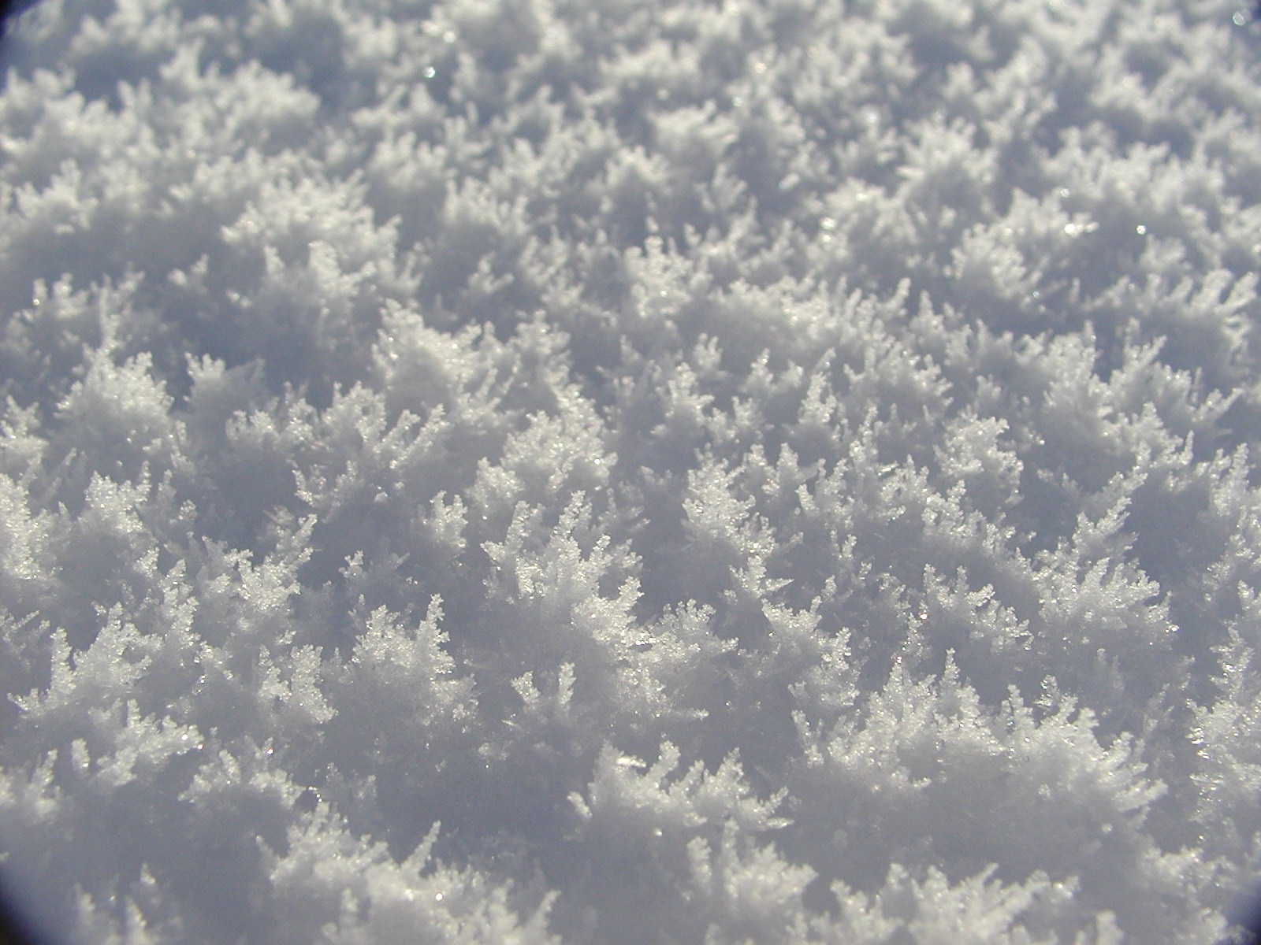




Towards a suite of US ITASE West Antarctic paleoclimate records
Daniel A. Dixon,
P. A. Mayewski, S. Kaspari, S. Sneed,
M. Handley, K. Maasch, K. Kreutz,
G. Hamilton, A. Carleton
ACKNOWLEDGEMENTS: Office of Polar Programs, National Science Foundation, 109th Air National Guard,
Ice Core Drilling Services, Raytheon Polar Services.

Slide 2
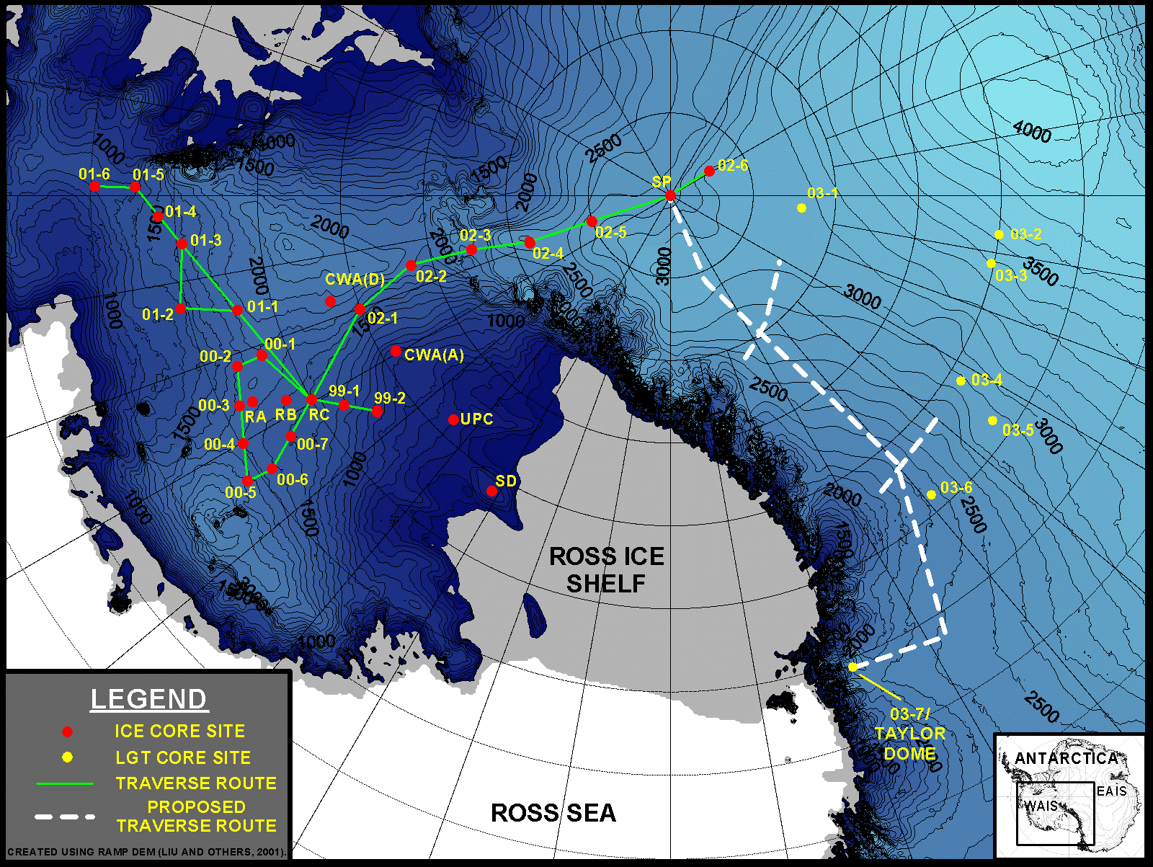
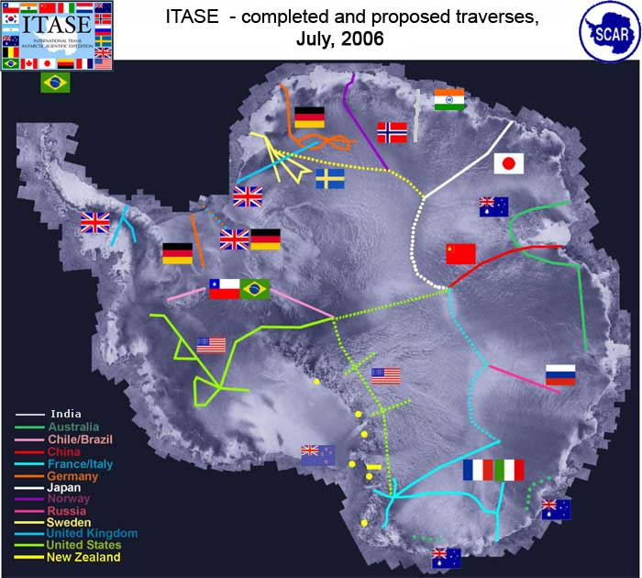
U.S.ITASE TRAVERSES
DOME-A
INTERNATIONAL
ITASE
TRAVERSES

Slide 3
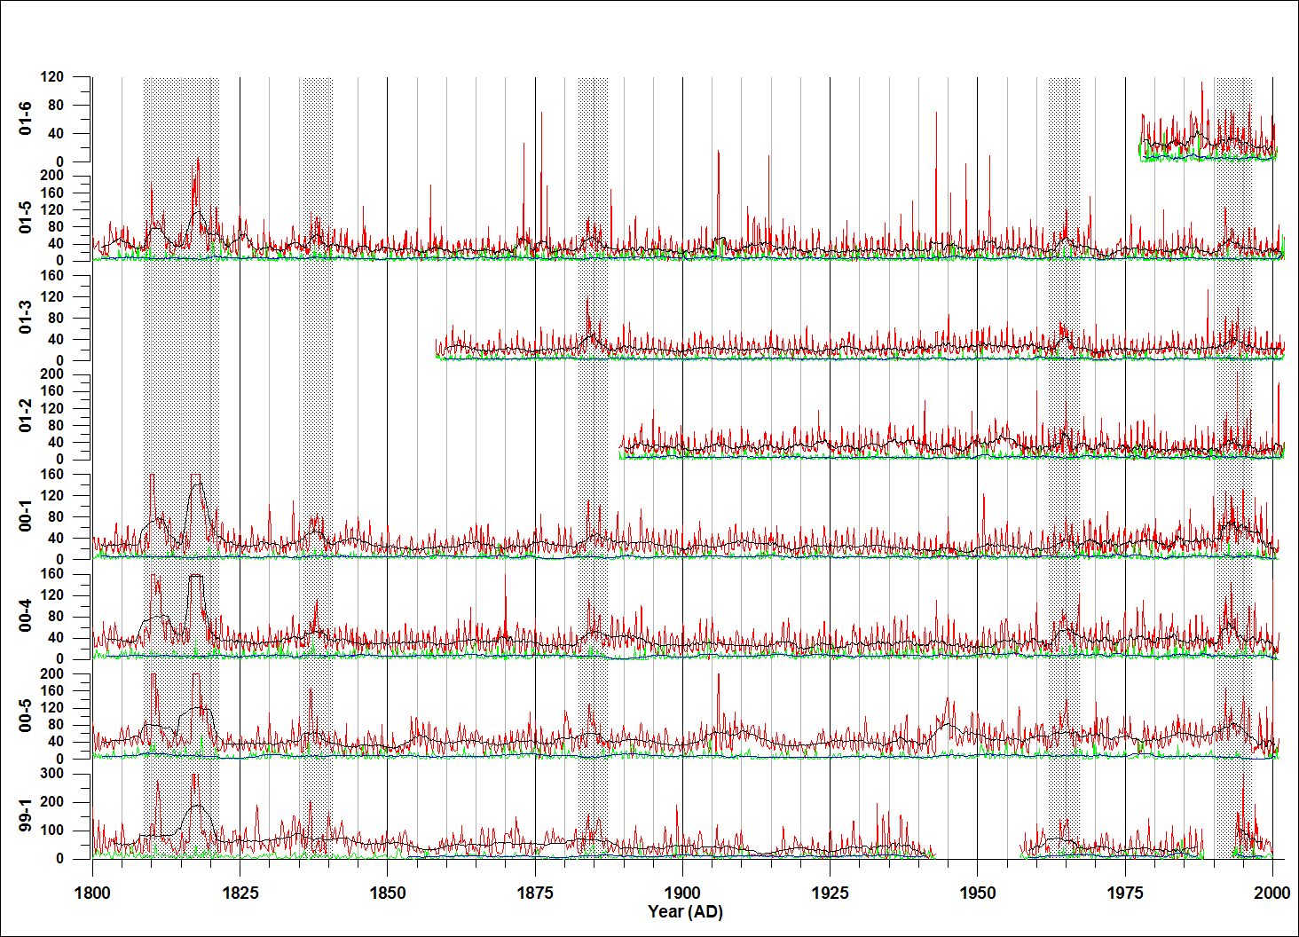
RAW xsSO4 (RED) AND ssSO4 (GREEN)
CONCENTRATIONS FROM 1800-2002 AD

Slide 4
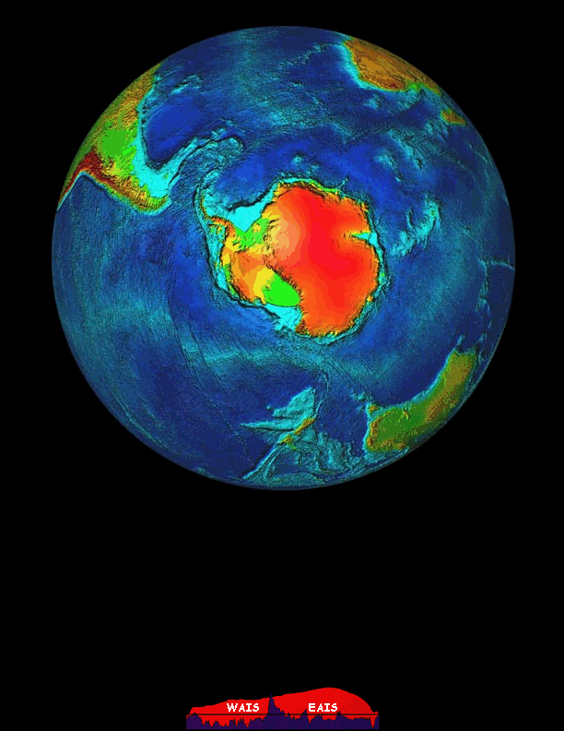

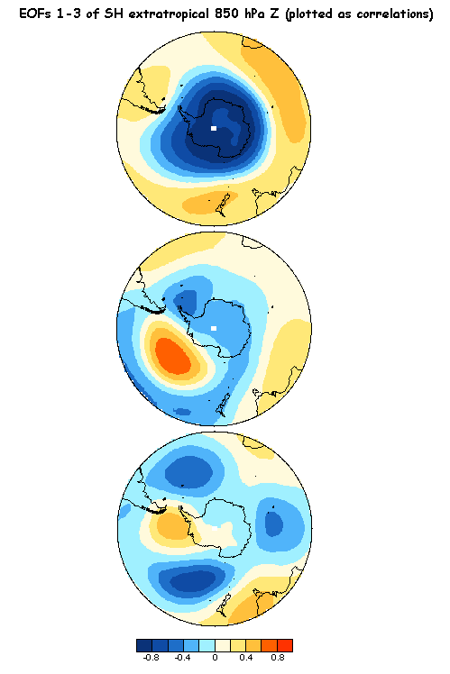

A.A.O.
or
S.A.M.
EOF 1
(33%)
H
EOF 2
(11%)
A.S.L.
Zonal
Wave
#3
EOF 1
EOF 3
(9%)
Approx. Sea Level
(Modified from http://www.jisao.washington.edu/aao)

Slide 5
A.A.O.
or
S.A.M.
EOF 1
(33%)
L
L
EOF 2
(11%)
A.S.L.
Zonal
Wave
#3
EOF 2
Strong correlation in area of Amundsen Sea Low
Potential teleconnections to SOI
and Antarctic Dipole
EOF 3
(9%)
(Modified from http://www.jisao.washington.edu/aao)

Slide 6
A.A.O.
or
S.A.M.
EOF 1
(33%)
L
L
EOF 2
(11%)
A.S.L.
Zonal
Wave
#3
EOF 2
Strong correlation in area of Amundsen Sea Low
Potential teleconnections to SOI
and Antarctic Dipole
EOF 3
(9%)
(Modified from http://www.jisao.washington.edu/aao)

Slide 7
A.A.O.
or
S.A.M.
L
EOF 1
(33%)
H
L
EOF 2
(11%)
A.S.L.
L
Zonal
Wave
#3
EOF 3
Correlated with major circum-Antarctic lows and blocking high
Potential teleconnections to SOI
and Antarctic Circumpolar Wave
EOF 3
(9%)
(Modified from http://www.jisao.washington.edu/aao)

Slide 8
A.A.O.
or
S.A.M.
L
EOF 1
(33%)
H
L
EOF 2
(11%)
A.S.L.
L
Zonal
Wave
#3
EOF 3
Correlated with major circum-Antarctic lows and blocking high
Potential teleconnections to SOI
and Antarctic Circumpolar Wave
EOF 3
(9%)
(Modified from http://www.jisao.washington.edu/aao)

Slide 9
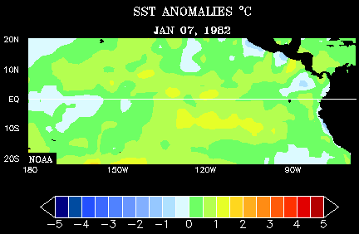
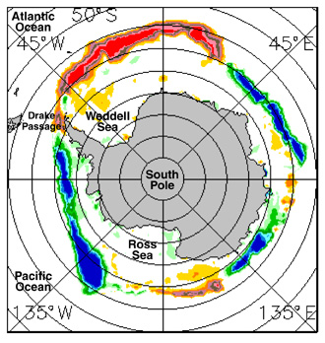
El Niño
H
L
http://www.cdc.noaa.gov/map/clim/sst_olr/el_nino_anim.shtml
WEAKENED
WALKER
CIRCULATION
L
Adapted from Cullather et al., (1996)
El Niño
A.S.L. moves towards Peninsula
Greater sea ice extent in Atlantic sector during El Niño (shown in red)
Image courtesy: Claire Parkinson and Nick DiGirolamo, NASA

Slide 10
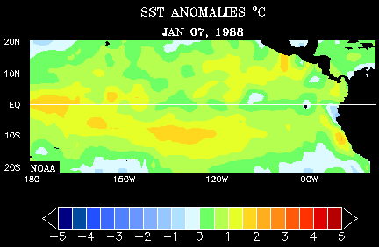
La Niña
H
http://www.cdc.noaa.gov/map/clim/sst_olr/el_nino_anim.shtml
L
STRENGTHENED
WALKER
CIRCULATION
L
Adapted from Cullather et al., (1996)
La Niña
A.S.L. moves away from Peninsula
Greater sea ice extent in Pacific sector during La Niña (shown in blue)
Image courtesy: Claire Parkinson and Nick DiGirolamo, NASA

Slide 11
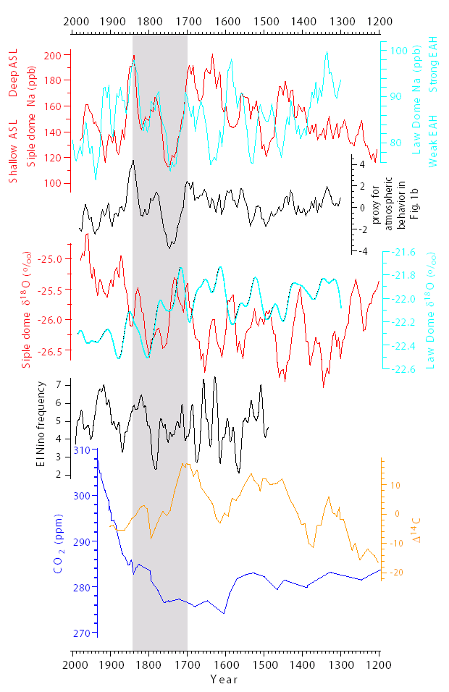
L
Adapted from Kreutz et al., (2000) and Mayewski et al., (2005)
ITASE 01-2 Na Correlated
to Surface Pressure in the
region of the A.S.L.
SD Na Correlated to
SON SLP from ECMWF
r=-0.32 (annual) to
r=-0.75 (3-year smooth)
P<0.001 (AD 1900-1995)
Approx. Sea Level
From Mayewski et al., (2004)

Slide 12
H
Adapted from Souney et al., (2002) and Goodwin et al., (2003)
Wilkes Land NO₃ Correlated to Winter SLP Gradient Between East
Antarctica and the Sub-Antarctic r=-0.52, p<0.005 (AD 1957-1984)
DSS Na Correlated to Winter (June) SLP Across EAIS
r=0.35-0.636 (for 11 Stations), p<0.05 (AD 1957-1996)
Approx. Sea Level
From Mayewski et al., (2004)

Slide 13
WARMING
COOLING
Adapted from Steig et al., (2000) and Van Ommen and Morgan, (1997)
25-year running mean SD and DSS δ¹⁸O (‰) used as a proxy for temperature in coastal West- and East-Antarctica respectively
Estimated temperature developed from calibration with instrumental mean annual and seasonal temperature values
Approx. Sea Level
From Mayewski et al., (2004)

Slide 14
L
Adapted from Meyerson et al., (2002)
South Pole MS Positively Related to Amundsen/Ross (185-245ºE) Sea Ice Extent and SOI from AD 1973-1992 (Principal EOF results represent 47%, 65%, and 47% of each series respectively)
MS
SEA ICE
Approx Sea Level
From Mayewski et al., (2004)

Slide 15
COOL
H
L
WARM
El Niño data from Meyerson et al., (2002)
Δ¹⁴C data from Stuiver and Braziunas, (1993)
AD 1200-1700
Maunder
Minimum
Spörer
Minimum
Wolf
Minimum
CO₂ data from DSS ice core (Etheridge et al., 1998)
Approx. Sea Level
From Mayewski et al., (2004)

Slide 16
WARM
H
L
COOL
El Niño data from Meyerson et al., (2002)
Δ¹⁴C data from Stuiver and Braziunas, (1993)
AD 1200-1700
Periods of increased El Niño occurrence are relatively short
Encompasses the onset and majority of the Little Ice Age event
Solar variability decreases steadily (as indicated by Δ¹⁴C values)
CO₂ concentrations fall steadily from 284ppm to 274ppm
Maunder
Minimum
Spörer
Minimum
Wolf
Minimum
CO₂ data from DSS ice core (Etheridge et al., 1998)
Approx. Sea Level
From Mayewski et al., (2004)

Slide 17
COOLING
H
L
COOLING
El Niño data from Meyerson et al., (2002)
Δ¹⁴C data from Stuiver and Braziunas, (1993)
AD 1700-1850
Maunder
Minimum
Spörer
Minimum
Wolf
Minimum
CO₂ data from DSS ice core (Etheridge et al., 1998)
Approx. Sea Level
From Mayewski et al., (2004)

Slide 18
WARMING
H
L
WARMING
El Niño data from Meyerson et al., (2002)
Δ¹⁴C data from Stuiver and Braziunas, (1993)
AD 1700-1850
The intensity and duration of El Niño events increases
Traditionally thought of as the end of the Little Ice Age period
Both solar variability and atmospheric CO₂ increase significantly
Maunder
Minimum
Spörer
Minimum
Wolf
Minimum
CO₂ data from DSS ice core (Etheridge et al., 1998)
Approx. Sea Level
From Mayewski et al., (2004)

Slide 19
WARMING
H
L
COOLING
El Niño data from Meyerson et al., (2002)
Δ¹⁴C data from Stuiver and Braziunas, (1993)
AD 1850-Present
Maunder
Minimum
Spörer
Minimum
Wolf
Minimum
CO₂ data from DSS ice core (Etheridge et al., 1998)
Approx. Sea Level
From Mayewski et al., (2004)

Slide 20
WARMING
H
L
COOLING
El Niño data from Meyerson et al., (2002)
Δ¹⁴C data from Stuiver and Braziunas, (1993)
AD 1850-Present
The intensity of long duration El Niño events stays high
Solar variability remains high
Atmospheric CO₂ concentrations increase exponentially
Maunder
Minimum
Spörer
Minimum
Wolf
Minimum
CO₂ data from DSS ice core (Etheridge et al., 1998)
Approx. Sea Level
From Mayewski et al., (2004)

Slide 21
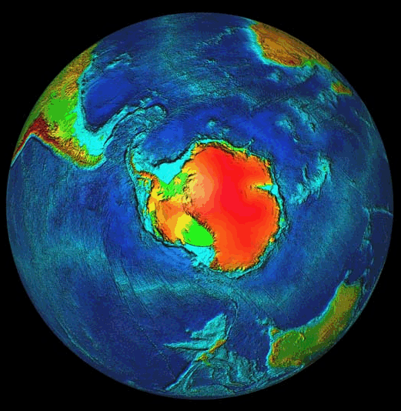

Slide 22
Proxies Developed So Far…
L

Slide 23
Proxies Developed So Far…
H
WARMING
H
ACCUMULATION
L
COOLING
SEA
ICE
WALKER
CIRCULATION
L

Slide 24
U.S.ITASE TRAVERSES
DOME-A
H
WARMING
H
ACCUMULATION
L
COOLING
SEA
ICE
WALKER
CIRCULATION
L

Slide 25
CONCLUSIONS
Strong link between West Antarctica and tropical Pacific
Since AD 1700 extra-tropical regions of the SH have experienced significant climate variability coincident with changes in both solar variability and greenhouse gas concentrations
Antarctic atmospheric circulation intensity is currently operating within the normal range of variability of the last ~700 years
Temperature at SD is currently above the natural range of variability of the last ~700 years (temp. at LD is within range)
ITASE proxy records corroborate and strengthen the longer proxies from deeper Antarctic ice cores

